Slide 1


Unified Improvement Planning During the State Assessment Transition, 2.0
Summer 2015

Slide 2


Introductions
CDE: Improvement Planning Unit | Center for Transforming Learning and Teaching (UCD)
Erin Loften Lisa Medler Alyssa Pearson | Julie Oxenford O’Brian

Slide 3
Session Purpose
Develop background knowledge and provide access to tools to support schools and districts with unified improvement planning during the 2015-16 school year.

Slide 4
Introductions
With your Table Group Share:
Name, Job Title, School/District/Organization
Your role in:
  Unified Improvement Planning
  Your most important outcome for this session
Full-Group – share important outcomes.

Slide 5
Materials

Slide 6


The materials used during this session were developed in partnership with the Center for Transforming Learning and Teaching (CTLT) located in the School of Education and Human Development at the University of Colorado Denver.

Slide 7
Norms
The standards of behavior by which we agree to operate while we are engaged in learning together.

Slide 8
Participating from Different Perspectives
Three different lenses:
Learn about changes in improvement planning and accountability for the 2015-16 school year.
Prepare to take information back to local stakeholders to prepare them to engage in improvement planning during the 2015-16 school year.
Provide feedback to CDE related to engaging in improvement planning during the state assessment transition.

Slide 9
Session Outcomes
Turn to UIP During the State Assessment Transition Spring 2015: Session Overview (Tools, p. 1).
Consider Session Topics:
  Is this what you expected to be the focus of the day?
  Do you have questions?
Review Outcomes (for each topic)
  Do they make sense?
  Do you have questions?

Slide 10
Agenda
Assessment Transition Implications for Accountability and UIP 2015
UIP Template and Expectations for 2015-16
Data Analysis for Academic Achievement and Growth
Utilizing TELL Survey Results in UIP Processes
READ Act and UIP

Slide 11
Impacting Accountability and UIP for 2015-16 School Year
State Transition to new assessment system:
  CMAS Science and Social Studies first administered in the 2013-14 school year.
  CMAS administered by PARCC in English Language Arts and Mathematics first administered in the 2014-15 school year.
2015 Statutory Changes:
  HB 15-1323 – State Assessment
  SB 15-056 – Frequency of State Social Studies Assessment
  HB 15-1170 – Postsecondary and Workforce Readiness Measures
READ Act Requirements met by the UIP

Slide 12
HB 15-1323 State Assessment
Eliminates 11th grade PARCC ELA and math state assessments
Replaces 10th grade PARCC assessments
Retains science state assessments, once per grade span (no 12th grade testing)
Requires district policies allowing parents to excuse students from state tests
Eliminates redundancies between READ Act and school readiness assessments
Allows districts to request paper/pencil format of online state assessments
Allows more flexibility in testing English learners in their native language
Clarifies use of state assessments in educator effectiveness evaluations
No accountability ratings for 2015-16; continued implementation of 2014-15 accreditation ratings and school plan types for the 2015-16 school year (accountability clock will pause for one year)
Creates a two-phase assessment pilot program for districts and the state
Notes:
I may have a summary doc to share of this whole bill- will ask Jill.

Slide 13
SB 15-056 Frequency of State Social Studies Assessment
Social studies will still be assessed using a sampling method:
  Once per grade span (elementary, middle and high)
  Each school to be assessed once every three years
High school testing cannot occur in the 12th grade
Notes:
Kady

Slide 14
2013-2014 TCAP/CMAS | 2014-2015 CMAS | 2015-16 CMAS
TCAP Reading and Writing (Grades 3-10) | New CMAS English Language Arts (Grades 3-11) | CMAS English Language Arts (Grades 3-9)
TCAP Mathematics (Grades 3-10) | New CMAS Mathematics (Grades 3-8 and 3 high school assessments; choice from 2 sequences) | CMAS Mathematics (Grades 3-9)
New CMAS Science (Grades 5 and 8) | New CMAS Science (Grades 5, 8 and 12) | CMAS Science (Grades 5, 8 and HS (not 12th))
New CMAS Social Studies (Grades 4 and 7) | New CMAS Social Studies (Grades 4, 7 and 12) | CMAS Social Studies (Grades 4, 7 and HS (not 12)- rotating 3 year cycle
CO ACT- 11th Grade | CO ACT- 11th grade | 11th grade “curriculum-based college entrance exam”
NA | NA | 10th grade assessment aligned to CAS and 11th grade exam

Slide 15
HB 15-1170 PWR Measures
Adds sub-indicator to the PWR indicator:
  Percentages of high school graduates who enroll in a career and technical education program, community college, or 4-year institution of higher education in the year immediately following graduation.
  CDE must give each postsecondary enrollment option equal weight in calculating performance.
  http://www.statebillinfo.com/bills/bills/15/1170_enr.pdf
Notes:
Kady

Slide 16

2015
2016
Feb | Mar | April | May | June | July | Aug | Sept | Oct | Nov | Dec | Jan | Feb | Mar | April | May
CMAS/ PARCC
CMAS/ PARCC
CMAS/ PARCC
CMAS/ PARCC
Assessment
PBA
Standard
Setting
EOY
2015 PARCC Achievement
Scores released
2015 PARCC Growth Results
MAY be
released
Reporting
Informational SPF/DPF 2.0
Release
Accountability
UIPs
Due
for posting
Optional Submission
PI/T
PI/T UIPs due
for review
UIPs
Due
for posting
UIP

Slide 17
2015 School and District Accountability
District accreditation ratings will not be assigned in fall 2015 (based on 2014-15 assessments).
School plan types will not be assigned in fall 2015 (based on 2014-15 assessments).
Districts and schools will implement the 2014 ratings in 2015-16.
UIP requirements will hold firm during the 2015-16 school year.
CDE will provide an update on assessments and accountability to the Joint Education Committee in 2015 and provide information to determine if accountability should resume in 2016-17.
* As required by HB15-1323
Notes:
This is our plan for 2015. NOT A 2 YEAR RATING!!!
I think you know the rest…

Slide 18
Request to Reconsider Process
2014-15 and 2015-16 local assessment data can be submitted for the fall 2016 request to reconsider process. Since ratings will not be given in 2015, there will not be a request to reconsider process in fall 2015.
Fall 2015 Technical Assistance:
  Local assessment results
  Request to reconsider local assessment template
  UIP planning and request to reconsider preparation
  Prepared to add in 2015-16 results to submit fall of 2016
Notes:
I usually end up talking about this on the previous slide- but it’s a more detailed list of data that can be provided in 2015 for adjusting ratings/understanding performance for UIP.

Slide 19
Data Used for School Plan Types and District Accreditation Ratings
Year | Assessment Results Included in School and District Accountability Ratings | Optional Data For Submission in Request for Reconsideration
2014 | TCAP (participation, achievement and growth) ACCESS (growth) CO ACT (participation and PWR) CMAS science and social studies (participation only) | CMAS science and social studies (achievement) Local assessments aligned with the Colorado Academic Standards (CAS)
2015 | No ratings | No ratings to reconsider
2016 | CMAS PARCC English language arts and math (participation, achievement and growth) science and social studies (participation and achievement) ACCESS (growth) CO ACT (participation and PWR) | Local assessments aligned with the CAS (multiple years)
Notes:
Again- this is a good one to use as a reference document, if they find it useful.

Slide 20
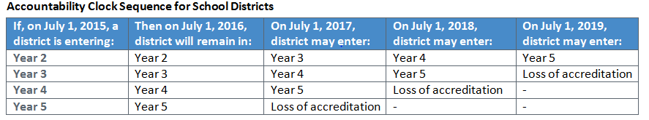
Accountability Clock
The state accountability clock will be paused for one year.
The accountability clock resumes in 2016-17, which will count as if it were consecutive to 2014-15.
For example:
Notes:
Depending upon audience… but basically clock doesn’t hold- may go on year 5 or 6 based on transition rating.
The counter balance is the SBE having more flexibility with schools.

Slide 21
Next Steps for Accountability
SPF/DPF 2.0
The Accountability Work Group is meeting monthly to research, discuss and propose recommendations to the Commissioner on the next iteration of the performance frameworks.
Initial recommendations will be shared and input collected in the summer/fall.
Meeting agendas, power points and minutes are posted here: www.cde.state.co.us/accountability/accountabilityworkgroup
Technical Advisory Panel (TAP) is involved with all technical recommendations as well.
Notes:
You can mention how we are working to enhance and improve the frameworks to make them more actionable (better for UIP). We’ve been asking lots of people for feedback and will continue to do so. If anyone has opinions, thoughts they can reach out to me.

Slide 22
Unified Improvement Planning Processes
Preparing to Plan
Gather and Organize
Data
Section IV:
Target Setting
Section IV:
Action Planning
Section III: Data Narrative
Review Performance Summary
Describe Notable
Trends
Prioritize Performance Challenges
Identify
Root
Causes
Set
Performance Targets
Identify Major Improvement Strategies
Ongoing:
Progress Monitoring
Identify
Interim Measures
Identify Implementation Benchmarks

Slide 23
Unified Improvement Planning Processes | Types of data used
Review current performance and prior performance targets or goals | State Performance data
Analyze data to identify notable trends | State and Local Performance data
Prioritize performance challenges | State and Local Performance data
Identify root causes of performance challenges | Local Process and Perception data
Establish annual performance targets | State and Local Performance data State and local expectations (comparison points)
Identify measures and monitor the impact of action steps on student performance. | Local Performance data
Identify implementation benchmarks & monitor implementation of action steps. | Local Process and Perception data
Looking Backward
LOOKING FORWARD

Slide 24
State Assessment Transition Impact on UIP
Unified Improvement Planning Processes remain consistent.
CDE staff review of priority improvement and turnaround plans remains consistent.
Processes which typically utilize state performance data (metrics and comparison points) will need adjustment:
  Review current performance
  Describe notable trends
  Prioritize performance challenges
  Set performance targets
No impact in some performance indicator/sub-indicator
areas.

Slide 25
Measures/Metrics Available during the State Assessment Transition
Postsecondary and Workforce Readiness (PWR) metrics: dropout rates, Colorado ACT composite scores, graduation rates, and disaggregated graduation rates.
English Language Proficiency (sub-indicator within Academic Growth): ACCESS for ELLs metrics and comparison points.
K-3 Literacy Interim Measures required by the READ ACT.
CMAS in Science and Social Studies at the elementary and middle levels (available for 2013-14 and 2914-15 in fall 2015).
Locally administered interim assessments.

Slide 26
Guidance for UIP during the State Assessment Transition, Version 2.0
Background on the State Assessment System Transition and Accountability
Overall Implications for UIP
Options for Data Analysis for Academic Achievement, Growth and Growth Gaps
Staying the Course: K-3 Literacy ,PWR, ELL
Options for Target Setting for Academic Achievement, Growth and Growth Gaps (similar to 2014-15 version)

Slide 27
Taking it Back
Turn to “Planning for UIP During the 2015-16 School Year,” p. 1
Reflect on State Assessment Transition Implications for Accountability and UIP (row one).
Make notes about:
  Critical Information related to this topic that you will take back to your local context.
  The tools/resources that you will use.
  With whom, when and how you will share this information.

Slide 28
Agenda
Assessment Transition Implications for Accountability and UIP 2015
UIP Template and Expectations for 2015-16
Data Analysis for Academic Achievement and Growth
Utilizing TELL Survey Results in UIP Processes
READ Act and UIP

Slide 29
UIP Template and Expectations
Revisions to UIP Templates for 2015-16 school year reflect changes in the availability of state performance data. They include:
  Executive Summary (New)
  Pre-Populated Report
  Data Analysis (directions)
  Target Setting Form (directions)
  Addenda Forms
Turn to Revisions to UIP Template and Expectations for 2015-16 (Tools, p. 11).
  Work with a partner to locate each of the identified revisions in using one of the School UIP Templates on your table.
  Identify any questions about these revisions.

Slide 30
CDE Staff Considerations for UIP Review
CDE Staff review of Priority Improvement and Turnaround Plans will remain consistent for 2015-16.
Staff review considerations will be revised to accommodate changes in the availability of state performance data.
Deadlines for submission of UIP will also remain consistent.
Talk with a partner:
  Does this affect your district or schools within your district?
  What questions/concerns do you have about CDE plan review?

Slide 31
On-Line UIP Tool
Turn to Online UIP System Overview (Tools, p. 13).
Use this overview to answer these questions:
  Will districts and schools be required to use the On-Line UIP tool for 2015-16?
  To which features of the online UIP system are you most interested in having access?
  What are some advantages of using the on-line UIP tool to report improvement plans to the state?
Questions/Concerns?
Discussion: What are options for beginning to use the online UIP system in 2015-16?

Slide 32
Taking it Back
Turn to “Planning for UIP During the 2015-16 School Year,” p. 1
Reflect on UIP Template revisions.
Make notes about:
  Critical Information related to this topic that you will take back to your local context.
  The tools/resources that you will use.
  With whom, when and how you will share this information.

Slide 33
Your feedback. . .
Take a few minutes to review the introductory sections of Draft UIP Transition Guidance for 2015-16, consider:
  Background on State Assessment System Transition and Accountability (p. 1-2)
  Overall Implications for UIP (p. 3-4)
Using the UIP Transition Guidance Feedback Form, make notes about the following for these two sections:
  Useful information, keep it
  Missing, need it
  Too much, delete it

Slide 34
Agenda
Assessment Transition Implications for Accountability and UIP 2015
UIP Template and Expectations for 2015-16
Data Analysis for Academic Achievement and Growth
Utilizing TELL Survey Results in UIP Processes
READ Act and UIP

Slide 35
The Challenge. . .
During the state assessment transition. . .
  Release of state assessment results will be delayed.
  Growth data may not be available/usable.
  Typical comparison points used for data analysis and target setting will not be identified until winter/spring 2016.
  Participation rates may have an impact on 2014-15 results.
School/District Planning teams must determine how to analyzing data for:
  Academic Achievement (Math, Reading, Writing, Science and Social Studies?)
  Academic Growth (Math, Reading and Writing)

Slide 36
Data Analysis for Academic Achievement and Growth
The Basic Approach
2014-15 Performance Data Sources
Adjusting Data Analysis Processes

Slide 37
Options for Data Analysis for Achievement and Growth
Depends on if teams are writing, rewriting or updating UIPs
No new SPF/DPF reports available as a starting point
A basic approach . . .
  Start with 2014 Performance Framework Reports and 2014-15 UIP.
  Review additional performance data available for the 2014-15 school-year (aligned to the CAS).
  Determine if performance data available for 2014-15 provides evidence that school/district performance has changed.
  Strengthening the Evidence: consider multi-year trends in performance using alternative performance data sources.

Slide 38
Updating, Re-Writing, or Writing
Updating:
  Utilize trend data as analyzed from prior years UIP.
  Build on trends with additional performance data as available.
Re-Writing (prior UIP doesn’t reflect current school context)
  May require re-analysis of prior years’ performance trends.
  Build on trends with additional performance data as available.
Writing (no SPF or UIP in prior year)
  Consider guidance on UIP process for New Schools.
  http://www.cde.state.co.us/uip/supplementalguidance_newschools_2013pdf.

Slide 39
Re-Analysis Performance Data from prior to 2014-15
Tools to help analyze performance data from prior to 2014-15
  School: School Dashboard (http://www.schoolview.org/dish/schooldashboard.asp)
  District: District Dashboard (http://www.schoolview.org/dish/dashboard.asp)
Have you accessed either or both of these tools?
Job Aides available in Tools packet
  District: District Dashboard Overview, p. 15
  School: School Dashboard Overview, p. 17

Slide 40
Your thoughts. . .
Read: UIP Transition Guidance 2015, Options for Data Analysis for Academic Achievement, Growth and Growth Gaps, A Basic Approach (p. 4-5)
Discuss with your table:
  Does this approach seem reasonable? Appropriate? Why or why not?
  What questions or concerns do you have about this approach?
  Do you have other suggestions/options for data analysis for academic achievement and growth during the state assessment transition?
Provide Written Feedback on: UIP Transition Guidance Feedback Form . . .Full-Group Share out

Slide 41
Taking it Back
Turn to “Planning for UIP During the 2015-16 School Year,” p. 1 (Row 3)
Reflect on a basic approach to data analysis for academic achievement and growth during the state assessment transition.
Make notes about:
  Critical Information related to this topic that you will take back to your local context.
  The tools/resources that you will use.
  With whom, when and how you will share this information.

Slide 42
Data Analysis for Academic Achievement and Growth
The Basic Approach
2014-15 Performance Data Sources
Adjusting Data Analysis Processes

Slide 43
Additional Performance Data for 2014-15
Locally administered interim assessment results;
CMAS achievement results for science and social studies for the 2013-14 and 2014-15 school-years (elementary and middle);
Once the State Board of Education approves cut-scores, CMAS/PARCC results in English language arts and mathematics (may not be available until winter/spring 2016);
Results of locally administered (state required) K-3 literacy assessments;
English Language proficiency and growth from ACCESS for ELLs;
Discussion: Other?

Slide 44
Performance Data Sources Resources
Measures | Resources
Locally Administered Interim Assessments (Acuity, Galileo, NWEA MAP, Scantron Performance Series, STAR Math and Reading Enterprise) | UIP Transition Guidance, p. 7-8; Assessment Instrument Descriptions (2013) ; Updated Assessment Instrument Descriptions (coming soon)
CMAS Science and Social Studies (elem. and middle) | UIP Transition Guidance, p. 5-7, Appendix A
CMAS/PARCC Math and ELA | UIP Transition Guidance, p.5, Appendix A
K-3 Literacy Interim Assessments | UIP Transition Guidance, p. 12-13, Assessment Instrument Descriptions (2014); Updated Assessment Instrument Descriptions (coming soon)
ACCESS for ELLs | UIP Transition Guidance, p. 13-14, Assessment Instrument Description (2014)

Slide 45
Locally Administered Interim Assessments
Did your district administer interim assessments during the 2014-15 school year? Was it a new version of the instrument from prior years?
In what content areas? Grade levels?
What interim assessment instrument (Acuity, Galileo, NWEA MAP, Scantron Performance Series, STAR Math and Reading Enterprise, other)?
Have you accessed the 2013 Assessment Instrument Description for your Interim Assessment?
http://www.cde.state.co.us/uip/assessment_instrument_descriptions

Slide 46
New State Data Reports for 2015-16
State Data Resource Report (Fall 2015)
TCAP/PARCC Achievement percentile Comparison Report with Participation Rates
(Winter 2016 after SBE approves cut-scores)
Informational SPF/DPF 2.0 (Late Spring 2016)
Not available in 2015-16:
  SPF/DPF
  School Growth Summary Reports
  Data Lab/Data Center Updates

Slide 47
2015 State Data Resource Report
ACCESS Growth and Language Proficiency
Elementary and Middle school science and social studies results
Graduation Rates
Disaggregated Graduation Rates
Dropout Rates
Composite ACT Scores

Slide 48
CMAS Science and Social Studies
Science and social studies results for available in fall of 2015 for:
  2013-14 and 2014-15
  Elementary and middle levels only
Beginning with the 2015-16 school year, schools will only be required to administer social studies assessments once every three years.
Would you recommend planning teams include social studies results in their UIPs?

Slide 49
K-3 Literacy Interim Assessments
What K-3 Literacy Interim Assessment did your district administer during the 2014-15 school year?
Was it the same instrument and version of the instrument as prior years?
Have you accessed the 2014 Assessment Instrument Description for your K-3 Literacy Interim Assessment?
Available for: DRA 2, DIBELS 6, DIBELS Next, FAST, iReady, Istation, PALS, STAR.
http://www.cde.state.co.us/uip/assessment_instrument_descriptions

Slide 50
To what 2014-15 performance data will you have access?
Turn to “Planning for UIP for 2015-16”, p. 2
List performance data sources (measures) for which your local planning teams would have results from the 2014-15 school year (first column, one per row). See example.
Identify for which indicators/sub-indicators these data sources could be used (second column). Include grade levels.
With our Table Group, discuss:
  For which students will results be available?
  When will results be available?
  How will local planning teams access results? In what format(s) will results be available?

Slide 51
Issues that could impact validity of 2014-15 performance data
Student Participation Rates
Text Administration Issues
Changing from reading and writing to ELA
Changes to cut scores/performance level descriptors
Assessment instruments not aligned with Colorado Academic Standards
New versions of assessment instruments (interim, K-3)
Other?
Planning to Plan, p. 4-5

Slide 52
Student Participation Rates
Federally required participation rate = 95%
Consider:
  Did your districts (schools within your district) have student participation rates substantially below the federal minimum?
  To what degree did issues with test administration affect participation rates?
  For which schools, grade-levels, disaggregated student groups were participation rates below the federal minimum? How much below?
  Did students who did not participate in the assessment disproportionally come from certain groups within the school (e.g., those participating in AP courses)?

Slide 53
Addressing Participation Rate Issues
What will be your approach to addressing participation rates substantially below federally recommended minimums?
Some Options:
  Report participation rates in data narrative (as part of reporting on trends).
  Specify any over-representation/under-representation of participating students by group.
  Don’t include data for grade levels with significantly low participation rates.
Discussion: Other?

Slide 54
Reading, Writing and ELA
CSAP/TCAP reading and writing were assessed and results were reported separately.
CMAS administered by PARCC assesses reading and writing together and reports ELA results.
How should planning teams analyze reading and writing results for 2015-16?
Option: Continue to consider reading and writing performance separately for 2015-16. Consider ELA trends beginning on 2016-17.
Your thoughts?

Slide 55
Response to Issues that could Impact Validity
Turn to Planning for UIP during the 2015-16 School Year, p. 4-5
Talk with your table group.
Identify any issues that may be of concern in your district (add “others” for any not listed).
Discuss/Make notes: How could you address these issues?

Slide 56
Issues to consider?
Turn back to “Planning for UIP for 2015-16”, p. 2-3
Identify issues that could impact validity of your specific performance data sources for 2014-15.
What will be your approach to addressing these issues?
Group share out.

Slide 57
Data Analysis Metrics and Comparison Points
Metrics (scores) – quantify performance indicators/sub-indicators:
  Two Levels: Individual and Group
  Group metrics are aggregates of individual metrics (mean, median, percent, sum)
  Use group/aggregate metrics in UIP data analysis and target setting
Comparison Points:
  Determining how good is good enough performance.
  Criterion Referenced (compare to a specific expectation)
  Norm Referenced (compare to others)

Slide 58
CMAS Metrics and Comparison Points
Turn to UIP Transition Guidance p. 6-7, and Appendix A
Work with a partner, consider:
  What aggregate metrics will be available for Science? Social Studies? Mathematics? ELA?
  What are advantages/disadvantages of using each metric for planning?
  What comparison points will be available?
  When will they be available?
  Which would you recommend local planning teams use?
Group Discussion: For what would you recommend teams use percent correct by PGC/GLE?

Slide 59
Metric and Comparison Point Resources
Measures | Resources
Locally Administered Interim Assessments (Acuity, Galileo, NWEA MAP, Scantron Performance Series, STAR Math and Reading Enterprise) | UIP Transition Guidance, p. 7-8; Assessment Instrument Descriptions (2013) ; Updated Assessment Instrument Descriptions (coming soon)
CMAS Science and Social Studies (elem. and middle) | UIP Transition Guidance, p. 6-7, Appendix A
CMAS/PARCC Math and ELA | UIP Transition Guidance, p. 6-7, Appendix A
K-3 Literacy Interim Assessments | UIP Transition Guidance, p. 12-13, Assessment Instrument Descriptions (2014); Updated Assessment Instrument Descriptions (coming soon)
ACCESS for ELLs | UIP Transition Guidance, p. 13-14, Assessment Instrument Description (2014)

Slide 60
Metrics and Comparison Points
Turn to “Planning for UIP for 2015-16”, p. 2-3
For each listed 2014-15 Performance Data Source identify:
Achievement Metrics
  Science
  Math
  Reading
  Writing
  Social Studies?
Growth Metrics (if available)
  Math
  Reading
  Writing
  Language Proficiency
What will be your comparison points for each metric. . .

Slide 61
Your Feedback. . .
Review UIP Transition Guidance, p. 5-8.
With regard to identifying additional performance data sources for 2014-15:
  What aspects of the guidance will you use with local planning teams?
  About what do you have additional questions? Concerns?
  How could the guidance be improved?
  What additional support would help your local planning efforts?
Share your feedback on the UIP Transition Guidance Feedback Form, p. 3

Slide 62
Data Analysis for Academic Achievement and Growth
The Basic Approach
2014-15 Performance Data Sources
Adjusting Data Analysis Processes

Slide 63
Adjusting UIP Data Analysis Processes
Data Analysis Processes will need to be modified during the 2015-16 school year for Academic Achievement, Growth, and Growth Gaps.
These processes include:
  Reviewing current performance;
  Identifying notable performance trends; and
  Prioritizing performance challenges.

Slide 64
Reviewing Current Performance
In the absence of new SPF/DPF Reports how will local teams:
Identify the school/district overall plan type assignment or accreditation rating;
Gauge the magnitude of the overall school/district performance challenge in order to select priority performance challenges and identify root causes at the appropriate level;
Identify performance indicator(s) (and related sub-indicators) for which performance did not meet minimum state and/or local performance expectations (for which priority performance challenges are required); and
Compare current performance to the targets established in the prior year’s plan to determine the degree to which current improvement strategies seem to be on track.

Slide 65
Adjustments to Reviewing Current Performance
Work with a partner.
Independently read: Review Current Performance (UIP Transition Guidance, p. 8-9).
Discuss:
  How will teams identify plan type assignments?
  What could be different about determining the magnitude of overall performance challenges?
  Under what conditions might a school/district performance indicators for which priority performance challenges are required change?

Slide 66
Planning for Local Planning
Turn to Planning for UIP during 2015-16, p. 6
Consider changes in Reviewing Current Performance for 2015-16.
Make notes (in the first row) about:
  Critical information to share, what could be different for 2015-16.
  Tools/Resources you will use with local planning teams.
  With whom, when and how you will share this information.

Slide 67
Identifying Performance Trends
Read “Identifying Notable Performance Trends” (UIP Transition Guidance, p. 10)
Discuss with your table group:
  What does the guidance recommend for identifying performance trends in science and social studies at the elementary and middle school levels?
  Will you encourage local planning teams to include social studies in their trend analysis? Why or why not?
  How will you approach reporting performance trends in math, reading and writing for 2015-16?
  What academic growth metrics could you use?

Slide 68
Planning for Local Planning
Turn to Planning for UIP during 2015-16, p. 6
Consider changes in Identifying Notable Performance Trends for 2015-16.
Make notes (in row 2) about:
  Critical information to share, what could be different for 2015-16.
  Tools/Resources you will use with local planning teams.
  With whom, when and how you will share this information.

Slide 69
Prioritizing Performance Challenges
Planning teams must identify priority performance challenges in any indicator area for which performance did not meet minimum state expectations.
This will be based on:
  The indicators/sub-indicators for which priorities established in the prior year UIP (submitted during the 2014-15 school year); and
  Review of current performance that include additional data for the 2014-15 school year.

Slide 70
Prioritizing Performance Challenges: Key Decision Points
For which performance indicators/sub-indicators were priority performance challenges identified in the 2014-15 UIP?
Did performance change in any of these areas during the 2014-15 school year?
Is there evidence (of performance change) that suggests the school/district priorities should change for 2015-16?
How should priority performance challenges change for 2015-16?

Slide 71
Reviewing Priority Performance Challenges
Trends show . . . | Decision Point | Evidence
Performance has improved in area previously identified as a priority performance challenge. | Did performance improve enough that a different performance challenge should be the focus for the upcoming year? | Report on evidence that supports the assertion that performance improved significantly.
Performance remained stable in an area previously identified as a priority performance challenge. | Did performance decline more in another area? Should another performance challenge replace this priority for the school/district? | Report on evidence that supports the assertion that performance remained stable in this area and declined more in another area.
Performance declined in an area previously identified as a priority performance challenge. | Maintain the priority performance challenge. | Report on evidence that performance declined.

Slide 72
Planning for Local Planning
Turn to Planning for UIP during 2015-16, p. 7
Consider changes in Prioritizing Performance Challenges for 2015-16.
Make notes about:
  Critical information to share/what could be different for 2015-16.
  Tools/Resources you will use with local planning teams.
  With whom, when and how you will share this information.

Slide 73
Feedback on UIP Transition Guidance
Review UIP Transition Guidance, Adjusting UIP Data Analysis Processes for Academic Achievement, Growth and Growth Gaps, p. 8-11.
Using the UIP Transition Guidance Feedback Form (p. 4-5), make notes about the following for the sections on adjusting UIP processes:
  Useful information, keep it
  Missing, need it
  Too much, delete it

Slide 74
Agenda
Assessment Transition Implications for Accountability and UIP 2015
UIP Template and Expectations for 2015-16
Data Analysis for Academic Achievement and Growth
Utilizing TELL Survey Results in UIP Processes
READ Act and UIP

Slide 75
TELL Survey
TELL = Teaching, Empowering, Learners, and Learning.
On-line anonymous survey of public school educators about perceptions of current teaching and learning conditions.
20-30 minute survey - “yes/no” and “Likert scale” ??s
Data available at school, district, and state levels.
Spring 2015 was the fourth administration of this biennial survey first established in 2008 through HB08-1384.

Slide 76
Previous TELL Colorado Initiatives have shown. . .
It’s About Kids: School conditions can constrain or catalyze effective teaching and student learning. Reports in 2009, 2011 and 2013 demonstrate connections to state assessment results.
It’s About Keeping Effective Teachers: Conditions have a strong influence on teacher retention and future employment plans, especially school leadership.
Where You Sit Shapes How You See Things: Conditions are perceived differently within and across schools by role and experience.

Slide 77
What we have learned over time. . .
Overall, Colorado educators are very positive about school conditions!
Time is consistently the biggest challenge.
Sense of efficacy and support from leadership affects teacher attrition more than other factors (e.g., salary).
Effective induction support and mentoring is not systematically available to novice educators.
The construct with the strongest relationship to student performance is community involvement and support.

Slide 78
About the 2015 Respondents
51 percent of Colorado educators participated.
31,849 Educators:
  10,631 (88.9 percent) Teachers
  607 (1.9 percent) Principals
  503 (1.6 percent) Assistant Principals
  2,440 (7.7 percent) other education professionals (school counselors, school psychologists, social workers, etc.)
991 schools met or exceeded the 50 percent participation threshold (55 percent).

Slide 79
2015 TELL Survey State Results
About 85% of respondents agree that overall their school is a good place to work and learn (increase from 83% in 2013)
Colorado educators indicate that Community Support and Involvement in schools remains positive and stable.
Educators view of time for teaching improved slightly, but it remains the least positively viewed teaching condition assessed in the survey.
While nearly all respondents (94%) report teachers use formative assessment to make adjustment to instruction, they reported less use of assessments administered outside of their classroom (declined from 75% to 59%) and fewer indicated state and local assessment data are useful to improve student learning (65% to 49% ).
Less than half of participants (44 %) in 2015 agree that the teacher evaluation process accurately identifies effectiveness, compared to 62 %in 2013.

Slide 80
TELL Survey Basics
Work with a partner, and review the 2015 TELL Survey Basics handout (Tools, p. 21) and Data Use Guide (Tools, p. 27).
Answer the following questions:
What is the purpose of the TELL Survey? How should it be used? What are ways it should not be used?
From whom is data collected?
What response rate is required for results to be reported?
Have you accessed your district/school TELL survey results? Did your district/school have a high enough response rate for results to be reported?

Slide 81
TELL Terminology
Consider the “TELL Terminology” – at the end of the 2015 TELL Basics handout (Tools, p. 26).
What is a construct?
What are items?
What does TELL mean by “Teaching Conditions”?

Slide 82
Survey Focus: TELL Constructs
  Time
  Facilities and Resources
  Community Support and Involvement
  Managing Student Conduct
  Teacher Leadership
  School Leadership
  Professional Development
  Instructional Practices and Support
Consider the description of the TELL Survey Focus, discuss the following:
Why would it be important to find out about teachers’ responses related to each of the listed constructs?
How could knowing about teacher perception of these aspects of their working conditions help with root cause analysis?
Tools, p. 22

Slide 83
Using TELL Results in UIP
Root Cause Analysis:
  Setting the stage for root cause analysis by considering the school/district context.
  Validating proposed root causes.
Implementation Benchmarks:
  Measuring the degree to which action steps related to improving the working conditions of teachers have been implemented.

Slide 84
Using TELL data for UIP: Root Cause Analysis
Focus on a performance challenge (or closely related performance challenges).
Consider school/district context.
Generate explanations (brainstorm).
Categorize/classify explanations.
Narrow (eliminate explanations over which you have no control) and prioritize.
Deepen thinking to get to a “root” cause.
Validate with other data
Iterative
Notes:
Root cause analysis can be broken down into several different sub-steps.
It is important to note that root cause analysis is focused on a clearly defined performance.
The process of getting to root causes of priority performance challenges (priority needs) can be described as similar to a funnel. It starts broad, like the widest part of the top of a funnel, with brainstorming in a way that brings everyone’s thinking into the process. It is important to start broad for two reasons. First, so that everyone who you want to be part of the solution will have a chance to help define what needs to be fixed. Second, so that the possibility for “out of the box” thinking is present.
Next, the ideas that are generated through the brainstorm should be systematically narrowed, first by categorizing or grouping like causes together, and then by applying criteria. This takes you to the narrow point in the funnel.
Once the list of possible causes has been narrowed, the team needs to intentionally deepen their thinking to get to an actual “root” causes. Several possible processes can help deepen your teams thinking. We’ll introduce a tool called the 5 Why’s.
Once the team believes a root cause has been identified, it will be important to validated with other data.
This may not be the end of the process, however. [Click to animate “iterative”]. This process is iterative rather than linear. Planning teams may get through the deepening process only to realize they had prioritized the wrong cause, or validation may result in the team starting over with a different possible root cause.
First we are going to focus on the first three steps in root cause analysis

Slide 85
Root Cause Analysis and TELL Results
Common Root Causes | Using TELL Data as Verification
Culture of low expectations | “Instructional practices and supports” section on staff beliefs
Not enough time for instruction | Any items in the “Time” section
School does not have a system to address student behavior | Any items in the “Managing student conduct” section
Staff turnover | “Overall” section on future employment plans and reasons for staying
Staff need to strengthen their skills | Any items in the “Professional development,” “Instructional practices and supports,” and “New teacher supports” sections

Slide 86
TELL Reports
Tellcolorado.org
Reports/Views:
  Detailed Results for 2015 [PDF]
  Summary Results for 2015 [Excel or PDF]
  Summary Comparison Results 2011, 2013, 2015 [Excel or PDF]
Interactive Tool (New for 2015!)
  Individual School or District HEAT Maps
Additional reports for districts (not public):
  Scatterplot [Excel]
  By School Heat Map for Districts [Excel]

Slide 87
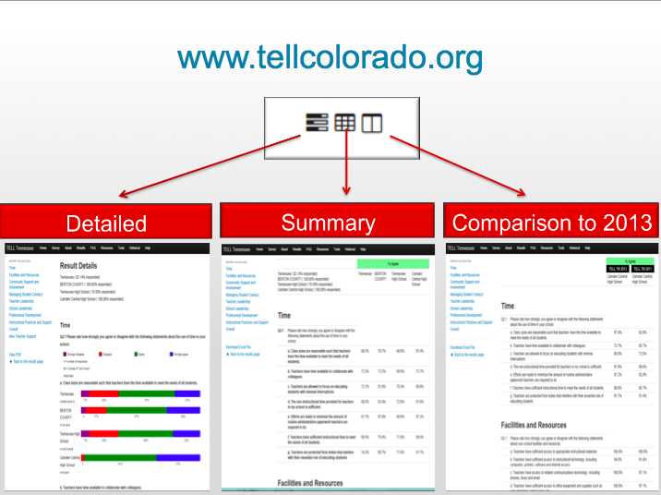

Slide 88
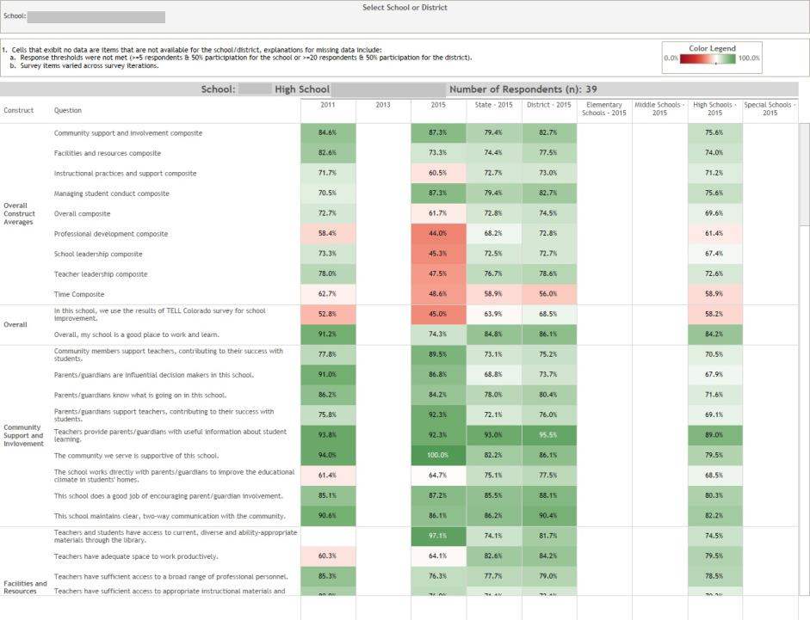
Interactive School/District Heat Map

Slide 89
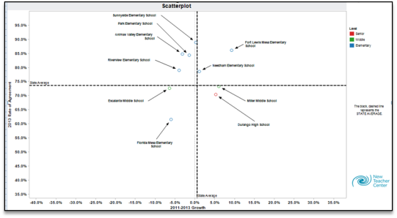
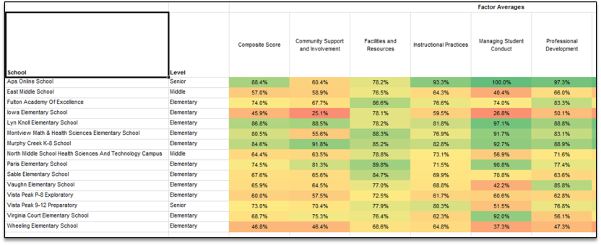
Scatter Plot
By School HEAT Map

Slide 90
A path through the TELL Data
Review Constructs
Examine Items Within the Construct
Determine an Item of Focus
Determine a Construct on which to Focus
Analyze Individual Items

Slide 91
Lots of Data, Where to Start?
Use HEAT Maps to identify a construct to start with:
  For which constructs were our teachers’ responses significantly lower than others? (compared to)
  Significantly higher? (compared to. . .)
Consider state-level results by construct:
  Time continues to be the least positively viewed teaching condition assessed in the survey.
  In reporting on their Instructional Practices, educators report high levels of use of classroom assessment, but declining use of state and district administered assessment results.
  In reporting on Supports, less than half of the respondents (44 %) in 2015 agree that the teacher evaluation process accurately identifies effectiveness, compared to 62% in 2013.

Slide 92
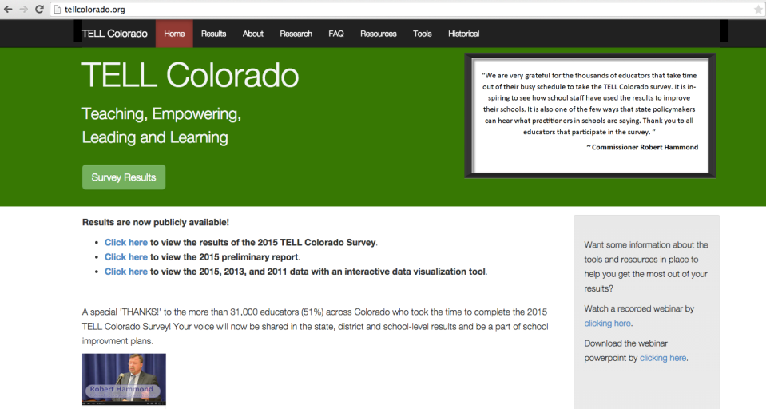
Accessing TELL Results
TELLCOlorado.org
www.tellcolorado.org
All districts and schools with at least a 50% response rate (and a minimum of 5 responses).
Survey Results:
  By District
  By School
Have you accessed your TELL Survey Results?

Slide 93
Practice
Access your school/district TELL Data, either:
  Review your School/District Level HEAT maps (interactive tool), OR
  Download the spread sheet of your Summary Results or Summary Comparison Results.
Consider:
  On which construct(s) would you focus first?
  What would be your path through your TELL data?

Slide 94
Planning for Local Planning
How will you use TELL results for improvement planning during the 2015-16 school year?
How will you help folks:
  Access TELL their Survey Results
  Determine where to start to analyze their TELL data
Turn to Planning for UIP for 2015-16, page 9, make notes about:
  Critical information to share
  Tools/Resources to Use
  With whom, when and how you will share this information

Slide 95
Agenda
Assessment Transition Implications for Accountability and UIP 2015
UIP Template and Expectations for 2015-16
Data Analysis for Academic Achievement and Growth
Utilizing TELL Survey Results in UIP Processes
READ Act and UIP

Slide 96
READ Act Requirements for UIP
The READ Act included requirements for UIP that took effect during the 2014-15 school year.
Work with a partner to consider READ Act Provisions related to Unified Improvement Planning (Tools, p. 35).
Consider the following questions :
  Which aspects of Unified Improvement Planning are addressed in the READ Act?
  What analysis of K-3 reading assessment results are required?

Slide 97
HB 15-1323 Revisions to READ Act Requirements

Slide 98
READ Act and UIP Processes
Data Analysis (Data Narrative/Data Analysis Worksheet):
  Identify notable trends in K-3 reading assessment results.
  Determine if K-3 reading is a priority performance challenge and identify associated root causes.
Setting Performance Targets (Target-Setting Form):
  Increase # of students achieving grade-level expectations.
  Reduce # of students with significant reading deficiencies.
Action Planning (Action Planning Form):
  Include action steps related to addressing the needs of K-3 grade students who are identified as having significant reading deficiencies.

Slide 99
Using K-3 Reading Interim Assessment Results for UIP
UIP and Accountability Process | Assessment Results
Data Analysis: Identifying Notable Trends and Prioritizing Performance Challenges | Use aggregate metrics (at the grade level, school, or district level) to identify trends over time in K-3 reading performance (spring to spring administrations). Aggregate metrics should include the %/number reading at grade level, and %/number identified with a significant reading deficiency.
Setting Performance Targets | Establish performance targets for reducing the number of students identified with a significant reading deficiency (fall) and increasing the number reading at grade level (spring).
Progress Monitoring | Use aggregate metrics (identified above) for fall, winter and spring administrations (within the school year).
Future: SPF/DPF 2.0 | CMAS Results for 3rd and 4th graders at one time identified as having a significant reading deficiency.

Slide 100
Approved K-3 Reading Interim Assessments
2013-14 through 2015-16:
  DIBELS (6 and NEXT edition);
  DRA2; and
  PALS
Beginning in 2014-15:
  Aimsweb;
  DIBELS (NEXT edition only);
  Formative Assessment System for Teachers (FAST);
  I Ready;
  ISP ER, Istation;
  Phonological Awareness Literacy Screening (PALS); and
  STAR Early Literacy Enterprise

Slide 101
READ Act Data reported to CDE
K-3 Reading interim assessment instrument used in determining students’ significant reading deficiency (and administration date).
Students identified as having a significant reading deficiency.
Students’ K-3 reading interim assessment score:
  DIBELS
  DRA2
  PALS
For UIP processes Schools/Districts must use K-3 reading interim assessment aggregated metrics not reported to CDE.
Vendors reports include some aggregated metrics.

Slide 102
Using K-3 Reading Interim Assessment Results for UIP
Assessment Instrument Descriptions available for (2014):
  Aimsweb (not available);
  DIBELS (NEXT);
  DRA2;
  FAST;
  I Ready;
  ISP ER, Istation;
  PALS; and
  Star Early Literacy Enterprise
Which early literacy assessment was in use in your district for 2014-15? Which will be used in 2015-16?
Send one person up to get an instrument description for your literacy assessment.
Updated instrument descriptions coming soon. . .

Slide 103
K-3 Reading Interim Assessment Instrument Descriptions
Work with a partner to review the Assessment Instrument Description for your K-3 Reading Interim Assessment.
Consider:
  What individual metrics are available? What metric is used to determine if students have significant reading deficiencies?
  What aggregate metrics are available?
  What comparison points are provided by the vendor?
  What comparison points are provided by CDE?
  About what can inferences be made based on the results?

Slide 104
K-3 Literacy Trend Statements
Turn to “K-3 Reading Example Trends and Targets” (Tools, p. 37)
Work with a partner to review the example Trend Statements and Priority Performance Challenge. Consider:
  What information is included in the trend statements?
  Why are trends related to students scoring at grade level and students identified as having a significant reading deficiency described separately?
  How would you change these trend statements?
  Do you agree with the Prioritized Performance Challenge that is listed? How could it be improved?

Slide 105
K-3 Literacy Performance Targets
Planning teams are required to include K-3 Literacy Performance Targets in their UIPs related to:
  Increasing the percent of students reading at grade level.
  Decreasing the percent/number of students identified with a significant reading deficiency.
  Note: For most K-3 Interim Assessment Instruments the cut score below which students would be identified as having a significant reading deficiency is below grade level expectations.
Review example performance targets, consider:
  What information is included?
  Do you agree with these targets? How could they be improved?

Slide 106
Incorporating K-3 Reading Strategies in the UIP Action Plan
Schools and districts are required to include the following in their UIP Action Plans.
  “The strategies to be used in addressing the needs of students enrolled in kindergarten, first, second, and third grade who are identified as having significant reading deficiencies.”
Discuss with your table:
  How could you meet this READ Act requirement?
  What if you don’t have a major improvement strategies related to K-3 reading?
Share out. . .

Slide 107
Planning for addressing READ requirements in UIP
Turn to “Planning for UIP for 2015-16”, p. 10-12
Reflect on how local teams might respond to READ Act Requirements in the UIP.
Make notes about:
  Critical Information related to each sub-topic that you will take back to your local context.
  The tools/resources that you will use.
  With whom, when and how you will share this information.

Slide 108
Give us Feedback!!
Written: Use sticky notes
  + the aspects of this session that you liked or worked for you.
  ⬇The things you will change in your practice or that you would change about this session.
  ? Question that you still have or things we didn’t get to today.
  Ideas, ah-has, innovations.
Oral: Share one ah ha!

