Slide 1
UIP 101:
Priority Performance
Challenges (PPCs)
Notes:
Hello! Thank you for joining us in the next video in our UIP 101 series. This video covers priority performance challenges, also referred to as PPCs, in the Unified Improvement Plan.

Slide 2
Session Outcomes
This video will answer the following questions:
What are priority performance challenges?
How do priority performance challenges fit into the improvement planning process?
Notes:
At the conclusion of the session today you should be able to describe what priority performance challenges are and describe how they fit into the improvement planning process.

Slide 3
Where are we in the UIP Process?
2
Where are we going?
How will we get there?
3
1
Prepare to
Plan
Where are we now?
Target
Setting
Action
Planning
Data
Analysis
Review Current Performance
Describe Notable Trends
Prioritize Performance Challenges
Identify Root Causes
Set Student Centered Targets
ID Major Strategies & Action Steps
How will we know if we’re getting there?
Progress Monitoring
Identify Interim Measures
Identify Implementation Benchmarks
4
Notes:
After you’ve completed your data analysis in your current performance and notable trends section of your UIP, you should begin prioritizing your performance challenges. This section is the first step in understanding where your school is going.

Slide 4
What are Priority Performance Challenges?
Priority Performance Challenges (PPCs) identify the student data trends that you want to focus on improving.
PPCs should:
Be limited (e.g., 3 or fewer)
Be at the appropriate magnitude
Include rationale
Address areas where the school is not meeting expectations (local, state, federal, etc.)
Notes:
Priority performance challenges identify the student data trends that you want to focus on improving. When writing your school’s PPCs, make sure they address each of the four following areas. The first is to make sure the PPCs you include in your plan are limited and focus on 3 or fewer performance challenges. The second is to ensure your PPCs are at the appropriate magnitude. PPCs should be student focused challenges that are within the realm of control for your school. Do not include challenges or conditions that are not possible for your school to impact. The third is to include rationale for why you are prioritizing that specific performance challenge in your plan. Finally, your PPCs should address areas where the school is not meeting expectations (either at the local, state, federal, district, or whatever level you decide). PPCs are challenges you’d like to overcome. Throughout the UIP, you’ll have other opportunities to name areas of strength.

Slide 5
PPCs’ Role in the UIP Process
Once you have a strong foundation in your current state and the trends you're seeing through current performance and notable trends section of the UIP…
PPCs are the student-focused challenges or data trends you’re prioritizing in your plan.
Your PPCs will inform the root causes you select, the strategies you choose to address your challenges, and the actions you progress monitor.
Notes:
The performance challenge section of the UIP is based on the strong foundation you create in the current performance and notable trends section of your UIP. Once you have this strong foundation, PPCs are the student-focused challenges or data trends you’re prioritizing in your plan. Your PPCs will inform the root causes you select, the strategies you choose to address your challenges, and the actions you progress monitor. For instance, if you identify you’d like to focus on early literacy due to data trends you’re seeing in your kindergarten through third grade interim assessments, you can decide to include this as a priority performance challenge. From there, you’ll determine what is the root cause of your early literacy performance concerns, which will then inform the strategy you select, and the actions you take.

Slide 6
Example
Priority Performance Challenge: Low Student Attendance
“Attendance decreased in 2019 and continues to be below expectations. The attendance rate at the school was tracking about 2% lower in 2020 before the shutdown. Attendance saw a small increase in 2021 but is still a focus.”
Addresses student data trends
Includes rationale
Addresses an area where the school is not meeting expectations (i.e., local, non-assessment data)
Focused and at the appropriate magnitude
Notes:
This slide contains an example of a priority performance challenge from a school’s UIP. The school identified low student attendance as their PPC. As they describe, “Attendance decreased in 2019 and continues to be below expectations. The attendance rate at the school was tracking about 2% lower in 2020 before the shutdown. Attendance saw a small increase in 2021 but is still a focus.” This sentence would meet expectations on the UIP Quality Criteria because it clearly addresses a student data trend, it includes a rationale for inclusion in the UIP, it addresses an area where the school is not meeting expectations, and is focused and at the appropriate magnitude. Note that this PPC is focused on attendance, which is an example of non-assessment data. Attendance is a leading indicator of other student outcomes. Therefore, the focus of this school on attendance may actually lead to improved assessment results. In your school’s UIP, you can use non-assessment or assessment results as the base of your PPC. When choosing a data trend to prioritize, choose a challenge that, once addressed, will bring about the level of change your school needs.

Slide 7
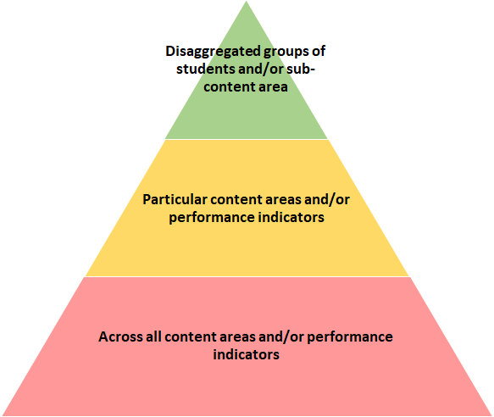
Examples of PPCs by Levels of Magnitude
For the past three years, students with IEPS have demonstrated declining growth in math that is well below state expectation. Overall, the school’s math achievement is trending upward.
Achievement in mathematics has increased over the last three years but is well below minimum state expectations.
For the past three years, achievement and growth has been flat and well below state expectation across all content areas, subgroups, and grade levels.
Notes:
To contextualize the level of change you’re hoping to impact with your PPCs, it is helpful to understand the varying levels of magnitude. The bottom portion of the triangle, shown in red, describes PPCs that impact students across all content areas and/or performance indicators. For example, a PPC might say “For the past three years, achievement and growth has been flat and well below state expectation across all content areas, subgroups, and grade levels”. The next portion of the triangle, shown in yellow, describes PPCs that impact students in particular content areas and/or performance indicators. For example, a PPC at this level of magnitude might say “achievement in mathematics has increased over the last three years but is well below minimum state expectations.” The final, and smallest portion, of the triangle, shown in green, describes PPCs that impact students across specific disaggregated groups of students and/or sub-content areas. For example, a PPC could say, “For the past three years, students with IEPs have demonstrated declining growth in math that is well below state expectation. Overall, the school’s math achievement is trending upward”. Across the levels of magnitude, from the bottom to the top of the triangle the number of students, targeted by the PPC narrows. Your school should decide which level of magnitude is appropriate for the level of change required in your school.

Slide 8
Common Misconceptions
PPCs only address areas where the school is not meeting state expectations.
Both state and local data can be used to define performance challenges, including non-assessment data (e.g., attendance).
PPCs address adult actions.
PPCs should be specific statements about student performance. They are not action steps that need to be taken, or concerns about budget, staffing, curriculum, or instruction. Adult actions will be addressed in other areas of the UIP.
PPCs focus on no more than one student data trend.
A single PPC can synthesize multiple concerning trend statements. For instance, both the growth and achievement of students with disabilities in English Language Arts may be combined as a single PPC.
Notes:
There are three common misconceptions about this section of the UIP. The first is that PPCs only address areas where the school is not meeting state expectations. In fact, you can use both state and local data to define performance challenges, including non-assessment data like we saw in the previous example. The second is that PPCs address adult actions. Instead, PPCs should be specific statement about student performance. They are not action steps that need to be taken, or concerns about budget, staffing, curriculum, or instruction. For example, a priority challenge is not a lack of teacher instructional time in math. Instead, focus your priority challenge on declining math performance across state and local assessments. Adult actions will be addressed in other areas of the UIP. The final misconception is that PPCs should focus on no more than one student data trend. A single PPC can synthesize multiple concerning trend statements. For instance, both the growth and achievement of students with disabilities in English Language Arts may be combined as a single PPC.

Slide 9
Why PPCs Matter
Focuses your improvement efforts on the challenges you’d most like to improve
Frames investigation into root cause analysis
Sets the tone for each of the subsequent steps in your planning process
Defining clear performance challenges supports strong target setting and interim measures
Notes:
This presentation has hopefully highlighted many ways why setting appropriate priority performance challenges is important. The first is that they focus your improvement efforts on the challenges you’d most like to improve. Because UIPs should be implemented over the course of a year, you cannot change everything all at once, so it is important to make sure your improvement efforts are focused on what is most needed. PPCs also frame the investigation you’ll do in the next section of the UIP on root cause analysis. PPCs provide you with the areas of student performance you’d like to change, and root causes help you understand the underlying reasons for these performance issues. Next, PPCs set the tone for each of the subsequent steps in your planning process. You’ll continue to come back to your performance challenges throughout the rest of your planning process. Finally, defining clear performance challenges supports strong target setting and interim measures because it focuses your efforts on your student performance goals.

Slide 10
Thank you for your time!
Email any questions to
uiphelp@cde.state.co.us
Notes:
Thank you for your time today. If you have any questions, please email uiphelp@cde.state.co.us

