Slide 1
UIP 101:
Overview and Brief Description
Notes:
What is this resource series-
School focus- most of which applies to

Slide 2
Session Outcomes
This video will answer the following questions:
What is Unified Improvement Planning?
What resources are available to help me in the planning process?
What should be included in the Brief Description of the plan?
Notes:
Check by angelina fara from NounProject.com

Slide 3
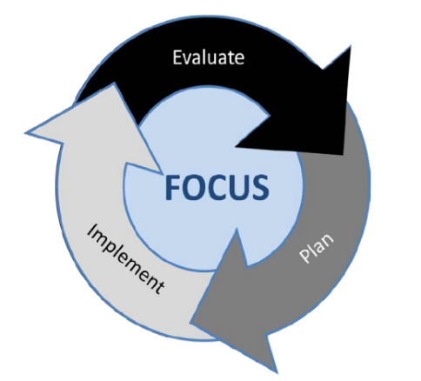
What is the Unified Improvement Plan?
Manage a single, consistent process for all schools and districts
Meet state and federal accountability improvement planning requirements
Describes improvement efforts that will take the school from the current to desired level of performance
Notes:
Manage a single process for all schools and districts to meet state and federal accountability improvement planning requirements
Create tools, resources, and guidance for schools and districts around improvement planning
Offer direct technical assistance (training/coaching) to districts and schools engaging in the improvement planning process
Provide a consistent process to engage with districts/schools on improvement efforts

Slide 4
Multiple Purposes
CDE has developed both a process and template to support schools and districts in their performance management efforts.
Alignment
Support
Best Practice
Documentation
Transparency
Notes:
Process and product

Slide 5
Overview of the UIP Process
2
Where are we going?
How will we get there?
3
1
Prepare to
Plan
Where are we now?
Target
Setting
Action
Planning
Data
Analysis
Review Current Performance
Describe Notable Trends
Prioritize Performance Challenges
Identify Root Causes
Set Student Centered Targets
ID Major Strategies & Action Steps
How will we know if we’re getting there?
Progress Monitoring
Identify Interim Measures
Identify Implementation Benchmarks
4

Slide 6
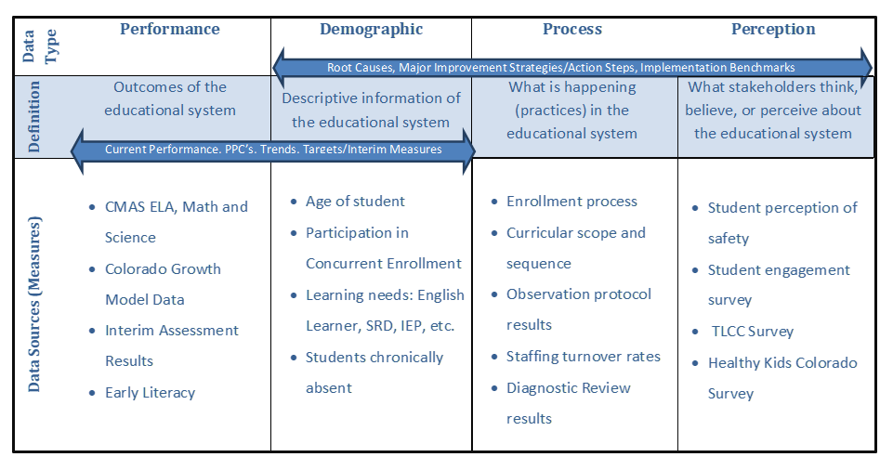
Types of Data for Improvement Planning

Slide 7
Timeline
Spring | April 15- UIP Template Roll Over Review Quality Criteria and review planning expectations Organize Data Develop initial draft of the data analysis Identify what strategies and actions may carry forward from previous plan
Early Fall August – September | Review and integrate relevant performance data (Performance Frameworks/ESSA) Consult with stakeholders Develop or finalize Action Plan Begin implementation of the plan
Fall | October 15 Plan due to CDE for public posting Eligible schools/districts may exercise biennial flexibility
Fall/Winter | Plan implementation continues Progress monitoring and adjusting planning accordingly January 15 submission for those participating in R2R or newly identified for CDE review
Winter/Spring | review local performance and implementation data to begin revising/building next year’s UIP Engage stakeholders in the UIP process, including quarterly review of implementation

Slide 8
Resources to support the UIP process
Primary Resources
UIP Handbook
Online System Guidance
Quality Criteria (District and School)
Dashboards
Specialized Resources
Data Analysis for Small Student Populations
Guidance for Combined Plans
Short Cycle and UIP
UIP Guidance for New Schools
Support for Accountability Clock (Year 4, Parent Notifications, etc.)
Notes:
Handbook- includes background information on key concepts, UIP requirements, samples from Colorado schools and districts, and recommendations for facilitating some of the planning processes. Includes definitions and requirements, samples for each element, and recommended processes.

Slide 9
Brief Description

Slide 10
What is the Brief Description?
The Brief Description provides a summary of the school or district and background information that helps the reader understand the context, focus of the school, and process that the school or district used to involve stakeholders in the development of the UIP.

Slide 11
Role of the Brief Description in the UIP Process
Sets the context for the plan, in which the school frames what follows.
Sets up the performance review that will occur in the immediate next steps of Current Performance and Notable Trends.
This section is flexible and may be a couple of paragraphs to a page. It is up to the writer the level of detail.

Slide 12
Common Misconceptions
Common challenges are that other areas of the plan come into the brief description:
Prior Years Targets
Current Performance
Generically written-difficult to tell when the plan was written (no dates) missed opportunities for highlighting good things - public facing
Not brief- includes the full school history
Notes:
1800s

Slide 13
Why The Brief Description Matters
It allows the school to own and describe its narrative and features that are important to the school
It may include elements such as:
School Mission/Vision/Design (IB, Charter)
Demographic Shifts
Leadership/Staffing Changes
Geographic Location/Community Notes

Slide 14
Videos that Follow in this 101 Series
Current Performance and Notable Trends
Priority Performance Challenges
Root Causes
Major Improvement Strategies, Actions and Implementation Benchmarks
Target Setting and Interim Measures
Additional Video:
UIP Online System

Slide 15
Thank you for your time!
Email any questions to
uiphelp@cde.state.co.us
Notes:
Thank you for your time today. If you have any questions, please email uiphelp@cde.state.co.us

