Slide 1
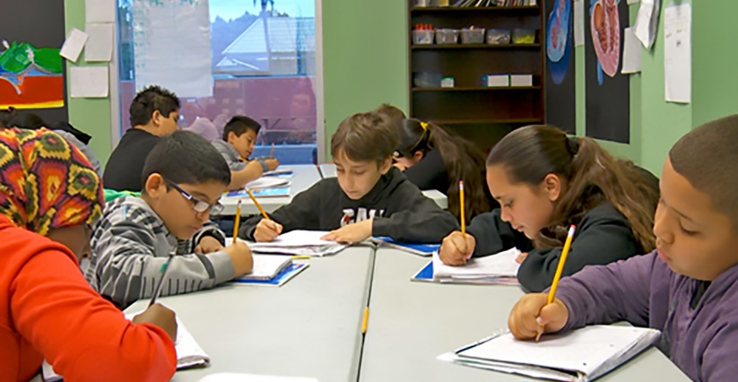
Colorado’s Framework for Writing Instruction: What is it?

Slide 2
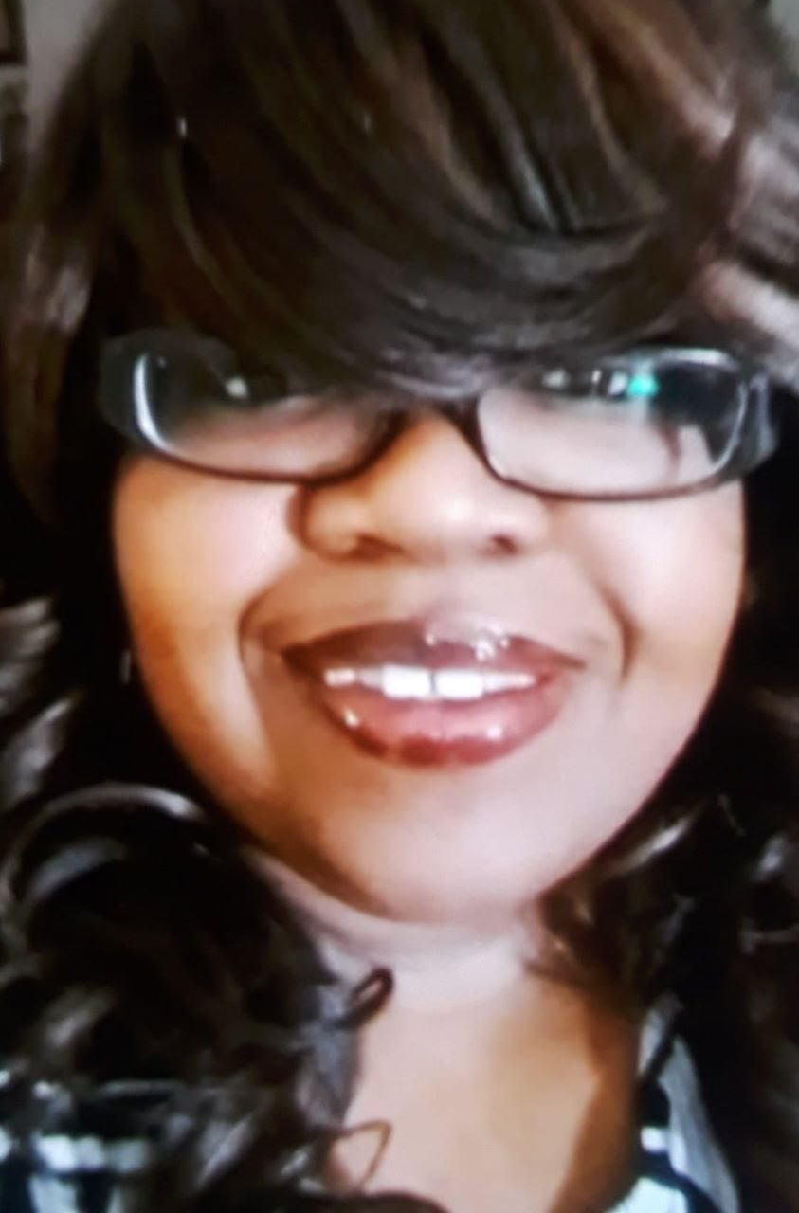
Welcome!
Dr. Olivia Gillespie Ed.D
Reading, Writing, and Communicating Content Specialist, Office of Standards and Instructional Support
gillespie_o@cde.state.co.us
720-930-1298
Notes:
[Estimated time: 2 minutes]

Slide 3
Introductions
Name, district and/or school, and current role
Tell us about a moment during the school year that brought you joy.

Slide 4
Session Norms
Be present and engaged in the work.
Speak your truth and respect the truth of others.
Everyone’s voice is not only welcomed, but also needed.
This is a JUDGEMENT FREE ZONE!
Notes:
[Estimated time: 1 minute]

Slide 6
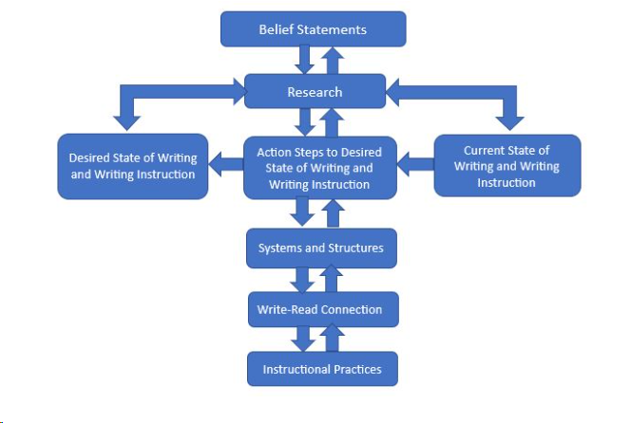
What is the Colorado Framework for Writing Instruction?

Slide 7
The Colorado Framework for Writing Instruction is intended to support district- and school-level leaders in facilitating conversations with their literacy leaders, instructional coaches, and teachers to develop a research-based framework toward the teaching of writing.

Slide 8
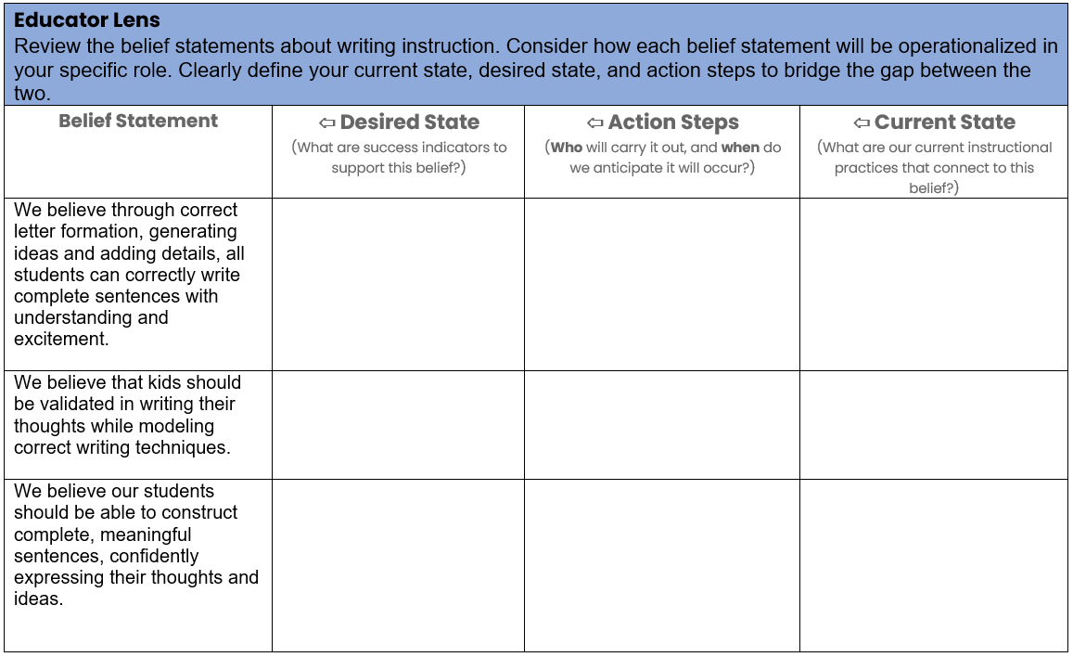
This framework connects these more abstract beliefs to a research base.
From there, it offers the elements of a “desired state” of teaching writing: the observable teacher behaviors that demonstrate effective writing instruction and the student behaviors that follow those actions.
Both teachers and leaders are asked to examine their current state of writing v. their desired state of writing and then, develop measurable action steps to achieve their desired state of writing.

Slide 9
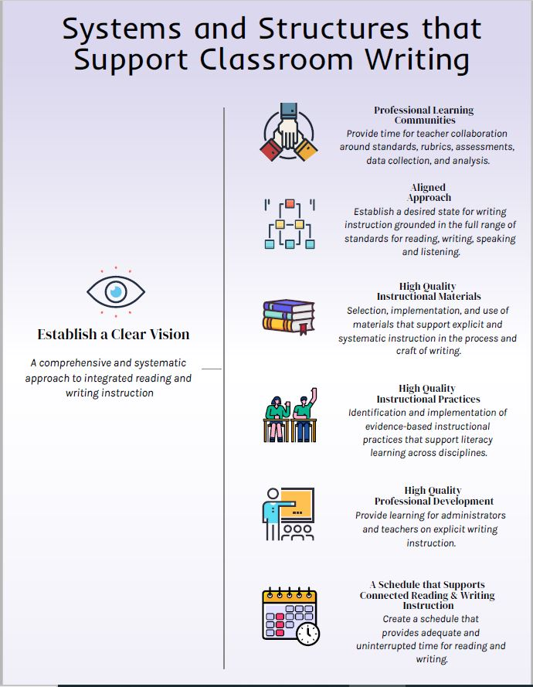
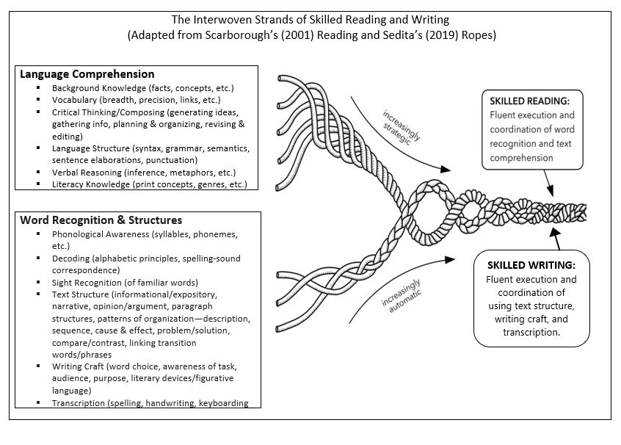
Finally, the framework connects the instructional practices to the implementation of an instructional system that is comprehensive and systematic in its approach to integrate research and evidence-based structures that sees the importance, interdependence, and intersectionality of writing and reading.

Slide 10
The Importance of Explicit Writing Instruction

Slide 11
Why is writing and explicit writing instruction important?
Why is it critical that we view writing and writing instruction as foundational and as an essential component of literacy?
11

Slide 12
Breakout Rooms

Slide 13
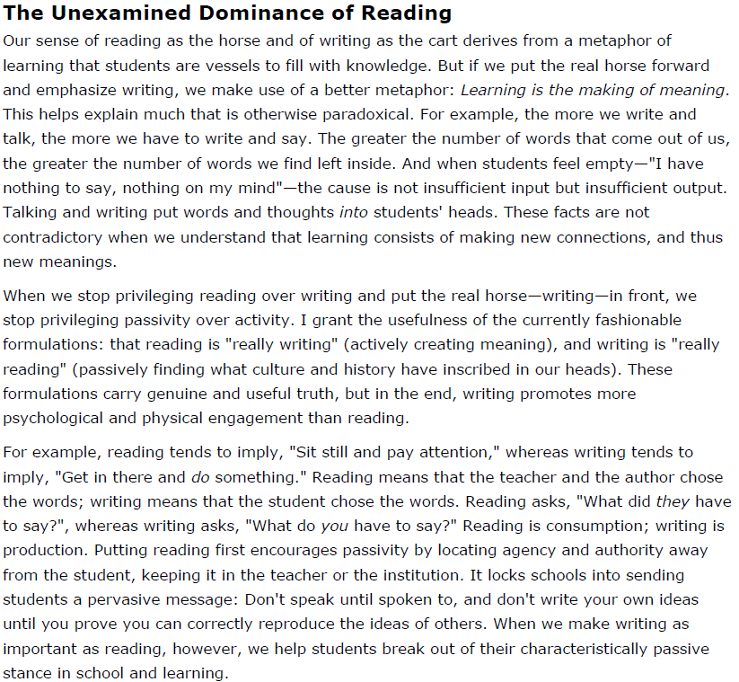

Slide 14
Whole Group Discussion:
How does what Peter Elbow wrote align with what you discussed in your breakout rooms?
Does writing within your district, school, or classroom hold the same level of importance as reading? If not, why?

Slide 15
Four Principles of Writing and Writing Instruction

Slide 16
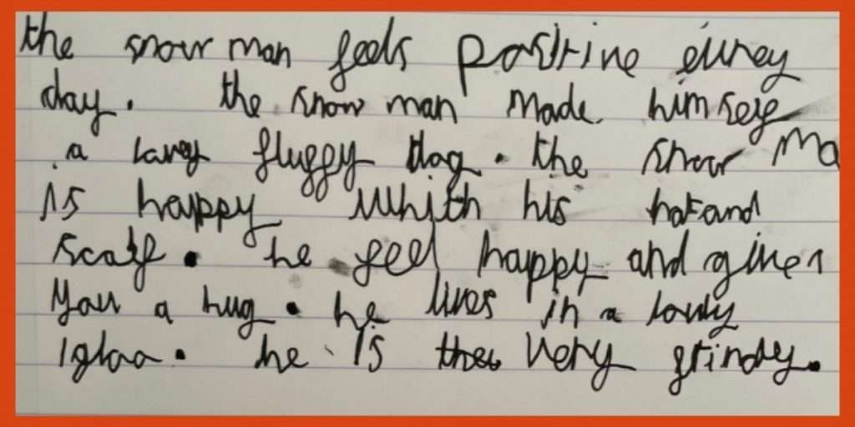
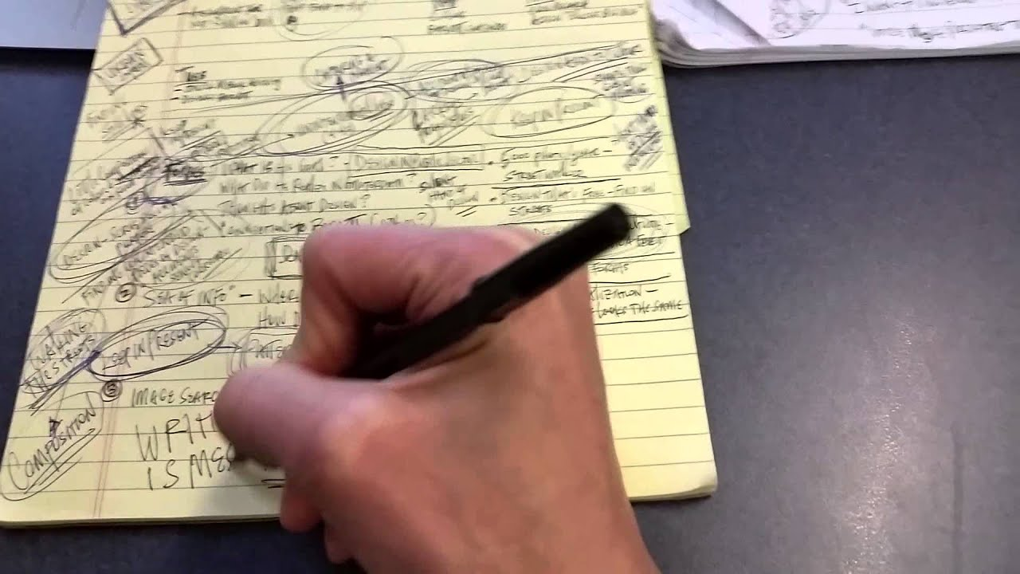
Principle 1: Writing is messy!

Slide 17
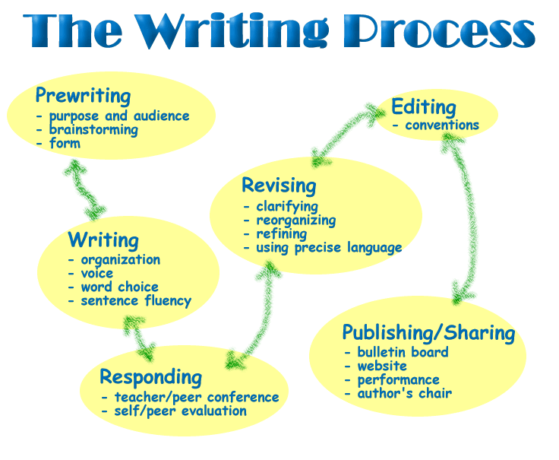
If only writing were this simple . . .

Slide 18
Prewriting/
Planning
Brainstorming ideas
Purpose and audience
Genre and modality of writing (form)
Revision
Clarifying
Reorganizing
Refining
Using precise language
Drafting/
Writing
Organization
Voice (tone, mood)
Word choice
Fluency
Editing
Grammar/ Punctuation
Conventions
Publishing/ Sharing
(Best Draft)
Bulletin
Website
Parents/Students
Responding
Teacher/peer conferencing
Self/peer evaluation

Slide 19
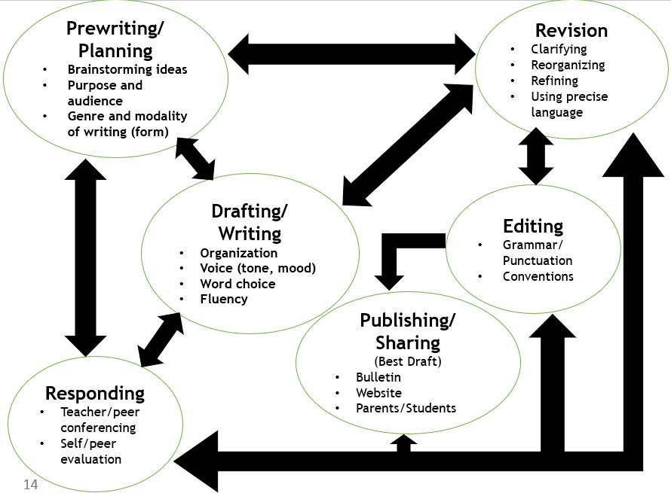
What does the writing process look like in your classroom? Does it mirror this one?

Slide 20
Prewriting/
Planning
Brainstorming ideas
Purpose and audience
Genre and modality of writing (form)
Revision
Clarifying
Reorganizing
Refining
Using precise language
Drafting/
Writing
Organization
Voice (tone, mood)
Word choice
Fluency
Editing
Grammar/ Punctuation
Conventions
Publishing/ Sharing
(Best Draft)
Bulletin
Website
Parents/Students
Responding
Teacher/peer conferencing
Self/peer evaluation

Slide 21
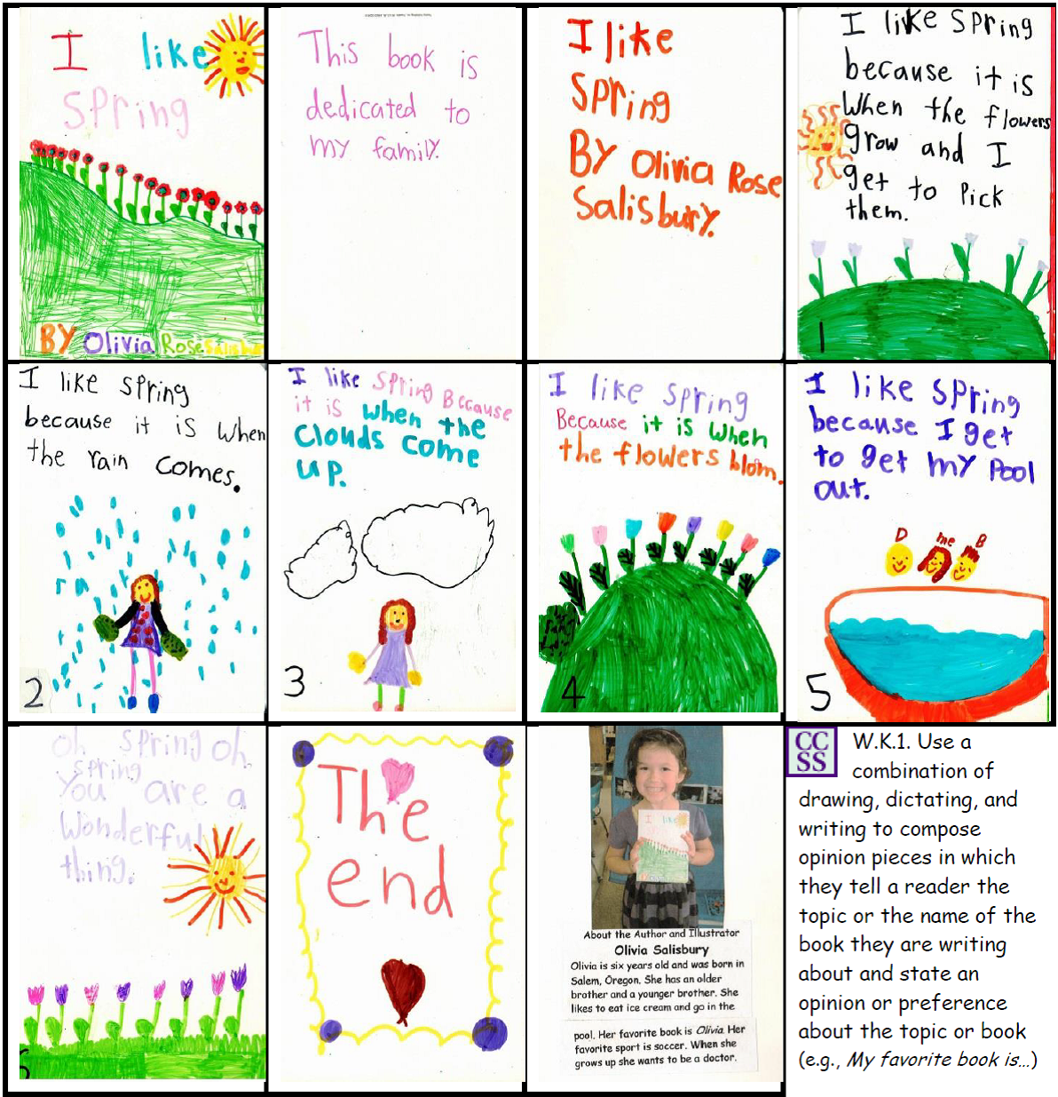
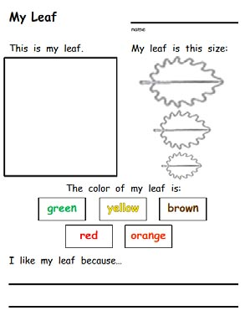
Elementary Example: Grades K-2
Lead your children into organizational thinking with this template. Help them identify the topic, provide a detailed drawing, add facts about the topic, and summarize with a statement of opinion. Later in the year, this organizational plan becomes a way of thinking that leads to quality informational writing.
Children take “writerly/scientific walks” and notice the changing seasons. Connections to nature inspire thinking, talking, drawing, and writing. We sing ”______ is coming, ______is coming, how do you think I know?” We talk about what we like about each season and why. Children are challenged to use the word “because” to extend their writing.

Slide 22
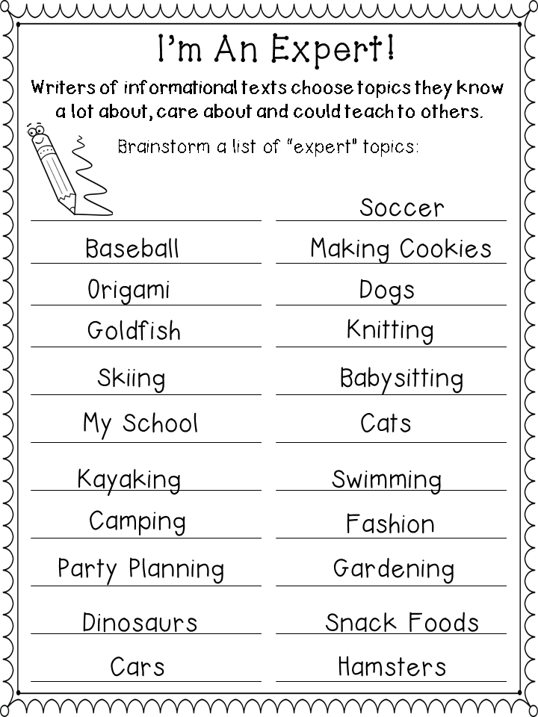
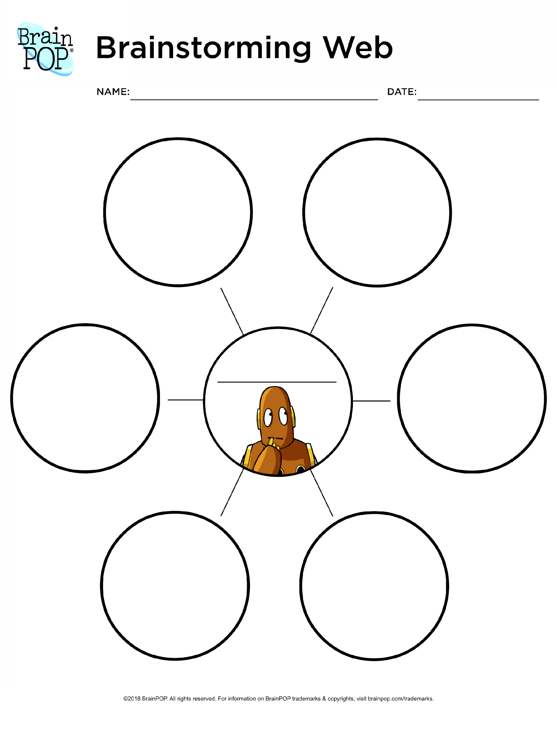
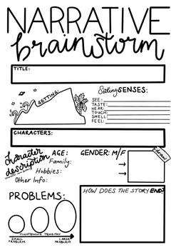
Elementary Examples: Grades 3-5
Student prompt: If you can write a _____________ about anything, what would you write?

Slide 23
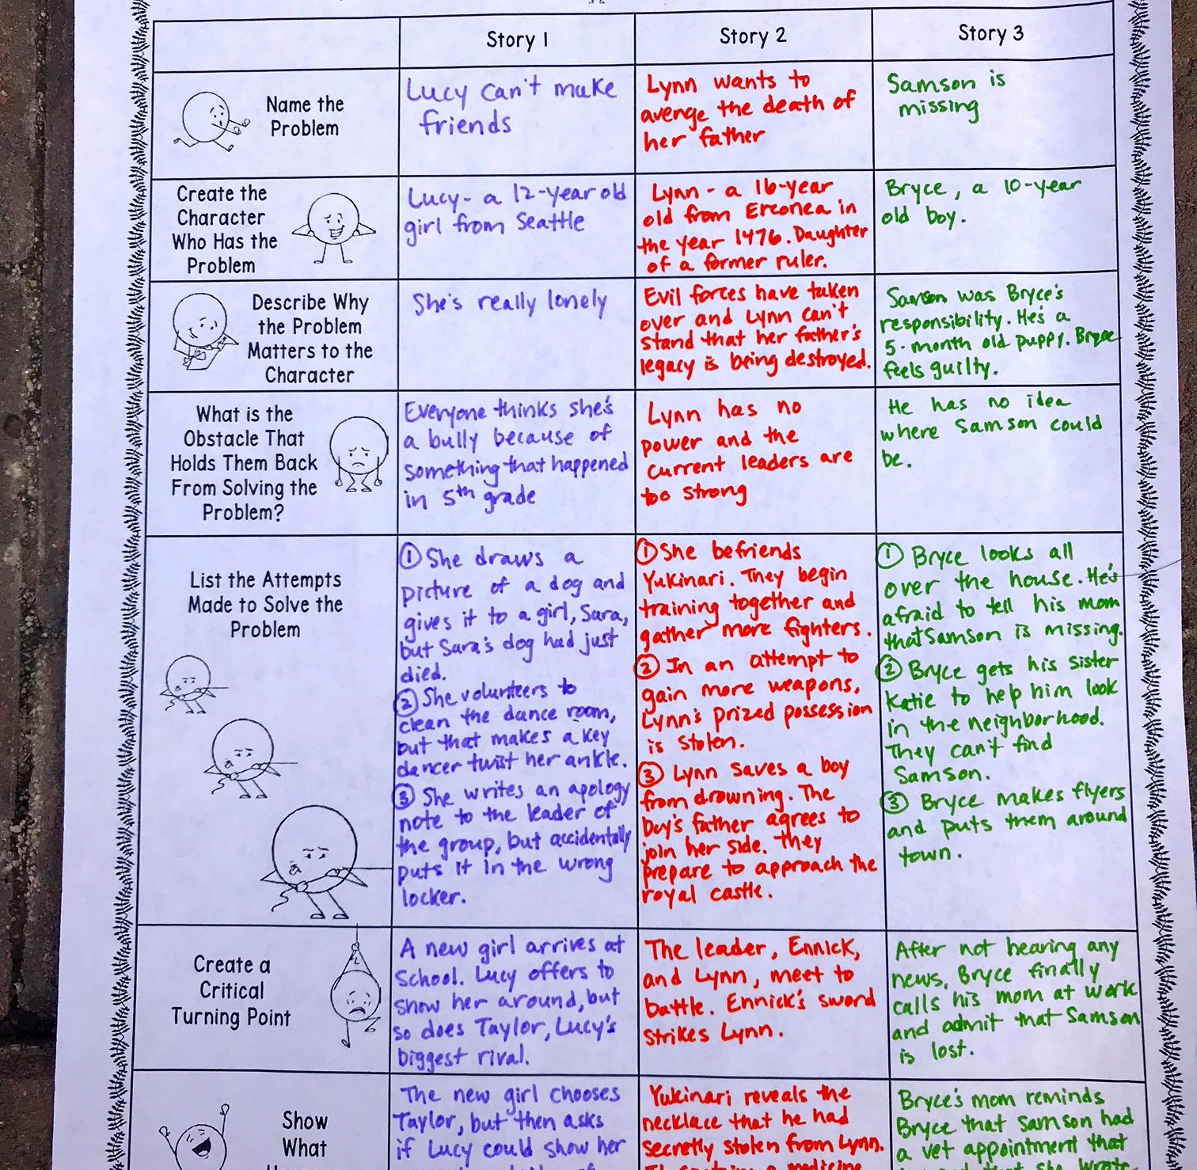
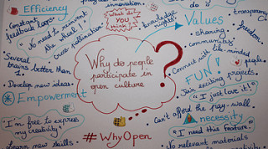
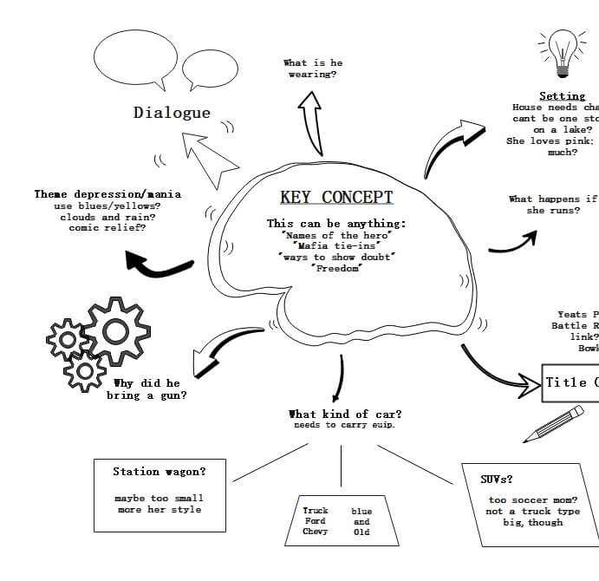
Middle/High School Examples

Slide 24
Prewriting/
Planning
Brainstorming ideas
Purpose and audience
Genre and modality of writing (form)
Revision
Clarifying
Reorganizing
Refining
Using precise language
Drafting/
Writing
Organization
Voice (tone, mood)
Word choice
Fluency
Editing
Grammar/ Punctuation
Conventions
Publishing/ Sharing
(Best Draft)
Bulletin
Website
Parents/Students
Responding
Teacher/peer conferencing
Self/peer evaluation

Slide 25
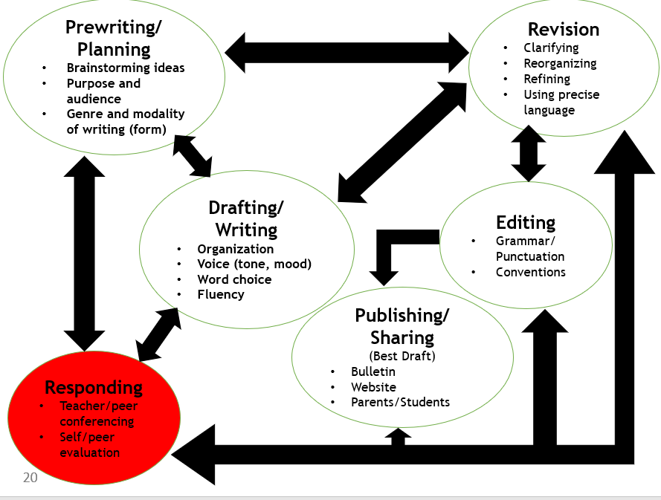
How are you building in time for teacher/peer conferencing and peer/self evaluation in your classroom?
Teacher/peer conferencing should focus on 1-2 elements each time. Refrain from focusing on grammar, punctuation, and spelling until student has a strong topic, clear and specific details, and development of narrative or informational writing.

Slide 26
Prewriting/
Planning
Brainstorming ideas
Purpose and audience
Genre and modality of writing (form)
Revision
Clarifying
Reorganizing
Refining
Using precise language
Drafting/
Writing
Organization
Voice (tone, mood)
Word choice
Fluency
Editing
Grammar/ Punctuation
Conventions
Publishing/ Sharing
(Best Draft)
Bulletin
Website
Parents/Students
Responding
Teacher/peer conferencing
Self/peer evaluation

Slide 27
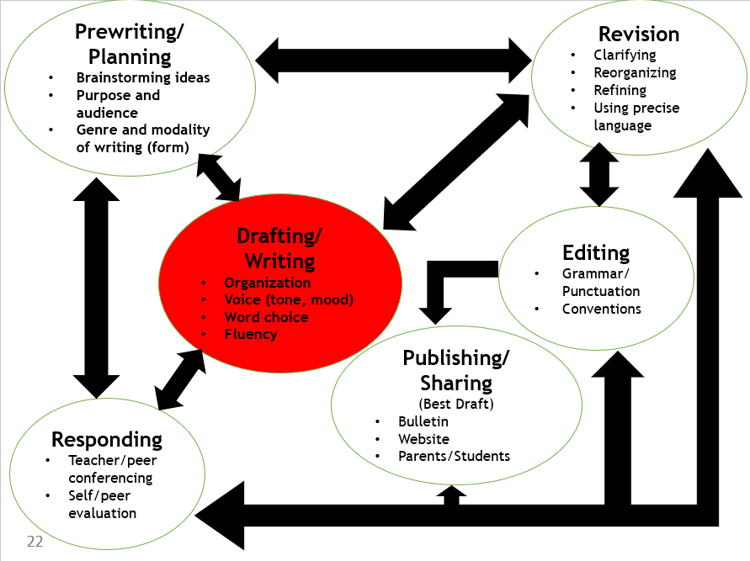
Are you writing alongside your students? Why or why not? How are you modeling writing for your students?
Demonstrating writing in real-time in which students can see your process—how you brainstorm/gather ideas, how you begin drafting, and revisions to your writing—builds confidence, reduces the pressure, and inspires risk taking.

Slide 28
Prewriting/
Planning
Brainstorming ideas
Purpose and audience
Genre and modality of writing (form)
Revision
Clarifying
Reorganizing
Refining
Using precise language
Drafting/
Writing
Organization
Voice (tone, mood)
Word choice
Fluency
Editing
Grammar/ Punctuation
Conventions
Publishing/ Sharing
(Best Draft)
Bulletin
Website
Parents/Students
Responding
Teacher/peer conferencing
Self/peer evaluation

Slide 29
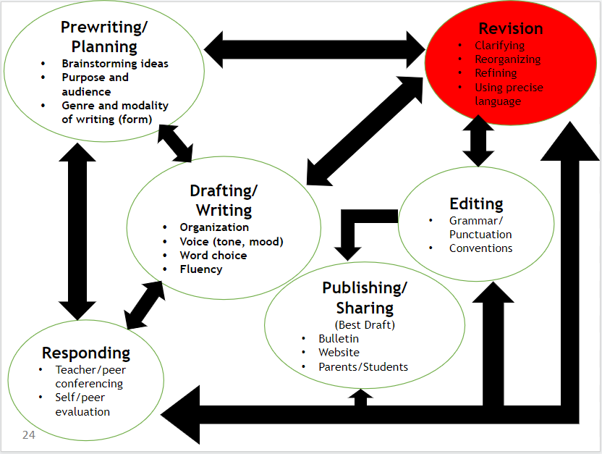
Do you have a revision process in place for your students? If so, how often are students given the opportunity to revise their writing? Does it only occur after they have submitted a rough draft? How many drafts are students permitted to submit and revise?
Writing is iterative! Therefore, students should be permitted to revise their drafts as often as needed in order to turn in their “best” draft. Teachers should place more value on the process than the final product. This does not preclude or negate requiring student submission of what we call a final draft but understanding that even the “best” so-called writers submit their best drafts for publishing!

Slide 30
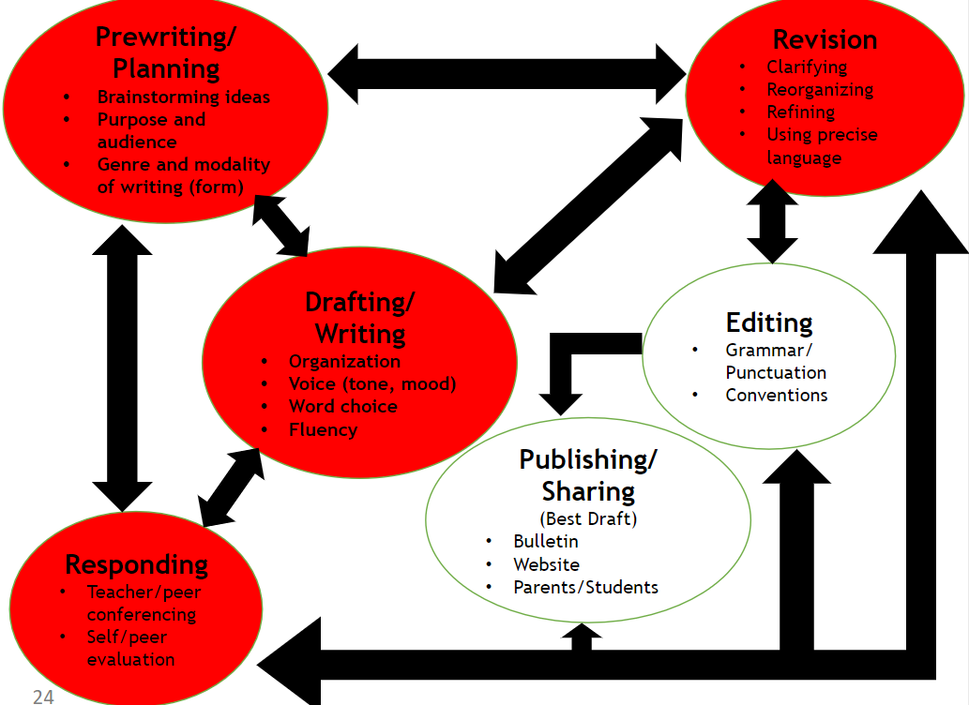
The writing process requires . . .
Commitment from teachers across all content areas and grade levels.
Consistency in practice, because practice makes permanent.
Flexibility. Writing is not a linear process.
Conferencing in each stage
Modeling writing for students
Acceptance of the best draft as the final product.

Slide 31
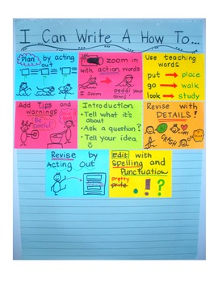
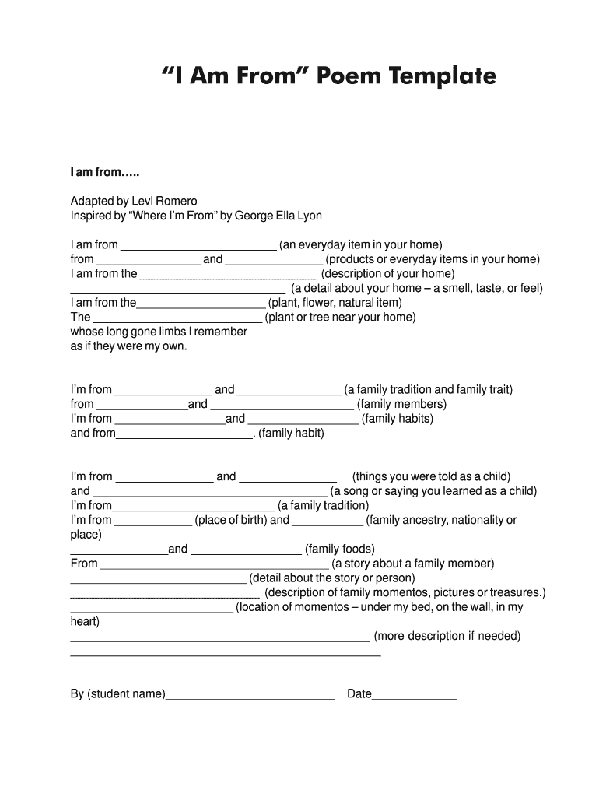
Principle 2: Writing serves a variety of purposes
Sometimes, writing can be utilitarian: it is produced to achieve a specific purpose that can be quite disassociated from the writers’ identity or ideas (e.g., How To Manuals)
At other times, writing can be enormously personal, as when a writer is composing a story, poem, or a song that reflects deeply held beliefs or ideas.

Slide 32
In each of these instances and regardless of purpose, what writers produce reflects their own assessment of the purpose, audience, context, and value of the writing—for themselves and/or for others.
Importantly, writing happens far beyond the walls of a classroom or school—and for school-aged writers, lately more often out of school than in (Applebee and Langer; Lenhart et al).
When writers compose—texts to friends, Instagram posts, fan fiction, blogs, or any one of a myriad of sites where they can create identities—they are writing. However, writers increasingly do not recognize these acts as writing, seeing them as distinct from what they are asked to do in school (Lenhart et al).

Slide 33
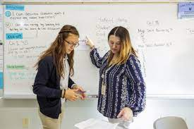
Principle 3: Everyone is a writer!
Multilingual Learners
Students with Disabilities
(IEPs)
Dyslexia
Students with significant reading deficiencies (SRD)
Teachers

Slide 34
Everyone has the capacity to write. Writers are not static. They develop skills and enhance their writing skills throughout their writing lives; thus, writers grow continually. Becoming a better writer requires practice. The more writers write, the more familiar it becomes. As writers, sometimes they feel confident; at other times, they may feel afraid and insecure. Therefore, students learn to write by writing.
Writers can be beginning or advanced writers in different situations. Just because they may be advanced in one situation, it does not make them advanced in all situations. Writers are researchers too, and they should develop the critical ability to evaluate their own work. They may collaborate with each other in different stages of writing, from drafting to revision to publication. Thus, writers learn how writing is a social act when they consider audiences and contexts and when they work with other writers as they compose.

Slide 35
Principle 4: Writers bring multiliteracies, and they bring cultural and linguistic assets to whatever they do.
Because writing is linked to identity, writers represent different ideologies, values, and identities. Thus, writers’ cultures and languages influence their writing. Recognizing that students are language users with multiple literacies will help teachers engage students in writing. Writers also bring their past writing and reading practices with them whenever they write or read. In short, everything they have experienced, who they are, where they have been, and what they have done impact their writing practices, literacies, and language attitudes.

Slide 36
Why is writing and explicit writing instruction important?
Why is it critical that we view writing and writing instruction as foundational and as an essential component of literacy?

Slide 38
Dr. Olivia Gillespie, Ed.D
Reading, Writing, and Communicating Content Specialist, Office of Standards and Instructional Support
gillespie_o@cde.state.co.us
720-930-1298
Notes:
[Estimated time: 2 minutes]

