Slide 1
Setting the Standard
CDE Office of Standards and Instructional Support

Slide 2
Introduce the “Setting the Standards Series”
Purpose: The Colorado Department of Education Standards & Instructional Support is hosting an ongoing virtual webinar series called Setting the Standard. Join the team to stay up-to-date on high impact instructional strategies, CDE resources for teaching and Colorado Academic Standards implementation updates.
Time and dates: Webinars will be hosted on the 1st and 3rd Friday of each month from 11:30am-12:30pm.
Audience: Educators, school and district administrators, school and district instructional leaders, community partners supporting standards and instruction in schools.

Slide 3
Objectives
Identify the key components of the CDE Return to School Toolkit and guidance
Identify resources for implement guidelines
Identify resources of instructional practices

Slide 4
Agenda
CDE COVID-19 Return to School Resources
Q and A
Standards and Instruction Resources
Q and A
Closure

Slide 5
Expectations

Slide 6
CDE Toolkit Updates August 7, 2020
Sarah Blumenthal, RN, MSN, NCSN
State School Nurse Consultant/Assistant Director of Health and Wellness

Slide 7
As of, July 28, 2020
What we know…
COVID-19 information continues to evolve and shape decisions and planning
Regional approaches are different based on unique circumstances
Layers of protections work!
Currently, all of Colorado is in the Safer-at-Home phase
Statewide Executive Mask Order is in effect 30 days from July 16, 2020, unless further extended
What we don’t know…
How the COVID-19 pandemic will evolve

Slide 8
NEW
CDE Re-opening School Guidance Toolkit – ongoing
CDPHE/CDE Reopening Schools: Health Guidance by COVID-19 Phase

Slide 9
What we are working on….
In collaboration with experts, advisors, stakeholders and state agencies:
CDPHE - School closure guidance
CDE–Vision and Hearing Guidance during COVID-19 Pandemic
CDPHE Infectious Disease template letters for COVID-19
CDPHE’s “How Sick is Too Sick”

Slide 10
Colorado Case Summaries
July 12, 2020
August 5, 2020
Notes:
Sarah

Slide 11
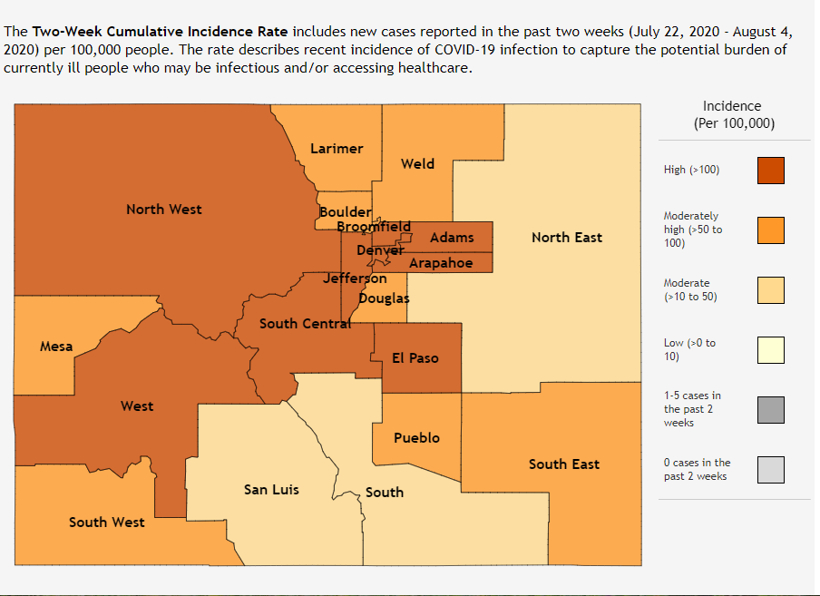
CDPHE Incidence Rate LINK July 22 – August 4, 2020
Notes:
Sarah

Slide 12
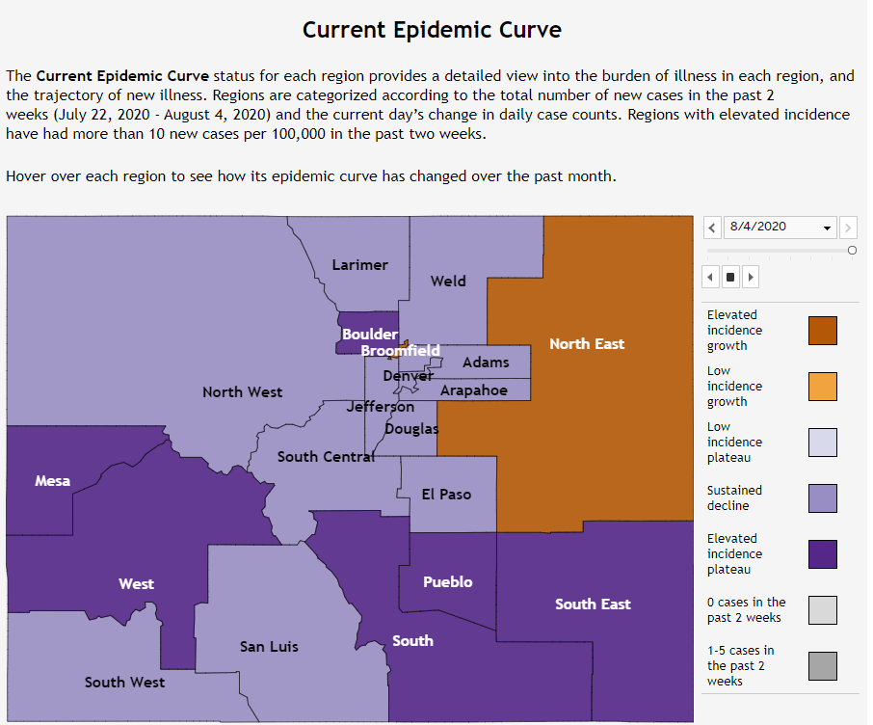
Current Epidemic Curve July 22 - Aug 4, 2020
LINK

Slide 13
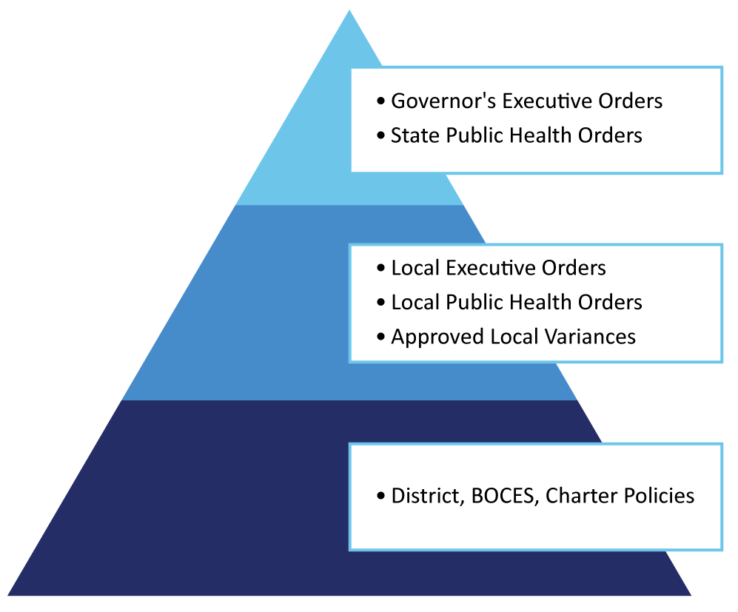
2020-21 PLANNING FRAMEWORK AND TOOLKIT Regulatory Awareness: COVID-19
Enforcement of public health orders FAQ LINK
Notes:
Sarah
It’s important to understand the regulatory structure as it relates to COVID-19. State executive and public health orders apply to all Coloradans. Local governments can choose to enact stricter guidance than the state. In some cases, local governments may seek a variance from the state’s orders. At the local school level, districts, BOCES, and charters may adopt policies related to COVID-19.

Slide 14
Grounding Our Work

Slide 15
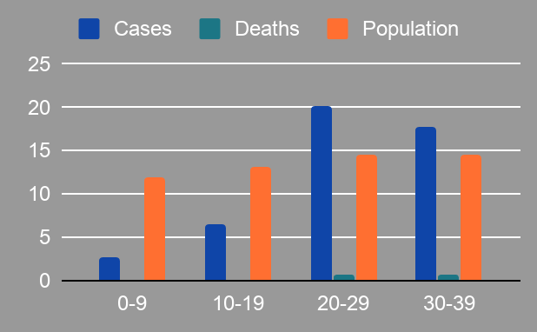
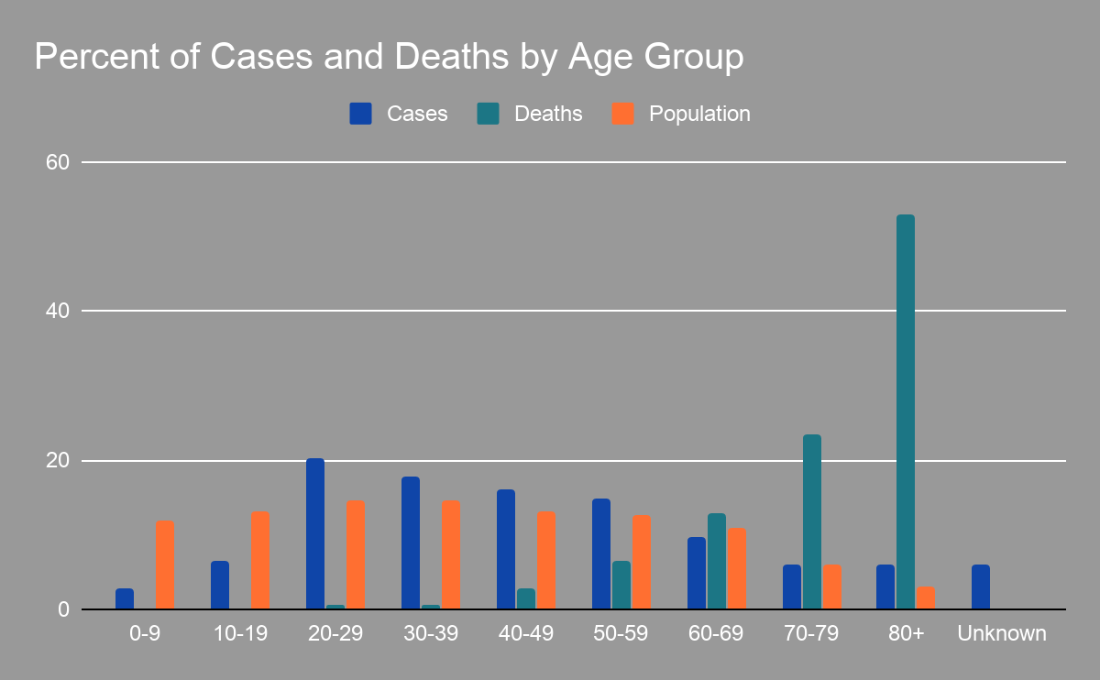
Children Respond Differently to COVID
Notes:
Brian - CDPHE
Even though schools in Colorado have not had in person learning for many months, we can still learn about the risk of COVID in children from other sources.
In this data from CDPHE, we can see important trends. Kids respond very differently to COVID than adults; they get sick less often and are at lower risk for severe outcomes.
This changes through adolescence and into the early 20s, when people start to have more adult-like transmission patterns. However, even these young adults are at low risk of severe outcomes.

Slide 16
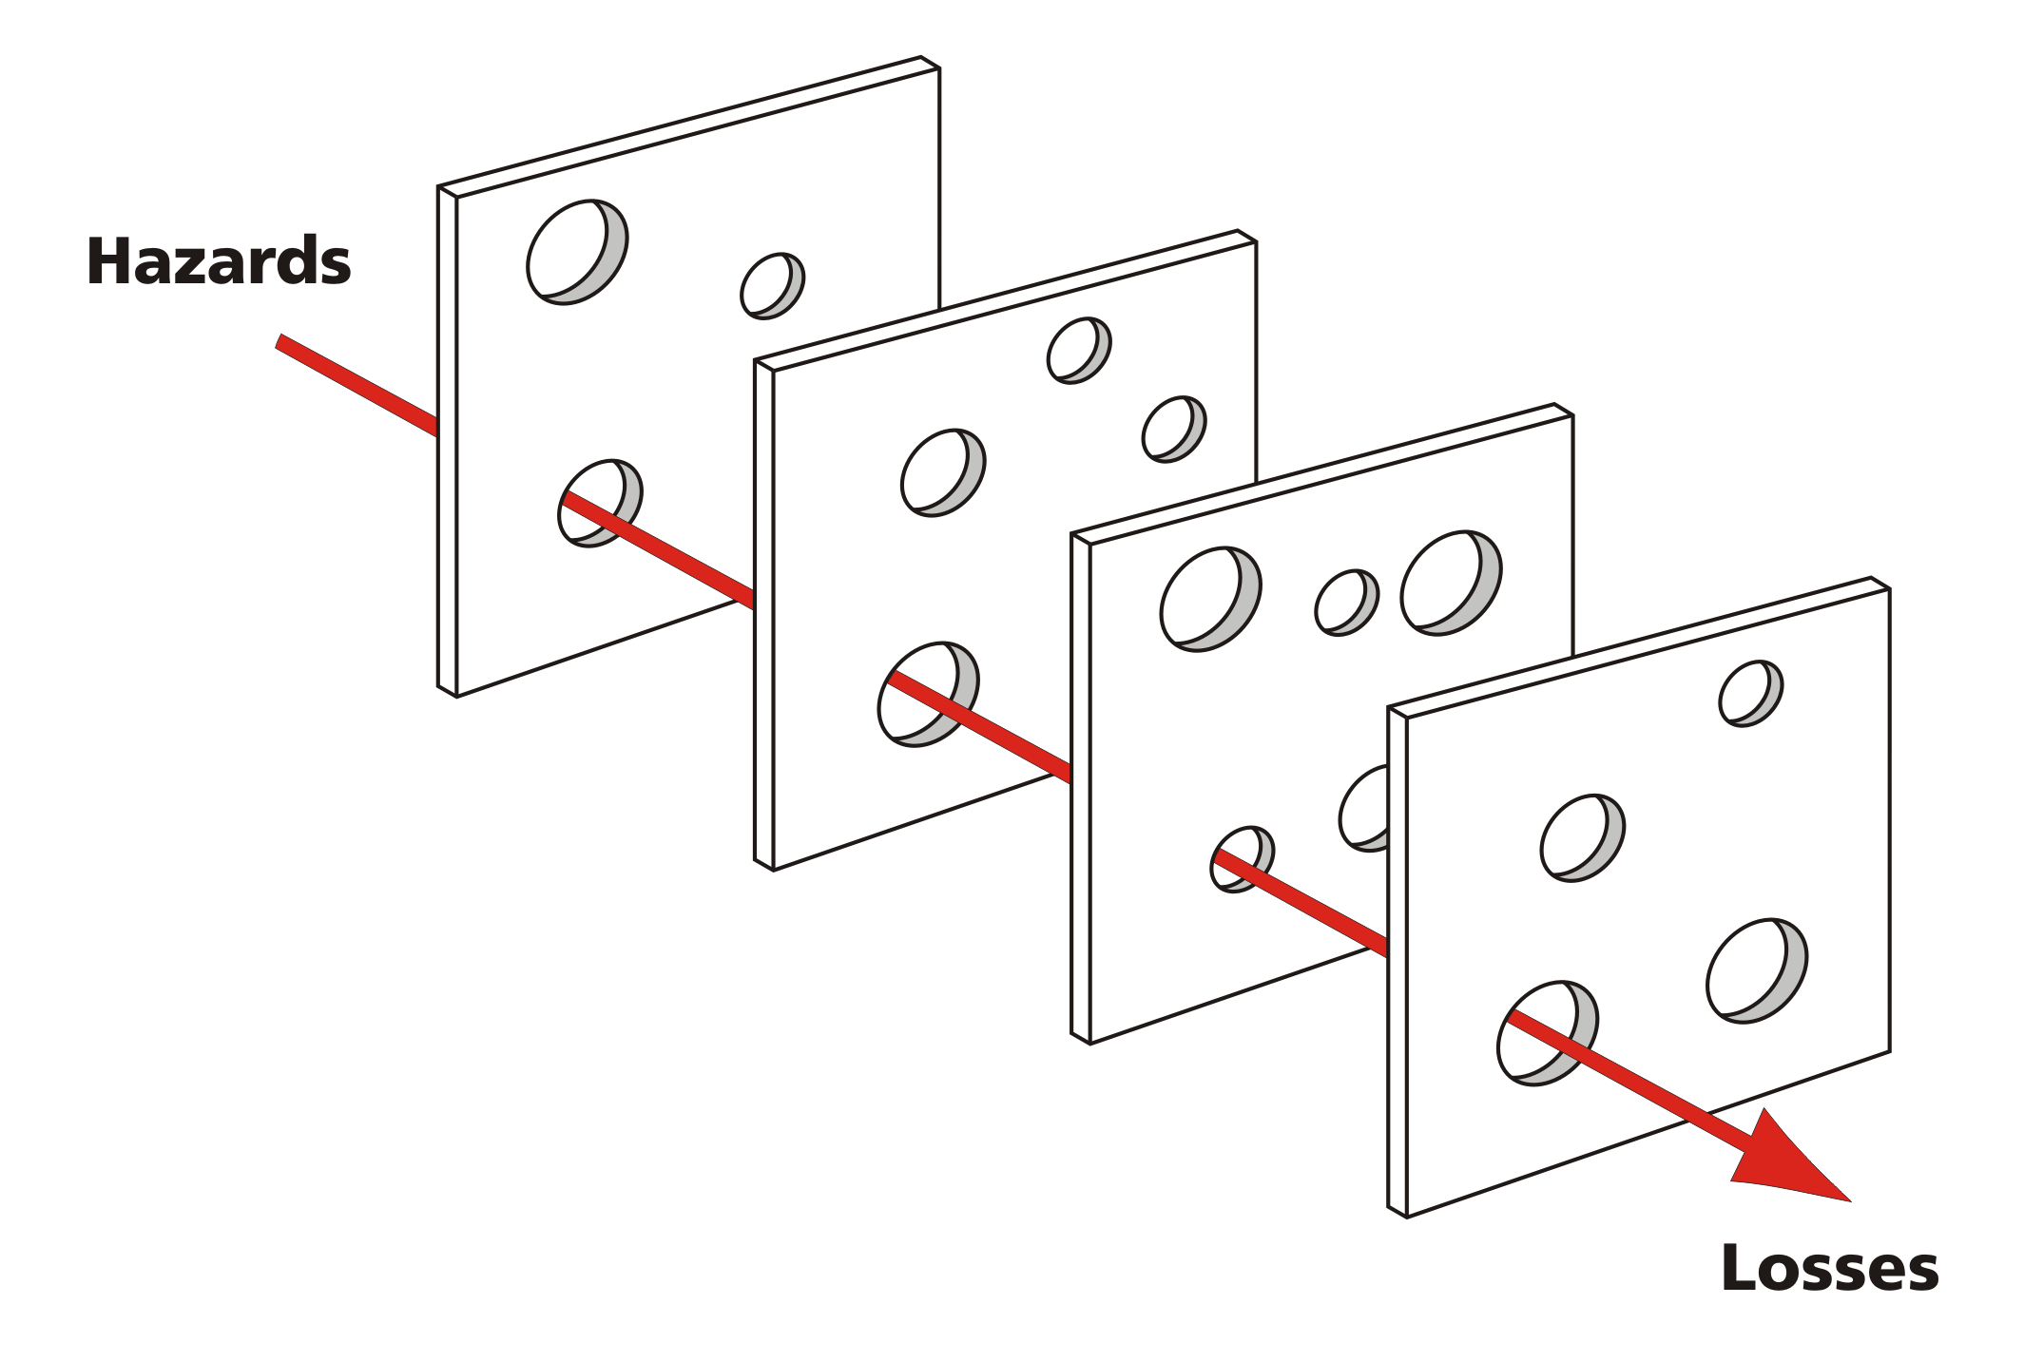
Layers of Protection
Reducing the number of contacts
Screening and encouraging sick individuals to stay home
Reducing number of contacts
Face coverings
Support hand hygiene, respiratory etiquette with signage and supplies
Physical distancing, ventilation, and room setup strategies
Notes:
Brian - CDPHE:
We have learned a lot about controlling the spread of COVID-19 in the past few months. We’ve been tracking and monitoring outbreaks throughout the state and looking at the effects of different social distancing measures.
We know from experience that no single intervention works perfectly, which is why a layered strategy is so critical.
For example, about 50% of people contagious with COVID have symptoms; screening is worth doing to detect those people, but it’s not enough on its own.
Additionally, we know that face coverings, when worn properly, can dramatically reduce disease transmission. But even hospital-grade N95 don’t make the risk of transmission 0, and we also need to protect people who are unable to wear masks.
Spacing, ventilation, and room setup are important strategies too, and I want to talk more about them on the next slide.
Source: wikimedia commons

Slide 17
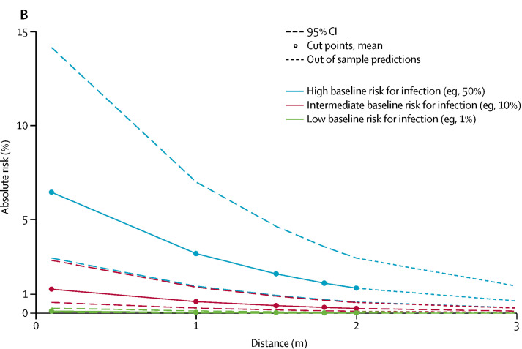
Spacing: 6 vs 3 feet
Notes:
Brian- CDPHE:
One of the biggest questions we hear from schools is concerns about how to space children 6 feet apart in a classroom.
We’ve already talked about how transmission is different for younger ages, and that impacts spacing recommendations. Children under about 12 don’t play a large role in viral transmission, and spacing is less important for this group.
For older kids, who have more adult-like disease transmission, we can look at data about spacing at different distances. And this graph from Lancet demonstrates a key point; while 6 feet is fantastic, nothing magic happens between 5 and 7 feet, and 3 feet still provides a lot of protection.

Slide 18
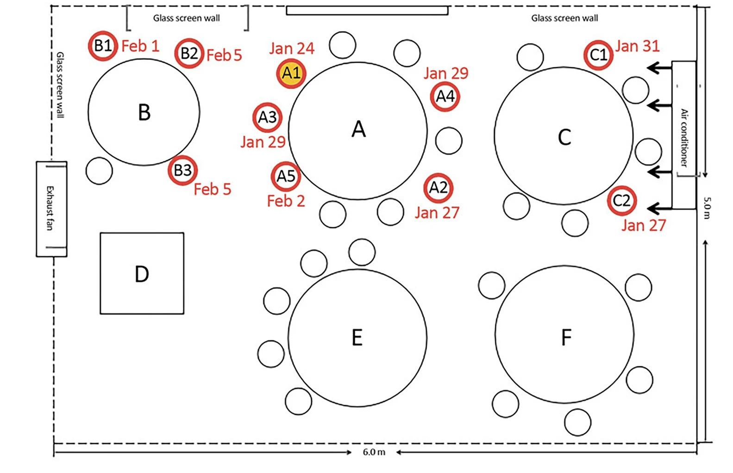
Spacing and Ventilation Example
~5ft
~10ft
Notes:
Brian:
But I also want to talk about other important considerations. If the ventilation setup in a room is blowing infectious virus around the room, even far beyond 6 feet there can be risk of infection.
In this outbreak in a restaurant, reported by the CDC, an air conditioning unit caused air to circulate and swirl among table A, B, and C, where a lot of people were infected at distances of up to 10 feet.
But even people sitting very close to the source patient at table E weren’t infected, because the air flow didn’t affect them.
We’ve found that being outdoor is great for preventing infection, and maximizing the amount of outdoor air coming into the building is a powerful way to prevent infection.

Slide 19
Importance of Cohorting Example
Contained response in cohorted classrooms
Widespread disruption without cohorting
KEY
COVID+ case
Group requiring quarantine and evaluation
Group continuing without disruption
Unknown COVID status
Notes:
Brian Finally, I want to talk about the most important infection control method; reducing the number of contacts each person has during the day. And the best way to do this is to keep people in what we are calling cohorts, although some people call them bubbles or fixed classrooms.
If you look at the two diagrams here, each represents a school with a single infected person. On the left, there is excellent cohorting, and only students in the same classroom as the case need to be quarantined and tested, and the rest of the school can continue without even a single day of interruption.
On the right, the infected person has interacted with an unknown number of people across the entire school. To prevent further transmission, the whole school might need to be dismissed, and many more people will be subject to quarantine and testing.
We saw exactly this play out in two Colorado childcare center where staff were found to be infected. The facilities were similar sizes, but in one only 11 people in total had to quarantine, but in the other the entire center (70+ people) were quarantined.

Slide 20
Ways to Cohort
Hybrid In-person / Online Instruction
Simultaneous remote instruction at differing proficiency levels.
Remote Instructor
KEY
In-person Proctor
Discussion Group
Notes:
Brian:
We feel so confident about the effectiveness of cohorting that we’ve written out different plans for responding to outbreaks in cohorted and non cohorted schools.
But cohorting doesn’t have to look like just one thing. For younger students, cohorting may just mean having separate lunch and recess periods from other classes.
For older students who take multiple different classes at different levels, there are many different strategies.
Here’s a model for hybrid learning, where for subjects where students are at many different levels, one in-person proctor supervises groups of students working on hybrid instruction from remote teachers at different levels. This way, students can stay in their cohort while having their different learning needs addressed.

Slide 21
Transmission Controls
Frequent cleaning and disinfecting of commonly touched surfaces https://covid19.colorado.gov/cleaning-guidance
Maximize ventilation - increased air exchanges, filter effectiveness
Keep handsinks stocked, use signage, directional arrows and reminders about distancing, hand hygiene, respiratory etiquette
Notes:
Therese

Slide 22
Hygiene & Respiratory Etiquette
Train staff in basic health and safety protocols
Have staff and students wash hands when they arrive and frequently throughout the day for 20 seconds with soap and water
Remind staff and students about the importance of covering their coughs, not touching face, physical distancing
Notes:
Therese

Slide 23
Masks and Face Coverings
In compliance with applicable state and local mask orders
Face coverings are required for staff and students over 10 years old, with limited exceptions (medically contraindicated)
Transparent alternatives can be used temporarily for specific learning needs (hearing impairment, language learners)
Face covering must be worn over the mouth and nose and be tight fitting on the sides of the face
Encourage face covering for those 10 and younger
No masks while sleeping
Students should be able to remove own mask
Notes:
Therese

Slide 24
Cohorting
Cohorts reduce exposures and are one of the best strategies to minimize transmission and disruptions to in person learning
Cohorts can be accomplished across grades with planning and creative scheduling
Cohorts can also be achieved by planning at least 2 weeks between schedule changes
Partner cohorts in later phases allow for teacher support and coverage while still limiting exposures
Notes:
Therese

Slide 25
Physical Distancing
Physical distancing reduces transmission between individuals. Applies to middle and high schoolers and adult staff
6-foot is best and recommended, but 3-foot is still beneficial and acceptable
Teachers and other staff should, to the extent possible, maintain 6-foot distance from others
Maximize spacing in classrooms and create seating assignments to assist with contact tracing efforts should they be needed
Stagger arrival, departure, meals, recess and passing periods to reduce crowding in entrances, hallways and other common spaces
Use separate entrances if available
Notes:
Therese

Slide 26
Students and Staff at Increased Risk of Severe Illness
Comply with legal requirements to provide alternate work assignments for teachers and staff
Accommodate students who are at increased risk of severe illness from COVID-19 by providing remote options for learning.
Here is a complete list of those that may be at risk for severe illness:
www.cdc.gov/coronavirus/2019-ncov/need-extra-precautions/people-at-increased-risk.html
Online and hybrid learning is likely to remain a component of curriculum for many districts
Notes:
Therese

Slide 27
Health Screening
CDPHE and CDC recommend self-screening prior to arrival to the extent possible
Screening templates are available here:
https://covid19.colorado.gov/guidance-resources
Screening must include temperature and other COVID specific symptoms
A full list of COVID-19 symptoms can be found here: symptom checking
Upon arrival screening should be available, in the event it’s needed
Notes:
Therese -
Notes: The current CDPHE guidance for p-12 education falls under safer at home which requires daily temperature and symptom monitoring for any person entering the building. The CDC also has recommendations on conducting temperate and symptoms checks for staff and students. You will find links to both resources here. Currently, there are discussions occurring around the children’s screenings being done at home.
.

Slide 28
Symptoms While at School
When children or staff exhibit a symptom of COVID they need to be excluded.
Dedicate a separate area for this purpose
Monitor to see if the symptom improves or worsens
Send home if symptom worsens or can’t be explained by an alternate diagnosis
Encourage testing
Isolation at home
Work with local public health agency (LPHA )to determine close contacts
In the event you are unable to reach your LPHA call (303) 692-2700 to reach a public health expert in COVID response
Communicate with parents, staff and students
Quick action is key to controlling transmission
Notes:
Therese

Slide 29
Planning the 2020-2021 School Year

Slide 30
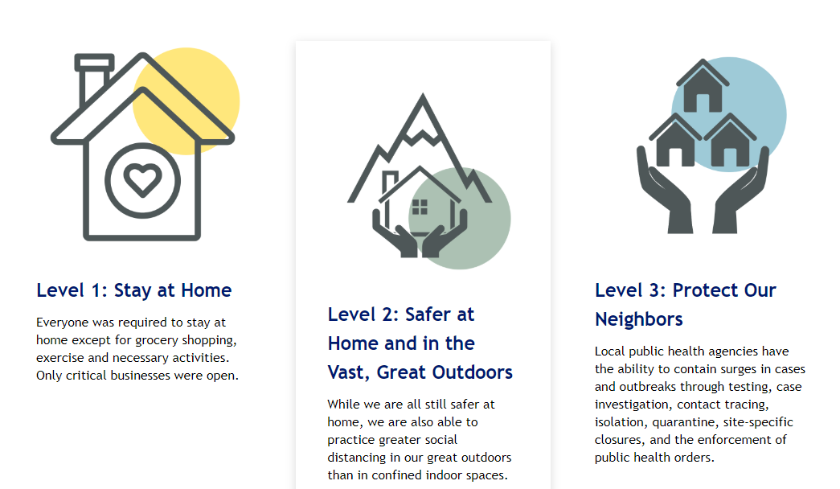
CDPHE’s Framework LINK
Notes:
RHONDA
Hello, it is good to be here with you. I know you are handling so many complex situations right now, and you are working so hard. Please accept our sincere appreciation for all that you have done for our state and for so many families.
Last week, CDPHE released new school guidance that CDE and CDPHE partnered to create. The guidance released from CDPHE is based on the latest science and health recommendations by the American Academy of Pediatrics and others.
As local public health agencies work with districts to reopen schools this fall, the guidance provides specific recommendations on what school operations should look like based on the severity of COVID-19 incidence in their community. And the guidance is presented by elementary, middle, and high school level.
Additionally, the guidance has age-group specific recommendations on mask wearing, social distancing, and keeping students in cohorts. Evidence suggests the risk of COVID-19 transmission between younger children and from children to adults is low, and this is why preschools and elementary schools should have different guidelines than middle schools and high schools.

Slide 31
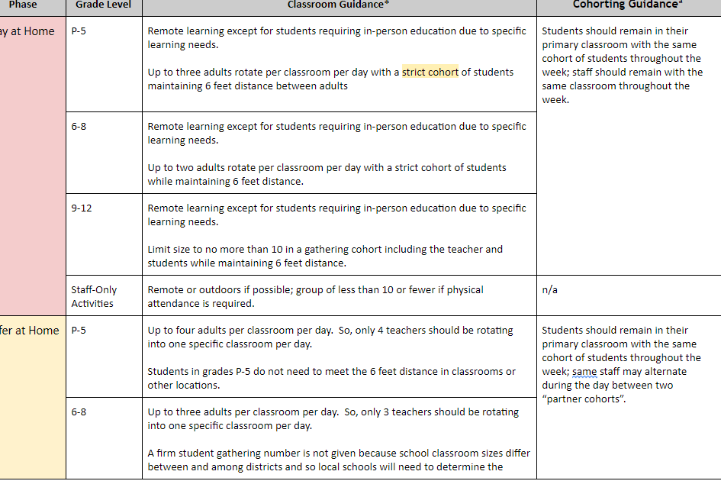
CDE Planning Framework and Toolkit
Notes:
Rhonda
As the COVID-19 situation continues to evolve, we will continue to adjust the CDE Planning Framework and Toolkit with CDPHE.
We appreciate the ongoing collaboration and hard work that you, our amazing school nurses, have dedicated to helping schools and districts open in the fall. Thank you for the opportunity to join you today, and I’ll hand it over to Amy Gammel from CDPHE.

Slide 32
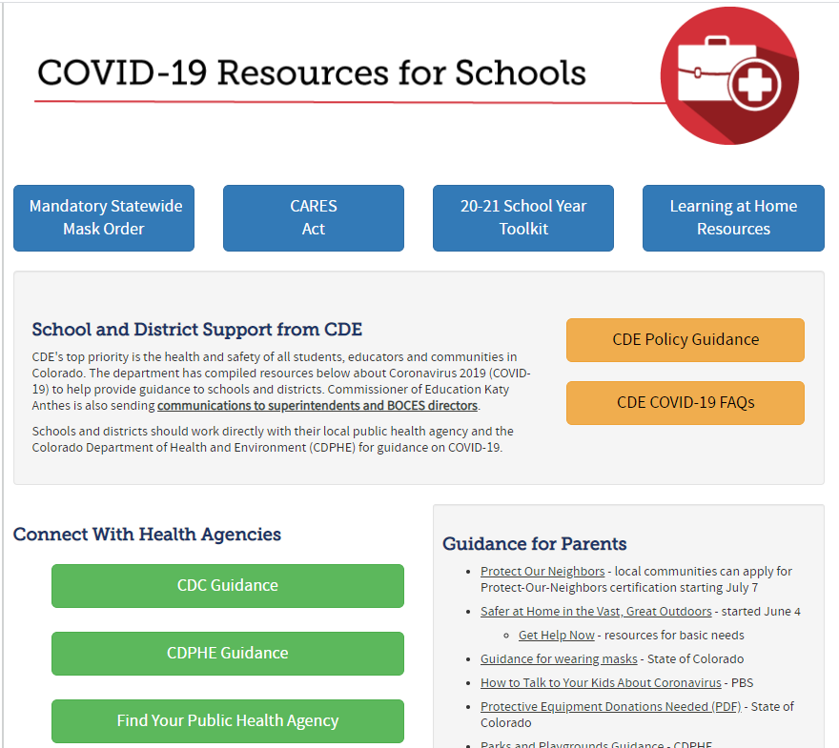
CDE - COVID-19 Resources for Schools LINK

Slide 33
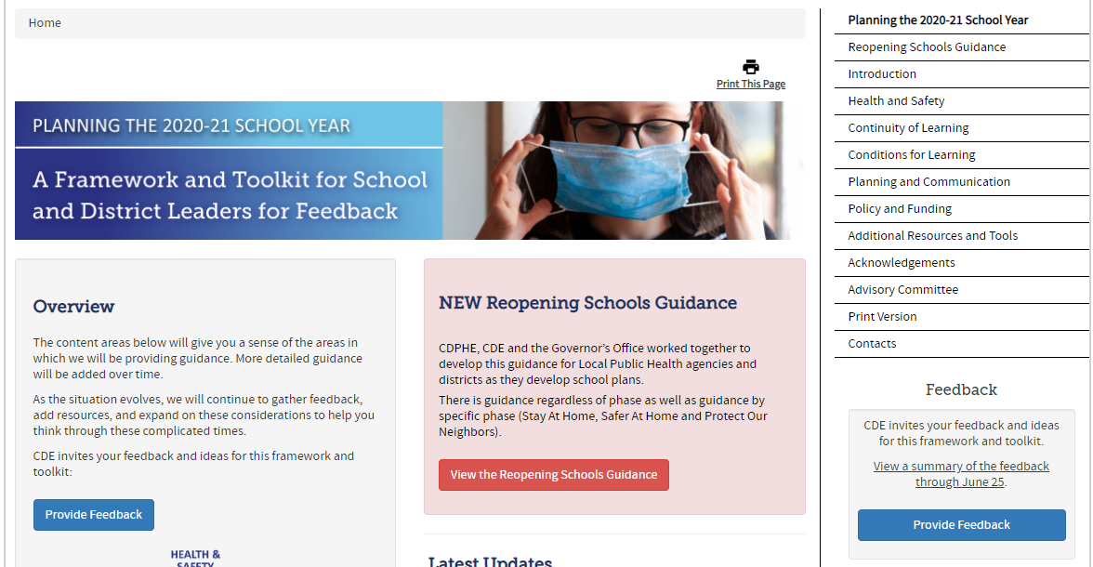
CDE Planning the 2020-21 School Year Toolkit LINK

Slide 34
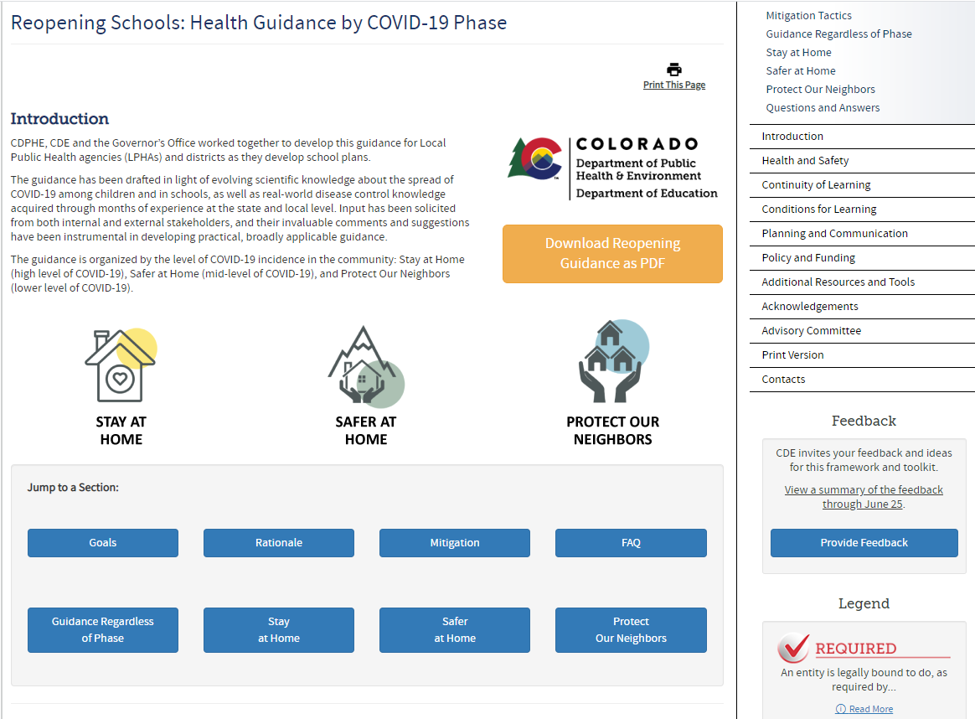
CDE Reopening Schools: Health Guidance by COVID-19 Phase LINK

Slide 35
Q and A

Slide 36
High Impact Instruction in Diverse Settings

Slide 37
Attending to Equity Across Learning Settings
Ensure that learning recommendations are not limited by access to technology.
Ensure educators have standards-aligned materials that offer focused, coherent, rigorous content that adheres to the practices and essential skills within the Colorado academic standards.
Students in poverty and students in special populations may be especially vulnerable during this time.
Learning recommendations should leverage student interest, identity, and agency.
Student home languages should be valued as an asset to learning.
Notes:
Ensure that learning recommendations are not limited by access to technology. Student learning should not be solely dependent on access to devices and the internet. Encourage approaches that can be pursued without technology and/or asynchronously to set students up for success.
Recognize that students and family members may be available to play different roles in learning when at home. Students and families may need to juggle home, caretaking, school, and work responsibilities. Consider a menu of options for learning experiences that allow for different types and levels of engagement during remote learning.
Students in poverty and students in special populations may be especially vulnerable during this time. Families in poverty may be experiencing several of the considerations described above, along with additional concerns including regular access to meals, utilities, health services, or shelter. Undocumented students and students receiving special education services may face challenges in accessing resources that they need. Encourage educators to prioritize the physical, mental, and emotional well-being of all students.
Learning recommendations should leverage student interest, identity, and agency. Equitable learning experiences should be both responsive to the current need as well as meaningful to learners.
Student home languages should be valued as an asset to learning. Take steps to bridge the gap in access to bilingual and native language resources that support learning for students and their families.

Slide 38
Considerations for Resources to Support Diverse Learning Settings
Consider how the materials/tools or instructional strategies you leverage:
Support flexible scheduling and limited technology access when shifting to hybrid/blended or remote learning settings.
Engage students in meaningful explorations, investigations, inquiries, analysis, and/or sense-making.
When in remote or hybrid settings, encourage students to engage in activities that already happen in their homes with materials that families already have.
Help students make explicit connections to their interests and identities.
Notes:
Considerations for Resources to Support Diverse Learning Settings
Consider how the materials/tools or instructional strategies you leverage:
Support flexible scheduling and limited technology access when shifting to hybrid/blended or remote learning settings.
Engage students in meaningful explorations, investigations, inquiries, analysis, and/or sense-making.
When in remote or hybrid settings, encourage students to engage in activities that already happen in their homes with materials that families already have (especially so families do not need to purchase additional supplies).
Help students make explicit connections to their interests and identities.
Invite family members to be a partner in students’ learning.
Provide students with choices for how they engage, what they investigate/research, or how they demonstrate learning
Support students in self-reflection related to content and process to support their learning.
Exercise sensitivity when referencing the current pandemic as a topic for instruction.
Encourage, support, and facilitate first-language family participation in the learning across multiple settings.

Slide 39
Considerations for Resources to Support Diverse Learning Settings (cont’)
Invite family members to be a partner in students’ learning.
Provide students with choices for how they engage, what they investigate/research, or how they demonstrate learning.
Support students in self-reflection related to content and process to support their learning.
Exercise sensitivity when referencing the current pandemic as a topic for instruction.
Encourage, support, and facilitate first-language family participation in the learning across multiple settings.

Slide 40
Resources
COVID-19 Resources for Schools
2020/2021 Toolkit for Schools
High Impact Instruction in the Time of COVID-19
Colorado Essential Skills
Dropout Prevention Framework

Slide 41
Q and A

Slide 42
Thank you for your passion and dedication to building strong communities where children and families can thrive!

Slide 43
Closure
Next webinar August, XX 2020, 11:30 am.
TOPIC ??

Slide 44
What are the metrics and thresholds for closing school?
School and individual cohorts may be dismissed temporarily if there is a pattern of cases that suggests within-school transmission:
Several cases within a cohort, but the rest of the school unaffected → cohort dismissal
Several cases within a school → school dismissal
High percentage of school unexpectedly absent → school dismissal
Final document is undergoing review at GOV.
If the state or county moves to a different phase (stay at home, safer at home, protect our neighbors) the guidance for school opening for the new phase should be applied.
Notes:
Brian

Slide 45
What about mixing students from different cohorts in the health office? If a student tests positive, will health staff need to be quarantined?
If several people are in the health office and one is later identified as having COVID-19, the other individuals in the health office will have been exposed and will be required to quarantine.
Because the exposure to COVID-19 happened outside of the context of students’ normal cohorts, only the cohort of the person with COVID-19 will need to be quarantined initially. If other students later develop COVID-19, their cohorts may require quarantine as well.
Extensive CDC guidance on exposure risk assessment for healthcare workers would be applied to health staff, including considerations of activities performed and PPE worn.
Notes:
Brian
https://www.cdc.gov/coronavirus/2019-ncov/hcp/guidance-risk-assesment-hcp.html

Slide 46
How is it safe to provide in-person ed to high risk students under the stay at home orders?
Circumstances where viral transmission is high a stay-at-home order are necessary pose a challenge to all community members
For students who don’t require in-person education, remote learning will be the best option
For students who require in-person education, smaller class sizes, cohorting, and adhering closely to other infection prevention guidance will make the school setting as safe as possible during a difficult time
Notes:
Brian

Slide 47
If a student is unable to wear a mask, what recommendations are there to keep them safe?
Our overall guidance strategy of layers of protection means substantial protection can be provided even if one intervention (e.g. mask wearing) is not possible
Limiting exposures
Ventilation
Screening
Cohorting
Physical spacing
Schools should be considering all of these interventions for all of their students, whether or not masking can be universally observed.
Notes:
Brian

Slide 48
If a parent refuses the “mask mandate”, is a note required? R
The Governor’s Executive Order requires that masks covering the nose and mouth be worn by individuals 11 and older.
The K-12 Education guidance includes this information and adds:
except during outdoor recess and exercise activities where appropriate distancing can occur, and unless the student has a health or education reason for not wearing a mask.
Each school/district should work with the family to determine how best to meet the needs of the student.
Notes:
Rhonda

Slide 49
What if the district refuses to make their population wear masks or follow the guidelines?
Contact your Local Public Health Agency for concerns LINK
Mask enforcement Q and A LINK
For additional concerns, you can contact CDPHE LINK
Notes:
Rhonda
Executive Orders issued by the Governor’s Office and/or Public Health Orders issued by the state or local government are requirements.
The local public health agency has the authority to enforce requirements in Executive Orders and Public Health Orders. Likewise, the Colorado Department of Public Health and Environment has the authority to enforce requirements in Executive Orders and Public Health Orders. Wearing face coverings over the nose and mouth for individuals 11 and older is an Executive Order and thus a requirement.
However, there is guidance that is neither found within and executive order or a state public health order -- such as cohorts. Although cohorts are recommended guidance and are encouraged to reduce contact with others, which will result in fewer students and staff required to quarantine in a confirmed COVID-19 case, cohorts are not required. A school or a district has the ability to do less than what’s in this cohort guidance, but they need to be prepared to pivot to full-time learning in the situation of a confirmed case because they may not be able to track which individuals came into contact with the COVID-19 case.

Slide 50
Our local public health is recommending N95 masks, gloves, gowns when caring for symptomatic individuals. If districts can’t or won’t buy them, then what?
ESSER and CRF funds both may be used to purchase Personal Protective Equipment, including N95 masks, gloves, gowns, etc.
The local public health agency may support a school or district in acquiring the PPE they recommended.
Governor’s announcement that all K-12 schools will receive medical grade masks. Additional logistics/details coming.
Notes:
Rhonda
We are grateful for the Governor’s leadership in this area, and it is one more safety precaution and tool to reopen schools safely. We are working on those details with the Governor's office and will share more later. Because of Colorado’s success in acquiring personal protective equipment (PPE), the Governor announced on July 24th that all K-12 schools will receive one medical grade mask per week per teacher for the next ten weeks. This includes all district public schools, private schools, charter schools, and boarding schools. Exact details and logistics will be announced at a later date.

Slide 51
What are school staff required to do under the stay at home orders? Do they need to report to work?
In all grade levels (K-12), remote learning occurs, except for a limited number of students requiring in-person education due to specific learning needs.
Provide remote learning outdoors, if possible.
Groups of 10 or fewer with physical distancing and wearing face coverings over the nose and mouth for individuals 11 and older.
Students should remain in their primary classroom with the same cohort of students throughout the week.
Staff should remain with the same classroom throughout the week.
Notes:
Rhonda

Slide 52
What is the guidance for preschool programs?
Preschool programs should follow the guidance for child care facilities which can be found here.
CDC also has guidelines for child care which can be found here.
Notes:
Amy

Slide 53
What are the recommendations on cleaning products?
Schools should continue to use the same cleaning and sanitizing products as they would under normal circumstances.
Disinfectants should be effective against SARS-CoV-2. A list of products can be found here.
Always follow labeled instructions including contact time. Note, most products state that they should not be used by children.
Notes:
Amy

Slide 54
How safe are water fountains and water bottle stations?
It is important to provide drinking water.
Drinking fountains should be treated as a frequently touched surface and disinfected throughout the day.
Provide supervision.
Consider posting signs.
Notes:
Amy

Slide 55
Are there any specific guidance parameters around isolation rooms?
Designate a room or space that can be used to isolate symptomatic children. Can be an empty classroom.
Space should be separate from normal health office functions.
If more than one child is present in the designated space they should be separated by at least 6 feet and a barrier is strongly recommended.
Always disinfect between uses.
Notes:
Amy

Slide 56
If a student answers YES to any of the screening questions, what is next?
If a student or staff member has any symptoms of COVID-19, they must be isolated and observed. If symptoms worsen, the individual should be sent home and testing recommended.
If symptom or symptoms resolve, and can be explained by another diagnosis by a HCP, or attributed to a known chronic condition, then the individual can return to school.
Symptomatic and suspect cases must remain out of school until at least 10 days since the onset of symptoms and at least 24 hours about fever resolves and other symptoms are improving.
Work with your local health agency to determine close contacts and necessary quarantine and closure
Notes:
Therese

Slide 57
When will the “How Sick is Too Sick Guidance be available?
CDPHE is working on updating “How Sick is Too Sick” to include COVID symptoms, isolation and testing. We are hoping this will be released soon and before the start of school.
We are also close to releasing guidance on how to respond to a case or outbreak in a school.
Notes:
Therese

Slide 58
What if our school does not have an isolation room?
Discuss this with your school leader to determine the safest area possible.
Reach out to your LPHA for guidance
*Board of health rules 6 CCR 1010-6 March 2018 – “Separate rooms or areas shall be available in every school for emergency use in providing care for persons who are ill or suspected of having communicable diseases”.
LINK
Notes:
Sarah

Slide 59
There are conflicts with CDC, CDPHE, AAP, and Local public health. Which ones should nurses follow?
Each organization shares the same goals
Support in-person learning in as safe and healthy way as possible
Ensure a reasonable level of safety for students and staff for in-person learning
Minimize disruptions to education
Ensure equity
Encourage flexibility, adaptation, innovation
In Colorado, schools should follow local executive and public health orders
Notes:
Sarah

Slide 60
How soon can a county opt out of the mask requirement for the Protect Our Neighbors phase?
There is no timeline for this
Regions will need to obtain certification to move to Protect Our Neighbors (PON) phase
Regions may submit an opt out for masks while in the PON Phase
Notes:
Sarah

Slide 61
What are the PPE recommendations for the school health office?
NASN Guidance for Healthcare Personnel on the use of PPE in schools during COVID-19 LINK
Key Considerations
Healthcare Personnel in Schools
Those providing close contact interventions
Face Shields
Provide eye protection
For respiratory droplet protection, must be used with a facemask
Not a substitute for facemask or cloth coverings
Surgical Mask
Used to protect patients and healthcare workers from people who may have respiratory infections
Notes:
Sarah

Slide 62
Resources

