Slide 1

READ Plans Beyond Third Grade: An Overview of the 4+ READ Plan Guidance

Slide 2

Welcome!
Dr. Olivia Gillespie
Reading, Writing, and Communicating Content Specialist, Office of Standards and Instructional Support
gillespie_o@cde.state.co.us
720-930-1298
Notes:
[Estimated time: 2 minutes]

Slide 3

Who’s in the Room?
Name, position/title, district and/or school
If you could be any character from a novel, play, or movie, who would it be?
What are you most looking forward to learning from our conversation today?

Slide 4



Session Norms
Be present and engaged in the work.
Speak your truth and respect the truth of others.
Everyone’s voice is not only welcomed, but also needed.
This is a JUDGEMENT FREE ZONE!
Notes:
[Estimated time: 1 minute]

Slide 5



Writing for Discussion
(Choose One)
What systems and structures does your district, school, or you, as the classroom teacher, have in place to support students on READ Plans in grades 4-12?
How comfortable are you with your knowledge of legislative requirements and components of READ Plans as a secondary educator or leader
What type(s) of guidance are you hoping to receive from CDE regarding READ Plans in grades 4-12?
Notes:
Estimated time: 3 minutes
Say: Before we begin, I wanted to take two minutes to do a heart check. Oftentimes, as teachers, we always check on the social-emotional well-being on our students and our colleagues, often at the expense of ourselves; however, how many times do we stop to do it for ourselves? Therefore, before we dive into this standards training further, I wanted each of you to do your own heart check, especially now with what is happening. I want you to take a few minutes and free write, doodle, make that to-do list, or just process your thoughts, feelings, etc., even if it’s about having to sit through this virtual PD on Zoom. It is your thoughts. I am not collecting it to assess your writing skills or artistic expression. I will however, ask for a few brave souls to share out.

Slide 6

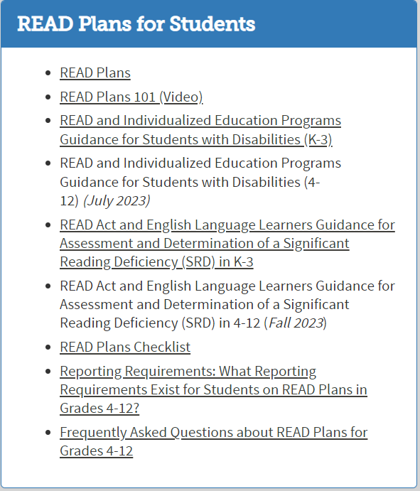
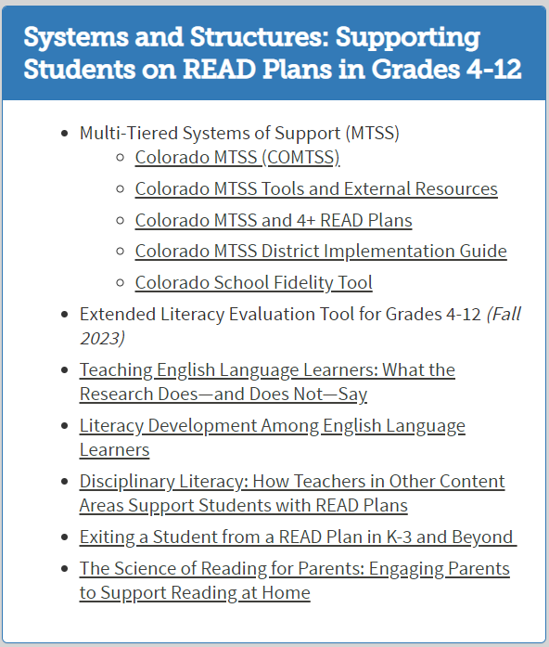
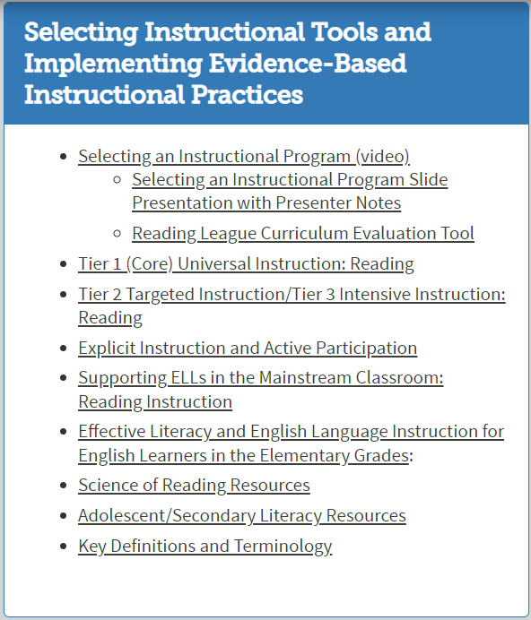
Walk educators and leaders through components of The READ Plan Guidance for Students in Grades 4-12.

Slide 7


Slide 8

The Timeline
Formation of CDE 4+ READ Plans Working Group
Feb-March 2022
Logic Model and Four Phased Approach Concentrating on Grades 4-5, 6-8, 9-12, and PD
April-July 2022
Compiling Data from District Request for Guidance on READ Plans in Grades 4-12
Aug 2022-March 2023
Released the FAQ about READ Plans in Grades 4-12. Revamped Guidance Plan, Resource Vetting and Guidance Approval Processes, and Assigned Specific Guidance by Office and Unit.
Nov 2021
May-June 2023
Release the first iteration of guidance for READ Plans Beyond Third Grade

Slide 9

Our Purpose:
The purpose of the 4+ READ Plans Working Group was to create guidance and resources to support the field in meeting the literacy needs of students who remain on READ Plans in grades 4-12.
Our Objectives:
Answer the question “What does it mean when students in grades 4-12 are on READ Plans?”
Devise a structure for creating and deciding what types of guidance and subsequent resources will effectively support districts in meeting the literacy needs of students on READ Plans in grades 4-12.

Slide 10

Identified Barriers:
The master schedule in both MS and HS and credits/competencies in HS
Teachers don’t understand how to teach reading or why students are struggling.
Teacher training in how to teach reading for secondary teachers is not present.
Students' past 3rd grade are automatically referred to special education
Students may exhibit behavioral issues and be referred.
ELD/ELA--paperwork is laborious and falls on one teacher. Hard to see the purpose with time constraints and responsibility to write the plan. Core instruction is not differentiated or targeted for ELs.
No system or structure to provide intervention. No personnel to deliver the service.
The only intervention seen in secondary is special education.
What is the core instruction and how does it impact students transitioning from grade level to grade level and/or building to building?

Slide 11

Data Literacy
How are we looking at data? What does data literacy mean in the upper elementary and secondary space?
  Data based decision making is not always occurring.
  Understanding why students struggle with reading at the basic level—looking at the data to determine the next steps.
Multilingual Learners
  Core instruction conflated with literacy instruction.
  Myth and misconception is All READ programs are good for multilingual learners. We must look at and ensure their needs are being met, not just grouped with everyone.
  Instruction must account for language proficiency levels and backgrounds of students
Documents/Resources/PD
How to create and sustain systems and structures to support secondary teachers with teaching reading.
Chunk it out grades 4-5, 6-8, and 9-12. Each has its own challenges.
Scientifically and Evidenced-Based practices in all grades. The need for teachers in grades 4-12 being trained in the Science of Reading.

Slide 12
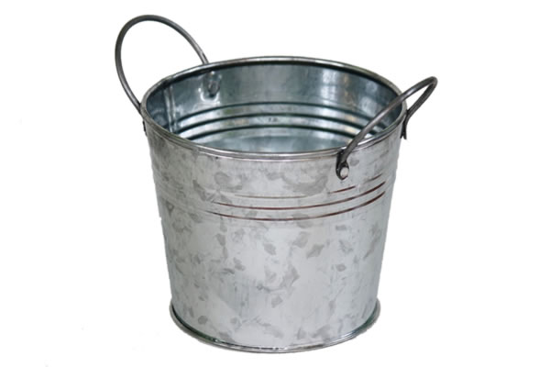
Categorical Guidance Buckets
Introduction
Legislation
READ Plans
  Content and implementation
  Monitoring and Reporting?
Systems and Structures
  MTSS implementation
Curriculum and Instruction
  What curricular programs from K-3 will support grades 4-12? (Recommendations since there is no legislation mandating districts and schools to choose from the CDE Approved Advisory List)
  Tier 1 accessible instructional practices for students with disabilities and multilingual learners on READ Plans
  Resources (research and evidence-based)
Assessments
  What types of assessments can educators use to assess and monitor the progress of struggling readers and students with a significant reading deficiency (SRD) in grades 4 and 5?
  How often should students in grades 4-12 be assessed?
Transition
How do students in grades 4-12 transition off or exit from READ plans?
What body of evidence should be collected to demonstrate reading proficiency or mastery?
How should students be supported after transition?
When should teams consider special education services for a student with SRD?
English Language Learners
Special Education
Leadership
Professional Development and Learning Opportunities

Slide 13


Slide 14
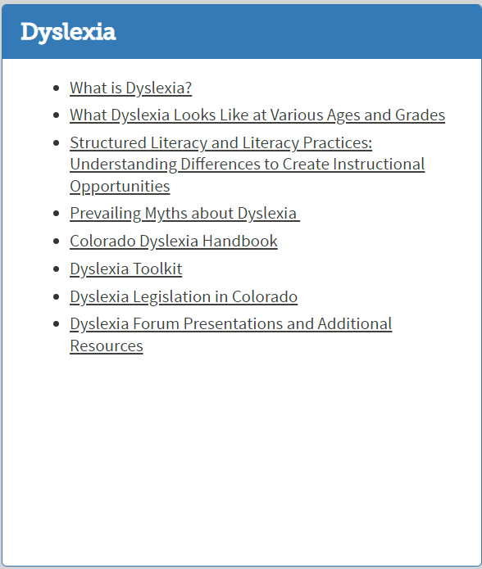
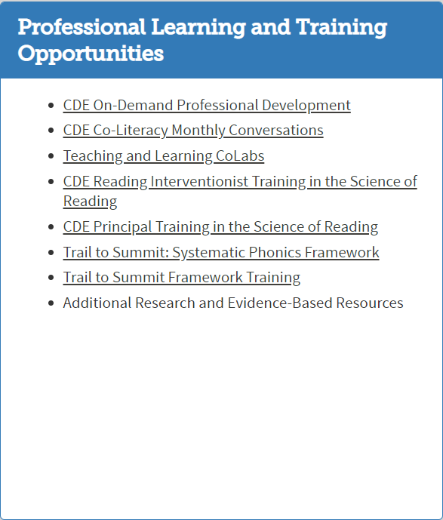
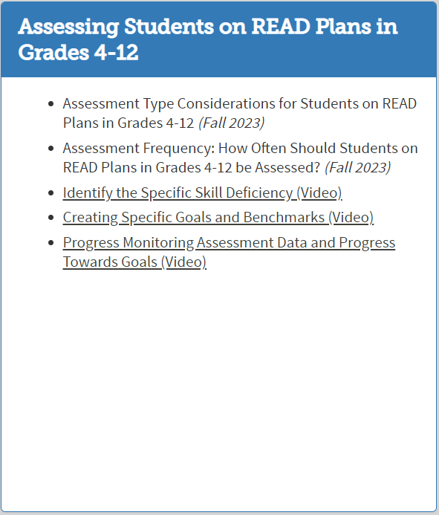

Slide 15

Breakout Rooms

Slide 16
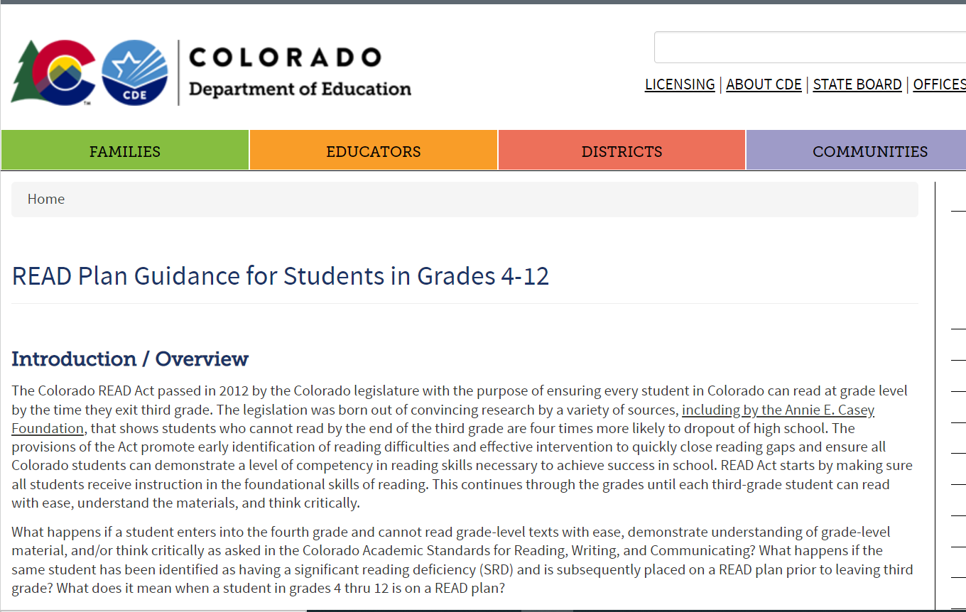
https://www.cde.state.co.us/standardsandinstruction/4plusreadplans
You will have 7 minutes to navigate the guidance. As a group discuss your noticings regarding the individual sections of the guidance. On the Jamboard capture any questions or wonderings you may have individually or as a group.
https://jamboard.google.com/d/1D0KmexVaB21dyfVO2Vhk6QysM8iNWss5XfyyFHSjmN0/edit?usp=sharing

Slide 17


Slide 18

What does legislation say?

Slide 19
READ Plans: What does the legislation say?
The READ Act requires the creation and implementation of an individual intervention plan, called a READ plan, for students in K-3 identified as having a significant reading deficiency (SRD).
Colorado's READ Act requires that a READ plan acquired in grades K-3 remains in place until a student has reached grade level reading competency. ​
http://www.cde.state.co.us/coloradoliteracy/readplans101
19
Notes:
Estimated time: 3 minutes
Say: Before we begin, I wanted to take two minutes to do a heart check. Oftentimes, as teachers, we always check on the social-emotional well-being on our students and our colleagues, often at the expense of ourselves; however, how many times do we stop to do it for ourselves? Therefore, before we dive into this standards training further, I wanted each of you to do your own heart check, especially now with what is happening. I want you to take a few minutes and free write, doodle, make that to-do list, or just process your thoughts, feelings, etc., even if it’s about having to sit through this virtual PD on Zoom. It is your thoughts. I am not collecting it to assess your writing skills or artistic expression. I will however, ask for a few brave souls to share out.

Slide 20



Do students in grades 4-12 need a READ plan?
Yes, but only if the student was identified as having a significant reading deficiency (SRD) and was placed on a READ plan prior to entering fourth grade.
C.R.S 22-7-1206 (6) states, "Each local education provider shall ensure that a teacher continues to revise and implement a student's READ plan until the student attains reading competency, regardless of the student's grade level and regardless of whether the student was enrolled with the local education provider when the READ plan was originally created, or the student transferred enrollment to the local education provider after the READ plan was created."

Slide 21
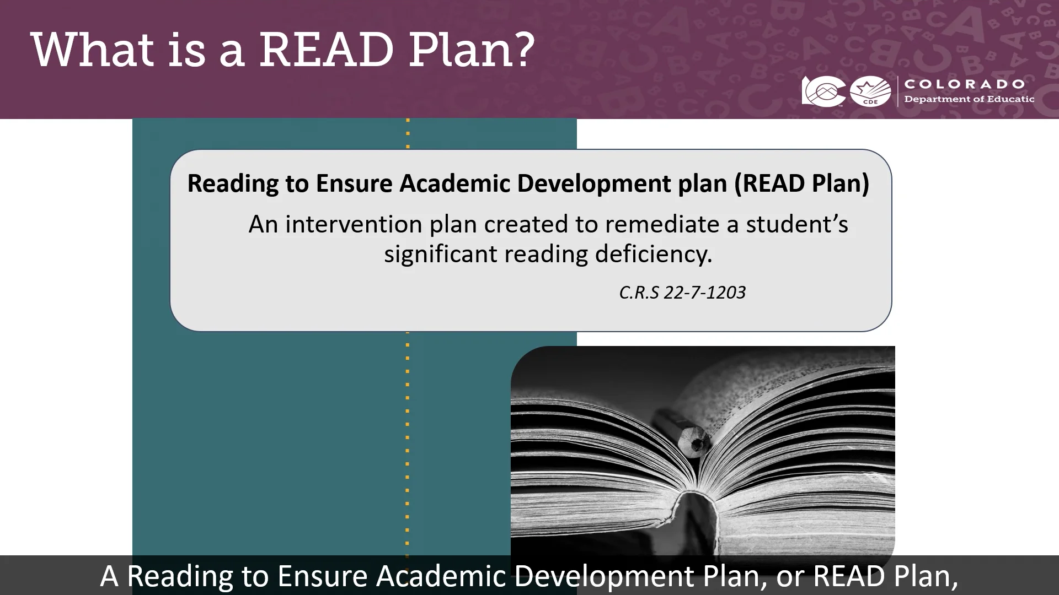
READ Plans 101

Slide 22
Breakout Rooms

Slide 23
As a group, discuss what READ plans in grades 4-12 look like in your school and/or district. Think about the components, types of assessment and assessment cycles, the progress monitoring/data cycles that occurs, and the processes in place to support students on READ plans.
https://jamboard.google.com/d/1D0KmexVaB21dyfVO2Vhk6QysM8iNWss5XfyyFHSjmN0/edit?usp=sharing

Slide 25
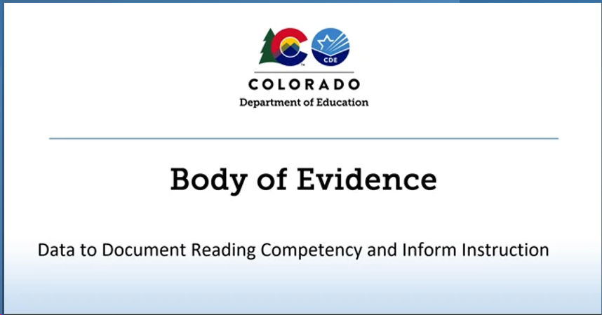

Slide 26
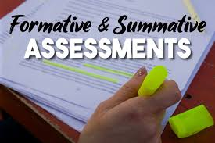
The Colorado READ Act defines a body of evidence as a collection of information about a student’s academic performance which, when considered in its entirety, documents the level of a student’s academic performance.
A body of evidence, at a minimum, shall include
  Scores on formative, interim, and benchmark assessments
  Work that a student independently produces in a classroom.
A body of evidence may include scores on summative assessments (e.g., CMAS ELA, PSAT, SAT, district/curriculum/end of unit, etc.) if a local education provider decides that summative assessments are appropriate and useful in measuring students’ literacy skills (C.R.S. 22-7-1203).

Slide 27
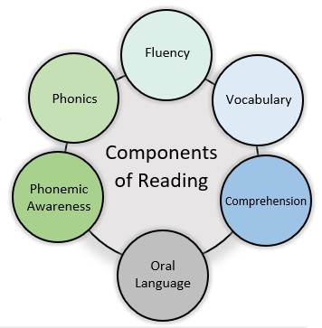
Utilizing a Body of Evidence to Inform Literacy Instruction
A body of evidence is developed over time and used to inform implementation of scientifically and evidence-based core instruction and intervention for all students. For students who are determined to have a significant reading deficiency (SRD), a body of evidence is used to inform the development and implementation of a READ Plan. For these and all other students, a body of evidence should guide instruction and interventions.
To effectively inform literacy instruction, all components of reading should be addressed in the body of evidence. The progression of skills and interconnectedness of the components of reading should also be considered. The Colorado Academic Standards and Minimum Reading Competency Skills provide guidance for skills at each grade level.

Slide 28
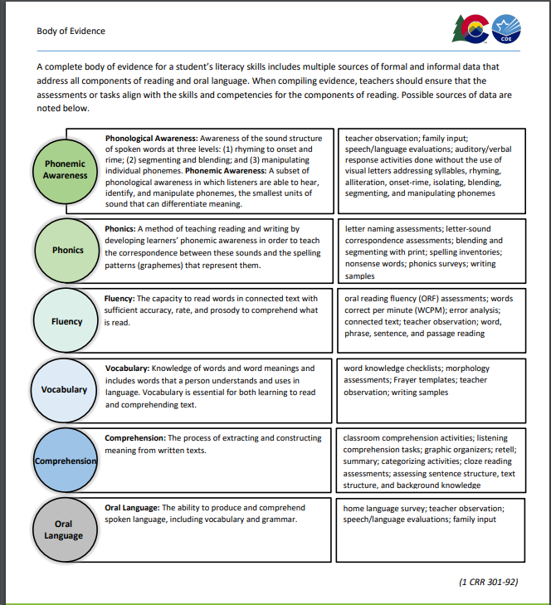

Slide 29
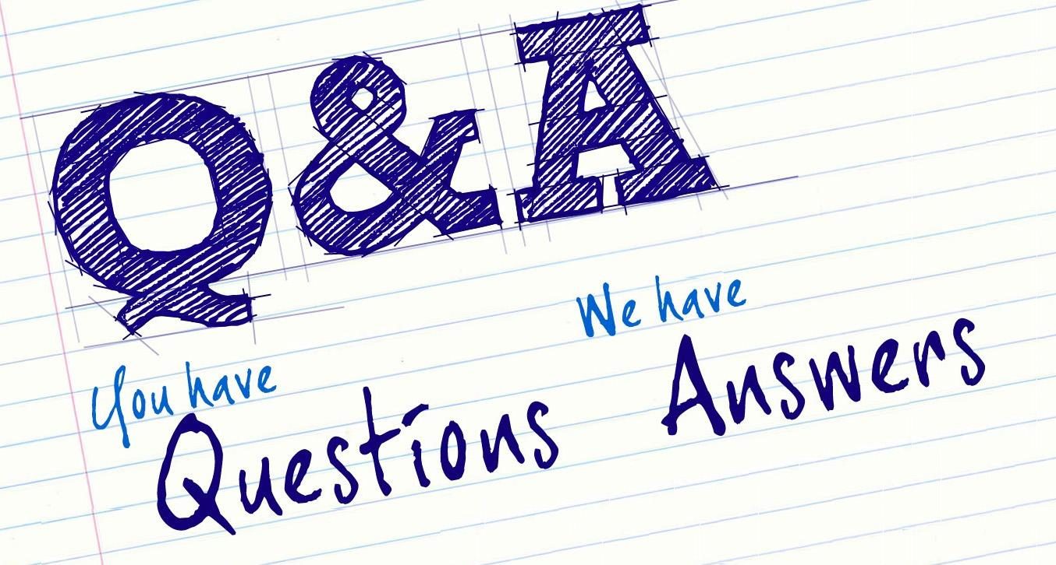

Slide 30

Exiting a Student from a READ Plan in Grades 4-12

Slide 31
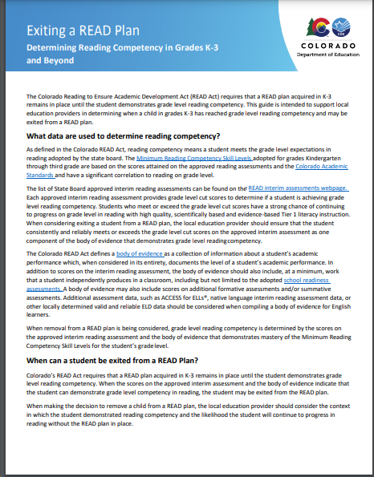
Exiting a Student from a READ Plan Beyond Third Grade
READ plans are living documents that keep record of:
  the associated interim and diagnostic assessment data,
  specific skill deficits that will be addressed through intervention services,
  the intervention programming that will target the student’s reading skill deficits, and
  goals and objectives for remediating the reading deficiency and helping the student achieve grade level reading competency.
Progress monitoring data, any changes in intervention services, and updated goals and objectives are recorded on the READ plan over time.
Each local education provider is responsible for ensuring that a student’s READ plan continues to be revised and implemented, regardless of grade level, until the student attains reading competency. This responsibility applies regardless of whether the student was enrolled with the local education provider when the READ plan was originally created.

Slide 32
Exiting a Student from a READ Plan Beyond Third Grade
For any student who remains on a READ plan beyond third grade, a data driven process should be in place that includes periodic reading assessment using a valid and reliable assessment measure, including diagnostic assessments when needed, targeted intervention to address specific reading skill deficits and regular progress monitoring.
The READ Act requires intensified efforts to assist the student in attaining reading competency for all students who remain on a READ plan for a second or subsequent consecutive school year (C.R.S 22-7- 1206 (7)(a)(I-III)(b). This includes:
  Revising the READ plan to include additional, more rigorous strategies and intervention instruction, including increased daily time for reading instruction.
  Ensuring the student receives reading instruction in conjunction with and supported through the other subjects in which the student receives instruction during the school day.
  Receiving reading instruction from a teacher with expertise in teaching reading and who is identified as effective or highly effective, when possible. • The option to provide mental health support, with parent approval.
The historical and current body of evidence are critical factors in determining whether a student demonstrates reading competency and may exit a READ plan beyond third grade

Slide 33
What should be considered before exiting a student from a READ plan beyond third grade?
  Does the body of evidence demonstrate mastery of the K-3 Minimum Competencies in each of the areas of phonemic awareness, phonics, fluency, vocabulary, including oral language, and comprehension?
  Has the student demonstrated grade level competency on a valid and reliable universal screening assessment appropriate for the student’s current grade level?
  Does diagnostic assessment data confirm that skill deficits related to the student’s reading deficiency have been successfully remediated?
  Have progress monitoring assessments demonstrated consistent results demonstrating grade level reading competency over multiple measures?
  Do informal classroom assessments and formative assessments support that the student is able to maintain grade level reading competency and meet grade level reading standards?
  Do scores on summative assessments support that the student is adequately accessing grade level content and instruction?
  Does the body of evidence support that the student can maintain grade level reading competency without additional reading interventions in place?
  If the student is an English learner, are adequate language supports provided through Tier 1 programming, including English Language Development instruction, to ensure continued progress in reading?

Slide 34

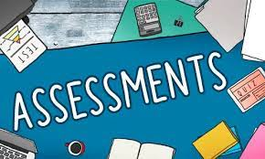

Slide 35

What assessments can be used to determine reading competency beyond third grade?
The Colorado READ Act requires the state board to adopt a list of approved evidence-based or scientifically based reading assessments for use in grades K-3, and to review and update the list every four years.
While the purpose of the READ Act approved list of interim assessments is to ensure kindergarten through third grade students receive appropriate evidence-based or scientifically based reading assessment to determine which students may be at risk for reading failure early on, some of these approved assessments provide options for assessing students beyond third grade.

Slide 36
Other curriculum-based measurement (CBM) reading assessments can be used beyond third grade to track student progress and inform the body of evidence with measures such as oral reading fluency measures and maze measures. Typically, these measures correlate to grade level through the eighth grade for basic measures of fluency and comprehension, though this is dependent on the assessment selected.
In addition, state-aligned benchmark assessments can be used as periodic benchmarks to determine if a student on a READ plan is reaching grade level reading competency.
A variety of CBM reading assessments and state-aligned benchmark assessments are commercially available, and some assessments are available online at no cost. It is the responsibility of each local education provider to select assessments for use in measuring student’s reading development and monitoring student progress in reading beyond third grade. The National Center on Intensive Intervention at the American Institutes for Research provides an online Academic Screening Tools Chart that can assist districts in identifying appropriate screening assessments for use with older students.

Slide 37

Once it has been determined that a student has reached grade level reading competency in reading and may be exited from a READ plan, the process for exiting the READ plan is the same as for students in grades K-3, including notifying the parents that the student will be removed from the READ plan.
It is important that the local education provider has well established procedures in place for continuing to monitor student progress and provide support as needed through a Multi-Tiered System of Supports (MTSS) to ensure continued academic growth.

Slide 38


Slide 39

In February, deep dive into writing READ plans and goal setting.
In March, deep dive into collecting a body of evidence and exiting READ plans.
In April, deep dive into assessment types, cycles, and progress monitoring

Slide 41
Contact Information
Olivia Gillespie
Reading, Writing, and Communicating Content Specialist, Office of Standards and Instructional Support
gillespie_o@cde.state.co.us
720-930-1298
Notes:
[Estimated time: 2 minutes]

