Slide 1
Comprehensive Health Instructional Unit Samples
Colorado’s District Sample Curriculum Project
http://www.cde.state.co.us/standardsandinstruction/instructionalunits-comphealth

Slide 2
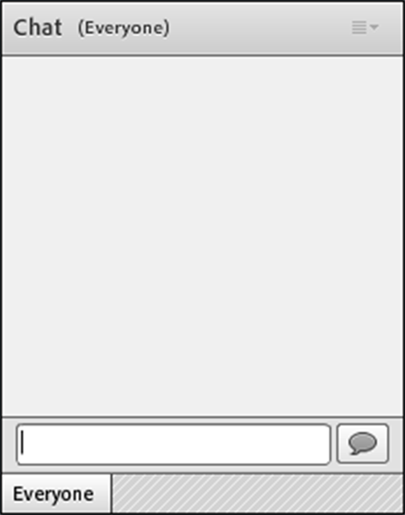
How to Chat
Notes:
The primary way you’ll be participating is through chat. For those who may be new to these web conferencing systems – to chat, you just type your comment or question in the text box here, and then click the talk bubble or click return. Your chat will appear up in the window for all to see.

Slide 3
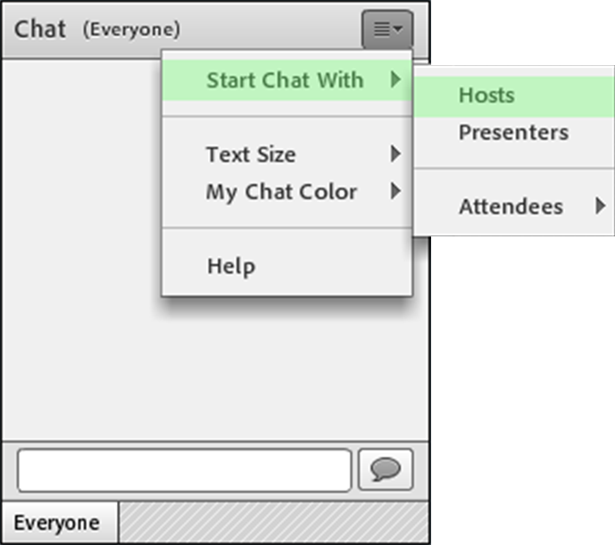
How to Chat with Hosts
Notes:
If you’re having any tech issues, you can also send me a private chat. You can do this by clicking the options on the top right of the chat window and sending a private chat to hosts.

Slide 4
Webinar Goals
During this webinar, we will be using one instructional unit to explore:
The components of the units
The processes utilized to create them
The possible next steps in utilizing these resources
As an introduction to the units, this webinar will not address:
State summative assessments
Educator evaluation
Send questions- I will address them at the end

Slide 5
Colorado District Sample Curriculum Project Big Picture
From its beginning, the District Sample Curriculum Project has had a singular focus: to build the capacity of teachers to use their content expertise and passion for student learning to create samples that support teaching to student mastery of the Colorado Academic Standards.

Slide 6
Teacher-Authored Samples
Curriculum Overviews
700+ unit overviews- all content areas (k-12)
All samples coded to the Colorado Academic Standards-Ensuring attention to all Evidence Outcomes (indicators of mastery)
Teacher/educator authorship and district affiliation noted at the bottom of every unit overview
Samples available in PDF and Word formats on the Standards and Instructional Support website-by individual content area and grade level
Videos detailing specific aspects of the unit overviews available as a resource
Each sample provides an option for standards-based planning that emphasizes what students should understand, know, and be able to do at the end of a given unit of instruction

Slide 7
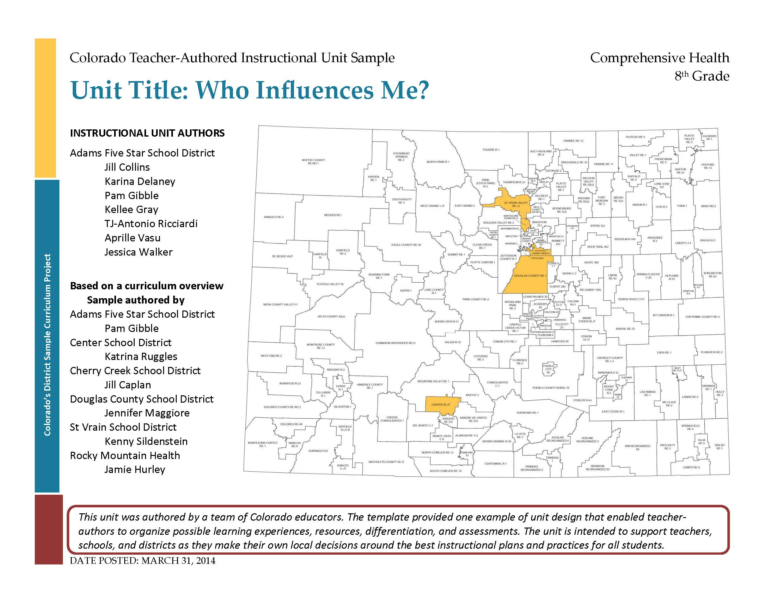

Slide 8
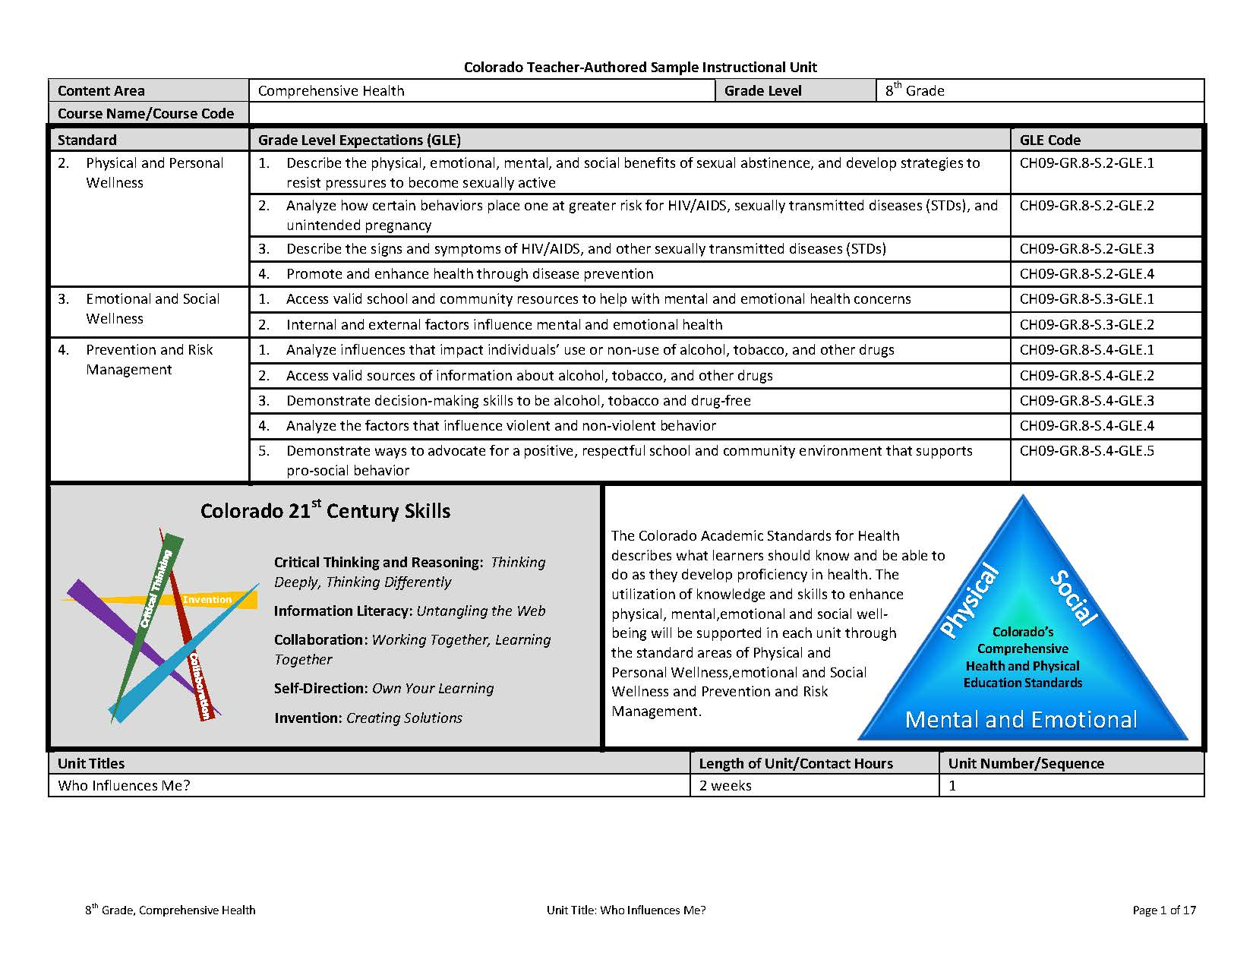

Slide 9
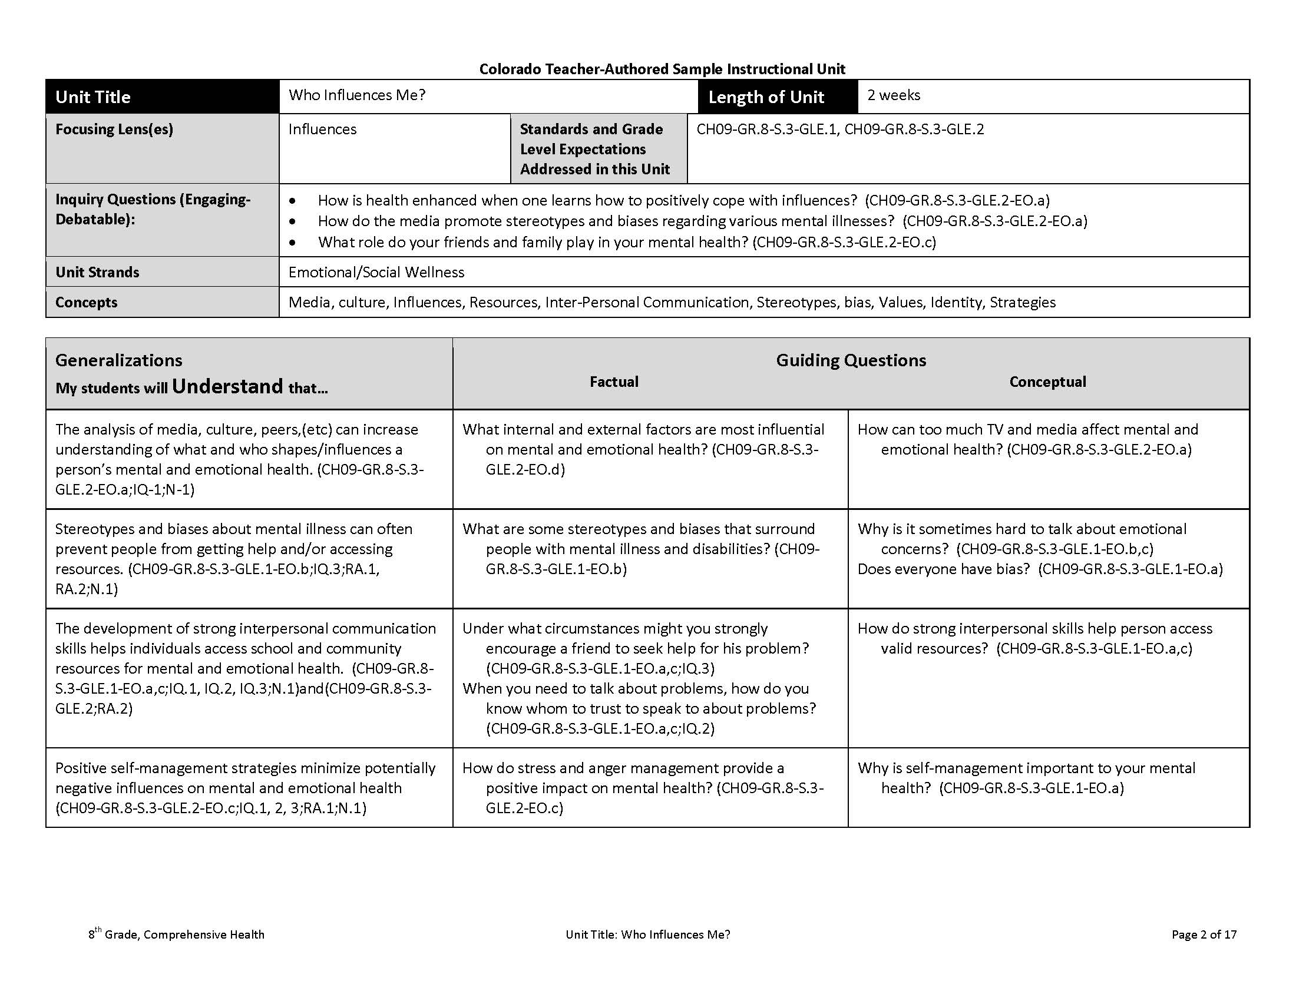

Slide 10
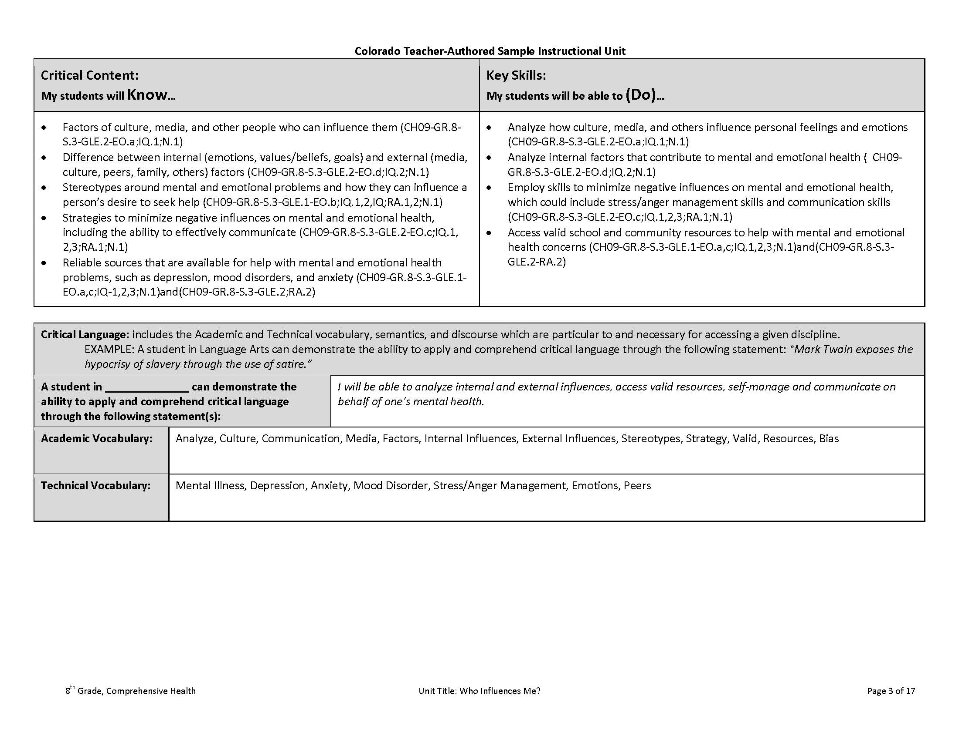

Slide 11
The samples leave work to be done….
The Curriculum Overviews do NOT contain:
learning experiences
resources
assessment ideas
differentiation options

Slide 12
Project Overview
Lesson Plans will be the work of individual schools and teachers.
Lesson Plan
Standards
Lesson Plan
Instructional Unit Development
Lesson Plan
Unit Overview
Year At A Glance
(page 1)

Slide 13
Teacher-Authored Samples
Instructional Units
During a three-day workshop a team of educators created an instructional unit designed to provide teachers with support for using their professional judgment to teach to student mastery of the standards-based generalizations, content, and skills of one selected overview.
Teams were typically comprised of:
2 general education teachers (content specialists)
1 ELL teacher
1 Counselor or School Psychologist
1 Special education teacher
District Comp Health Coordinators
Nurse
100+ units developed and published on March 31, 2014 (one for each grade k-12 mathematics, reading, writing, and communicating, science, social studies, comprehensive health, visual arts, drama/theatre, dance, and music).

Slide 14
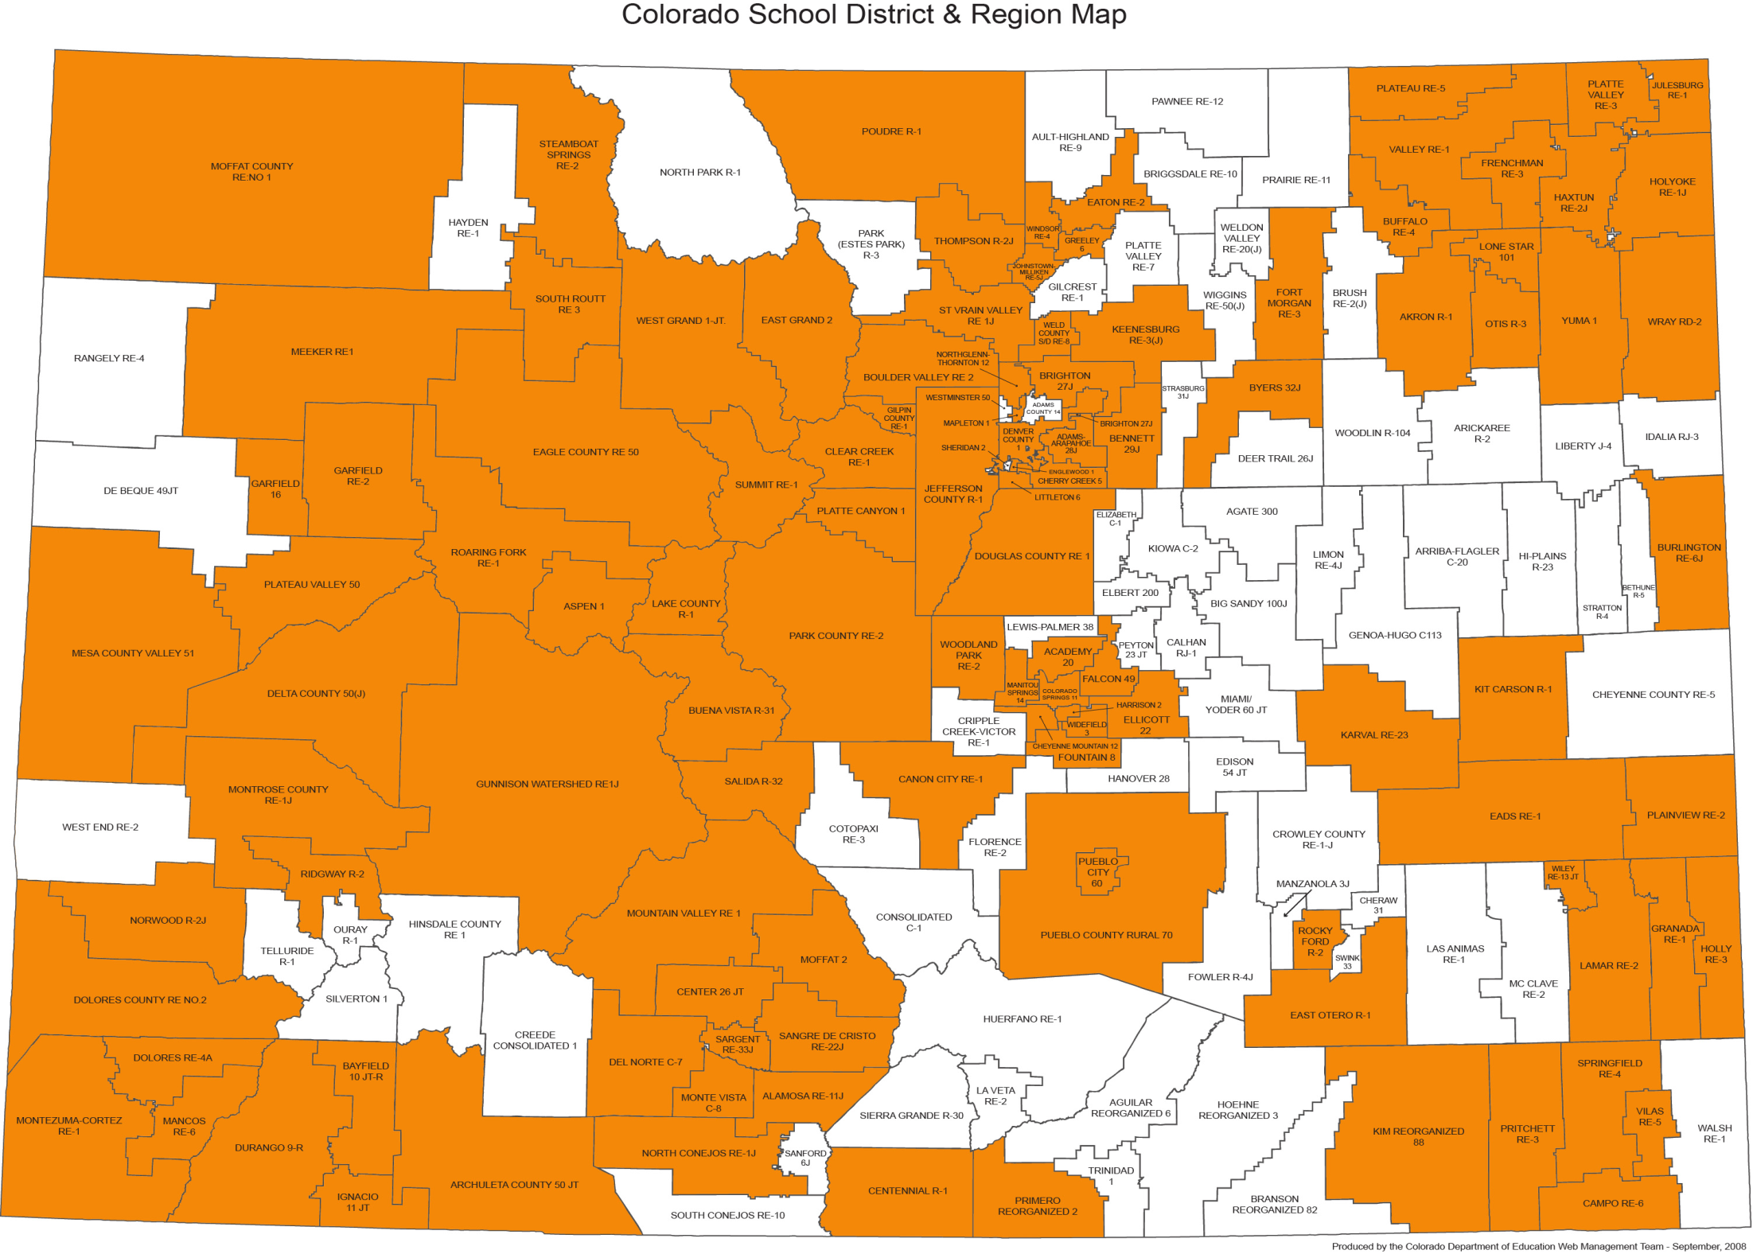

Slide 15
Generalizations: The Starting Point
Generalizations My students will Understand that… | Guiding Factual Conceptual
The analysis of media, culture, peers,(etc.) can increase understanding of what and who shapes/influences a person’s mental and emotional health. (CH09-GR.8-S.3-GLE.2-EO.a;IQ-1;N-1) | What internal and external factors are most influential on mental and emotional health? (CH09- GR.8-S.3-GLE.2-EO.d) | How can too much TV and media affect mental and emotional health? (CH09-GR.8-S.3-GLE.2-EO.a)
Stereotypes and biases about mental illness can often prevent people from getting help and/or accessing resources. (CH09-GR.8-S.3-GLE.1- EO.b;IQ.3;RA.1, RA.2;N.1) | What are some stereotypes and biases that surround people with mental illness and disabilities? (CH09-GR.8-S.3-GLE.1-EO.b) | Why is it sometimes hard to talk about emotional concerns? (CH09-GR.8-S.3-GLE.1-EO.b,c) Does everyone have bias? (CH09-GR.8-S.3-GLE.1- EO.a)
The development of strong interpersonal communication skills helps individuals access school and community resources for mental and emotional health. (CH09-GR.8-S.3-GLE.1-EO.a,c;IQ.1, IQ.2, IQ.3;N.1)and(CH09-GR.8-S.3-GLE.2;RA.2) | Under what circumstances might you strongly encourage a friend to seek help for his problem? (CH09-GR.8-S.3-GLE.1-EO.a,c;IQ.3) When you need to talk about problems, how do you know whom to trust to speak to about problems? (CH09-GR.8-S.3-GLE.1-EO.a,c;IQ.2) | How do strong interpersonal skills help person access valid resources? (CH09-GR.8-S.3-GLE.1- EO.a,c)
Positive self-management strategies minimize potentially negative influences on mental and emotional health (CH09-GR.8-S.3-GLE.2-EO.c;IQ.1, 2, 3;RA.1;N.1) | How do stress and anger management provide a positive impact on mental health? (CH09-GR.8-S.3- GLE.2-EO.c) | Why is self-management important to your mental health? (CH09-GR.8-S.3-GLE.1-EO.a)

Slide 16
The KEY Generalization- The all encompassing heart of the unit!
Key Generalization | The analysis of media, culture, peers,(etc) can increase understanding of what and who shapes/influences a person’s mental and emotional health.
Supporting Generalizations | Stereotypes and biases about mental illness can often prevent people from getting help and/or accessing resources.
 | The development of strong interpersonal communication skills helps individuals access school and community resources for mental and emotional health.
 | Positive self-management strategies minimize potentially negative influences on mental and emotional health

Slide 17
The Capstone Performance Assessment-R.A.F.T.
Key generalization-the basis for the creation of the PA (RAFT):
Role: Who are you? A health advocate, student school leader, peer mediator etc..
Audience: To whom are you writing/speaking/presenting? The school community, class of peers, etc…
Format: In what format are you writing/speaking/presenting? A letter? An advertisement? A speech? An action plan?
Topic: What are you writing/speaking/presenting about ?
R: Student leader A: School community F: Action plan T: Promotion of positive behaviors

Slide 18
Performance Assessment
R.A.F.T. | As a group of student school leaders you have been asked by administrators to design and present an action plan for the school community that promotes positive behaviors and suggests ways to alter/diminish negative stereotypes around mental and emotional health and well-being. Your goal is to increase understanding of the ways in which attention to individual mental and emotional health can benefit an entire community. As part of your action plan you will: • Identify positive & negative behaviors in the school community • Choose a target behavior within your school that you would like to change or promote • Outline specific steps that address the selected (negative/positive)behavior • Promote the community benefits associated mental health and healthy behaviors

Slide 19
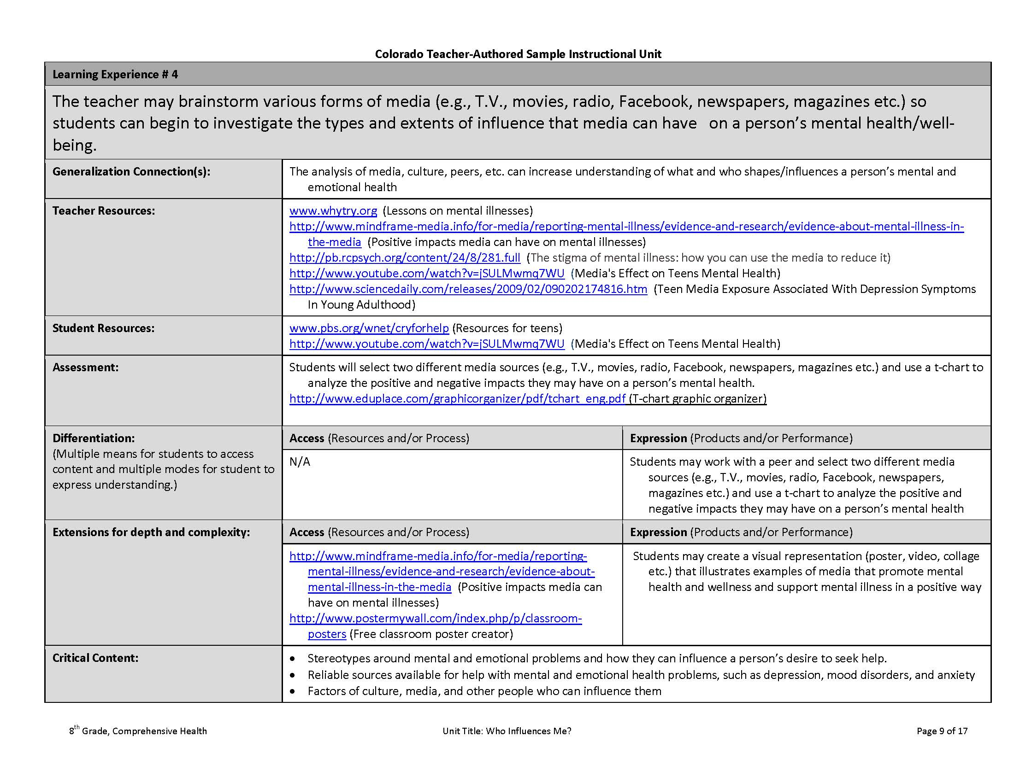
Instructional Unit Learning Experiences
The teacher may brainstorm various forms of media (e.g., T.V, movies, radio, Facebook, newspapers, magazines etc.) so students can begin to investigate the types and extents of influence that media can have on a person’s mental health/well-being.

Slide 20
Instructional Unit Learning Experiences
Generalizations
Connection(s):
The analysis of media, culture, peers, etc. can increase understanding of what and who shapes/influences a person’s mental and emotional health

Slide 21
Instructional Unit Learning Experiences
Teacher Resources
http://www.whytry.org/ (Lessons on mental illnessess)
http://www.mindframe-media.info/for-media/reporting-mental-illness/evidence-and-research/evidence-about-mental-illness-in-the-media (Positive impacts media can have on mental illnesses)
http://pb.rcpsych.org/content/24/8/281.full (The stigma of mental illness: how you can use the media to reduce it)
http://www.youtube.com/watch?v=jSULMwmq7WU (Media's Effect on Teens Mental Health)
http://www.sciencedaily.com/releases/2009/02/090202174816.htm (Teen Media Exposure Associated With Depression Symptoms in Young Adulthood)
www.pbs.org/wnet/cryforhelp (Resources for Teens)
http://www.youtube.com/watch?v=jSULMwmq7WU (Media's Effect on Teens Mental Health)
Student Resources

Slide 22
Instructional Unit Learning Experiences
Assessments:
Students will select two different media sources (e.g., T.V., movies, radio, Facebook, newspapers, magazines etc.) and use a t-chart to analyze the positive and negative impacts they may have on a person’s mental health.
http://www.eduplace.com/graphicorganizer/pdf/tchart_eng.pdf (T-chart graphic organizer)

Slide 23
Instructional Unit Learning Experiences
Differentiation
(Multiple means for students to access content and multiple modes for student to express understanding.)
Access (Resources and/or Process)
Expression (Products and/or
Performance)
N/A
Students may work with a peer and select two different media sources (e.g., T.V., movies, radio, Facebook, newspapers, magazines etc.) and use a t-chart to analyze the positive and negative impacts they may have on a person’s mental health

Slide 24
Instructional Unit Learning Experiences
Extensions for
Depth and
Complexity:
Access (Resources and/or
Process)
Expression (Products and/or Performance)
http://www.mindframe-media.info/for-media/reporting-mental-illness/evidence-and-research/evidence-about-mental-illness-in-the-media (Positive impacts media can have on mental illnesses)
http://www.postermywall.com/index.php/p/classroom-posters (Free classroom poster creator)
Students may create a visual representation (poster, video, collage etc.) that illustrates examples of media that promote mental health and wellness and support mental illness in a positive way

Slide 25
Instructional Unit Learning Experiences
Critical Content:
Stereotypes around mental and emotional problems and how they can influence a person’s desire to seek help.
• Reliable sources available for help with mental and emotional health problems, such as depression, mood disorders, and anxiety
• Factors of culture, media, and other people who can influence them

Slide 26
Instructional Unit Learning Experiences
Key Skills:
Analyze internal factors that contribute to mental and emotional health. Analyze how culture, media, and others influence personal feelings and emotions
• Access valid school and community resources to help with mental and emotional health concerns
• Analyze how culture, media, and others influence personal feelings and emotions

Slide 27
Instructional Unit Learning Experiences
Critical Language:
Analyze, factors, internal influences, external influences, stereotypes, bias, resource, mental illness, depression, anxiety, mood disorder, emotions

Slide 28
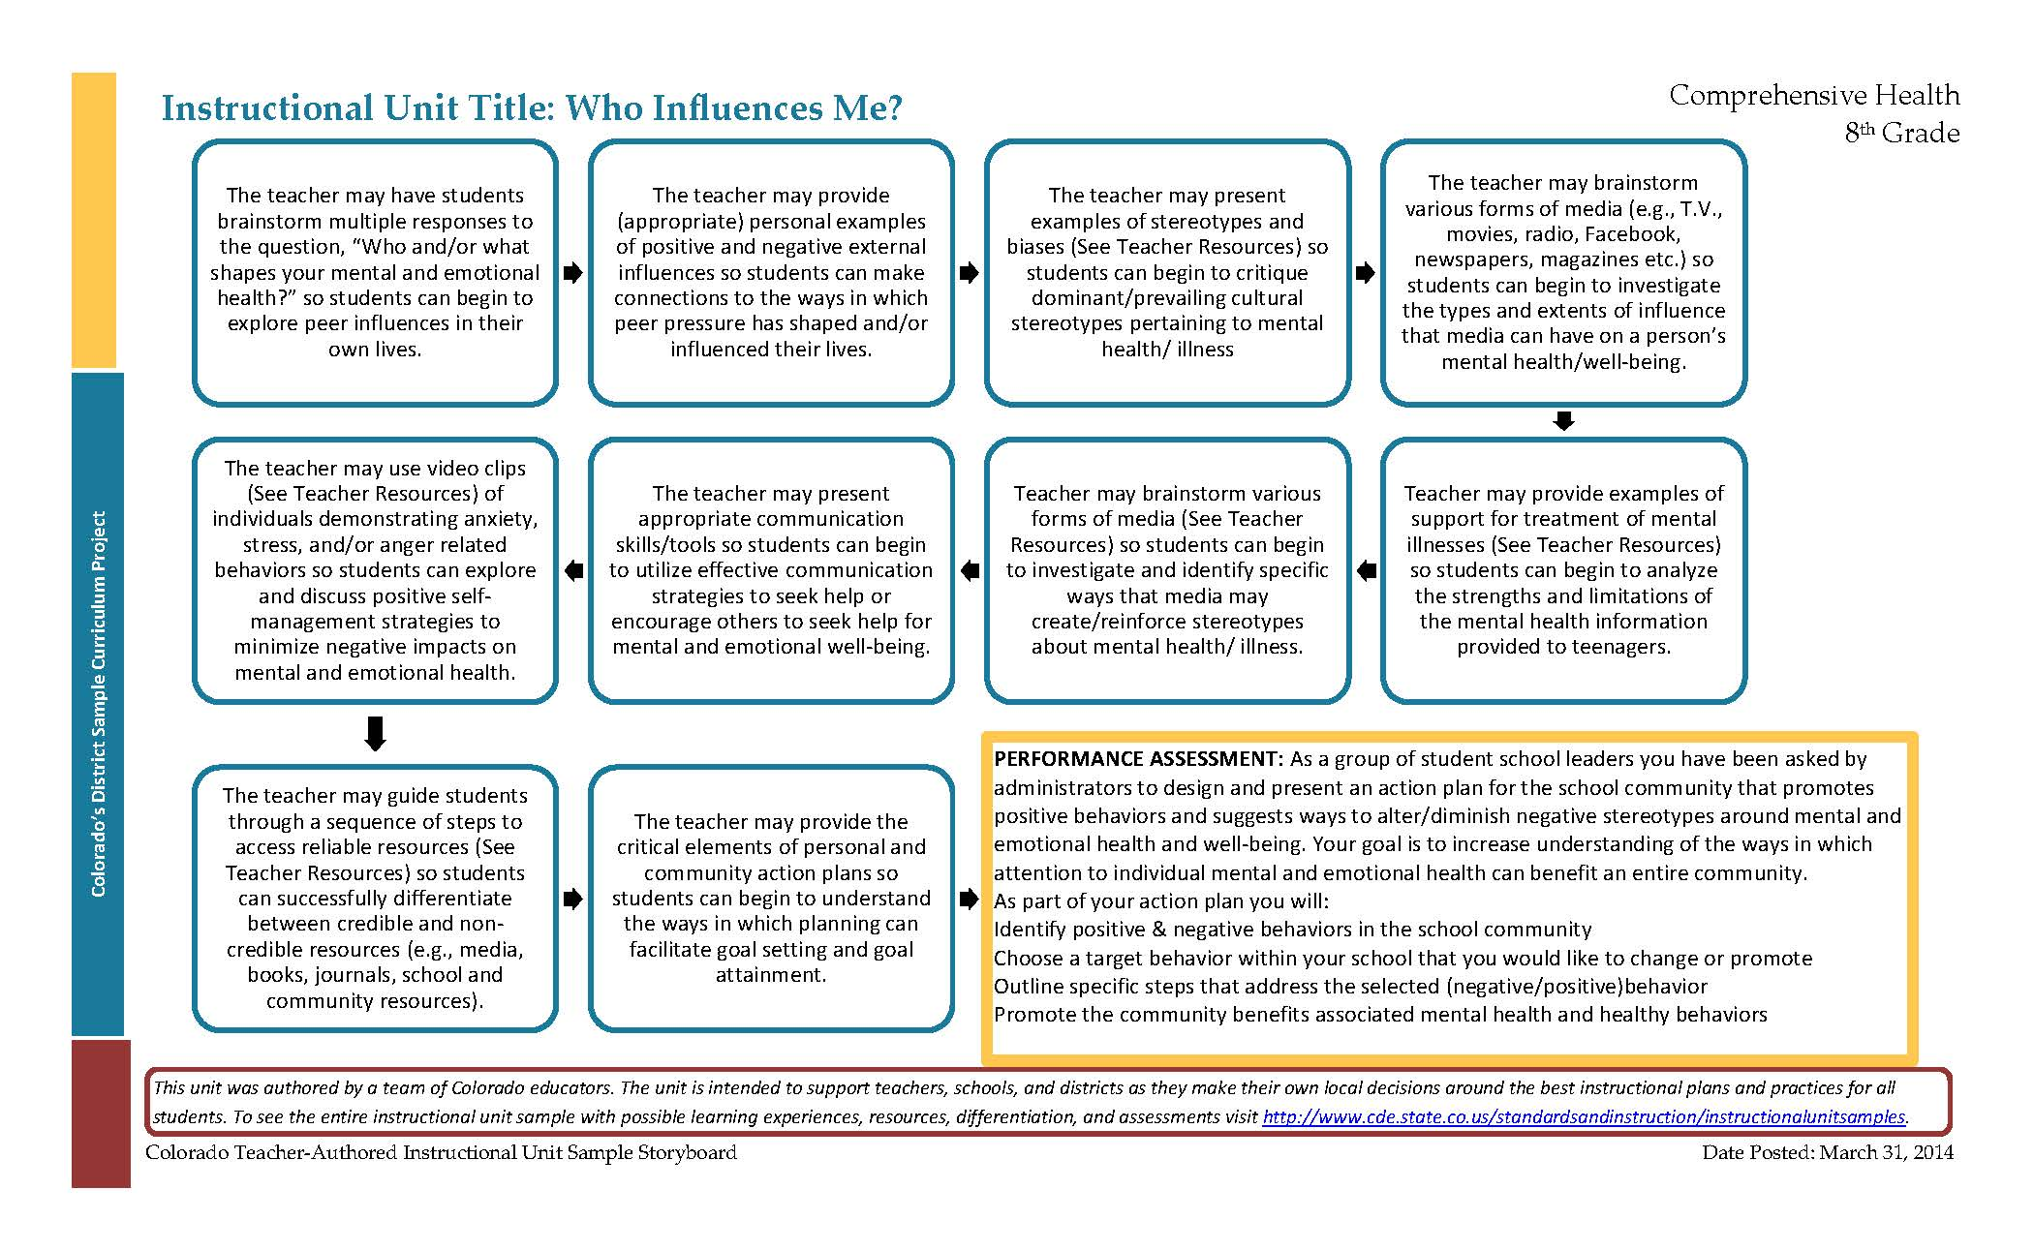
Unit Trajectory- Learning Experiences

Slide 29
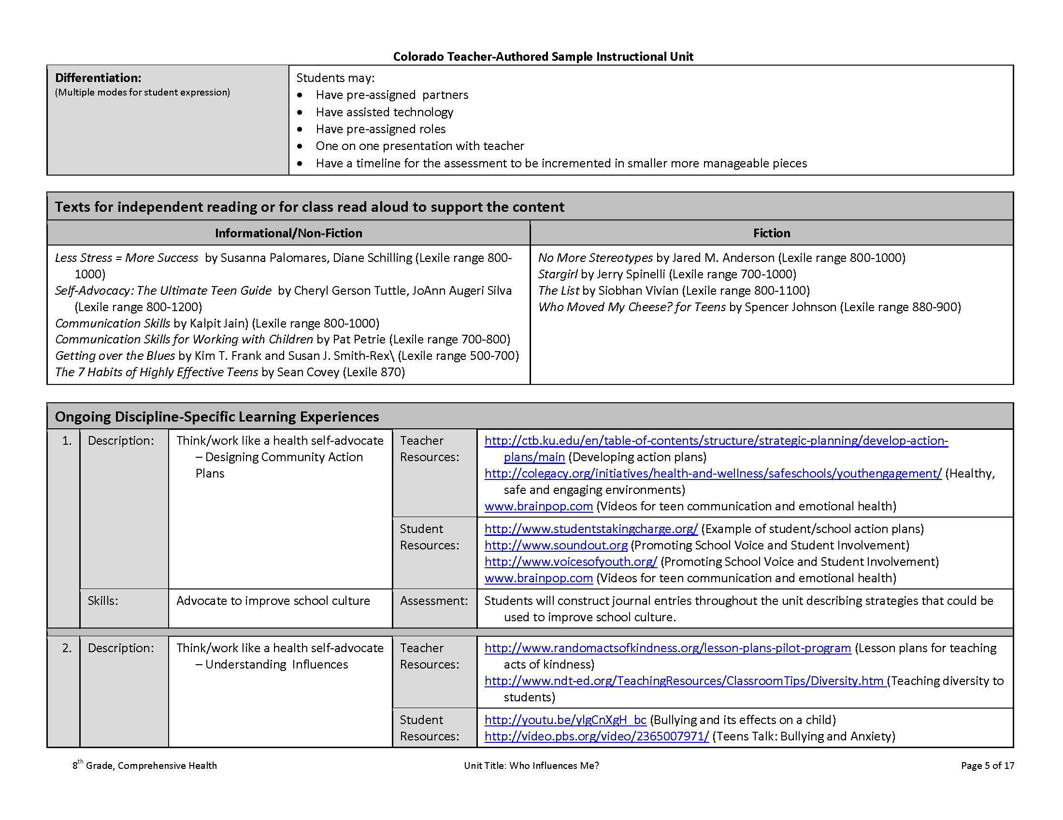
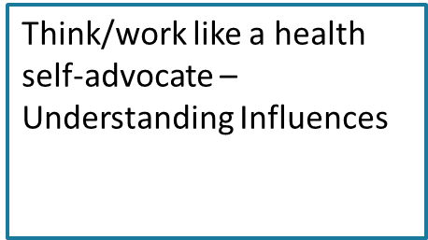
Ongoing Learning Experiences

Slide 30
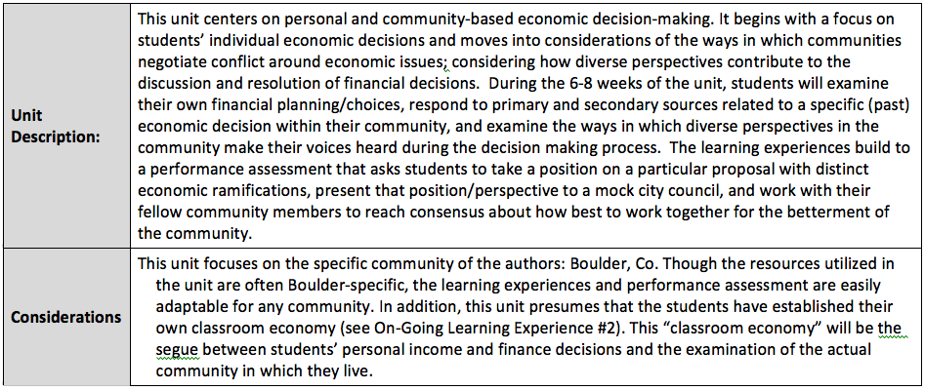
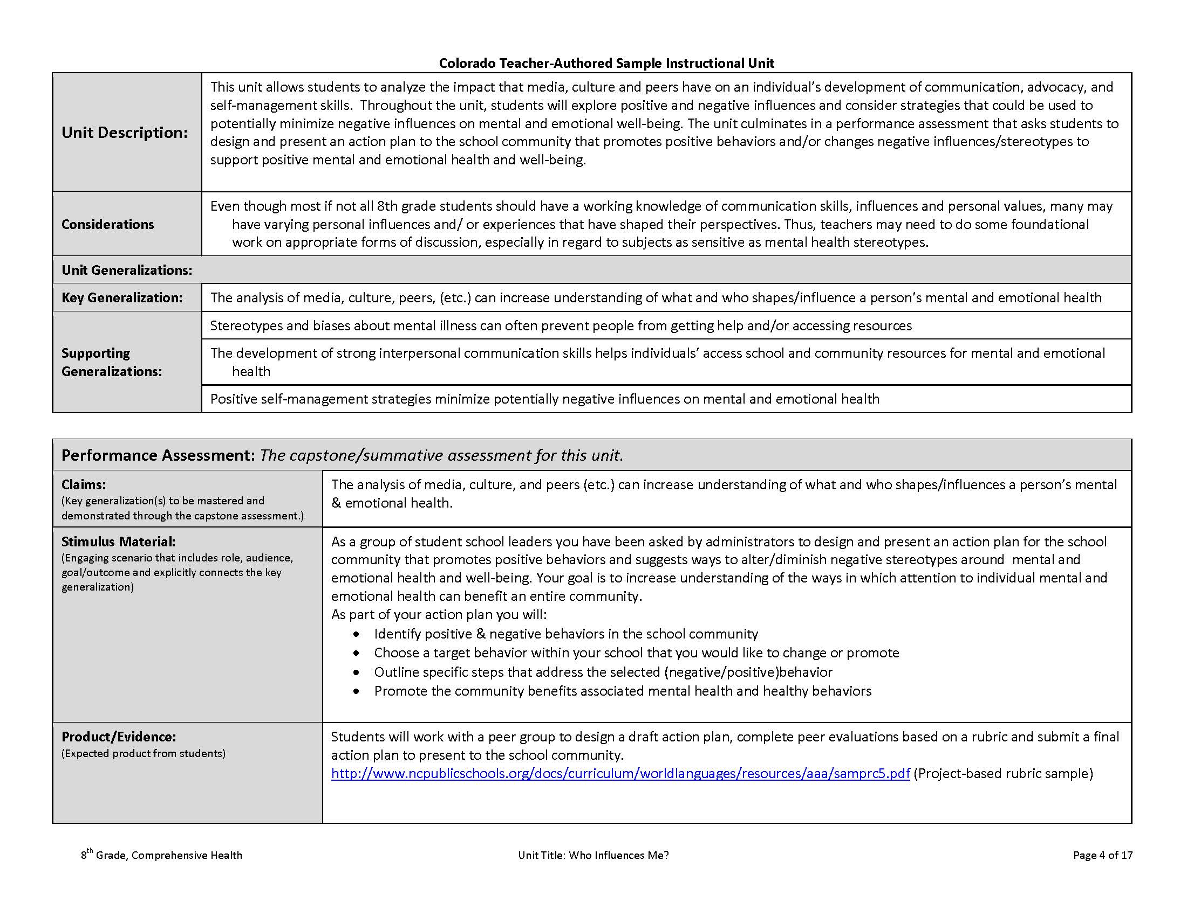
Instructional Unit Description & Considerations
Unit Description
This unit allows students to analyze the impact that media, culture and peers have on an individual’s development of communication, advocacy, and self-management skills. Throughout the unit, students will explore positive and negative influences and consider strategies that could be used to potentially minimize negative influences on mental and emotional well-being. The unit culminates in a performance assessment that asks students to design and present an action plan to the school community that promotes positive behaviors and/or changes negative influences/stereotypes to support positive mental and emotional health and well-being.
Even though most if not all 8th grade students should have a working knowledge of communication skills, influences and personal values, many may have varying personal influences and/ or experiences that have shaped their perspectives. Thus, teachers may need to do some foundational work on appropriate forms of discussion, especially in regard to subjects as sensitive as mental health stereotypes.
Considerations

Slide 31
Things To Remember….
The instructional units:
Are Not lesson plans
Are meant to be a resource for teachers to support current content
Allow for additional resources, conceptual questions, factual questions and differentiations to be added.
Descriptions of URLs in the resource section are placed there in case links break. So teachers still know the intention behind the resources.

Slide 32
Possible Access Points for Integration
Since not all campuses within a district at the elementary and secondary levels may have a designated Health course there may be multiple people who teach the curriculum throughout a semester or year. (ex. PE teacher, nurse, counselor, science teacher, etc.)
The concepts that are taught in Health units such as: (Decision-making, consequences, relationships, perspective, communication, resources, problem-solving, resources, cooperation etc.) can easily be integrated throughout many other content areas.
Resources that can be found within the health units often can be helpful to use in other content area lessons, especially at the elementary level.

Slide 33

Discussion Time
Questions?

Slide 34
Upcoming Webinars
Reading, Writing, and Communicating Instructional Units April 18 @ 12:30 http://connect.enetcolorado.org/siu_rwc/
Visual and Performing Arts Instructional Units April 21 @ 12:30 http://connect.enetcolorado.org/siu_arts/
Science Instructional Units April 22 @ 12:30 http://connect.enetcolorado.org/siu_science/
Comprehensive Health Instructional Units April 23 @ 12:30 http://connect.enetcolorado.org/siu_health/
Mathematics Instructional Units April 24 @ 12:30 http://connect.enetcolorado.org/siu_mathematics/
Social Studies Instructional Units April 25 @ 12:30 http://connect.enetcolorado.org/siu_socialstudies/

Slide 35
Contact Information
Phyllis Reed – Comprehensive Health Content Specialist
Phone: 720-498-2059
Email: reed_p@cde.state.co.us
Webpage: http://www.cde.state.co.us/cohealthpe

