Slide 1

READ Plans Beyond Third Grade: An Overview of the 4+ READ Plan Guidance

Slide 2

Walk leaders through components of The READ Plan Guidance for Students in Grades 4-12, specifically:
SRD determination
What assessments can be used to determine reading competency beyond third grade?
Utilizing a body of evidence to inform instructional decisions.
Goal setting and progress monitoring.

Slide 3
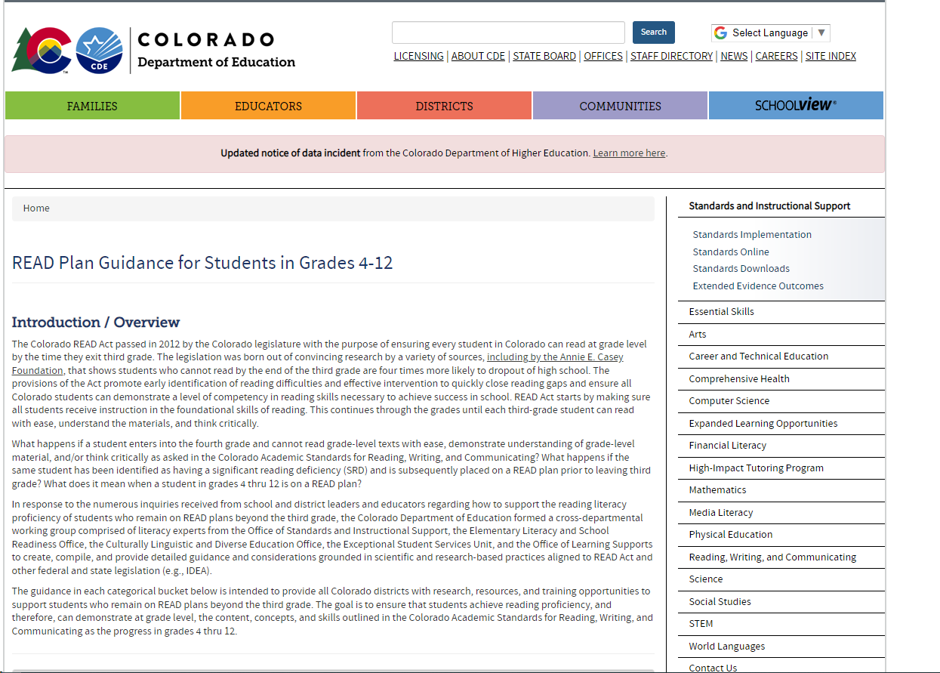
https://www.cde.state.co.us/standardsandinstruction/4plusreadplans

Slide 4
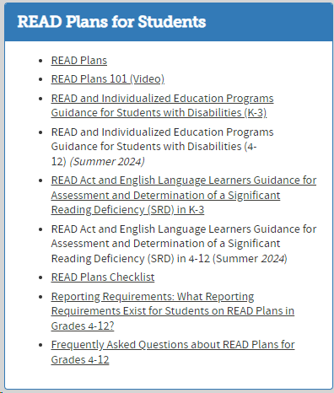
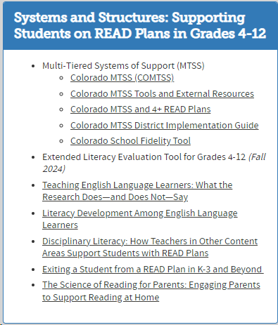
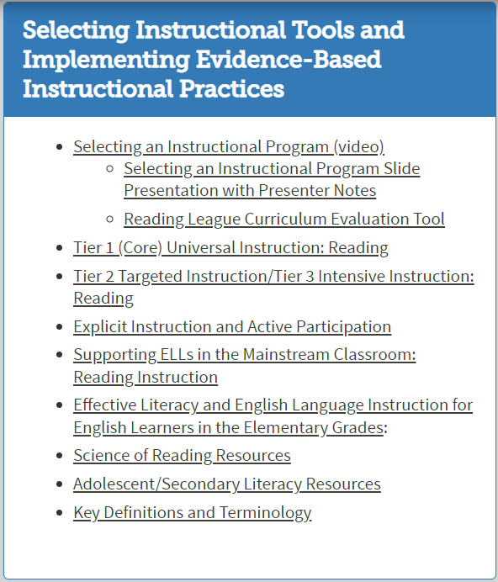
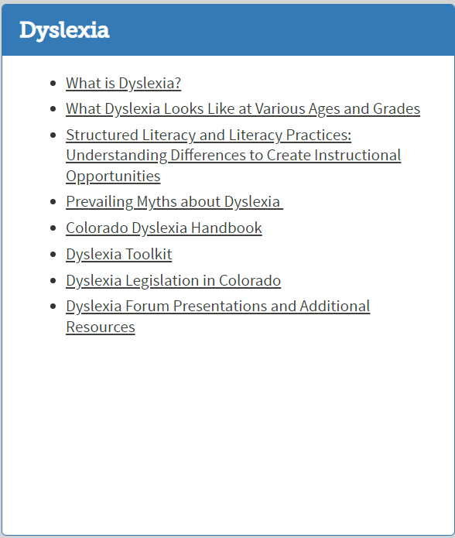
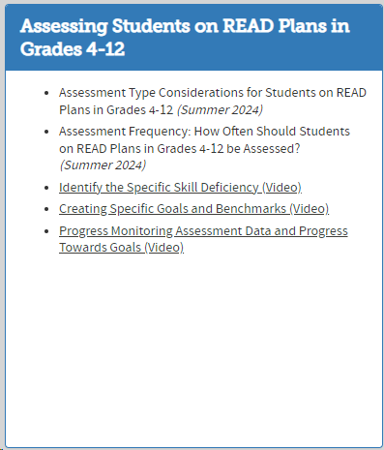
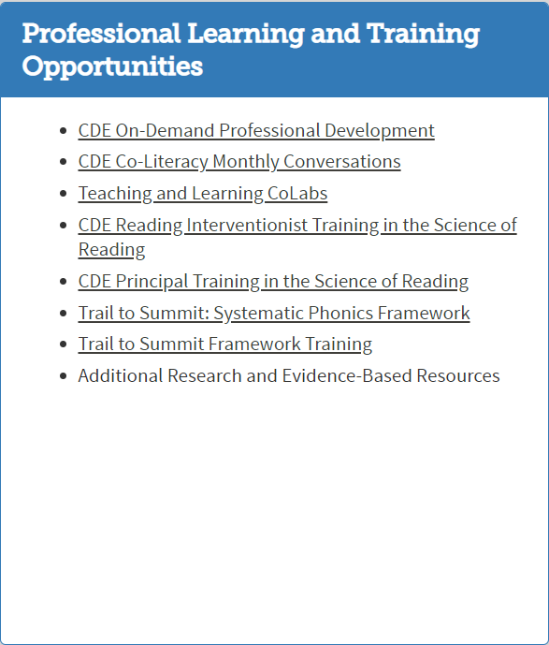

Slide 5

What does legislation say?

Slide 6
READ Plans: What does the legislation say?
Colorado's READ Act requires:
The creation and implementation of an individual intervention plan, called a READ plan, for students in K-3 identified as having a significant reading deficiency (SRD).
A READ plan acquired in grades K-3 remains in place until a student has reached grade level reading competency. ​
http://www.cde.state.co.us/coloradoliteracy/readplans101
6
Notes:
Estimated time: 3 minutes
Say: Before we begin, I wanted to take two minutes to do a heart check. Oftentimes, as teachers, we always check on the social-emotional well-being on our students and our colleagues, often at the expense of ourselves; however, how many times do we stop to do it for ourselves? Therefore, before we dive into this standards training further, I wanted each of you to do your own heart check, especially now with what is happening. I want you to take a few minutes and free write, doodle, make that to-do list, or just process your thoughts, feelings, etc., even if it’s about having to sit through this virtual PD on Zoom. It is your thoughts. I am not collecting it to assess your writing skills or artistic expression. I will however, ask for a few brave souls to share out.

Slide 7



Do students in grades 4-12 need a READ plan?
Yes, but only if the student was identified as having a significant reading deficiency (SRD) and was placed on a READ plan prior to entering fourth grade.
C.R.S 22-7-1206 (6) states, "Each local education provider shall ensure that a teacher continues to revise and implement a student's READ plan until the student attains reading competency, regardless of the student's grade level and regardless of whether the student was enrolled with the local education provider when the READ plan was originally created, or the student transferred enrollment to the local education provider after the READ plan was created."

Slide 8

Significant Reading Deficiencies

Slide 9
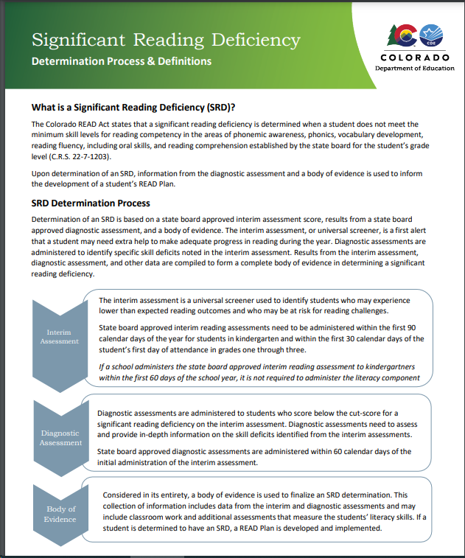

Slide 10
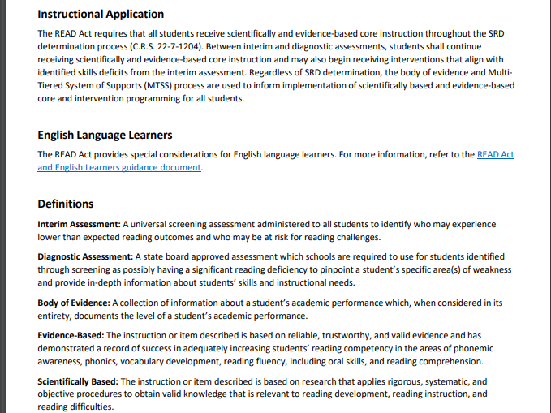

Slide 11
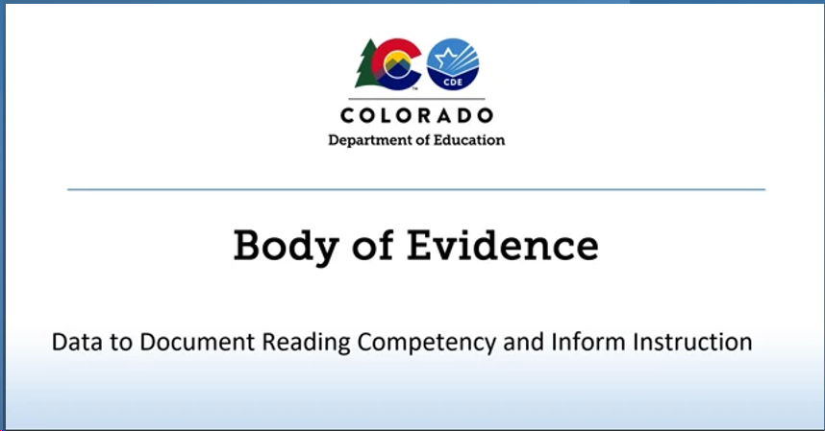

Slide 12
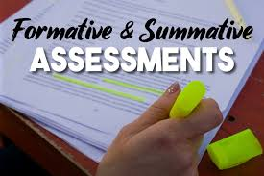
The Colorado READ Act defines a body of evidence as a collection of information about a student’s academic performance which, when considered in its entirety, documents the level of a student’s academic performance.
A body of evidence, at a minimum, shall include:
  Scores on formative, interim, and benchmark assessments.
  Work that a student independently produces in a classroom.
A body of evidence may include scores on summative assessments (e.g., CMAS ELA, PSAT, SAT, district/curriculum/end of unit, etc.) if a local education provider decides that summative assessments are appropriate and useful in measuring students’ literacy skills (C.R.S. 22-7-1203).

Slide 13
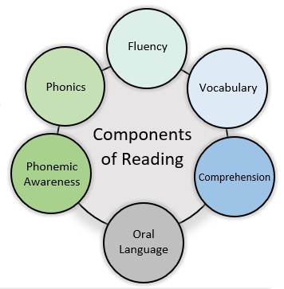
Utilizing a Body of Evidence to Inform Literacy Instruction
A body of evidence is developed over time and used to inform implementation of scientifically and evidence-based core instruction and intervention for all students.
For students who are determined to have a significant reading deficiency (SRD), a body of evidence is used to inform the development and implementation of a READ Plan. For these and all other students, a body of evidence should guide instruction and interventions.
To effectively inform literacy instruction, all components of reading should be addressed in the body of evidence.
The progression of skills and interconnectedness of the components of reading should also be considered. The Colorado Academic Standards and Minimum Reading Competency Skills provide guidance for skills at each grade level.

Slide 14
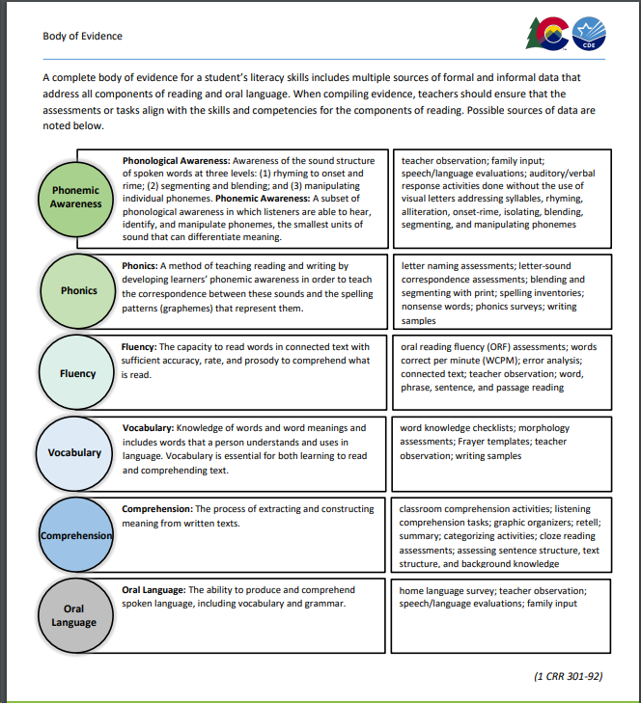

Slide 15

What types of body of evidence does your school or district use for students in secondary?

Slide 16

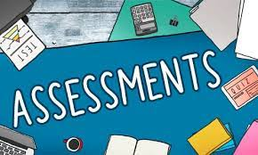

Slide 17

What assessments can be used to determine reading competency beyond third grade?
Some assessments on READ Act approved list provide options for assessing students beyond third grade.
Other curriculum-based measurement (CBM) reading assessments can be used beyond third grade to track student progress and inform the body of evidence with measures such as oral reading fluency measures and maze measures. Typically, these measures correlate to grade level through the eighth grade for basic measures of fluency and comprehension, though this is dependent on the assessment selected.
In addition, state-aligned benchmark assessments can be used as periodic benchmarks to determine if a student on a READ plan is reaching grade level reading competency.
A variety of CBM reading assessments and state-aligned benchmark assessments are commercially available, and some assessments are available online at no cost.

Slide 18


The National Center on Intensive Intervention at the American Institutes for Research provides an online Academic Screening Tools Chart that can assist districts in identifying appropriate screening assessments for use with older students.
Screening for Reading Problems in Grades 4-12
RTI Action Network (rtinetwork.org)
This article provides helpful information for schools or teachers who wish to provide appropriate reading instruction, implement a screening process to identify struggling readers and identify the right assessments to use in this process. The article includes examples of assessment measures that can be used to identify specific reading problems.
Assessments to Guide Adolescent Literacy Instruction
Center on Instruction (centeroninstruction.org)
Another useful resource from the Center on Instruction is this guide focused on assessments for adolescent literacy. Its contents include a comprehensive system for adolescent literacy, formative assessments to guide instruction and challenges to using assessments for instruction with adolescents.
It is the responsibility of each local education provider to select assessments for use in measuring student’s reading development and monitoring student progress in reading beyond third grade.

Slide 19
What types of assessments does your school or district use for students in secondary?

Slide 20
How is your district supporting secondary students on READ plans? Think about the components the READ plan format your district uses, the types of assessments and frequency of assessment cycles, the progress monitoring/data cycles that occurs, and your systems and structures in place to support students on READ plans.

Slide 21

Collaboration of ELSR, CLDE, and SIS to solidify and specify guidance with supports for multilingual students on READ plans in secondary (4-12).

Slide 22
