Slide 1
Work-Based Learning During COVID-19
June 2, 2020

Slide 2
Agenda
Introductions
Promising Practices
Industry Data Update
Virtual Job Fair Spotlight
Work Based Learning Incubator Announcement
Discussion
Q&A

Slide 4
Promising Practices
Notes:
Sample Business letter from Linked Learning

Slide 5
Career Awareness and Exploration
Education Coordinated
Virtual Guest Speaker with Q&A - synchronous
Facility tours and job shadows - asynchronous
Virtual Industry Panel
Virtual Job Shadow - Free Account through Connecting Colorado

Slide 6
Project Based Learning
Client Project
Examples: Research, summary of findings, create brochure, marketing plan, social media account development, HR interview projects
Mentors
Source from local businesses with consultant model
Projects at Home - Skilled Trades
Remodeling, repairs, service
America Achieves Performance Tasks

Slide 7
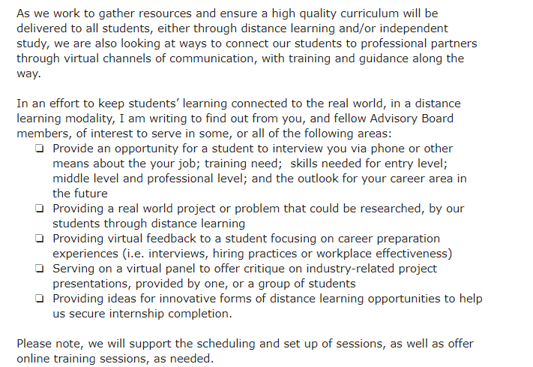
Engagement Strategies
Mobilize current partners - Letter of interest (LinkedLearning)

Slide 8
Colorado Career Conversations Training and Resources

Slide 9
Add’l Promising Practices
Utilizing CDIP for independent study program
Education Internships continuing in support of remote learning
In-house training from businesses
1-on-1 plan making with businesses
Career Exploration class utilizing virtual job shadowing

Slide 10
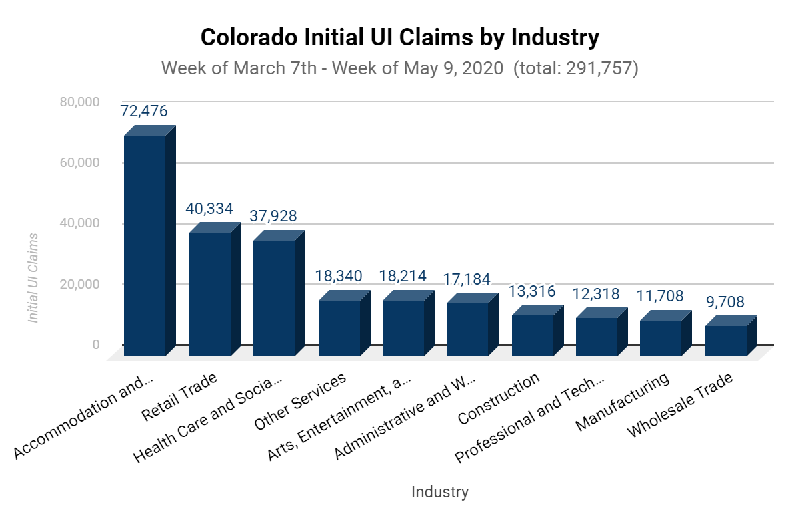
Notes:
Accommodation and Food Services
Retail Trade
Health Care and Social Assistance
Other Services
Arts, Entertainment, and Recreation
Administrative and Waste Services
Construction
Professional and Technical Services
Manufacturing
Wholesale Trade

Slide 11
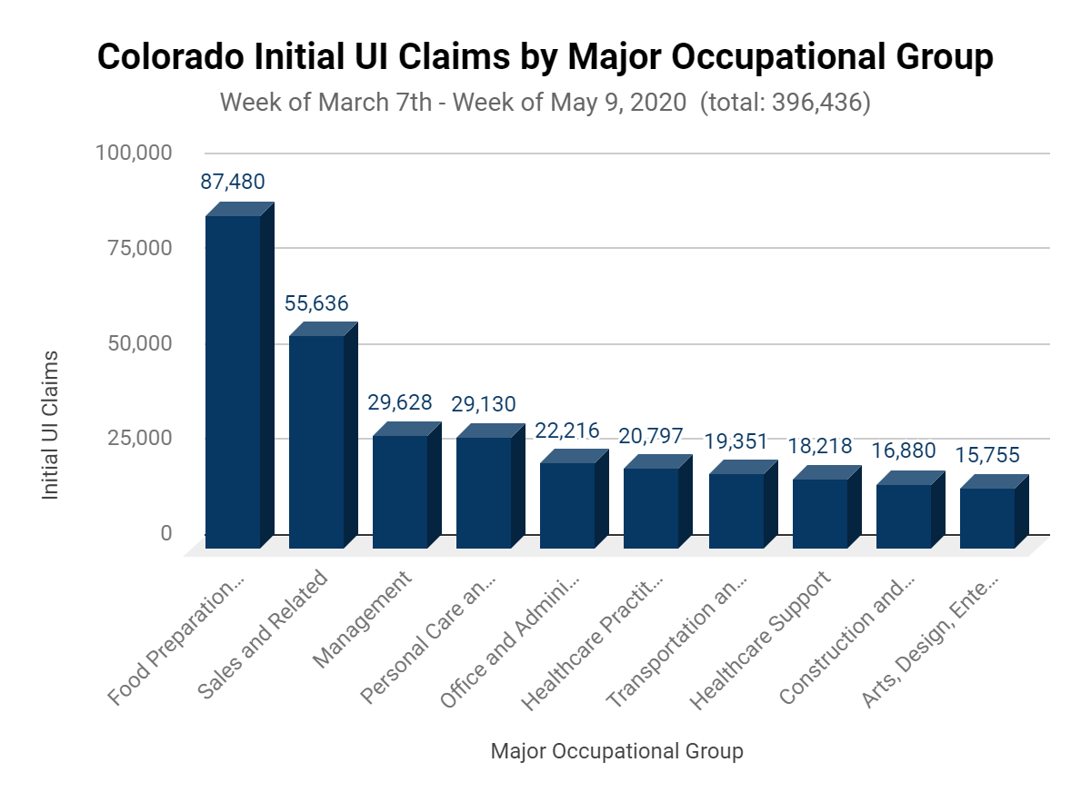
Notes:
Food Preparation and Serving Related
Sales and Related
Management
Personal Care and Service
Office and Administrative Support
Healthcare Practitioners and Technical
Transportation and Material Moving
Healthcare Support
Construction and Extraction
Arts, Design, Entertainment, Sports, and Media

Slide 12
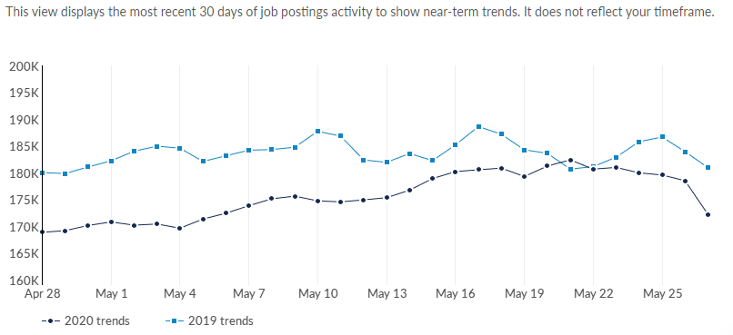
CO Job Postings | April 26-May 27, 2020

Slide 13
CO Top 10 Posted Occupations
Occupation (SOC) | Unique Postings (Apr 2020)
Registered Nurses | 10,945
Heavy and Tractor-Trailer Truck Drivers | 9,999
Software Developers, Applications | 7,419
Retail Salespersons | 5,542
First-Line Supervisors of Retail Sales Workers | 4,967
Customer Service Representatives | 4,810
Computer Occupations, All Other | 4,538
Marketing Managers | 3,521
Network and Computer Systems Administrators | 3,257
First-Line Supervisors of Office and Administrative Support Workers | 3,247

Slide 14
CO Top 10 Industries Posting Jobs
Industry | Unique Postings (Apr 2020)
Administrative and Support and Waste Management and Remediation Services | 36,487
Professional, Scientific, and Technical Services | 26,232
Retail Trade | 24,982
Health Care and Social Assistance | 24,894
Accommodation and Food Services | 14,406
Manufacturing | 13,840
Information | 13,635
Transportation and Warehousing | 9,806
Finance and Insurance | 9,353
Educational Services | 8,224
Notes:
Administrative and support and Waste management and Remediation Services (this includes employment services)
Professional, Scientific, and Technical Services (this includes consulting services, accountants, and lawyers)
Administrative and support and Waste management and Remediation Services (this includes employment services)
Retail trade includes grocery store and other essential workers
Professional, Scientific, and Technical Services (this includes consulting services, accountants, and lawyers)

Slide 15
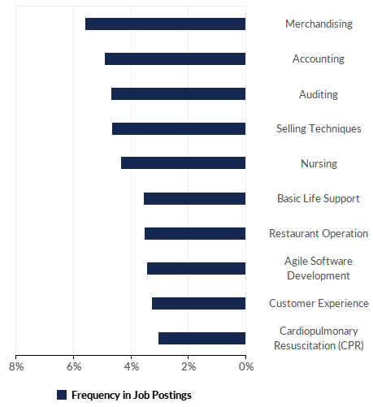
CO Top Posted Technical Skills April 2020

Slide 16
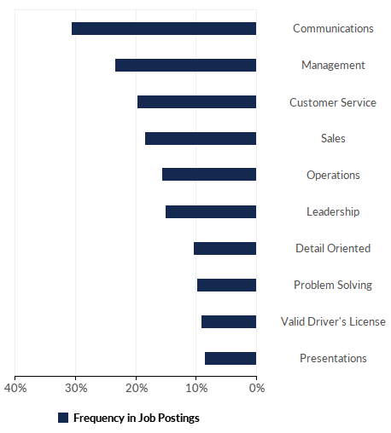
CO Top Posted Essential Skills April 2020

Slide 17
CO Top Posted Qualifications April 2020
Qualification | Postings with Qualification
Commercial Driver's License (CDL) | 9,144
Certified Nursing Assistant | 2,732
Licensed Practical Nurse | 2,632
Master Of Business Administration (MBA) | 2,579
Bachelor of Science in Nursing (BSN) | 1,657
Certified Information Systems Security Professional | 1,232
Project Management Professional Certification | 1,080
CompTIA Security+ | 1,038
Nurse Practitioner | 1,021
Associates Degree In Nursing | 929
Notes:
Qualifications represent certifications or degrees listed in job postings

Slide 18
Resources
COVID-19 Case Data Visualizations
https://onwardco.org/
https://covid19.colorado.gov/
BLS Employment Situation (National Data)
EMSI Job Posting Dashboard
Colorado LMI Gateway
March 2020 Employment Situation
Economic Recovery Resources & Business News
Governor’s Council on Economic Stabilization and Growth
OSPS Economic Forecast
PPT
Full Report
https://coloradomaskproject.com/
State Demographer’s Office COVID-19 Map Series***
Social Vulnerability Index
Strada Education Public Viewpoint
Notes:
Qualifications represent certifications or degrees listed in job postings

Slide 19
Westminster Public Schools - Victoria Rimmey
Virtual Hiring Fair
Background: Annual hiring fair event, multi-day during the last two months of school
Focus on graduating seniors, but provide access to part-time and seasonal work for underclassmen, as well as career exploration
Focus on work or paid training with growth opportunities
Problem: COVID-19 cancelled our in-person Hiring Fair. How do we help students access these opportunities at a time it may be more important than ever?

Slide 20
Move to Virtual Hiring Fair
Google Sites
Pre-Interviews with all prospective employers, posted as YouTube videos
Reuse Pre-Interviews on Future Center Regular Jobs page for future job seekers and in ICAP for career exploration
Zoom sessions for students who want to connect with employers for questions
Invited CTE teachers to these sessions to connect with industry partners

Slide 21
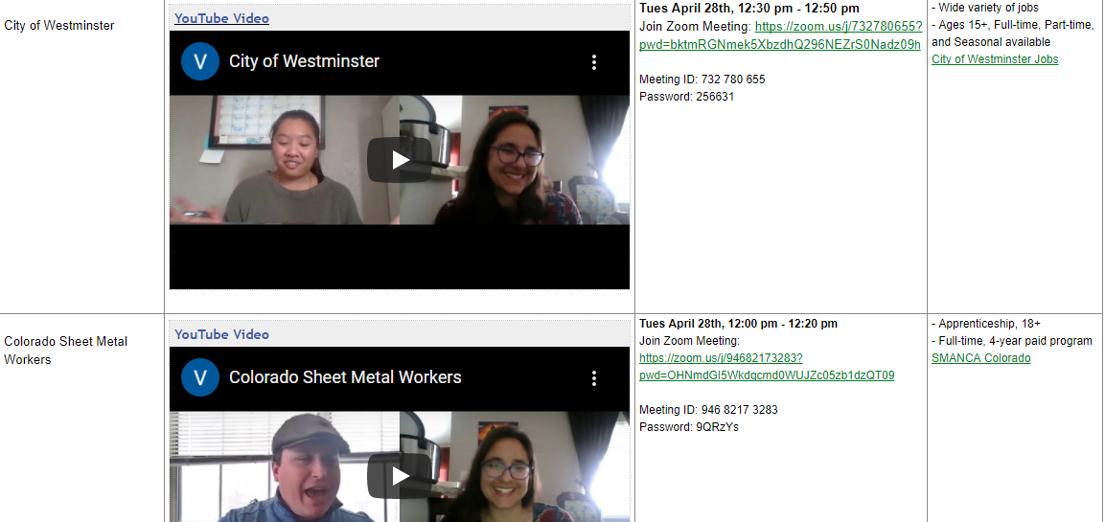
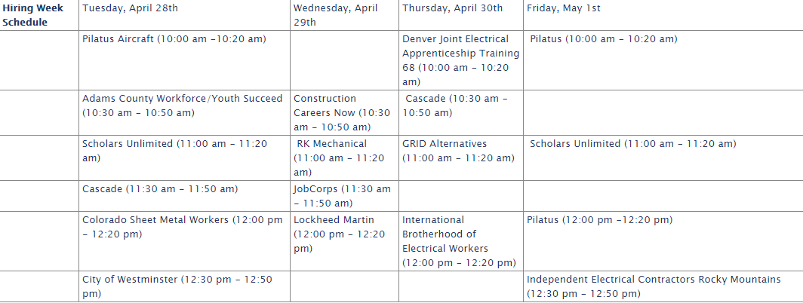
https://sites.google.com/a/westminsterpublicschools.org/westminster-public-schools-hiring-fair-2020/home

Slide 22
Work Based Learning Incubator
August - June
Bi-monthly webinars hosted around work-based learning topics of interest
August - December
Technical assistance module to work through program planning and implementation during COVID-19
Notes:
Mentimeter

Slide 23
Breakout Rooms Discussion
Questions:
What is standing out to you as a possible opportunity to explore?
What are you doing or have heard about around WBL during COVID?
What challenges are you running into with setting up your experience?

Slide 24
What did you hear?

Slide 25
Q&A

Slide 28
Thank You!
Please complete our survey

