Slide 1
Engaging Business
October 8, 2020
Work-Based Learning Incubator
Welcome!
Please rename yourself on Zoom to include your location
*This meeting will be recorded

Slide 2
Objectives
Learn about current industry data and gain resources for your own utilization - Jean Dougherty, CWDC and CDHE
Gain perspective on national practices that may support your own work-based learning programs and industry partnership- Wendy Brors, Maher & Maher
Better understand how to approach businesses and frame WBL opportunities as mutually beneficial - Erin Kerr, Colorado Succeeds

Slide 3
Agenda
Incubator Overview
Big Picture
Labor Market Information with Jean Dougherty
National Perspective - Changing Business Engagement with Maher and Maher
How to Reach out to Business with Colorado Succeeds
Survey and Punch Card

Slide 4
Community of Practice Application Information
January - June
5-8 Districts
Application to open Oct 6th and close December 7th
Goal: Build a sustainable work-based learning program utilizing design based thinking strategies
To find more information: https://cwdc.colorado.gov/resources/technical-assistance
Notes:
https://mailchi.mp/state.co.us/wbl-incubator?e=2a23b764ce

Slide 5
WBL Funding Matrix
Updated
The matrix is designed to support talent development network local partners in exploring public funding streams available to support work-based learning programs in the state.
Using feedback from agency partners and wbl communities we have updated opportunities as well as increased ease of use
Notes:
In Colorado, work-based learning is a strategy that provides individuals with opportunities to gain awareness, exposure, and training for in-demand occupations and the skills needed by business and industry. The matrix is not an exhaustive list of funding sources. Additional eligibility requirements and deadlines may apply to secure these funding sources. Please contact the appropriate contacts for further information and guidance on applying for these funds.

Slide 6
Running Commentary and Expertise
Mark Tapy
Apprenticeship Program Manager at
Pinnacol Assurance
Find commentary from Mark in the slide comments

Slide 7
Mentimeter Backchannel
Engage throughout webinar
Emailed afterwards as an additional resource
Go to www.menti.com and use the code 65 54 47 3

Slide 8
Notes:
The major theme you will hear in this presentation is when engaging with business and developing programs focus on the business need.
In developing experiences that meet business need you are creating more sustainable and mutually beneficial programs that aren’t the first to be cut when the situation gets tight.
This also creates more authentic experiences for students as they become integrated in the work versus a side project
Change the ask from “can we place interns” to “ What are your business needs”
In doing this the opportunity becomes mutually beneficial. Students are gaining skills and experience and businesses are gaining help in moving their work forward versus having an additional add to their plate in service.

Slide 9
Example Questions
“What needs do you have that you aren’t able to meet”
“Are there any projects you’ve had to put on the back burner?”
“What are your staffing concerns - short term and long term?”
“What skills do you wish your workforce had?”
“How do you determine which opportunities are worth your investment (ROI)?”
Notes:
From Mark: Utility driven propositions from the business side is critical. Other considerations, are you experiencing or anticipating any organizational or industry trends that may require additional talent or deeper “bench strength” in some areas of your operations? Especially in the remote/virtual landscape. Workforce demands are shifting for many companies. The value of digital natives is only increasing!

Slide 10
Join Shared Tables When Possible
Sector Partnerships
Workforce Centers
Local Chamber of Commerce

Slide 11
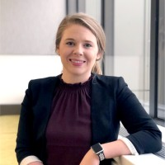
Labor Market Information
Jean Dougherty - Talent Pipeline Analyst
Colorado Workforce Development Council and Department of Higher Education
Mentimeter Question: What are the implications?

Slide 12
Labor Market Information
Since Aug. 2019
nonfarm payroll jobs fell by
147,800
Job Recovery Rate
52.1%
August Unemployment Rate
6.7%
Average Hourly Earnings by
$0.67
to
$30.79
This increase reflects the job loss among lower paid workers
Notes:
Total # of Permanent Job Loss:
Since August 2019, nonfarm payroll jobs have decreased 147,800, with losses totaling 124,200 in the private sector and 23,600 in government.
Largest private sector losses were in leisure and hospitality (~66,300)
Trade Transportation, and Utilities (~18,100)
other services (~10,700).
Colorado’s rate of job loss over the past year is -5.3 percent, compared to the U.S. rate of -6.8 percent.
Since May, Colorado has gained back 178,500 of the 342,300 nonfarm jobs lost between Feb and April
That is a job recovery rate of 52.1%
Colorado’s seasonally adjusted unemployment rate decreased to 6.7 percent in August from 7.4 percent in July.
Over the year, the average workweek for all Colorado employees on private nonfarm payrolls increased from 33.6 to 34.2 hours, while average hourly earnings rose from $30.12 to $30.79, over a dollar more than the national average hourly earnings of $29.47.

Slide 13
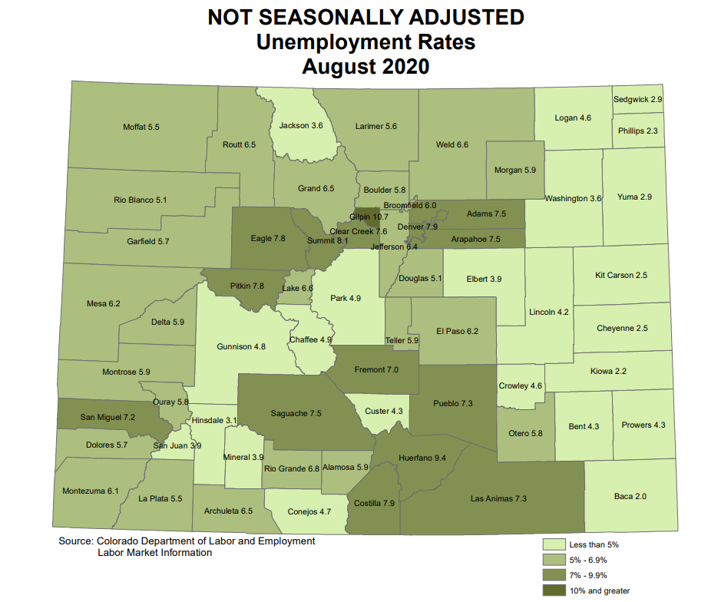
Labor Market Information (Jean)
Notes:
Colorado’s seasonally adjusted unemployment rate decreased to 6.7 percent in August from 7.4 percent in July.
During the same period, the national unemployment rate declined one and eight-tenths of a percentage point to 8.4 percent.
The Colorado counties with the highest unemployment rates in August were: Gilpin (10.7%), Huerfano (9.4%), Summit (8.1%), Costilla (7.9%), and Denver (7.9%). County-level unemployment rates are not seasonally adjusted and are directly comparable to Colorado’s August unadjusted rate of 6.6 percent.

Slide 14
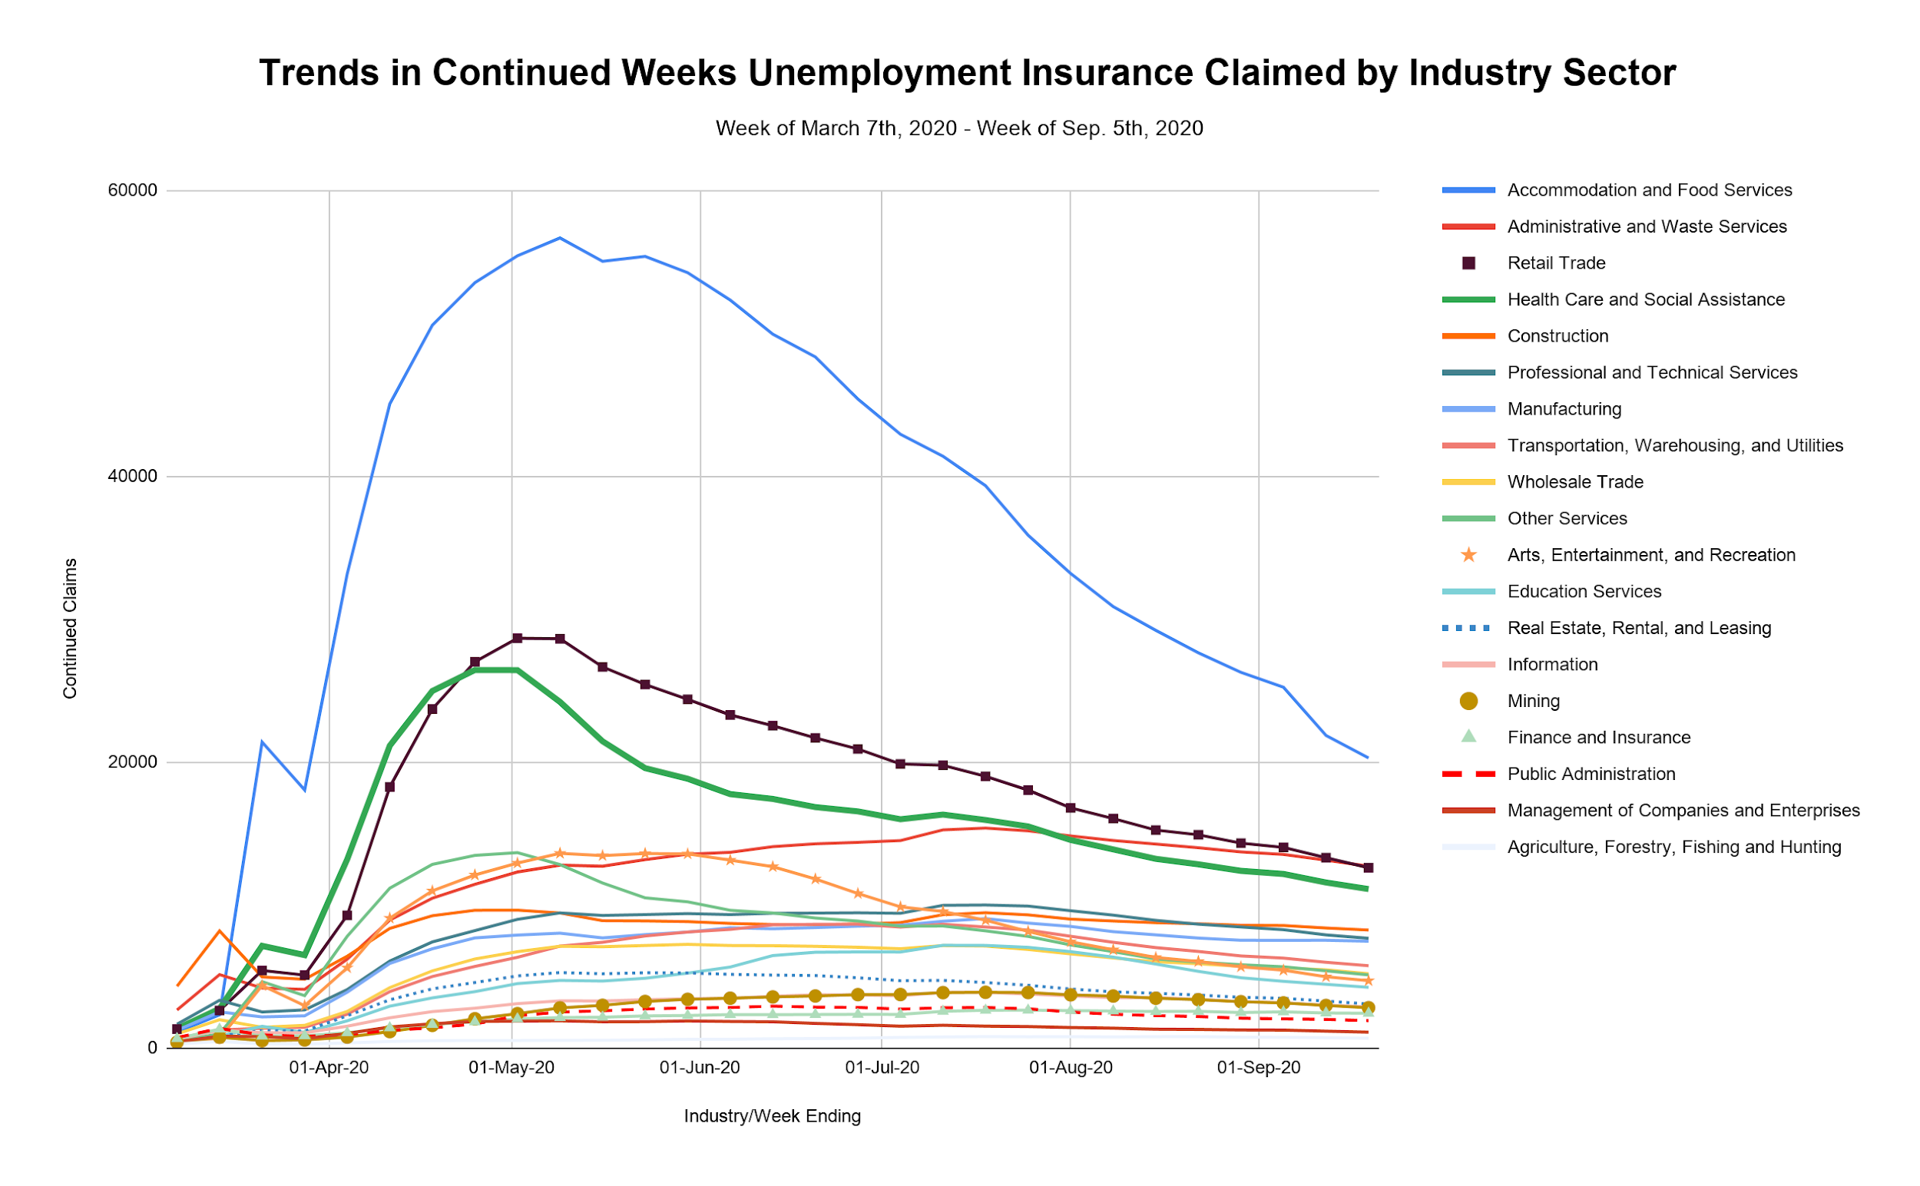

Slide 15
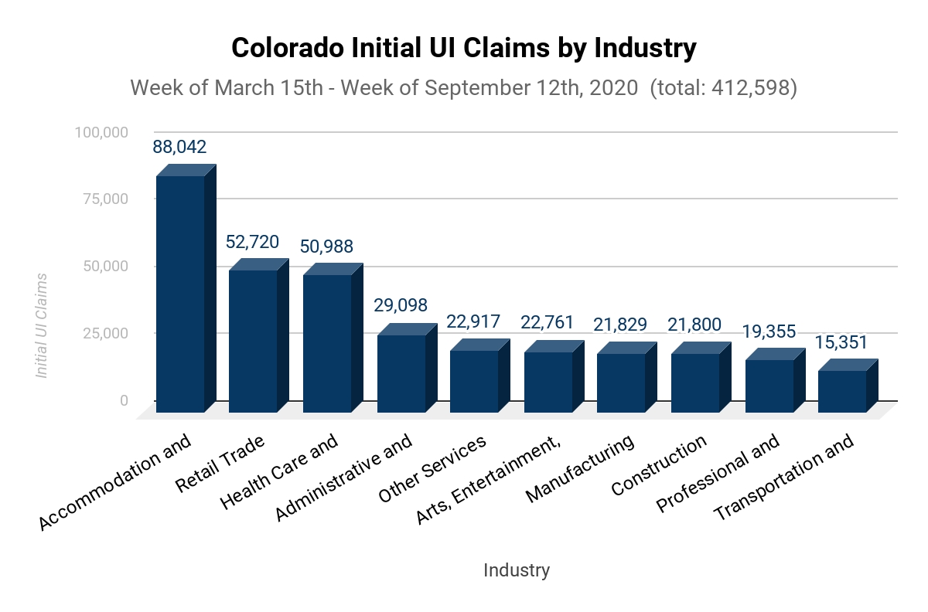
Unemployment Insurance Claims

Slide 16
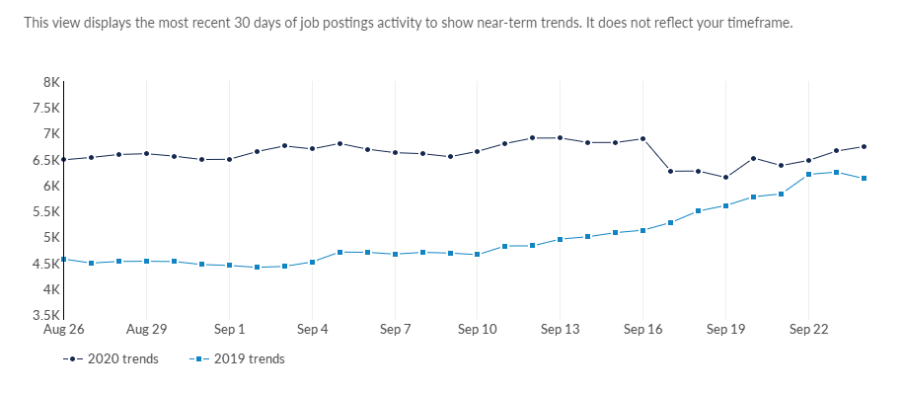
Job Postings
Job Postings in the last 90 days have increased
7.1%
March 29th - June 26th
vs
June 27th - Sep. 24th
Job Postings
EMSI Data Run 2020.3
Free Resource: https://www.economicmodeling.com/job-posting-dashboard/
Notes:
It is looking up.
in the last 90 days, job postings are up 7.1% compared to the previous 90 days
Latest 90 Days Unique Postings % Change (Active)
Latest 90 days % change in unique active postings (comparing March 29th—June 26th to June 27th—September 24th)

Slide 17
Implications
Notes:
summary to tie back into business and implications for k-12
Building programs for k-12 pass to kelly for

Slide 18
Top Posted Occupations
Occupation (SOC) | Unique Postings (Aug. 2020)
Heavy and Tractor-Trailer Truck Drivers | 15,050
Registered Nurses | 10,639
Software Developers and Software Quality Assurance Analysts and Testers | 10,022
Retail Salespersons | 6,176
First-Line Supervisors of Retail Sales Workers | 6,111
Computer Occupations, All Other | 5,094
Stockers and Order Fillers | 5,089
Customer Service Representatives | 4,931
Light Truck Drivers | 4,036
Childcare Workers | 3,876
EMSI Data Run 2020.3
Free Resource: https://www.economicmodeling.com/job-posting-dashboard/
Notes:
thirty-six jobs that meet the top job growth criteria that was utilized in the 2019 Talent Pipeline Report--20.5 percent growth over ten years. Twenty-eight occupations meet Tier 1 criteria and eight meet the Tier 2 criteria (see Appendix B for a full list). Of these highest growth top jobs, a majority fall into the Computer and Mathematical (e.g., software developers, research analysts, statisticians), Educational Instruction (postsecondary teachers), and Healthcare fields.³
March 2019-August 2019 top posted occupations
Heavy and Tractor-Trailer Truck Drivers
Registered Nurses
Software Developers and Software Quality Assurance Analysts and Testers
Retail Salespersons
Customer Service Representatives
Computer Occupations, All other
First-line supervisors of retail sales workers
first-line supervisors of office and administrative support workers
sales representatives, wholesale and manufacturing, except technical and scientific products
marketing managers

Slide 19
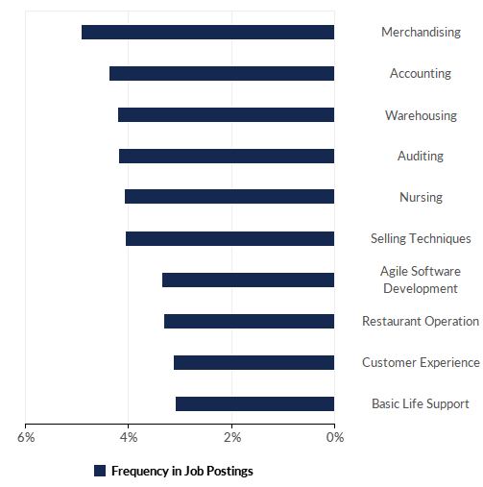
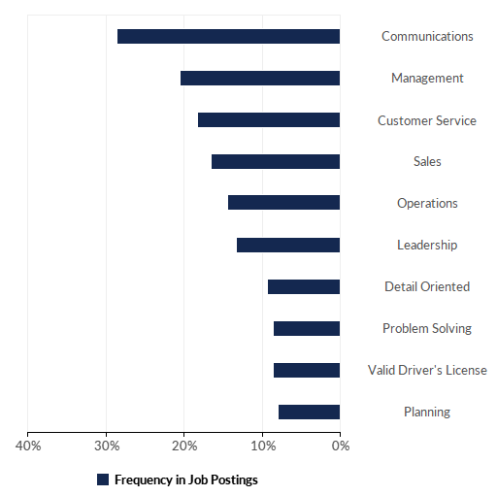
Top Posted Skills
March-August 2020
Technical Skills
Essential Skills
EMSI Data Run 2020.3
Notes:
From Mark (Pinnacol Assurance - Denver CO) :
It’s only one company’s data, granted, but we have continued hiring even through the COVID recession especially for Customer Service and IT positions
Per our Hiring team the characteristics we seek in addition to core values are:
non-tech roles: customer-focus/customer-facing background, ability to handle a fast-paced environment, organization/time management/ability to prioritize, teamwork/collaboration, strong communication, adaptability and independent decision making.
tech roles: curiosity/passion for tech, humility, innovation, teamwork/collaboration, strong communication skills, adaptability and independent decision making.

Slide 20
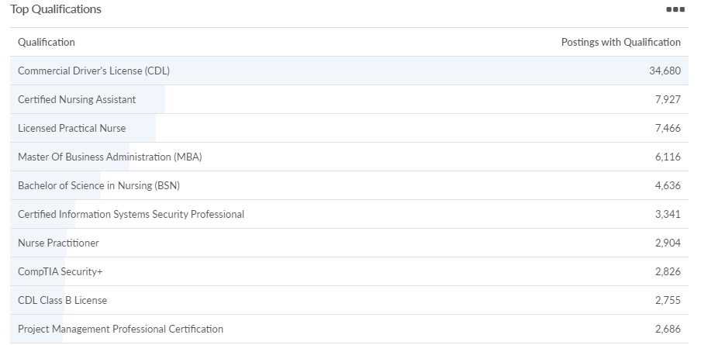
Top Posted Qualifications
March-August 2020
EMSI Data Run 2020.3
Notes:
From Mark: CompTIA and CAPM are both certs we have apprentices pursue through our model as requested by our SMEs

Slide 21
Implications
Notes:
https://public.tableau.com/profile/dhe.state#!/vizhome/AppendixB2020ColoradoTopJobs/AppendixB
Digital piece and communication are huge
summary to tie back into business and implications for k-12
top jobs discussion
how reactive
Building programs for k-12 pass to kelly for

Slide 22
Resources
EMSI Job Posting Dashboard
State Demographer’s Office COVID-19 Map Series*** and
Demographic Profiles
Colorado Talent Pipeline Report
COVID-19 Case Data Visualizations
https://onwardco.org/
https://covid19.colorado.gov/
BLS Employment Situation (National Data)
EMSI Job Posting Dashboard
Colorado LMI Gateway
August 2020 Employment Situation
Economic Recovery Resources & Business News
Strada Education Public Viewpoint
State Demographer’s Office
Interactive Data
Demographic Dashboard
Demographic Profiles
COVID-19 Map Series***
Social Vulnerability Index

Slide 23
Questions???

Slide 24
National Perspective
Wendy Brors, Senior Analyst and Consultant
Maher & Maher
Mentimeter Question: How have you adapted your business engagement for the virtual environment?

Slide 25
WBL Continuum

Slide 26
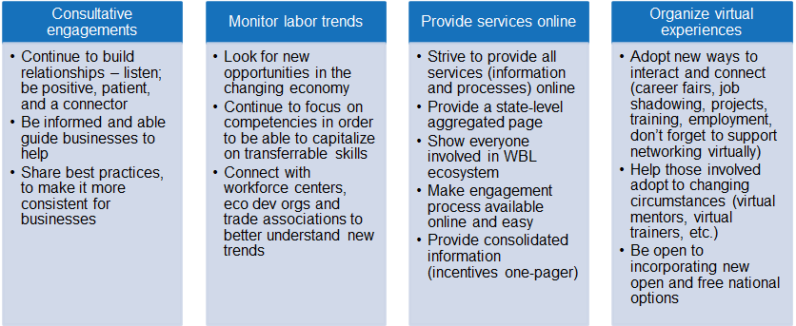
National Trends
Notes:
From Mark: Agree that many businesses and industries are pinched and hyperfocused on operations and staying afloat. Knowing industry trends, needs, challenges and resources can certainly serve as assets to bring to the relationship building process to drive engagement. Easily accessible resources and content absolutely helps remove barriers.
We have had to pivot many aspects of our program to accommodate the remote workforce. Prioritizing relationship building time with staff and mentors has been essential for our participants ongoing success in this climate.

Slide 27
Resources
Apprenticeship Expansion: Adapting Business Engagement in an Economic Downturn
Four Ways to Adapt Business Engagement to Changing Economy
Tips for Engaging Businesses During Economic Recovery
Virtual Job Fairs
Supporting the Apprenticeship Ecosystem in an Economic Downturn
National Mentor resources
National Governor’s Association’s June 23rd memo on transitioning dislocated and incumbent workers into high-demand industries provides insights into sectors that are seeing increased demand and experiencing labor shortages and could be targeted for apprenticeship opportunities for workers looking for employment and upskilling opportunities.
Apprenticeship Carolina released new online mentor training modules that are designed to empower and prepare mentors to succeed in virtual mentorship. Modules introduce the concept of online mentoring and provide industry-specific guidance for the manufacturing and healthcare sectors.
In response to COVID-19, DTE Energy in Michigan is operating a virtual internship program this summer with more than 500 high school and college students. The company documented the processes and tools it used for the program and created the Work from Anywhere toolkit, which is designed to help other organizations develop their own virtual job training programs.

Slide 28
Questions???

Slide 29
Business Engagement & Your School
Erin Kerr
Colorado Succeeds
Mentimeter Question: What are your “Aha’s”?

Slide 30
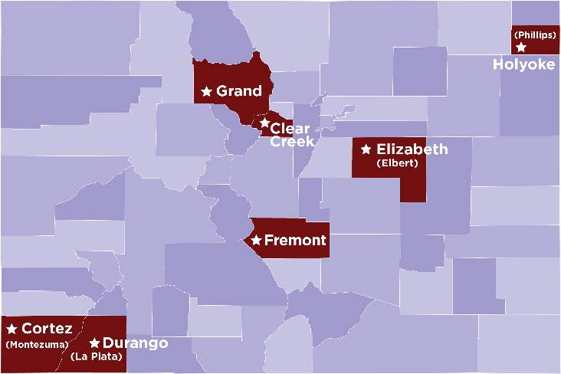
Homegrown Talent Initiative
The Homegrown Talent Initiative (HTI) is a statewide partnership that supports regional cohorts of rural communities to develop career-connected learning experiences for K-12 students. To better prepare students for life after graduation, schools and communities strategically focus on skill development, work-based learning experiences, and flexible programming that align student interests and local industry needs.
An integral part of HTI’s success in a community is the collaboration between K-12, higher education, and local industry partners to benefit students, community, and economy – the educonomy.
Notes:
Why am I talking to you about business engagement – CEI and Colorado Succeeds having been working with schools to bolster business engagement, among other things, for the last year.
Technical assistance and experience of Colorado Education Initiative combined with business and policy experience of Colorado Succeeds to support schools throughout this process.
Colorado Succeeds is a coalition of business leaders invested in education reform.

Slide 31
HTI: Overview of Career-Connected Learning
INTERNSHIPS
CAPSTONE
POSTSECONDARY
PATHWAYS
EXPLORATION
OTHER CCL
Clear Creek
Durango
Job Shadow, Mentorships
Externships
Elizabeth
Flexible Schedule
Fremont
STEAM Lab & PBL
The Grands
Capstone & PBL (future years)
Holyoke
Notes:
Each community developed a plan to offer career connected learning opportunities based on the needs, interests and strengths of the educonomy – community, schools and industry. We did not prescribe any one path for any community.

Slide 32
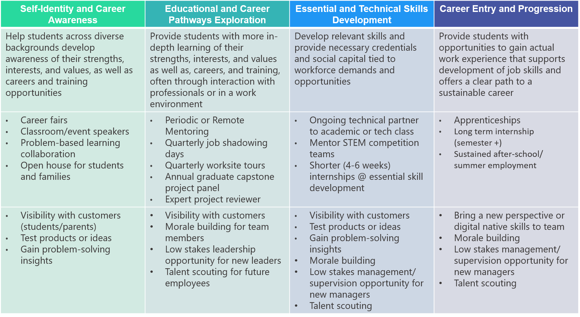
Career-Connected Learning Continuum: Business Case
Stages of the Career-Connected Learning Continuum (i.e., pathway)
Notes:
From Mark : Consideration, once established can you parlay or capitalize on momentum related career-connected learning opportunities with partners? Help partners invested in one layer of the learning continuum maintain momentum into other layers etc. could job shadows turn into internships? Internships into apprenticeships when the fit is right? Often once an employer sees a success on one layer/has built relationships with students, they are open to staying engaged.
16:08:58 From Mark Tapy (Pinnacol Assurance - Denver CO) : The ROI is always critical. ROI comes in many forms in addition to the bottom line, added bandwidth, talent pipelines, staff development, cultural implications within the workforce, exposure to high need industry, higher organizational visibility and engagement with the community. There are many angles to consider as part of the value proposition.

Slide 33
Building a Business Case
Think about and understand why a business would want to work with your students. What value are they getting?
Articulate what you are asking the business to do
Donate money? Donate personnel or resources?
What is the time commitment?
Will you provide structure, trainings and support?
Are these requests reasonable amidst running their business?
What does success look like from your perspective?
What does success look like from the business perspective?
Notes:
From Mark: Agree with all. I want to underscore the concept of provide examples, consider bringing students/student profiles, share examples of success. For business, if you can see it you can do it especially when WBL is an abstract concept. Businesses can be risk averse, seeing experiences done and done well, helps paint a picture of what is possible. Knowing that they are not out on an island in this endeavor and there is precedent.

Slide 34
How to Approach Businesses
Speak the Language of Business
Do your homework and know the position of the business
Have something to offer
Be clear and succinct
Know Your Ask
What kinds of businesses are you targeting?
Anticipate questions and be prepared with answers
Outline the benefit to the business

Slide 35
How to Approach Businesses
Start Small
Build early wins to develop relationship
Easy engagement will make them feel good and want to do more
Be prepared for them to say no
Ask why
What would make this valuable?
What could we change?
Where to connect with businesses
Chamber of Commerce
Fundraising
Parents
Notes:
From Mark: Pre existing relationships YES! I will also say it is worth knowing what are the values of the organization and how the business interacts with the community or workforce in CSR capacities, won’t necessarily close the partnership as often, but those insights could serve as inroads or at least help target champions and partners to approach within the organization.

Slide 36
HTI Learnings
Businesses want to help, they don’t always know how
Use contacts and pre-existing relationships to jumpstart the process
Businesses are primarily concerned with their bottom line
Follow up! One great conversation doesn’t always translate to engagement
Having a staff member dedicated to work-based learning and internships is a huge asset. They will have the time and capacity to build and maintain business relationships.

Slide 37
Tips, Tricks & Resources
Look to examples in your area doing this work
St. Vrain Valley Schools Community Strong Program
Colorado Roadmap to Work-Based Learning
Career-Connected Learning Continuum
Homegrown Talent Initiative Website
OEDIT Regional Economies and Funding Initiatives
D.C. Public Schools Internship Program
Notes:
From Mark: There are intermediaries available that can also help support some of these initiatives. We work directly with CareerWise Colorado to facilitate our implementation.

Slide 38
Questions???

Slide 39
What are your major takeaways?
What is your immediate next step?

Slide 40
Survey and Punch Card
Notes:
https://docs.google.com/forms/d/e/1FAIpQLSdRYwVW_jFEw7YvrRuXJUkxYDJnwPCgws-PEiMu0j0UM4uf8g/viewform?usp=sf_link

Slide 41
Thank you!
Next Webinar: November 13 3-4:30
Equity, Access and Data
https://mailchi.mp/state.co.us/wbl-incubator?e=2a23b764ce
Notes:
https://mailchi.mp/state.co.us/wbl-incubator?e=2a23b764ce

