Slide 1
Town Hall
Re-engaging Students During COVID
Office of Student Engagement and Dropout Prevention
Office of Postsecondary and Workforce Readiness
Office of Student Support
September 17, 2020
Notes:
Presenter: Andy

Slide 2
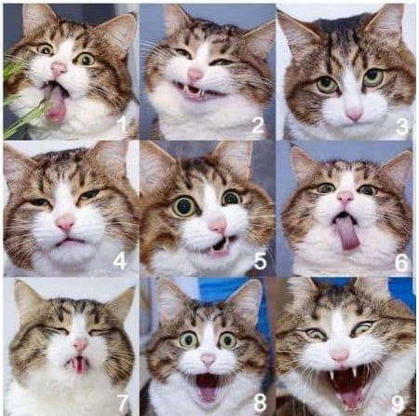
On the "Emotive Cat" scale below, how are you feeling about the start of the school year?
Notes:
Presenter: Andy

Slide 3
Agenda
Welcome
Student Engagement – Lessons Learned
  Boulder Valley School District
Considerations for Highly Mobile Students
  Cherry Creek School District
Maintaining Engagement
  St. Vrain School District
  Ed reEnvisioned/BOCES
Questions/Discussion
Notes:
Presenter: Andy
Previous Notes:
* Welcome (Andy)
Student Engagement – Lessons Learned
Connecting with Students
Highly Mobile Population
Boulder Valley School District
Cherry Creek School District
Now what?
Positive Staff-Student Mentoring
General
Kristin Hefflon – SVVSD
Virtual World
Nicole Tiley – Ed reEnvisioned/BOCES
Flexibility
Academic Engagement
Questions/Discussion

Slide 4
Introductions
Representatives from the Field
Nicole Tiley
Head of School
Education reEnvisioned BOCES
CURRENT EARSS GRANTEE
Kristin Hefflon
Student Services Coordinator
Office of Student Attendance & Engagement
St. Vrain Valley Schools
CURRENT EARSS GRANTEE
Maurice Henriques
Attendance Advocate
Boulder Valley School District
PAST SRG GRANTEE
Leslie Navarro-Walker
McKinney Vento Liaison
Cherry Creek School District
Colorado Department of Education:
Andy Tucker
Director Postsecondary Readiness
Office of Postsecondary Readiness
Juliana Rosa, Ph.D.
Research and Evaluation Consultant
Office of Student Engagement and Dropout Prevention
Kristin Myers, Ph.D.
Foster Care Education Coordinator
Office of Student Support
Kerry Wrenick
State Coordinator
Education of Homeless Children & Youth
Office of Student Support
Amy Werpy
EARSS Grant Coordinator
Office of Student Engagement and Dropout Prevention
Notes:
Presenter: Andy

Slide 5
Student Engagement – Lessons Learned
Dedicate staff to engagement efforts
Maintain contact logs
Be relentless
Be creative with engagement strategies
  Engage the community
  Socially distancing visits (e.g., job sites, home, neutral location)
  Text messaging and social media
  Engage peers
  Connect students and families with needed resources
Notes:
Presenter: Juliana
Lessons we have learned so far from our grantees, the field, and current research around strategies for successful student engagement during COVID...
Dedicated Staff to finding students whether it is specific staff members (e.g., counselors, coaches, liaisons) or involvement from all staff members
Easier to connect with students if established relationship exists
Communal contact log with a list of students- Allows all staff involved in engagement efforts to know who is assigned to which student and/or who has contacted student, when it occurred, method used, which method worked best, and student’s status.
Consistent and relentless effort to contact students
There too many contacts
Students have also stated that it shows that the school cares about them and it increases the chances they will return when they are ready.
Be creative with engagement strategies
Engage the community - Is there a community liaison or someone in the community that can help you reach out to students? Are their volunteers, employers, community agencies and partners you can work with?
Socially distancing visits - Can you safely effectively go where the students are? (e.g., job sites, home, neutral location)
Use nontraditional communication channels to find students (e.g., Text messaging, Social media, Video chat groups)
Engage engaged peers in getting other students back to school
Connect student and family with what they need - Are their helpful resources that might reduce the barriers of coming back to school? Common barriers are technology, financial, and helping with siblings.

Slide 6
Building Relationships with Students and Families
Families/Parents
Make first phone call a positive interaction
Show genuine kindness and compassion
Ask questions and actively listen
Create a parent survey:
  What makes your child happy?
  Is there anything that upsets your child?
  Would you like to volunteer?
Create Parent Engagement Group / Support Group for parents
Notes:
Presenter: Maurice (Boulder)

Slide 7
Building Relationships with Students and Families
Students
Get to know the students
Inspire them
Appreciate them
Reward them
Involve them
Create Student Survey
Create Student Peer Support
Notes:
Presenter: Maurice (Boulder)

Slide 8
Engagement during Covid 19
Positive Effects
More staff involved
More calls/ emails from teachers, and support staff
More Home Visits conducted by assistant principals, teachers and school staff members
Barriers
Lack of resources for students and families in need
Questions: Maurice Henriques, maurice.henriques@bvsd.org

Slide 9
  Considerations for Highly Mobile Students
Foster Care Considerations
Reports of child abuse and neglect in Colorado have dropped by more than 45% since March
Foster caregivers often have multiple children and youth placed in their homes and they do not always come from the same school districts.
Achievement gaps could widen if academic support is not available in the foster care setting
Foster care placements may disrupt due to the extra caregiving burden placed on foster caregivers—resulting in potential school moves
Homeless Considerations
Research from Columbia University estimates a 40% increase in homelessness due to COVID-19
Consider access to internet, devices, meals, academic support, and adult mentorship
Current levels of unemployment suggest imminent increases in homelessness among families who have never experienced it before, and who lack familiarity with available services and systems
The student may be at higher risk of disengagement due to caring for siblings or seeking employment to support families
Families may have relocated due to homelessness
Homeless liaisons with additional district responsibilities may lack capacity to balance both roles with an increase in COVID related homelessness
Homeless Considerations
Research from Columbia University estimates a 40% increase in homelessness due to COVID-19.
Consider access to internet, devices, meals, academic support, and adult mentorship.
Current levels of unemployment suggest imminent increases in homelessness among families who have never experienced it before, and who lack familiarity with available services and systems.
Families may have relocated due to homelessness.
Homeless liaisons with additional district responsibilities may lack capacity to balance both roles with an increase in COVID related homelessness.
The student may be at higher risk of disengagement due to caring for siblings or seeking employment to support families.
Foster Care Considerations
Reports of child abuse and neglect in Colorado have dropped by more than 45% since March.
Foster caregivers often have multiple children and youth placed in their homes and they do not always come from the same school districts.
Achievement gaps could widen if academic support is not available in the foster care setting .
Foster care placements may disrupt due to the extra caregiving burden placed on foster caregivers—resulting in potential school moves.
Notes:
Presenters: Kerry and Kristin

Slide 10
Raising awareness In CCSD
*Starting from the Top down
*Strategies
*Covid actually helped me!
*identifying stereotypes and misconceptions
*Be a champion and find others to join you
*Be present in the community
Talk to everyone and anyone, become a partner
Admissions Staff
Mental Health
Counselors/Deans
Transportation
Nutrition Services/Cafeteria Staff
Medicaid/Insurance Outreach
Foster Family Liaison
Before & After Director
Office Managers/Registrars
Neighboring Districts
Contact information: Leslie Navarro-Walker
Homeless and Family Engagement Liaison
Cherry Creek School District
lnavarrowalker@cherrycreekschools.org
720-554-5081
Notes:
Presenters: Leslie (Cherry Creek)

Slide 11
Maintaining Student Engagement
Positive Staff-Student Mentoring
Consistent Positive Messages
Listen to concerns and realities
Virtual
  Honor internet issues
  Minimize required video feed
  Consistent platform
  Flexibility
Notes:
Presenters: Amy
Consistent Positive Messages:
We are in this together
I’m here for you
Listen to concerns the students’ truth
Don’t just listen to the words – look beyond to the true meaning of the words
Help identify feelings
Wow! It sounds frustrating. . .
It sounds like . . .
Ask clarifying questions
If I hear you correctly. . .
Just to clarify, when you said . . .
A students truth may look different than your truth
remember that their perception is currently their reality.
Offer ways and support to address the students reality,
Try to avoid telling the student why they are wrong
Personalized Connection
Try to make personal contact, especially for students who are not engaging in large group virtual instruction

Slide 12
EARSS Success in St. Vrain Valley Schools
Kristin Hefflon
Student Services Coordinator
Office of Student Attendance & Engagement
We have 4 schools running eCredit EARSS programs in schools
Teachers have an extra plan per day in order to provide wraparound supports including connections with community partners, additional basic needs support, frequent check ins, mental health and academic support
Teachers have found success with having a work cell phone to text message and increase accessibility throughout the day and after work hours
In house teachers taking over EARSS eCredit has proven to be successful because they are highly connected with the school offering additional wraparound academic and SEL support
Administrator buy-in is increased when we staff an “in house” teacher
Notes:
Presenters: Kristin Hefflon

Slide 13
Education reEnvisioned BOCES
Nicole Tiley
Head of School
Supporting Students in
Digital Learning
Notes:
Presenters: Nicole

Slide 14
Relationships
Every student assigned a Champion Teacher
Required weekly check in meetings in an online platform between students and Champion Teacher
Advisor support for students identified using a bi-weekly data monitoring tracker
Student celebrations in newsletters
Monthly Assemblies to recognize students

Slide 15
Accountability
Daily Attendance Calls
Tracking system to document when students miss sessions and auto-dialer calls to parents
Implement a TIER System of Supports for Engagement
Power Hours
Daily Check In and Check Outs

Slide 16
Wraparound Services
Check in call with school social worker for students missing 7 unexcused absences
Interviews with students during enrollment to identify needs
Custom support groups based on student needs

Slide 17
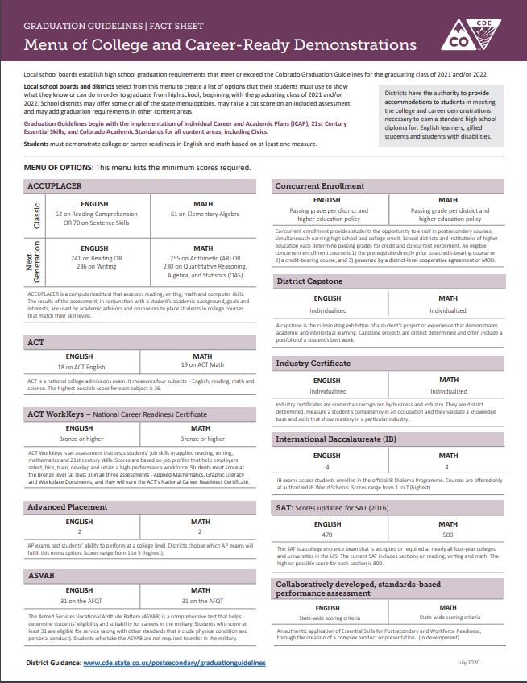
Graduation Guidelines https://www.cde.state.co.us/postsecondary/graduationguidelinesmenuofoptions3-12-20pdf
Notes:
Presenters: Andy

Slide 18
Questions?
Notes:
Presenters: Andy

Slide 19
Resources
The Colorado Student Re-Engagement Grant Program
  Approximately $2M annual appropriation to provide educational services and support to maintain student engagement and facilitate student re-engagement.
The Expelled and At-Risk Student Services (EARSS) Grant Program
  Approximately $10M annual appropriation to assist in providing educational and support services to expelled students, students at risk of suspension and expulsion, and students at risk of habitual truancy as defined by unexcused absences.
The Colorado Dropout Prevention Framework
  The dropout prevention framework outlines how to accelerate progress at the school and district level. It provides a foundation for rigorous and relevant coursework, teacher preparedness and instruction, and development of systems to ensure ALL students reach their full potential.
Best Practice Guide for Dropout Prevention
  This guide provides educational administration and dropout prevention specialists with updated tools to better address the needs of students in danger of school failure or dropout, in conjunction with the Colorado Department of Education’s Dropout Prevention Framework.
Graduation Guidelines

Slide 20
Thank you for joining us today!
Notes:
Presenters: Andy

