Slide 1
Colorado Counselor Corps Development Year 2013-14
Misti Ruthven
Office of Postsecondary Readiness
February 2014

Slide 2


Warm Up
VS

Slide 3


Slide 4
Landscape
By 2020 74% of all jobs in Colorado (3 million jobs) will require education beyond high school
  26% will require a high school diploma or less
  32% will require some college, an associate’s degree or certificate
  29% will require a bachelor’s degree
  12% will require a master’s degree or better
    Source: Georgetown University, Job Growth and Education Requirements, 2013
Notes:
<Rebecca>
It’s also important to acknowledge Colorado’s shared reality. We are a state that will have significant job demands that we cannot meet with our current rate of graduating students in Colorado and their options to pursue the pathway of their choice. We cannot rely on continuing to import our talent.
By 2020, 74% of all jobs in Colorado will require education beyond high school
32% will require some college, associate’s or certificate
29% will require a bachelor’s degree
12% will require a master’s degree or better
In order to even begin to support this type of growth, demand and opportunity for our students, they must be prepared.

Slide 5
Landscape Continued…
Between 2010 and 2020, new jobs in Colorado requiring a postsecondary education and training will grow by 716,000, while jobs for high school graduates will grow by 268,000.
  Nearly 3x the rate of growth for jobs requiring training beyond high school.
Colorado ranks 3rd in terms of the proportion of its 2020 jobs that will require a bachelor’s degree and is 48th in jobs for high school graduates or dropouts
    Source: Georgetown University, Job Growth and Education Requirements, 2013
Notes:
<Rebecca>
In order for our students to have the opportunity to hold a job in Colorado, they must have the option to pursue education beyond high school, whether a technical or vocational certificate, bachelor’s degree, military or have the skills necessary to earn a living wage in the workforce.
Colorado ranks 3rd in terms of the proportion of jobs that will require a 4-year degree and is nearly last in job opportunities for students without training beyond high school.

Slide 6
What is systemic change?
Why School Counselors?
Purpose - Create a better counseling system than what currently exists!
Definition = “change that pervades all parts of a system, taking into account the interrelationships and interdependencies among those parts.”
If you always do what you always did, you will always get what you always got—Henry Ford
At first I didn't see the magnitude of the change. I thought if we just did better what we had always done, we would be OK. Then I realized we had to do something totally different, but I didn't know what. Gradually we began trying some new approaches. One change led to another and another and another like dominos. I started to see what people meant by systemic change. A new energy and excitement surged among its as hope grew and the cloudy vision of what we wanted became clearer and clearer.
-Principal of a restructuring high school
We believe that a community should decide what changes it needs, and that our role should be to share and facilitate what we have learned about the change process and systemic change.
Notes:
Consider the following changes in transportation systems (chosen because it is both familiar and concrete). Initial system: the horse. Change 1: adding a saddle and bridle. Change 2: adding a wagon or coach. Change 3: replacing the horse with a gasoline engine. Change 4: replacing the whole thing with an airplane. Clearly these represent vastly different points on the continuum from piecemeal to systemic change
Consider the following changes in transportation systems (chosen because it is both familiar and concrete). Initial system: the horse. Change 1: adding a saddle and bridle. Change 2: adding a wagon or coach. Change 3: replacing the horse with a gasoline engine. Change 4: replacing the whole thing with an airplane. Clearly these represent vastly different points on the continuum from piecemeal to systemic change

Slide 7
Systemic Change
Accountability for student success must become a driving force for transforming and reframing the work of school counselors. (Gysbers)
A School counseling program is data informed, is proactive and preventive in focus, assists students in acquiring and applying lifelong learning skills, and is delivered in a comprehensive and accountable manner. (Stone &Dahir, 2006)
For systemic change to occur, all aspects of the system must move forward.
The comprehensive K -12 School Counseling Program has to connect to the mission of the school and to the goals of the annual UIP.
School counselors need a commitment to fully participate in school improvement, take initiative as leaders and social advocates to use data to inform programs and strategies, and seek to continuously improve their practice.
Beliefs and good intentions alone will not contribute to systemic change. Using data provided a solid foundation for school counselors to act on their belief system and to identify and rectify issues that affect every student’s ability to achieve at expected levels. By your willingness to work to create systemic change, you will defy the pervasive belief that socioeconomic status and color determine a young person’s ability to learn.
School counselors need to accept responsibility as social justice advocates, focus strategic and intentional interventions to remove barriers in learning and to raise the level of expectations for students for whom little is expected.
School counselors ethically cannot sit back and watch the gaps grow.

Slide 8
SYSTEMIC CHANGE
Examples of Systemic Change that Promote Equity
Removing barriers to access to rigorous courses and the creation of learning paths that lead to college and career readiness for all students.
Modeling inclusive language.
Strategies for Measuring Positive Results of Systemic Change Initiatives
Increased promotion and graduation rates.
Decreased discipline or suspension rates.
Increasing access to educational opportunities.
Creating clear guidelines for addressing inappropriate behavior.
Increasing awareness of school safety issues.
Promoting knowledge and skills regarding working with diversity.
Addressing over and under-representation of specific groups in programs.
Creating an environment that encourages any student or group to come forth with concerns.
Increased attendance at school.
Increased attendance in educational opportunities.
Increased numbers of students completing high school college and career ready.
Notes:
Strong leadership, dynamic advocacy, and effective collaboration ultimately lead to positive systemic change. School counselors strive to make a difference in their schools for the benefit of all students they serve. Systemic change does not come easy and there are some possible barriers to this change including legal, policy, and procedure issues. Anderson, 1993, as articulated by ASCA, 2013, outlines six stages that occur within the systemic change process. These include maintenance of the old system, awareness that change needs to occur, exploration of changes needed, transition to new policies or procedures, emergence of a new infrastructure, and predominance of the new system. The charts above reflect key bullet points from the systemic change section of the ASCA National Model (2013), pages 9 & 10. The examples of systemic change that promote equity is taken from a 2006 ASCA position statement.
Take several minutes to review the chart on the left and identify at least two examples which you believe are already present in your work environment.

Slide 9
School Counseling
How are students succeeding as a result of your school counseling program?

Slide 10
THINKING OUTSIDE/INSIDE THE BOX
http://www.youtube.com/watch?v=p9Ig19gYP9o
http://www.youtube.com/watch?v=b8frFixZbyg

Slide 11

What we believe in
VALUES
DESIGN FOR SUCCESS
Results Matter
Do right by customers/colleagues
Create a fun and rewarding workplace
Take action
Take pride in your work
Do what you say
Think like a customer
Be positive and find solutions
Vision
Mission
What we do
How we do it
Long Term Goals 2016
Goals for 2014
How do we operate

Slide 12
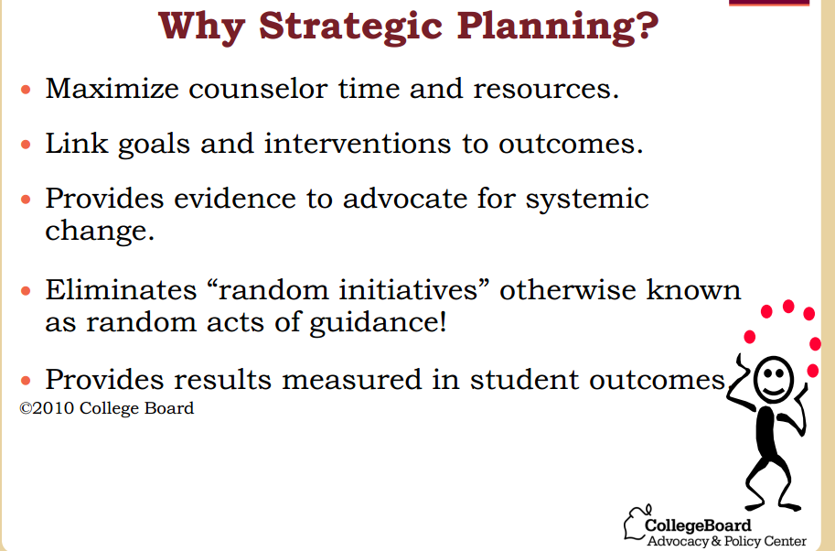

Slide 13
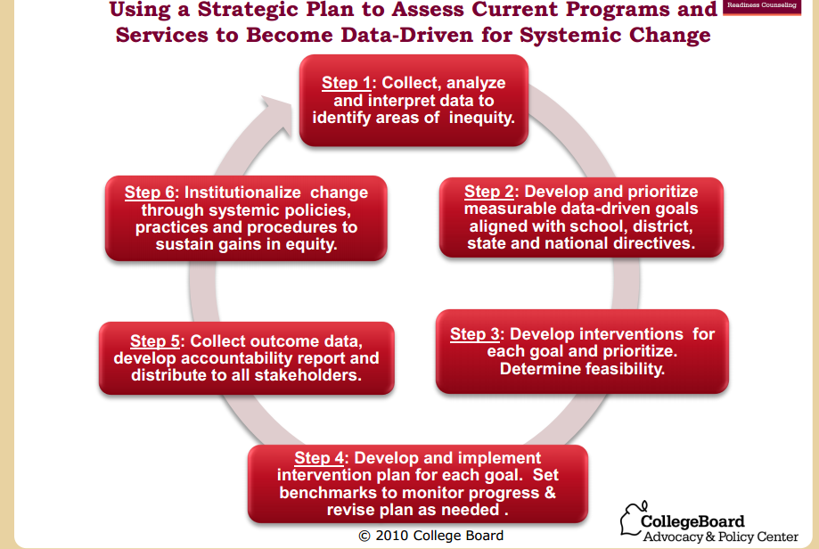

Slide 14
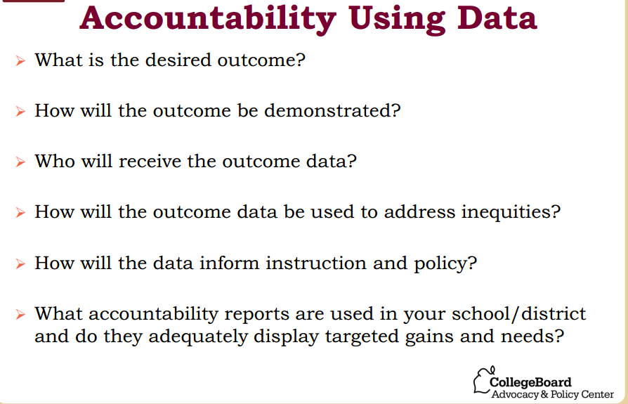

Slide 15
Data
What instruments did you use to collect data?
  Parallel survey
  UIP
  Needs Assessment
  Environment Scan

Slide 16
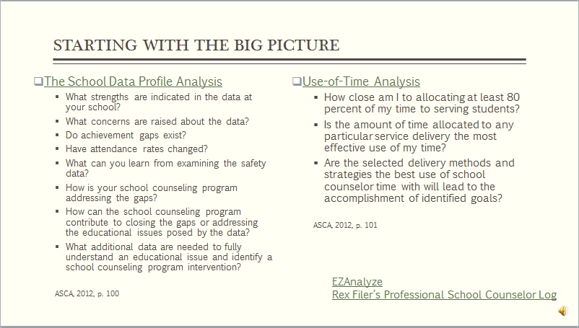

Slide 17
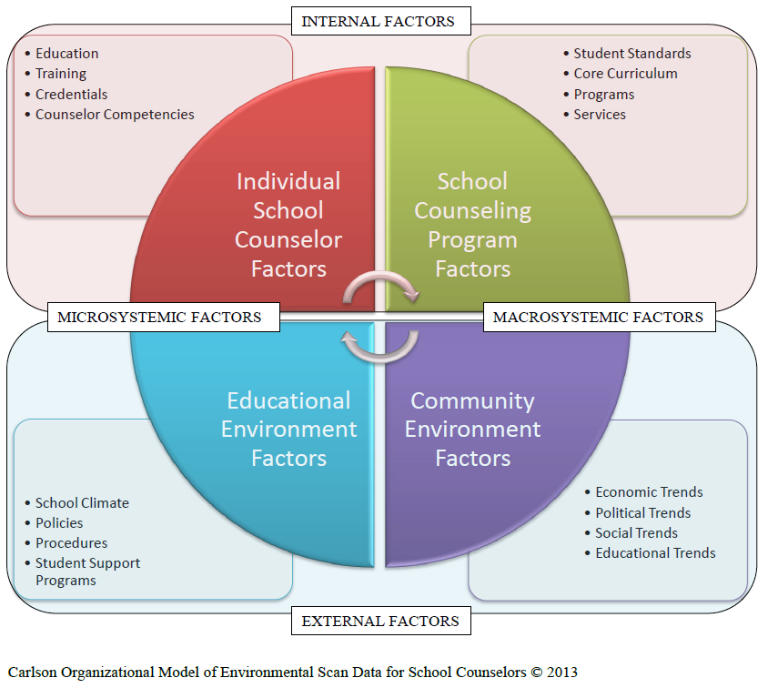
FROM ANALYSIS TO INTERPRETATION
Notes:
Now that you have conducted some basic descriptive and perhaps inferential analyses of your raw data you are ready to collate it into a format that will allow for interpretation and prospection. It makes sense to use the organizational model that you used when conducting your scan. Remember you have already begun preparing your scan data for this analysis by recording it on your Factor Analysis Summary. The next slide will cover the scoring of the FAS.

Slide 18
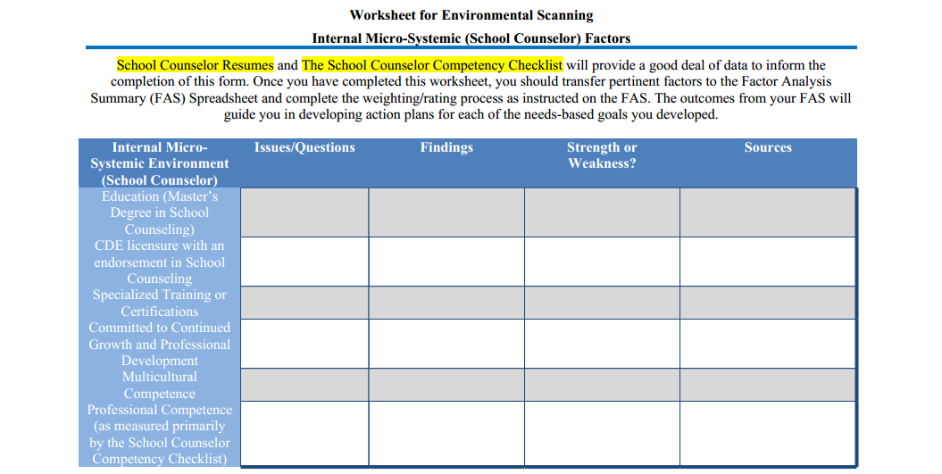
Internal Micro-Systemic Factors

Slide 19
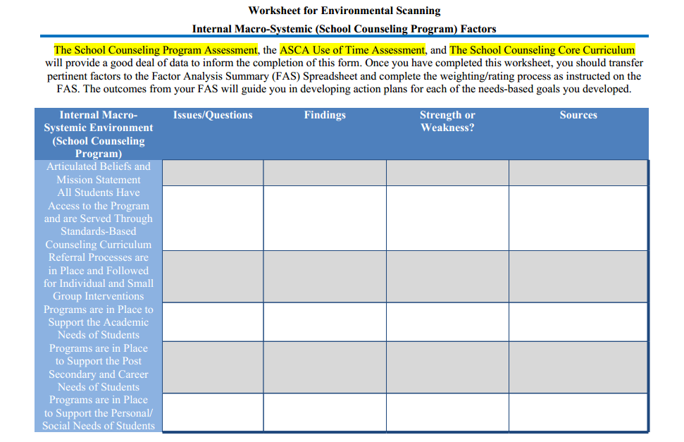
Internal Macro-Systemic Factors

Slide 20
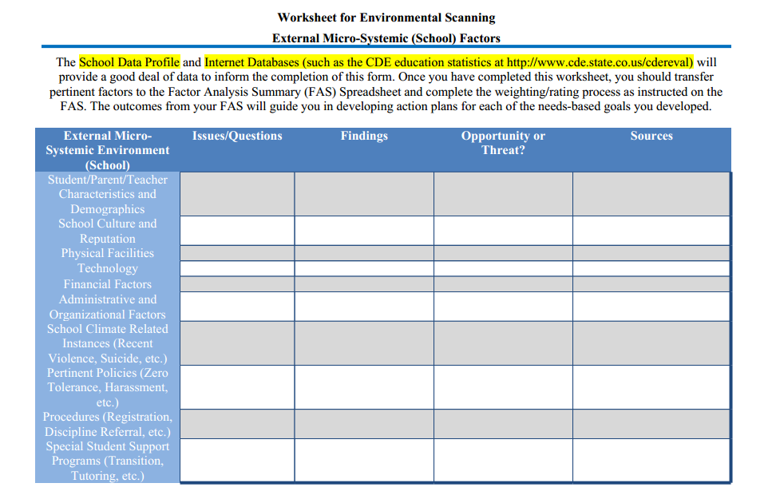
External Micro-Systemic Factors

Slide 21
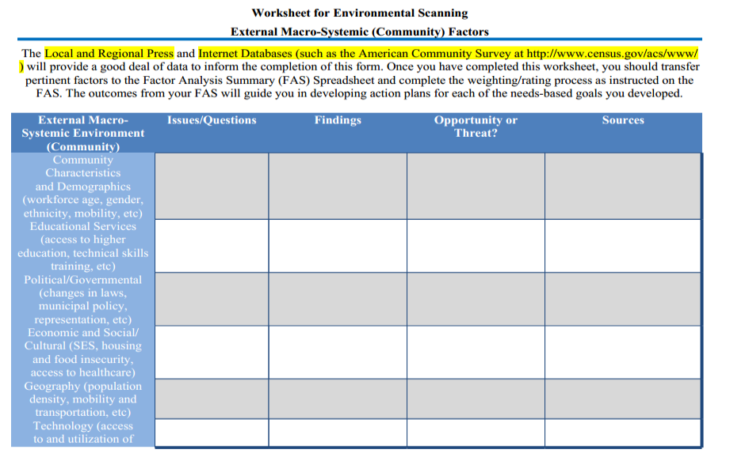
External Macro-Systemic Factors

Slide 22
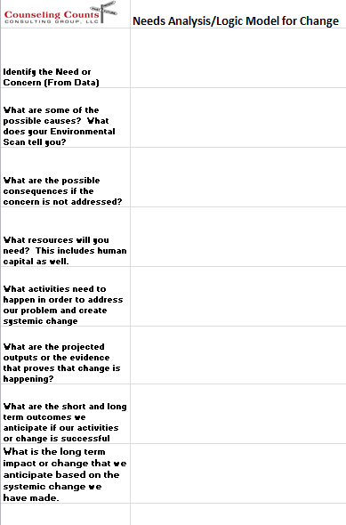
.
Additional Needs Analysis/Logic Model

Slide 23
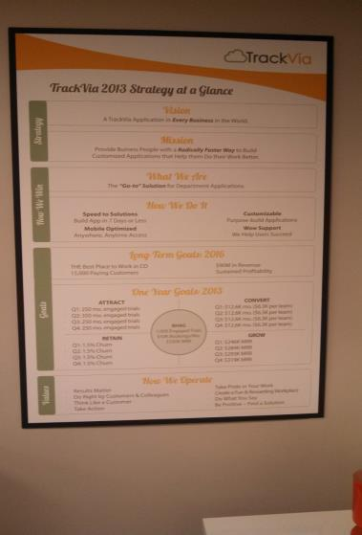
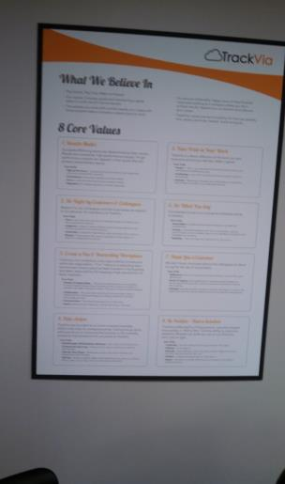
Trak Via…..company info

Slide 24
Guided Work Session
Work groups- Work in your school groups
You will all be at different stages of the flow chart.
Determine where you are at and start or continue the process for your district/school.
Determine what tools you have used or will use.
Be prepared to report out where you are at, what you accomplished and next steps.

Slide 25
Grant Administration

Slide 26
Roles
Principal/Leadership
Counselors
Program Manager
Fiscal Manager

Slide 27
Timeline 2013-2014
Annual Report – Due May 1st, 2014
Annual Financial Report – Due September 30th, 2014
Interim Financial Reports
  Screen Shot of from financial system
  First working day of the month
    October
    January
    April

Slide 28


Slide 30
Budget Expenditures
Professional Development
Academic Counseling for Career & College
  Tools & Resources
  Curriculum
  Materials
Counselor Salary & Benefits
Transition Programs
College & Career Exploration
Consultants & Professional Services
  Trainers
  Change Experts

Slide 31
Budget Adjustments
Approvals:
  Out-of-state Travel
  Personnel
  Technology
  >10% of Budget
Counselors
  Laptop or IPAD
  Basic Materials

Slide 32
Review and Questions
Budget Information
CDE Annual Report for Counselor Corps
  6 – 7 Questions
  Includes Budget information

