Slide 1
SCCG Webinar
January 8, 2020 Counselor Corps Grant Development Year

Slide 2
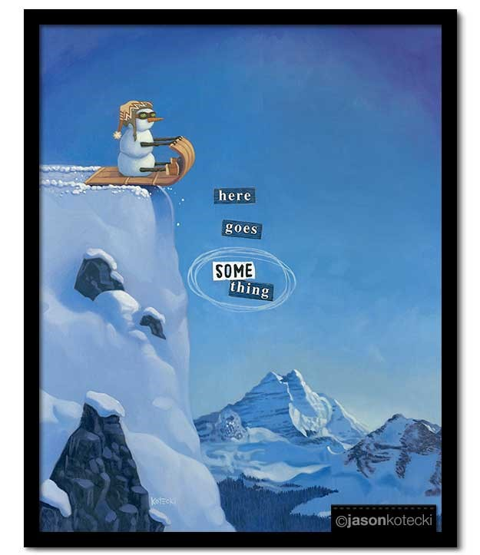

Slide 3
Counselor Corps Grant Checklist
We have completed:
A vision/mission statement for counseling
Read our Counselor Corps Grant application
Needs Assessment – creating, distributing, collecting
Analyzed the data from our Needs Assessment
Reviewed other data available – UIP, Community Surveys, School Report Cards, school site visit reports, etc.
Environmental Scan – all 4 quadrants – currently happening
A knowledge base for systemic change
A Vision
Discovered our Root Causes
Working on creating our SMART Goals

Slide 4
AGENDA
Developing Action Plans
Identifying Interventions
Timeline to Implementation

Slide 5
Take Aways
You will look at SMART goals and break them down into smaller actions.
You will understand and have a format for Action Planning.
You will understand interventions and how to determine them.
You will have tools for a good management strategy.
You will start a timeline for Implementation.

Slide 6
End Of the Year Report
Question #4:
List SMART Goals (no more than three) for the remainder of the grant cycle.
Question #5:
What are the appropriate interventions you plan to implement to address your district and school identified needs, root causes, and goals?

Slide 7
Tools of Implementation Action Plan Phase Tools
The Action Plan: Establishes accountability with focus on progress towards goals
Feedback Loop: Establishes a way to evaluate the intermediate results. It gives you a place to make corrections if the plan isn’t giving the necessary outcomes hoped for.

Slide 8
Chat Box
In the chat box list what you identified as the root cause from last month and the data point you want to change.
-
-
-
-
-
-
-
-

Slide 9
Chat Box
Write out the SMART goal for the root cause that you want to change based on last month’s webinar.
-
-
-
-
-

Slide 10
Action Plan Have you seen this before?

Slide 11
ASCA Model The Continuous Improvement Cycle

Slide 12
ASCA ACTION PLANS
Classroom and Group Mindsets & Behaviors Action Plans
Closing the Gap

Slide 13
Classroom and Group Action Plans
Philosophy is “all students need some, some students need more”.
Monitor student progress individually and school-wide at regularly scheduled reporting times each year.
After analyzing the data, determine which students need which type of additional intervention support.

Slide 14
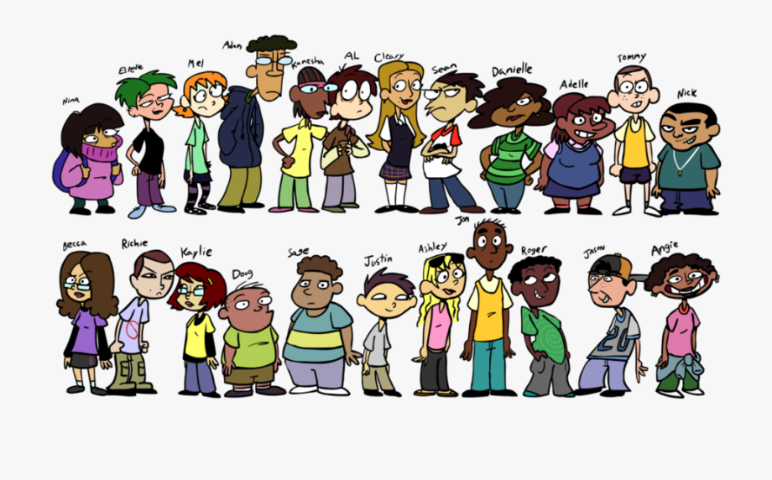
Classroom and Group Action Plans
By virtue of breathing, every student in the school receives the school counseling curriculum
The curriculum is:
Developmental in design
Preventative in nature
Comprehensive in scope

Slide 15
Core Curriculum Action Plans Include

Slide 16
Example of Classroom and Group Action Plan
Lesson Content = 9th, 10th, 11th and 12th grade
Promotion/Retention; Study Skills; Importance of Homework
ASCA Mindsets and Behaviors
Mindset – 3 Behavior –Learning Styles -3
Activity = Presentation
Participants = 1500 students, ALL Students
Always keep in mind the data you will be keeping to evaluate your effectiveness!

Slide 17
School Counseling Small Group Action Plans
Now added to the Classroom and Group Mindsets & Behaviors Action Plan for a more comprehensive program view.
Groups are run for students who are experiencing similar challenges, but challenges not experienced by 70-80% of the school.
Good group ideas include: ICAP, studying, attendance, leadership, friendship, etc.
Bad group ideas include: cutting, suicide, gangs

Slide 18
Closing the Gap Action Plan
NEW! Included with the Results Report
What are the priorities based on school data.
Academic/Attendance/Behavioral
Disaggregate the data
Look for root causes
Identify what mindsets/behaviors (1 or 2) that you want to address.
Design the activities and interventions.
Design a way to evaluate.

Slide 19
Closing the Gap Action Plan

Slide 20
Closing the Gap Action Plan

Slide 21
In The Chat Box
Based on your SMART goals, give us an idea of what action plan you might want to design:
-
-
-
-
-

Slide 22
Identifying Interventions

Slide 23
Identifying Interventions

Slide 24
From Issue to Intervention
Interventions should be based on your data and not just “random acts/thoughts”
Needs Assessment
Environmental Scan
Use research to help facilitate this process
Do not recreate the wheel! What’s out there that has worked - do it!
One needs to consider feasibility
Time, capacity, resources
Demmitt, Carey, & Hatch (2007)

Slide 25
Interventions Musts
Don’t bite off more than you can chew
Always keep your mission and vision in the forefront of the change
Never say “can’t” instead go with: “Here goes something!”
Have a plan for data collection and collect throughout
Don’t recreate the wheel - with both interventions and with data!
If it is not working, stop doing it

Slide 26
Great Materials for Interventions
Missouri Center for Career Education’s eLearning Center contains hundreds of valuable resources for school counseling http://www.missouricareereducation.org/for/content/guidance/
What Works Clearninghouse--https://ies.ed.gov/ncee/wwc/
CSCORE--http://www.umass.edu/schoolcounseling/
SCALE—https://scale-research.org

Slide 27
Implementation in Action
Example: Graduation Rate
Systemic Change requires an “Upstream Approach” (Targeted Interventions for Lasting Change)
Data Demonstrated:
Gap in understanding around credits/high school academic expectations (Needs Assessment)
Academic success aligned with attendance (District Dashboard)
Graduation Rate hovering around 75% (UIP)
Low parental engagement (Environmental Scan)

Slide 28
Implementation in Action
Data Demonstration
Needs Assessment Data:
I want help to learn about graduation requirements and how to meet them:

Slide 29
Implementation in Action
Data Demonstration
District Data - Grades/Attendance:

Slide 30
Implementation in Action
Root Causes:
Lack of understanding of credits and academic success
Lack of understanding of correlation between attendance and academic success
Lack of Parent Engagement
Lack of Early Intervention

Slide 31
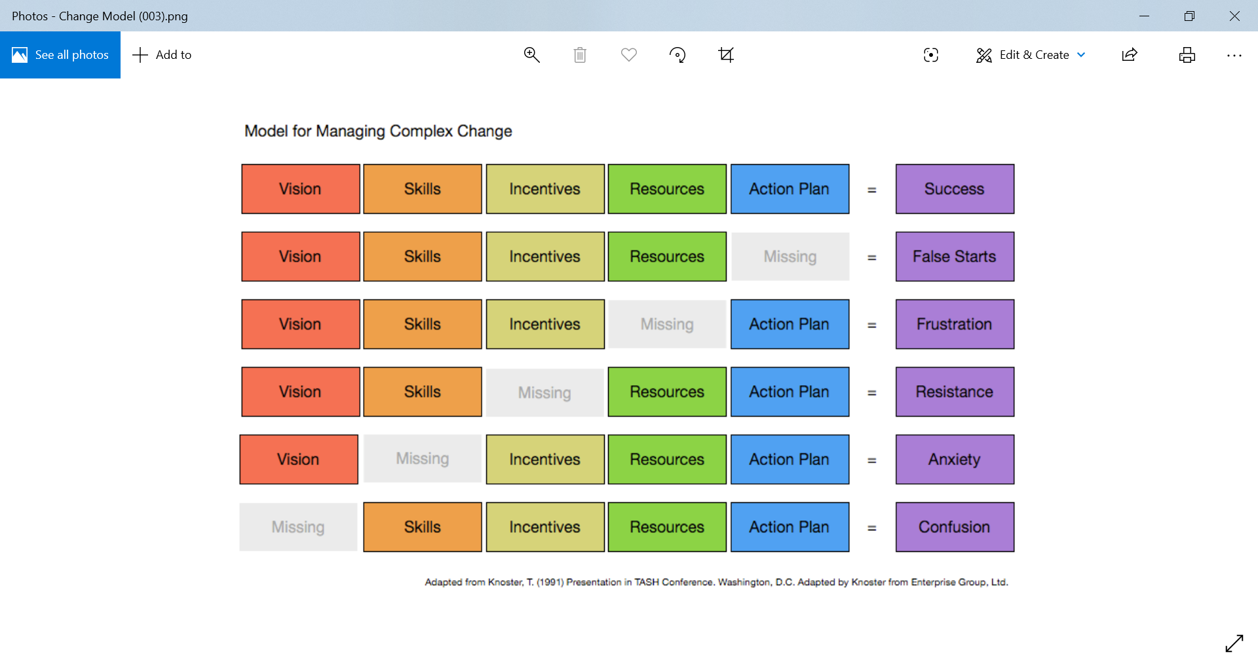
Implementation in Action

Slide 32
Implementation in Action
Root Causes:
Lack of understanding of credits and academic success (Skills Gap)
Lack of understanding of correlation between attendance and academic success (Skills Gap)
Lack of Parent Engagement (Resource Gap)
Lack of Early Intervention (Action Plan Gap)

Slide 33
Implementation in Action

Slide 34
Implementation in Action

Slide 35
Interventions Musts
Always keep your mission and vision in the forefront of the change
Never say “can’t” instead go with: “Here goes something!”
Don’t recreate the wheel - with both interventions and with data!

Slide 36
Interventions Resources

Slide 37
Interventions Musts
Have a plan for data collection and collect throughout
If it is not working, stop doing it
Don’t bite off more than you can chew

Slide 38
PUTTING INTERVENTIONS INTO ACTION

Slide 39
In the Chat Box
Give us one intervention strategy that follows your action plan. In other words—what are you going to do? What is your “here goes something!”?
-
-
-
-

Slide 40
Here Goes Something!
Create Action Plans based on data driven interventions
Follow your Action Plan
Answer the questions and solve the problems that your Action Plan identifies
Get Ready for Implementation

Slide 41
February
February 21, 2020 CDE Training
Colorado State University - Pueblo
Link to Register: http://www.cde.state.co.us/postsecondary/scc_training
Next Webinar is March 4, 2020

Slide 42
THANKS SO MUCH! Have a great January and see you on February 21st Sam, Cass and Eve

