Slide 1
UIP and Me
Counselor Corps Meeting
Colorado State University
October 9, 2019

Slide 2
Background
Counselors
School Administrators
District Administrators
Fist to Five
Fist- I know what the acronym UIP stands for
Five- I can (or maybe have) taught a class on it

Slide 3
Overview of Topics
UIP Fundamentals
Connections- Why?
Digging In
Relationship to Accountability
What’s Next

Slide 4
What is Unified Improvement Planning?
Alignment | A system to align improvement planning requirements for state and federal accountability into a “single” plan.
Documentation | A common format for schools and for districts to document improvement planning efforts. Schools/districts identified for improvement must demonstrate a coherent plan for dramatic change and adjustments over time. Reviews conducted by CDE and the State Review Panel.
Transparency | A process for including multiple voices, including staff, families and community representatives. Plans are also posted publicly.
Best Practice | A statewide strategy to promote improvement planning based on best-practice, including use of state and local data and engagement in a continuous improvement cycle.
Support | A mechanism for triggering additional supports through CDE (especially for schools/districts on accountability clock).

Slide 5
Unified Improvement Planning Processes
Prepare to
Plan
Target
Setting
Action
Planning
Data
Analysis
Review Current Performance
Describe Notable Trends
Prioritize Performance Challenges
Identify Root Causes
Set Student Centered Targets
ID Major Strategies & Action Steps
Progress Monitoring
Identify Interim Measures
Identify Implementation Benchmarks

Slide 6
Types of Data
Enrollment Practices
Instructional Practices
Assessment Calendars
Student Engagement Surveys
Working Conditions (TLCC)
Parent Satisfaction Survey
SAT
Dropout Rate
Graduation Rate
Early Literacy
Students Habitually Truant
AP/IB Participation
Home Language

Slide 7
Systems Awareness- Altitude
About all, not just each
Prevents “reactionary” practices
A different mindset
Embrace multiple perspectives

Slide 8
Overview of Topics
UIP Fundamentals
Connections- Why?
Digging In
Relationship to Accountability
What’s Next

Slide 9
UIP and Me
Golden Circle
Notes:
How are we meeting the elements they identified connected to offerings throughout the offerings of the day?

Slide 10
Turn to a partner
“Why” Counselor Corps and Unified Improvement Planning?
What connections are there between the “what” and the “how?”

Slide 11
Overview of Topics
UIP Fundamentals
Connections- Why?
Digging In
Relationship to Accountability
What’s Next

Slide 12
Activity
Envelope of strips of paper with different data written on it
In groups, sort each strip of paper into data types

Slide 13
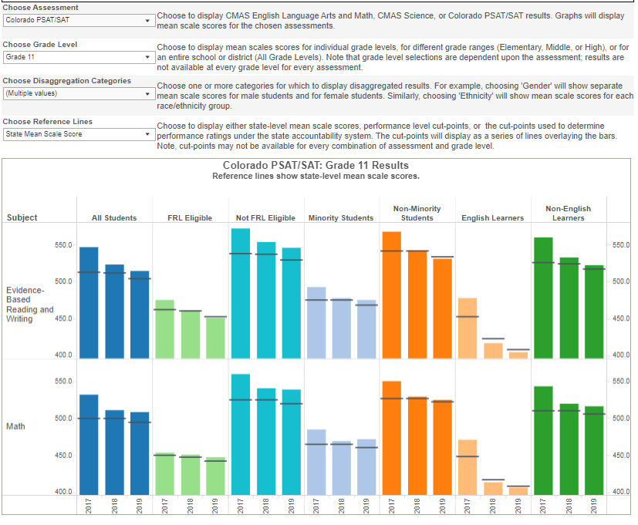
Dash Board
Different Views
Assessments (by whole school, grade level)
Disaggregation Categories
Reference (comparison) points

Slide 14
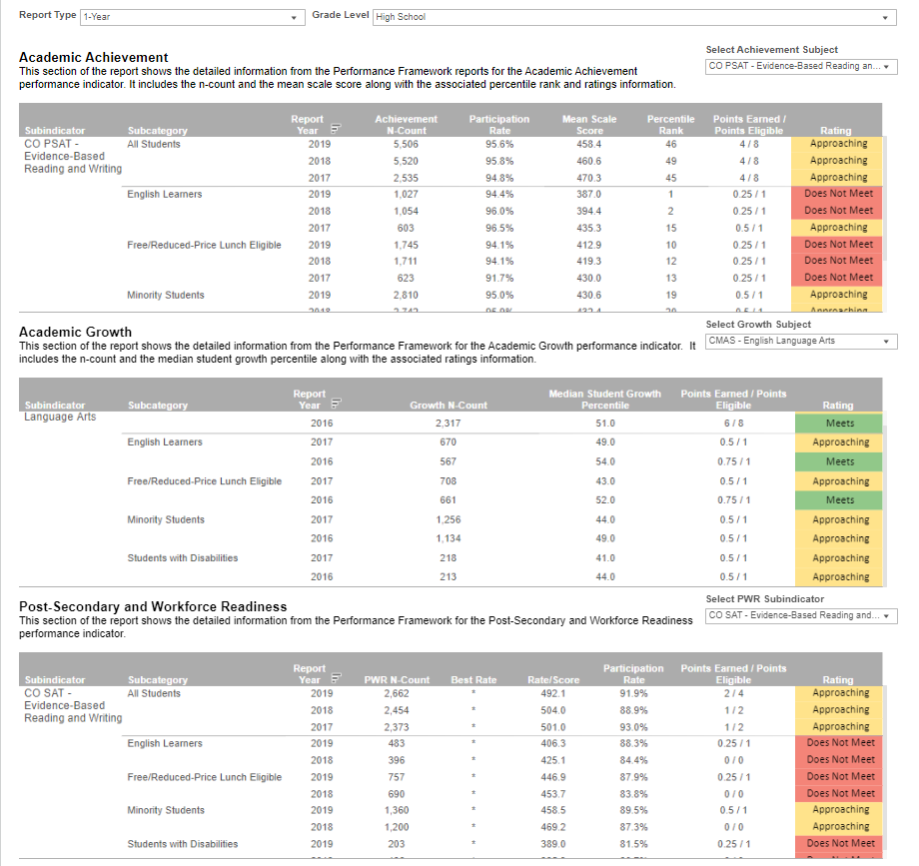
Dashboards: Accountability Detail
SPF Detail
Over time!

Slide 15
Overview of Topics
UIP Fundamentals
Connections- Why?
Digging In
Relationship to Accountability
What’s Next

Slide 16
Framing of Accountability
Notes:
Erin

Slide 17
Colorado’s Accountability System
Local accountability
Locally elected boards oversee superintendent and district policies
State Accountability
Colorado Educational Accountability Act
Performance frameworks, Improvement planning, Accountability clock
Federal Accountability
Every Student Succeeds Act – State plan approved
Schools on improvement (CS, TS, A-TS)
State
Local
ESSA
Notes:
LIsa M. Focus of the session will be on state and federal, not local. Although local boards have a role to play.
Local Accountability:
Local School Boards are the focus of accountability in every district. ‘Local taxpayers look to the school board if school finances are not handled appropriately. Parents look to the board on matters of students safety, teacher quality, student achievement, and any other matter pertaining to the district or their child’. (From CASB web-site, https://www.casb.org/domain/52)
State Accountability:
The Colorado Educational Accountability Act (SB 09-163) is the foundation of our state accountability requirements
It calls for one set of outcome data to determine overall district and school accountability -- the Performance Frameworks
Expects each school and district to develop an improvement plan aligned with its assigned performance framework – Unified Improvement Plan
It identifies those schools and districts with the greatest need, in order to direct resources and support.
Federal Accountability:
During 2017, Colorado submitted their Every Student Succeeds (ESSA) state plan and it outlines federal accountability requirements.

Slide 18
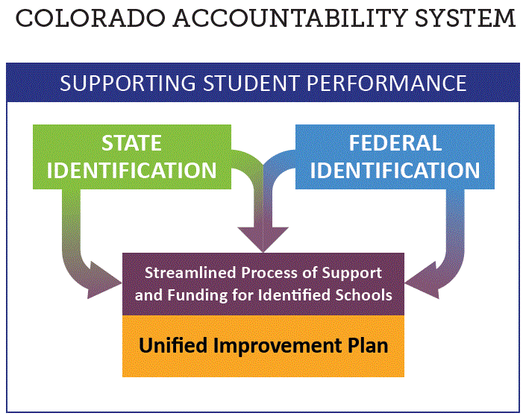
Accountability Overview
Notes:
Lisa

Slide 19
ESSA: Identified Schools
State
ESSA
Annual Identification of 2 Types of Schools for Support and Improvement under ESSA
Comprehensive Support and Improvement (CS)
CS - Lowest 5%
CS - Low Graduation Rate
CS - Former ATS (first year of identification will be 2020-2021)
Targeted Support and Improvement (TS)
TS - based on disaggregated group(s)
ATS - based on disaggregated group(s) that on their own meet the criteria for lowest 5%
ESSA data will be sent to districts via Syncplicity
Notes:
Erin

Slide 20
Overview of Topics
UIP Fundamentals
Connections- Why?
Digging In
Relationship to Accountability
What’s Next

Slide 21
Next Steps
Take a moment for yourself to identify:
What steps do YOU want to take?
What additional information is needed?
Who else needs to be involved?
What structures or expertise is available to tap into?
Check in with a partner.
Notes:
Think about a successful initiative you participated with in the past? What were the elements that made it successful? What can you replicate with this work?

Slide 22
Contact Information
Erin Loften, Improvement Planning
loften_e@cde.state.co.us
303.866.6642
Website: www.cde.state.co.us/uip

