Slide 1
TOWN HALL
June 29, 2020
EmPWRing educators with options for student success.
Notes:
Andy

Slide 2
AGENDA Updates Announcements Questions/Answers Summer Dates
Notes:
Robin

Slide 3
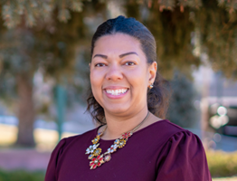
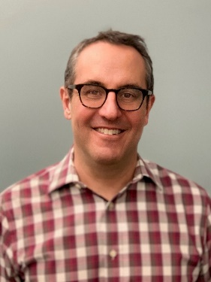
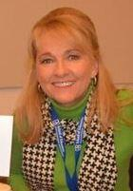
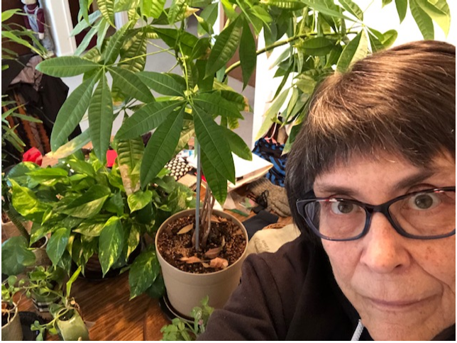
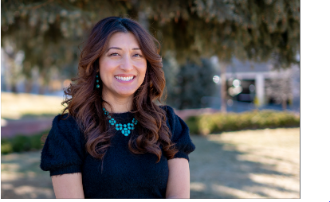
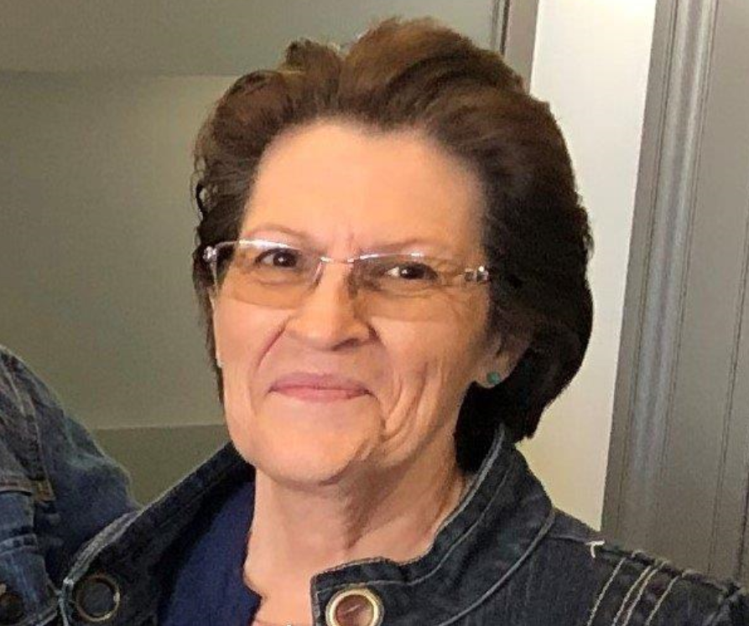
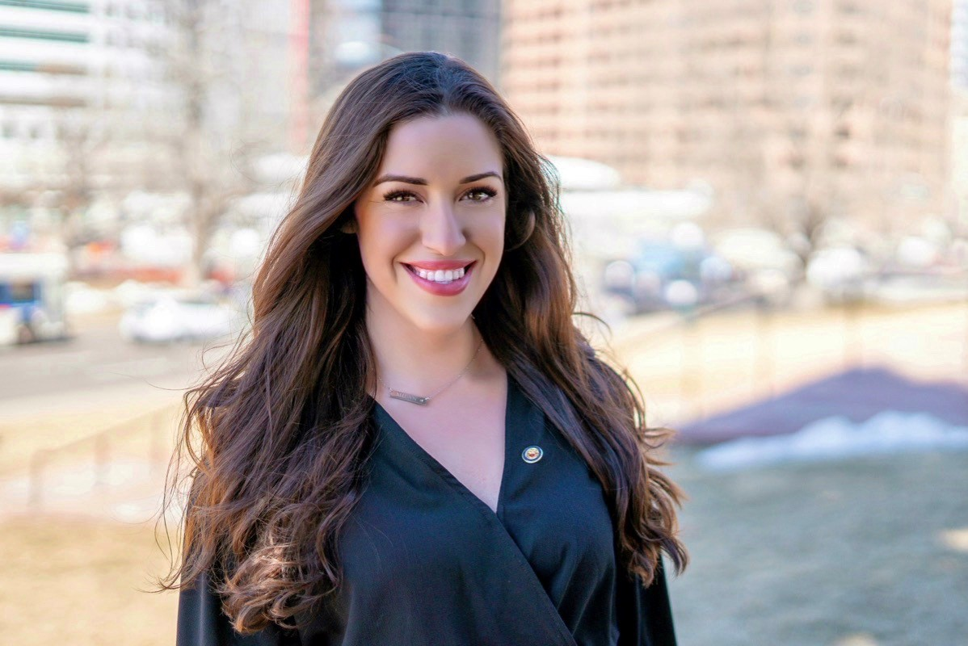
Misti Ruthven
Executive Director, Student Pathways
Andy Tucker Director, PWR Office
Pam Hitt Program Support
Mary Anne Hunter Ascent, Early College, PTECH, Innovative Learning Opportunities
Marina Kokotovic Advanced Placement,
Career Development Incentive Program
Office of Postsecondary and Workforce Readiness (PWR)
Kelly Mitchell
CDE and CWDC,
Work-based Learning and Connecting to Business
Eve Pugh
School Counselor Corps Grant
Michelle Romero
Concurrent Enrollment
Robin Russel Graduation Guidelines and ICAP

Slide 4
Graduation Guidelines
Graduation Guidelines
July 8 Board Meeting
Availability of Menu Options updated weekly

Slide 5
Grant Programs
Correct? Do we want to divide?
Funded
School Counselor Corps
Career Development Incentive Program
Concurrent Enrollment
ASCENT
PTECH
Innovative Learning Opportunities Pilot
Early College
Reduced
AP/IB Exam Fee
Eliminated
AP Incentive Program

Slide 6
Announcing: Concurrent Enrollment Website - July 1
http://www.cde.state.co.us/concurrentenrollment

Slide 7
Work-Based Learning Incubator

Slide 8
Questions?

Slide 9
Town Hall Summer Dates
Open Office Hours Are Available in July
July 14 and 28
2:00 p.m.
Town Hall Conversations Resume in August
August 11 and 25
2:00 p.m.
Dates, Times, Zoom Information
http://www.cde.state.co.us/postsecondary

Slide 10
Policy Guidance
Planning for the 2020-21 School Year Toolkit
Flexibilities for Grant Management
http://www.cde.state.co.us/postsecondary/graduationguidelines

Slide 11
Resources
Resources
CDE Updates are sent to Superintendents, monthly (or more often). Open to all.
Concurrent Enrollment Website http://www.cde.state.co.us/concurrent enrollment
Town Hall meeting dates/times http://www.cde.state.co.us/postsecondary
WBL Incubator information ________________________________

Slide 12
Misti Ruthven
Executive Director, Student Pathways
Ruthven_M@cde.state.co.us
Andy Tucker Director, PWR Office
Tucker_A@cde.state.co.us
Pam Hitt Program Support
Hitt_p@cde.state.co.us
Mary Anne Hunter Ascent, Early College, PTECH, Innovative Learning Opportunities
Hunter_Mary@cde.state.co.us
Marina Kokotovic Advanced Placement
Career Development Incentive Program
Kokotovic_M@cde.state.co.us
Office of Postsecondary and Workforce Readiness (PWR)
Kelly Mitchell
CDE and CWDC,
Work-based Learning and Connecting to Business
Kelly.Mitchell@state.co.us
Eve Pugh
School Counselor Corps Grant
Pugh_E@cde.state.co.us
Michelle Romero
Concurrent Enrollment
Romero_M@cde.state.co.us
Robin Russel Graduation Guidelines and ICAP
Russel_R@cde.state.co.us

