Slide 1
Welcome
Train the Facilitator
January 29, 2015

Slide 2
The Programs
 | CE/ ASCENT | CTE | FAFSA | ICAP | School Counselor Corps Grant | AP | Grad Guidelines
Grad Rate | x | x |  | x | x | x | x
Dropout | x | x |  | x | x | x | x
Higher Ed Matriculation | x | x | x | x | x | x | x
Remediation | x | x |  | x | x | x | x
MS/HS Transition |  |  |  | x | x
Student Engagement | x | x | x | x | x | x | x
PWR | x | x | x | x | x | x | x

Slide 3
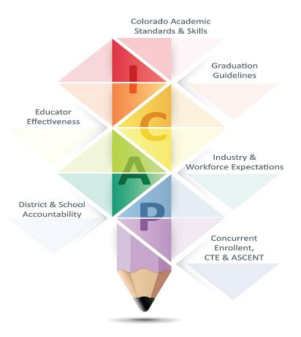
PWR & ICAP

Slide 4
Process | Outcome
Concurrent Enrollment | Graduation Rate/Dropout Rate
Career & Technical Education | Graduation Rate/Dropout Rate
FAFSA Completion | Postsecondary Matriculation
Transitions | Remediation Rates/Graduation Rate/Dropout Rate
Professional Development | Remediation Rates
ICAP * | Graduation Rate/Dropout Rate/Postsecondary Matriculation
ASCENT | Graduation Rate
AP | Remediation Rates/Graduation Rate/Dropout Rate

Slide 5
Concurrent Enrollment
http://highered.colorado.gov/data/k12/districtataglance/districtglancedefault.html
District At A Glance
Tracking the success of high school graduates
The Colorado Department of Higher Education is committed to providing timely and relevant information to school districts regarding the postsecondary progress and success of their high school graduates.
On this page, you can find two-page overviews (PDFs for easy printing) of your school district’s outcomes. These overviews follow Colorado's Class of 2012 and provide information on college-going rates, first-year postsecondary outcomes, concurrent enrollment and remedial education.
In addition, four years' worth of these data - back to the Class of 2009 - are included in a searchable database. This database also includes information by high school.

Slide 6
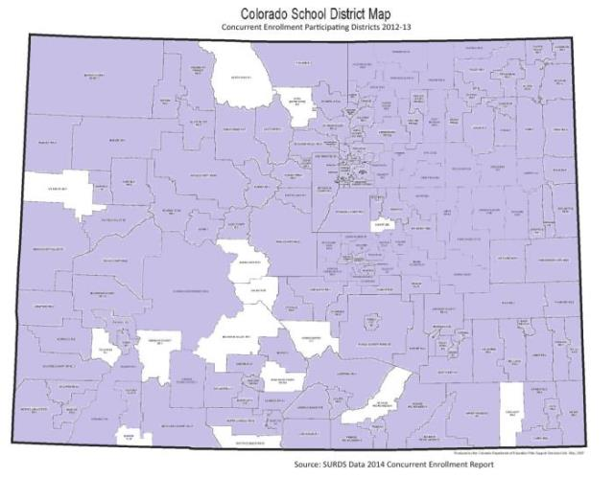
Concurrent Enrollment District Participation
92% of districts and 75% of high schools participating in CE

Slide 7
District at a Glance
Snapshot
Total graduates
Ethnicity
Free and Reduced Lunch percentage
4-Year Graduation Rate
Concurrent Enrollment
College Enrollment Rate
Remediation Rate
Retention Rate

Slide 8
School View
http://www.cde.state.co.us/
UIP
http://www.cde.state.co.us/schoolview/performance

Slide 9
Career and Tech Ed
http://www.coloradostateplan.com/
Vision of Colorado Career and Technical Education:
Colorado CTE delivers proven pathways to lifelong career success!
Mission of Colorado Career and Technical Education:
CTE ensures a thriving Colorado economy by providing relevant and rigorous education that is connected, responsive, and real.

Slide 10
FAFSA Completion
Increase enrollment in postsecondary education and degree/credential completion
Ensure students maximize Federal financial aid resources, such as Pell
Connect “summer melt” resources
Replicate studies with Colorado data
Resources for high-need populations and wrap-around services for homeless, foster, and other independent student populations
Systemic change lever to utilize data to maximize resources for students
Highered.colorado.gov/fafsa

Slide 11
Transitions
Drop Out Prevention Intervention
What process or activities give students best opportunity for success when transitioning from middle to high and high to post-secondary?
Mobility between schools/districts
Graduation Requirement Consistency
Transcript evaluation
Course Description
Advocacy for students

Slide 12
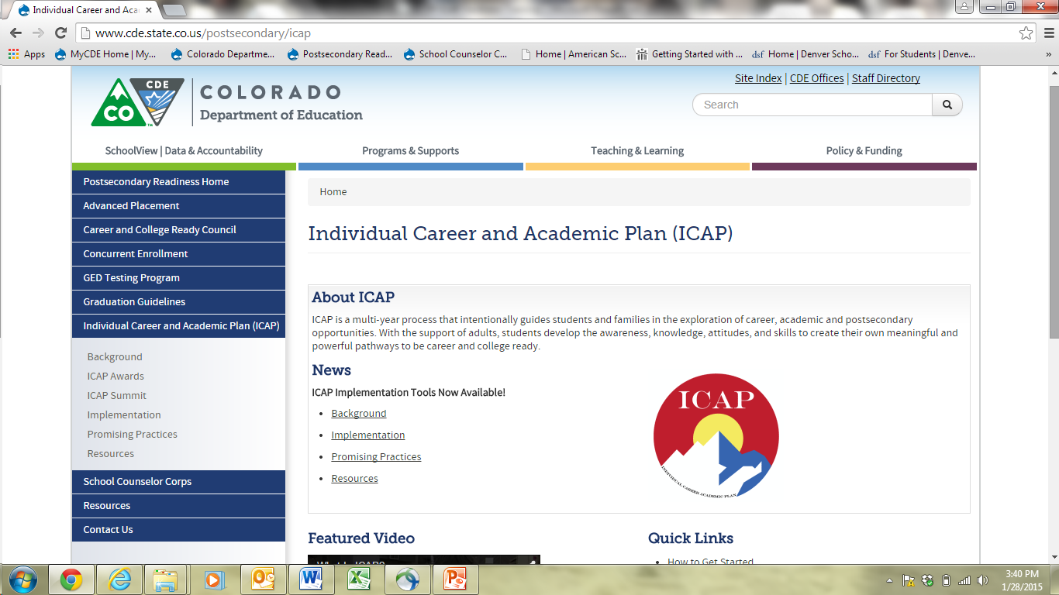
ICAP

Slide 13
Local Data Availability
Data available through your school data system
Infinite Campus
Power School
Naviance
Other

