Slide 1
It Takes a village:
School-Based ICAP Village Members
Notes:
As I was looking through the toolkit and deciding on which part resonated with me, I fell upon the implementation team. The words “Guides”, “Climbers” and “Mountain” resonated with me and I immediately compared it with preparations to climb Mt. Everest. Clearly I have never done that, so I researched it and found the preparation to be a bit like the ICAP preparation.

Slide 2
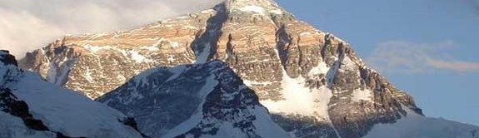
What it takes
Notes:
First you have to bulk up. You need to mentally prepare yourself for the ICAP. We keep hearing we are already doing many of these components and we are right. In my case, getting it down on a form with a list of activities and an action plan was daunting. But it was also important to get it done. It helped me to see where my strengths were. And my weaknesses. Next, you have to put together a team of people around you who are experts. They know the mountain inside and out. With the ICAP, putting together a team of people who buy into the process is essential to the success of the implementation. They have to A) understand what it is and how it works; and B) what their part is. And although it costs $10,000 for a permit and up to $70,000 or more for a guided trip to Everest, treats in the teachers lounge or at meetings can do wonders to get listening ears and more enthusiasm at school. Getting supplies stocked up for Everest can be the same as getting supplies gathered for your “toolkit” on the ICAP. For as many people as there are in this room, there are resources and activities that we can glean from each other and use in our schools to help our students better prepare for life after high school. Finally, you are ready to climb (or implement). It may take three weeks to climb up and down this mountain, but I see the ICAP as an ongoing pursuit. I As more opportunities present themselves, the goal can change.

Slide 3
Guides
Administrators
Counselors
CTE Instructors
Special Education
Notes:
Backing from the administrators, allowing time in the master schedule or in the school day for activities
The counselor is the one who keeps the idea moving forward
CTE instructor who bring ideas to the table; FBLA to help develop interests
Special Education and local BOCES who ensure that paperwork follows student, helps find support services, etc.

Slide 4
climbers
Teachers
Coaches
Support staff
Notes:
Teachers are the experts in their areas. Core teachers get students excited about content, ACT prep. Elective teachers find students’ strengths.
Coaches are positive role models, teach self-discipline, whole child

Slide 5
Mountain
Students
Parents
Community
Businesses
Notes:
Students guide the direction of their plan and pathway. Goals Questionnaire
Parents – meetings 1-on-1 soph, jr and sr
Community – giving opportunities for community service hours (Operation Smile), churches, recycling center, OJC
Businesses – work study, internships, shadowing, work

