Slide 1

Basic Mental Health Awareness for Educators
Jamie Soucie
Northeast Regional Training Consultant
720-498-9645
jamie.soucie@state.co.us

Slide 2
Virtual Training
Participants who are not speaking, please mute to minimize background noise.
Please enter questions/comments into the comment box.
Following completion, a follow-up email will be send, to include a short evaluation form.
Upon receipt of completed evaluation, Certificate of Completion will be provided by CSSRC.
Please open tabs in your browser of videos within presentation.

Slide 3
Support
Colorado Crisis Services 1-844-493-TALK (Text: 38255)

Slide 4
What is Mental Illness?
A mental disorder, also called a mental illness or psychiatric disorder, is a behavioral or mental pattern that causes significant distress or impairment of personal functioning.
Notes:
Mental disorders are usually defined by a combination of how a person behaves, feels, perceives, or thinks.

Slide 5
Prevalence
17% of youth between 6-17 experience a mental illness
1 in 5 adults experiences a mental illness
1 in 25 adults experience a serious mental illness
Average delay between onset and treatment is 11 years
NAMI(National Alliance on Mental Illness
Notes:
Serious mental illness (SMI) is defined as a mental, behavioral, or emotional disorder resulting in serious functional impairment, which substantially interferes with or limits one or more major life activities.
National Institute of Mental Illness

Slide 6
Youth Mental Illness
8.9 million youth reported having a mental illness in 2018
2 in 5 did not receive treatment
5.1 million with a substance abuse disorder
9 in 10 did not receive treatment
SAMHSA (Substance Abuse and Mental Health Administration)
Notes:
40% did not receive treatment
Youth.gov
Estimated rates of co-occurring mental illness among adolescents with substance use disorders range from 60 to 75 percent.¹ Among adolescents with no prior substance use, the rates of first-time use of drugs and alcohol in the previous year are higher in those who have had a major depressive episode than in those who did not.²
Other commonly documented co-occurring mental disorders include conduct disorder, oppositional defiant disorder, attention-deficit/hyperactivity disorder, anxiety, and post-traumatic stress disorder.³
Youth who experience a major depressive episode were twice as likely to begin using alcohol or an illicit drug, compared to youth who had not experienced a major depressive episode.⁴
Youth who experienced serious depression were twice as likely to use alcohol as their peers who had not been seriously depressed. Over 29 percent of youth who had not used alcohol previously initiated alcohol use following a major depressive episode within the past year, compared with 14.5 percent of youth who had not experienced a major depressive episode in the past year.⁵
Similarly, many more youth who had not previously used illicit drugs did so after a major depressive episode. Sixteen percent of youth who had not used an illicit drug in the past year initiated illicit drug use after a major depressive episode, compared with 6.9 percent of youth who had not experienced a major depressive episode in the past year.⁶

Slide 7
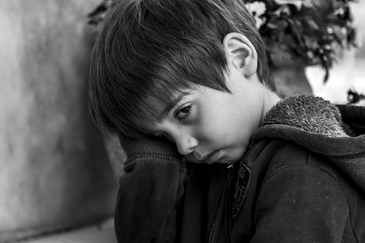
Common Mental Illnesses
Anxiety Disorders
Mood Disorders
Eating Disorders
ADHD
Autism Spectrum Disorders/Asperger’s Syndrome
Disruptive Behavior Disorders
*Trauma considerations
Notes:
Generalized Anxiety, Phobias, PTSD
Depression, Bipolar Disorder
Anorexia and Bulimia – binge-eating disorder
Conduct Disorder
*This is not a comprehensive list; however, we are highlighting some of the most common disorders that may be identified in children/youth

Slide 8

Anxiety Disorders
Can include Generalized Anxiety Disorder, Phobias and Panic Disorders, PTSD, OCD
Symptoms may include:
        Worry
        Fearfulness
        Persistent thoughts, impulses, images
        Intrusive thoughts, avoidant behaviors
Notes:
Many anxiety disorders in youth can be manifested through somatic (physical) symptoms – upset stomach, frequent headaches, sense of chest tightness
VIDEO – NEXT SLIDE – Connect following info before proceeding.
Anxiety disorders are the most common psychiatric condition in youth. Lifetime prevalence rates for any anxiety disorder in adolescents is 31.9%. Anxiety disorders occur early in childhood with a median age of onset of 6 years. These disorders lead to significant impairment in academic, social, and family functioning.
Mental Illnesses are commonly seen as ‘invisible’ illnesses; however, there are functions within the brain that indicate these are happening within the physical body. This speaks to the level of stigma surrounding mental illness and the hesitation in acknowledging that these disorders are serious and prevalent.

Slide 9
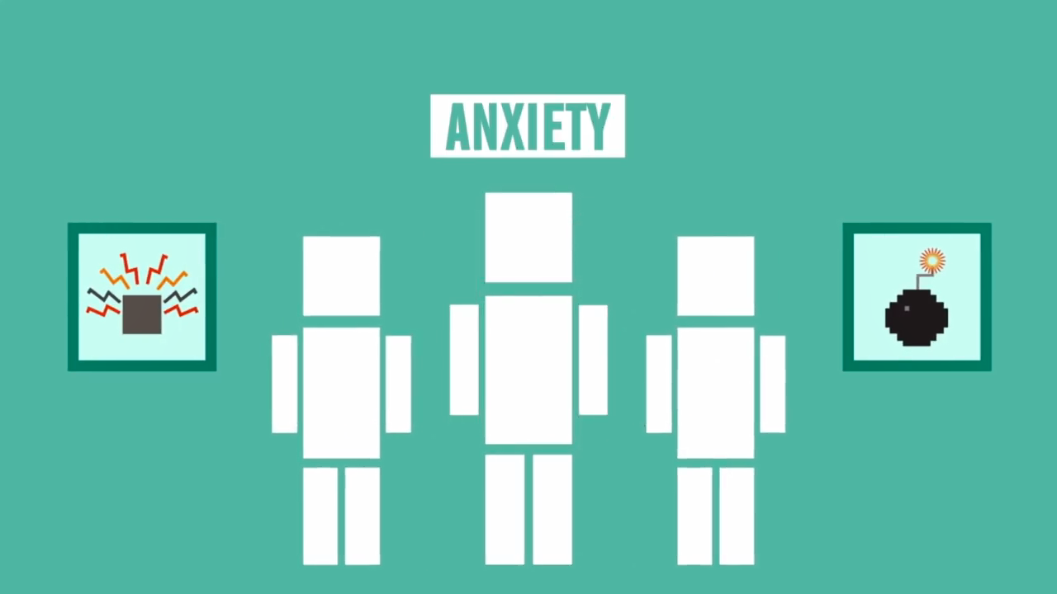
Science of Anxiety
Notes:
*The purpose of this video is to explain how the brain reacts in someone with an anxiety disorder – this is a physical phenomenon that manifests in mood adjustments/impacts that are not necessary ‘seen’ by others.
Discuss Normal vs. Abnormal – anxiety that lasts more than 6 months may indicate presence of a mental illness. Stressful situations that create Anxiety symptoms are normal and expected – when the symptoms are severe and persistent, they may impact the ability to function in a normal manner.

Slide 10

Mood Disorders
Depression:
Third leading cause of death for adolescents
Bi-Polar:
Has been diagnosed in children as young as 5
Notes:
Depression – 6 months or more of symptoms for more days than not (diagnosis by licensed clinician). Please take a look at the Healthy Kids Colorado Survey results for 2017
Felt sad for two or more weeks in a row within the last 12 mo.
31.5%
7% reported attempting suicide
Bipolar Disorder – 6 months or more of symptoms (diagnosed by licensed clinician) characterized by significant depressive episodes, as well as manic episodes, which include impulsive behaviors (these might include: rapid/pressured speech, feelings of grandiosity, sexual acting out, gambling, spending inordinate amounts of money, lack of need for sleep). This is the definition of Bipolar I.
All people who suffer from Bipolar Disorder don’t experience the really high manic stages. Instead, they suffer hypomania which can be mistaken for a return to a more level mood. This is Bipolar II. If the clinician diagnoses depression and is not aware of the hypomania and prescribes an anti-depressant, the individual may become very manic. This is one of the reasons that Bipolar Disorder can take such a long time to diagnose and a long time to find the correct medication for each individual. School staff can help by giving parents feedback on changes in behavior while a student is on a new medication. Prescribing medication is not an exact science and feedback is important for the medical professional.
Can be treated through talk therapy, plus medication

Slide 11
Eating Disorders
Anorexia
        Restriction of food intake
Binge Eating Disorder
            Shame, guilt, secrets, cravings, low self-esteem
Bulimia
            Bingeing and compensatory behaviors
            According to Mental Health America: 20 million women and 10 million men suffer from a clinically significant eating disorder at some time in their life, including anorexia nervosa, bulimia nervosa, binge eating disorder.
Notes:
American Academy of Child & Adolescent Psychiatry:
In the United States, as many as 10 in 100 young women suffer from an eating disorder. Disordered eating related to stress, poor nutritional habits, and food fads are relatively common problems for youth. In addition, two psychiatric eating disorders, anorexia nervosa and bulimia, are on the increase among teenage girls and young women and often run in families. These two eating disorders also occur in boys, but less often. Research shows that early identification and treatment leads to more favorable outcomes. Parents who notice symptoms of anorexia or bulimia in their teenagers should ask their family physician or pediatrician for a referral to a child and adolescent psychiatrist.
Binge eating can also occur on its own without the purging of bulimia and can lead to eventual purging. Children with binge eating disorder also require treatment from a mental health professional.

Slide 12
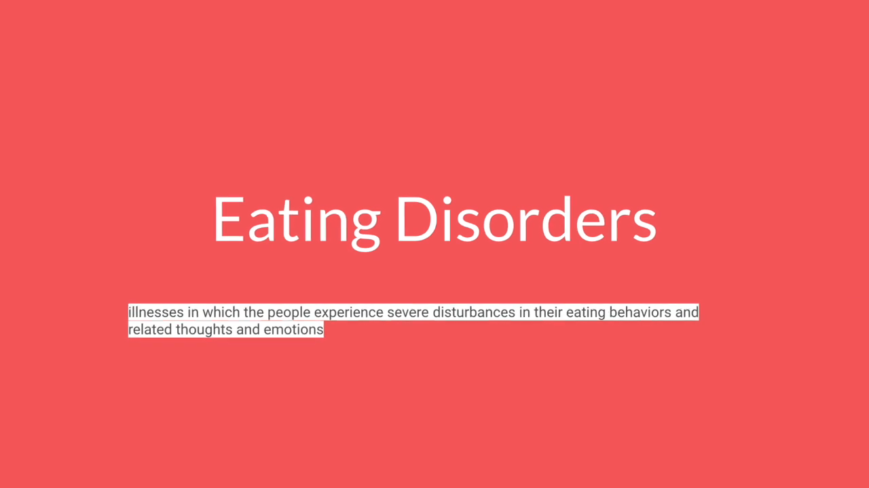
NEDA Awareness
Notes:
National Eating Disorders Association – The National Eating Disorders Association (NEDA) is the largest nonprofit organization dedicated to supporting individuals and families affected by eating disorders. NEDA supports individuals and families affected by eating disorders, and serves as a catalyst for prevention, cures and access to quality care.

Slide 13

ADHD
The estimated number of children ever diagnosed with ADHD, according to a national 2016 parent survey,¹ is 6.1 million (9.4%). This number includes:388,000 children aged 2–5 years
4 million children aged 6–11 years
3 million children aged 12–17 years
*Consider history of exposure to trauma
Notes:
Many times, over-diagnosed; must demonstrate behaviors for 6 months or more.
As school staff become more aware of the effects of trauma, it may become evident that a student diagnosed with ADHD may be suffering the effects of trauma instead that are leading to a difficulty to concentrate, hyperalertness and other symptoms of trauma that could be confused with ADHD.
Difficulty in social situations
Delayed fine motor & language
Independent work difficult
Sleeping problems
Difficulty entertaining self
Difficulty sitting still (staying in seat)

Slide 14
ADHD and other Illnesses
According to a national 2016 parent survey,¹ 6 in 10 children with ADHD had at least one other mental, emotional, or behavioral disorder:
About 5 in 10 children with ADHD had a behavior or conduct problem.
About 3 in 10 children with ADHD had anxiety.
Other conditions affecting children with ADHD: depression, autism spectrum disorder, and Tourette Syndrome.
Sourice: CDC (Center for Disease Control and Prevention)
Notes:
Source: CDC (Center for Disease Control and Prevention)

Slide 15

Autism Spectrum Disorders
Prevalence in US is 1 in 54 births
More than 3.5 million Americans live with an autism spectrum disorder
Fastest-growing developmental disability
Source: Autism Socity
Notes:
PREVALENCE
About 1 percent of the world population has autism spectrum disorder. (CDC, 2014)
Prevalence in the United States is estimated at 1 in 54 births. (CDC, 2020)
More than 3.5 million Americans live with an autism spectrum disorder. (Buescher et al., 2014)
Prevalence of autism in U.S. children increased by 119.4 percent from 2000 (1 in 150) to 2010 (1 in 68). (CDC, 2014) Autism is the fastest-growing developmental disability. (CDC, 2020)
Prevalence has increased by 6-15 percent each year from 2002 to 2010. (Based on biennial numbers from the CDC)
Easily frustrated, difficulties making and keeping friends, interprets language literally, social cues

Slide 16
Autism Spectrum Disorders
Autism is characterized in the DSM-V by:
Persistent differences in communication, interpersonal relationships, and social interaction across different environments
Notes:
What this can look like: Being nonverbal or having atypical speech patterns, having trouble understanding nonverbal communication, difficulty making and keeping friends, difficulty maintaining typical back-and-forth conversational style
Restricted and repetitive behavior, patterns, activities and interests
What this can look like: Repeating sounds or phrases (echolalia), repetitive movements, preference for sameness and difficulty with transition or routine, rigid or highly restricted and intense interests, extreme sensitivity to or significantly lower sensitivity to various sensory stimuli
Autism impacts an individual throughout the lifespan. However, research shows that early diagnosis can lead to improved quality of life. For more information on developmental milestones, visit the CDC’s “Learn the Signs. Act Early” site. Here are some signs to look for:
Speaks later than typical or not at all (nonverbal)
Repetition in language or movement, such as repeating the same word or sounds, hand flapping, or any repeated movement
Atypical nonverbal communication, including avoiding eye contact, giving few facial expressions, or having a monotone
Prefers solitary or parallel play rather than engaging in associative or cooperative play with other children
Extremely distressed by changes, including new foods or changes in schedule
Preference for predictable, structured play over spontaneous or make-believe play
Strong, persistent interest on specific topic, part of a toy, or item

Slide 17
Classroom Strategies
Be calm and positive.
Model appropriate behavior
Be aware of the characteristics of autism and general strategies -
Use an informational sheet to get to know relevant facts about each particular student’s likes, fears, needs, etc.
Ask specific questions regarding safety and impulsivity.
Promote a welcoming environment
Teach understanding and acceptance
Notes:
Be calm and positive.
Model appropriate behavior for the student with autism, as well as for other students, by greeting him and engaging him in a respectful way.
Be aware of the characteristics of autism and general strategies -
Use the “About Me” information sheet to get to know relevant facts about each particular student’s likes, fears, needs, etc.
Ask specific questions regarding safety and impulsivity.
Promote a welcoming environment, and provide opportunities for your student (and others!) to develop social interaction skills and extended learning
Teach understanding and acceptance

Slide 18
Asperger’s Syndrome
Mild form of Autism
Less severe symptoms
Absence of language delays
Good language and cognitive skills
Notes:
Asperger syndrome (AS), also known as Asperger's, is a developmental disorder characterized by significant difficulties in social interaction and nonverbal communication, along with restricted and repetitive patterns of behavior and interests.
In 2013, the DSM-5 replaced Autistic Disorder, Asperger’s Disorder and other pervasive developmental disorders with the umbrella diagnosis of autism spectrum disorder. (Autism Society) What distinguishes Asperger’s Disorder from classic autism are its less severe symptoms and the absence of language delays. Children with Asperger’s Disorder may be only mildly affected, and they frequently have good language and cognitive skills. To the untrained observer, a child with Asperger’s Disorder may just seem like a neurotypical child behaving differently.

Slide 19
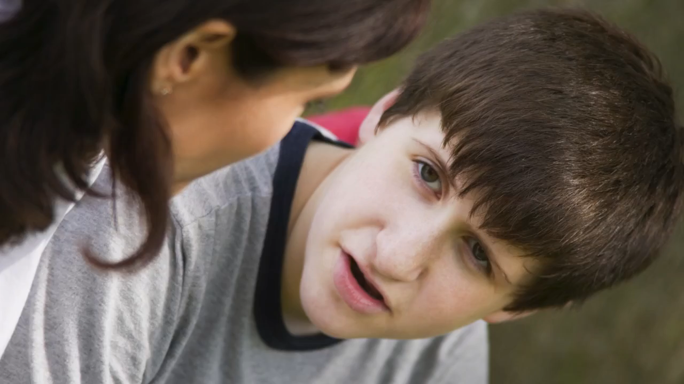
Asperger’s – The Science

Slide 20
Disruptive Behavior Disorders
Behavioral issues extend beyond a period of 6 months
Behaviors occur more frequently than in others
Difficulties within friendships
Overall functioning considerably compromised
*Please consider trauma as a component contributing to the individual’s behaviors.
Notes:
Again, these behavioral difficulties may be a function of trauma. Instead of asking, “What’s wrong with this student?” Ask, “What may have happened to this student?”
Often times discovering a trauma history that is confidentially shared with the teacher, can help the teacher better understand and appreciate a student. All children need positive adult connections and traumatized students need these more than most. There are many trauma-informed strategies that teachers can use in their classrooms. Helping teachers discover these strategies can help everyone in the classroom.

Slide 21
Trauma Considerations
Worry
Sadness
Crying often
Difficulties thinking
Flashbacks
Irritability
Avoidance of places or people
Isolation
Source: National Institute of Mental Health
Headaches
Stomach pain and digestive issues
Feeling tired
Racing heart and sweating
Being very jumpy and easily startled
Notes:
In the United States, 61 percent of men and 51 percent of women report exposure to at least one lifetime traumatic event, and 90 percent of clients in public behavioral health care settings have experienced trauma. SAMHSA
Worrying a lot or feeling very anxious, sad, or fearful
Crying often
Having trouble thinking clearly
Having frightening thoughts or flashbacks, reliving the experience
Feeling angry, resentful, or irritable
Having nightmares or difficulty sleeping
Avoiding places or people that bring back disturbing memories and responses.
Becoming isolated from family and friends

Slide 22
Warning Signs?
Hopelessness
Loss of energy
Hallucinations
Loss of interest
Avoidance of activities
Abuse of substances
Changes in eating habits
Thoughts of suicide
Extreme mood changes
Relationship difficulties
Frequent disobedience or aggression
Changes in school performance
Notes:
This is not a comprehensive list; however, these are signs to watch for in your students.
One of the main takeaways from this, is look for changes in the student from their baseline behavior and be sure to refer them to the mental health professional in your building.
You really need to underscore them sharing concerns with their school mental health professionals as quickly as possible!

Slide 23
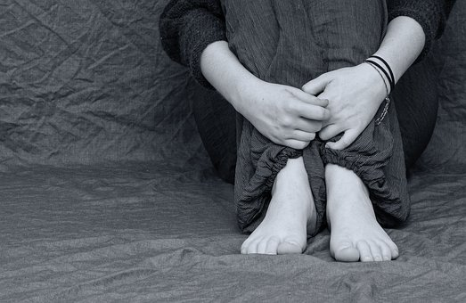
Distance Learning: COVID-19
During this time, students will experience:
Additional stressors
Increased anxiety regarding education
Uncertainty surrounding the future
Lack of opportunities to reach out
Changes in sleep or eating patterns
Fear and worry about health
Lack of connection
Lack of coping strategies
Impacts similar to a traumatic event
Notes:
What has worked and what barriers have you identified?
Jamie, I think I’d ask about stressors so that folks are thinking about the possibilities of families suffering financial hardship, domestic violence, child abuse, parents abusing substances, students having more access to illicit substances, etc. This is a place in your presentation for some rich discussion.
I just heard that the sale of alcoholic beverages is up over 50% in Colorado since the COVID epidemic.

Slide 24
Additional Warning Signs
Physical:
Chest Pain
Difficulty Breathing
Upset Stomach
Dizziness
Rapid Heartbeat
Emotional:
Agitation/Nervousness
Difficulty Concentrating
Excessive Worry/Thoughts/Fears
Sleep Disturbance
Unexplained Outbursts
Notes:
Can't eat or sleep
Can't perform daily tasks like going to school
Don't want to hang out with your friends or family
Don't want to do things you usually enjoy
Fight a lot with family and friends
Feel like you can't control your emotions and it's affecting your relationships with your family and friends
Have low or no energy
Feel hopeless
Feel numb or like nothing matters
Can't stop thinking about certain things or memories
Feel confused, forgetful, edgy, angry, upset, worried, or scared
Want to harm yourself or others
Have random aches and pains
Smoke, drink, or use drugs
Hear voices

Slide 25

What Now?
Decide it’s OK to talk to students about struggles
ASK!
Address Stigma
Encourage students to identify trusted adult/family member
Notes:
Discuss what they do in each of their buildings; how can these issues be incorporated into school culture?

Slide 26

Barriers to Treatment
Lack of Experienced Providers
Missed Opportunities
Poorly Coordinated Services
Stigma
Lack of Health Care Coverage
Notes:
“Most children and adolescents do not seek or receive the services they need. For instance, it is estimated that between 60-90% of adolescents with mental health disorders do not receive treatment. Identifying mental health disorders in children and youth is difficult for health care providers and even more so for school staff.
Missed Opportunities Audio: “Sometimes parents, school officials, and medical providers miss the opportunity to address the prevention or identification of a child’s issue.”
Poorly coordinated services Audio: “When educators, primary health care providers, and social services providers are not working collaboratively, students have the potential to fall through the cracks.”
Stigma Audio: “Sometimes children and adolescents feel shame associated with their disorder and fear being labeled. No parent wants their child to have a mental health disorder so denial may be strong for everyone involved.”
Lack of health care coverage Audio: “Adolescents who lack health insurance are less likely to use mental health services than are those who have coverage. In 2009, more than one in ten 12 to 17 year olds was uninsured, a total of 2.7 million adolescents according to Child Trends.”
Lack of experienced providers Audio: “Shortages in providers with specific expertise in child and adolescent mental health may also be a barrier to receiving the proper treatment.”

Slide 27
How do I support youth?
Slow the situation down
Be compassionate
Using “I” statements, state nonjudgmentally what you have noticed
Ask questions, but don’t push
Realize it may be a relief for the person to talk about how s/he feels
Remember it’s about the person not you
Notes:
Jamie: I think I’d take the last 4 bullets and make them part of your notes and not on the slide. That would give them less to look at and more time to listen to you.
His/her experiences are not the same as yours
His/her perspective is not the same as yours or necessarily of other people’s
His/her culture may not be the same as yours
S/he needs empathy
Be genuine and respectful
Be careful about using slang
Be comfortable with silence
Be in the present with them without comparing them to others
Be aware that their feelings are very real- Especially youth
Be accepting even though you may not agree
Be aware of your body language and facial expressions
Be positive with your feedback
Be helpful with language without telling them how they feel or “should” feel

Slide 28

Notes:
Discuss the video with students. Do they find there is a stigma in their communities? What are they doing to help break the stigma?

Slide 29

Resources
Colorado Crisis Services 1-844-493-TALK (Text: 38255)
Safe2Tell 1-877-542-SAFE
The Trevor Project (LGBTQ) 1-800-850-8078
Notes:
You may be the ‘key’ to getting someone connected to resources that can address a crisis. How can we do that during this time?

Slide 30

Thank you for your time!
Jamie Soucie
Northeast Regional Training Consultant
720-498-9645
jamie.soucie@state.co.us

