Slide 1
Colorado Graduation Guidelines

Slide 2
Introduction
Colorado is the last state to align graduation expectations for all students.
State statute (section 22‐2‐106) required the State Board of Education to adopt a set of guidelines for high school graduation requirements by May 2013.
Local school boards may use their own locally‐developed graduation requirements so long as they “meet or exceed” any minimum standards or core competencies/skills adopted by the state board.

Slide 3
Purpose of State Guidelines
To articulate Colorado’s shared belief about the value and meaning of a high school diploma
To outline the minimum components, expectations and responsibilities of local districts and the state to support students in attaining a high school diploma

Slide 4
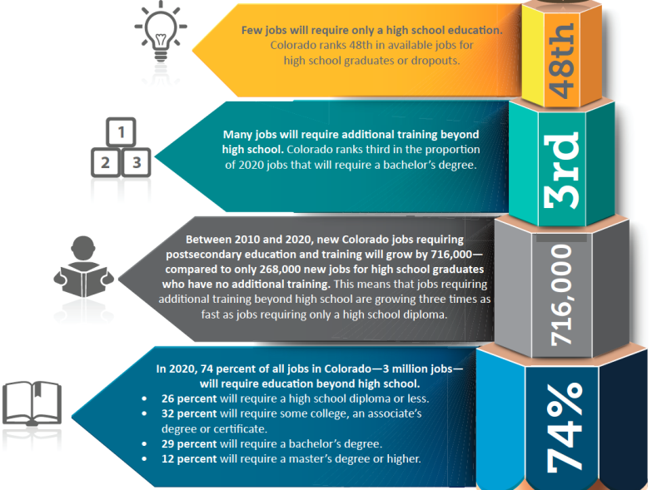
The Why
Source: Georgetown University, Job Growth and Education Requirements, 2013

Slide 5
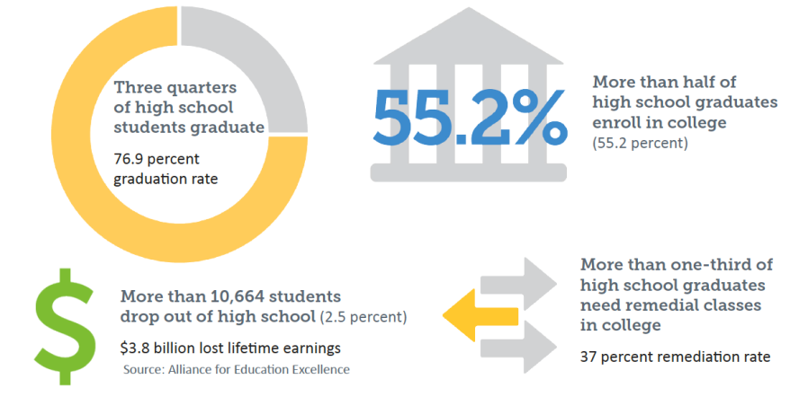
The Why: Why New Graduation Requirements? Colorado by the Numbers

Slide 6
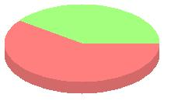
The Why Englewood by the Numbers
District 2012-13
6-Year Graduation Rate
2012 Graduates Enrolled in
College
25.7%
EHS: 81.1%
CFAHS: 45.9%
Completion: 72.1%
$
Englewood’s 2012-13 Dropout Rate
was 7.4% (122 students)
58.8 % of 2012 Graduates Required College Remediation
$43.5 Million in lost Lifetime Earnings
($356,000 per student)

Slide 7
The Why
The goal is for students to graduate from high school prepared to be successful in school and in life, earning a living wage and contributing to Colorado’s economy.
Colorado is committed to educating students so they enter the workforce with in-demand skills that meet business, industry, and higher education standards.
Colorado’s graduation guidelines reflect our state’s rigorous expectations for students and educators.
The state’s graduation guidelines are a meaningful link to improvements that Colorado has already made to set clearer, higher expectations for students and educators.

Slide 8
Review Existing
Graduation Requirements

Slide 9
EHS Graduation Requirements Beginning with Class of 2018
ENGLISH 4 units
MATH 3 units
SCIENCE 3 units
SOCIAL SCIENCE 3.5 units
(Global Studies, World History, US History, American Government, Economics)
FINANCIAL LITERACY .5 units
PE 1.5 units
ACADEMIC ELECTIVES 3 units
ELECTIVES 4.5 units
TOTAL 23.0 Units

Slide 10
CFAHS Graduation Requirements Beginning with Class of 2018
ENGLISH 4 units
MATH 3 units
SCIENCE 3 units
SOCIAL SCIENCE 3.5 units
U. S. History 1.0
World History .50
Economics/Financial Literacy .50
Government .25
Geography .50
Psychology or Sociology .25
Social Studies Electives .50
HEALTH .5 units
FINE ARTS or PE 1.5 units
ELECTIVES 7.5 units
TOTAL 23.0 Units

Slide 11
The What What Does the Change Look Like?
Beginning in 2021, students must demonstrate competency—or show what they know. Their high school diploma will prove they are ready to enter work, military, or college.
This year’s 6th graders, or the 9th graders in fall 2017, will be the first class to demonstrate their readiness in English, math, science, and social studies through the graduation guidelines menu. They may select from a list of options to demonstrate competency. Students could fulfill one or more of these options any time during their high school career by:
Earning minimum scores on state and national tests
Completing rigorous learning projects
guided by a faculty mentor
Passing college-level courses taken during high school
Earning professional certifications

Slide 12
The Grad Guidelines Menu
DEMONSTRATION of Readiness | DEMONSTRATION of Readiness
English Math | English Math
ACCUPLACER | Concurrent Enrollment
62 Reading Comprehension 61 Elementary Algebra | Passing Grade Passing Grade
ACT | District Capstone
18 ACT English 19 ACT Math | Individualized Individualized
ACT Compass | Industry Certificate
79 63 | Individualized Individualized
ACT WorkKeys | International Baccalaureate
Bronze or Higher Bronze or Higher | 4 4
Advanced Placement | SAT
2 2 | 430 460
ASVAB | Collaboratively-Developed, Standards-Based Performance Assessment
31 31 | In development In development

Slide 13
The How: How Will We Make the Change?

Slide 14
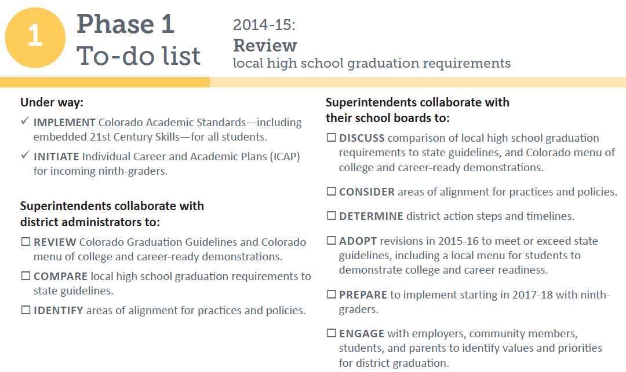
Next Steps for Englewood

Slide 15
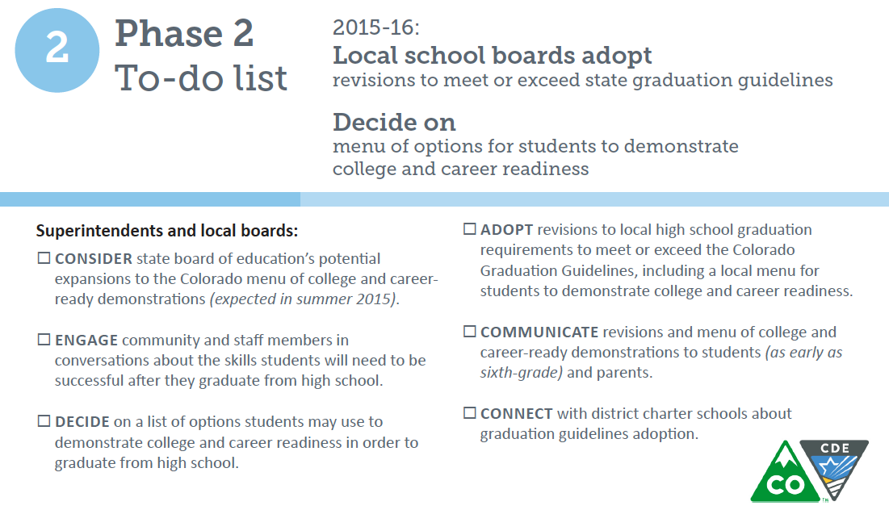
Planning for 2015-16

Slide 16
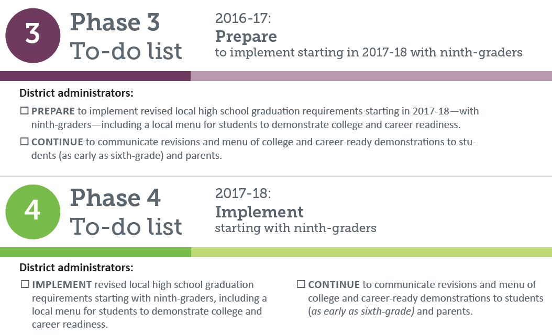
Looking Ahead to 2016 - 2018

Slide 17
Guiding Questions For Cabinet
What requirements must our current student meet to earn a high school diploma from our district?
How do our current local high school graduation requirements compare to the Colorado’s graduation guidelines?
Which of our current requirements meet or exceed the state guidelines?
What additions do we need to meet the state guidelines?
Using student achievement data, in what ways do students currently demonstrate their readiness for college and careers based on the Colorado menu of college and career-ready demonstrations?
Which of our current requirements no longer are needed? What do we want to keep or eliminate?
What processes do we have in place or should we consider options to bring community members, workforce, and higher education to discuss input for our diploma planning process.
Are there other requirements beyond the state’s guidelines that we should consider adding to our local high school graduation requirements (e.g. world languages, music, art, health, etc.)?
How would we like to incorporate the state’s civics requirement for high school?
Do we want to permit students longer or shorter time periods to earn a diploma?
How will we provide flexibility within our policy for students with disabilities?

