Slide 1
Colorado counselor corps professional development modules
Module 6: Measuring and Sharing Results
Notes:
In the first five modules you have learned about the framework for the ASCA National Model, developed and implemented a needs assessment and an environmental scan, analyzed needs assessment and environmental scan data to develop SMART goals, and then turned those SMART goals into clearly articulated action plans. This sixth and final module addresses the final step before the process would start all over, and that is measuring and sharing the results of the action plans you put into place.

Slide 2
Module Content
How results reports and stakeholder reports fit into the ASCA National Model
Gathering results data
Utilizing results reports
Utilizing stakeholder reports
Deliverables
Notes:
The outline of content for this model begins with clarification of how results reports and stakeholder reports fit into the ASCA National Model. You will then learn the basics of how to gather results data to measure the effectiveness of interventions articulated in your action plans, how to present those results in professional results reports, and finally how to develop and share stakeholder reports to showcase the accomplishments of your program.

Slide 3
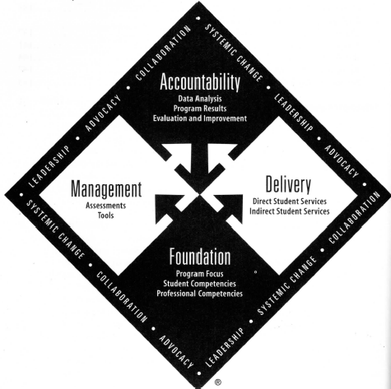
Results Data, Results Reports, and Stakeholder Reports within the ASCA National Model
Notes:
Activities within this module comprise the Accountability Component of the ASCA National Model. Best practice dictates that school counselors continually analyze and monitor their program’s activities to ensure that “students are different as a result of their school counseling program” (ASCA, 2012). Within this component, ASCA identifies three practice points, data analysis, program results, and evaluation and improvement.

Slide 4
Revisiting Key data points to gather results data
Notes:
The first step in accountability is gathering results data. For some of these data points you will be revisiting data sources from your earlier work.

Slide 5
BROAD CATEGORIES OF DATA FOR PROGRAM RESULTS
Perception Data
Ask what participants think they know
Attitudes and self-reports
Process Data
Number of participants involved
Evidence that an event occurred
Outcome Data
Shows impact of an intervention
Collected from multiple sources
Collected through surveys and pre-posts tests
Number of times an intervention took place
Reports the extent to which program has a positive impact
ASCA, 2012, p. 102
Notes:
The ASCA National Model outlines three broad categories of data the should be accessed, analyzed and reported for accountability measures. These include perception, process and outcome data. Perception data identifies what individuals think they know and how they perceive the effectiveness of the school counseling program and its services. Examples of perception data include pre and post tests on interventions, needs assessments, and program evaluation or feedback surveys. Process data identifies who, when and how many. It is essentially a count of participants and services. An example of process data would be “200 students participated in classroom guidance lessons regarding ICAP completion.” The last category of data is the newest on the school counselor accountability scene. Outcome data shows the impact of an intervention and reports the extent to which the program has a positive impact on student achievement and/or behavior. Examples of outcome data measures include number of discipline referrals, graduation rates, attendance rates, etc.

Slide 6
STARTING WITH THE BIG PICTURE
The School Data Profile Analysis
What strengths are indicated in the data at your school?
What concerns are raised about the data?
Do achievement gaps exist?
Have attendance rates changed?
What can you learn from examining the safety data?
How is your school counseling program addressing the gaps?
How can the school counseling program contribute to closing the gaps or addressing the educational issues posed by the data?
What additional data are needed to fully understand an educational issue and identify a school counseling program intervention?
ASCA, 2012, p. 100
Use-of-Time Analysis
How close am I to allocating at least 80 percent of my time to serving students?
Is the amount of time allocated to any particular service delivery the most effective use of my time?
Are the selected delivery methods and strategies the best use of school counselor time with will lead to the accomplishment of identified goals?
ASCA, 2012, p. 101
EZAnalyze
Rex Filer’s Professional School Counselor Log
Notes:
The ASCA National Model identifies the School Data Profile Analysis and the Use-of-Time Analysis as data points within the accountability component. You have already used the school data profile analysis as part of your environmental scan process, but it is imperative to revisit the data following implementation of intervention strategies to see if there are any measureable impacts. Questions that guide review of the school data profile analysis include What strengths are indicated in the data at your school?
What concerns are raised about the data?
Do achievement gaps exist?
Have attendance rates changed?
What can you learn from examining the safety data?
How is your school counseling program addressing the gaps?
How can the school counseling program contribute to closing the gaps or addressing the educational issues posed by the data?
What additional data are needed to fully understand an educational issue and identify a school counseling program intervention?
ASCA also offers a simple time charting tool that can be utilized for the Use-of-Time Analysis. This tool is linked to the subheading on the slide. There are also a number of other dynamic and free tools available to you. My two favorites are EZAnalyze and Rex Filer’s Professional School Counselor Log. Both offer the ability to create summary reports and charts. Questions that you should ask when analyzing your use of time include:
How close am I to allocating at least 80 percent of my time to serving students?
Is the amount of time allocated to any particular service delivery the most effective use of my time?
Are the selected delivery methods and strategies the best use of school counselor time with will lead to the accomplishment of identified goals?

Slide 7
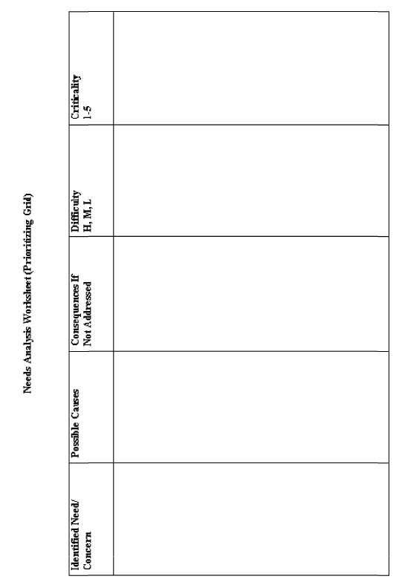
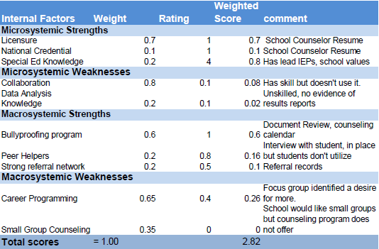
REVISIT NEEDS ANALYSIS AND ENVIRONMENTAL SCAN DATA
Parents identify a
Need for a financial
Aid night in spite of
Having one each year
With low attendance.
Financial aid night is not well advertised.
Fewer students will
Matriculate to college.
L
2
Notes:
At this time you will want to revisit your needs assessment and environmental scan result to determine if any outcome data related to those data points should be recollected. Often, however, such data is not fully impacted immediately so be cautious about making drawing premature conclusions regarding perceived changes.

Slide 8
Results Reports
Notes:
Results reports are modeled after the action plans you developed and clearly articulate “how students are different as a result of your implemented action plans.”

Slide 9
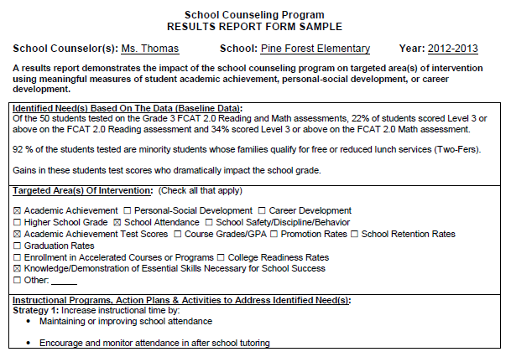
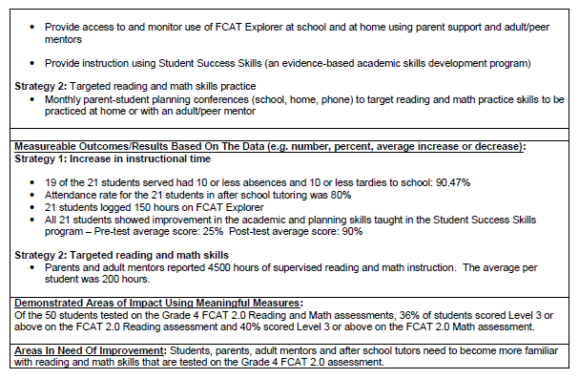
THE COMPREHENSIVE SCHOOL COUNSELING PROGRAM RESULTS REPORT
Form from Alachua Public Schools. Downloaded at http://www.sbac.edu/pages/ACPS/Departments_Programs/DepartmentsLZ/Guidance/4921314836428531314/4921314934220833938
Notes:
ASCA does not provide a template for comprehensive program results reporting, but the form as presented above comes from Alachua Public Schools and provides a well-developed template. The image on this slide is an example of the completed for and the template is hyperlinked to the slide title. The template is also included in the deliverables for this module.

Slide 10
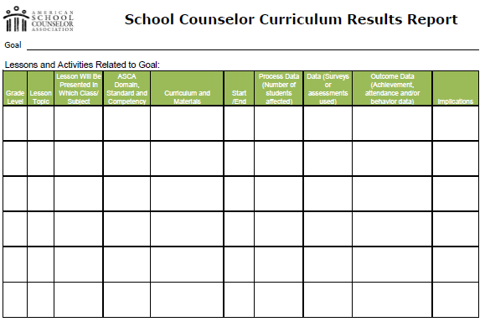
THE SCHOOL COUNSELING CURRICULUM RESULTS REPORT
Were appropriate goals identified and did curriculum or activities support these goals?
What can be learned from analyzing the process data?
What can be learned from analyzing the perception data?
What can be learned from analyzing the outcome data?
After reviewing the report, what are the implications or recommendations?
ASCA, 2012
Notes:
The Curriculum Results Report template comes from the ASCA National Model. Once the template is completed, you should ask yourself the following questions:
Were appropriate goals identified and did curriculum or activities support these goals?
What can be learned from analyzing the process data? (Did all students receive the curriculum? Were all lessons delivered?)
What can be learned from analyzing the perception data? (Did the curriculum meet the goals of teaching knowledge, attitudes and skills? Did students report an increase in knowledge of lesson content?)
What can be learned from analyzing the outcome data? (What impact did the curriculum have on achievement, attendance or behavioral data, such as GPA, report card data, state testing, discipline referrals, safety report, and/or attendance?)
And After reviewing the report, what are the implications or recommendations?
The template is included in the deliverables for this module.

Slide 11
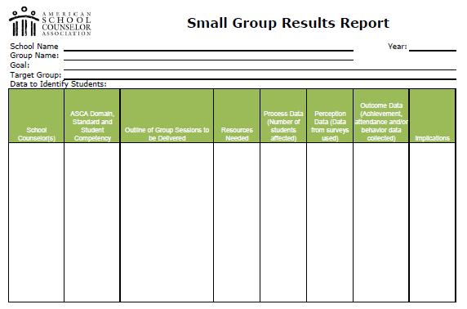
THE SMALL GROUP RESULTS REPORT
Were the right goals identified for the group of students?
What can be learned from analyzing the process data?
What can be learned from analyzing the perception data?
What can be learned from analyzing the outcome data?
After reviewing the report, what are the implications or recommendations?
ASCA, 2012
Notes:
The Small Group Results Report template also comes from the ASCA National Model. Once the template is completed, you should ask yourself the following questions:
Were appropriate goals identified for this particular group of students and did the choice of interventions or activities support these goals?
What can be learned from analyzing the process data? (Did the size of the group, the amount of time or the number of sessions affect the outcome data? What changes might need to be made should this intervention be used again?)
What can be learned from analyzing the perception data? (Did the curriculum meet the goals? Did students report an increase in knowledge of lesson content? Do pre and post-test outcome data indicate there was an increase in learning?)
What can be learned from analyzing the outcome data? (What impact did the curriculum have on achievement, attendance or behavioral data?)
And After reviewing the report, what are the implications or recommendations?
The template is included in the deliverables for this module.

Slide 12
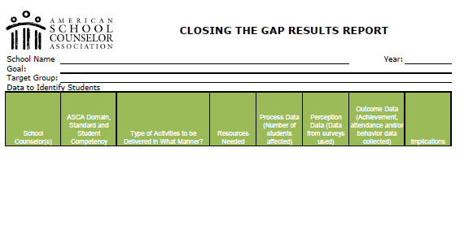
THE CLOSING THE GAP RESULTS REPORT
What can be learned from analyzing the process data?
What can be learned from analyzing the perception data?
What can be learned from analyzing the outcome data?
After reviewing the report, what are the implications or recommendations?
ASCA, 2012
Notes:
The final results report template to come from the ASCA National Model is the Closing the Gap Results Report. Once the template is completed, you should ask yourself the following questions:
What can be learned from analyzing the process data? (Did all students receive the intervention? Were the scheduled sessions conducted? Did this number increase?)
What can be learned from analyzing the perception data? (Did the curriculum meet the goals? Did students report an increase in knowledge? Do pre- and post-test data indicate there was an increase in knowledge?)
What can be learned from analyzing the outcome data? (What impact did the curriculum have on achievement, attendance, or behavioral data?)
And After reviewing the report, what are the implications or recommendations?
The template is included in the deliverables for this module.

Slide 13
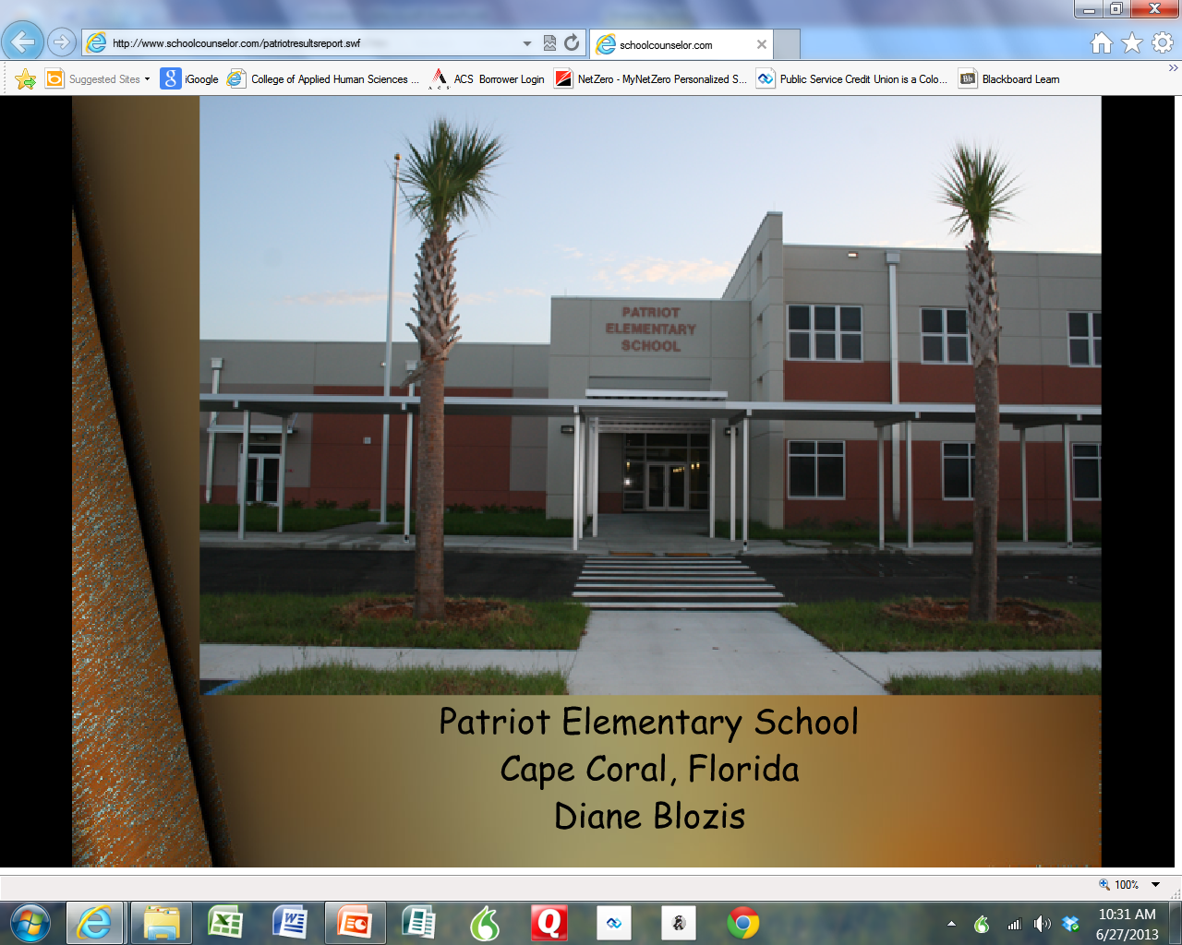
CREATING A DYNAMIC RESULTS REPORT
http://www.schoolcounselor.com/patriotresultsreport.swf
Notes:
Results reports do not need to be static documents only. Russell Sabella of Florida Gulf Coast University is our profession’s technology guru. He has compiled a wonderful site, schoolcounselor.com, that offers a plethora of tips and ideas around technology. One guide that he has developed involves creating multi-media results reports. This pdf document is linked to the title of this slide and can be found in the “resources folder.” If you would like to see an example of the multi-media results report in action, click on the image.

Slide 14
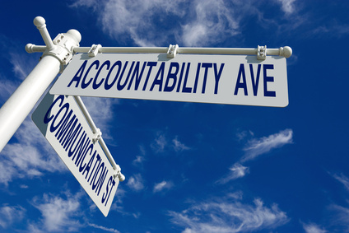
THE STAKEHOLDER REPORT
Notes:
Results reports are modeled after the action plans you developed and clearly articulate “how students are different as a result of your implemented action plans.”

Slide 15
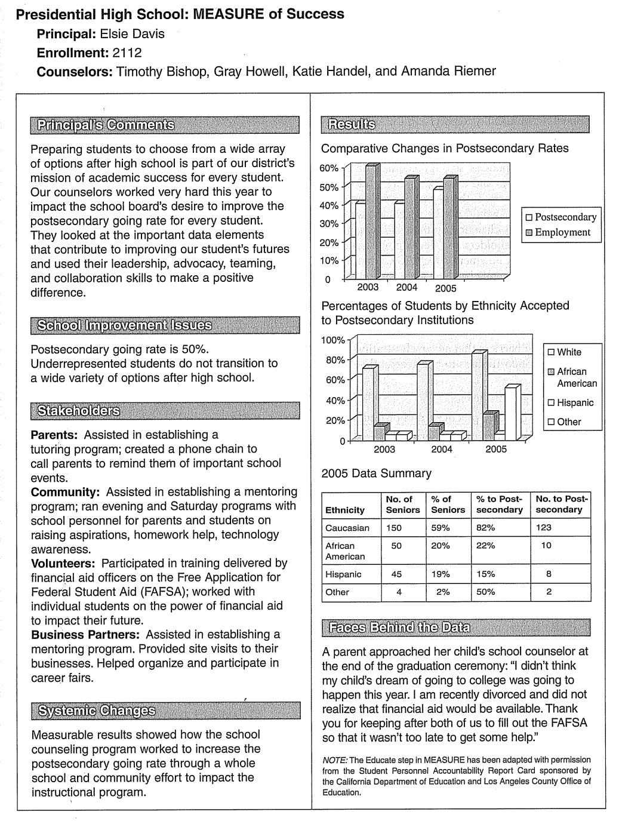
THE MEASURE OF SUCCESS MODEL
Collates a variety of data points
Disseminate information to all stakeholders
Show positive changes in targeted behaviors and outcomes.
There are a variety of formats that one can use
Create a report format appropriate for your needs.
Stone & Dahir, 2010
Notes:
The stakeholder report is your opportunity to share your successes with the public thus increasing your visibility and enhancing accountability. The sample report on this slide is an example offered by Stone and Dahir in their text, “School Counselor Accountability: A MEASURE of Student Success.” You will also find another article by Dahir and Stone in the references folder which articulates beautifully the connections between school counselor accountability activities and social justice and systemic change. A stakeholder report is the final deliverable in this training series.

Slide 16
RECAP
In this module you learned about:
How results reports and stakeholder reports fit into the ASCA National Model
Gathering results data
Utilizing results reports
Utilizing stakeholder reports
Notes:
In this module you learned about how SMART goals and action plans fit into the ASCA National Model. You also learned that having a strong team to generate goals and identify research-based interventions is critical to meeting needs identified through needs assessment and environmental scans data. Lastly, you saw action plans in action and are now ready to move on to the last module in this training series and tie everything together.

Slide 17
The Deliverables for Module 6 are:
The Comprehensive School Counseling Program Results Report
The School Counseling Curriculum Results Report
The Small-Group Results Report
The Closing the Gap Results Report
The Stakeholder Report

Slide 18
REFERENCES
American School Counselor Association (2012). ASCA National Model: A framework for school counseling programs (3rd ed.). Alexandria, VA: Author.
Dahir, C. A. & Stone, C. B. (2009). School counselor accountability: The path to social justice and systemic change. Journal of Counseling and Development, 87, 12- 20.
Stone, C. B., & Dahir, C. A. (2010). School counselor accountatibility: A MEASURE of student success (3rd ed.). Upper Saddle River, NJ: Pearson.

