Slide 1
Automatic Enrollment in Advanced Courses Grant Program
Pursuant to SB 19-059
Application Webinar 2021-2022

Slide 2
Introduction
All students deserve the opportunity to learn higher-level content, and students who have access to a rigorous curriculum perform better across multiple measures, including graduating high school and completing higher education.
Traditionally, disadvantaged minorities and low-income students of all racial and ethnic backgrounds who perform well in school do not enroll in advanced classes at the same rate as their peers, regardless of preparedness.
High school Graduation Guidelines adopted by the Colorado State Board of Education require students to demonstrate competency in Mathematics and Reading/Writing/Communicating to graduate, which can include achieving a sufficient score on an Advanced Placement or International Baccalaureate exam.
A school's or school district's course placement policies and decisions impact a student's opportunity to reach his or her full academic potential.

Slide 3
Purpose
The John W. Buckner Automatic Enrollment in Advanced Courses Grant Program is intended to increase the number of students enrolled in advanced courses for subjects in which the student has demonstrated proficiency.
"Advanced course" means an advanced course of study in any subject, including:
an Advanced Placement course;
an International Baccalaureate course;
or a course designated by a school district as an honors, gifted, or accelerated course.

Slide 4
Eligible Applicants
Local Education Providers (LEPs) are eligible to apply for this opportunity. An eligible LEP is:
A School District (a school operating within the district may not submit a standalone application);
A School (only if the authorizing district does not intend to submit an application)
A Board of Cooperative Educational Services (BOCES);
A Charter School authorized by a School District; or
A Charter School authorized by the Charter School Institute.
An application from an individual school must be submitted by the Chief Administrative Officer of the school (if the authorizing district does not intend to submit an application) and, if the school is not a charter school, the school must notify the superintendent of the authorized school district of the application. The school’s district will be the fiscal agent, if funded.
A charter school’s authorizer will be the fiscal agent, if funded. A charter school may also be included in a district application.

Slide 5
Eligible Applicants (continued)
An LEP is eligible for the grant program if the LEP automatically enrolls each student entering the ninth grade or higher in an advanced course based on any of the following criteria:
The student achieved a score that is equivalent to, or exceeds, demonstrating proficiency on the state assessment that was administered pursuant to section 22-7-1006.3 for the preceding academic year, referred to in this section as an "eligible score", as follows:
Students who achieve an eligible score in a subject related to mathematics must be automatically enrolled in advanced courses in mathematics;
Students who achieve an eligible score in subjects relating to reading and writing must be enrolled in advanced courses in English, social studies, humanities, or other related subjects; and
Students who achieve an eligible score in a subject related to science or social studies must be automatically enrolled in advanced courses in science or social studies; or
Any other measure applied to all students enrolled in the LEP that, in the judgment of the LEP, is an indicator that a student demonstrates the ability to succeed in an advanced course.

Slide 6
Available Funds
Approximately $220,000 is available for the 2021-2022 school year. CDE anticipates to award grants for a one-year period. Funding in subsequent years for grantees is contingent upon continued appropriations.
The Department will award funds based on the following formula:
The Department will use the aggregate information provided by each applicant LEP under Rule 3.03(2) to determine an overall average cost per student.
The Department will apply the average calculated in Rule 3.04(1)(a) to each LEP by multiplying the overall average cost per student times the number of students served.
The Department will award an amount to each eligible LEP based on the number of students and average cost per student served under Rule 3.04(1)(b).
If the total funding requested in an eligible Local Education Provider’s application is less than the award determined under Rule 3.04(1)(c), then the Local Education Provider’s award will be equal to the total funding requested in its application.
Additionally, supplemental funding based on the number of grade levels served may be included in the award.
If the total amount appropriated by the General Assembly in a given fiscal year is insufficient to fully fund awards as determined under Rule 3.04(1)(c), the Department will reduce each eligible Local Education Provider’s award by a proportional amount.

Slide 7
Allowable Use of Funds
An LEP that receives a grant under the program shall use the funding as follows:
Expanding the number of advanced courses offered in the Local Education Provider, including the use of technology to increase the number of advanced courses offered;
Incentivizing teachers to teach advanced courses, including teacher training and professional development in areas relating to advanced course instruction;
Developing advanced course curriculum; or
Expanding parent and student engagement with the Local Education Provider as it relates to advanced course availability and enrollment and student success in advanced courses.
A Local Education Provider that is awarded a grant may not use the grant money for the purpose of hiring new teachers.

Slide 8
Duration of Grant
Awards will by provided by April 1, 2022, and grantees will have the entirety of school year 2022-2023 to use the funds. Additional grant funding for subsequent years will be contingent upon annual appropriations by the State Legislature.
Funded applicants for the 21-22 school year are not guaranteed any additional funding at this time. Funds must be expended by June 30, 2023.

Slide 9
Evaluation and Reporting
Each LEP that receives funding through the Automatic Enrollment in Advanced Placement Courses Grant Program must submit an annual report to the Department that includes the following information on or before June 30, 2023.
The number of students enrolled in advanced courses before and after implementation of the grant program;
The number of students automatically enrolled in advanced courses by the Local Education Provider before and after implementation of the grant program;
Demographic information of students automatically enrolled in advanced courses, including grade, race, ethnicity, gender, and socioeconomic information before and after implementation of the grant program;
The number of students in grades 4-8 automatically enrolled in advanced courses before and after implementation of the grant program if applicable; and
The ways in which grant dollars were utilized.

Slide 10
Review Process and Timeline
Applications will be reviewed by CDE staff and peer reviewers to ensure they contain all required components. Applicants will be notified of final award status no later than March 15, 2022.
Note: This is a competitive process – applicants must meet all rubric criteria to be approved for funding. Applications that do not meet all criteria may be asked to submit revisions that would bring the application up to a fundable level. There is no guarantee that submitting an application will result in funding or funding at the requested level. All award decisions are final. Applicants that do not meet the qualifications may reapply for future grant opportunities.

Slide 11
Submission Process and Deadline
The application must be submitted online via Smartsheet by Wednesday, December 15, 2021 by 11:59 pm.
You must attach these items to your application in Smartsheet:
The Program Assurances Form (page 8 of the RFA)
The Excel Budget Workbook
(These are available for download on the CDE website at http://www.cde.state.co.us/postsecondary/autoenrollment )
Do not submit a PDF, Word, or written version of your application. Type directly in the Smartsheet fields.
Incomplete or late applications will not be considered.

Slide 12
Application Format
The total narrative (Part II) of the application cannot exceed 1500 words total (about 3 single spaced pages).
The Program Assurances Form (Part IC, page 8 of the RFA) must include original signatures of the lead organization/fiscal agent.

Slide 13
Required Elements
The format outlined below must be followed in order to assure consistent application of the evaluation criteria. See Evaluation Rubric (page 10 of RFA) for specific selection criteria needed in Part II (Narrative).
Part I: Application Introduction (not scored)
Part IA: Applicant Information
Part IB: Recipient School Information
Part IC: Program Assurances Form (to be signed and uploaded to Smartsheet)
Part II: Narrative (scored)
Narrative Responses (1-5)
Excel Budget Workbook (to be completed and uploaded to Smartsheet)

Slide 14
Review Process

Slide 15
Evaluation Rubric
Part II: Narrative The following criteria will be used by reviewers to evaluate the application as a whole. In order for the application to be recommended for funding, it must meet all rubric criteria.

Slide 16
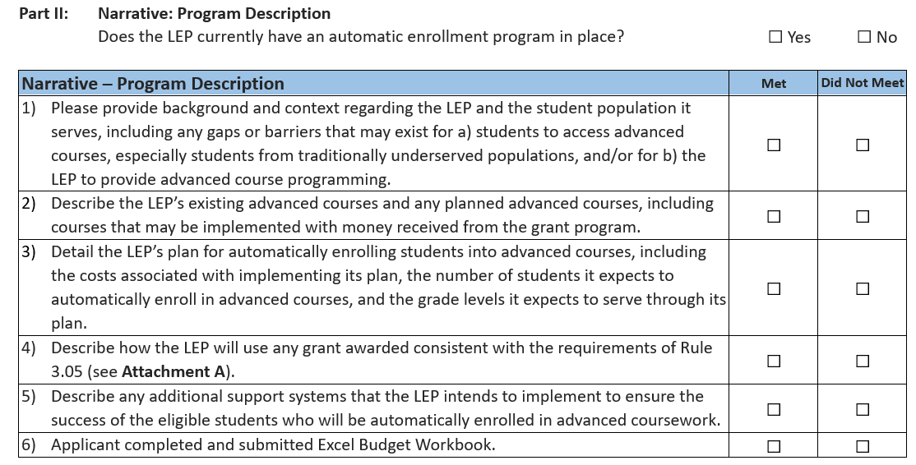
Evaluation Rubric (continued)

Slide 17
Questions?

Slide 18
Contact Information
Program Questions:
Alena Barczak, Office of Postsecondary & Workforce Readiness (303) 548-8427| Barczak_A@cde.state.co.us
Budget/Fiscal Questions:
Anna Friedman, Office of Grants Fiscal (720) 778-1877| Friedman_A@cde.state.co.us
Application Questions:
Mandy Christensen, Office of Competitive Grants and Awards (303) 866-6250 | Christensen_A@cde.state.co.us

