Slide 1
2021 Student October Count for Approved Online Schools and Programs
March 18, 2021

Slide 2
Intros and Agenda
Student October Count Overview
Pupil Enrollment Count Date
Student October Count Audit Resource Guide
Funding Requirements
Audit Documentation Requirements
Clarification to the Online School and Program section
At-Risk/Free Lunch Count
Electronic Signatures
Contact Information
Questions

Slide 3
Purpose
Online schools and programs can be designated as one of the following, through the Colorado Department of Education (CDE):
Multi-District Online School
Must be certified by CDE
Per pupil funding is different than a brick-and-mortar school
Single-District Online School or Program
Must be recognized by the Office of Blended and Online Learning
Per pupil funding is the same as a brick-and-mortar school
Will receive verification from the Office of Blended and Online Learning that the statutory definition has been met
A complete list of approved or recognized online schools and programs for the 2020-21 SY can be found at the following URL:
http://www.cde.state.co.us/onlinelearning/schools

Slide 4
Student October Count Overview
Each year, all public school districts in the state of Colorado and the Charter School Institute participate in the Student October Count data collection
The data reported by each district and CSI during this data collection is used to determine the pupil and at-risk funding each district and CSI is eligible to receive
After the data collection is final, and within 5 years following certification, all districts and CSI are subject to a compliance audit completed by the School Finance Unit’s School Auditing Office to ensure accurate reporting of specific funding related fields including, but not limited to: grade level, funding code, and FRL code

Slide 5
Pupil Enrollment Count Date
Because Colorado funds districts based on a one-day pupil membership count known as the pupil enrollment count date, all data submitted in the Student October Count data collection should reflect what was true as of the pupil enrollment count date
The pupil enrollment count date for the 2021 Student October Count data collection is:
Friday, October 1, 2021
The 11-day count period is comprised of the five school days prior to the pupil enrollment count date, the count date, and the five school days following the pupil enrollment count date (as determined by the district’s adopted calendar)
*Districts can request an alternative count date or 11-day count period on behalf of an individual school, if applicable.

Slide 6
Student October Count Audit Resource Guide
In order to assist districts with the Student October Count data collection, the School Auditing Office posts an annual Student October Count Audit Resource Guide which addresses:
Funding Requirements
Audit Documentation Requirements
This Guide is intended to be read as a whole. Individual sections of the Guide provide additional information and definition for specific student types, courses, schools, and program types. The individual sections are not meant to stand alone or to contradict or supersede the general sections of the Guide
While the Guide has been developed to conform to state statute and the Code of Colorado Regulations (Administrative Rules), the Guide is not meant to be comprehensive and is not intended to replace state statute or administrative rules

Slide 7
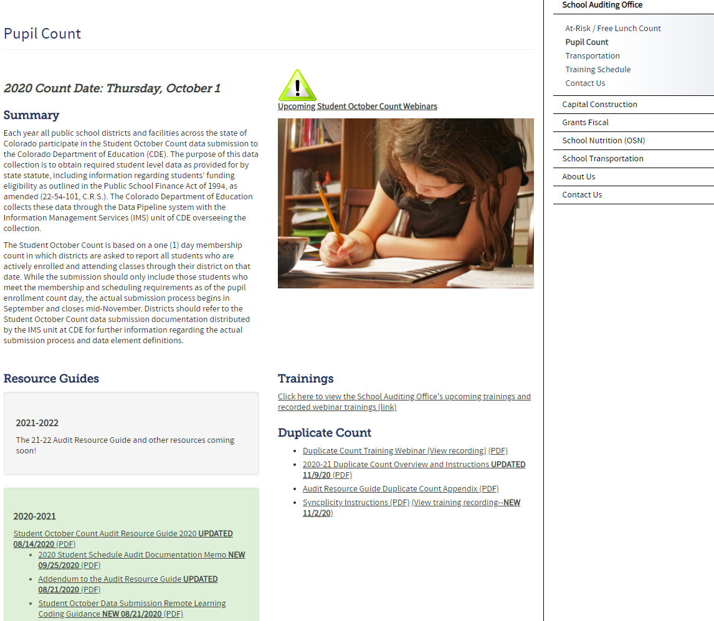
Student October Count Audit Resource Guide
The Guide can be found on the School Auditing Office’s Pupil Count webpage and is usually posted on or about July 1 for the upcoming school year
http://www.cde.state.co.us/cdefinance/auditunit_pupilcount

Slide 8
Student October Count Audit Resource Guide
The first 15 pages of the guide provide a general overview and primary funding and documentation requirements which apply to all students, regardless of the type of school or program in which they are enrolled and participate
The next section of the guide addresses unique students, courses, schools, and programs. Those listed are considered unique because:
The way in which a funding requirement is documented may vary from how they are documented for a traditional educational setting; AND/OR
They have additional funding requirements that must be met compared to students attending a traditional educational setting: AND/OR
They are an exception to the general funding requirement and documentation is necessary to show that the student meets the funding exception

Slide 9
Student October Count Audit Resource Guide

Slide 10
Funding Requirements

Slide 11
Funding Requirements
All students (regardless of the type of school or program in which they are enrolled) must meet the enrollment and attendance requirements in order to be considered for funding
If these requirements are met, then the level of funding for which students are eligible will be determined based on the number of teacher-pupil instruction and contact hours into which they are scheduled during the semester of the pupil enrollment count date

Slide 12
Enrollment and Attendance Requirements
All students (regardless of the type of school or program into which they are enrolled) who are submitted for funding must:
Be enrolled with the district as of the pupil enrollment count date, unless they qualify as a transfer enrollment exception
Within-State Transfer Exception
Out-of-State Transfer Exception
Must be in attendance (or participate) on the pupil enrollment count date
If absent for any reason:
Must establish attendance prior to the pupil enrollment count date during the current school year AND resume attendance within 30 days following the pupil enrollment count date

Slide 13
Scheduled Hours Requirement
If a student meets the enrollment and attendance requirements for funding, then the level of funding for which a student is eligible is determined by their individual student schedule as of the pupil enrollment count date
Part-time funding: Student is scheduled to receive a minimum of 90, but less than 360, hours of teacher-pupil instruction and contact time in the semester of the pupil enrollment count date
Full-time funding: Student is scheduled to receive a minimum of 360 hours of teacher-pupil instruction and contact time in the semester of the pupil enrollment count date

Slide 14
Audit Documentation

Slide 15
Audit Documentation Requirements (for All Students Regardless of School or Program Type)
School/Program Level Documentation
Calendar
Course catalog/student handbook
Course descriptions
Bell schedule (traditional classroom setting)/equivalency statement(s) (online school or program)
Student-Level Documentation
Evidence of enrollment
Evidence of participation/attendance
Individual student schedule
Any additional documentation as described in the Audit Resource Guide
For example: required audit documentation for transfer enrollment exception students, concurrent enrollment courses, work-based learning experience courses, etc.

Slide 16
Additional Audit Documentation (for Online School and Programs)
Authorizer Assurances
This document outlines all the ways in which an online school or program can demonstrate online participation at the student level
http://www.cde.state.co.us/onlinelearning/resources
Proof of Colorado Residency
Pursuant to 1 CCR 301-71-8.06, an online school or program must verify and document a student’s residency in the state of Colorado upon initial enrollment and annually thereafter, and retain a copy of the document or written statement in the student’s mandatory permanent record
Colorado residency is determined by the student and parent/legal guardian currently residing within the state of Colorado boundaries, except for students of military families
http://www.cde.state.co.us/onlinelearning/resources
Course Catalog/Documentation*
Should include course code, course title, assigned semester credit hours, equivalent teacher-pupil instruction and contact time, and (beginning in 21/22) a description of the course content
*Pursuant to 1 CCR 301-71-8.02, “the determination of full-time or part-time status is based upon the minimum number of hours provided for a student to receive instruction. Minimum hours can be based on the number of hours per day (or week) required to earn an equivalent number of credits in a traditional classroom setting.” As such, information in the course documentation is necessary to ensure that a reasonable equivalent teacher-pupil instruction and contact time is being applied to each scheduled course in order to arrive at the appropriate funding level for each student

Slide 17
Online Schools and Programs Section of the Guide

Slide 18
Online Schools and Programs section
This section of the Guide has been updated for the 2020-21 school year to provide more clarification regarding the funding and audit documentation requirements for online schools and programs
This information includes, but is not limited to:
Considerations when developing student schedules, and
Information about determining and documenting equivalent teacher-pupil instruction and contact time (i.e., “equivalency statements” and “course documentation”)

Slide 19
Online Schools and Programs section- Student Schedule Considerations
As of the pupil enrollment count date, all student schedules should clearly state all courses into which the student is scheduled during the semester of the pupil enrollment count date
Students should be aware of all courses in which they are expected to participate during the semester of the pupil enrollment count date
The school or program should be able to clearly document all schedule changes occurring during the semester of the pupil enrollment count date
Each student’s schedule should be developed to meet the student’s individual needs
Funding level should be based on the student’s entire equivalent fall semester schedule (i.e., semester 1, or quarters 1 and 2, or hexters 1, 2, and 3, etc.)

Slide 20
Online Schools and Programs section- Equivalent Hours considerations
Online schools and programs are encouraged to work closely with their Authorizer to determine an appropriate equivalent teacher-pupil instruction and contact time per course
Equivalency is meant to emulate the amount of teacher-pupil instruction and contact time a student would receive in a traditional classroom setting, if taking the same or similar course
Courses with varying assigned credits earned may have different equivalencies
For example, homeroom and orientation courses
Refer to the “Determining Equivalent Teacher-Pupil Instruction and Contact Time” subsection of this section of the Guide for more information

Slide 21
Online Schools and Programs section- Course Documentation (requirement)
Specific to the determination of full- and part-time funding eligibility
Can be contained within a singular document (such as course catalog, vendor course guidebook, student handbook, etc.), or a combination of documents
For each course listed on a student schedule (and used in the determination for funding), documentation that states the following:
Assigned semester credit hours (for students in grades 9-12)
Equivalent teacher-pupil instruction and contact time (i.e., equivalency statement as to the instructional hours per semester)
Should be within 10% of the total scheduled instructional hours for the same or similar course offered in a traditional classroom setting (as evidenced by credit hours)
Beginning with the 2021/2022 school year, a description of the course content with sufficient information so that a reasonable individual would have enough understanding of the material covered to understand the overall breadth of the course.

Slide 22
At-Risk/Free Lunch Count/Funding

Slide 23
At-Risk/Free Lunch Audit Resource Guide
The School Auditing Office has an At-Risk/Free Lunch Count webpage:
http://www.cde.state.co.us/cdefinance/auditunit_atrisk_freeandreduced
This webpage contains resources with which all online schools and programs should be familiar. These resources include:
At-Risk/Free Lunch Count Audit Resource Guide
At-Risk Data Validation Best Practices
Family Economic Data Survey (FEDS) form with instructions

Slide 24
Free Lunch Reporting/ At-Risk Count
In the Student October Count data collection, districts must report each individual student’s free and reduced-price meal status. The options are:
Not eligible/Paid
Free lunch eligible
Reduced lunch eligible
Students reported as free lunch eligible are included in the district’s at-risk count.

Slide 25
At-Risk Count Documentation
Districts must have documentation to support any student who is reported as free lunch eligible in the Student October Count data collection
Failure to have documentation to support a free lunch status may result in an at-risk count audit adjustment and subsequent audit liability
All current year documentation evidencing free lunch eligibility must be received on or between July 1 and the pupil enrollment count date
In the absence of current year documentation evidencing any lunch status, the district may use prior year (i.e., carryover) documentation, if one of the following applies:
The pupil enrollment count date falls within the first 30 school days of the current school year, or
The district requests, and is granted, a variance waiver

Slide 26
At-Risk Count Documentation
Acceptable audit documentation includes:
SNAP/TANF and Migrant Direct Certification Lists
Applications for Free and Reduced-Price School Meals
Family Economic Data Survey (FEDS) forms
Categorical Eligibility determination lists (such as district-created migrant, homeless, Head Start, runaway, and/or foster child lists)

Slide 27
Electronic Signatures

Slide 28
Electronic Signatures
Guidance related to acceptable electronic signatures for the Family Economic Data Survey (FEDS) form and the Affidavit of State of Colorado Residency will be included in the 2021 Student October Count and At-Risk Count Audit Resource Guides

Slide 29
Contact School Auditing Office: Rebecca McRee mcree_r@cde.state.co.us School Auditing Office Website http://www.cde.state.co.us/cdefinance/auditunit Office of Blended and Online Learning: Renee Martinez martinez_r@cde.state.co.us Rachel Matston matson_r@cde.state.co.us Office of Blended and Online Learning Website http://www.cde.state.co.us/onlinelearning

