Slide 1
Community Engagement in the Summer Food Service Program
Colorado Child Nutrition Programs Statewide Sharing Call
February 25, 2021
Notes:
Hi Everyone! I’m Kristi Brennan and I will be facilitating today with McKenna Pullen and Allison Butler. Welcome to our monthly statewide sharing call for Child Nutrition Program operators. These calls are scheduled for the last Thursday of each month and are a great opportunity to hear about what is happening around Colorado. Just a reminder that you can register for these calls through the Dish each month or via the CDE- School Nutrition training website.
The structure of this month’s call is going to be a little different than previous On the Menu calls. It is the first call of our Masterclass Leadership series, which is a part of our Blueprint to End Hunger grant through the Colorado Health Foundation. The leadership series is going to focus on using partners and peers who are experts in the field to present on topics that will help you build skills and provide you with tools to grow your program. Today’s call focuses on community engagement in the Summer Food Service Program. We are very excited to have partners and sponsors share their experiences and hope you walk away with actionable steps to incorporate into your program.
Hunger Free Colorado will speak to the importance of engagement and being participant-centered, sponsors will share their experience with community engagement, and Cooking Matters will share ways to connect parents with the resources they need.

Slide 2
Audio Details
Use Q&A to ask submit questions
Mute and unmute yourself on the conference line
For technical difficulties, contact Allison Butler:
Butler_a@cde.state.co.us
303-242-6830
Notes:
I’m going to cover some quick housekeeping items before we jump into the conversation.
One thing you may have noticed is we are using a different platform, Zoom, this month. We have a bilingual presentation planned with both English and Spanish speakers. On the next slide, we’ll walk you through how to turn on interpretation so you can follow the entire presentation in the language of your choice.
We are in a webinar format so all attendees will be muted throughout the presentation. Please submit all questions using the Q&A. All questions will be answered at the end.
If you experience audio or technical difficulties, please contact Allison Butler. Her information is listed on the slide and available in the Chat.

Slide 3
Interpretation (Interpretación)
This presentation will be bilingual with English and Spanish on all slides
Click Interpretation > English for interpretation
Click “Mute original Audio”
Esta presentación será bilingüe con inglés y español en todas las dispositivas.
Haga clic en Interpretación > Español para traducir
También haga clic en “Mute Original Audio”

Slide 4
Interpretation (Interpretación)
To access interpretation on the zoom phone application, press the 3 dots on the bottom right → click language interpretation → click on english and mute original audio
Para acceder la interpretación a través de la aplicación de zoom en el teléfono, presione los 3 puntos en la parte de abajo hacia la derecha → haga clic en “language interpretation” → haga clic en “Spanish” y en ”mute original audio”

Slide 5
CDE Vision
All students graduate ready for college and careers and are prepared to be productive citizens of Colorado.
CDE School Nutrition Unit Mission
The School Nutrition Unit is committed to ensuring all school-aged children have equal access to healthy meals by supporting, training, and connecting Colorado’s child nutrition community.
5

Slide 6
Non-Discrimination Statement
In accordance with Federal civil rights law and U.S. Department of Agriculture (USDA) civil rights regulations and policies, the USDA, its Agencies, offices, and employees, and institutions participating in or administering USDA programs are prohibited from discriminating based on race, color, national origin, sex, disability, age, or reprisal or retaliation for prior civil rights activity in any program or activity conducted or funded by USDA. Persons with disabilities who require alternative means of communication for program information (e.g. Braille, large print, audiotape, American Sign Language, etc.), should contact the Agency (State or local) where they applied for benefits. Individuals who are deaf, hard of hearing or have speech disabilities may contact USDA through the Federal Relay Service at (800) 877-8339. Additionally, program information may be made available in languages other than English.
To file a program complaint of discrimination, complete the USDA Program Discrimination Complaint Form, (AD-3027) found online at: https://www.usda.gov/oascr/how-to-file-a-program-discrimination-complaint, and at any USDA office, or write a letter addressed to USDA and provide in the letter all of the information requested in the form.
To request a copy of the complaint form, call (866) 632-9992. Submit your completed form or letter to USDA by: (1) mail: U.S. Department of Agriculture Office of the Assistant Secretary for Civil Rights; 1400 Independence Avenue, SW Washington, D.C. 20250-9410;
(2) fax: (202) 690-7442; or (3) email: program.intake@usda.gov.
This institution is an equal opportunity provider.
Notes:
This slide features the non-discrimination statement, again something you are likely all familiar with.

Slide 7
Learning Objectives
Understand the importance of authentically engaging the community (those with lived experience) to implement community centered summer meals programming
Learn what tools are available for better outreach and what is needed to incorporate outreach in your program
Professional Standards: Communications and marketing (4100)

Slide 8
HungerFreeColorado.org
Notes:
NOTE: Feel free to personalize if wanted.
TALKING: Use this opportunity for the “last word” – What do you want to leave people with? What do you want them to remember?

Slide 9
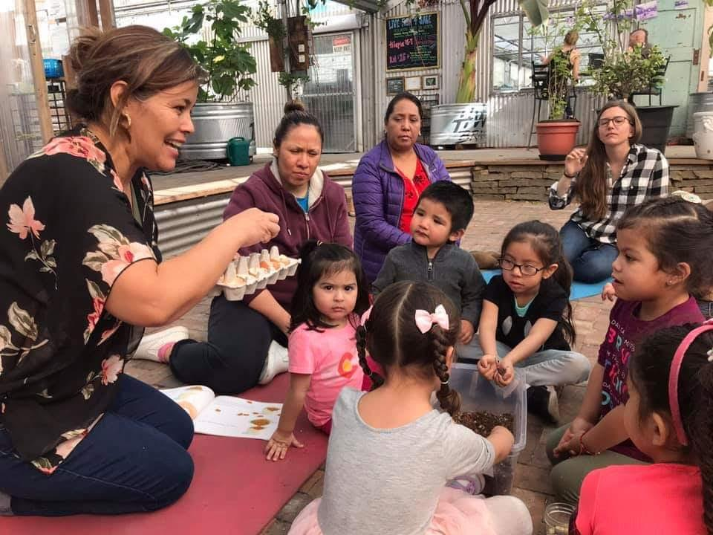
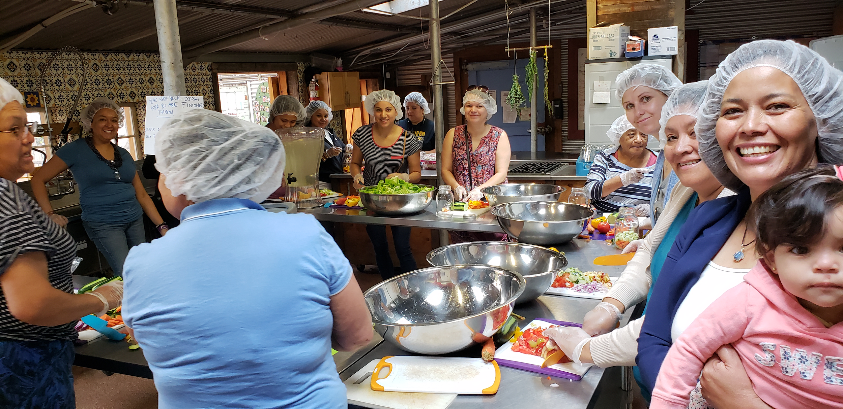
Notes:
Paola Babb
Before I start talking about community engagement, I want to start with why I am passionate about this work.
Originally from Mexico moved to Colorado when I was 5 – been here even since. I grew up in Lafayette.
Grew up undocumented we overstayed our VISAs
Food insecure – used programs like Summer meals, NSLP and food pantries
DACA recipient
Green card Holder now US Citizen
Past work experience that ignited my passion in food access
Nutrition
WIC
Food Panrty
Hunegr Free CO

Slide 10
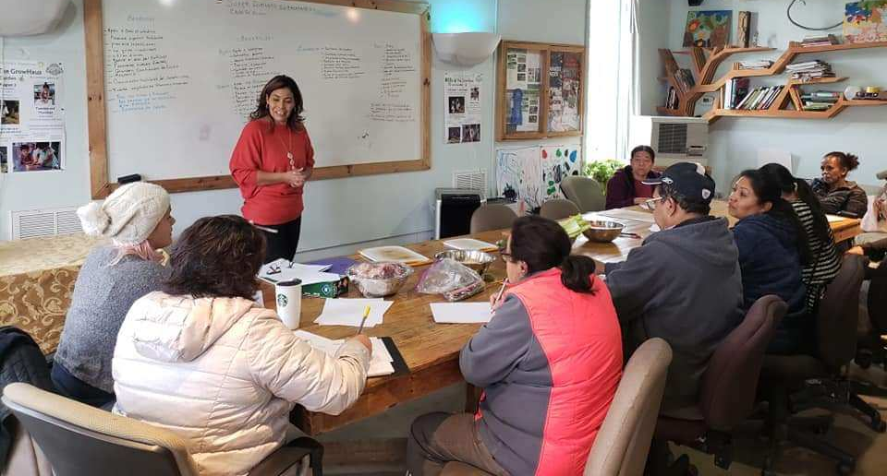
Community Engagement
The goal of Community engagement is to have a society where each member has the tools and power to direct the creation of community resources and be valued as the experts in health, education and well being of their families.
What do we mean by community?
What is lived experience?
El objetivo de la participación comunitaria es tener una sociedad donde cada miembro tenga las herramientas y el poder para dirigir la creación de recursos comunitarios y ser valorado como los expertos en salud, educación y bienestar de sus familias.
¿Qué entendemos por comunidad?
¿Qué es la experiencia vivida?
Notes:
Today we will be talking about the importance of community engagement in SFSP When doing community engagement the goal is to have a society where each member has the tools and power to direct the creation of community resources and be valued as the experts in health, education and well being of their families.
Before we begin on defining that we have to first acknowledge and define what do we mean when we say community? What is lived experience.
What we mean by that is Expertise that doesn’t come from training or formal education.
Knowledge from an experience in a person’s past or present with an issue or challenge.
People with lived experience know a system, process or issue from the perspective of those affected, or trying to engage with a resource.
They know what works, what doesn’t work, and what resources (formal or informal) are or should be available.
They know what’s needed to make things better

Slide 11
The Importance of this work
The community is a pillar for its programs, that is why a connection must be created, that connection:
Create links and trust
Informs programs and decision:
You have a better idea of ​​what type of program the community would benefit from and take advantage of
Gives for better communication
The community feels that their ideas and needs are taken into account
You have program rooted in Equity
La comunidad es un pilar para sus programas, por eso se debe crear una conexión, esa conexión:
Crea enlaces y confíanza
Informa programas y decisiones:
Que asegura que tengas una mejor idea de qué tipo de programas beneficiaría a la comunidad
Da para mejor comunicación
La comunidad siente que los toman en cuenta y que sus ideas y necesidades son importantes
Tienes programa basados en la equidad
Notes:
Ya que hablamos de a quien nos referimos cuando hablamos de la comunidad ahora vamos a hablar del porque debemos de involucrar a la comunidad en nuestros programas (como las comidas se verano - summer meals)
La comunidad es un pilar para sus programas, por eso se debe crear una conexión, esa conexión:
Crea enlaces y confíanza
Informa programas y decisiones:
Que asegura que tengas una mejor idea de qué tipo de programas beneficiaría a la comunidad
Facilita el Trabajo basado en sus Culturas y necesidades ( una de ellas comida Saludable)
Las familias se familiarizan con el programa
Da para mejor comunicación
La comunidad siente que los toman en cuenta y que sus ideas y necesidades son importantes
Tienes programa basados en la equidad

Slide 12
How to engage the community
Authentic community engagement will create an inclusive process for informing, designing, implementing, and evaluating Summer Meals programming that centers the community.
How to engage the community:
Create a vision/goals for engaging the community
Commit to engaging people for the success of your program
Ask questions that will help lead to solutions
Create opportunities for additional engagement
Partner with community organizations to help get this work off the ground
El enlace comunitario auténtico va a crear un proceso inclusivo para informar, diseñar, implementar y evaluar la programación de las comidas de verano que centra la comunidad.
Pasos para involucrar a la comunidad?
Crear una visión/metas
Comprometerse a involucrar a las personas para el éxito de su programa.
Hacer preguntas que le ayudarán a encontrar soluciones
Crear oportunidades para que la comunidad se involucre en el programa:
Colaborar con organizaciones comunitarias
Notes:
El enlace comunitario auténtico va a crear un proceso inclusivo para informar, diseñar, implementar y evaluar la programación de las comidas de verano que centra la comunidad.
Ahora vamos hablar sobre los pasos que deben tomar para poder hacer este tipo de trabajo en una manera autentica.
Primero tienen que desarrollar una visión: Háganse la pregunta de Cual es tu meta/visión para hacer enlaces con la comunidad esto es muy importante PORQUE si nomas estan involucrando a las comunidad por beneficio propio y no les nace van a fracasar y no van a poder inspirar confianza en una manera sincera en su comunidad.
Después de crear la visión no nomas van a embarcar en este trabajo sino comprometerse a involucrar a las personas para el éxito de su programa. Esto quiere decir que van a:
Hacer relaciones/crear conexiones
al hacer esto deben de Invertir tiempo en las familias
Tener conversaciones con las familias sobre su experiencia y sobre sus necesidades
Pueden tener conversaciones cuando las familias están en fila y hacer preguntas como “que piensas del programa” “que te gustaría ver mas”
Esto tambien se puede llevar acabo a través de encuestas. Cuando estan haciendo enscustas deben de ser transparentes con su comunidad y explicar la meta del uso de la información que se está recaudando y preguntar cómo la comunidad gusta seguir involucrada
Organizar procesos participativos
Siempre es importante tener interpretación disponible o empleados bilingües porque esto derrumba las barreras del Idioma y ayuda a que más personas participen en sus programas
También se deben crear oportunidades para que la comunidad se involucre más en el programa esto ayudará a movilizar a la comunidad en la toma de decisiones y de acción, con las familias con las que han estado conversando o entrevistado o hecho preguntas a través de encuestas a esas familias las puedan reclutar y
Hacer sesiones de escucha
Tener juntas comunitarias
Crear un comité directivo
en estas oportunidades se pueden tener conversaciones sobre necesidades, barreras de acceso y juntos deciden cuales son las soluciones necesarias
Donde se deben de abrir más lugares o donde podemos alcanzar a las familias, con quienes más podemos colaborar para correr la voz
También se brinda la oportunidad de proyectos comunitarios como recaudar recetas o identificar cuales son los dones de cada persona y ellos mismos se van a querer involucrar y dar de su parte
Al hacer todo esto también es importante dar Seguimiento y siempre seguir la conversación. All involucrar a la comunidad nos comprometemos a escuchar cuales son las necesidades y estar dispuestos a invertir tiempo para juntos colaborar en las soluciones.
Otra cosa importante es colaborar con organizaciones comunitarias para que ellos puedan referir a más familias y para dar confianza

Slide 13
Community Engagement Results
Having programs in accessible times/places that eliminate barriers to participation
Creating a culture of inclusion
Having trust in the community
Sharing power
Ensuring kids have access to proper nutrition!
Resultados de involucrar a la comunidad:
Tener programas en tiempos / lugares accesibles que eliminan barreras en la participación.
Crear una cultura de inclusión
Tener confianza en la comunidad
Compartir el poder
Los niños tendrán acceso a una alimentación saludable
Notes:
El resultado de involucrar a la comunidad es que sus programa de verano tendrán más éxito!!!!!
Van a tener programas que son accesibles, en lugares apropiados en tiempos apropiados que eliminan barreras
Ustedes van a conocer mejor a su comunidad y van a poder mejorar el programa poco a poco a través de las soluciones propuestas de la comunidad
Van a crear una cultura de inclusión en la que las familias van a estar satisfechas y participarán más en programa PORQUE se sentirán que los están tomando en cuenta al hacer en la implementación de los programas, ellos se sentirán que ustedes los ven como expertos en la comunidad y quieren colaborar con ellos para estos programas que son para ellos.
Esto crea confianza y hace que las familias mismas corran la voz y algan el alcance para que todas las familias sepan del buen trabajo que están haciendo
VAN A COMPARTIR PODER porque juntos hacen las decicones
Y lo mas importante es que Los niños tendrán acceso a una alimentación saludable

Slide 14
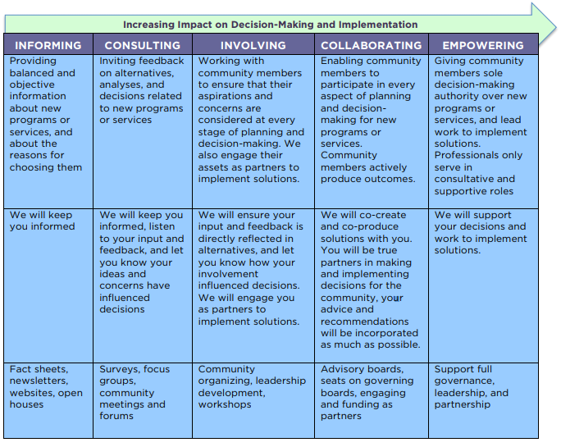
Community Engagement Spectrum
Activities Message to the Community Goals
Notes:
For true community engagement, professionals need to take a step back to create a space for residents, program participants, community members to discuss their own hopes and dreams and the roles they can play to achieve their dreams. True support is when professionals allow citizens to be in charge of their own destinies and then step in when their help is requested. e Collective Impact Forum
Thriving, diverse, equitable communities are possible through deep participation, particularly by communities commonly excluded from having power.
https://movementstrategy.org/b/wp-content/uploads/2019/09/Spectrum-2-1-1.pdf

Slide 15
Outreach Strategies
Simple outreach steps sponsors can take to help inform students/communities to ensure students receive the summertime nutrition they need:
Send flyers home with site locations/hours
Do robo-calls
Send an email to parents
Print information about summer meals on the back of lunch menus
Share information on social media pages
Partner with community organizations/promotoras - start building trust
Pasos sencillos de alcance comunitario que los patrocinadores pueden tomar para ayudar a informar a los estudiantes / comunidades y garantizar que los estudiantes reciban la nutrición de verano que necesitan:
Mandar volantes con las horas y el lugar
Hacer llamadas robóticas
Mandar correos electrónicos
Compartir la información en las redes sociales en los sitios de web
Colaborar con organizaciones comunitarias / promotoras - comiencen a generar confianza
Notes:
Ya que hablamos de cómo involucrar más a la comunidad en sus programas para poder tener programas exitosos guiados por la comunidad, también debemos de hablar sobre cómo correr la voz de nuestro programa.
Si queremos generar conversaciones tenemos que tener participación. A través de sesiones de escucha que Hunger Free Colorado a hecho y también por experiencia propia sabemos que a las familias les gusta recibir la informacion atravez de todos los métodos porque esto asegura que las familias van a recibir la información. Ustedes como patrocinadores para el programa de verano si quieren informar a los estudiantes / comunidades sobre su programa y garantizar que los estudiantes reciban la nutrición de verano que necesitan deben:
Distribuir volantes con la información de sus programa esto se puede hacer en:
Las escuelas, bibliotecas, lugares comunitarios,
Hacer llamadas robóticas
Mandar correos electrónicos
Mandar mensajes de texto
Compartir la información en las redes sociales en sus sitios de web
Colaborar con organizaciones comunitarias / promotoras - comiencen a generar confianza - estas personas u organizaciones ya tienen la confianza en sus comunidades y pueden explicarles a las familias sobre los programas disponibles en la comunidad

Slide 16
Outreach Resources
SFSP Outreach Materials:
CDE SFSP Toolkit
HFC SFSP Promotora Toolkit
Important links/number:
Kinds Food Finder Website
No Kid Hungry Texting Line 877-877
Materiales de alcance de SFSP:
Kit de herramientas de CDE SFSP
Kit de herramientas de HFC SFSP
Enlaces importantes/número:
Sitio web de Kinds Food Finder
Línea de mensajes de texto de No Kid Hungry 877-877
Notes:
The toolkit includes:
Flyers
Step by step guide on how to fill out the application
Templates for:
Email/Newsletter
Robo Call/Phone Call
Text Messages
Social Media messaging, pictures and a video
Powerpoint
Frequently Asked questions

Slide 17
Community Engagement Resources
Need help getting started with Community Engagement? Consult Hunger Free Colorado!
paola@hungerfreecolorado.org
¿Necesita ayuda para comenzar con la participación comunitaria? ¡Consulte a Hunger Free Colorado!
paola@hungerfreecolorado.org

Slide 18
Sponsor Stories

Slide 19
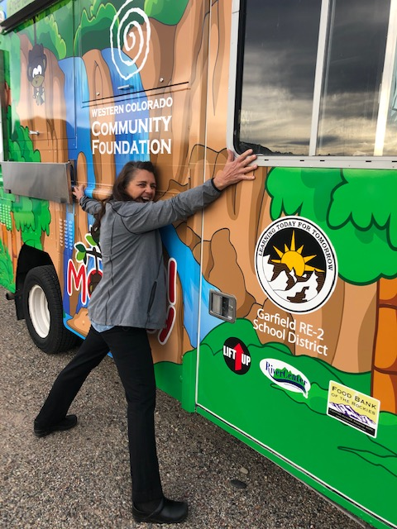
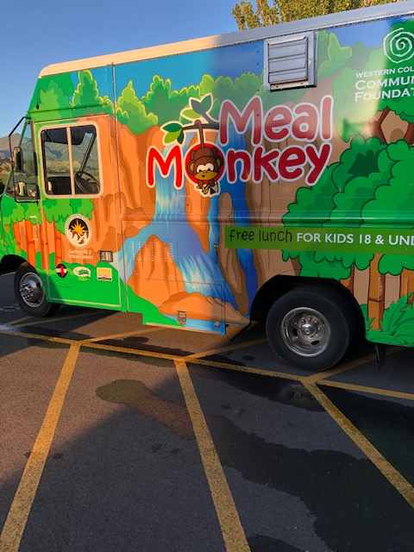
Garfield RE2
Notes:
Intro: Mary McPhee is the Director of Nutrition at Garfield RE-2 School District in Rifle, CO. She wasn’t able to be here today but shared some community engagement strategies that have worked for her program. Their program operates via a food truck called the Meal Monkey.
Mary stresses that relationships are key to success in the summer meals programs. She has worked with groups like:
Fire/Colorado River Rescue
Local library
Animal Shelter
Police Dept.
Wilderness/Parks Dept.
Youthzone
High School students
Elks Club
These types of organizations want to help kids. When reaching out, she recommends having a plan and a specific ask- like, "would you be willing to send someone from your group to help us feed the kids free lunches?" or maybe " Is there any way you could help support our Summer Feeding Program and feed all children this summer?"
They will say yes, and then ask “What do you need”? Again, be specific with your response. Something like, “we could use your help on Tuesdays on our Meal Monkey Route from 11a-1P to hand out stickers and badges” Or whatever it is that your program needs support with. Mary was able to secure a food truck, the Meal Monkey, as a donation from the Western Colorado Community Foundation after telling the story of her program and asking for support. The food truck has allowed Mary to expand her program and provide meals to more kids than she can with traditional sites.
Mary’s second point is that businesses always want good publicity. Mary recommends calling or emailing the business and asking for the general manager. Again, be specific and explain how they can help ensure that kids in their community have access to no-cost, nutritious meals when those kids are not in school. Mary explains that if the business is able to provide a small donation, she puts their logo on flyers and other promotional materials for her program. Mary has had success working with local car dealerships and local banks in this capacity. You can also reach out to local non-profits that have a mission that aligns with that of the summer meals program to see if they can provide a donation for your program. When reaching out to these organizations for support, Mary recommends bringing pictures of the program, participation statistics, or other information to demonstrate how their support can help kids in their community.
Finally, Mary wants to stress that building a strong program takes time. If an organization doesn’t have capacity to help this year, keep reaching out year after year to continue building those relationships.

Slide 20
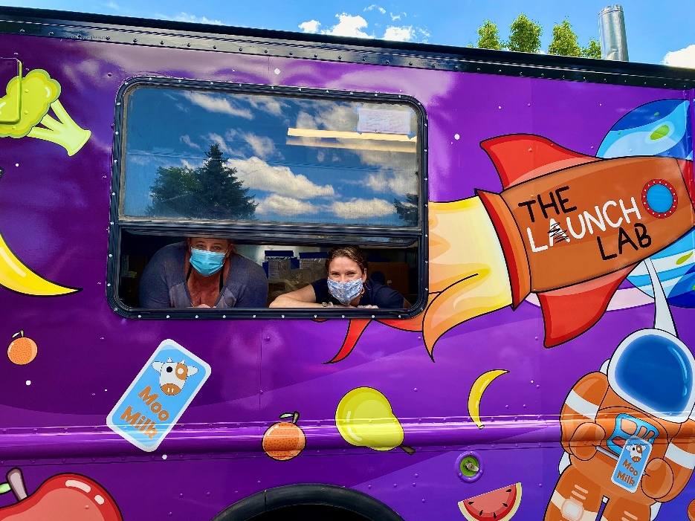
The Food Bank for Larimer County
The Lunch Lab
Mobile meal program
Program rebrand to reduce stigma and increase fun
Kid-centric
No Food Bank logo
Increasing participation
Punch cards, prizes, free books, bubble machine
Notes:
The Lunch Lab is our food truck that we take 3-4 locations daily. Typically we serve hot meals out of the food truck. With meal waivers last summer we also provided additional cold meals to take home. Previously our food truck had a wrap that was photos of fruit. It was pretty, but it wasn’t super kid friendly. Last summer we decided to give our program a name “Lunch Lab” and create fun, kid-centric branding to go along with the new name. The idea was to make the food truck fun, approachable, and less food bank-y. Some other fun things we have done to increase participation is creating a punch card. Once kids come to 6 meal services they get to choose a prize. They could even be $1 store toys. But, the kids get very excited about filling up their punch cards. Last summer, a local library gave us free new books to hand out. That helped us draw in more children and provided an additional resource to kids. We also really work to make it fun. Our staff that runs the food truck is always wearing fun hats or glasses and she puts out a bubble machine that the kids love! One last thing is we very intentionally did not put our logo on the truck. We want their to be no stigma attached to the food truck and truly make it so the food truck represents a place that any child can get a healthy meal.

Slide 21
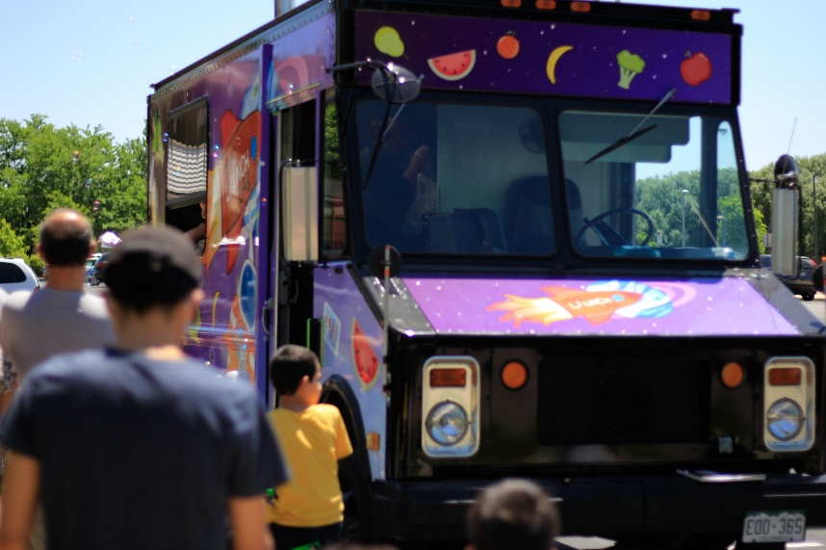
The Food Bank for Larimer County
Community partnerships
Meeting children where they congregate
Parks, libraries, housing locations, Farmer’s Market
Activity partners
Bookmobile, Parks & Rec, UC Health
Adult meals
Grant funded
Provide dignity
Model healthy eating
Contact Information:
Diane Matthews
Dmatthews@foodbanklarimer.org
Notes:
You may be wondering where we go with our food truck! I should note this food truck is only one of our summer routes. Last summer we also partnered with our school districts and they provided buses to do an additional route! With all of our meal sites we try to meet the kids where they are at—whether a park, library, or mobile home park. Over the years we have learned which parks are the most popular. Typically it’s parks that have some sort of water feature. We also have partnered with other programs, such as a Bookmobile or a program with Parks and Rec that provided games/activites for kids at low-income housing complexes (pre-COVID). One last success we found was providing adult meals last summer. We know that children model parent’s eating habits. Additionally it was always difficult knowing that adults often skip meals to feed their children and it was difficult not being able to feed the adults as well. We found funding and provided hot meals to any adult that came to a meal service with a child.

Slide 22
Share Our Strength’s Cooking Matters Colorado
Sara Diedrich - Program Manager
sdiedrich@strength.org
Maria Ashley – Program Manager
mashley@strength.org
Notes:
Resources from Cooking Matters Colorado:
• Stretching Food Resources: COVID-19 – https://co.cookingmatters.org/stretching-food-resources-covid19 Cooking Matters is currently redesigning the flyers found at this link. The content will be the same, but the new flyers will be more colorful and eye catching. We’ll inform you once they’ve been updated for summer meal site distribution.

Slide 23
P-EBT Updates
Pandemic-EBT (P-EBT) benefits for SY2020-21 are coming soon!
Currently sponsors should:
Complete direct certification uploads as much as possible
Encourage families to continue to apply for free and reduced-price meals
Encourage families to ensure mailing address, phone number and email are up to date within parent portals and/or at the district level
Ensure pertinent staff in your district responsible for updating student household information are in the know!

Slide 24
P-EBT Updates
P-EBT benefits to be auto-issued to eligible students based on up-to-date sponsor level data for:
Student eligibility status
Household information (mailing address)
Hybrid schedules, remote or in-person
Please help collect information for Hybrid schedules by completing this form:
Hybrid schedule information will help determine simplified assumptions for P-EBT benefit amounts
For questions, contact free&reducedpriceschoolmeals@cde.state.co.us

Slide 25
Questions?
Notes:
Allison to facilitate Q&A

Slide 26
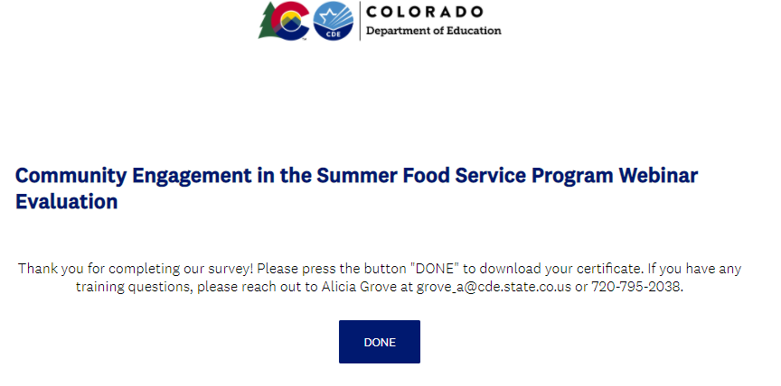
Training Evaluation and Certificate
Click this link to complete a quick training evaluation
https://www.surveymonkey.com/r/TLW5V6N
When you submit your evaluation, click “DONE” on the survey thank you page to download your certificate
Notes:
This link will be emailed out to all training attendees. This information is included for those watching this training at a later date as a recording.
Thank you so much for your feedback- we are always looking for ways to improve our trainings to better support you.

Slide 27
Next On the Menu Call:
March 25, 2021, 2-3pm
Summer Food Service Program Sponsor Training
Part 1
Notes:
Thank you all so much for joining todays on the Menu Call. Please join us on, March 25 from 2-3 pm where we will discuss the Summer Food Service Program Sponsor Training Part 1. If you have previously registered for the On the Menu calls through Adobe Connect, you will use the same link to join this call. If you need to register for this call, stay tuned for registration links for the SFSP part 1 and part 2 trainings in The Dish.

