Slide 1
Civil Rights in Child Nutrition Programs
School Nutrition Unit

Slide 2

CDE School Nutrition
Vision
Mission
Nourish young bodies and minds. End childhood hunger.
We support the child nutrition community through innovation, training, and partnerships to ensure all youth have access to healthy meals.
Notes:
We have spent time updating our vision and mission, so please take a few seconds to read these to yourself.

Slide 3
Non-Discrimination Statement
In accordance with federal civil rights law and U.S. Department of Agriculture (USDA) civil rights regulations and policies, this institution is prohibited from discriminating on the basis of race, color, national origin, sex (including gender identity and sexual orientation), disability, age, or reprisal or retaliation for prior civil rights activity.
Program information may be made available in languages other than English. Persons with disabilities who require alternative means of communication to obtain program information (e.g., Braille, large print, audiotape, American Sign Language), should contact the responsible state or local agency that administers the program or USDA’s TARGET Center at (202) 720-2600 (voice and TTY) or contact USDA through the Federal Relay Service at (800) 877-8339.
To file a program discrimination complaint, a Complainant should complete a Form AD-3027, USDA Program Discrimination Complaint Form which can be obtained online at: https://www.usda.gov/sites/default/files/documents/USDA-OASCR%20P-Complaint-Form-0508-0002-508-11-28-17Fax2Mail.pdf, from any USDA office, by calling (866) 632-9992, or by writing a letter addressed to USDA. The letter must contain the complainant’s name, address, telephone number, and a written description of the alleged discriminatory action in sufficient detail to inform the Assistant Secretary for Civil Rights (ASCR) about the nature and date of an alleged civil rights violation. The completed AD-3027 form or letter must be submitted to USDA by:
1. mail:
U.S. Department of Agriculture
Office of the Assistant Secretary for Civil Rights
1400 Independence Avenue, SW
Washington, D.C. 20250-9410; or
2. fax:
(833) 256-1655 or (202) 690-7442; or
3. email:
program.intake@usda.gov.
This institution is an equal opportunity provider.
Notes:
We include the nondiscrimination statement in our trainings as a reminder of our responsibilities to ensure all eligible people may participate in our child nutrition programs. As equal opportunity providers, we prohibit discrimination in our programs and provide fair treatment to every participant.

Slide 4
Learning Objectives
Learning Objectives
Demonstrate understanding of civil rights laws, regulations and procedures related to child nutrition programs.
Make use of resources and information to ensure compliance with all civil rights requirements.
Notes:
USDA requires all Child Nutrition Program staff to attend civil rights training annually to understand laws, regulations, and procedures
The purpose of civil rights training is to inform, educate, and support all staff who have a role in the child nutrition programs. This training will cover USDA civil rights requirements, staff responsibilities, and resources and information available to assist staff in carrying out their civil rights responsibilities. These regulations are intended to ensure that the benefits of the child nutrition programs are made available to all eligible people in a non-discriminatory manner.

Slide 5
Civil Rights Training Requirements
Training Requirements
Training must be completed annually for all staff
Sponsors must keep training records for all staff
Visit our Civil Rights webpage for additional training resources
Administrations: Program Management 3200: 1 hour
Notes:
This training counts as your annual training requirement.
All staff who work with child nutrition programs must receive training on all aspects of civil rights compliance that is specific to the USDA child nutrition programs.
As with all training, be sure to record completion of this training and any other staff civil rights training on your professional standards log and training sign-in sheets as applicable.

Slide 6
Civil Rights Topics Overview
Topics Overview
Civil Rights Background and Purpose
Public Notification Requirements
Complaint Requirements
Customer Service/Conflict Resolution
Racial and Ethnic Data Collection
Reasonable Accommodations
Limited English Proficiency
Administrative Reviews and Resolutions of Noncompliance
Notes:
Listed here are the required training topics that we will cover in this training. These must also be included with all staff civil rights training.

Slide 7
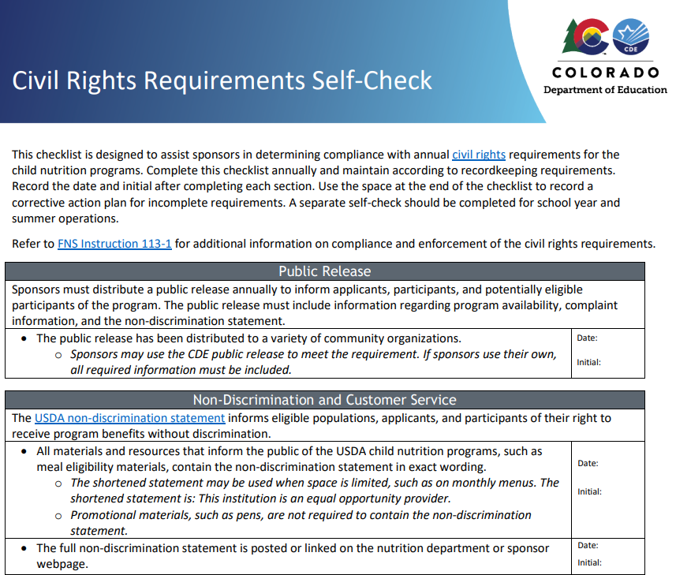
Self-Check
Notes:
I do want to call attention to new resource, the civil rights requirements self-check. This resource is designed to help you check that all civil rights requirements are in place for the upcoming school year and take action on any that may need to be completed. We are going to drop it in the chat so you can follow along and make notes if needed today. This is also available on our civil rights webpage.

Slide 8
Background and Purpose
Notes:
Let’s begin by reviewing the background and purpose of our civil rights.

Slide 9
Civil Rights are:
“The nonpolitical rights of a citizen; the rights of personal liberty guaranteed to U.S. citizens by the 13th and 14th Amendments to the U.S. Constitution and the acts of Congress.”
Notes:
Civil rights refer to the rights of “personal liberty” guaranteed by the 13th and 14th Amendments to the US Constitution and Acts of Congress and to the fair and equitable treatment of all customers and employees. There are numerous civil rights acts and laws that were enacted over the course of the last 50 years, and it began with Title VI (six) of the Civil Rights Act of 1964. This act led the way and addressed discrimination in relation to race, color, and national origin in programs and activities that receive federal financial assistance.

Slide 10
Civil Rights in Child Nutrition Programs
Regulations provide the procedures to follow so benefits are made available to all eligible persons in a non-discriminatory manner
All sponsors receiving federal money must implement civil rights requirements
Food and Nutrition Services (FNS) Instruction 113 is the federal regulation governing civil rights in the child nutrition programs
Notes:
The purpose of this training is to provide guidance to ensure compliance with civil rights requirements and protect against discrimination in all our nutrition programs.
Our regulations direct us on the proper procedures to follow so that benefits of our programs are made available to all eligible persons in a non-discriminatory manner
All sponsors receiving federal money must implement civil rights requirements to be eligible for the child nutrition programs
Food and Nutrition Services (FNS) Instruction 113 is the federal regulation governing civil rights in the child nutrition programs

Slide 11

Goals of Civil Rights
Eliminate barriers to programs
1
Provide equal treatment to all
2
Explain rights and responsibilities
3
Show respect and dignity
to all
4
Notes:
The goals of civil rights include:
Eliminating barriers that prevent or deter people from receiving benefits of a government-sponsored or funded program
Providing equal treatment to all in the delivery of programs and services to all applicants, participants, and beneficiaries of a federal program
Ensuring that all applicants and participants understand their rights and responsibilities
Showing respect and dignity to all

Slide 12
What is Discrimination?
Discrimination is the act of distinction of one person or a group of persons from others; either intentionally, by neglect, or by actions or lack of actions based on their protected classes
  Protected classes:
    Race
    Color
    National origin
    Sex (including gender identity and sexual orientation)
    Age
    Disability
Notes:
What is discrimination? Discrimination is the act of distinction of one person or a group from others; either intentionally, by neglect, or by actions or lack of actions based on their protected classes.
A protected class refers to any person or group of people who have characteristics for which discrimination is prohibited based on a law, regulation, or executive order.
Protected classes in the child nutrition programs are: race, age, color, sex, national origin, and disability. Note that sex now includes gender identity and sexual orientation.

Slide 13
Unlawful Discrimination Examples
Giving one group or type of participants larger or extra helpings of food while not providing the same to other groups or types of participants
Failing to provide program information to all potential program participants
Failing to provide children with meals to meet their medically-documented dietary needs
Notes:
Let’s look at examples of unlawful discrimination; which may include:
Giving one group or type of participants larger or extra helpings of food, such as serving male students larger portions than female students
Failing to provide program information to all potential program applicants, which may include not distributing program information in a language specific to the population your program serves
Failing to provide meal accommodations for children with documented special dietary needs

Slide 14
Knowledge Check
Which staff members must receive annual civil rights training?
  A: Kitchen staff
  B: Staff processing free and reduced-price meal applications
  C: Teachers serving and counting meals in the classroom
  D: All the above
True or False?
  Acts of discrimination are always intentional.
Notes:
Which staff members must receive annual civil rights training?
A: Kitchen staff
B: Staff processing free and reduced-price meal applications
C: Teachers serving and counting meals in the classroom
D: All the above
*click for answer*
Answer: all the above
All staff involved with the federal meal programs must receive annual civil rights training. Teachers who take part in serving and counting meals in the classroom can receive training using CDE School Nutrition’s training memo or by viewing training specific to the child nutrition programs.
Memo: https://www.cde.state.co.us/nutrition/civilrightsbicteacherstrainingmemo
*click*
True or False?
Acts of discrimination are always intentional.
*click for answer*
Answer: False
Discrimination can be intentional, by neglect, or by lack of actions.

Slide 15
Public Notification
Notes:
All our child nutrition programs must include a public notification system. The purpose of this system is to inform applicants, participants, and potentially eligible persons of the program availability, program rights and responsibilities, the policy of non-discrimination, and the procedure for filing a complaint.
The public notification system includes 3 basic elements.

Slide 16
Program Availability
1. Take specific action to inform applicants, participants, and potentially eligible persons of their program rights and responsibilities and the steps necessary for participation.
Eligibility and benefits
Services
Accommodations for participants with disabilities
Location of local facilities or service delivery points
Hours of service
Notes:
First, the public notification system must provide information on program availability. Each state agency, local agency, or other sub-recipient that distributes program benefits and services must take specific action to inform applicants, participants, and potentially eligible persons of their program rights and responsibilities and the steps necessary for participation.
This also includes making information available on how you make accommodations for children with disabilities, which may include posting a special dietary needs procedure on your website.

Slide 17
Public Notification
  2. Complaint Information
    Applicants and participants must be advised of their right to file a complaint, how to file a complaint, and the complaint procedures
  3. Non-discrimination statement
    All informational materials and resources, including websites, used to inform the public about Food and Nutrition Services (FNS) programs must contain the nondiscrimination statement
Notes:
The other two required elements of the public notification are providing complaint information and including the non-discrimination statement.
Applicants and participants must be advised at the service delivery point of their right to file a complaint, how to file a complaint, and the complaint procedures.
All informational materials and resources, including websites, used to inform the public about FNS programs must contain a non-discrimination statement. We will cover complaint procedures and the non-discrimination statement later in this presentation.

Slide 18
Methods of Public Notification
Public notification can include methods such as:
  Internet and computer-based applications
  Newspaper
  Radio/television
  Letters/leaflets/brochures
  Bulletins
  All notifications must include non-discrimination statement
Notes:
Public notification can include methods such as:
Internet and computer-based applications, such as social media
Newspaper
Radio/television
Letters/leaflets/brochures
Bulletins

Slide 19
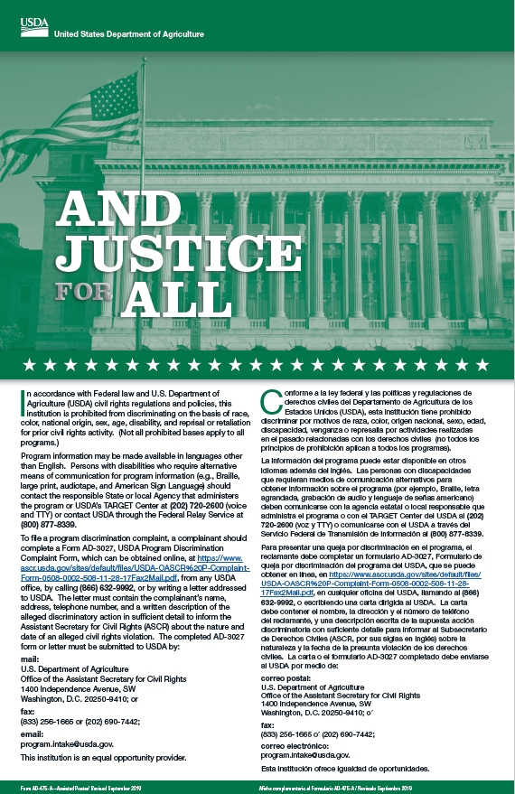
“And Justice for All” Poster
Prominently display the current “And Justice for All” USDA non-discrimination poster
In each dining location
SFSP sponsors must also display in the sponsor’s office
In a location that is easily visible
Must be 11”x17” in size
Temporarily allowable PDF version
Notes:
Sponsors are required to prominently display the current “And Justice for All” USDA non-discrimination poster. Posters should be displayed in each dining area and in a location that is easily visible to the students and the public. It does not need to be posted in each classroom if meals are served in classrooms. Summer Food Service Program sponsors must also display the poster in the sponsor’s office. The poster must be 11” x 17” in size and in color.
*Please note that the USDA is currently in the process of updating the And Justice for All posters with the most recent non-discrimination statement. Until the new posters can be distributed, it is acceptable to keep the current version posted and/or print and post the PDF linked on this slide and on our Civil Rights webpage. We will announce additional information in the Dish as it is available.

Slide 20
Non-Discrimination Statement
The USDA non-discrimination statement must be included on program materials
The statement:
  Must use exact wording and cannot be changed in any way
  Must use the same font size as the majority of the font used in the document
  Must be included (or hyperlinked) on the home page of the program information (i.e., your district’s nutrition webpage)
  Available on the Civil Rights webpage
Notes:
The USDA non-discrimination statement must be included on program materials. The full statement should be included on vital documents, which are those that could affect a person’s participation in the program. For example, eligibility documents require the full statement.
The statement:
Must use exact wording and formatting and cannot be changed in any way
Must use the same font size as the majority of the font used in the document
Include the non-discrimination statement (or link to it) on the home page of the program information (i.e., your district’s nutrition webpage). It is not required that the non-discrimination statement be included on every page of the program’s website.
As I mentioned, the full non-discrimination statement has recently been updated. The updated version prohibits discrimination based on gender identity and sexual orientation. Sponsors must plan to update the full statement on their nutrition webpage by August 3 and all other materials as they run out or by September 30, 2023. The updated statement is available on civil rights webpage in English and Spanish. This information will also be included in this week’s Dish.

Slide 21
Non-Discrimination Statement for
Small Materials
May be used on documents too small to permit the full statement
“This institution is an equal opportunity provider.”
Notes:
If the document is too small to permit the full statement, the shortened statement may be used. Just as with the full statement, the wording must be exact and cannot be changed in any way and must be in the same font size as the majority of the document. The shortened statement reads: This institution is an equal opportunity provider.

Slide 22

Non-Discrimination Statement for
Program Materials
Must be included on informational materials
  Enrollment forms
  Menus
  Employee handbooks
  Newsletters
  Brochures
  Parent handbooks
  Public Release
  Websites
  Computer-based applications
Notes:
These are examples of informational materials that may require the non-discrimination statement. Items that are purely promotional and do not convey program information, such as cups or pens, do not require the non-discrimination statement.
Consider also conveying the message of equal opportunity and showing diversity and inclusion in all program or program-related information, photos, and graphics.

Slide 23
Knowledge Check
True or False?
  Each sponsor is responsible for communicating how they make accommodations for participants with disabilities.
The full non-discrimination statement must be included on:
  A: monthly menus
  B: promotional stickers
  C: sponsor and/or nutrition department webpage
Notes:
Time to check our learning so far.
True or False?
Each sponsor is responsible for communicating how they make accommodations for participants with disabilities.
*click for answer*
Answer: True
This information can be included on the sponsor’s website and/or in communication to households.
*click*
The full non-discrimination statement must be included on:
A: monthly menus
B: promotional stickers
C: sponsor and/or nutrition department webpage
*click for answer*
Answer: C
Monthly menus may contain the shortened statement and purely promotional items, such as stickers, are not required to contain the non-discrimination statement.

Slide 24
Knowledge Check
The correct shortened non-discrimination statement is:
  A: This institution is an equal opportunity provider.
  B: USDA is an equal opportunity employer and provider.
  C: This institution does not discriminate.
True or False?
  The “And Justice for All” poster must be displayed in each dining area and be visible to participants.
Notes:
The correct shortened non-discrimination statement is:
A: This institution is an equal opportunity provider.
B: USDA is an equal opportunity employer and provider.
C: This institution does not discriminate.
*click for answer*
Answer: A
*click*
True or False?
The “And Justice for All” poster must be displayed in each dining area and be visible to participants.
*click for answer*
Answer: True

Slide 25
Complaint Requirements

Slide 26
What is a civil rights complaint?
An allegation of discrimination based on race, color, national origin, age, sex (including gender identity and sexual orientation ) or disability
Examples include:
  Allegation of failing to accommodate for disabilities
  Allegation of treating a student of one race or national origin differently than others
Notes:
A civil rights complaint is an allegation of discrimination based on race, color, national origin, age, sex, or disability (the protected classes). Examples may include but are not limited to: alleged failure to accommodate children with disabilities or allegations of treating students differently based on race or national origin.

Slide 27
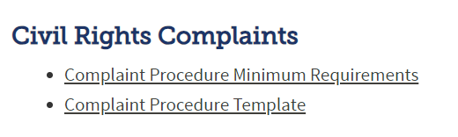
Sponsor Requirements
  Advise participants of their right to file a complaint, how to file a complaint, and complaint procedures
  School nutrition programs sponsors must have a written complaint procedure specific to food and nutrition services
  Visit CDE School Nutrition website for resources on complaint procedure minimum requirements and a complaint procedure template
Notes:
Applicants and participants must be advised of their right to file a complaint, how to file a complaint, and complaint procedures.
School nutrition program sponsors must have their process outlined in writing and be specific to your food and nutrition services department; it does not have to be written into board policy. Your district may have a standard civil rights procedure in place; however, this often does not meet the requirements for USDA’s child nutrition programs.
We have a document outlining the minimum requirements for your complaint procedure, as well as a complaint procedure template, available on our civil rights webpage that you can use to ensure you are meeting the complaint procedure requirements.
Summer Food Service Program Sponsors are not required to have their own written policy but must still advise participants of their rights and follow all USDA process requirements.

Slide 28
Accepting a Complaint
Procedures to include:
  Contact information for whom civil rights complaints will be directed to at the district level
  Language stating that complaints can be received verbally, in writing or anonymously
  Language stating that complaints must be received within 180 days of the alleged discriminatory action
  Note: a complaint form can be used but cannot be a prerequisite to filing a complaint
Notes:
The complaint procedure should include procedures for accepting a complaint, including:
Contact information for whom civil rights complaints will be directed to at the district level, including name, address, phone number, and email address
Language stating that complaints can be received verbally, in writing or anonymously
Language stating that complaints must be received within 180 days of the alleged discriminatory action
A complaint form can be used but cannot be a prerequisite to filing a complaint.

Slide 29
Transcribing a Complaint
Language stating that the complaint will be processed within 90 days
Obtain relevant information (verbally, in writing or anonymously). Information may include:
  Contact information for complainant
  Nature of the incident or action that led to the complainant to feel discrimination
  Basis on which complainant believes discrimination exists
  Contact information of persons who may have knowledge of the alleged discriminatory action
  Dates of alleged discriminatory action
Notes:
The complaint procedure should also include information on transcribing a complaint, including language stating that the complaint will be processed within 90 days.
It should also provide direction on how to obtain the relevant information about the complaint, including:
Contact information
Description of the complaint and alleged discrimination
Basis on which complainant believes discrimination exists
Contact information for additional people who may have knowledge of the alleged discriminatory action
Dates of alleged discriminatory action

Slide 30
Forwarding a Complaint
Sponsor must forward the complaint within five days of receipt
May be forwarded to:
  CDE School Nutrition Unit,
  USDA Mountain Plains Regional Office,
  USDA Office of Civil Rights, or
  FNS Office of Civil Rights
View the minimum requirements document for each agency’s contact information
Notes:
All civil rights complaints must then be forwarded to either the USDA Office of Civil Rights, FNS Office of Civil Rights, USDA Mountain Plains Regional Office or CDE School Nutrition Unit. Our minimum requirements document includes the contact information for each agency.
Sponsors may not resolve a civil rights complaint on their own.

Slide 31
Knowledge Check
If a sponsor receives a civil rights complaint, they should:
  A: Resolve the complaint themselves.
  B: Immediately begin a thorough investigation.
  C: Forward the complaint to CDE School Nutrition or USDA
  within five days.
True or False?
  Sponsors must communicate how to file a complaint to all participants.
Notes:
If a sponsor receives a civil rights complaint, they should:
A: Resolve the complaint themselves.
B: Immediately begin a thorough investigation.
C: Forward the complaint to CDE School Nutrition or USDA
within five days.
*click for answer*
Answer: C
Civil rights complaints may not be processed by the sponsor and must be forwarded on within five days. Note that general program complaints (those not related to discrimination) may be processed by sponsors.
*click*
True or False?
Sponsors must communicate how to file a complaint to all participants.
*click for answer*
Answer: True

Slide 32
Customer Service
and Conflict Resolution

Slide 33
Customer Service
Effectively communicating with customers, responding to the customer’s needs, valuing the customer’s worth, and instilling excellence through courtesy, confidence, and enthusiasm.
All participants must be treated in an equal manner
  Each participant is offered the same menu items in the same amounts
  All participants are included in meals, snacks, activities, and discussions
  Participants with special needs or disabilities will be provided reasonable accommodations
  Standards of behavior are not based on membership in a protected class
Notes:
Customer service is defined as effectively communicating with customers, responding to the customer’s needs, valuing the customer’s worth, and instilling excellence through courtesy, confidence, and enthusiasm. Ensuring customer service delivery is the best possible, sponsors should have standard policies regarding customer service and ensure employees are applying rules, policies, and procedures consistently and equally.
Treating customers with respect and dignity through excellent customer service saves you time and minimizes opportunities for complaints and angry customers.
In order to reduce the risk of a civil rights discrimination complaint ask yourself the following questions each time an applicant and/or participant comes to your program for services:
Am I treating this person in the same manner I treat others?
Have I given this person the opportunity to ask questions?
Have I provided the person with the information they need to make necessary decisions?

Slide 34
Conflict Resolution Goals
Avoid the desire to blame
Improve the situation
Communicate your feelings directly
Improve relationships and increase communication
Avoid repeating the situation
Notes:
In no way is a sponsor to impede with a customer’s right to file a civil rights complaint. However, most conflicts are easily resolved by using appropriate tools. Conflict resolution consists of useful skills to assist with the solution of complaints.
These skills include:
Using a win/win approach: change the conflict from an attack and defense to cooperation and avoid the desire to blame.
Use a creative response: turn problems into possibilities to improve the situation.
Demonstrate empathy: help others feel that they are understood by being an active listener.
Appropriate assertiveness: state your case without arousing the defenses of another person. Remember to use “I” statements to communicate your feelings directly.
Manage emotions: stick strictly to the facts of the complaint and communicate your feelings directly.
Have a willingness to resolve: identify barriers to a resolution and overcome those barriers. Avoid repeating the situation.
If the complainant persists with their complaint, direct them to file their complaint according to your complaint procedure and forward it to the appropriate agency.

Slide 35
Racial and Ethnic
Data Collection
Notes:
The next required topic is racial and ethnic data collection.

Slide 36
Racial/Ethnic Data Collection
Sponsors must establish a system to collect racial and ethnic data
  Helps to effectively reach potentially eligible children and guide outreach
Data must be collected on an annual basis
  Schools must collect this information on free and reduced-price meal applications
  May also be collected at the time of student enrollment or by other student data systems
  Self-reporting is the preferred method for data collection
  Visual identification is not allowed in the Summer Food Service Program
Notes:
All sponsors that participate in a USDA child nutrition program must have a system to collect the racial and ethnic data of applicants and program participants in accordance with FNS Instruction 113-1. Data is used to determine how effectively your program is reaching potentially eligible children and where outreach may be needed.
USDA regulations state that “respect for individual dignity should guide the process and methods for collecting data on race and ethnicity”. Therefore, using sources where the participant has reported this information themselves is the preferred method of obtaining this data.
For school nutrition program sponsors, this data must be collected on free and reduced-price meal applications. It is optional for applicants to provide this information when completing their applications; however, if missing, sponsors must complete this information on their behalf based on other school records or visual identification.
Please note that visual observation is no longer allowable in the Summer Food Service Program and this data must be collected using other methods, such as school or program enrollment data or census data.
The collection of this information is strictly for statistical reporting requirements and has no effect on the determination of their eligibility to receive program benefits.

Slide 37
Ethnic Categories
There are two ethnic categories
Choose one:
Hispanic or Latino: persons of Cuban, Mexican, Puerto Rican, South or Central American, or other Spanish culture, or origin regardless of race
Not Hispanic or Latino
Notes:
A two-question format must be used for ethnic and racial categories. Ethnicity is to be asked first followed by race. Ethnicity is based on religion, language, culture, or background and race is more biologically based on origins. The first question is ethnicity. The respondent should choose one of the two categories.

Slide 38
Racial Categories
There are five racial categories
Choose one or more:
Black or African American
Asian
American Indian & Alaska Native
White
Native Hawaiian or other Pacific Islander
Notes:
The second question is race. The respondent should choose one or more racial designations.

Slide 39
CDE Racial/Ethnic Data Collection
CDE data by district, site and county can be found here on the Pupil Membership webpage
Records must be kept by the sponsor for 3 years plus the current year in secure manner
Notes:
CDE does have this information available at the link on this slide, collected directly from each district. The data submitted by the district is stored on the state website in an aggregated format that is not personally identifiable
At the sponsor level, this data must be maintained in a confidential file for 3 years plus the current year and this information should be restricted to authorized school personnel and other authorized state and federal personnel, when requested.
Data not included in this analysis may be made available upon request through CDE’s data request page.

Slide 40
Knowledge Check
True or False?
  School Nutrition Programs sponsors must complete the racial and ethnic data on free and reduced-price meal applications if applicants do not answer.
True or False?
  Racial/ethnic data must be stored following recordkeeping requirements and only be accessible to authorized personnel.
Notes:
True or False?
School Nutrition Programs sponsors must complete the racial and ethnic data on free and reduced-price meal applications if applicants do not answer.
*click for answer*
Answer: True.
This section must be completed on applications, preferably by applicants, but if not, then by sponsor staff. It is preferable to use other available data, such as school enrollment data, to complete this section on the applicant’s behalf. Visual identification by the sponsor is allowable in the school nutrition programs, but not in the Summer Food Service Program.
*click*
True or False?
Racial/ethnic data must be stored following recordkeeping requirements and only be accessible to authorized personnel.
*click for answer*
Answer: True

Slide 41
Reasonable Accommodations for Persons With Disabilities

Slide 42
What is a Disability?
The Americans with Disabilities Act of 2008 and Section 504 of the Rehabilitations Act define a person with a disability as any person who has a physical or mental impairment which substantially limits one or more “major life activities”
Includes conditions that impair immune, digestive, neurological, and bowel functions, as well as many others
Notes:
The ADA Amendments Act of 2008 made important changes to the meaning and interpretation of the term “disability” under the ADA.
Under the ADA, anything that substantially limits a major life activity (most mental and physical impairments) constitutes a disability. This includes conditions that impair immune, digestive, neurological, and bowel functions, as well as many others.

Slide 43
What Is a Sponsor’s Responsibility?
Ensure access to facilities for participants with disabilities
Provide appropriate information in alternative formats for persons with disabilities
Provide meal modifications for students with disabilities when documented in writing by a licensed healthcare professional
Notes:
The sponsor’s responsibility for students with a documented disability includes:
Ensuring access to facilities for participants with disabilities including: accessible parking lots, entrances and exits, halls, elevators, restrooms, allowing service animals, Braille signage, and alternative arrangements for service.
Providing information in alternative formats, if needed. For example: Braille program materials and sign language interpreters.
Providing meal modifications for students with disabilities when documented in writing by a licensed healthcare professional.
These accommodations may be made through cooperation from the sponsor and the food service department. Information on accommodations must be made available to households by including it on the website and/or in enrollment or program information.

Slide 44
Reasonable Accommodations –
Meal Modifications
Must be related to the disability or limitations caused by the disability
Obtain a written medical statement from a licensed healthcare professional for meal modifications that do not meet meal pattern requirements
Meal modifications made within the meal pattern do not require a medical statement
View the Special Dietary Needs Documentation Flowchart
Notes:
The process of providing modified meals for students with disabilities should be as inclusive as possible. It is essential to work collaboratively with parents and guardians to ensure students receive a safe meal and have equal opportunity to participate in the child nutrition programs.
Sponsors must make meal modifications for students with disabilities when documented in writing by a licensed healthcare professional. The requested meal modifications must be related to the disability or limitations caused by the disability. Sponsors must obtain a written medical statement from a licensed healthcare professional in order to receive reimbursement for meal modifications when they do not meet program meal pattern requirements.
Any meal modification that can be made within the meal pattern does not require a statement from a licensed healthcare professional. However, sponsors are encouraged to have a policy in place explaining if or how accommodation requests will be handled for reasons other than disabilities or without documentation.

Slide 45
Meal Modifications Scenarios
Obtain a medical statement:
Student can only consume almond milk due to allergies
Student cannot consume raw fruits or vegetables
Student requires larger serving sizes
May accommodate without medical statement:
Student prefers a vegetarian diet
Student requests lactose-free milk
Notes:
Here are some examples of when to obtain medical documentation versus when you may be able to make accommodations without medical documentation.
For example, if a student can only consume almond milk, cannot consume raw fruits or vegetables, or requires larger serving sizes, these accommodations would need to be supported with a medical statement since they do not (or likely would not) meet the meal pattern requirements.
In cases of requests for accommodations for preferences or requests without medical documentation, sponsors may choose to accommodate, but meals must still meet the meal pattern requirements. For example, a student who prefers a vegetarian diet may be accommodated using Offer versus Serve. A student requesting lactose-free milk without medical documentation could be accommodated by purchasing lactose-free milk. Lactose-free cow’s milk does meet the meal pattern requirements.

Slide 46
Limited English Proficiency
Notes:
Let’s move on to talk about accommodations for persons with Limited English Proficiency. Persons with LEP do not speak English as their primary language and have limited ability to read, speak, write, or understand English.

Slide 47
LEP and Program Access
Organizations participating in Child Nutrition Programs have a responsibility to take “reasonable steps” to ensure access to their programs and activities by those with LEP.
Consider:
  Number or proportion of LEP persons eligible or in you program area
  Frequency with which LEP persons are in contact with your program
  Importance of your program
  Resources available for the participant and the cost
Notes:
Organizations participating in the USDA Child Nutrition Programs have a responsibility to take reasonable steps to ensure meaningful access to their programs and activities by those with Limited English Proficiency. Meaningful access is accomplished my providing reasonable, timely, competent, accurate, and effective language services to individuals with LEP.
Utilize the following when determining the need for LEP services:
The number and proportion of LEP persons served or encountered by the program;
The frequency with which LEP individuals come into contact with program;
Determine the importance to LEP persons of your program activities and services;
Determine the resources available to the recipient and costs

Slide 48
Making Accommodations
Use competent language interpreters
Use language access lines
Use oral interpretation services
Contact community organizations
Provide translated written materials
Meaningful Access for Persons Memo with Limited English Proficiency (LEP) in the School Meal Programs: Guidance and Q&As
Notes:
To make accommodations for individuals with LEP, consider the following:
Interpreters, whether staff, contracted, or volunteer, must be competent and demonstrate ability to communicate information accurately in both English and the other language. They must also understand and follow confidentiality rules. A language interpreter may be a bilingual staff member that can competently and confidentially assist with translating and interpreting program information. It is important for an interpreter to also understand the terms and concepts you are speaking about in both languages. Children may not be used as interpreters.
Know how to access language lines or video interpreting to assist in communicating with households or students with LEP.
Contact local community organizations to determine if they may be able to assist you in communicating with households.
And provide translated written materials. The USDA provides the free and reduced-price meal prototype application in over thirty-three languages. CDE School Nutrition has school meal eligibility and program outreach materials available in English and Spanish. If the required language is not available, translation services are an allowable school nutrition program expense.
For more information see the USDA Memorandum linked on this slide.

Slide 49
Knowledge Check
If many of your participants and households speak Spanish, you should:
  A: Provide program material in Spanish
  B: Know how to request qualified translators
  C: Allow children to translate for households
  D: A and B
Notes:
If many of your participants and households speak Spanish, you should:
A: Provide program material in Spanish
B: Know how to request qualified translators
C: Allow children to translate for households
D: A and B
*click for answer*
Answer: A and B
Remember, children may not act as translators. All translators and interpreters should be qualified and competent to relay program information.

Slide 50
Administrative
Reviews and Resolutions of Noncompliance

Slide 51
Reviews
Civil rights policies and processes are assessed during reviews, or at any time outside of a review, to ensure compliance
Review schedules, questions and tips to ensure compliance can be found on the Child Nutrition Program Reviews webpage
If non-compliance is indicated, corrective action must be taken immediately to achieve voluntary compliance
Notes:
Compliance with the civil rights requirements is assessed during reviews. Non-compliance will be addressed in the corrective action plan and the sponsor must indicate the immediate corrective action taken as well as the process or plan in place to ensure future compliance. You can view the review information, including the civil rights questions and tips on our child nutrition program reviews webpage.

Slide 52
Examples of Non-compliance
Denying an individual or household the opportunity to apply for program benefits or services on the basis of a protected class
Providing program services or benefits in a dissimilar manner on the basis of a protected class (except as a disability accommodation)
Selecting program sites or facilities in a manner that denies an individual access to program benefits, assistance, or services on the basis of a protected class
Notes:
Common examples of noncompliance include denying an individual or household the opportunity to apply for FNS program benefits or services on the basis of a protected class, providing FNS program services or benefits in a dissimilar manner, or selecting program sites or facilities in a manner that denies an individual access to program benefits, assistance, or services on the basis of a protected class.

Slide 53
Summary
Train staff annually on civil rights and document the training
Prominently display the “And Justice for All” poster
Include the non-discrimination statement on all materials providing program information
Develop and fully implement the sponsor’s civil rights complaint procedure
Collect and maintain racial/ethnic data annually
Make reasonable accommodations for persons with disabilities
Provide meaningful access for persons with Limited English Proficiency
Notes:
We covered a lot today, so here is a summary of the main points. This information is also included on the civil rights requirements self-check to assist you in meeting all requirements.

Slide 54
Resources
CDE School Nutrition Civil Rights webpage
  Civil rights training PowerPoint
  Civil rights self-study guide
  Training agenda and sign-in sheet template
  Complaint procedures template
  Complaint procedure minimum requirements
  Civil rights self-check
  Non-discrimination statement
  “And Justice for All” printable pdf
Food and Nutrition Service Instruction 113-1
Institute of Child Nutrition "Focus on the Customer" Training
Notes:
Here are the main resources related to civil rights. The CDE School Nutrition civil rights webpage contains all the resources, training, and templates that we discussed today. You can also use ICN’s “Focus on the Customer” training as a resource for additional customer service training.

