Slide 1
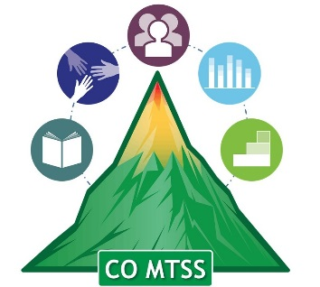
Bullying Prevention Training Series
What is Bullying?
October, 2018
Adam Collins, Ph.D.
Bullying Prevention and Education Grant Coordinator
Collins_A@cde.state.co.us

Slide 2
What is Bullying?
Notes:
Four roles in bullying

Slide 3
What is Bullying?
Three components that define bullying
  Intent to harm
  Behavior is repeated or likely to be repeated
  Imbalance of power
Three types of bullying
  Physical
  Verbal
  Relational
Two modes of bullying
  Direct
  Indirect
Four roles in bullying
  Perpetrator
  Victim
  Bully-Victim
  Bystander
  (See Gladden et al., 2014)
Notes:
Four roles in bullying

Slide 4
What is Bullying?
Three Components that Define Bullying
  (See Gladden et al., 2014)
Notes:
Four roles in bullying

Slide 5

What is Bullying?
Three Components that Define Bullying
  Intent
  (See Gladden et al., 2014)
Notes:
Four roles in bullying

Slide 6
What is Bullying?
Three Components that Define Bullying
  Intent
  Repeated
  (See Gladden et al., 2014)
Notes:
Four roles in bullying

Slide 7

What is Bullying?
Three Components that Define Bullying
  Intent
  Repeated
  Imbalance of Power
  (See Gladden et al., 2014)
Notes:
Four roles in bullying

Slide 8
What is Bullying?
Three Types of Bullying
  (See Gladden et al., 2014)
Notes:
Four roles in bullying

Slide 9
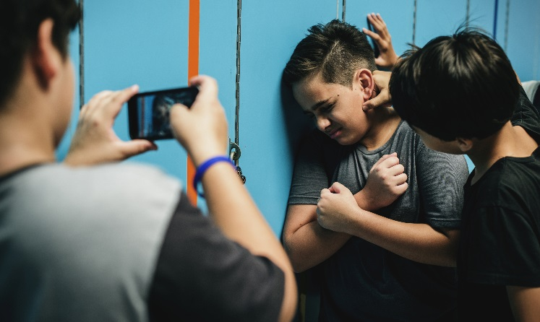
What is Bullying?
Three Types of Bullying
  Physical
  (See Gladden et al., 2014)
Notes:
Four roles in bullying

Slide 10

What is Bullying?
Three Types of Bullying
  Physical
  Verbal
  (See Gladden et al., 2014)
Notes:
Four roles in bullying

Slide 11

What is Bullying?
Three Types of Bullying
  Physical
  Verbal
  Relational
  (See Gladden et al., 2014)
Notes:
Four roles in bullying

Slide 12


What about Cyberbullying?
NOT a type of bullying
Spans across the other types of bullying
CDC considers cyberbullying a context or location

Slide 13
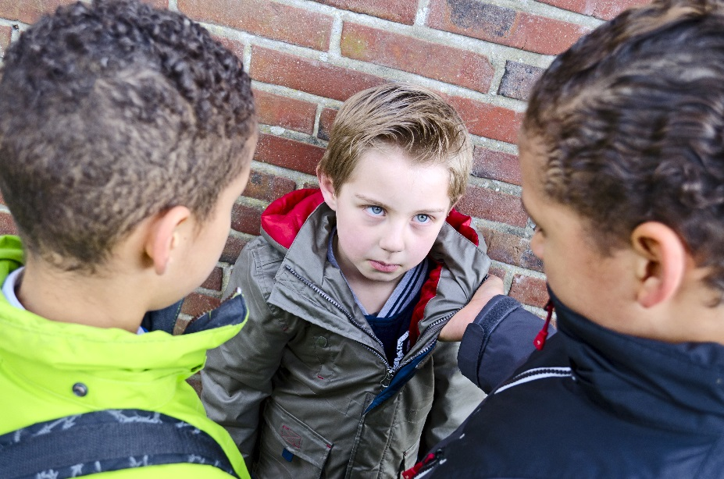

What is Bullying?
Two Modes of Bullying
  Direct
  Indirect
  (See Gladden et al., 2014)
Notes:
Four roles in bullying

Slide 14
What is Bullying?
Four Roles in Bullying
Notes:
Four roles in bullying

Slide 15
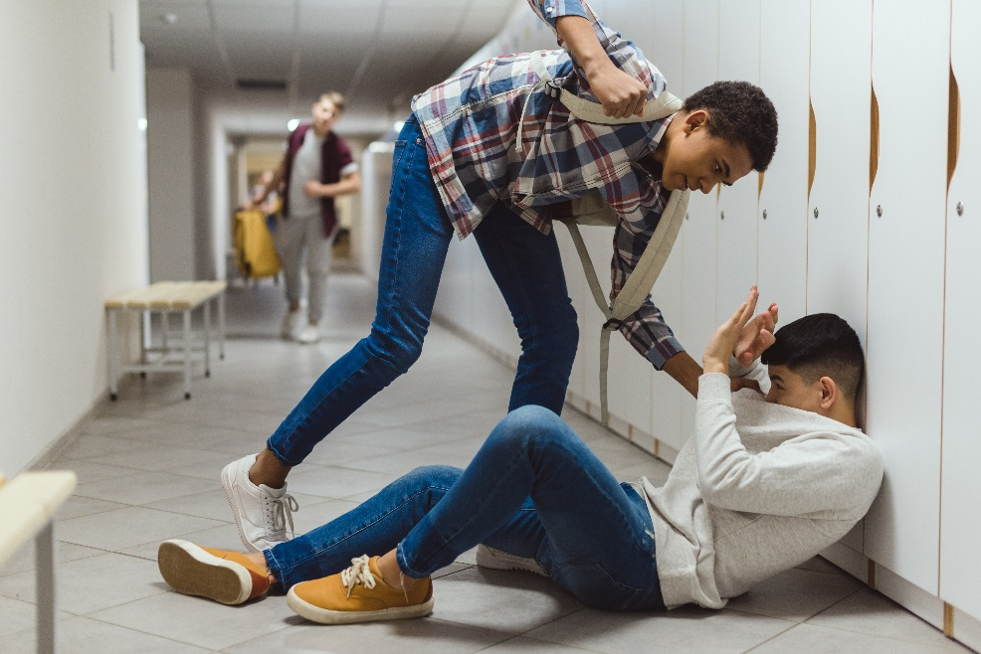
What is Bullying?
Four Roles in Bullying
Notes:
Four roles in bullying

Slide 16
What is Bullying?
Four Roles in Bullying
  Perpetrator
Notes:
Four roles in bullying

Slide 17
What is Bullying?
Four Roles in Bullying
  Perpetrator
  Target
Notes:
Four roles in bullying

Slide 18
What is Bullying?
Four Roles in Bullying
  Perpetrator
  Target
  Bystander
Notes:
Four roles in bullying

Slide 19
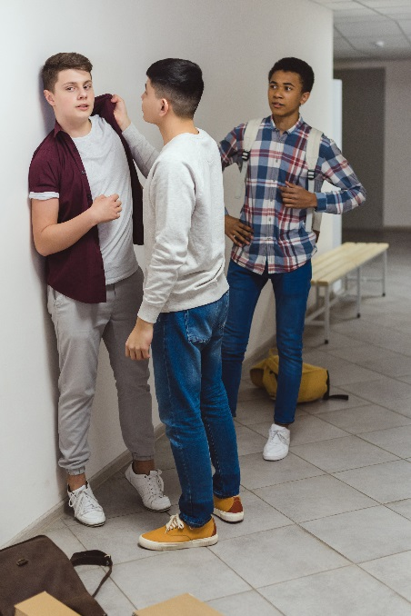
What is Bullying?
Four Roles in Bullying
  Perpetrator
  Target
  Bystander
Notes:
Four roles in bullying

Slide 20
What is Bullying?
Four Roles in Bullying
  Perpetrator
  Target
  Target
  Bystander
  Bystander
  Bully-Victim
Notes:
Four roles in bullying

Slide 21
What is Bullying?
Four Roles in Bullying
  Perpetrator
  Target
  Bystander
  Bully-Victim
Notes:
Four roles in bullying

Slide 22
What is Bullying?
Four Roles in Bullying
  Perpetrator
  Target
  Target
  Bystander
  Bystander
  Bully-Victim
Notes:
Four roles in bullying

Slide 23
What is Bullying?
Three components that define bullying
  Intent to harm
  Behavior is repeated or likely to be repeated
  Imbalance of power
Three types of bullying
  Physical
  Verbal
  Relational
Two modes of bullying
  Direct
  Indirect
Four roles in bullying
  Perpetrator
  Victim
  Bully-Victim
  Bystander
  (See Gladden et al., 2014)
Notes:
Four roles in bullying

Slide 24
What is Bullying
In Colorado/CDE:
  "Bullying" means any written or verbal expression, or physical or electronic act or gesture, or pattern thereof, that is intended to coerce, intimidate, or cause any physical, mental, or emotional harm to any student.
Notes:
So how do these components, forms, and types fit into the definition of bullying in Colorado?
The components, forms, and types of bullying are color coded from the previous slide.

Slide 25
Bullying Prevention Training Series
What is Bullying?
October, 2018
Adam Collins, Ph.D.
Bullying Prevention and Education Grant Coordinator
Collins_A@cde.state.co.us

