Slide 1
Cohort 1 - Year 2 Kickoff
Pre-Learning Activities
September 2017

Slide 2
Outline of this Learning Experience
Introduction
MLT Capacity-Building
Implementation Practice & Science
Implementation Stages
MLT – Exploration Stage
Readiness
PD Planning – Colorado Evidence-Based Personnel Development Rubric
MLT Self-Assessment Assignment

Slide 3
Outcomes
Expectations before the Sept. SPDG Kickoff:
View this recording (as/if needed, take notes/pauses/breaks) 30 minutes
Preview CO-EBPD Rubric: 10 minutes
Reflect on MLT progress thus far: Complete MLT Self-Assessment individually and submit data 15 to 20 minutes

Slide 4
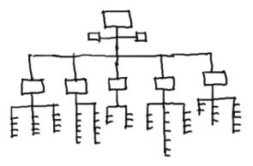
Design matters…
"All organizations [and systems] are designed, intentionally or unwittingly, to achieve precisely the results they get."
-R. Spencer Darling
Business Expert
Notes:
Horner, George Sugai, 2008
4
Prompt: Consider the design of your organization/system…how is its “design” correlated to/connected to/impacting its outcomes?

Slide 5
MTSS and Essential Components
Team-Driven Shared Leadership
Family, School, and
Community Partnering
Data-Based
Problem Solving and Decision-Making
Layered Continuum
of Supports
Evidence-Based
Practices
Notes:
CO-MTSS is a prevention-based framework of team-driven, data-based problem solving for improving the outcomes of every student through family, school, and community partnering and a layered continuum of evidence-based practices applied at the classroom, school, district, region, and state level.
The Mountain graphic = note the dynamic nature and the ‘blurred lines’, not finite division between the colors (fluidity is represented).
You’ll notice the color-coded icons throughout the content (correlating different Components with connected content).
Kim has said, we often “start at 12 o’clock”, or the “Team-Driven Shared Leadership” component.

Slide 6
Implementation Practice & Science
Implementation Stages
MLT Capacity-Building
Readiness

Slide 7
Implementation Science & Practice
Notes:
The conceptual alone doesn’t/won’t resonate with everyone.
Those who are “practitioners” look for what is practical.
[The theory helps it make shape, and implementation science helps get to the practice.]

Slide 8
Active Implementation Frameworks
Usable Innovations
Implementation Stages
Implementation Drivers
Improvement Cycles
Implementation Teams
Enabling Change
CDE MTSS Implementation Science page: http://www.cde.state.co.us/mtss/implementationscience
Notes:
http://nirn.fpg.unc.edu/learn-implementation
http://www.all-about-forensic-science.com/dna-pictures.html
-innovations: take those innovative, powerful strategies and put them into practice
-stages: progress through stages of using the innovation
-drivers: small levers of change
-cycles: adopt an approach where we learn from our use of innovations and implementation processes
-teams: who does the work, that will be knowledgeable of implementation
-enabling change: “contexts are designed to get exactly what they are designed to get. (If you do what you always’ve done, you’ll always get what you’ve always got.) support the systems, the people, and the organization in making that change. Change the system to support the innovation.

Slide 9
MTSS Formula for Success
What
How
Where
Effective Interventions
Effective Implementation Methods
Effective Systems
Academic, Behavior,
Family,
Staff Supports, etc.
Implementation Science
Supportive Infrastructure
Why
Socially Significant Outcomes
Adapted from 2012 Dean Fixen and Karen Blasé, National Implementation Research Network

Slide 10
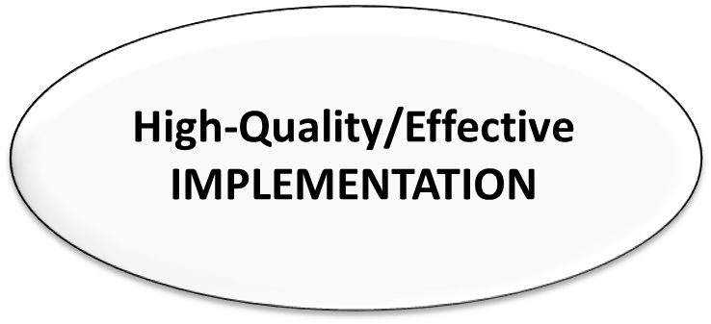
Implementation Science & Practice
Implementation science and practice are distinct, but related.
Implementation science refers to the emerging scientific study of variables that influence the use of new innovations in practice,
While implementation practice refers to the activities that are necessary to support the use of new innovations in typical service environments.
Implementation science provides the generalizable principles that guide implementation practice, while implementation practice provides the settings in which implementation science is conducted, and drives the questions it asks.
SCIENCE
(theory)
CLASSROOM
(practice)
GAP
Adapted from “Just Do It…” (FrameWorks Institute, 2015) & NIRN

Slide 11
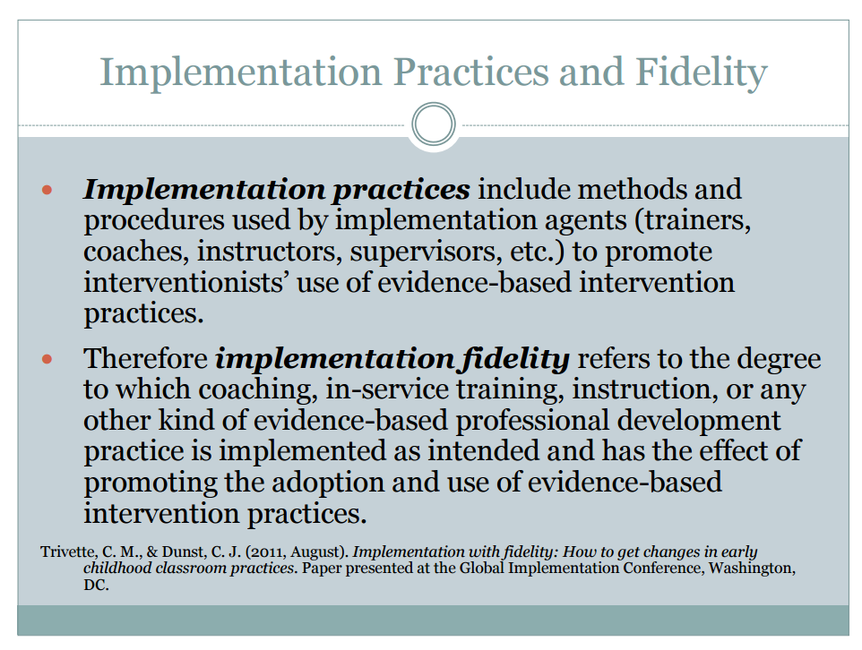
http://sisep.fpg.unc.edu/sites/sisep.fpg.unc.edu/files/resources/Blase-Trivette-Measuring-Implementation-Intervention-Fidelity-07-2012_0.pdf
Notes:
Definitions to consider – note: implementation agents (coaches, supervisors)
What are you looking at (depending on what practice you’re implementing)?

Slide 12
What & Why…
“Just Do It…” (FrameWorks Institute, 2015)

Slide 13
Predictions & Implications
“Just Do It…” (FrameWorks Institute, 2015)

Slide 14
Implementation Practice & Science
Implementation Stages
MLT Capacity-Building
Readiness

Slide 15
Establish Implementation Team & Readiness
Use of Organizational Resources to Support Implementation Drivers
Use of Innovation with “Customers” for First Time
More than 50% of Practitioners Using Innovation with Good Fidelity
http://nirn.fpg.unc.edu/learn-implementation/implementation-stages

Slide 16
Positive Outcomes for Students
Why:
What:
High Fidelity Use of Effective Educational Practices
Integrated and Compensatory
Staff capacity to support children/families
with the selected practices
Institutional capacity to support teachers & staff in implementing practices with fidelity
Competency Drivers
Organization Drivers
How:
Leadership
Capacity to provide direction and vision
© Fixsen & Blase, 2008
Notes:
We want the “why”, so we need the “what”, the Integrated & Compensatory drivers show “how”.
[Integrated = the drivers are integrated & connected; Compensatory = some areas may “compensate” for others; cautionary tale: do not let something “over-compensate” to become ‘dependent’ on one area only]
(resource information: NIRN - http://nirn.fpg.unc.edu/)

Slide 17
Lessons Learned (approx. time 12:35-12:48); no narration in recording (read slide for content)
You don’t get to skip any stages
Do the “right work” for the stage
Exploration and installation stages are (often) neglected
Always in “exploration” stage with somebody, somewhere
Stages are not necessarily linear; they can be iterative and overlapping
Notes:
Slide content (reading content):
You don’t get to skip stages and should do the right work for that stage;
Be aware we sometimes move “too quickly” past exploration and installation stages that may lead to a false-start or poor implementation
We are always in exploration with somebody/somewhere: as new stakeholders come on – we must keep them up-to-date.
Stages aren’t necessarily linear, they are iterative and overlapping.
Reflection: Consider how these stages can apply to any innovation. Be intentional. Think through data, think about what to choose; think about if it can be implemented and what steps to take to intentionally plan and implement.

Slide 18
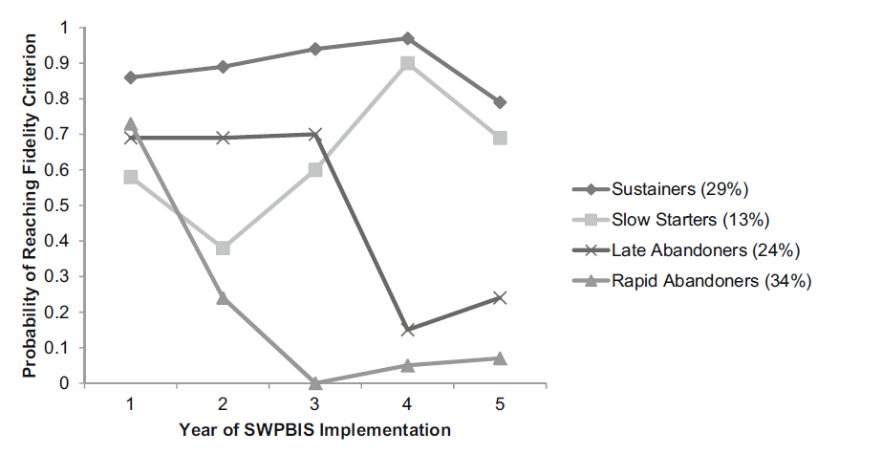
Implementation Fidelity Over Time
Notes:
2 minutes
It also takes time and consistent effort –
Emphasize installation and initial implementation stages while talking

Slide 19
http://www.healingtoolbox.org/hol-psy-blog/551-managing-complex-change-infographic-for-successful-change-making
Notes:
Look at this visual. (some used this more frequently/formally for categorizing)
-FYI: Other versions (online variations) have varied the roles, different sequence
Can you imagine how these “gaps” could lead to these outcomes”?
Are all of these elements essential?
How can we assure change?
[We often discuss any/all of these within MTSS implementation…think strategically about your Action Plan…otherwise that “false start” or treadmill effect.]

Slide 20
Implementation Practice & Science
Implementation Stages
MLT Capacity-Building
Readiness

Slide 21
Enabling Change
System-wide; every stakeholder
Create readiness: Culture of commitment
Ongoing Support; capacity-building
Personnel Development
“For every increment of performance I demand of you, I have an equal responsibility to provide you with the capacity to meet that expectation.”
(Elmore, 2002)
Notes:
We can support “enabling change”. It’s our responsibility. (we don’t want change to happen ‘on accident’; we want to be strategic)

Slide 22
Leadership Teams (Fixsen, Blase, 2012)
Important Initial Tasks
Develop the Capacity to Implement Well
Create alignment and Common language
Define initiative
Create process to support and problem-solve
Create common goal to implement effectively
Operationalize definitions
Notes:
This comes from Implementation Science literature. (but you’ll see it in other places; as MTSS is about “Educational Reform”, the literature on change in other educational areas, prioritizes these same things; this is “what works” for establishing strong collaborative leadership and sets the stage for transformation)
As you can see, these are the IMPORTANT INITIAL TASKS. This is where to start!!
Reminder that “operationalizing definitions” is so important. We often think that “we are all on the same page,” but we may need to be explicit to ensure that. (e.g., ‘what does rigor/robust mean to you’?)

Slide 23
Team Identity
Composition: Roles and responsibilities, whose voice do you need in the room?
Vision: Craft your vision/mission
Expectations: Logistics (when will you meet? where? how often?), who will wear what hat?
Norms and agreements: How will you make decisions? How will you evaluate your meetings?

Slide 24
IDENTITY
Who are we “as a team”?
Why are we collaborating? (a.k.a. “why do we exist”)
What is our purpose?
What are the benefits of “us”?
What are our engagement strategies?
What mechanisms do we have for internal/external communication?
Notes:
Could you answer these questions for each of your teams?
TEAM IDENTITY is primary to having effective teaming in place. We need to know “why we’re here”.
Spending time on this (initially and revisiting ongoing) can only benefit. Being mindful of these considerations so that the Team Identity remains “intact.”

Slide 25
Teams & Implementation Science
Effective
NOT Effective
Actual Benefits
Inconsistent Not Sustainable Poor outcomes
Effective
Intervention Outcomes
NOT Effective
Poor outcomes
Poor outcomes; Sometimes harmful
IMPLEMENTATION
Paraphrased from NIRN:
(Institute of Medicine, 2000; 2001; 2009; New Freedom Commission on Mental Health, 2003; National Commission on Excellence in Education,1983; Department of Health and Human Services, 1999)
Notes:
Think back to the formula for success. That formula requires an effective innovation (which could be an intervention, policy, practice, et cetera), AND effective implementation. This is another way to think about those two pieces of the formula using a contingency table. The union of an effective innovation and effective implementation results in the actual benefits you want. [CLICK]
Teaming is used to enable effective implementation.

Slide 26
Teams & Implementation Science
‘Making it Happen’
‘Helping it Happen’
‘Letting it Happen’
http://implementation.fpg.unc.edu/module-3/topic-1
Notes:
Think back to the formula for success. That formula requires an effective innovation (which could be an intervention, policy, practice, et cetera), AND effective implementation. This is another way to think about those two pieces of the formula using a contingency table. The union of an effective innovation and effective implementation results in the actual benefits you want. [CLICK]
Teaming is used to enable effective implementation.

Slide 27
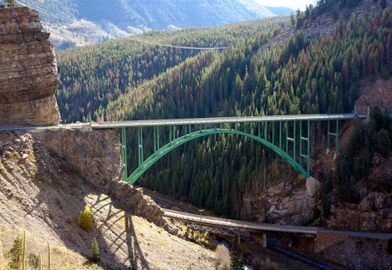
Taking Stock
Current State Desired State
We need to “take stock” to be able to “take action”…
HIGH-QUALITY IMPLEMENTATION
Notes:
Once we have identified ‘where we want to be’ (desired state), we must take stock to get to know ‘where we are’ (current state). We do this for our system, and then, we can bridge the gap between the two.

Slide 28
Taking Stock (slide 28, time approx. )
MTSS is outcomes-focused…this is foundational to Continuous Improvement
We often think we should “begin with the end in mind”…we need to do that with our systems.
What is the Desired State?
Then, we ask:
“Where are we now?” … How do you know?
Define the Current State (with tools/methods)
What “Inventories” or “Audits” do you conduct (at the systems level)?
Do you “take stock” of data/assessment frameworks, initiatives, practices, systems, resource allocations, etc.?
Notes:
We need to be assured we attend to TAKING STOCK! (reading slide and elaborating)
This (often) is first & foremost – it helps shape our prioritization.
(Some consider it a needs assessment)
OLS poses that the MTSS Self-Assessment is a great way to start doing that for your system, as a whole!
Once we have identified ‘where we want to be’ (desired state), we must take stock to get to know ‘where we are’ (current state). We need to also ask “How do we know?” Use tools/methods to define.
---You would do these same things with students (‘conducting gap analysis’…what’s the discrepancy between your target and your current reality)
When we do this for our system, we can have confidence in “where we are” to know “where we need to go” - and we can bridge the gap between the two.
Consider the last bullet: What do you have in existence to help you take stock? What do you need?
Have you taken stock? (of data/assessment frameworks, practices, systems)
We’ve specifically talked about investigating initiatives. This is foundational…MTSS 101.

Slide 29
Identification (time approx. 23:36-24:26)
= initiative
VISION
Notes:
Looking at this graphic…
Large arrow: We have that direction…that North Star – knowing what our vision is; just as we’ve asked MLTs to do, as any effort starts with strong (common) vision, but we also have so many initiatives (little arrows). And sometimes, we have initiatives that are “going in all directions” and we may be unsure how they are in alignment with our vision. We begin investigating our initiatives with an “Initiative Inventory”, and initially, we are just identifying each of the initiatives and articulating what those are clearly. (have clarity about what those initiatives are and how they contribute to the vision) So, “getting to know” each of those smaller arrows is important.

Slide 30
Alignment (time approx. 24:25 mins)
= initiative
VISION
Notes:
And , why do we do the Initiative Inventory? It helps build clarification; it helps us prioritize and configure what makes the most sense for capacity-building and collaboration.
So, our aim is to have our initiatives aligned to our vision. The more we can clarify and aim all of our initiatives in the “same direction,” the more-likely we are to have effective implementation of all of our efforts and scale-up MTSS well.

Slide 31
MTSS and Essential Components
Time: approx. 24:28-26:00 mins
Team-Driven Shared Leadership
Family, School, and
Community Partnering
Data-Based
Problem Solving and Decision-Making
Layered Continuum
of Supports
Evidence-Based
Practices
Selection
Notes:
Selection: Is critical throughout implementation. We need to think of SELECTION criteria in various aspects of our implementation efforts.
Look at the Components around the Mtn. graphic.
Examples:
Evidence-Based Practices: What has the right contextual fit? (e.g., Hexagon tool)
Family, School, and Community Partnering & Team-Driven Shared Leadership: Composition of teams…Who to partner and how
Data-Based Problem Solving & Decision-Making: What data do we have? We are going to select the right practices
Layered Continuum of Supports: To whom and for whom we can apply tiered logic? Who should receive training & Technical Assistance (TA)

Slide 32
Implementation Practice & Science
Implementation Stages
MLT Capacity-Building
Readiness

Slide 33
MTSS Formula for Success
What
How
Where
Effective Interventions
Effective Implementation Methods
Effective Systems
Readiness
Academic, Behavior,
Family,
Staff Supports, etc.
Implementation Science
Supportive Infrastructure
Why
Socially Significant Outcomes
Adapted from 2012 Dean Fixen and Karen Blasé, National Implementation Research Network

Slide 34
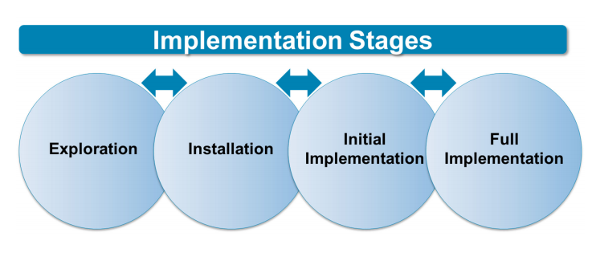
Creating: Readiness for Change
In education “readiness for change” is something that needs to be developed, nurtured, and sustained.
Readiness is not a pre‐existing condition waiting to be found or an enduring characteristic of a person, organization or system.
Adapted from “Just Do It” (Frameworks Institute, 2015)
Notes:
“During the Exploration Stage, individuals typically need information and time to process what the needs are, and what the innovation or change might mean for them.”

Slide 35
Readiness
Definition: Developmental point at which a person, organization, or system has the capacity and willingness to engage in a particular activity.
Adapted from “Just Do It” (Frameworks Institute, 2015)
Notes:
In some cases, leadership or management teams within
an organization or system have fully explored a “change initiative” and have
decided on a course of action. The same leaders and managers then are surprised
when collaborators, staff, or colleagues display what some call “resistance to
change.” “Resistance” occurs when people are asked prematurely to move to
action. They are “resistant to change” because they are not “ready for change.”
However, system leaders cannot simply wait for readiness to appear.

Slide 36
Readiness, The Heuristic
R
General and Innovation Specific Capacity
Motivation
Readiness
Scaccia et al. (2015). A practical implementation science heuristic for organizational readiness: R = MC². Journal of Community Psychology; 43: 484-501.
Weiner (2009). A theory of organizational readiness for change. Implementation Science 4:67.

Slide 37
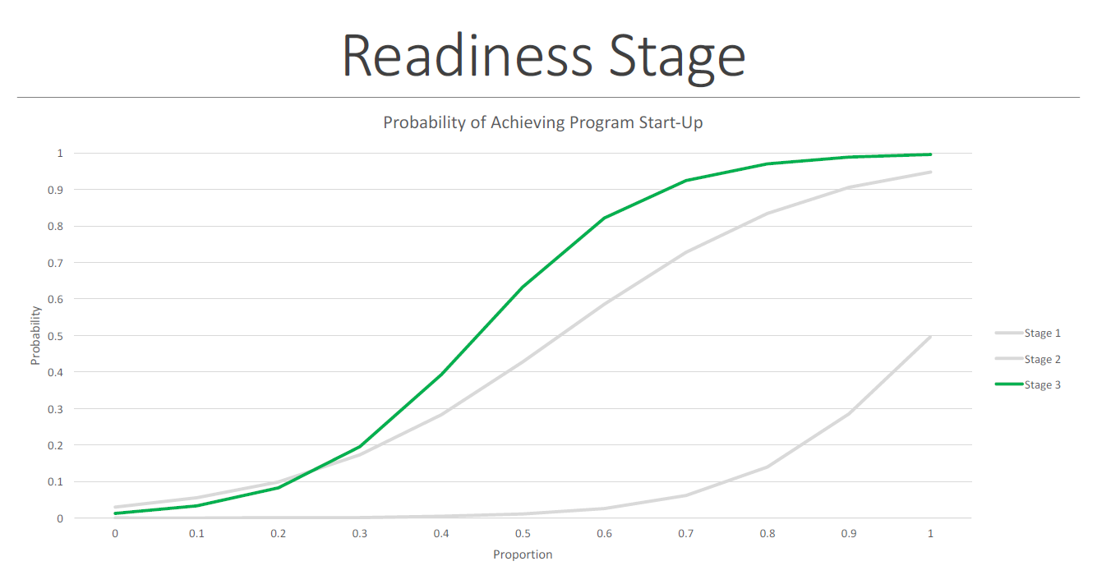
Implementation Science & Readiness
Readiness generally takes 3 to 9 months to establish, longer in some cases
Saldana (2014). The stages of implementation completion for evidence-based practice: Protocol for a mixed methods study. Implementation Science, 9:43.
Notes:
Saldana; 2017 –
Readiness generally took 3-9 months based on service sector
Readiness (she refers to this as pre-implementation, aka exploration) included engagement, consideration of feasibility, and readiness planning with systems leaders and agencies
Attending to engagement only will not predict successful startup
Leaders and agencies must attend to the majority of feasibility considerations including contact with program provider, and completing formal feasibility assessments
Agencies and leaders must attend to over 60% of readiness planning activities including planning for funding, staff selection, recruitment, communication planning, writing an implementation plan, and selecting a service provider

Slide 38
Colorado Evidence-Based Personnel Development

Slide 40
Professional Development Outcomes
Training Components | Knowledge of Content | Skill Implementation | Classroom Application
Presentation/ Lecture
Plus Demonstration
Plus Practice
Plus Coaching/ Admin Support Data Feedback
10%
5%
0%
30%
20%
0%
60%
60%
5%
95%
95%
95%
Joyce & Showers, 2002
Notes:
Note the value of coaching (from research)
If looking to get “transfer” (change in practice), how should you be composing your learning opportunities (to get desired outcomes)?

Slide 42
PD Planning: Delivery
PD Evaluation Level | Decisions Supported
1. PD participant reaction to training and coaching experiences | Improve program design and delivery
2. Participant acquisition of new knowledge and skills | Improve program content, format, and organization
3. Influences at the organizational level that can facilitate or hinder PD success | Document and improve organizational support Inform future change efforts
4. Participant use of knowledge and skills | Assess fidelity of implementation
5. Student behavioral and academic outcomes | Focus and improve all aspects of PD design, implementation, and follow-up Demonstrate overall impact of PD (i.e., summative evaluation)

Slide 44
Adult Learning Principles
Introduction
Illustration
Mastery
Practicing
Reflection
Evaluation
Adapted from:
Trivette, 2012 (http://www.signetwork.org/file_attachments/123/download)
Notes:
These authors were able to study and come out with these areas that we cite as “Adult Learning Principles” that would be applied with any adult learning opportunity.

Slide 45
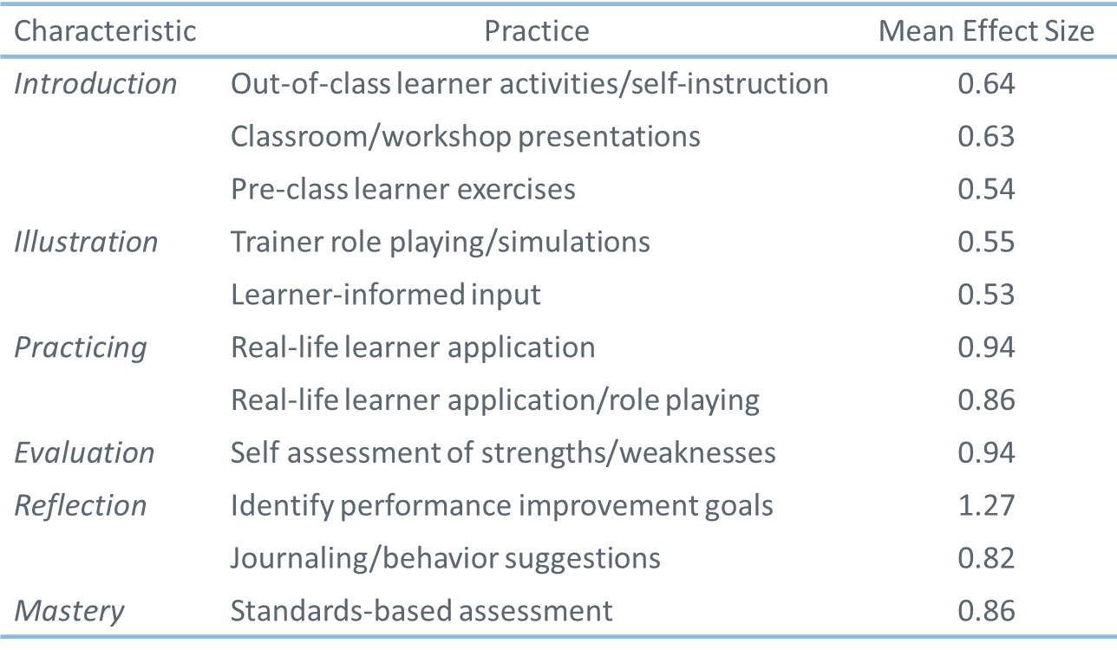
Most Effective Adult Learning Method Practices
Planning
Application
Deep
Understanding
Adapted from:
Trivette, 2012 (http://www.signetwork.org/file_attachments/123/download)
Notes:
From this research, these areas show varied effect size.
(the orange boxes on the right are how the types of approaches are categorized, according to Planning, Application, & Deep Understanding)

Slide 47
MTSS Leadership Team (MLT) Self-Assessment
Assignment (approx. 15-20 mins):
Reflect on your MLTs progress thus far using the MLT Self-Assessment.
You will be entering scores for each item for each Essential Component. You may want to jot down “notes to self” as evidence/rationale for your scoring. Online submission will not allow for tracking notes/comments.
Use the Survey Monkey link to enter your data. This will NOT be used as your LEA’s final score. We want you to complete this activity so you are prepared to work as an MLT to create a consensus score during the Year 2 Kickoff. Additionally, your responses will be a great help to us because we will use the responses to help validate the tool.
Links:
MLT Self-Assessment (online PDF version), also provided in Survey Monkey prompts: https://www.cde.state.co.us/mtss/mlt-selfassessment
Submission of Data for 9/18/17: https://www.surveymonkey.com/r/CO-MTSS-SPDG-Sept-18-2017-PreLearning-SelfScoring
Submission of Data for 9/25/17: https://www.surveymonkey.com/r/CO-MTSS-SPDG-Sept-25-2017-PreLearning-SelfScoring
Notes:
Images/links & survey monkey link and directions and credit worthiness

Slide 48
This CDE guidance document is meant for clarification, is not legally binding, and is not to be confused with legal advice. This guidance reflects CDE’s recommendations, but Local Education Agencies (LEAs) and Administrative Units (AUs) may have developed their own policies or procedures that differ from those described herein. Be sure to refer to your local AU’s policies and procedures through local leadership (e.g., Directors of Special Education, Title I Coordinators, superintendents). If you are seeking legal advice, please contact your legal counsel.
Note that the contents of this presentation and corresponding handouts were developed under a grant from the U.S. Department of Education. However, the content does not necessarily represent the policy of the U.S. Department of Education, and you should not assume endorsement by the federal government.
Notes:
Key Points:
This slide notes the funding source for this work.

