Slide 1
Trauma Informed Approaches Across the Tiers: What Every Practitioner Needs to Know
Lynne DeSousa, PBIS Statewide Coordinator, CDE
Desousa_l@cde.state.co.us

Slide 2


















Multiple Offices and Units
Bob Algozzine,
Kate Algozzine
Terry Scott
Hailey Uphaus
Karen Blasé,
Dean Fixsen
George Batsche
James Henry
Rob Horner,
Kent McIntosh,
Jessica Daily
Heather George
Mary Ruth Coleman
George Sugai,
Brandi Simonsen

Slide 3

Signal
Notes:
Signal to come back. Will raise hand. If you see it, do it. Be mindful of it, as there’ll be lots of back and forth, lots of time to talk.

Slide 4
Who is in the room?
Everyone Stand up! Sit down if you:
    Have attended a trauma training
    Are implementing trauma informed systems and practices
    Have coached and/or trained on Trauma sensitive schools or Trauma Informed Approaches

Slide 5
The Learner will...
Gain a foundational understanding of trauma and toxic stress
Consider how trauma impacts both staff and students in the learning environment.
  Discover how to integrate trauma informed approaches into existing tiers of supports.
  Increase their awareness about practical interventions, approaches, and strategies for supporting students/staff at Tier1/Tier 2

Slide 6
Activity 1: Personal Goal
Write down an answer to this question…
    What is a goal you have for this session? What is one thing you would like a deeper understanding of?
Notes:
1 minute

Slide 7
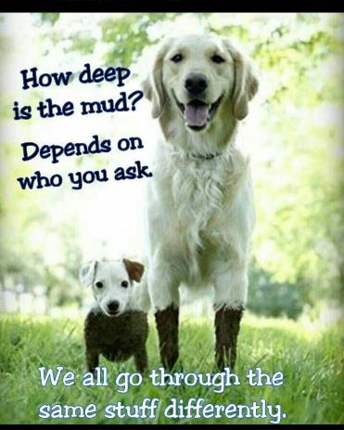
Take Care of yourself
Notes:
Our past experiences shape our reaction to our current reality

Slide 8
What is trauma?
  Trauma is a response to an event, series of events, or set of circumstances that is experienced by an individual as physically or emotionally harmful or life threatening and that has lasting adverse effects on the individual’s functioning and mental, physical, social, emotional, or spiritual well-being.
  (SAMHSA, 2014)
Notes:
Types of Trauma Handout

Slide 9
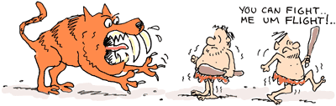
Our interpretation guides our own reactions.
Notes:
Our bodies are designed to respond to stress
Adrenalin and cortisol help us run or hide from the “tiger”
Threat of short duration

Slide 10
Types of Stress
National Scientific Council on the Developing Child (2005)
Toxic
Prolonged activation of stress response systems in the absence of protective relationships
Tolerable
Serious, temporary stress responses, buffered by supportive relationships.
Positive
Brief increases in heart rate, mild elevations in stress hormone levels.

Slide 11
Most Common Adverse Childhood Experiences (ACEs)
Recurrent physical
abuse
Emotional abuse
Sexual abuse
Alcohol/drug abuser
in household
Incarcerated house-
hold member
Household member
with chronic mental
illness
Violence between
adults in the home
Parental separation
or divorce
It is estimated that 66% of the population has at least 1 ACE and 25% have 2 or more ACEs before age 18.
Notes:
The Adverse Childhood Experiences Study (ACE Study) is a research study conducted by the American health maintenance organization Kaiser Permanenteand the Centers for Disease Control and Prevention.^{[1]} Participants were recruited to the study between 1995 and 1997 and have been in long-term follow up for health outcomes. The study has demonstrated an association of adverse childhood experiences (ACEs) with health and social problems as an adult. The study is frequently cited as a notable landmark in epidemiological research,^{[2]} and has produced many scientific articles and conference and workshop presentations that examine ACEs.[

Slide 12
Linking ACES & School Performance:
Are 2 ½ times more likely to fail a grade
Score lower on standardized assessments
Have more receptive & expressive language difficulties
Are suspended or expelled more often
Found eligible for special education more frequently

Slide 13
3 R’s of Being Truama Informed
Realizing
  and understanding trauma
Recognizing
  how trauma impacts students/staff
Responding
  by creating trauma informed environments
  by adding to your tool kit

Slide 14

Notes:
Where were you?
How did you feel?
How did this event changed your world?
Did it bring up any other sensory memories?

Slide 15
Reflect by yourself
Where were you?
How did you feel?
Did it bring up any other sensory memories?
How this event changed your world?

Slide 16

A traumatic stress response occurs when our ability to respond to the threat is overwhelmed.

Slide 17
Traumatic Event/Events
Traumatic Impact
Dr. James Henry, Children’s Trauma Assessment Center, Western Michigan University

Slide 18

Trauma Changes Perceptions
I am not safe
I cannot trust others
I cannot trust myself
I cannot depend upon others
I am not worthy of care
I deserve the bad things that happen to me
It’s my fault

Slide 19
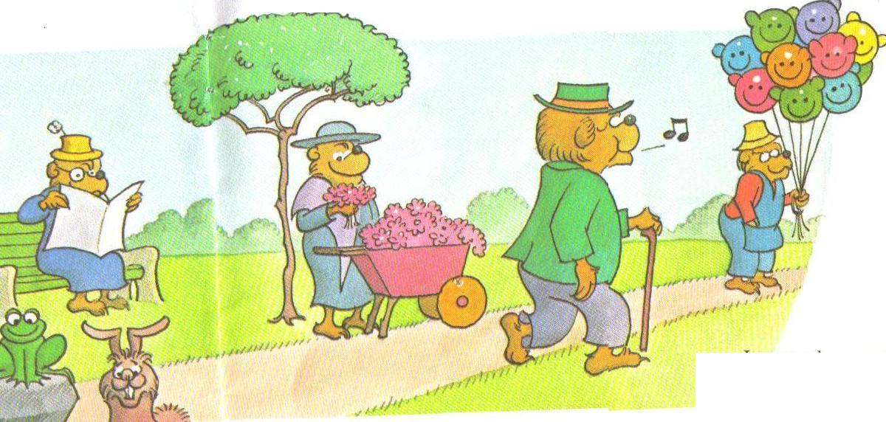
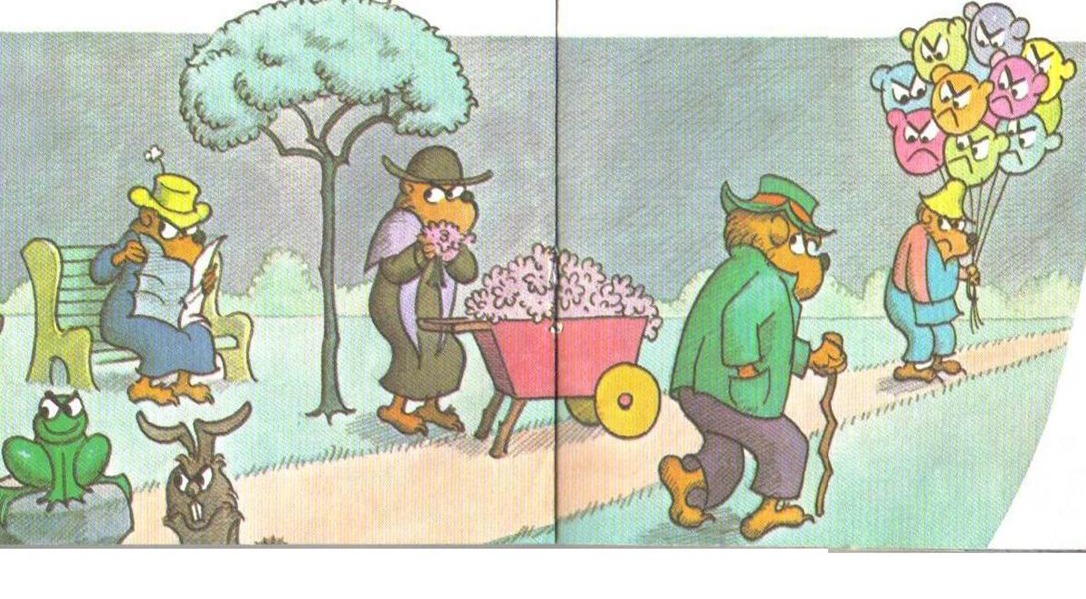

Slide 20
Impact of Secondary Trauma (Compassion Fatigue)
(Mayo Clinic)
Cognitive effects
Negative bias, pessimism
Social impact
Reduction in collaboration
Emotional impact
Physical impact
Loss of perspective and critical thinking skills
Threat focus – see parents, colleagues, supervisor, community members as enemy
Decreased self-monitoring
Withdrawal and loss of social support
Factionalism
Headache
Fatigue/sleep difficulty
All-or-nothing thinking
Depression
Freezing – unable to think straight or remember information
Muscle tension or pain
Chest pain
Fatigue
Stomach upset
Anxiety
Feelings of helplessness and hopelessness
Feelings of restlessness
Lack of motivation or focus for interests or hobbies
Feeling overwhelmed
Irritability or anger
Sadness or depression
Weight gain
Increased use of tobacco, alcohol, drugs
Minimizing the work
Stop hanging out with friends and loved ones
Notes:
Gentry’s (2012) 5 phases of compassion fatigue development process

Slide 21

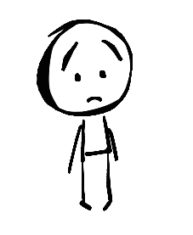
Parallel Process
If I had done my job better, this
wouldn’t
have happened.
It’s all my fault that I’m in foster care.

Slide 22
Parallel Process
I can't trust administration. They are waiting
for me to do something
wrong
I can't trust adults.
They will eventually hurt me.

Slide 23
Parallel Process
I have no power or
control over my work.
It doesn't matter what I do someone
will always take it away.

Slide 24
Activity 2: Write, Turn, and Talk
Discuss evidence of secondary trauma in your schools.
What are some takeaways you wish to share with colleagues about trauma and its impact on perspective and perception?
Notes:
1 minute

Slide 25
3 R’s of Being Truama Informed
Realizing
  and understanding trauma
Recognizing
  how trauma impacts students/staff
Responding
  by creating trauma informed environments
  by adding to your tool kit

Slide 26
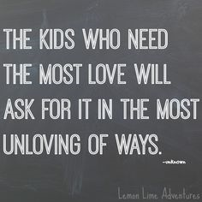
Notes:
Current problematic behaviors and symptoms may have originated as legitimate and even courageous attempts to cope with or defend against trauma. It really can start to shape our questioning from what is wrong with you to what has happened to you?

Slide 27
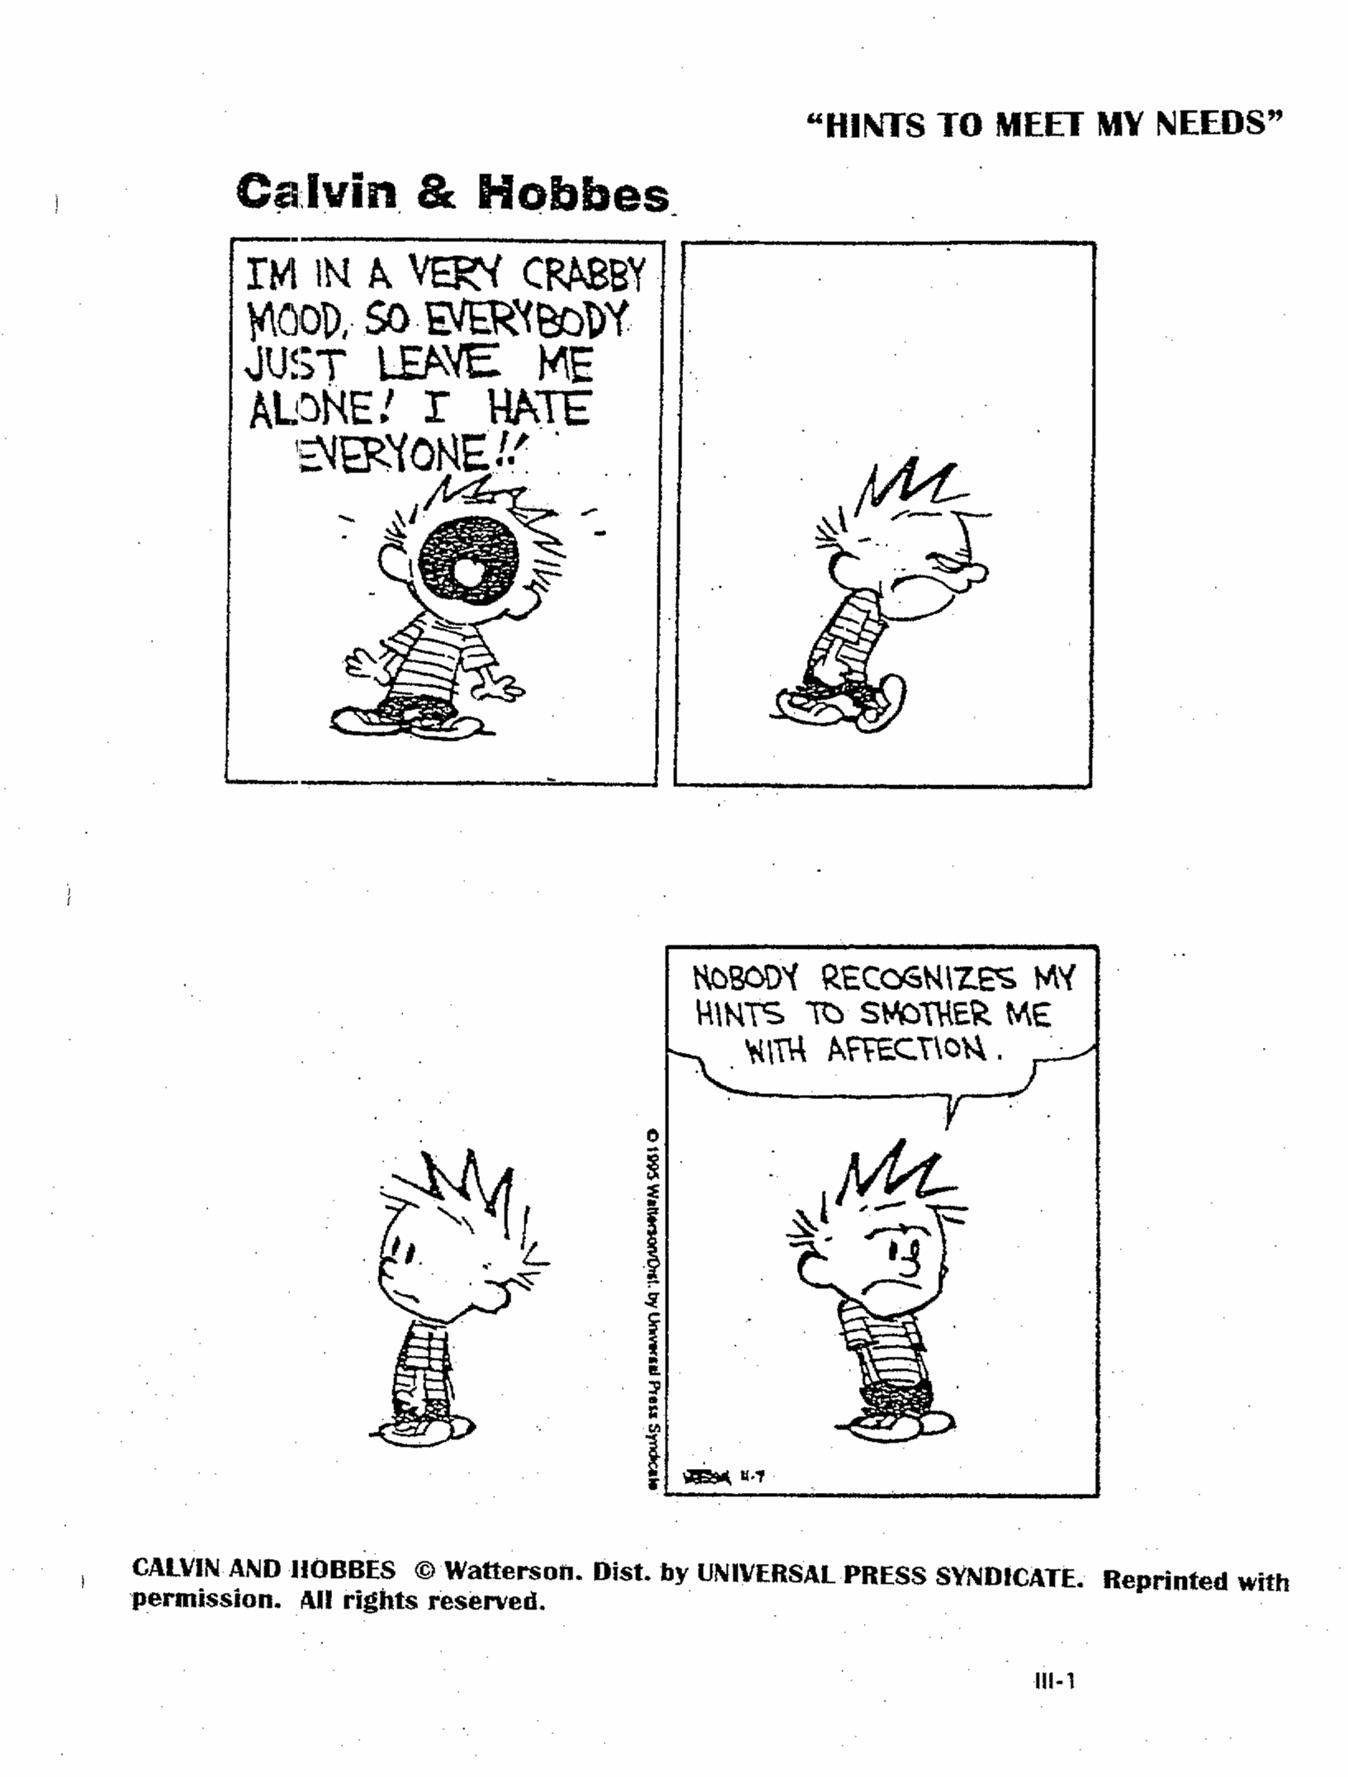

Slide 28
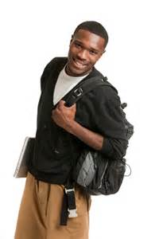


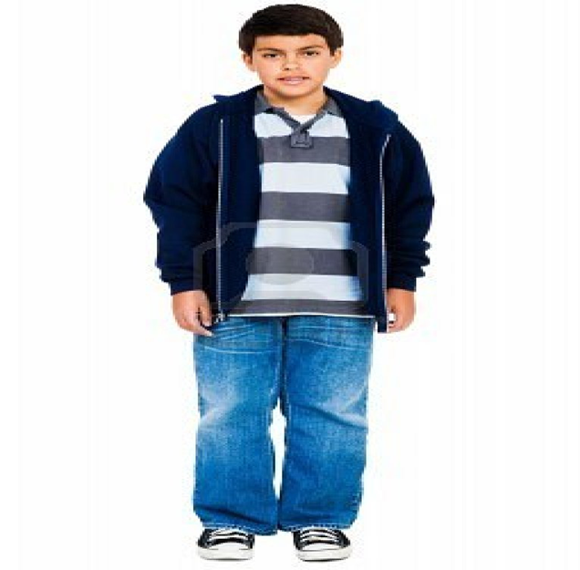



Slide 29

Thinking
Brain
Emotional
Brain
Instinctive
Brain

Slide 30
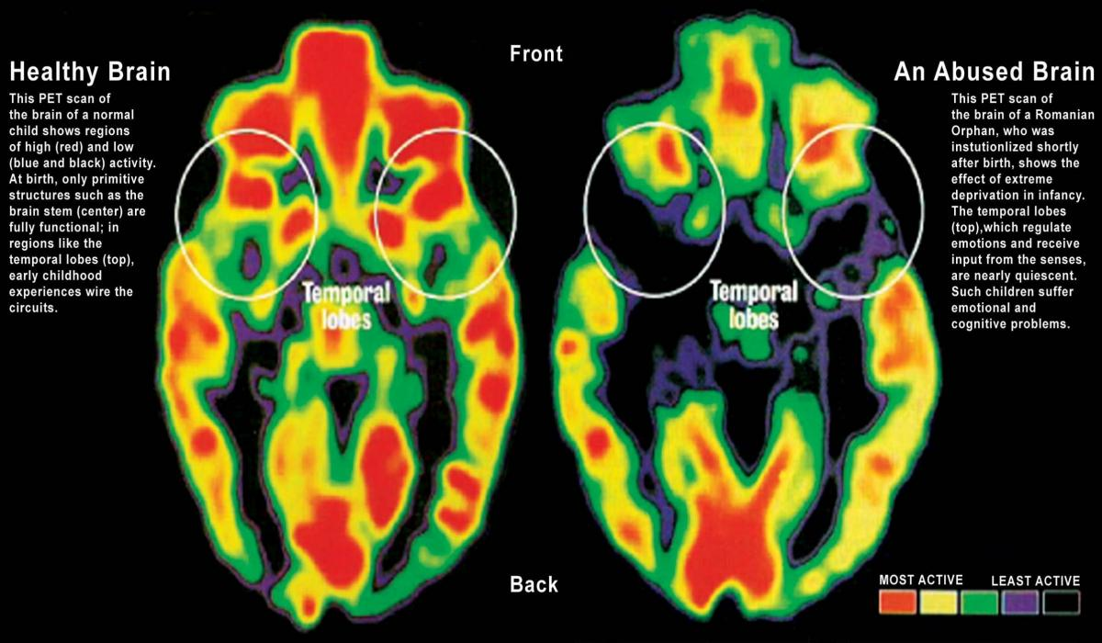
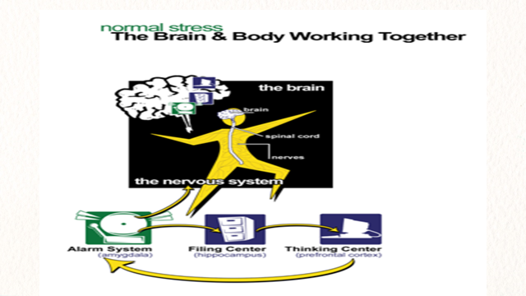
Dr. James Henry

Slide 31

“Jimmy”
A substitute
Change in schedule
Not having the snack/lunch
that was anticipated

Slide 32
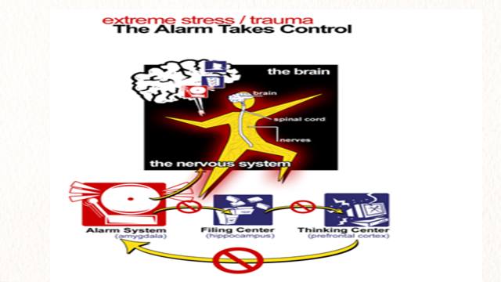
Dr. James Henry

Slide 33
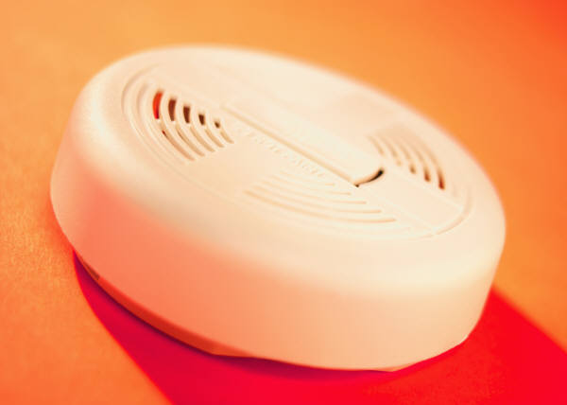
There and Then – Here and Now
Individual reacts as though
a “there and then” experience
is happening “here and now”

Slide 34
Impact of Trauma
Increased anxiety and/or depression
Increased aggression
Increased impulsivity
Decreased social ability
Reduced ability to regulate
Difficulty with attachment

Slide 35
“Skippy”
Can’t predict change
Not having the snack/lunch that was anticipated
Or
Change in schedule
Or
A Substitute
Feelings of worthlessness
Struggle with self-regulation
Not feeling safe
Homeless
Foster care
Violence in the home
Death of a loved one
Divorce

Slide 36
Survival Response
Fight
  Individual struggles to regain or hold on to power, especially when feeling coerced
  Mislabeled as: Non-compliant or combative
Flight
  Individual disengages, “no shows”, or “check outs” emotionally
  Mislabeled as: Uncooperative or resistant
Freeze
  Individual gives in to those in positions of power, does not or is unable to speak up
  Mislabeled as: Passive or unmotivated

Slide 37
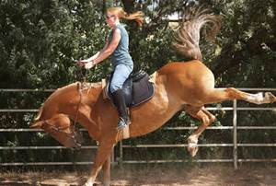
Think of the ‘learning brain’ as the rider, and the ‘survival brain’ as the horse. When a student is triggered, the ‘learning brain’ largely goes offline. The rider’s off the horse, and you’re just dealing with a really terrified horse.”

Slide 38
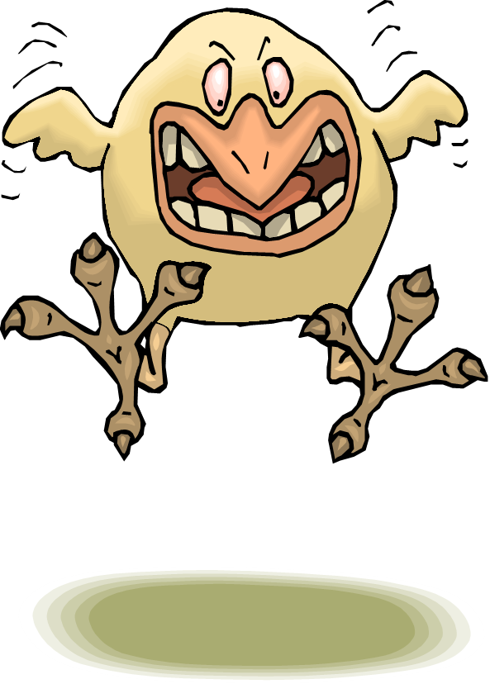
Emotional Reactivity
The primary impact of exposure to trauma is “emotional dysregulation.” (Van der Kolk, 2009)
An inability of the left side of the brain to talk to the right side of the brain, resulting in…
Ability to think clearly
Ability to calm
Ability to regulate
Ability to contain affect
…causing the child to become overwhelmed and irrational.

Slide 39

SEEKING TO COPE
Current problematic behaviors and symptoms may have originated as legitimate and even courageous attempts to cope with or defend
against trauma.
Notes:
An individual reacts as though a
“then and there” experience
is happening “here and now.”

Slide 40
Activity 3: Write, Turn, and Talk
What are some takeaways you wish to share with colleagues about how trauma impacts staff and students?
How can you or do you apply this information as you work with students?
Notes:
1 minute

Slide 41
3 R’s of Being Truama Informed
Realizing
  and understanding trauma
Recognizing
  how trauma impacts students/staff
Responding
  by creating trauma informed environments
  by adding to your tool kit

Slide 42
Resiliency Factors
Traumatic Event/Events
Traumatic Impact
Dr. James Henry, Children’s Trauma Assessment Center, Western Michigan University

Slide 43

Resiliency
Resiliency contextualizes a person’s strengths (individual, familial, community) against her/his adverse experiences.
(Zolkoski & Bullock, 2012)

Slide 44
“What works best is anything that increases the quality and number of relationships in a child’s life.”
(Perry, 2011)
“We learned in therapy that some of the most therapeutic experiences do not take place in ‘therapy’ but in naturally occurring healthy relationships.” (Perry, 2011)
It only takes one caring adult!

Slide 45
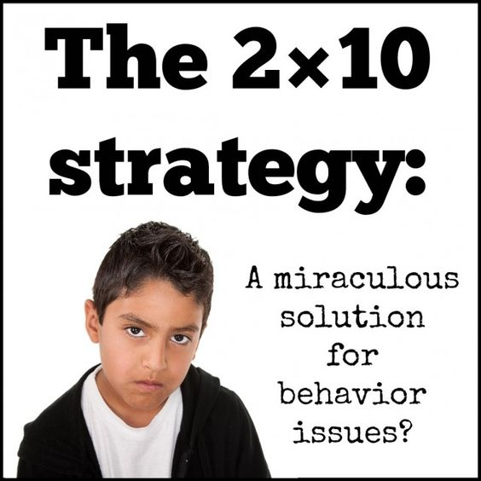

Slide 46
What exactly IS a trauma-sensitive school?
All staff understand the prevalence and impact of trauma of their students and themselves.
School strives for physical, emotional, social, academic safety for all.
The school addresses holistic student needs.
The school is inclusive and connects students to the community instead of excluding them.
The school staff work collaboratively to support students.
School leaders adapt services and supports based on contemporary needs of students.

Slide 47
Key Principles of Trauma Informed Approaches
Principle
Safety
Trustworthy and Transparency
Peer Support
Collaboration and Mutuality
Empowerment, Voice and Choice
Cultural, Historical and Gender Issues
Application In Schools
Safe, Predictable, Positive School Environment
Building the Collective Capacity of Staff, Students, and Families
Valuing Relationships, Partnering with Families and the Community
Child Centered Tiered Supports and Mentoring Programs
Instructional Discipline Policies that Emphasis Restoration over Punishment
Community Developmental Practices such as Student Fishbowls, Circles, and Class Meetings
(Adapted from SAMHSA)
Notes:
https://www.tolerance.org/classroom-resources/teaching-strategies/community-inquiry/fishbowl

Slide 48

Key Principles of Trauma Informed Approaches
Principle
Safety
Trustworthy and Transparency
Peer Support
Collaboration and Mutuality
Empowerment, Voice and Choice
Cultural, Historical and Gender Issues
Application In Schools
Safe, Predictable, Positive School Environment
Building the Collective Capacity of Staff, Students, and Families
Valuing Relationships, Partnering with Families and the Community
Child Centered Tiered Supports and Mentoring Programs
Instructional Discipline Policies that Emphasis Restoration over Punishment
Community Developmental Practices such as Student Fishbowls, Circles, and Class Meetings
(Adapted from SAMHSA)
Notes:
https://www.tolerance.org/classroom-resources/teaching-strategies/community-inquiry/fishbowl

Slide 49
Focus on the System
To get to “all”,
we must pay attention to “every”.
We must pay attention
to the “system” first, and then,
we move to small groups and individuals.
-Dave Tilly
Notes:
This quotation from Dave Tilly summarizes what we have been highlighting.
It is most efficient and effective to be thinking about how we support the system and then can provide additional supports. Focus first on the universal. We say “every” (each and every student) to ensure we don’t mean “most.” Sometimes, when people say “all,” they imply “most” – not attending fully to the needs of ‘every’.
If we are intentional and develop an organized way of addressing every students’ needs, we are more likely to impact more students positively and improve student outcomes.

Slide 50
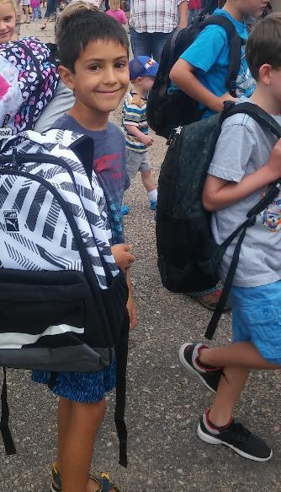
Here’s the kind of environment I want for “my” own child (4th grade)
A place that safe and predictable
A place where he feels welcomed and valued for who he is
A place where he feels like he belongs
A place where he develops self-confidence
Placed in situations where he feels a sense of accomplishment, self-assuredness, and self-motivation
Notes:
In an environment where he feels welcomed and valued for who he is, and I as his parent feel like a partner in his education.
An environment that safe and predictable where he is not afraid to explore, take risks and produces that love of learning
A place where he feels like he belongs and fosters the development of healthy relationships with teachers and peers
I want him placed in situations where he develops a sense of accomplishment, self-assuredness, and self-motivation

Slide 51

Activity 3: Turn, and Talk
Reflection: What would a positive, encouraging school climate look like?
Notes:
1 minute

Slide 52

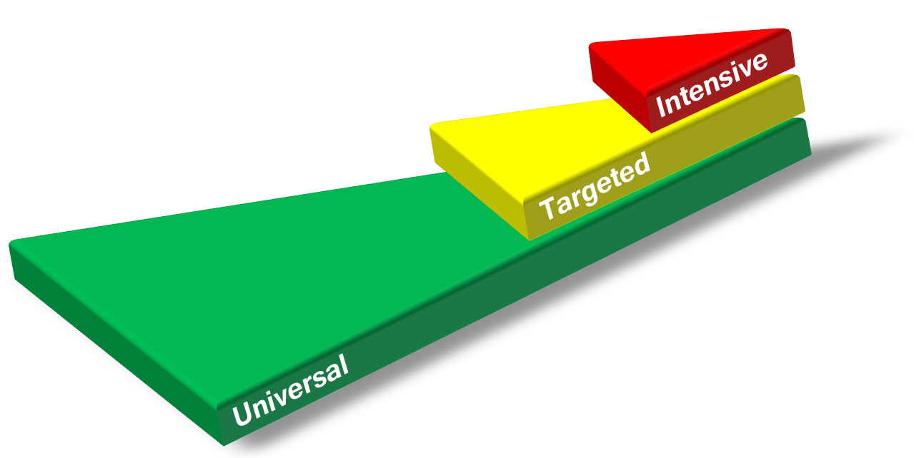
Layered Continuum
Support Matched to Stakeholders’ Needs
Every student = Universal
Some = Universal + Targeted
Few = Universal + Targeted + Intensive
Label supports…not students
Notes:
Prevent development of new problems
Reduce the number of existing challenges
Reduce the intensity and complexity of needed supports
“We layer supports on…(matching to need)…students do not ‘move through tiers’ (as if it were a “maze” for them to navigate).”
“layered continuum” = having a strong ‘core’ isn’t enough; having ‘quality interventions’ isn’t enough; all has to be equally supportive
Notes:
High quality instruction is provided to all students.
Some students benefit from additional instruction, progress monitoring and support to ensure educational gaps are eliminated.
Also, a few students benefit from more precise and explicit support to ensure their persistent academic or behavioral needs are met.

Slide 53
Proactive, Positive and Instructional
Reactive
Proactive
PROACTIVE
PRO-ACTIVE
PRAISE
PRAISE
CORRECTION
CORRECTION
TIME AWAY
TIME AWAY
Boys Town WMS

Slide 54
A Shift in Thinking
What about the interaction of the curriculum, instruction, learners, and learning environment should be altered so that the student(s) will learn?
What about the student is causing a problem?
STOP
Instead
This shift alters everything else!
Adapted from Batsche and Elliott materials (citing Ken Howell)
Notes:
A major conceptual shift. This puts the problem in the context of alterable variables and moves it outside of the student. When the focus of team meetings is on the discovery of instructional changes that will enable learning, the content of the meeting is quite different from one focused on the discovery of a disability.
Allowing time for discussion of this slide can bring about significant “aha”s.
*Remember our MTSS approach where we are focusing on what we can do or what supports (i.e. instructional changes) we can put in place (RtI triangle) to help the student be successful. This is a major conceptual shift. This puts the problem in the context of alterable variables and moves it outside of the student
FSCP Ideas:
Use of out-of-school time is considered a major factor in the achievement gap; and can be altered with family and community partnering; coordinated before and after-school programs, summer learning, homework support, technology access – and their interaction with the other variables can be influential

Slide 55
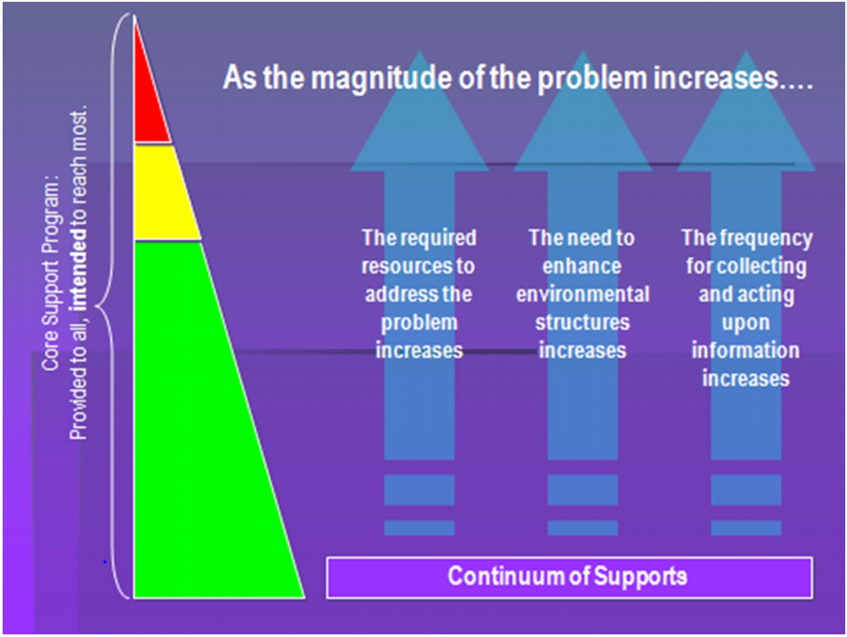

Slide 56
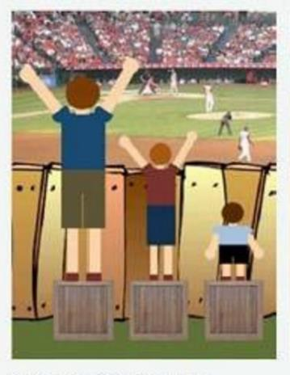
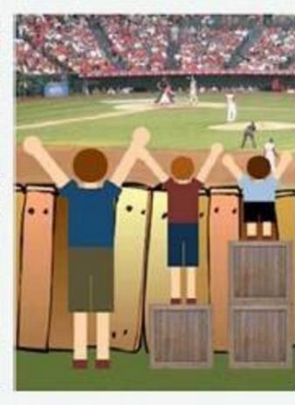
Equality VS Equity
We Can Do Better
Equality
Equity

Slide 57
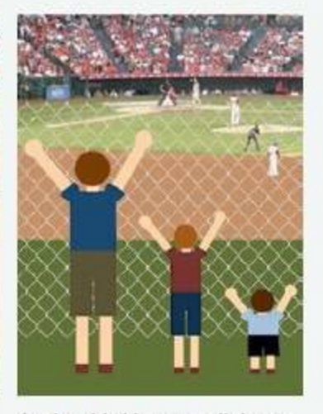
Remove the Barriers
Redesign of Environments
Systems Change
Prevention Science
Notes:
Prevent development of
new problems
Reduce the number of
existing challenges

Slide 58

PBIS Celebrates 20 Years!
Decreased disruptions in the classroom
Ever-Growing Evidence BASE
Decreased suspensions and expulsions
Positive Culture and Climate
Increased Student engagement
Increased feelings of safety
Increased Job satisfaction
Decreased time that Administrators spend on Discipline
Closing achievement Gap for Students on IEPs
Decreased Office Discipline Referrals
Notes:
Different programs are targeting schools every day claiming to have the answers to solve today’s toughest challenges. With our plates already full it is hard to find the cognitive capacity let alone the time to sit down and digest it all, determine what their angle is, whether it is evidence based, where it fits, how it can support, blend and braid within an already taxed and complex system…
So where do you begin? Starting with Desired outcomes is a great place to start…

Slide 59
Eight Guiding Principles of Effective Systems that are positive, predictable, consistent and safe:
Administrative Leadership invests in proactive approaches to discipline with resources, policies, and protocols
Team Implementation at all the Tiers
Define Concrete Expectations, Routines, and Rules
Teach Behavior Expectations to staff, students and families
Continuum of Acknowledges and Reinforcements for Positive Behavior
Monitor and Correct Behavior using an instructional lens
Use Data for Progress Monitoring and Decision Making
Create Family, School, and Community Partnerships
Notes:
The Eight Guiding Principles of SW-PBIS has been the map to implementation. Here is how they align with the priorities of MTSS.

Slide 60
It Starts in the Classroom
Alter the environment
Create a common language and expectations
Directly teach appropriate skills
Acknowledge expected, desired behavior
Correct unexpected and unwanted behavior fluently
Replace undesirable behavior with a new behavior or skill
Maintain emotional control at all times
Notes:
Always maintain dignity and respect for you and the child.

Slide 61

It Starts in the Classroom
Alter the environment
Create a common language and expectations
Directly teach appropriate skills
Acknowledge expected and desired behavior
Correct unexpected and unwanted fluently
Replace undesirable behavior with a new behavior or skill
Maintain emotional control at all times
No other prevention or intervention strategy will be successful if we cannot first control our own emotional response
Notes:
Always maintain dignity and respect for you and the child.

Slide 62
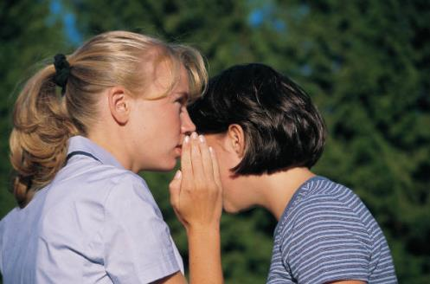
Correcting Unwanted or Undesired Behavior
The Big Secret…..
It starts with changing ADULT behavior!
Notes:
The Big Secret of all of this talk about acknowledgment is that PBIS is about changing adult behavior, which in turn changes student behavior!

Slide 63
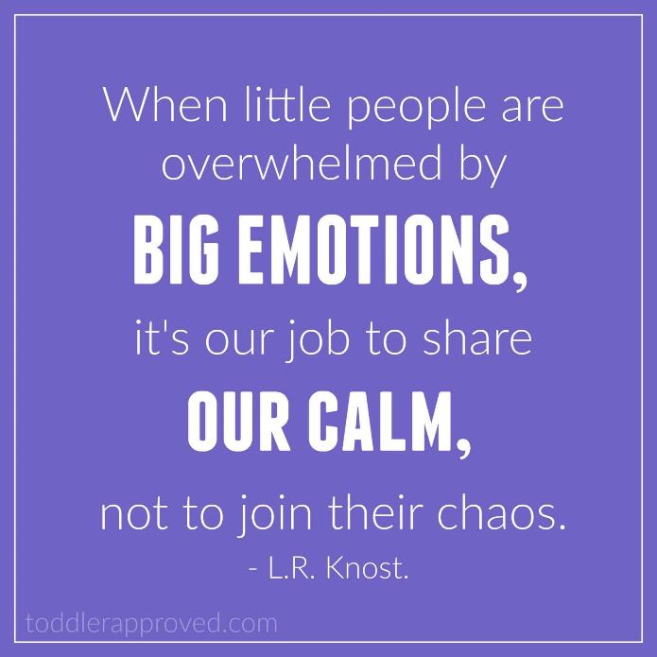
Notes:
Fighting fire with fire is not an evidence-based practice – fighting fire with WATER is…

Slide 64
Activity 4: Think, Pair, Share
Share examples of effective classroom systems of Positive Reinforcement
Describe systems that are not so positive?
What critical features were described that will consider as you support educators in their implementation of reinforcement systems?

Slide 65

Feedback & Acknowledgment
To learn any new skill (academic or behavioral) requires regular & frequent feedback
The behavioral shaping process is occurring in all environments and in all social situations even when we are not conscious of its existence.
Without formal feedback to encourage desired behavior, other forms of feedback shape undesired behaviors
Notes:
Why is acknowledgment and recognition important? In order to learn, humans require regular and frequent feedback. Remember the frontal lobe discussion from the behavior expectations module? We want to strengthen the neuron fibers and neural pathways for the expected and desired behavior!

Slide 66



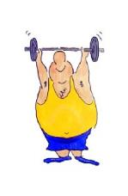



Why do we acknowledge prosocial behavior?
You have 30 seconds to write down all the reasons you can think of why we should acknowledge student’s behavior

Slide 67
Why acknowledge appropriate behavior
To build and maintain positive relationships
To create a positive culture and climate within the classroom and school
To motivate others to engage in the same appropriate behavior (shaping class/school behavior)
To show appreciation and gratitude
To shape behavior and new learning
To increase the likelihood of the same behavior happening in the future (create fluency)

Slide 68
High Rates of Positive Reinforcement
‘The best intervention you have in your tools to increase the motivation to make a good choice is positive reinforcement’.
Dr. Terry Scott
Notes:
Success breeds success. Students need 80% rate of success for mastery of any skill. This is true for reading and math as well. Unfortunately the typical elementary classroom provides positive to negative feedback at a rate of 2:1 so this must be increased if you want to create change.

Slide 69

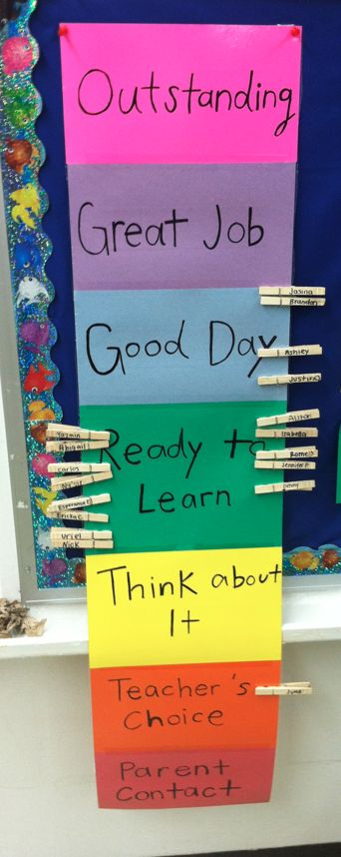
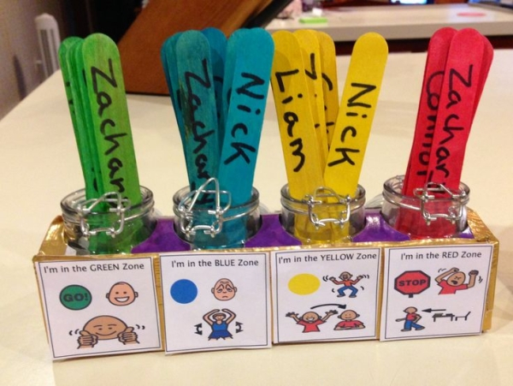


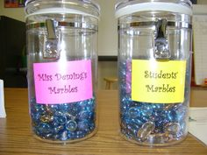
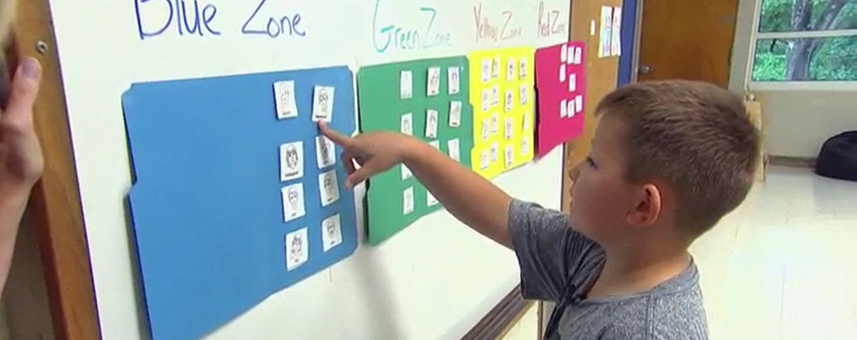

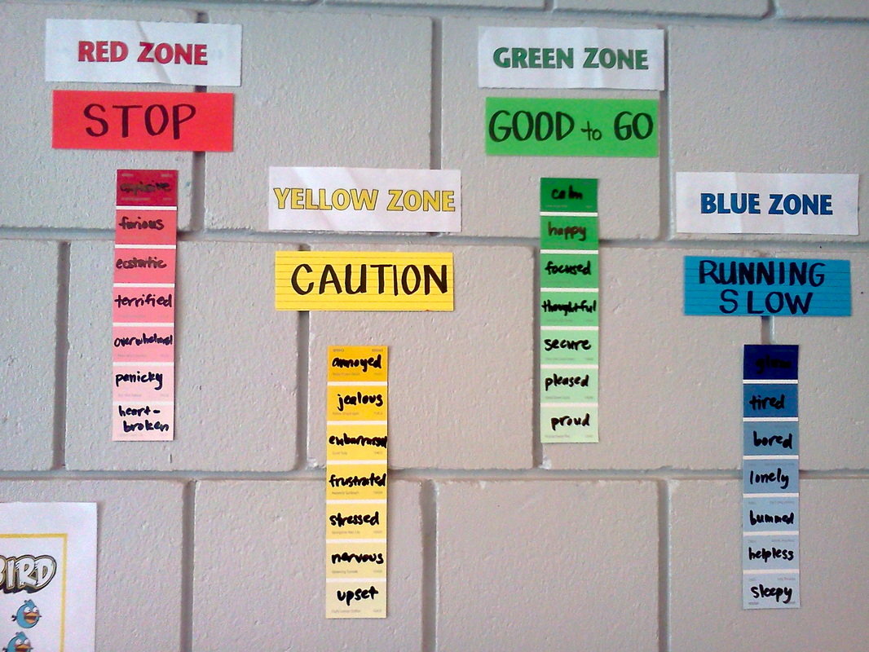
Behavior Management Systems

Slide 70
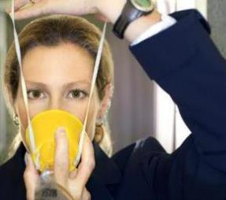
Reinforcing Staff
Acknowledging staff leads to higher job satisfaction
Invest in Self-Care
Keeping staff motivated is just as
important to the PBIS process as motivating students
Utilize family/community resources and local businesses
Schools
are a collection of individuals who are on a very lean schedule of reinforcement
Notes:
Here are a few examples. One school had families that offered staff incentives. For example, one owned a salon and offered a free haircut for a staff incentive. Another incentive was an afternoon of free lawn service by another parent who owned a lawn care company. Are there incentives that the parents at your school may be able to offer? GOOSE stands for Get Out of School Early – and it’s one of the most coveted acknowledgments!

Slide 71

Emotional Resiliency
Self-Care Strategies

Slide 72
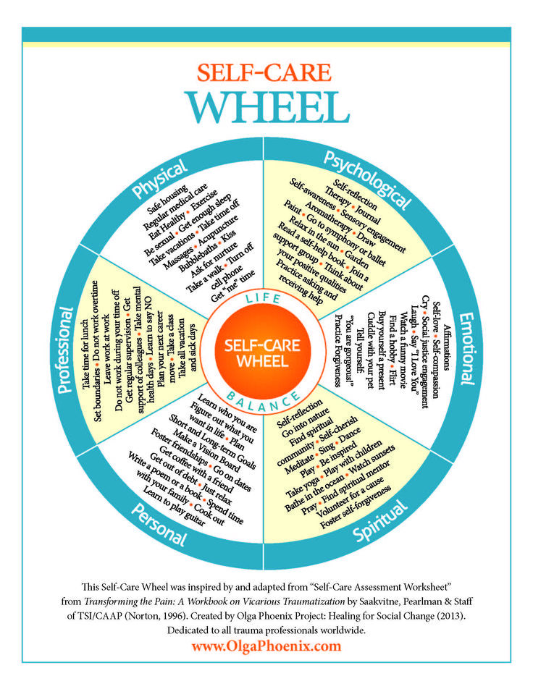
www.OlgaPhoenix.com
Notes:
www.OlgaPhoenix.com

Slide 73
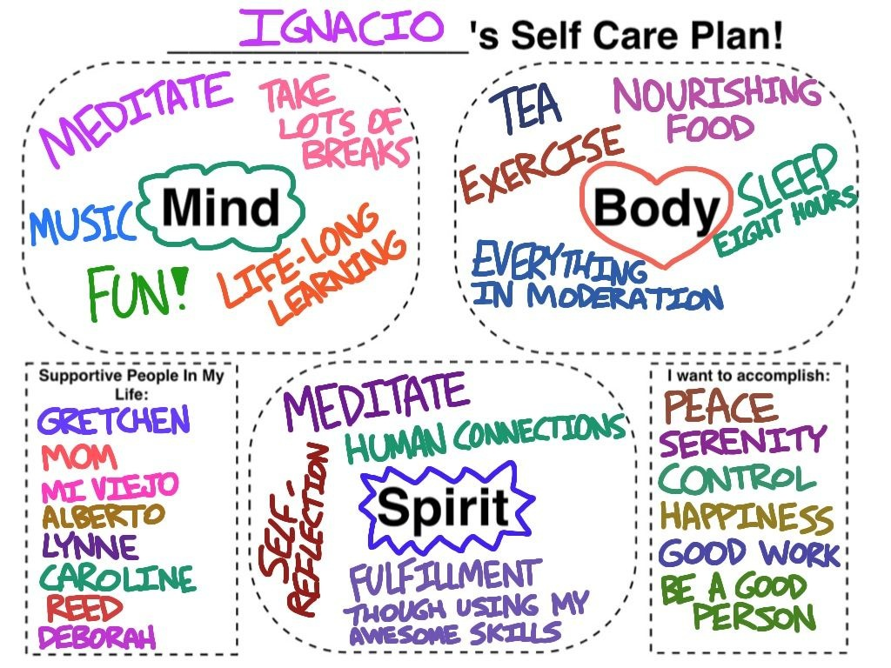

Slide 74
1 | 2 | 3 | 4 | 5
6 | 7 | 8 | 9 | 10
11 | 12 | 13 | 14 | 15
16 | 17 | 18 | 19 | 20
21 | 22 | 23 | 24 | 25
Take a walk
Positive self-
affirmation
Bubble bath
Cuddle with
pets
Practice
relaxation
Coffee w a
Friend
View a sun
set
Eat in the
Lunch Room
Be in Nature
Take a Lunch
Break
Say I love
you
Notes:
Principal’s 200 Club; teach probability?

Slide 75
Taking an Instructional Approach
4:1
4 Positive Interactions (successes)
to every
1 Negative Interaction (failure)
(Instructional Research, Dr. Terry Scott)
When learning any new skill
Notes:
Positive teacher-student interactions in the classroom are ESSENTIAL in building a culturally responsive community
Use of Positive Instructional Feedback to maintain motivation
Emphasize relationship building. Genuine, specific positive feedback will strengthen relationships – especially important when there are cultural differences within a school community.
Families can help increase this ratio, “continuing’ or “coordinating” the reinforcing positive behaviors at home?

Slide 76

Reinforce Approximation
“Focus on the learning process and show how Hard Work, Good Strategies, and Good Use of Resources lead to better learning.”
Carol Dweck
https://www.theatlantic.com/education/archive/2016/12/how-praise-became-a-consolation-prize/510845/

Slide 77
Reinforce Approximation
“Focus on the learning process and show how hard work, good strategies, and good use of resources lead to better learning.”
Carol Dweck
https://www.theatlantic.com/education/archive/2016/12/how-praise-became-a-consolation-prize/510845/

Slide 78
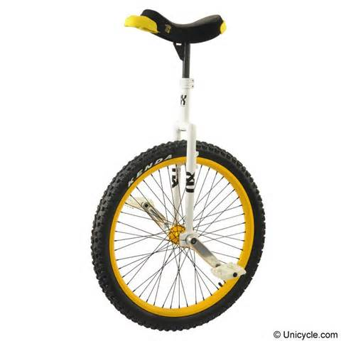

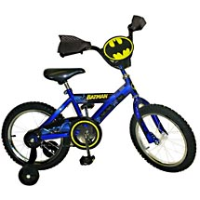
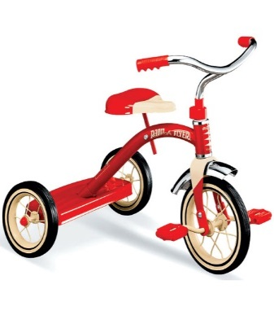
The Shaping Process
High
Self-Reinforcing
Skill Mastery
General Praise
Internal
Specific Praise
Effective Praise
Motivation
Low
External

Slide 79
How to provide an acknowledgment:
Staff taught to immediately acknowledge:
  Name behavior and expectation observed
  Give positive verbal/social acknowledgement
“Thanks for putting your backpack in your locker – that’s showing responsibility!”
Notes:
Here’s how to provide an acknowledgment. Name the behavior and expectation observered, give a positive verbal and/or social acknowledgmenet and give out the token for access to the school-wide reward system. The purpose of giving a tangible token is to make a connection with the student – it provides a reminder and mechanism for the adults. Giving out “tokens” can start to taper off – you can do fist-bumps, high-fives, or give a student the token to pass to someone else they see exhibiting the same behavior.
It’s also important to remember to acknowledge the behavior and not the person.

Slide 80
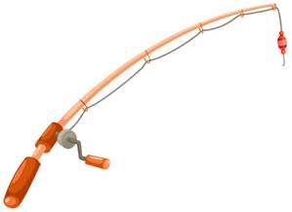

Bottom Line…
Catch’em Being Good!!!
Focus on POSITIVE not negative behavior
Provide POSITIVE not negative attention

Slide 81
Activity 5: Think, Pair, Share
How could you promote self-care in your school?
What roadblocks do you face when it comes to positive reinforcement?

Slide 82

Moving up the Tiers: Build local capacity
Learning opportunities build buy-in and confidence
Coaching support builds competence
Model, practice, feedback builds fluency
Notes:
Local capacity: build personnel and ability to overcome turnover (team owned…enough people know the model and sustain it so that turnover doesn’t kill it)
(budget line-item; team structure and infrastructure)

Slide 83
Change the Narrative to Connect
Instead of thinking “what is wrong with you” think “what has happened to you?”
Start where the student is at not where you want them to be. Safety is always the first step. “How can I help you feel safer?”
Recognize and honor a student’s inability to trust and feel safe despite how it feels for you. “Of course you can’t trust me.”
Know you cannot change a student’s perception because you tell them what your reality is. “I know you can’t believe me”
Notes:
Can give my Kindergarten Example

Slide 84
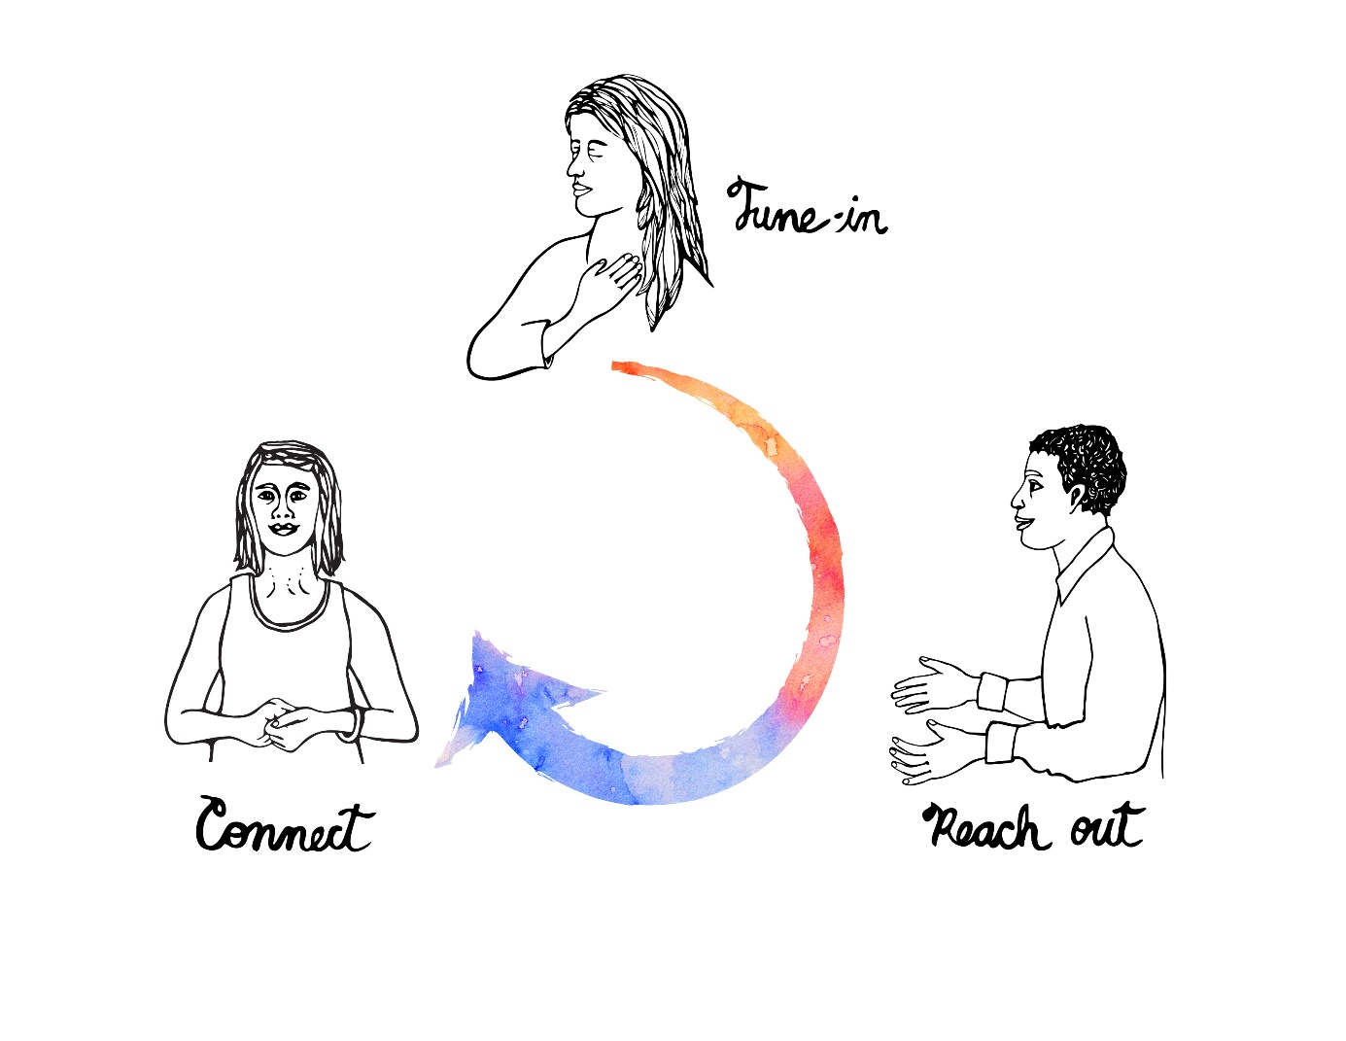

Resilience In Schools and Educators (RISE)
Hand to Heart Strategy
© 2016 Let's Connect

Slide 85
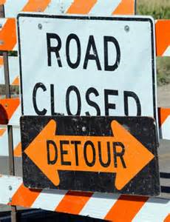
Detour Strategies:
Selection depends on the Behavior’s frequency, duration, intensity, and prior success.
Cool down time/space set a timer, alternative seat, space, environment, etc.)
Empathy “It does feel like a long time until lunch!”
“How can I help you?”
DIB/DAB Statements “right now you are
yelling you need to be quiet”
Reality Statements “the sooner you get calm
the sooner we can talk about what you
need.”
Praise – “Doing a good job getting calm.”

Slide 86
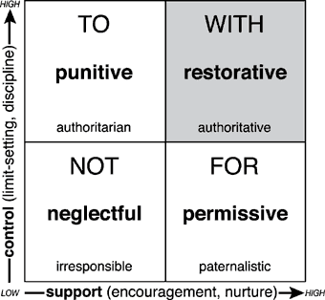
Restorative Practices In Schools

Slide 87
Activity 6: Turn and Talk
What are vulnerable decision points and why are neutralizing routines so valuable?
Discuss a neutralizing strategy that resonated with you? What will you share with others?
Consider the following scenario. You have given assignment in class. You go over to a student and ask them to get to work. They respond with, “You can’t make me!” What is your next move? What do you do? Say?
Come up with common student responses that may warrant scripts at your school.

Slide 88
Moving up the Tiers: Teach Replacement Behaviors
to Access Needs and build fluency
Executive Functioning
Emotional Regulation
Sensory Integration

Slide 89
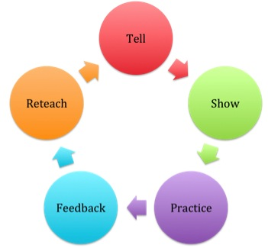
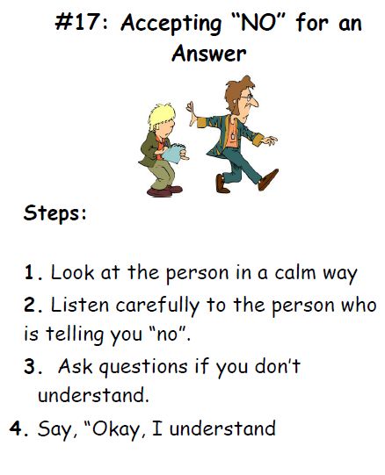
Directly Teach the Replacement Behavior
Peace 4 Kids

Slide 90
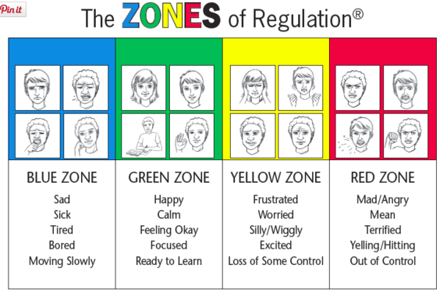
Regulation skills

Slide 91

Point Cards and Direct Behavior Rating
Trauma Informed Lens:
Must be positive in nature, artificially elevate reinforcement
Tied to newly developing skills and strategies to help build fluency,
Responsive to needs of student

Slide 92
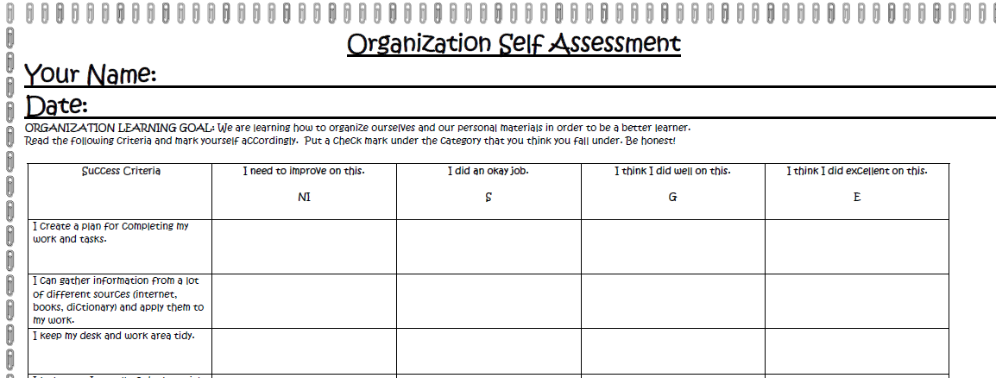
Self-Regulation tool
Notes:
Lynne

Slide 93
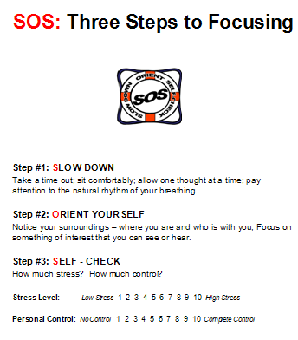

Slide 94
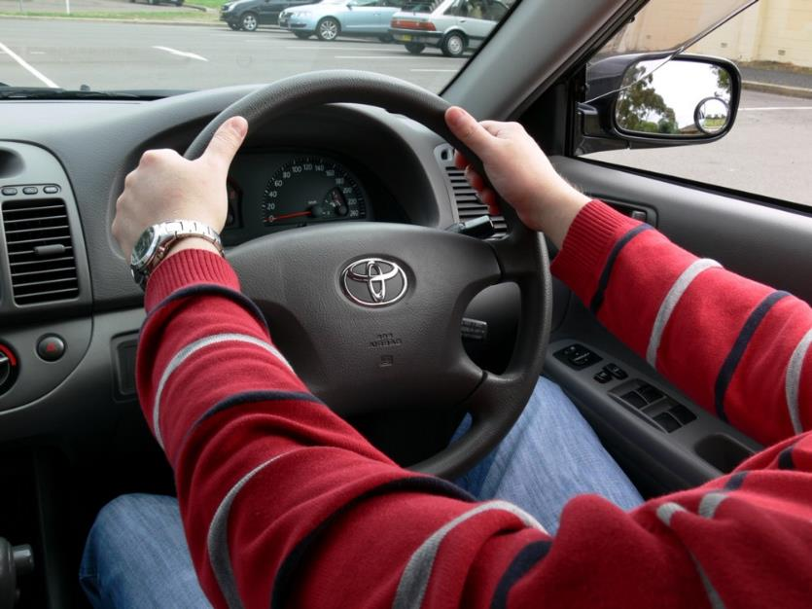
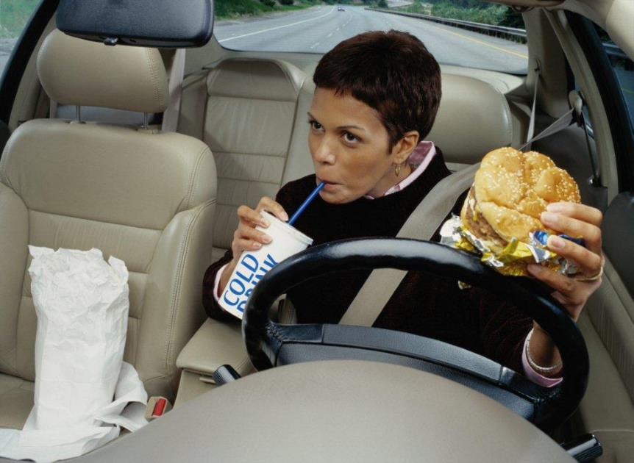
Notes:
Remember learning to drive? Hands at 10 and 2, radio off….now?
As we practice, overtime, we can do things without thinking….although maybe we shouldn’t?

Slide 95

“Skippy”
“Jimmy”

Slide 96
To Recap
Emphasize the recognition, understanding, and responsiveness to student needs using a preventive, positive, and instructional lens.
Recognize the necessity of building the collective capacity of school personal to create safe, predictable, and engaging learning environments for all students.
Make explicit efforts to build healthy, trusting relationships, emphasize choice and empowerment through skill building
Intentionally create positive opportunities where students can learn and practice self-regulation strategies and prosocial skills.
Collaborative partnerships between school, home, and community is viewed as essential for creating culturally relevant outcomes and sustained benefits for students.
Notes:
So now that we know a bit more about Trauma and its impact on our students, we want to talk about how to design interventions to support students who have experienced some sort of trauma or toxic stress. Thinking about Positive Behavioral Interventions and supports within the MTSS framework, we see a strong correlation to the Core Values of Tauma Informed Approaches.

Slide 97
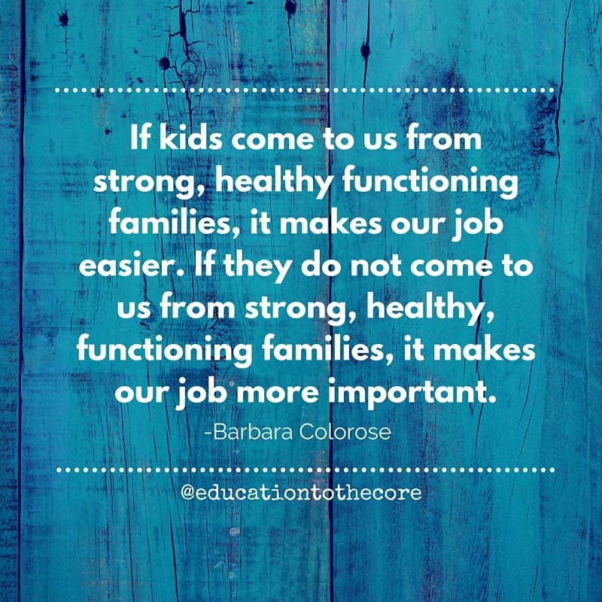

Slide 98
Activity 7: Write, Turn, and Talk
1. Identify some considerations you will utilize the next time you support struggling students.
3. Turn and Talk to an elbow partner.
Notes:
1 minute

Slide 99

Questions

Slide 100
References & Resources
Resources & References:
Boys Town Well Managed Schools
Dr. James Henry - The Children’s Trauma Assessment Center of Michigan
Crisis Prevention Institute
Trauma & Learning Policy Initiative of Massachusetts Advocates for Children & the Legal Services of Harvard Law School & Lesley University
Center for Study and Prevention of Violence
COACT Colorado
Books:
The Body Remembers by Babette Rothschild
Help for Billy by Heather T. Forbes, LCSW
The Body Keeps the Score by Van Der Kolk, M.D.
Lost At School by Ross W. Greene, PH.D
The Boy Who Was Raised as a Dog by Bruce Perry and
Supporting and Educating Traumatized Students: A Guide for School –Based Professionals
Coaching Classroom Management; Strategies & Tools for Administrators & Coaches By Sprick and Knight
Behavior Education Program
Documentary:
Paper Tigers by James Redford

Slide 101
References & Resources
Websites:
Pbis.org
Wisconsin Department of Public Instruction https://dpi.wi.gov/sspw/mental-health/trauma
Colorado State University – Child Trauma Resilience Assessment Center http://www.ctrac.chhs.colostate.edu/
We Teach Peace -The Center for Anti-bullying & Non-Violence (CAN) has taken leadership in developing the Peace4Kids model that is highly effective with aggressive youth http://wecanco.org/
Trauma Transformed http://www.t2bayarea.org
SAMHSA Trauma Resources http://www.samhsa.gov/nctic/
FBA/BIP:
https://sites.google.com/a/pdx.edu/basicfba/
https://www.pbis.org/school/school-mental-health/interconnected-systems

