Slide 1
The Five Evidence-Based Practices of Classroom Management
Presented at the 2018 BPEG Symposium
May 7, 2018
Jason Harlacher, Ph.D.
Harlacher_J@cde.state.co.us
Office of Learning Supports
Colorado Department of Education

Slide 2
Icebreaker
Choose a number 1 to 3:
Any kids, nieces, nephews, or pets?
Second career if not in education?
Favorite hobby or leisure activity?
Turn to neighbor, introduce self, and each answer your chosen question.

Slide 3
What to Expect
Prevent
Teach
Reinforce
Antecedent
Behavior
Consequence
Foundational
Teach New Behavior/Skills
Responses

Slide 4
5 Principles of Classroom Management
Identify and teach expectations
Establish procedures and structure
Actively engage students
Reinforce expectations
Manage misbehavior

Slide 5
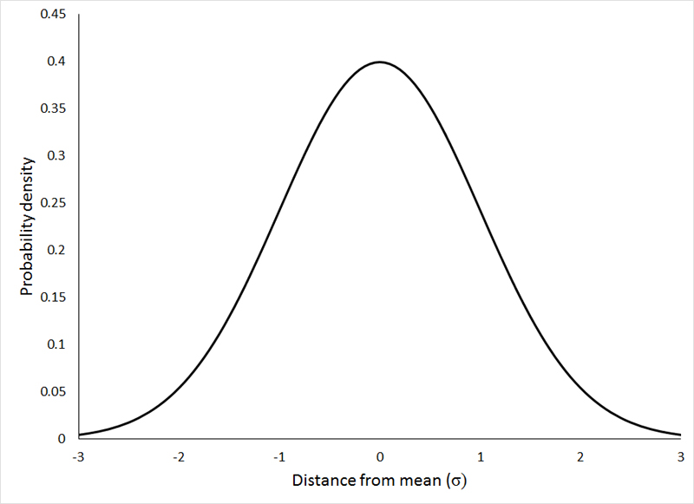
Average student 50th percentile
Average student with Classroom Management practices, 21st percentile
Less More
Rates of unwanted behavior

Slide 6
5 Principles of Classroom Management
Identify and teach expectations
d = .76
Establish procedures and structure
d = .76
Actively engage students
d = .62
Reinforce expectations
d = .98
Manage misbehavior
d = .74

Slide 7
“If a child doesn’t know how to read, we teach. If a child doesn’t know how to swim, we teach. If a child doesn’t know how to multiply, we teach. If a child doesn’t know how to drive, we teach. If a child doesn’t know how to behave, we punish?”
Why can’t we say teach as easily with behavior?
Instructional Approach to Behavior
John Herner (1998), former president of the National Association of State Directors of Special Education

Slide 8
1. Identifying and Teaching Expectations

Slide 9
Expectations
Foundation of classroom management is a set of common expectations that generally describe desired behavior across all routines, settings, tasks, etc within a classroom.
Shape values and climate of classroom
(1) No more than five, (2) positively worded, (3) short, developmentally appropriate, (4) translate into specific behaviors

Slide 10
Smith Station Elementary School Fredericksburg, VA
Bonnie Garcia Elementary School Laredo, TX
Lenihan Intermediate School
Marshalltown, IA
Houghton High School
Houghton, MI

Slide 11
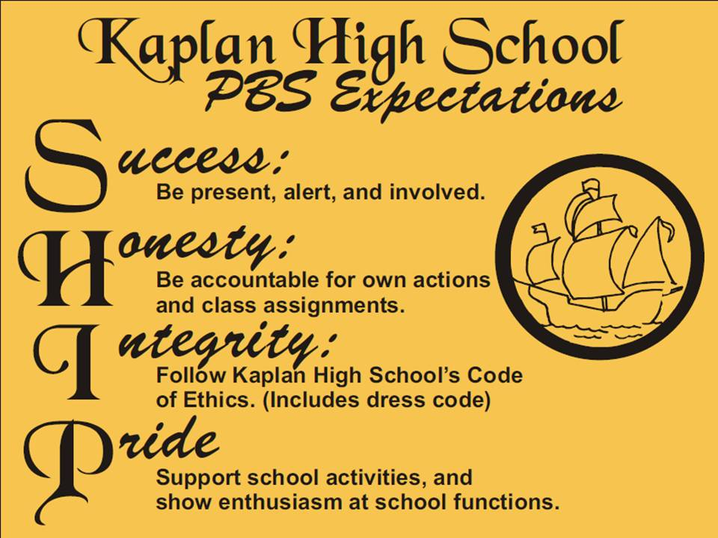
Cowden-Herrick CUSD 3A
Cowden, IL
Kaplan high School,
Kaplan, LA
Shelton High School
Shelton, WA

Slide 13
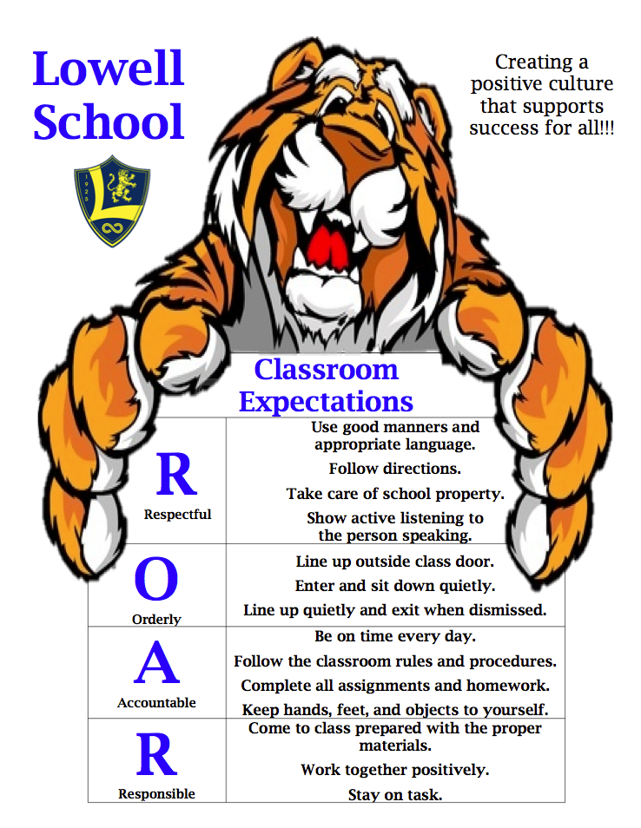
Defining Rules
Two options:
Define rules for the classroom that go across all events
Define rules for each event
P
Follow directions.
Treat others as you would want treated.
Use good manners and appropriate language
Practice Respect
A
Be on time every day and stay on-task.
Complete all assignments.
Come to class prepared.
Act Responsibly
W
Use active listening
Seek out others’ opinions
Be assertive when stating your needs.
Stay on-task
Work Together
S
Keep hands, feet, objects to self.
Use respectful language.
Be aware of your actions.
Stay Safe
https://www.ankenyschools.org/Page/11763

Slide 15
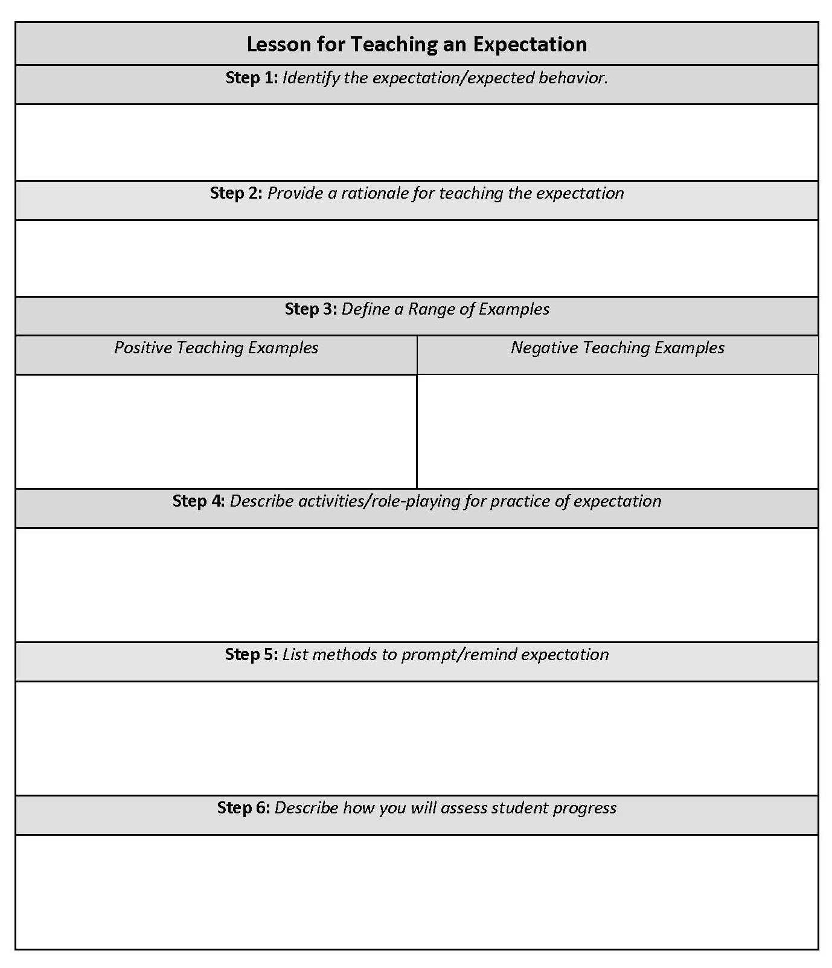
Teaching Expectations
Use a clear lesson plan to teach the expectations in the same manner as academics

Slide 16
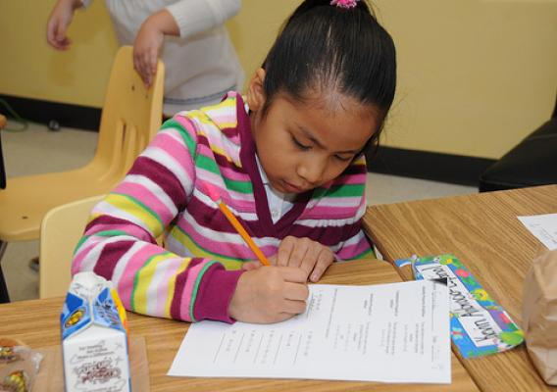
Example & Non-Example
During independent work time, you work quietly and without disrupting others. This is respectful.
During independent work time, you distract others by making noise and tapping your pencil.

Slide 17
Example & Non-Example
You show responsibility by coming into class quietly and sitting down. You start on your “daily work” right away.
You come into class loudly, saying hello to classmates and slapping people on the back. You ignore the “daily work” and make jokes with friends.

Slide 18
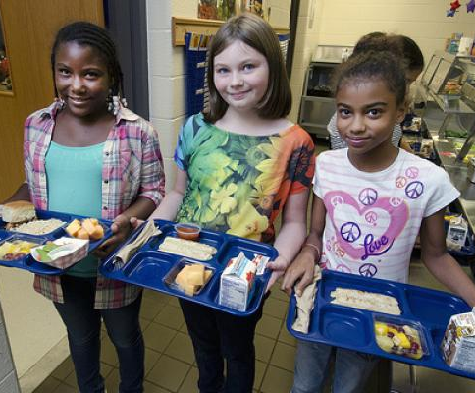
Example & Non-Example
You show respect by inviting your classmates to have lunch with you. You include anyone who wants to eat with you.
You grab a table at lunch and only allow 2 people to sit with you. You mock anyone else who wants to sit with you and make fun of them.

Slide 19
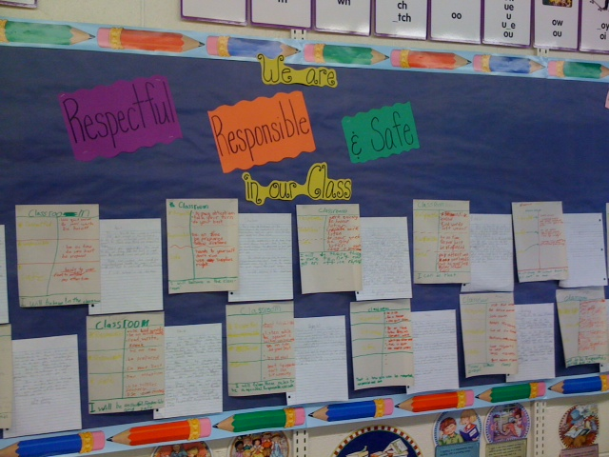

Slide 20
Activity
What is respect toward peers?
Think of an example and non-example for your classroom/setting for “respect”

Slide 21
2. Ensuring Structure and Routines

Slide 22
Ensuring Structure and Routines
Creating a space that is predictable and facilitates the desired behavior
Physical Space
Temporal Space
Harlacher. Designing Effective Classroom Management

Slide 23
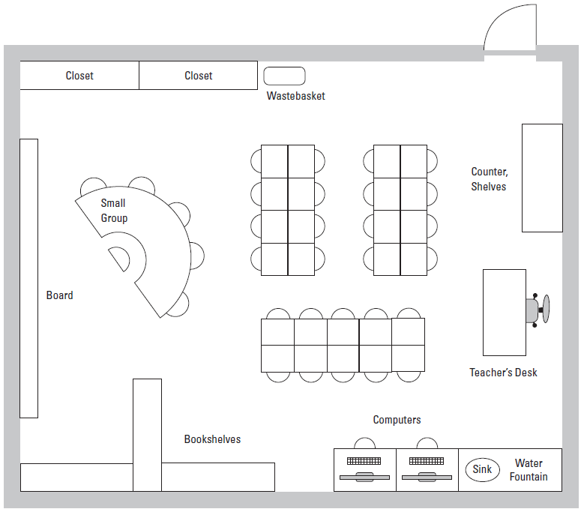
Harlacher. Designing Effective Classroom Management

Slide 24
Small group in front of the board makes it difficult to see and blocks students from having desks closer to the board. Teacher has his/her back to the rest of classroom.
Some students have their back facing the board.
Single desk is in the middle of high traffic area.
Common areas (computer, water fountain) are too close to student desks and hard to access without disrupting others.
Difficult to supervise students in the book center, as the bookshelf blocks the view.
Harlacher. Designing Effective Classroom Management
Notes:
We’ve included a red plus sign to indicate an area of concern. In the left top corner, you can see there’s an issue with the small group table.

Slide 25
Feature | Yes | No
Are high-traffic areas free of congestion?
Can all students be easily seen by the teacher and vice-versa?
Are frequently used materials easily accessible?
Can all students see whole-class presentations easily?
Do students have ample room around their desks and seats?
Are desks organized in a way that facilitates teaching (in circles for small groups, individual seats for independent work, etc?
During small-group instruction, can the teacher still see all students?
Does the layout accommodate students with special needs?
Is there space available for students who need a quieter work environment or time to wind down?
Harlacher. Designing Effective Classroom Management

Slide 26
Temporal Space: Routines
Teach students procedures for common tasks in class, such as entering classroom, handing in work, asking for a hall pass, getting teacher’s attention, etc
Define a procedure and its steps

Slide 27
Bathroom Pass
Goal: To get needs met without disruption.
1. When pass is available, raise hand, wait to be called upon.
2. Ask respectfully to use the restroom.
3. Write name and time on sign-out sheet.
4. Take pass. Return within five minutes.
5. Write time in. Return pass.

Slide 28
Bathroom Pass
Goal: To get needs met without disruption.
1. When pass is available, raise hand, wait to be called upon.
2. Ask respectfully to use the restroom.
3. Write name and time on sign-out sheet.
Model
Lead
Test
4. Take pass. Return within five minutes.
5. Write time in. Return pass.

Slide 29
Systematic Instruction
Number of correct repetitions in a row of a new word needed to
“automatize” the word
Type of Learner | Number of Repetitions
Most Able | Less
Average | 3-8
Least Able | More
Reitsma, 1983

Slide 30
For a child to unlearn an old behavior and replace with a new behavior, the new behavior must be repeated on average 28 times (Harry Wong; The First Days of School: How to be an Effective Teacher)

Slide 31
3. Actively Engage Students

Slide 32
Opportunities to Respond (OTRs):
Anytime a student can respond to an academically-oriented task/question/prompt
Provides a sensitive measure of engagement
Teacher Prompt (OTR)
Student Response
Teacher Feedback (Praise or Corrective Feedback)

Slide 33
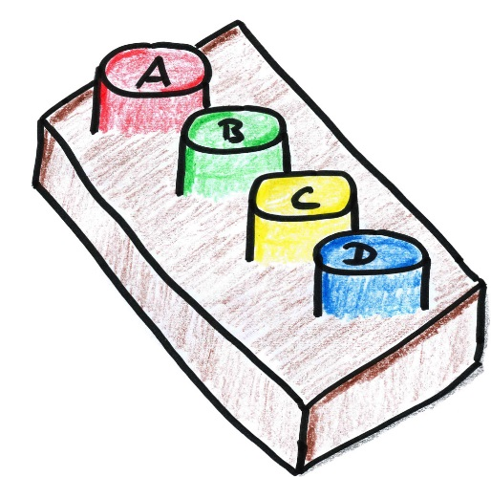
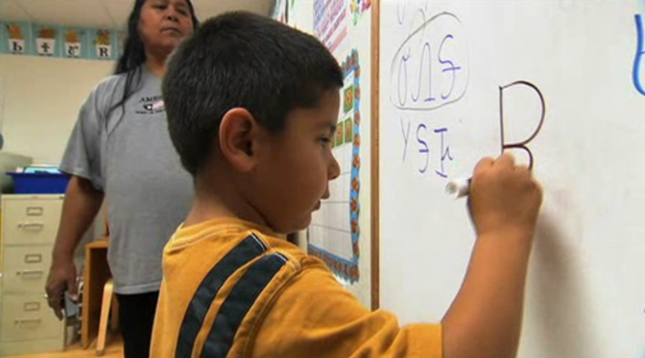
Verbal
Written
Action
EXIT
SLIPS

Slide 34
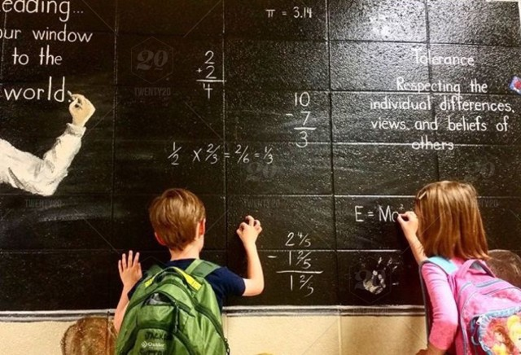
Ideal Rates?
Large-group: 3-6/minute
Small-group: 8-12/minute
New material: 4-6/minute, at least 80% accuracy
Review material: 8-12/minute, at least 90% accuracy

Slide 35
Structuring Peer Responses
One method to increase responses and engagement is by using peer-to-peer responses
First person: Answer in 60 seconds.
Second person: Use active listening.
When partner is done, summarize what you heard in 30 seconds.
Then change roles
Partner 1: Answer in 60 seconds
Partner 1: Summarize in 30 seconds
Partner 2: Summarize in 30 seconds
Partner 2: Answer in 60 seconds

Slide 36
Jigsaw Method
A cooperative learning technique in which students are organized to be dependent on each other for success.
Students are divided into jigsaw groups and each member is given a specific segment of a topic.
They then form temporary “expert groups” with others assigned the same segment.
Learn their segment in the expert groups.
Come back to jigsaw group and teach that segment.

Slide 37
Benefits
Greater empathy after 2 months of use (Bridgeman)
Greater attitudes toward school, peers (Geffner)
Increased liking toward peers, increases in self-esteem, less competitiveness (Blaney)
Improvements in achievement (Aronson)

Slide 38
4. Strategies to Acknowledge Behavior

Slide 39
Acknowledgement
Acknowledge and provide feedback to students on use of expectations and appropriate behavior
Approximations and exact skill/behavior
Praise, acknowledgement, feedback are synonymous.
All used to let students know they are performing a skill correctly.
Create a comprehensive acknowledgement system to strengthen desired behavior
Behavior-Specific Praise
High-frequency acknowledgment
Long-term acknowledgement

Slide 40
Behavior-Specific Praise

Slide 41
Behavior-Specific vs. General Praise
“Paul, I really appreciate how you facilitated your group discussion. Your peers had many ideas, and you asked each one to share.” | “Paul, great job!”
“Jimmy, you raised your hand and waited. (Gives thumbs up.) Raising your hand tells me you have something to say and is respectful.” | “Awesome. Well done.”
“Thank you for cleaning up your area.” | “Incredible!”
“You (making eye contact with student) saw me talking to someone and waited instead of interrupting. Thank you.” | “Nice work!”
I noticed you worked quietly on your essay and you identified details to support your main idea. (fist bump).” | “Excellent job! Well done.”

Slide 42
Behavior-Specific Praise
Before | After | Changes
1 per 4 mins | 1 per 1.5 mins | On task from 55% to 80%
1 per ~20 mins | 1 per ~10 mins | On-task from 50% to 80%
1 per 10 mins | 1 per 2 mins | On-task from 48% to 86%
Zero rates | 1 per 3 mins | Disruptive Behavior from 1 per 2 mins to 1 per 5 mins

Slide 43
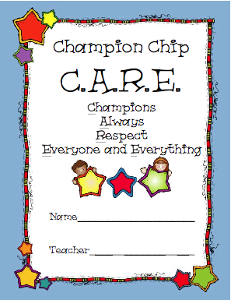
Immediate/Short-term:
Used to immediately communicate to the student that they were/are following the expectations
http://www.pbis.org/

Slide 44
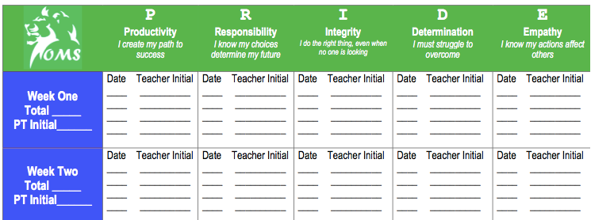
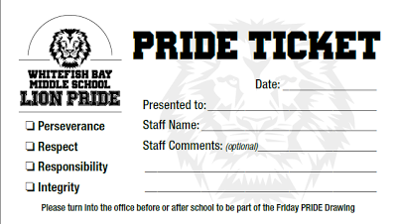
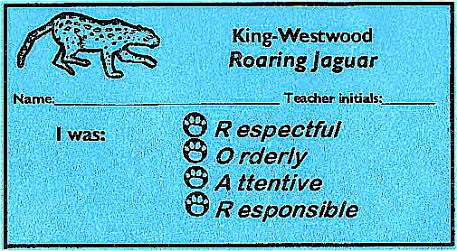
Washoe County School District, Reno NV
www.pbis.org/common/cms/files/pbisresources/2_UsingRewards.ppt
http://www.wfbschools.com/middleschool/Parent_Handbook_2017_18.pdf

Slide 45
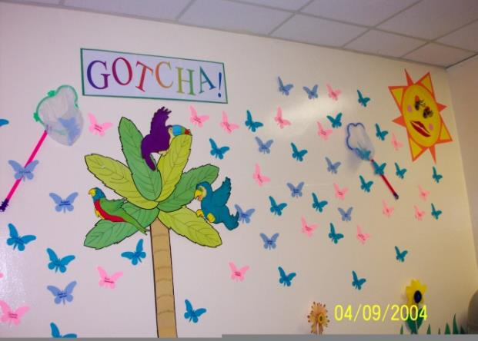
http://www.pbis.org/
South Elementary
Denver, Colorado

Slide 46
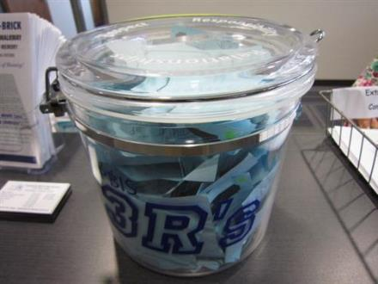
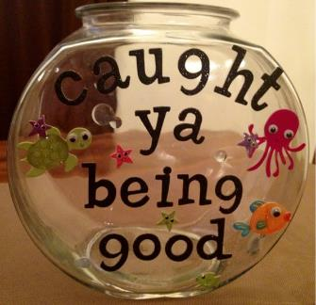
Long-Term/Group:
Larger types of acknowledgement used to build consistency and use of expectations over time.
http://www.pbis.org/

Slide 47
Examples
Teacher chair pass
First in line/first to leave class pass
Time with custodian, support staff, etc
10 minutes to listen to music
Homework/Help pass
“Office” for a day/period
Game with peers or with staff
http://interventioncentral.org/behavioral-interventions/rewards/jackpot-ideas-classroom-rewards

Slide 48
Lion Pride!
At Generic Middle School
our Lions are Grrreat!
Greatness means being…
Respectful, Responsible & Ready
Name: ___________________
Team: __________ Date: ____
Teacher: _________________
Place
Stamp Here
To:

Slide 49
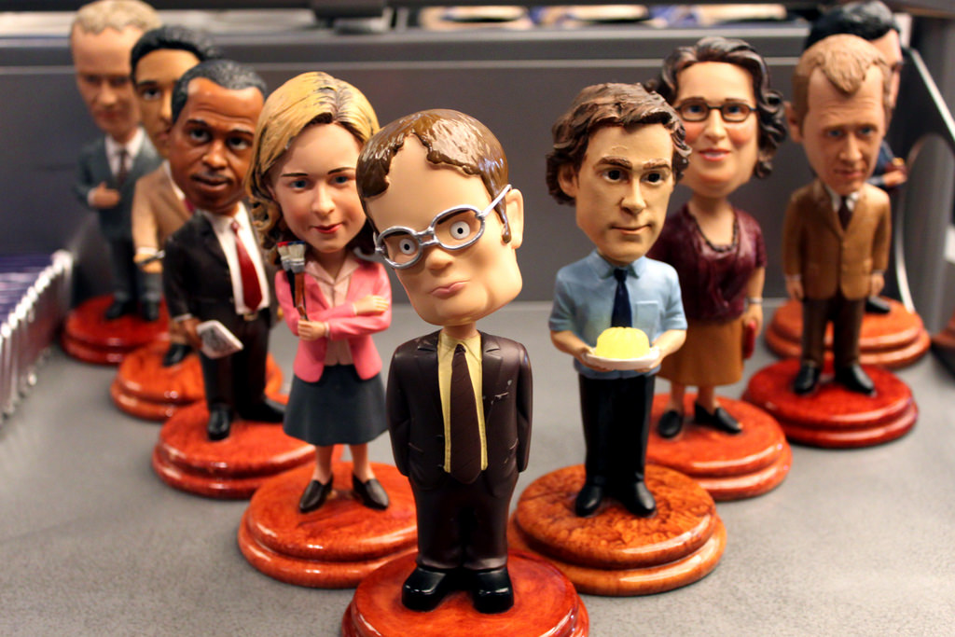

Slide 50
5. Strategies to Manage Misbehavior

Slide 51
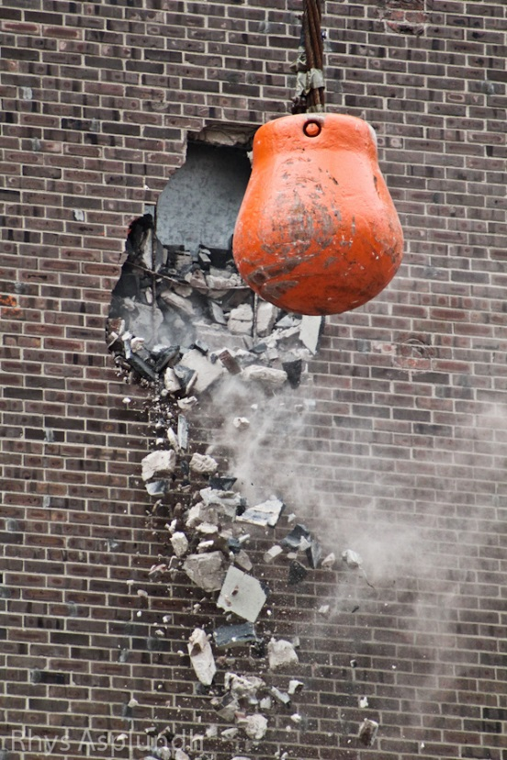
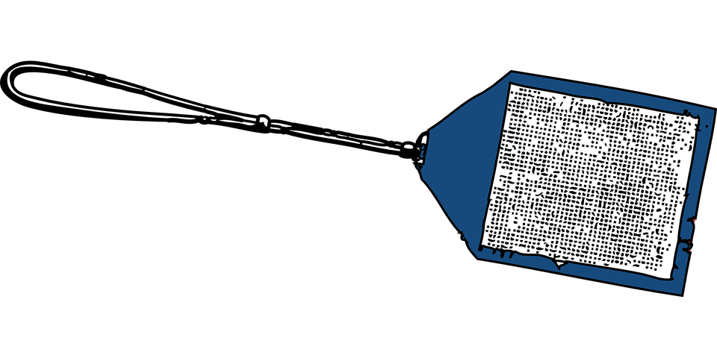
Managing Misbehavior
Have a range of strategies to use
Organized to use reinforcement prior to use of punishment
Create a structured, comprehensive system to manage misbehavior that is built on reteaching and reinforcing desired behavior prior to punishing misbehavior

Slide 52
Behavior Theory
Desired Behavior
Planned & Natural Reinforcement
Antecedent
Unwanted Behavior
Reinforcement (Function)

Slide 53
Competing Contingencies/Consequences
Ignore work or argue, etc
Avoid work
Work request
Complete work
Gain skills
Talk to peer
Peer attention
Look at phone
Peer attention; Get games, music, etc

Slide 54
Competing Contingencies/Consequences
Ignore work or argue, etc
Avoid work
Make this most appealing
Work request
Complete work
Gain skills
Most engaging, successful, praise, active
Talk to peer
Peer attention
Look at phone
Peer attention; Get games, music, etc

Slide 55
Desired Behavior
Planned & Natural Reinforcement
Antecedent
Unwanted Behavior
Reinforcement (Function)
Redo, Error Correction
Praise
Antecedent Strategies
Reteach more explicitly
Consequence Strategies
More/Different Antecedent Strategies
More/Different Consequence Strategies
Further reteaching

Slide 56
Key Points
Use of 5 principles = comprehensive and effective classroom management
Misbehavior is an opportunity to reteach
High rates of responding and behavior-specific praise are your two most effective tools
Supplemental Handout has resources and templates for use

Slide 57
The Five Evidence-Based Practices of Classroom Management
Presented at the 2018 BPEG Symposium
May 7, 2018
Jason Harlacher, Ph.D.
Harlacher_J@cde.state.co.us
Office of Learning Supports
Colorado Department of Education

