Slide 1
Binational School Transfer Document Training
Migrant Education Program

Slide 2
Outcomes
Compare and contrast the U. S. and Mexico school systems.
Understand Binational Migrant Initiative.
Understand the U. S. and Mexican grading policies.

Slide 3
Binational Initiative
  The Binational Initiative is one of many components of the Migrant Education Program and focuses on providing services in the areas of textbook donation, transfer document and the teacher exchange program.

Slide 4
Definition of a binational student
A binational student is a migrant student who moves between Mexico and the United States with his/her parents or as an emancipated youth at least once in the last 36 months.
The definition in Mexico is the same except that they do not have to be migrant.

Slide 5
Transfer Document
Can be used for all students going from the U.S. to Mexico or vice-versa (they don’t have to be migrant).
Exchanges information to ensure immediate enrollment of returning Mexican students.
Can be obtained from the Migrant Education Program.
Grades from 1-9 grades.

Slide 6
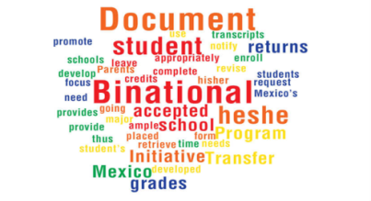
Transfer Document Elementary (1-6)
Secondary (7-9)
The Transfer Document ensures the continuity of schooling for students who travel between Mexico and the United States.
The document validates student’s grades upon arriving to Mexico or the U.S. allowing for proper placement of the student.

Slide 7
Transfer Document
The transfer document is accepted and utilized by Mexico and the United States in order to appropriately enroll and place students in their respective grade and in a timely manner.
The transfer document contains the name of the child, the last school attended, coursework and grades received, as well as other pertinent information.
Mexico utilizes a numbering system as opposed to the U.S. which uses a letter system:
A+ = 10 C = 7
A = 9 D =6
B = 8 F = 5

Slide 8
Requirements to Request the Binational Document
Birth Certificate
School Transcript with the School Stamp
Information about the latest school attended in Colorado, i.e., school name, school address

Slide 9
Who Can Expedite the Binational Transfer Document?
In México: The School principal.
In U.S.: The Mexican Consulate or School principal.
In Colorado: The Mexican Consulate in Denver, or the Binational Initiative coordinator.

Slide 10
Transfer Document Elementary School
1st - 6th Grades

Slide 11
Transfer Document

Slide 12
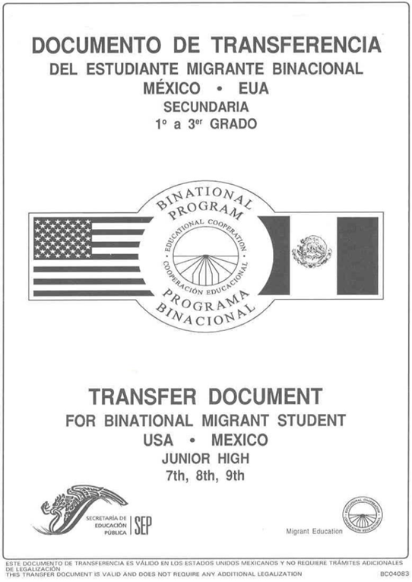
Transfer Document Secondary School
7th, 8th & 9th Grades

Slide 13
Filling Instructions
(1) The grade in which the pupil is registered.
(2) The school year, according to the following sample: 2002-2003.
(3) Two digits for the day and month, and four digits for the reporting year at the moment of transferring.
(4) The official name of the school.
(5) The address of the school.
(6) The complete student’s name. It should be copied from the birth certificate or equivalent legal document following this order: First name, second name, last name and second last name.

Slide 14
Filling Instructions cont.
(7) Clave Única de Registro de Población (CURP), if it´s known.
(8) Pupil´s date of birth. Two digits for day, month and year.
(9) Gender of the pupil (male or female).
(10) Complete name of the pupil´s father or guardian, in this order: last-middle-first.

Slide 15
Filling Instructions cont.
(11) Complete name of the pupil´s mother or guardian, in this order: last-middle-first.
(12) Name and telephone number of the person who can give information about health or special education requirements of the pupil. Check mark the appropriate box.
(13) The complete name and signature of the person responsible of issuing the transfer document at the moment of handing it to parents.

Slide 16
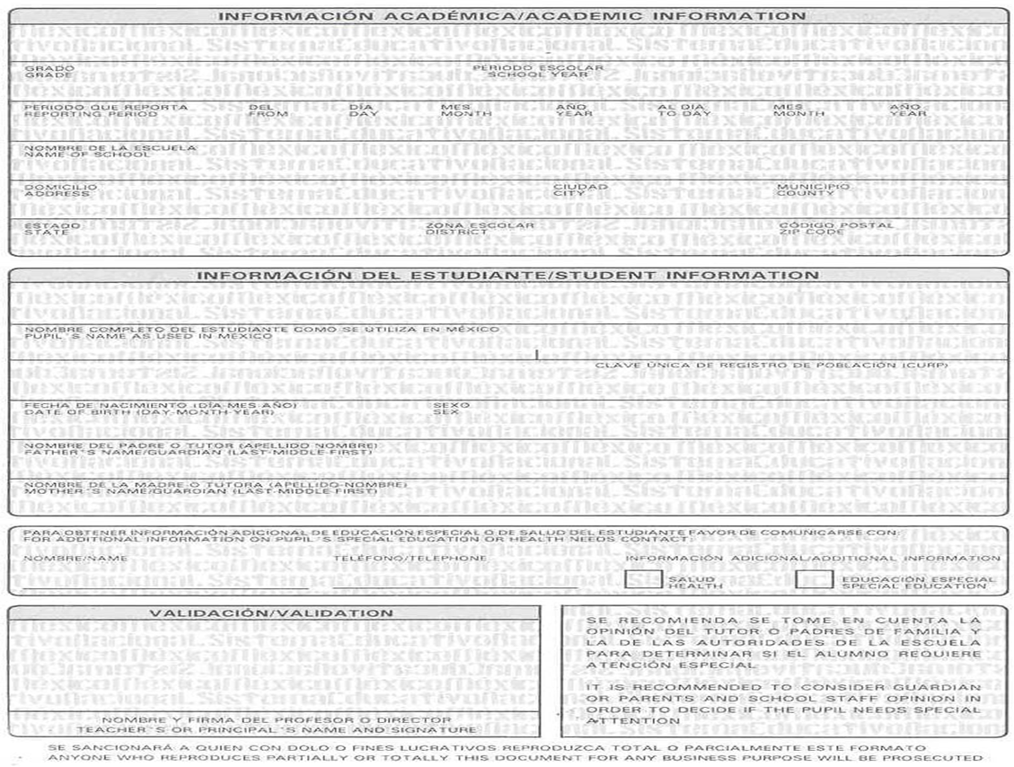
Elementary School Transfer Document
1
2
3
4
5
6
7
8
9
10
11
13
12

Slide 17
Back of form:
(14) The average of the reported period according to the Grade Scale in the transfer document. A, B, C, D, F.
(15) Observations about the pupil´s learning. (GEORGINA SHOWS A NATURAL ABILITY TO LANGUAGE STUDY).
(16) The teacher´s suggestions to the teacher who receives the pupil and to his/her parents in order to improve his/her learning. (GEORGINA NEEDS TO IMPROVE THE ABILITY TO STUDY LANGUAGE).

Slide 18
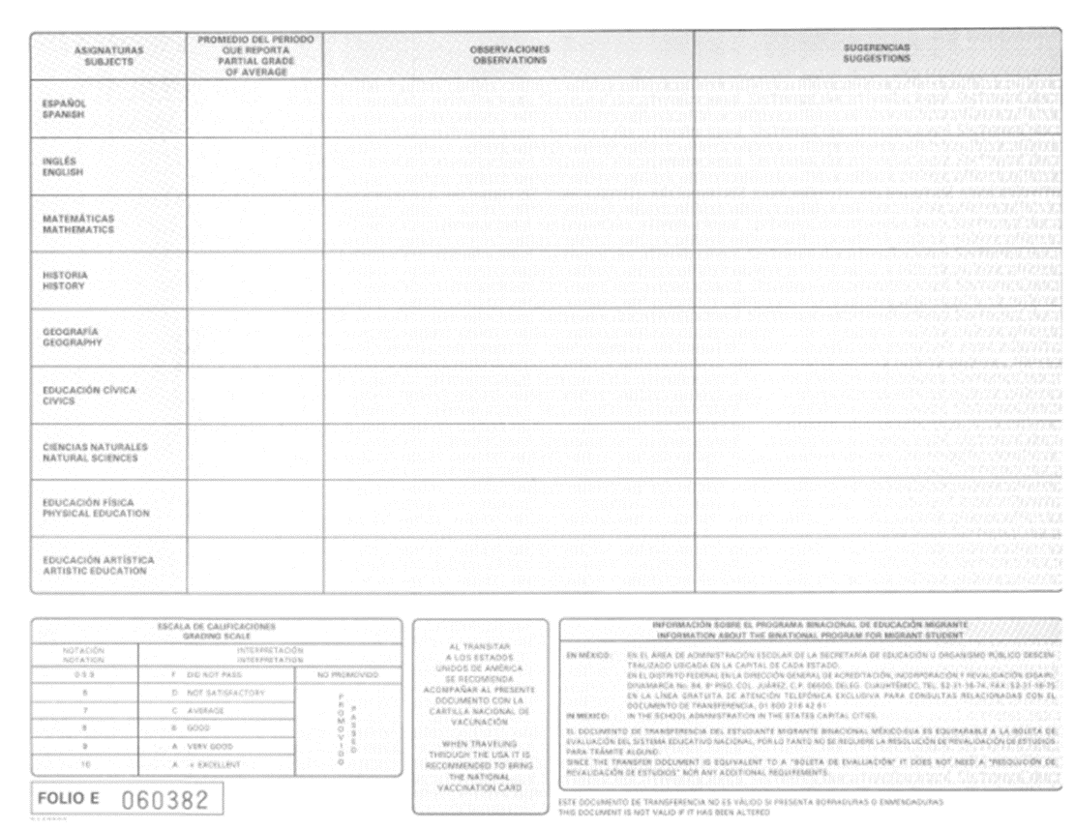
Transfer Document Back side
14
15
16

Slide 19
General Procedures for School Transfer Document
The signature of the person responsible for issuing the document must be in black and his/her title omitted.
If any mistake is made shred the Transfer Document and fill out a new one.
Spaces not filled should be crossed out with a line.
The numbers included in the sample corresponds to the sequence that must be followed by the person responsible for issuing the document.

Slide 20
General Procedures for Elementary School Transfer Document
Use only capital letters and Arabic numbers.
The Transfer Document is not valid if it has been altered in any way.
The signature of the person responsible for issuing the document must be in black and his/her title omitted.

Slide 21
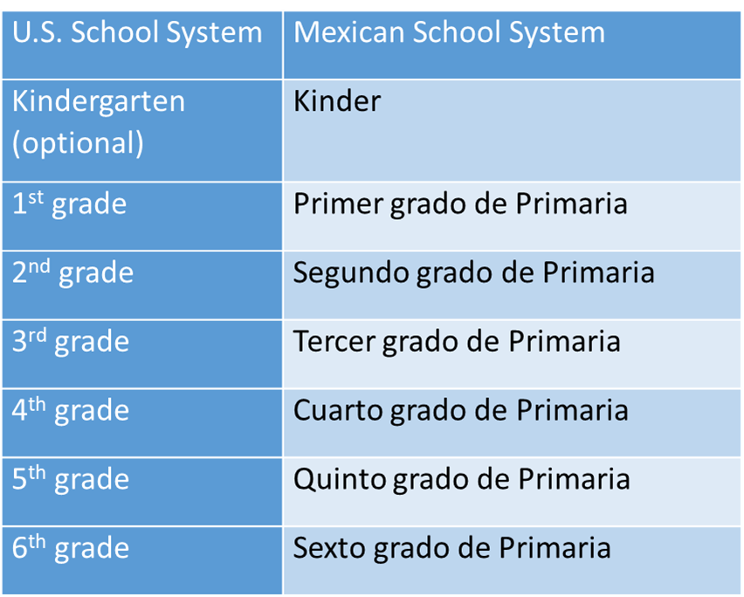
U.S. and Mexican School Systems

Slide 22
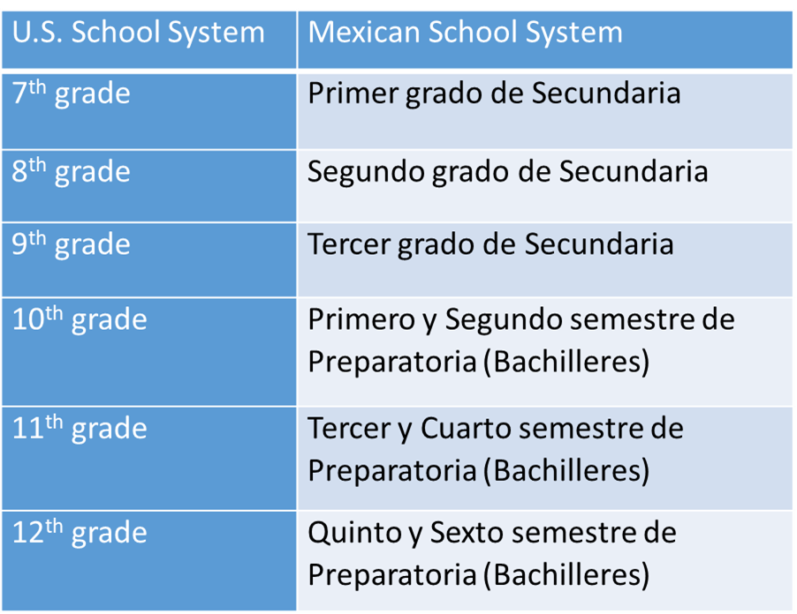
U.S. and Mexican School Systems

Slide 23
Grading Scale
México | U.S.
0-5.9 | F - Did not pass | Not promoted
6 | D - Not satifactory | Promoted
7 | C - Average
8 | B - Good
9 | A - Very good
10 | A + Excellent

Slide 24
Grading System
Report cards are issued 5 times in the school year.
Partial grades range from 5-10 in whole numbers
Final grade in each subject is the average of the 5 partial grades reported as whole number and a decimal.
6.0 is passing.
To convert to U.S. system move the decimal (ex.: 8.0 is 80)
Must have 80% attendance to be promoted.

Slide 25

Questions

Slide 26
Contact Information
Tomás Mejía
Director
Colorado Migrant Program
(303) 866-6592
mejia_t@cde.state.co.us
Laura Leyva
Binational Coordinator
(303) 866-6490 o (303) 549-6018 celular
Leyva_l@cde.state.co.us

