Slide 1





Learning Forum: Fire Up Your Feet Spring Activity Challenge
Sophia Mellow, Program Manager
Fire Up Your Feet, Safe Routes to School National Partnership
Notes:
Welcome.
A little more about myself
We are a team experience!

Slide 2



About Fire Up Your Feet
Fire Up Your Feet is a core program of the National Partnership, funded in large part through a grant from Kaiser Permanente that is aimed at encouraging families, students and schools to create active lifestyles that inspire our children to be healthy
and physically active.
Notes:
A little more about myself
We are a team experience!

Slide 3
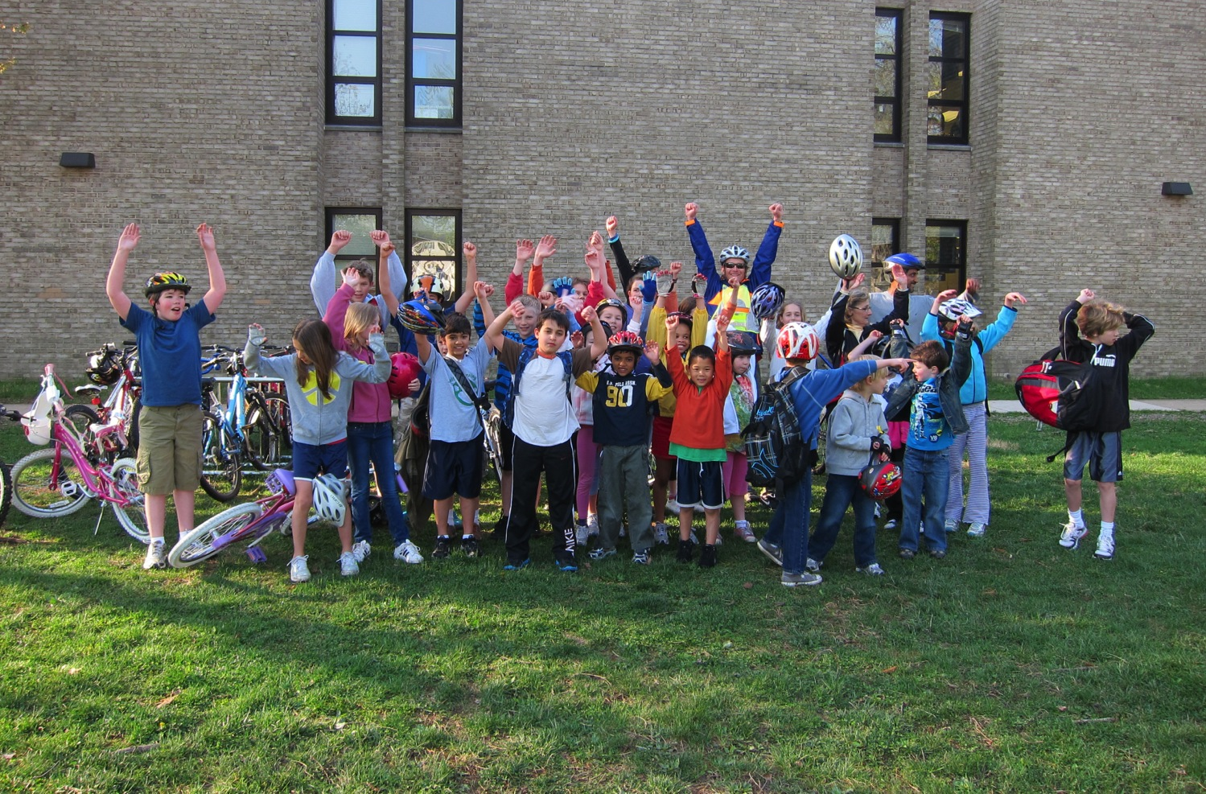
What is Fire Up Your Feet?
A year-round resource to get kids active, healthy and focused
An online healthy fundraising platform
A bi-annual “Challenge” with an opportunity to win cash awards
for tracking activity!
Notes:
Fire Up Your Feet! is a core program of Safe Routes to School National Partnership. Fire Up Your Feet! includes an online activity tracker, a school fundraising organizer, and free resources, all aimed at increasing physical activity before, during, and after school for students, parents, staff and teachers. The National PTA is an active partner to encourage family engagement to support both child and family health.
We want to be your tool to increase PA in your schools an added bonus is the opportunity to realize CASH funding for tracking that activity!

Slide 4

Today we’ll talk about
Where is Fire Up Your Feet available?
How is it going?
Who can participate and why target schools?
What does it take to get Fired Up?
Is it difficult, what if there is trouble when tracking?
Who is expected to track?
How much time will this take?
How much money can a school win?
Notes:
Introduce agenda for the presentation
Encourage questions
There will be a time to share ideas to get Fire Up Your Feet integrated in their schools

Slide 5
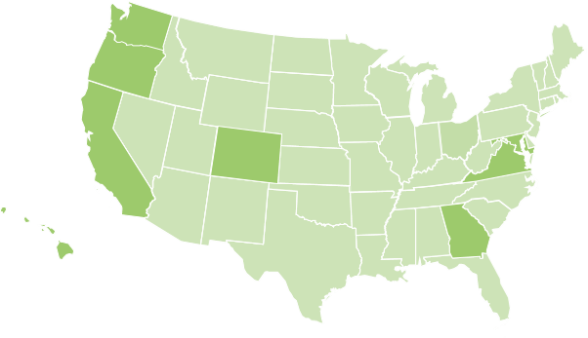
Fire Up Your Feet
Across our Regions
Kaiser Permanente Sponsored Regions Activity Challenge
California
Colorado
Hawaii
Metro Atlanta
Mid Atlantic (MD, DC, VA)
Oregon
SW Washington
Staff
NorCal
SoCal
Oregon (partner w BTA)
Virginia (consultant)
Notes:
Since February of 2013 we have offered 4 Challenges so far and continue to see growth and support for the program.
While our educational resources are available nationally to any school across the country,
More than 172 Fire Up Your Feet Challenge awards worth a total of $97,000 will be offered in the following KP regions.
Colorado
California
Georgia
Hawaii
Mid Atlantic (MD, DC, VA)
Oregon
Washington
In these regions, Fire Up Your Feet is available to any k-8 public, private or charter school. Students, parents and staff, but not district. Awards vary in amount, but can range from anywhere between$100 to $5,000 depending on the region. Most schools learn about Fire Up Your Feet, either through promotion by the National PTA, (our family engagement partners, Kaiser Permanente Thriving Schools and Community Benefit direct outreach, through the Alliance for a Healthy Generation or through the Safe Routes to School National Partnership.)

Slide 6
Highlights
Highlights
1574
schools registered
83 %
more schools
62,049
total participants
324 %
more participants
42 %
active schools are lower income
65 %
reported children increased physical activity during Fire Up Your Feet
Notes:
As of the Fall 2014 challenge

Slide 7
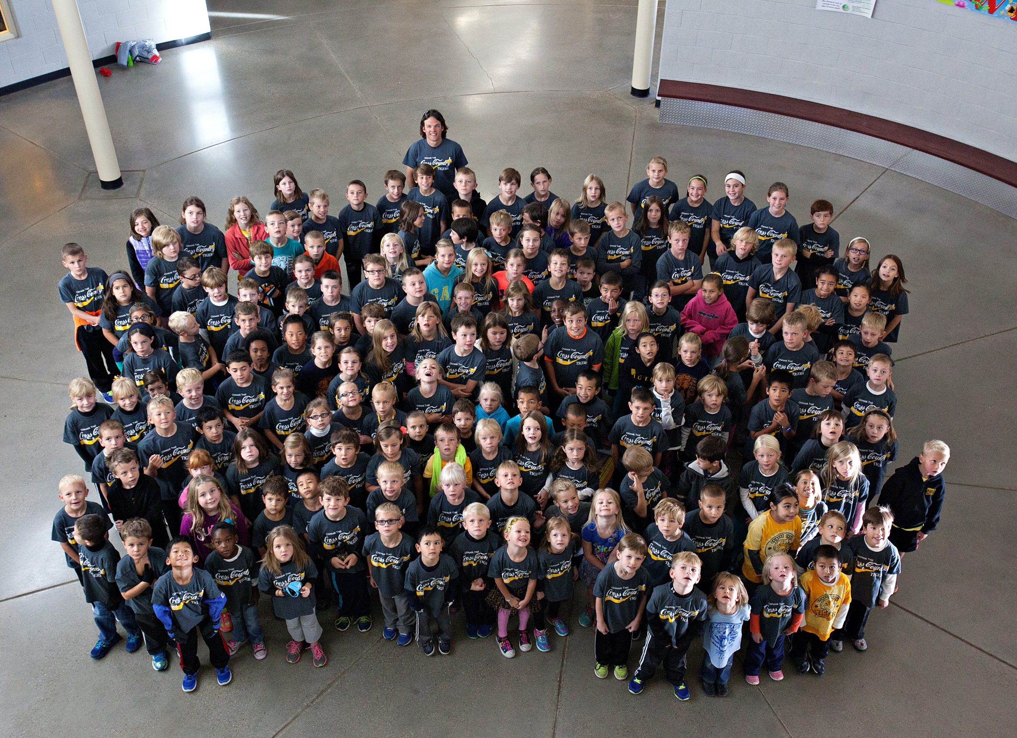
Resources
COLORADO
Run Club
Chinook Trail Elementary
Notes:
Let’s talk Colorado!

Slide 8
Fall 2014 Success
City | School Name | Award Summary | Award Totals
Colorado Springs | Chinook Trail Elementary | First Place Award Week 3 (Old Skool) Award | $ 2,150.00
Florence | Fremont Middle | Week 1 Award | $ 200.00
Canon City | Lincoln Elementary | Fire Up Your Walk to School Award | $ 500.00
Canon City | McKinley Elementary | Third Place Award | $ 500.00
Denver | Montclair Elementary | Week 2 Award | $ 200.00
Littleton | Peiffer Elementary | People for Bikes Challenge Award Week 3 New School Award Third Place Award | $ 1,150.00
Lafayette | Ryan Elementary | Week 1 Award | $ 200.00
Loveland | Van Buren Elementary | Second Place Award | $ 1,000.00
Canon City | Washington Elementary | Third Place Award Week 4 Award | $ 600.00
Colorado Total Award Amount |  |  | $ 6,500.00

Slide 9
Highlights
Highlights
Since fall, activated schools more than doubled and registered schools increased 145%.
Community Benefit intern assistance provided on-the-ground additional communications and support.
New Partners: Increased support and interest from the Denver PTA. 11 new Denver schools registered.
Local Fire Up Your Feet television coverage.
“There has been an overall awareness of fitness and a healthier lifestyle alike. The excitement that is evident among all involved has helped to improve school camaraderie and moral.”
- Soaring Eagles Elementary, Colorado

Slide 10
Why Schools?
Place where kids spend most of their day
School is a captive environment
Where many kids get their daily nutrition and exercise
One in five KP members spends the majority of each weekday at a school
Our opportunity: 13,000 schools in
750 districts within our service areas
Notes:
Why school health is important
Kaiser Permenente aims to make good health a part of everyday life for:
Over 13,000 Schools (K-12) and 700 School Districts across Kaiser Permanente service areas
1 in 5 Kaiser Permanente members who spend a majority of each weekday on a school campus
1.7 million children and 400 thousand staff & teachers who are our members across Kaiser Permanente regions

Slide 11
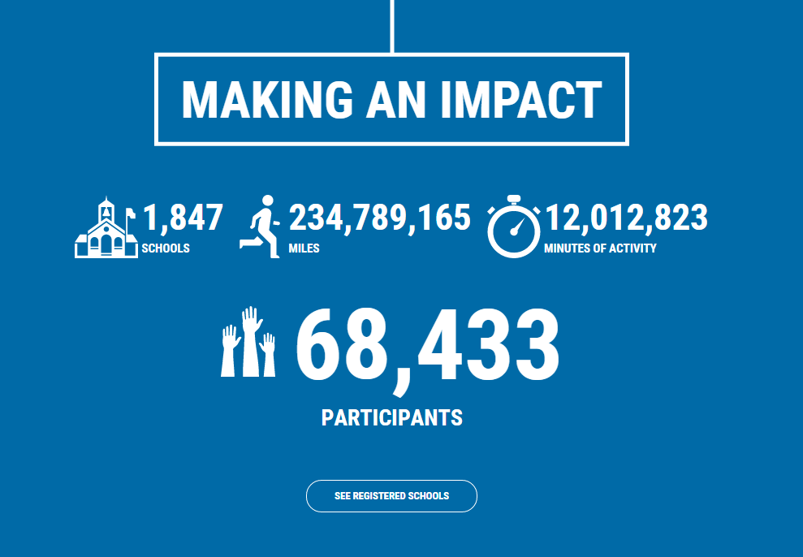
Let’s Get Tracking
and ready for the Spring Challenge!
Notes:
now that you know what’s at stake and how others have benefited from participating in the challenge. let’s get tracking…

Slide 12
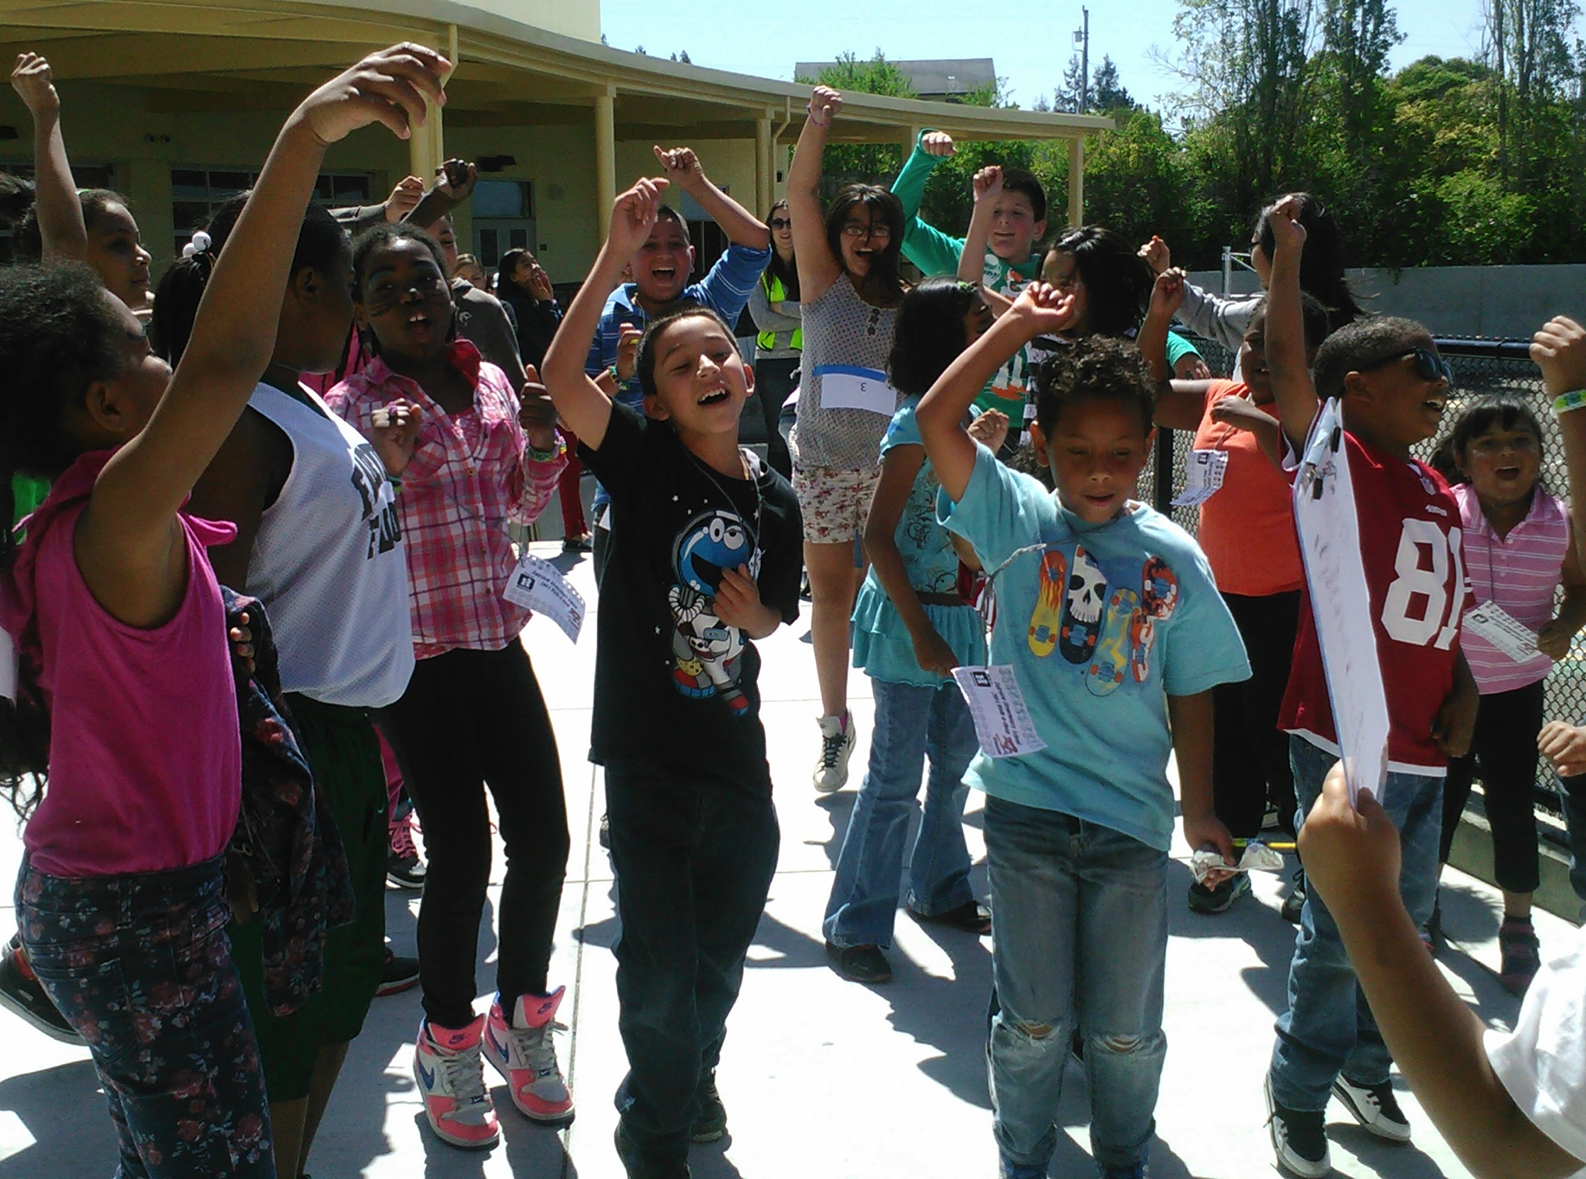
  $6,000 available in 2015 Spring Challenge Awards:
  1 $2,000 first place award
  1 $1,400 second place award
  3 $500 third place awards
  1 $500 LMAS award
  1 $100 small school or runner-up award
  2 $200 Week 1 Drawing: 3-2-1 Blastoff Award
  1 $100 Final Weekly Reflect and Reward Drawing
Notes:
What can we win?
Who can participate?
schools able to include staff, parents, teachers, administrators as part of the challenge? Or just students?

Slide 13

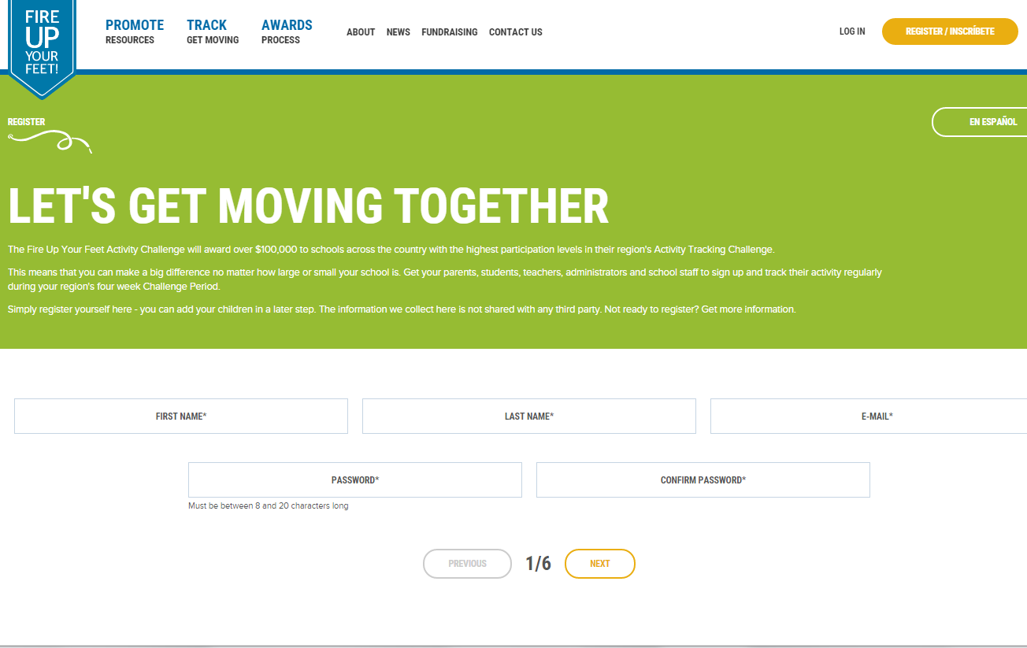
Register www.fireupyourfeet.org
Notes:
So let’s do it!
Registration takes less than a minute, and as I mentioned earlier, your school will already be in our database, so there is no need to register your school, but it may make sense to connect with the school principal or PTA to determine how you to best promote the Challenge at your school, such as whether to integrate it into an existing school wide event, have a single coordinator track for multiple children or families, or whether to have parents track for their own families.
Important to note here that children or parents should only be tracked under one account, in order to avoid double counting. Also want to note that we’ve built in privacy safeguards so that children can be tracked anonymously or by using a nickname, and optional permission forms can be offered to parents.
Performance data is only publicly shared at the school-wide level and the names of Activity Challenge participants are not made public. Email address and name information is not be sold or given away to any other parties not associated with Fire Up Your Feet and the Safe Routes to School National Partnership.
Who can participate?
schools able to include staff, parents, teachers, administrators as part of the challenge? Or just students?

Slide 14
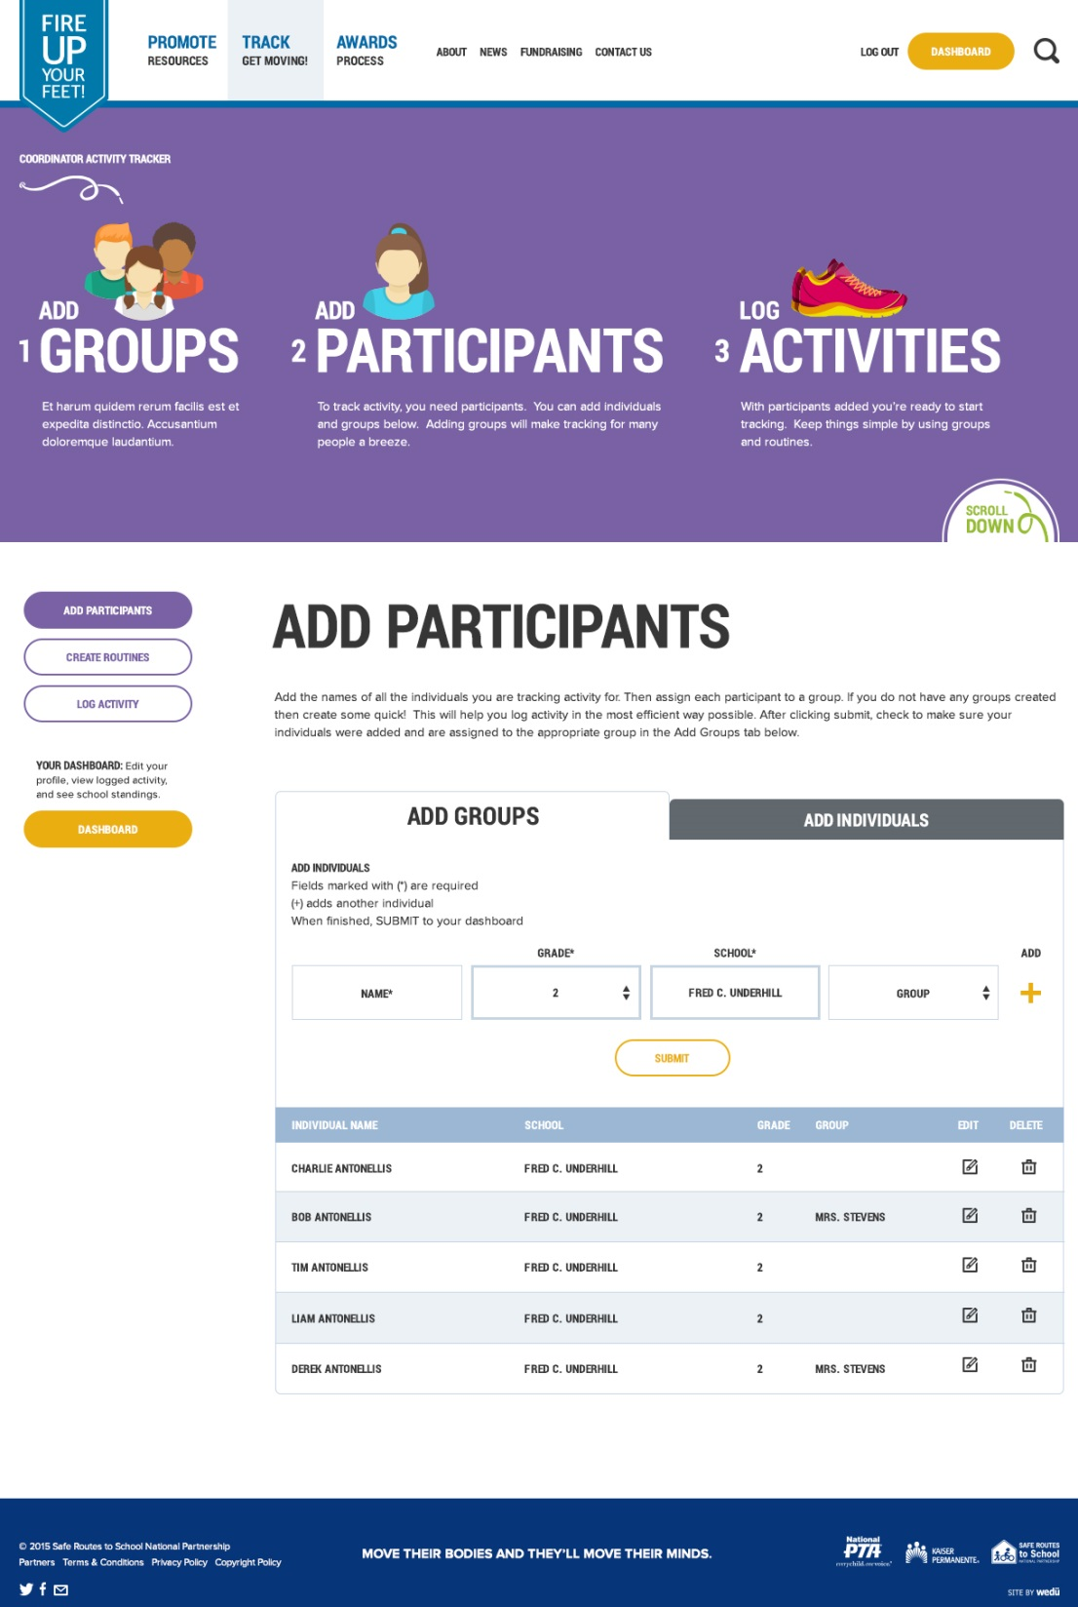

Notes:
OK – once our site is live you will want to get started and get tracking…
In the meantime you can register
First you’ll want to remember the date. The next Activity Challenges takes place between April 13-May 15 Schools do not specifically need to register for the program, since they are already in our database, but, parents, school staff and with the permission of the school, students, are welcome to register for Fire Up Your Feet and track their activity anytime during the month, even on the last day of the Challenge.
Walk through how easy it is to track using our online tracker
OK – let’s go…3 steps
1. Log in to [site:login-url]
2. Click on "Activity Tracker" in the main menu. Your username is your email address.
3. Start tracking a minimum of one activity in order to qualify as a Challenge participant.

Slide 15
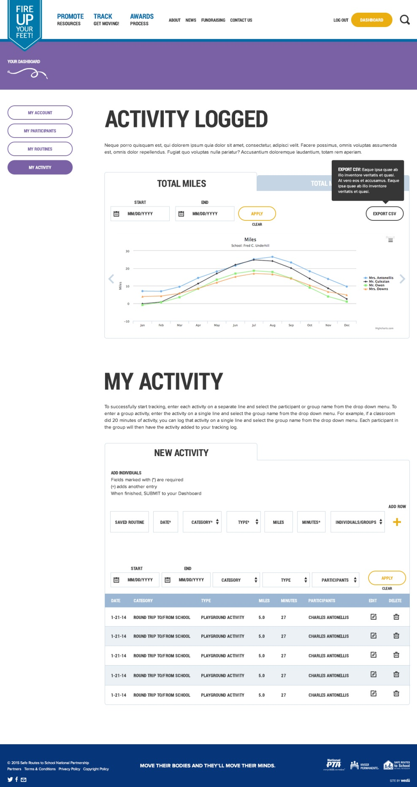
Notes:
OK – let’s go…3 steps
1. Log in to [site:login-url]
2. Click on "Activity Tracker" in the main menu. Your username is your email address.
3. Start tracking a minimum of one activity in order to qualify as a Challenge participant.

Slide 16

Resources
Notes:
Discuss resources available and ideas to get the challenge going in your schools

Slide 17
