Slide 1
Colorado Physical Education/ Physical Activity Cadre
Terry Jones
Colorado Department of Education
Physical Education and Physical Activity Content Specialist

Slide 2
History Of The Cadre
Started in 2009 with a grant from the Colorado Health Foundation.
Funded fro 3 Years to provide training and support to the districts funded for Healthy Schools Colorado and additional districts around the state.
Started with:
4 Cadre members
2 Trainings (Unpacking The Standards & Brain Based Learning)
15 Trainings a year and 800 teachers trained

Slide 3
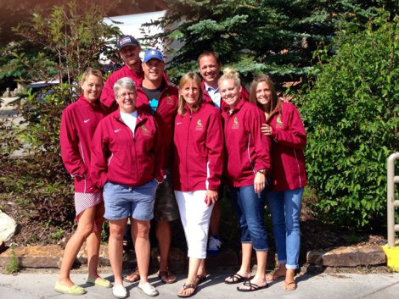
2013 Funded For Another 3 Years
8 Trainers

Slide 4
Expanded to 8 workshops
Highly Effective Teaching in Physical Education
Fitness Assessment in Physical Education
Using Technology in Physical Education
Physical Education Assessment Strategies P-5
Physical Education Assessment Strategies 6- 12
Integrating Physical Activity
Brain-Based Learning in Physical Education, #1
Teaching with the Brain in Mind, #2

Slide 5
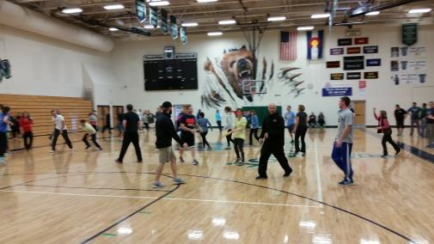
Trained over 1800 teachers and 80 school districts
Brain Based Learning Trainer of Trainers

Slide 6
2013/2014 Implementation Findings
88.5% responded that participants improved their teaching and program
87.10% responded that students benefitted from the skills and knowledge learned; and participants implemented what was learned from the training

Slide 7
Brain Based Learning Findings

Slide 8
Assessment in Physical Education

Slide 9
Technology in Physical Education

Slide 10
How to find local workshops
http://www.cde.state.co.us/HealthAndWellness/HS_PE.htm
Or search PE cadre on CDE website
How to request a workshop
Terry Jones
Jones_t@cde.state.co.us
Facebook Group
Colorado Health and PE Forum

