Slide 1

Colorado Coalition for Healthy Schools Meeting
December 5, 2014
Adams 12 Conference Center

Slide 2
Agenda
Introductions and Healthy Schools Updates
Presentation and panels on Family Engagement with stories from the field
  Break and Networking Time
Continue panel on Family Engagement
Overview from SACPIE
  Lunch and Networking Time
Presentation from Pew Charitable Trust on Family Engagement related to Smart Snacks in Schools and Healthy Schools efforts
  Closing and Safe Travels!

Slide 3
Background
Colorado Coalition for Healthy Schools
Offering professional development and communications regarding healthy schools
Currently supported by CDPHE and CDE
Next meeting on March 6, 2014
  Comprehensive Physical Activity Efforts

Slide 4
Meeting Norms
Take care of your personal needs
Help keep the meeting agenda on track
Silence phones and be thoughtful with technology
Meet someone new

Slide 5
Healthy Schools Updates
Healthy Schools Collective Impact
Healthy Schools Smart Source
Healthy Kids Colorado Survey

Slide 6
Healthy Schools Collective Impact
Launched Four Work Group
  ~80 organizations participating
  Next meeting on December 16, 2014
Launched Funder Group
  ~20 funders attended
Work Groups will help to develop strategies and work plans across health topics

Slide 7
Healthy Schools Smart Source
Finishing Year Two of the effort to align school health policy and practice indicators and build a system to collect data
Piloting a tool with schools through January 2015
Incentives for schools in priority areas
Contact Andrea Pulskamp with questions:
  apulskamp@coloradoedinitiative.org

Slide 8

Healthy Kids Colorado Survey
State and regional data tables now available at www.chd.dphe.state.co.us
Executive Summary and other reports being posted
Can request additional analysis

Slide 9
Percent of Colorado 9-12 graders who were obese or overweight, 2013

Slide 10
Percent of Colorado 9-12 graders who used marijuana in the past 30 days by grade level, 2013
Source: 2013 Healthy Kids Colorado Survey, Health Statistics and Evaluation Branch, CDPHE

Slide 11
Percent of Colorado 9-12 graders who went hungry sometimes, most of the time or always because of lack of food at home, 2013

Slide 12


Slide 13
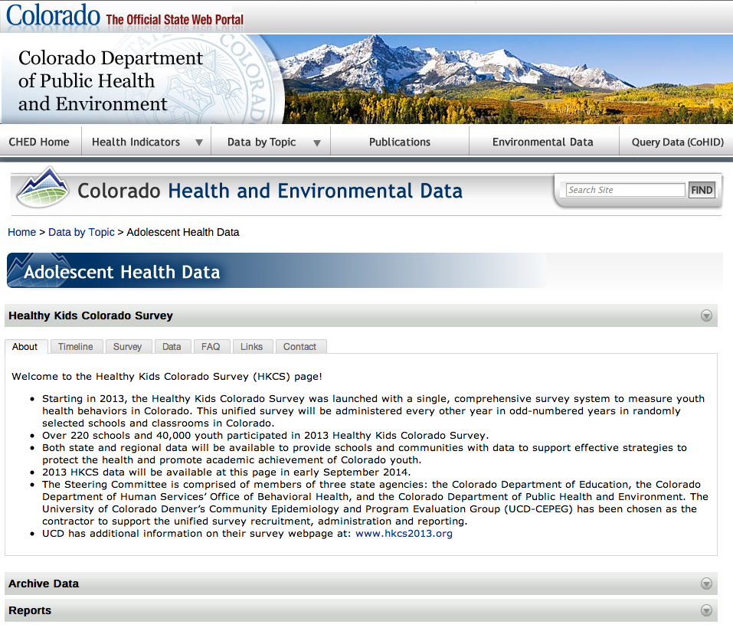

Slide 14
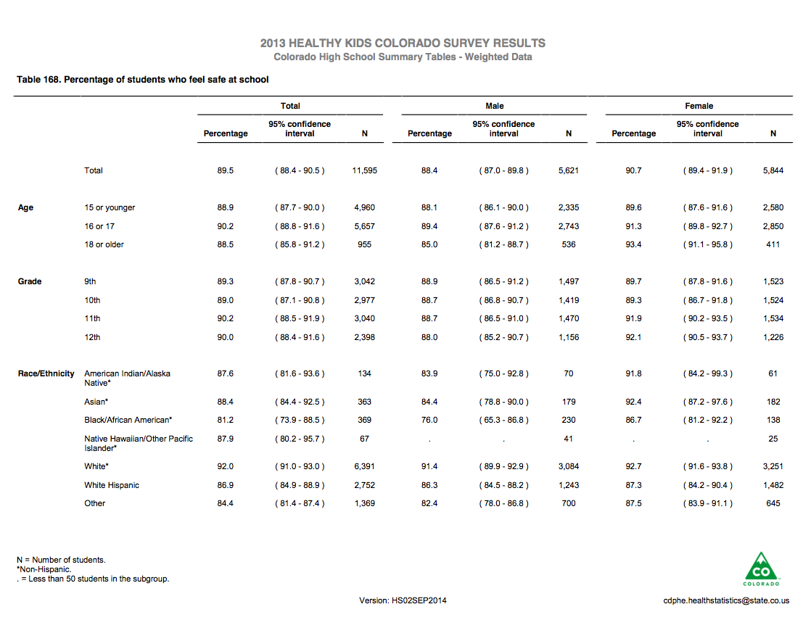

Slide 15
Professional Development on Family Engagement in Healthy Schools

Slide 16
Discussion
With a group of 3-4 people, discuss how you have (or would like to) engage families in your school health work?

Slide 17
Stories from the Field
Action for Healthy Kids
Family Leadership Training Institute
Family Resource Center

Slide 18
Thank you for attending!
Online evaluation will be sent soon.

