Slide 1
Colorado Academic Standards and District Sample Curriculum Project- Comprehensive Health and Physical Education Updates Brian Sevier- Standards Director
Standards and Instructional Support: http://www.cde.state.co.us/standardsandinstruction

Slide 2
Performance Task
Written to the student, these performance task all share 4 essential components……

Slide 3
Capstone Performance Assessment
A R.A.F.T. is an assessment strategy that helps students understand role, audience, formats, and topics. Using this strategy, teachers encourage students to write creatively, to consider a topic from a particular perspective, and to gain practice content-specific writing and presenting for different audiences.
Role: Who are you? A pilgrim? A soldier? The President?
Audience: To whom are you writing/speaking/presenting? A political rally? A potential employer?
Format: In what format are you writing/speaking/presenting? A letter? An advertisement? A speech?
Topic: What are you writing/speaking/presenting about?

Slide 4
6th Grade Story Board

Slide 5
The Colorado Academic Standards: Focus and Instructional Priorities
Rigor
Systematic, methodical, and deep thinking that transfers across content areas
Relevancy
Authentic, meaningful, real-world and engaging work that asks students to apply what they have learned
Disciplinary Literacy
To work, think, speak, read, write, argue as a….

Slide 6
6th Grade Story Board-

Slide 7
Focus and Instructional Priorities
Rigor
Systematic, methodical, and deep thinking that transfers across content areas
Relevancy
Authentic, meaningful, real-world and engaging work that asks students to apply what they have learned
Disciplinary Literacy
To work, think, speak, read, write, argue as a….
All Students, All Standards- 10 Content Areas-Vertical and Horizontal Connections

Slide 8
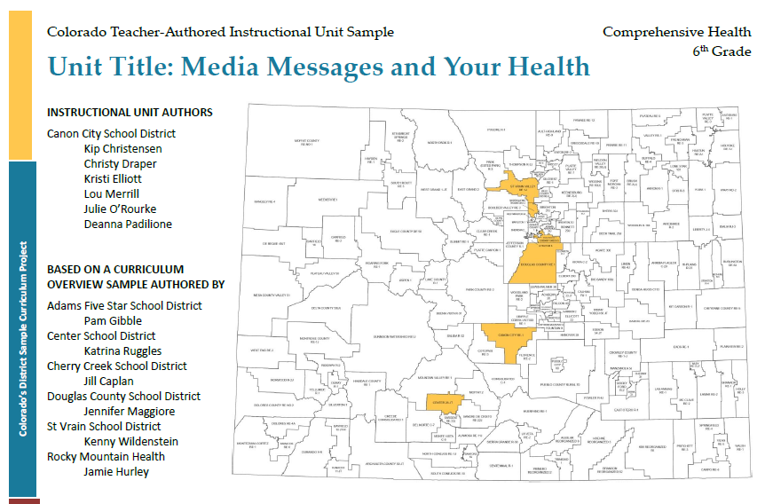

Slide 9
Focus and Instructional Priorities-Additional support for Building Disciplinary Literacy
Rigor
Systematic, methodical, and deep thinking that transfers across content areas
Relevancy
Authentic, meaningful, real-world and engaging work that asks students to apply what they have learned
Disciplinary Literacy
To work, think, speak, read, write, argue as a….

Slide 10
Literacy Design Collaborative

Slide 11
Colorado’s District Sample Curriculum Project-Phases and Outcomes
Phase One (Completed-Fall 2012):
Colorado educators work together in grade level and content area teams to engage in process of translating Colorado Academic Standards into curriculum overviews (sequencing maps)
Educators create 87 CH/PE maps for grades k-12 (48 Comprehensive Health and 39 Physical Education) http://www.cde.state.co.us/standardsandinstruction/curriculumoverviews
Phase Two (Completed-Spring 2013):
Hundreds of Colorado educators participate and begin process of adapting/modifying existing samples and/or creating their own unit overviews
Phase Three (Fall 2013-):
Educators create 27 full instructional CH/PE units grades k-12 (14 Comprehensive Health and 13 Physical Education-to be posted Spring 2015… additional CH units 7th and HS in September) http://www.cde.state.co.us/standardsandinstruction/instructionalunits-comphealth
LDC modules (6-12 units) in Comprehensive Health http://www.cde.state.co.us/standardsandinstruction/literacydesigncollaborative

Slide 12
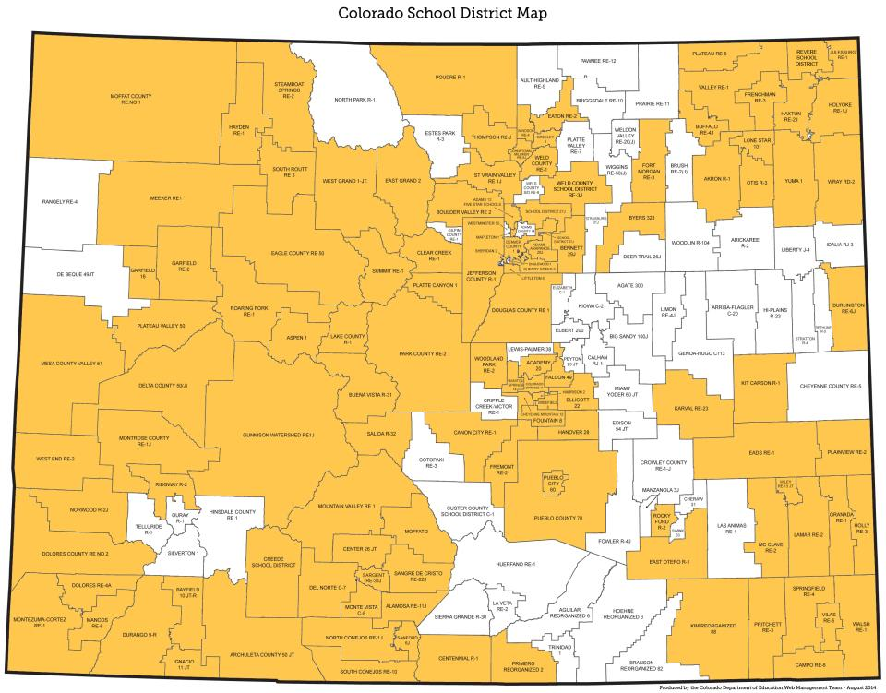

Slide 13
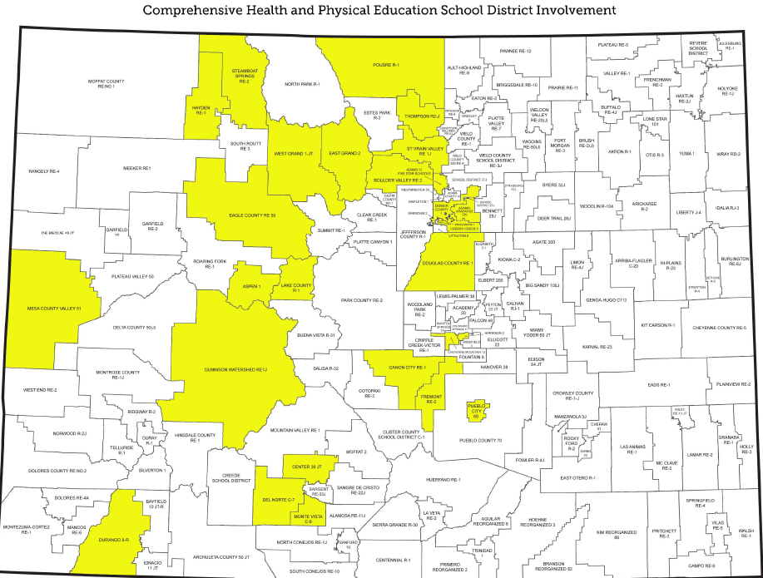
en

Slide 14
The Comprehensive Health/Physical Education Standards
The Comprehensive Health and Physical Education standards focus on personal decision-making around emotional and social well-being, positive communication, healthy eating, physical activity, tobacco, drug, and alcohol abuse prevention and violence prevention.
The standards underscore important skills for navigating today’s society with its complex and often confusing messages around health, beauty, and happiness.

Slide 16
Family Guides to The Colorado Academic Standards

Slide 17
Family Guides to The Colorado Academic Standards

