Slide 1
Fantastic Fund Requests and How to Support Them
November 2024

Slide 2
Agenda
Request for Funds (RFF) and Fund Request (FR) submissions
Timelines
Transitions
Requirements
Supporting documentation expectations
T&E
Procurement
Capital Property and Equipment
Capital Projects
Direction of fiscal monitoring

Slide 3
RFF/FR Submission Processing Times
Currently RFFs and FRs may be submitted through the more traditional formsite process (RFF) or through the new snazzy GAINS system (FR).
This will depend on the award you are requesting (typically based upon whether the award started in GAINS)
Processing times are mostly dependent upon the completeness of the submission
Current goal is 4 business days after the FR due date for the fiscal analyst to determine the request has been submitted correctly
The 1st business day of the month for Title, Stimulus, IDEA
The 15th of the month for EASI, Competitive awards
Goal is currently 45 days for processing from the reimbursement request DUE DATE indicated on our website. As an example, ESEA awards are due on the first of every month. The 45 day processing clock DOES NOT begin when the awardee submits and receives approval on the request, it begins the date FOLLOWING the published due date. See above for the due dates on each type of award (also listed on website).
CDE collaborates across several units including program and accounting to fully process reimbursements for payment.

Slide 4
RFF Submission vs FR Submission
Formsite process based on total expenditures less funds requested to date.
GAINS process drills down a bit more - reporting at object code level by function/award.
Notes:
GAINS automated controls for 10% variance (over only)
Fields only populated based on budgeted fields in application. However, all fields budgeted in the application must be consistently used throughout the grant management (i.e., FR have amounts entered that agree to how expenditures were posted in the GL)

Slide 5
FR Submission - Required Documents
FR submissions require an LEA to provide a General Ledger (GL) that agrees to and supports the requested expenditures.
E.g., budgeted in Purchased Professional Services but expenditure posted to Other Purchased Services would require either a PAR or a JE.
Two main types of GLs we are looking for - summary and transaction level
Summary level works for fiscal analyst review
Looking for total expenditure tie outs
Reasonableness check on amounts
Transaction level needed for monitoring reviews
Comparison to budget at object code levels
Used for sampling - additional support will be requested for specific transactions
Notes:
Note, GAINS is only so smart. It is checking that a file was uploaded; not that the RIGHT file was uploaded. Please upload a GL (FR will be sent back for revision without a GL).
Also note, GAINS does allow for multiple files to be submitted so both GLs can be submitted at the time of the request to avoid having to go back and provide one if requested later during monitoring for instance.

Slide 6
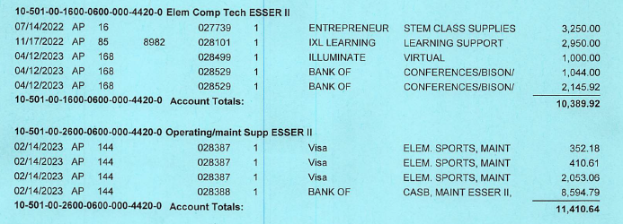
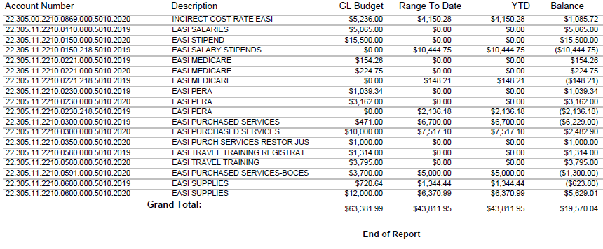
Detailed General Ledger vs Summary - Screenshots
The detailed general ledger shows individual transactions with summary totals.
DETAILED EXAMPLE
Ensure GL indicates parameters used such as dates to ensure correct FY is reviewed.
SUMMARY EXAMPLE
Notes:
Make sure it is a system generated report. Please have pertinent personnel reach out with specific questions about your LEA’s accounting system if needed to ensure the best format is used. Also, very helpful to have the parameters used when pulling the report - helps confirm the date range and other pertinent fields. PDF format can work on smaller data pulls but become extremely time consuming to analyze when they become much larger (recently had an LEA with several 50+ page GL reports). In those case, it is helpful to export them into Excel (or some version of spreadsheet) as the best format.

Slide 7
Accessorizing the RFF/FR
FR submissions through GAINS must include a GL as discussed in the previous slides
While not required as part of the official request submission, LEAs must maintain detailed internal documentation to support each request
This support is something that could be requesting during monitoring
Your auditors may request this information as well
Typically across four main categories:
Time and effort (personnel costs)
Procurement (how do you buy things)
Capital property and equipment (high dollar items)
Capital projects (heavy on additional requirements and reporting)
Support maintained must also follow internal policies/procedures
Documented process requested during monitoring
Follow record retention policies
Federal awards - records should be retained for a minimum of 3 years beyond the final financial disposition of the award
Notes:
Capital projects is one area your LEA may consider rethinking the use of federal funds. Strongly encourage reviewing, at a minimum the guidance on the resources page listed at the end of the slides (specifically the Mandatory ESSER-Funded Project and Construction Training - March 2024)

Slide 8
Follow Internal Policies/Procedures - What Does That Mean?
As part of determining sufficiency of the supporting documentation for your RFF, we need to know how your LEA’s process works - what are the steps from start to finish to accomplish a task?
Typically documented through a combination of policies and procedures
Policy
A guiding principle used to set direction in an organization.
Changes infrequently
States generally who, what, when, or why
Is broad and general
Procedure
A series of steps to be followed as a consistent and repetitive approach to accomplish a result.
Continuously changes and improves
States specifically who, what, when, and how
CDE recommends using titles rather than names when documenting the “Who”
Offers a detailed description of activities

Slide 9
How and What Should Be Documented?
Start with what, if anything, is documented. Any relevant CASB (or other Board approved) policies as the first stepping stone?
Does that tell the whole story? If not (and have not seen an instance where Board approved policy alone qualifies), fill in the gaps. The end result should be a documented process at a level of detail that would describe all the steps needed from start to finish to accomplish a task (e.g. – make a purchase, document time and effort, receive and track capital assets, etc.).
If nothing is currently documented, draft a narrative of how your LEA’s process works as a start.
Ensure the process works at your LEA. You may choose to have more controls or be more restrictive than the federal guidance. However, an LEA must follow their internal process, so avoid adding steps to a process your LEA is not prepared to follow.
To help facilitate this internal process evolution, CDE has compiled some rules and guidance an LEA should incorporate. Your LEA will need to determine how best to fit the required elements into the documented processes.
Notes:
Just to drive home the point, the ONLY file required with the FR submission is the GL. The rest of the slides detail the required support an LEA must maintain and have available when requested. The documented narrative can serve both as the required submission for our review as well as the start of getting your processes documented.

Slide 10
Documented Processes - Musts and Shoulds
Must (required in UGG)
Time and effort (200.430)
Employee benefits (200.431)
Procurement (200.318-320)
Equipment management (200.313)
Cost Allowability (200.403-405)
Cash management & Internal Controls (200.302, 303 and 200.305)
Fraud Waste and Abuse (200.113)
Travel (200.475)
Conflicts of interest (200.318(c)), (200.112)
Accounting Policies (200.400(a)), (200.302, 303)
Should (best practice)
Record retention (200.334)
Internal monitoring (e.g., risk assessments, subrecipient review, etc.)
Program specific requirements (e.g., eligibility, matching, etc.)
Internal processes and policies will be reviewed during monitoring to ensure that they reflect federal requirements AND that the entity is following its internal policies and/or procedures.

Slide 11
Time and Effort Support
Compensation for all employees paid even partially with federal funds must be supported by time and effort
Must reflect an after-the-fact distribution of actual activity (not based on budgeted amounts)
Support the distribution of the employee's salary or wages among specific activities or cost objectives
Must be incorporated into the official records
The recording method can vary, but it must comply with your internal procedures, reflect internal controls, and provide a reasonable assurance of accuracy. (2 CFR 200.430(g))
May include personnel contracts (including any extra duty), stipend memos, etc.
If implemented properly, timesheets and semi-annual certifications from the days of old (OMB circular) will always meet the requirements
Notes:
Best practice, always review and reconcile your labor costs against your budget, in case there are budget revisions or unintended individuals charging to the award.
Contracts and PARs should be reviewed and reflective of the actual activity performed as compared to budget line. Budget revision may be necessary.

Slide 12
Procurement Support
Typical support for transactions (specific to LEA)
Should follow the school’s internal policy/procedures. Some typical items may include:
Purchase Orders – based on dollar amounts
Approvals – departments, dollar levels
Invoices – approvals to pay, specific cost objective(s)
Receiving documents – any tagging required
Travel reimbursement forms/required documents
Pcard statements
Supported by strong internal controls
Document any allowed exceptions to internal rules
LEA’s Documented Procedures – purchase cycle
Federal guidance has specific requirements (e.g., purchase thresholds, segregation of duties, approvals, etc.)
Notes:
The Resources slide at the end has all the links.

Slide 13
Capital Property and Equipment Support
In addition to the procurement support to make the purchase, there are some additional requirements specific to equipment
These items must be tracked using some required fields
Description and serial number or other identification number
Source of funding for the property, including FAIN# (Federal Award Identification Number) and ALN# (formerly CFDA #)
Title owner/holder, acquisition date & cost, % for federal program
Location, use and condition of property
Disposition data including the date of disposal and sale price of the property, federal release of title/approval to dispose
Physical inventory conducted at least every two years
Results reconciled to property records
May request copies of the equipment tracker and/or evidence of a completed inventory during monitoring
Notes:
Again, ensure the support is in line with the document procedures for equipment management specific to your LEA

Slide 14
Fiscal Monitoring Evolution Continues
As more awards come on board in GAINS, the Fiscal Monitoring Team anticipates the ability to have an increased focus on reviewing FRs
Ensures allowability of LEA expenditures
Identifies cash balances
Surfaces potential issues with indirect cost rate application
All before federal funds are reimbursed rather than as an after-the-fact review
Based on areas already identified since Fiscal Monitoring began in 2021, we can offer more targeted technical assistance in the form of workshops (rather than just presentation style trainings)
Greater emphasis on universal fiscal reviews in collaboration with FPSU, ESSU, and other units across CDE
Promotes a consolidated CDE approach to monitoring as opposed to a more siloed, per unit monitoring
Notes:
Want to ensure broad coverage across all CDE awards as well as a focus on more real time feedback

Slide 15
Any Questions?

Slide 16
Grants Fiscal Contacts
Jennifer Austin
Grants Fiscal Management Director
Office of Grants Fiscal Management
EMAIL: Austin_J@cde.state.co.us
Bill Parsley
Fiscal Monitoring Supervisor
Office of Grants Fiscal Management
EMAIL: Parsley_B@cde.state.co.us
Hilery Morris
Fiscal Monitoring Specialist
Office of Grants Fiscal Management
Email: Morris_H@cde.state.co.us
Robert Hawkins
Lead Grants Fiscal Analyst
Office of Grants Fiscal Management
EMAIL: Hawkins_R@cde.state.co.us
Steven Kaleda
Grants Fiscal Analyst
Office of Grants Fiscal Management
EMAIL: Kaleda_S@cde.state.co.us
Tricia Miller
Fiscal Grants Supervisor
Office of Grants Fiscal Management
Email: Miller_T@cde.state.co.us
Evan Davis
Fiscal Grants Supervisor
Office of Grants Fiscal Management
Email: Davis_E@cde.state.co.us

Slide 17
Fiscal Grant Resources
Chart of Accounts: http://www.cde.state.co.us/cdefinance/sfcoa
Grants Fiscal: https://www.cde.state.co.us/cdefisgrant
Indirect Rates: https://www.cde.state.co.us/cdefinance/icrc
Request for Funds: https://www.cde.state.co.us/cdefisgrant/requestforfundsforms
Federal Regulation 2 CFR 200: https://www.ecfr.gov/current/title-2/subtitle-A/chapter-II/part-200?toc=1
EDGAR Regulation: https://www.ecfr.gov/current/title-34
Related School Finance Trainings: http://www.cde.state.co.us/cdefinance/upcomingschoolfinancetownhallsandtrainings
Colorado Revised Statutes: https://leg.colorado.gov/agencies/office-legislative-legal-services/colorado-revised-statutes
Colorado Office of the State Controller Fiscal Rules: https://osc.colorado.gov/financial-operations/fiscal-rules-procedures/fiscal-rules
CDE Grants Fiscal Resources: https://www.cde.state.co.us/cdefisgrant/webinarstrainingsguidance
GAINS: https://www.cde.state.co.us/idm/gains
Indirect Cost Guidance: https://www.cde.state.co.us/cdefisgrant/idcusesrequirements and 2 CFR 200.1 Modified Total Direct Cost (MTDC)

