Slide 1
Title III
Immigrant Set-Aside

Slide 2
Objectives
Understand the purpose of Title III, Immigrant Set-Aside Funds
Understand the eligibility requirements
Understand considerations around need identification and allowable uses
Have resources to support your decision-making to maximize the impact of these funds in support of students who are immigrants

Slide 3
Purpose
The Title III Immigrant Set-Aside grant is designed to support school districts that have experienced a significant increase in immigrant students over the past two years. This program provides enhanced instructional and supplemental support opportunities for immigrant students and their families.

Slide 4
Program Requirements and Eligibility
Colorado's Title III allocation is based on the number of English learners (ELs) reported through the American Community Survey and U.S. Census data. Before determining local allocations, CDE reserves 5% of its Title III allocation for the Title III Immigrant Set-Aside (ISA) grant. CDE determines local allocations based on the number and average number of immigrant students reported through the annual Student October Count in three school years prior to the current school year.

Slide 5
Immigrant Children and Youth: Definitions
Are aged 3 through 21,
Were not born in the U.S. or any U.S. Territory, and
Have not attended U.S. schools for more than three full academic years
Reminders:
The term “immigrant” as used in Title III is not related to an individual's legal status in the United States
Note that “State” is defined in Section 3201(13) of the ESEA to include the 50 States, the District of Columbia, and Puerto Rico. Therefore, students born in Puerto Rico cannot be included as “immigrant” students under Title III.
Not all Immigrant students are English learners

Slide 6
Planning and Implementing
Title III Immigrant Set-Aside Funds

Slide 7
Supplement, Not Supplant Reminder
Title III funds, including Immigrant Set-Aside, must only be used to provide additional services, staff, programs, or materials that are not provided with State or local resources absent federal funds; federal funds cannot pay for resources that would otherwise be purchased with State and/or local funds.

Slide 8
Needs Assessment
It is strongly encouraged that an LEA that receives Title III immigrant subgrant funds prioritizes activities that will meet the unique needs of the immigrant children and youth enrolled in the LEA, as well as parents and families of these students.
Conducting a needs assessment and measuring the impact of activities provided using Title III funds may help to ensure that these funds are used meaningfully and that LEAs are able to successfully support immigrant children and youth.

Slide 9
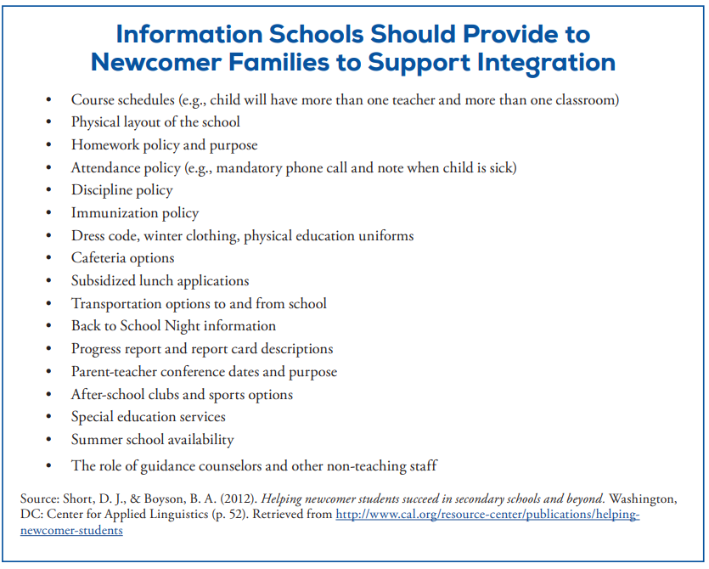
Providing Information About School Systems and Policies

Slide 10
How must an LEA use Title III immigrant subgrant funds? How might an LEA prioritize certain uses of funds to respond to the unique needs of the immigrant children and youth that it serves?
Under the statute, an LEA must use the immigrant subgrant to provide enhanced instructional opportunities for immigrant children and youth (ESEA Section 3115(e)).
Activities may include:
Basic services such as providing classroom supplies, transportation, and other supports
Collaborations with community organizations, higher education, private sector to assist immigrant families
Tutorials, Mentoring, Academic or Career Counseling for immigrant youth
Training activities to support active parent participation
Unique curricular materials or technology
Services to introduce immigrant youth to the educational system and civic education
Recruitment of personnel who have training to support immigrant youth
Notes:
Duplicate information (slide 7) - revisit
• Family literacy, parent and family outreach, and training activities designed to assist parents and families to become active participants in the education of their children;
• Recruitment of and support for personnel, including teachers and paraprofessionals who have been specifically trained, or are being trained, to provide services to immigrant children and youth;
• Provision of tutorials, mentoring, and academic or career counseling for immigrant children and youth;
• Identification, development, and acquisition of curricular materials, educational software, and technologies to be used in the program;
• Basic instruction services that are directly attributable to the presence of immigrant children and youth in the LEA, including the payment of costs of providing additional classroom supplies, costs of transportation, or such other costs as are directly attributable to such additional basic instruction services;
• Other instruction services that are designed to assist immigrant children and youth to achieve in elementary and secondary schools in the U.S., such as programs of introduction to the educational system and civics education; and
• Activities, coordinated with community-based organizations, institutions of higher education, private sector entities, or other entities with expertise in working with immigrants, to assist parents and families of immigrant children and youth by offering comprehensive community services.

Slide 11
Example Activities
Activity Description | Examples to Consider
Family literacy, parent outreach, and training activities to help parents to participate actively in their children’s education | Parenting classes to assist parents in becoming effective partners in their child’s education Support classes: introduction to US school systems, civics education, etc. Family nights/meetings

Slide 12
Example Activities
Activity Description | Examples to Consider
Support for personnel, including teacher aides, specifically trained to serve immigrant children | Family liaison Professional development for school staff in supporting immigrant students and their families

Slide 13
Example Activities
Activity Description | Examples to Consider
Tutoring, mentoring, and academic or career counseling | Before or after school tutoring programs for immigrant children and youth Summer school program Counseling on graduation pathways/post-secondary options Mentoring program

Slide 14
Example Activities
Activity Description | Examples to Consider
Collaborations with community organizations, higher education, private sector to assist immigrant families | ● Partnerships with community organizations ● Partnerships with universities or colleges ● Trauma informed education ● Social/Emotional Learning for families

Slide 15
Frequently Asked Questions
01
NO. Only students who meet the definition of immigrant children and youth are included in the count:
A child who is aged 3 through 21;
Was not born in any State or any U.S. territory
Has not been attending one or more schools in any one or more states for more than 3 full academic years
Are all English learners included in the immigrant count?
02
These funds are designed to help with the transition to a U.S.-based school. While these programs may also include English language development supports, the main focus is to address issues that immigrant students and families may face.
How is programming with these funds different from an EL program?
03
NO. English learners are identified under a different set of criteria. Keep in mind, many immigrants are identified as English learners, but not all.
Are all immigrant students English learners?

Slide 16
Resources
U.S. Department of Education
Educational Resources for Immigrants, Refugees, Asylees and other New Americans
USDE Non-Regulatory Guidance
English Learners and Title III of the Elementary and Secondary Education Act (ESEA), as amended by the Every Student Succeeds Act (ESSA) 2016
CDE Guidance
Title III Immigrant Set-Aside

Slide 17
Additional Resources to Support Immigrant Students and Their Families
U.S. Department of Education: Newcomer Toolkit
Chapter 1: Who Are Our Newcomers?
Chapter 2: Welcoming Newcomers to a Safe and Thriving School Environment
Chapter 3: Providing High-Quality Instruction for Newcomer Students
Chapter 4: Supporting Newcomers’ Social Emotional Needs
Chapter 5: Establishing Partnerships With Families
Helpful features:
About this Chapter (quick overview)
Terminology
Graphics, visuals, tables, classroom tools, activity guides
Resources
Bridging Refugee Youth & Children’s Services
Rocky Mountain Immigrant Advocacy Network

Slide 18
Now you…
Understand the purpose of Title III, Immigrant Set-Aside Funds
Understand the eligibility requirements
Understand considerations around need identification and allowable uses
Have resources to support your decision-making to maximize the impact of these funds in support of students who are immigrants

Slide 19
Contacts
If you have any questions, please contact your ESEA Regional Contact.

