Slide 1

Title III, Part A
Title III, Part A - Immigrant Set Aside
Notes:
Rachel

Slide 2
Objectives:
Provide an overview of the intent and purpose of Title III, Part A and Title III Immigrant Set Aside
  Colorado’s Title III allocation
Provide an overview of the upcoming Title III, Part A and Title III, Immigrant Set Aside narratives in the 24-25 Consolidated Application via the new Grants Management System, GAINS
Share tips for completing the Title III activities in the budget
  Key wording
  What to avoid
Notes:
Rachel

Slide 3
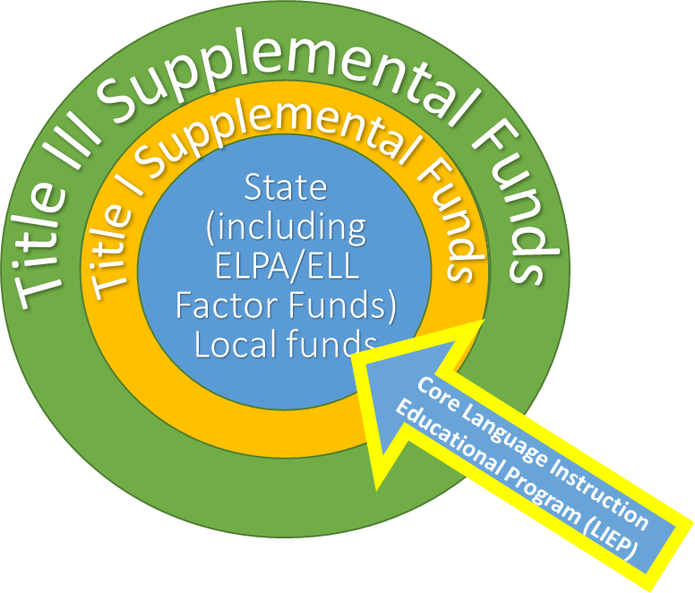
ESSA Revised Final Allocations | Fiscal Year 2023-2024 | Every Student Succeeds Act of 2015
Title III, Part A: $10,125,748
Title III is a supplemental grant under the ESEA that is designed to improve and enhance the education of multilingual learners (MLs) in becoming proficient in English, as well as meeting the Colorado Academic Content standards.
Notes:
Kim
revised allocations: https://www.cde.state.co.us/cdefisgrant/fy2324essaallocationsrf-0

Slide 4
Program Requirements and Eligibility
Colorado’s Title III allocation is based on the number of ELs reported through the American Community Survey and U.S. Census data.
The previous Student October count informs the subsequent school year Title III allocation. An LEA or consortium allocation must meet or exceed $10,000 in order to apply for a Title III grant.
Notes:
Kim

Slide 5
Consolidated Application in GAINS for FY 24-25
Changes to:
Cross program questions
Title III Narratives
Title III Immigrant Set Aside Narratives
Budget layout, format
Notes:
Kim

Slide 6
EL to ML
We cannot fully transition from EL (English Learner) to ML (Multilingual Learner) until we get our ESSA State Plan approved in 2025-2026.
Throughout the application you will see: EL/ML
Notes:
Kim

Slide 7
Previous Cross Program Questions:
3.3 Stakeholder Involvement:
Describe how the LEA will consult with relevant educators, families, and community members in developing proposed activities with Title III funding.
This question was removed from the Cross Program Questions.
4.1 Family, School Community Engagement Strategies:
Describe how the LEA implements effective outreach to parents and families of English Learners on their involvement in the academic achievement and being active participants in supporting their student to attain English proficiency, achieve at high levels within a well-rounded education and meet the Colorado Academic Standards.
This question was updated and added as 4.2 (specific to parents/families of EL/MLs).
Notes:
Rachel

Slide 8
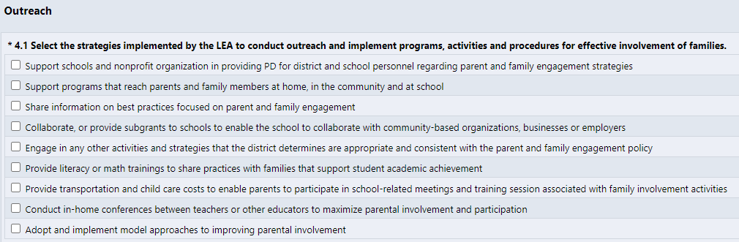
Cross Program Question Updates:
Specific to EL/MLs
Notes:
Rachel

Slide 9

Updated Cross Program Question:
Notes:
Rachel

Slide 10
Previous Title III Narrative:
Title III Narrative, Question 1 - Professional Development
Complete the tables to describe how professional development is funded.
The LEA must provide high-quality professional development to classroom teachers (including teachers in classroom settings that are not designed for only language instruction educational programs), principals, administrators, and other school or community-based organizational personnel. The professional development must:
Improve the instruction of ELs;
Enhance the ability of teachers to understand and use curricula, assessment measures, and instructional strategies for ELs;
Be scientifically research-based and of sufficient duration and intensity. §3115(c)(2))
Notes:
Rachel

Slide 11
Changes to Title III Narrative Section
Identify Core ELD programs for elementary, middle, and high school
Narratives for the required Title III activities:
  Increase English proficiency
    Supplemental activities
  Professional development
  Family, community engagement
Immigrant Set Aside
  Discuss needs assessment, describe student population
  Allowable activities
Notes:
Rachel

Slide 12
GAINS Title III Narrative Question 1:
Select the core English Language Development (ELD) programming methods/models of instruction provided within the LEA. Title III, Part A funds must be used for purposes that are supplemental to core ELD programming. This includes provision of direct instruction services, professional development, and the purchase of materials and supplies.
Notes:
Rachel

Slide 13
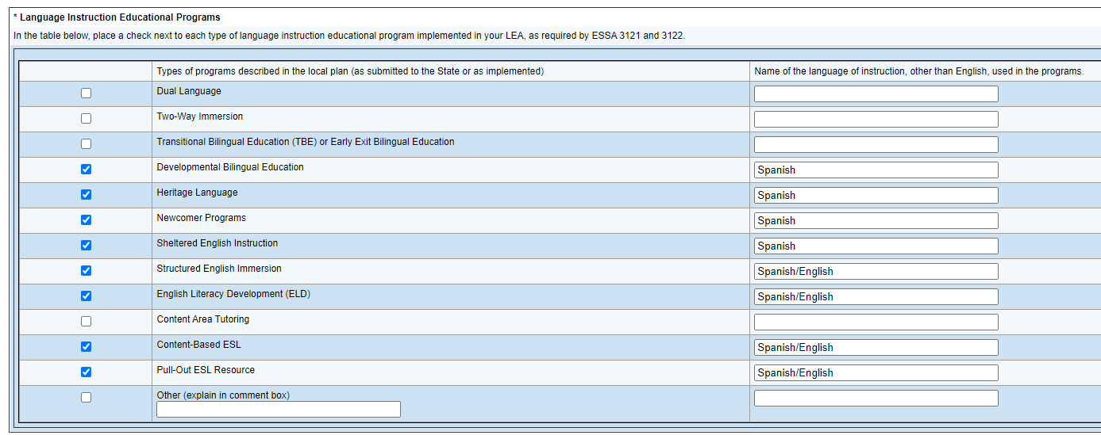
Other SEA Application Design
Notes:
Rachel

Slide 14
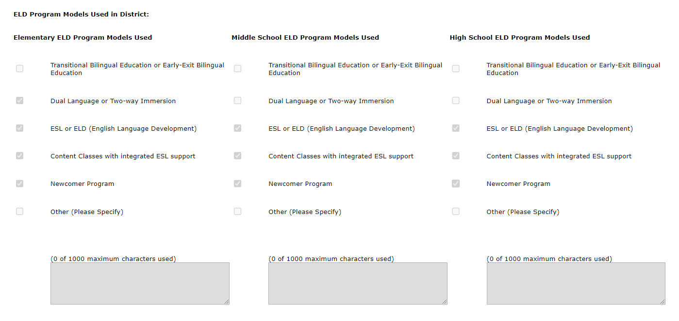
Other SEA Application Design
Notes:
Rachel

Slide 15
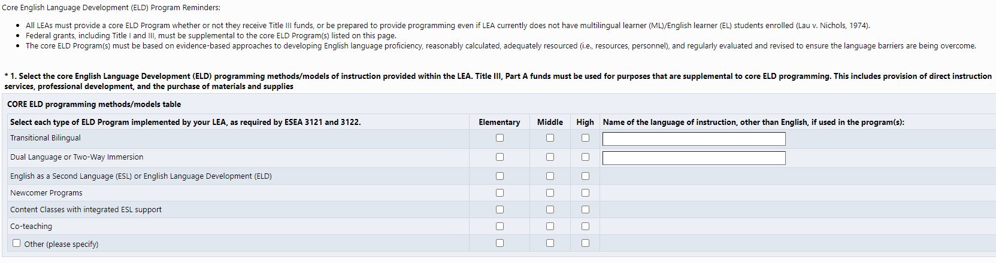
GAINS View
DRAFT
Alignment with Consolidated State Performance Report (CSPR)
Co-teaching was added (not part of CSPR)
Supporting document will be linked (see next slide)
Notes:
Rachel

Slide 16
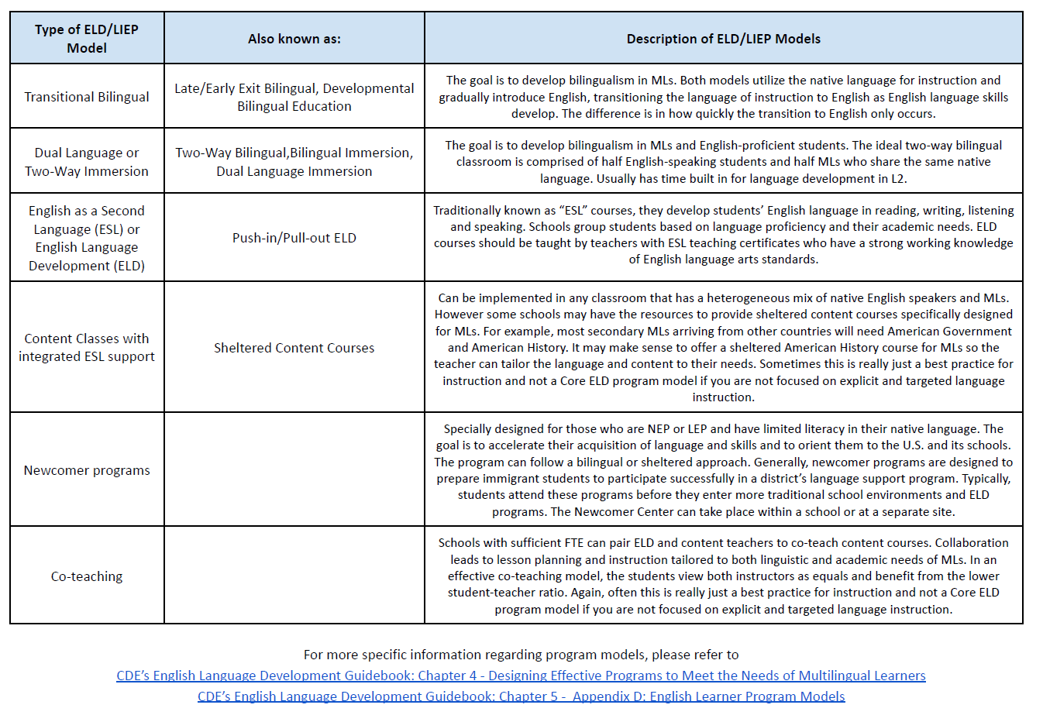
Supporting Document - will be linked in Narrative Question 1
DRAFT
Notes:
Rachel
https://www.cde.state.co.us/cde_english/eldguidebook2023chapter4
https://www.cde.state.co.us/cde_english/eldguidebook2023chapter5 (Appendix D: pages 26-27)

Slide 17
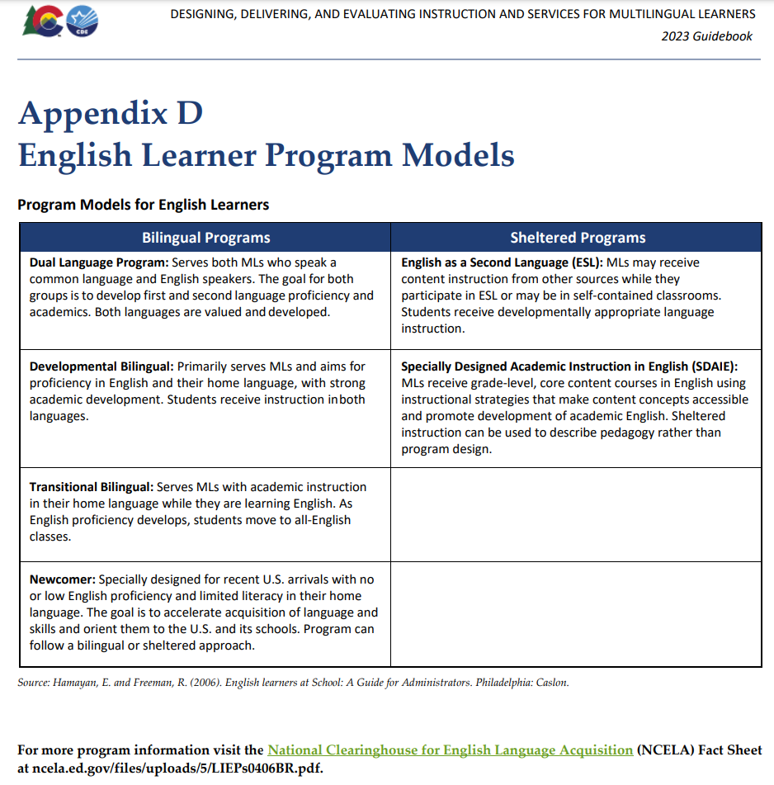
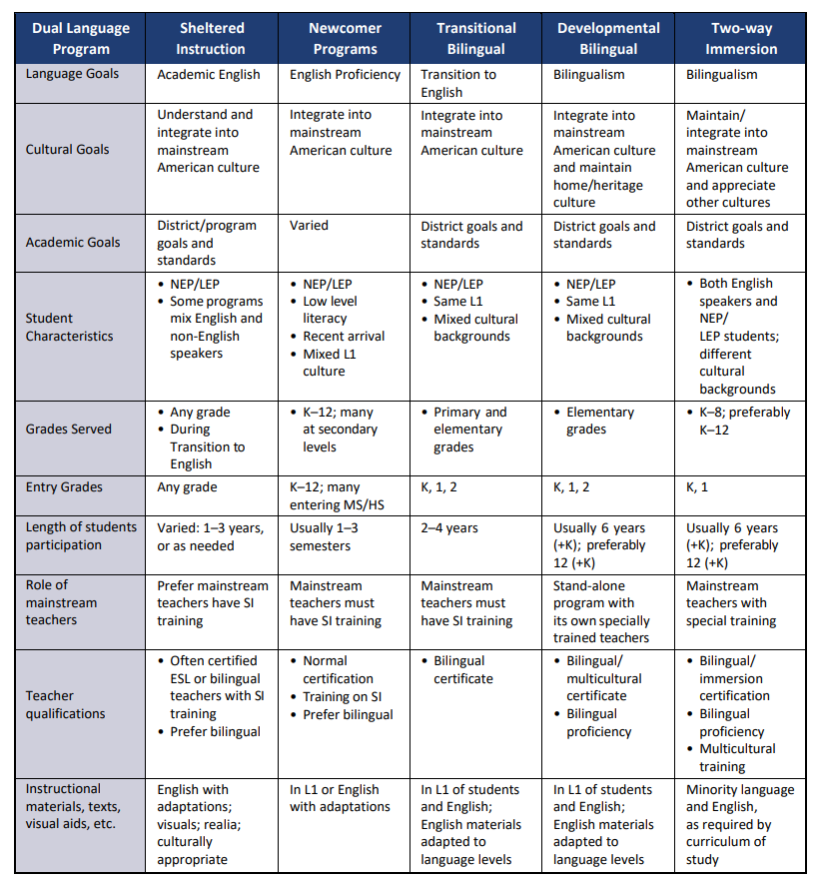
Chapter 5: Appendix D of ELD Handbook
ELD Handbook - Chapter 5: Components of an Effective Language Instruction Educational Program
Notes:
Rachel

Slide 18
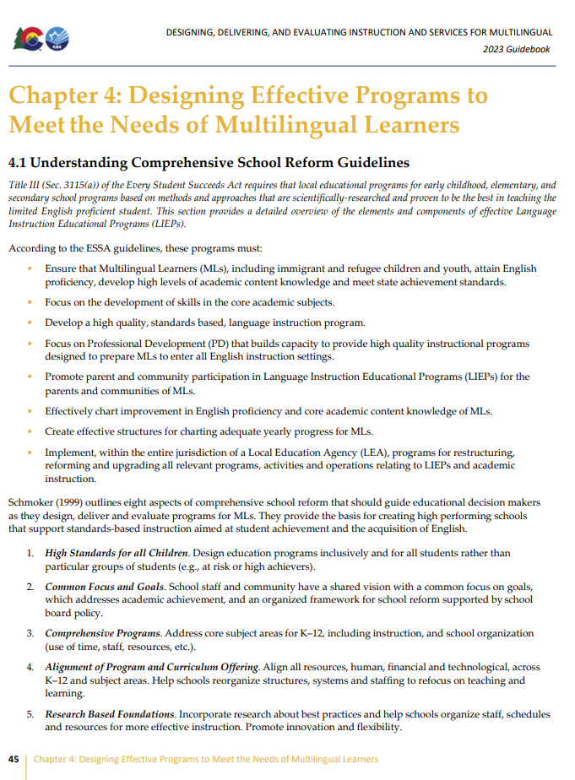
ELD Handbook: Chapter 4
4.1 Understanding Comprehensive School Reform Guidelines
4.2 Understanding and Selecting LIEP Models
  4.2a LIEP Models—Theoretical Framework
4.3 Promising Practices
Appendix B Lessons Learned: Practices of Successful Model Schools Serving Multilingual Learners
ELD Handbook: Chapter 4 - Designing Effective Programs to Meet the Needs of Multilingual Learners
Notes:
Rachel
https://www.cde.state.co.us/cde_english/eldguidebook2023chapter4

Slide 19
GAINS Title III Narrative Question 2:
Required Title III, Part A Activity: to increase the English language proficiency of multilingual learners (MLs) by providing effective language instruction educational programs that meet the needs of MLs and demonstrate success in increasing:
English language proficiency; and
Student academic achievement
Provide an overview of the supplemental activities (beyond required ELD Core Program/State and Federal Requirements) to be implemented this school year with Title III, Part A funds.
Notes:
Rachel

Slide 20
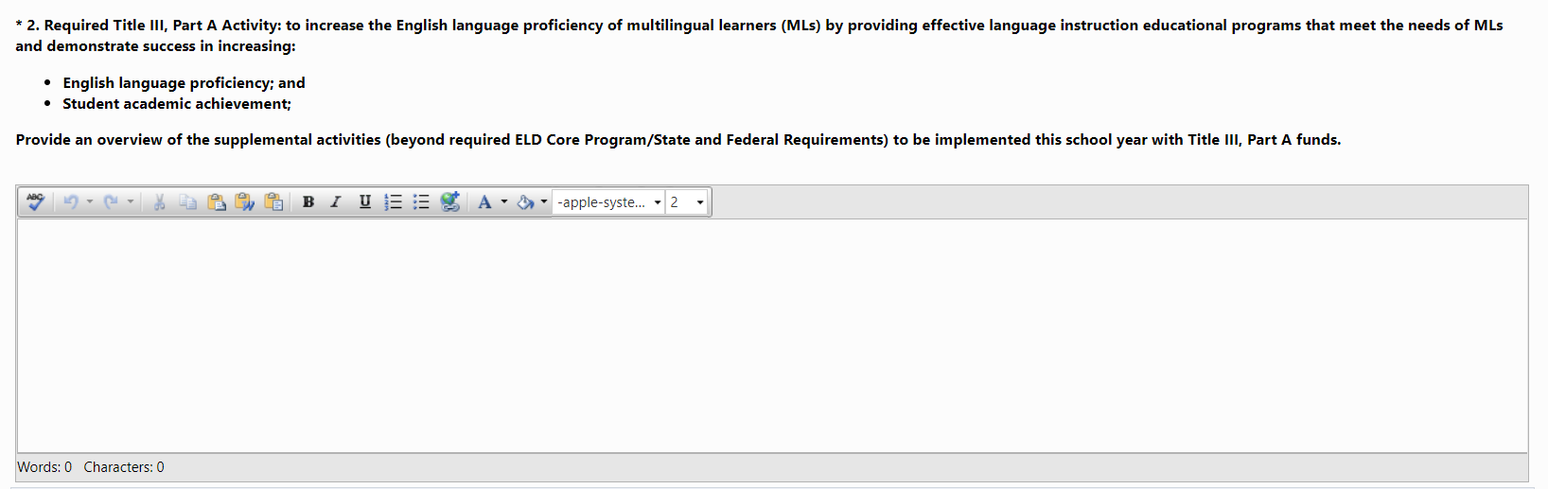
GAINS View
Notes:
Rachel

Slide 21
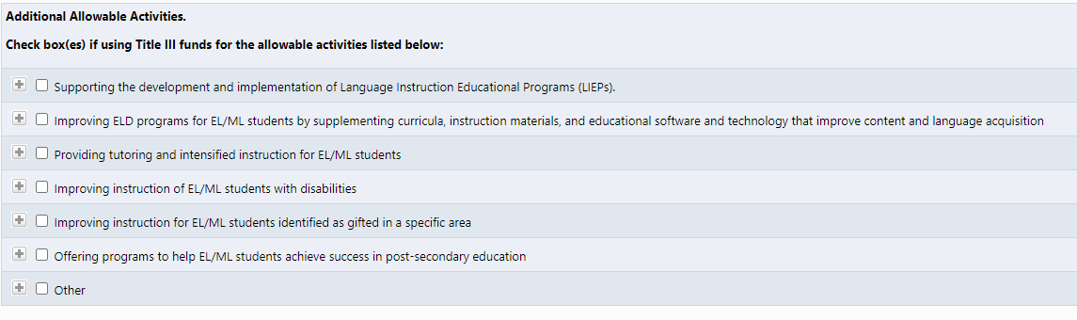
GAINS View
DRAFT
Notes:
Rachel

Slide 22
GAINS Title III Narrative Question 3:
Required Title III, Part A Activity: to provide effective professional development to classroom teachers (including teachers in classroom settings that are not the settings of language instruction educational programs), principals and other school leaders, administrators, and other school or community-based organizational personnel, that is:
designed to improve the instruction and assessment of multilingual learners;
designed to enhance the ability of such teachers, principals, and other school leaders to understand and implement curricula, assessment practices and measures, and instructional strategies for multilingual learners;
effective in increasing children’s English language proficiency or substantially increasing the subject matter knowledge, teaching knowledge, and teaching skills of such teachers; and
of sufficient intensity and duration (which shall not include activities such as 1-day or short-term workshops and conferences) to have a positive and lasting impact on the teachers’ performance in the classroom, except that this subparagraph shall not apply to an activity that is one component of a long-term, comprehensive professional development plan established by a teacher and the teacher’s supervisor based on an assessment of the needs of the teacher, the supervisor, the students of the teacher, and any local educational agency employing the teacher, as appropriate
Complete the table below by indicating the name of the professional development activity and provide a detailed description.
Notes:
Rachel

Slide 23
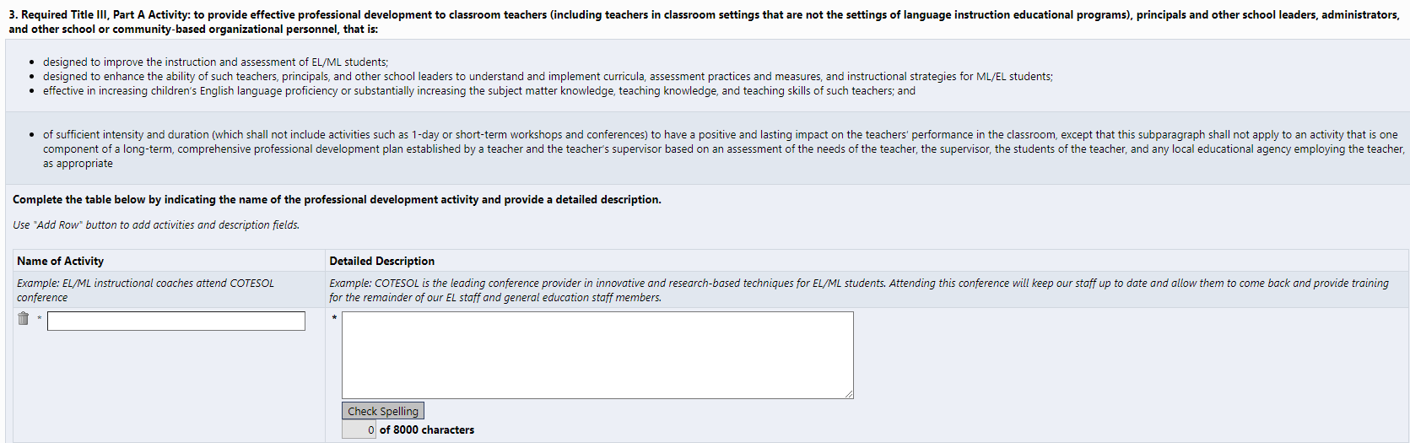
GAINS View
DRAFT
Notes:
Rachel

Slide 24
GAINS Title III Narrative Question 4:
Required Title III, Part A Activity: parent, family, and community engagement in language instruction educational programs using Title III funding.
Describe how the LEA uses Title III funds to implement ML-specific parent, family, and community engagement.
Notes:
Rachel

Slide 25
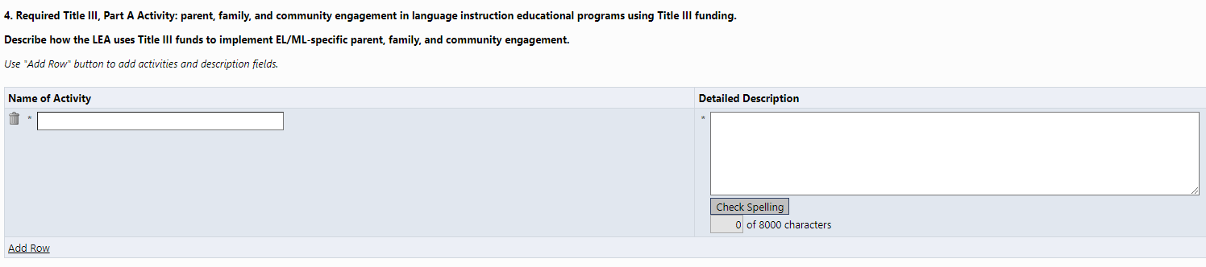
GAINS View
DRAFT
Notes:
Rachel

Slide 26
Immigrant Set Aside
Notes:
Kim

Slide 27
Immigrant Set Aside
The Title III Immigrant Set-Aside grant resides within this program and provides opportunities for LEAs to enhance the instructional opportunities for immigrant students and their families.
CDE reserves 5% of its Title III allocation for the Immigrant Set-Aside grant. Annual local education agency (LEA), including district or consortia, allocations are based on the number of multilingual learners reported through the annual Student October Count.
Notes:
Kim

Slide 28
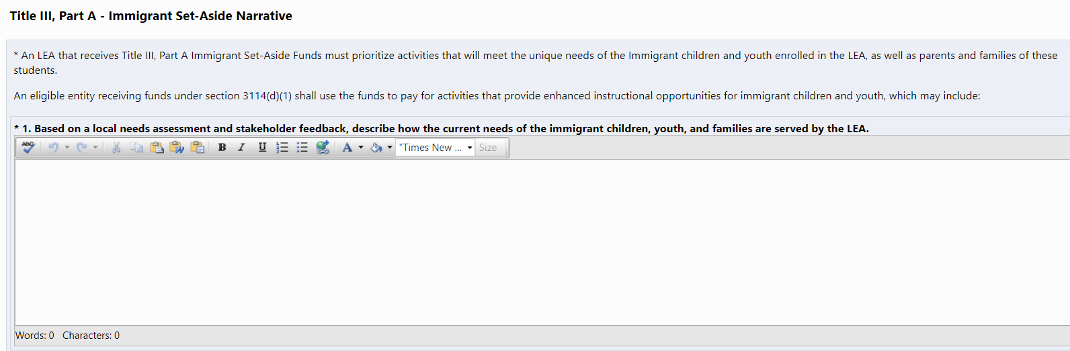
Immigrant Set Aside
DRAFT
Notes:
Rachel

Slide 29
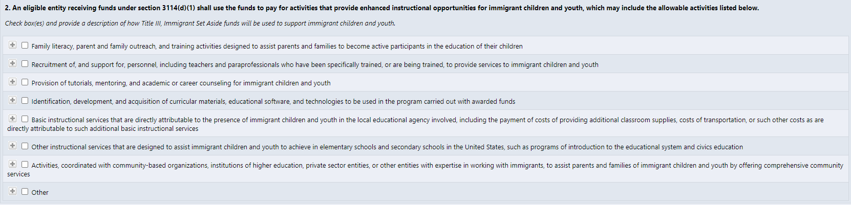
Immigrant Set Aside
DRAFT
Notes:
Rachel

Slide 30
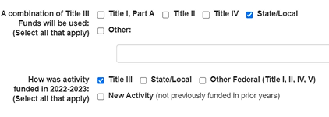
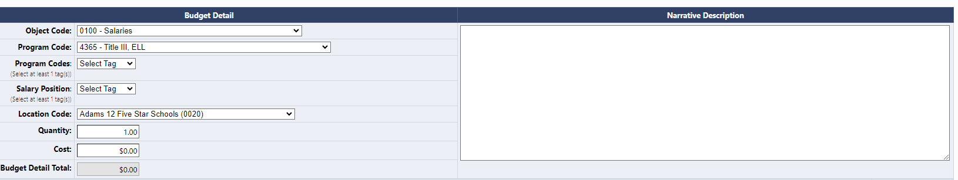
GAINS Budget
Similar to previous ConsApp
Additional tags
Required Title III activities
REMINDER: The U.S. Department of Education assumes that supplanting exists if an LEA uses Title III funds to provide services it provided in prior years with State, local, or other federal funds.
In Development
Notes:
Rachel

Slide 31
Things to keep in mind when
completing the application
Notes:
Kim

Slide 32
Common comments from reviewers
Please explain how this aligns with the intent and purpose of Title III.
Please explain how this is above and beyond what is required with State and Local funds.
As a reminder, Title III activities associated with translation/interpretation should only be used to translate/interpret for items beyond student’s academic successes/challenges or the health and safety of the student. Please provide clarification as to how Title III funds will be used beyond OCR requirements.
Notes:
Kim

Slide 33
Key Wording/Phrases
Supplemental
Above and beyond what is required with state/local funds
Examples from current activities:
“additional instructional support to ELL students outside of the ELL CLDE programming scheduled time…”
“this tutoring is an additional 45 to 60 minutes each day outside of scheduled CLDE group time…”
“Purchasing supplemental intervention materials to support ELL English acquisition…”
Notes:
Kim

Slide 34
CAUTION
FOOD:
Please be aware that generally there is a very high burden of proof to show that paying for food and beverages with federal funds is necessary to meet the goals and objectives of a federal grant.
INTERPRETATION/TRANSLATION:
Per Title VI of the Civil Rights Act, districts and schools are required to provide translation/interpretation to family members who do not speak English for items related to student’s education, personal well-being, or safety of the student. Therefore Title III activities associated with translation/interpretation should only be used to translate/interpret for items beyond student’s academic successes/challenges or the health and safety of the student.
Title III, Part A funds may be used only for supplemental translation and interpretation activities that are not provided by the LEA for all students and are specific to the Title III program.
Notes:
Kim

Slide 35
Rachel Temple
Federal Programs and Supports Unit
ESEA Title III Specialist
temple_r@cde.state.co.us
720-202-6135
Kim Boylan
Federal Programs and Supports Unit
ESEA/ESSER Monitoring Specialist
boylan_k@cde.state.co.us
720-354-7031
Notes:
Kim

