Slide 1
ESEA - February Virtual Training
Title III
February 15, 2022

Slide 2
Agenda
We will start each session on time
We may take short breaks in between if time allows
Feel free to stay on for all three or leave and come back
Type questions in the chat or come off mute to interact
All recordings and slides will be posted on the RNM webpage after the meeting
9:00- 10:00 am | Consolidating Funds Schoolwide
10:00 - 11:00 am | Title III
11:00 am - 12:00 pm | Monitoring

Slide 3
Title III

Slide 4
ESEA Title III: Key Differences between English Language Development and MTSS Intervention

Slide 5
What is English Language Development in Colorado?
ELPA- English Language Proficiency Act (HB14-1298)
Local education providers or local education agencies (LEAs), must provide evidence-based English language proficiency, or English language development (ELD) programs for English learners to enable them to develop and acquire English language proficiency while achieving and maintaining grade-level performance in academic content areas. The state and LEAs must enhance all educators' effectiveness in supporting English language development and in enabling English learners to achieve and maintain grade-level performance in academic content areas. Finally, the state must develop the educational approach and goals of LEAs to help ensure that English learners are postsecondary and workforce ready at graduation.
Notes:
PAR requests?

Slide 6
ESEA Title III Supplemental Supports for English Learners: Requirements
Increasing the English language proficiency of ELs by providing effective language instructional education programs (LIEPs)/ELD programs that have successfully demonstrated increasing English language proficiency and academic achievement.
Providing effective professional development to classroom teachers, principals and other school leaders, administrators, and other school or community-based organizational personnel that relates directly to the instruction of ELs that support their linguistic, academic, and social-emotional challenges and opportunities of ELs.
Providing and implementing other effective activities and strategies that enhance or supplement LIEPS/ELD programs for ELs. These activities and strategies must include parent, family, and community engagement activities, but may also include strategies that coordinate and align related programs.

Slide 7
What is MTSS in Colorado? (Multi-Tiered System of Supports (MTSS) Strategy Guide
A Multi-Tiered System of Supports (MTSS) is a systemic, continuous-improvement framework in which data-based problem solving and decision-making is practiced across all levels of the educational system for supporting students. The framework of MTSS is a “way of doing business,” which utilizes high quality evidence-based instruction, intervention, and assessment practices to ensure that every student receives the appropriate level of support to be successful. A Multi-Tiered System of Supports helps schools and districts to organize resources through alignment of academic standards and behavioral expectations, implemented with fidelity and sustained over time, in order to enable every child to successfully reach his/her fullest potential.

Slide 8
Supplement not Supplant Guiding Questions (ESEA Training April 2021)
How was this activity funded in the past? Other federal or state and local funds?
How is this activity supplemental to the core ELD program?
How is the program specifically designed for ELs (program requirements resource)?
Is this a Civil Rights requirement? ELPA? READ Act?
Is the activity required by the district or school’s OCR agreement or DOJ consent decree or agreement?
Title III funds cannot be used to pay for an activity (supplies, curricular resources, FTE, stipends, etc.) that is required for local ELD programming per Civil Rights, DoJ, and State laws or required by local policies, consent decrees, or agreements.

Slide 9
Title III, Part A: Requirements
Required activities include:
ELD programs that have successfully demonstrated increasing English language proficiency and academic achievement
Providing effective professional development to all staff that relates directly to the instruction of ELs that support their linguistic, academic, and social-emotional challenges and opportunities of ELs
Providing and implementing other effective activities and strategies that enhance or supplement ELD programs for ELs, which must include parent, family, and community engagement activities, but may also include strategies that coordinate and align related programs
Notes:
As a grant recipient, there are strings attached to federal money. This is where the narrative questions come into play as we are required to collect this data per the statutory law. Required to provide activities that are effective and enhance and supplement programs, but also include and supplement activities. We ask for this in the narrative questions and follow-up with monitoring support.
This would be a good place to discuss the new 45 hour requirement and that teachers need it now, so it would be great for districts to leverage that by offering their own PD opportunities for teachers that align to their ELD programs and student demographics.
The 45 hour requirement is a license requirement for teachers, not for districts so districts can set up a program that might meet the 45 hour requirement but it is still up to teachers to meet the 45 hour responsibility. It is up to the district to receive PD aligned with instructional practices in the district, but also meets that 45 hour requirement. At the end of the slide deck, we have a link to the

Slide 10
Title III, Part A: Allowable Activities
Funds may be used to support (must supplement core programming):
Upgrading ELD program objectives and effective instructional activities
Improving ELD programs for ELs by identifying, acquiring, and upgrading curricula, instructional materials, educational software and technology, and assessment procedures that improve content and language acquisition
Providing community participation programs, family literacy services, and parent outreach and training activities to EL students and their families
Providing tutoring and intensified instruction for EL students
Offering early college high school or dual/concurrent enrollment programs or courses designed to help ELs achieve in postsecondary education
Developing and implementing effective preschool, elementary or secondary school ELD programs that are coordinated with other relevant programs and services.
Improving the instruction for EL students, including EL students with a disability or identified as gifted in a specific area
Funds CANNOT be used to support:
W-APT, WIDA Screener, or ACCESS 2.0
ELPA requires LEAs to identify, provide services, and annually evaluate ELs.
LEAs cannot use Title III funds to purchase these materials, train teachers, or provide FTE/subs/release time to administer assessments.
Core ELD Programming
Curricular resources for core ELD or content blocks
ELD Resources - EL Achieve, Pearson Language Central, National Geographic Edge, Reach, Inside the USA
READ Act Assessment and approved programming
Required FTE for core ELD Program
FTE for core content programming
Whole school/whole district initiatives reflect percentage of students, not entirely covered by TIII
Notes:
Title III, Part A Funds may be used to support: MC – this is a list of potential allowable activities, I would note this only because what is allowable in one district may not be allowable in other, because of their core programming….Allowable is all in the eye of the beholder. Allowable is dependent upon what core ELD program is and how money was spent Based on local context that determines what is actually allowable. This list is not exhaustive, but ideas within parameters of supplement, not supplant and what your local plans.
Upgrading ELD program objectives and effective instructional activities.
Improving ELD programs for ELs by identifying, acquiring, and upgrading curricula, instructional materials, educational software and technology, and assessment procedures that improve content and language acquisition.
Providing community participation programs, family literacy services, and parent outreach and training activities to EL students and their families.
Providing tutoring and intensified instruction for EL students.
Offering early college high school or dual/concurrent enrollment programs or courses designed to help ELs achieve in postsecondary education.
Developing and implementing effective preschool, elementary or secondary school ELD programs that are coordinated with other relevant programs and services.
Improving the instruction for EL students, including EL students with a disability or identified as gifted in a specific area.
Title III, Part A Funds CANNOT be used to:
No ELD assessment and identification (HLS, WIDA Screener, ACCESS)
Can’t pay salary for someone to ID, can’t pay subs to release teachers to administer ACCESS
Could pay for teachers to have release time to meet to discuss WIDA scores
For ELD resources – need to show how the resources would be used in addition to core ELD block (might be used for a “double dip” of ELD or additional support)
Reading supports/curricular resources – How is the program specifically designed for ELs? Is this supplemental to the core reading instruction and ELD instruction?
Should not be funding core programming for Els; Can’t be used for literacy interventions for ELs – shouldn’t just provide it because they’re “ELs”

Slide 11
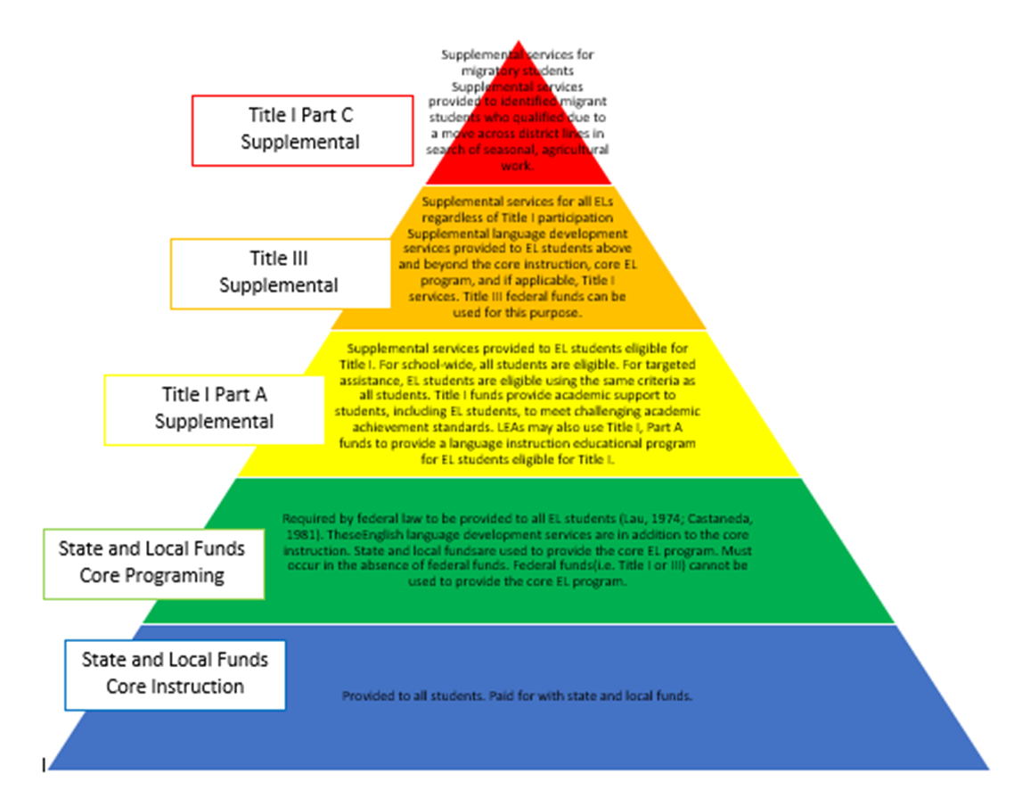
Funding Pyramid

Slide 12
Questions ?
Contacts
Kathryn Wisner Title III specialist in the ESEA office wisner_k@cde.state.co.us
Morgan Cox CLDE Director cox_m@cde.state.co.us
Lindsay Swanton ELD Specialist & ELPA Coordinator swanton_l@cde.state.co.us
Doris Brock-Nguyen CLDE Consultant brock-nguyen_d@cde.state.co.us

Slide 13
CDE Contact Information
ESEA Monitoring Team
Tammy Giessinger
720-827-5291 (c)
giessinger_t@cde.state.co.us
Michelle Prael
720-545-7368 (c)
prael_m@cde.state.co.us
Grants Fiscal Team
Bill Parsley
303-910-5163 (c)
parsley_b@cde.state.co.us
Sharon Mackey
303-358-4672 (c)
mackey_s@cde.state.co.us
Hilery Morris
720-471-4877 (c)
morris_h@cde.state.co.us
ESSER Monitoring Team
Kristin Crumley
720-660-1369 (c)
crumley_k@cde.state.co.us
Jonathan Schelke
720-388-0842 (c)
schelke_j@cde.state.co.us
Shannon Wilson
720-456-9701 (c)
wilson_s@cde.state.co.us
Mackenzie Owens
720-601-7112 (c)
owens_m@cde.state.co.us
Notes:
Michelle

