Slide 1
Every Student Succeeds Act (ESSA) Hub Committee
February 6, 2017

Slide 2
Agenda
Welcome
Accountability
School Improvement
Public Comment Process
Wrap-up
  Hub Member Updates
  Review and Approval of Meeting Minutes

Slide 3
ESSA and Accountability
ESSA Accountability Spoke ~
Accountability Work Group (AWG)
February Hub Meeting
(2/6/17)
Notes:
Nazie

Slide 4
Today’s Objectives
Discussion and Final Vote on Decision Items
  EL assessment
  EL progress indicator
  Major racial and ethnic groups
  Long-term goals and interim measures
Revisit other indicator – long term plan
Participation Input
Revisit School Identification (if there is time)
Next Steps
Notes:
Nazie

Slide 5
Discussion and
Final Vote
Options, Discussion and Making Recommendations to the State Board of Education (SBE)
Notes:
Nazie

Slide 6
ESSA Accountability Work Group
English Learner Assessment
Decision Point
February 6, 2017
Notes:
Marie

Slide 7
Testing EL Newcomers
Decision Point
How should first year in US EL’s be included in ELA testing, accountability, and reporting?
Recommendation
  If a student has been enrolled in a US school for less than 12 months and is classified as Non-English Proficient (NEP)- based on the WIDA screener and local body of evidence- he or she is exempt from taking the CMAS PARCC ELA assessment. A student’s parents can opt the child into testing if they choose, and the score results will be used for accountability and growth calculations.
Notes:
Marie
The specific decision point is around whether Colorado should test ELs new to the US within the last twelve months on the state’s English Language Arts assessment, and how those results should be used for state accountability and reporting.

Slide 8
Testing EL Newcomers
Decision Point
Recommendation (continued)
  If a student has been enrolled in a US school for less than 12 months and is classified as Limited-English Proficient (LEP) or Fluent-English Proficient (FEP)- based on the WIDA screener and local body of evidence- he or she should be assessed on the CMAS PARCC ELA assessment.
88% of public survey respondents indicated support or strong support for this recommendation.
Most comments in support of exempting NEP newcomers.
Varying opinions expressed about testing LEP newcomers, though general support for testing students once they had acquired adequate proficiency in English.
Notes:
Marie
The result of this consultation and collaboration has been a proposed statewide procedure for testing EL newcomers.
If a student has been enrolled in a US school for less than 12 months and is classified as Non-English Proficient (NEP)- based on the WIDA screener and local body of evidence- he or she is exempt from taking the CMAS PARCC ELA assessment. A student’s parents can opt the child into testing if they choose, and the score results will be used for accountability and growth calculations.
If a student has been enrolled in a US school for less than 12 months and is classified as Limited-English Proficient (LEP) or Fluent-English Proficient (FEP)- based on the WIDA screener and local body of evidence- he or she should be assessed on the CMAS PARCC ELA assessment.
The flexibility to use English language proficiency as a factor for decision-making was explicitly allowed under proposed regulation and well received by all stakeholder groups consulted.

Slide 9
ESSA Accountability Work Group
English Learner Progress
Decision Point
February 6, 2017
Notes:
Marie

Slide 10
EL Growth Decision Point
How will Colorado incorporate progress in acquiring English language proficiency for ELs in our state accountability system?
Recommendation #1
  Continue using the existing sub-indicator for ELP growth - median student growth percentile (MGP) on WIDA ACCESS
  MGP metric provides information on how much progress students with two+ consecutive years of WIDA ACCESS scores have made in acquiring English proficiency in comparison to their English proficiency peers.
Notes:
Marie
The specific decision point is around how Colorado will incorporate progress in acquiring English language proficiency for ELs into our state accountability system.

Slide 11
EL Growth Decision Point
Recommendation #2
  Add a sub-indicator for ELP accountability measuring growth-to-a-standard on WIDA ACCESS.
  Proposing to use CDE’s current 6-year stepping-stone timeline with potential modifications (depending on transition to ACCESS 2.0 and revised standard setting results) to determine students progress towards achieving English proficiency.
  If at any point a student did not make the progress expected on the stepping-stone trajectory based on their prior year proficiency level, they would be considered off-track.
  CDE has a plan of future action for establishing timeline and growth-to-standard expectations.
Notes:
Marie
The Accountability Working Group has an additional recommendation for adding a sub-indicator for English language proficiency (ELP) accountability measuring growth-to-a-standard on WIDA ACCESS.
The proposal is to use CDE’s current 6-year stepping-stone timeline with potential modifications (depending on transition to ACCESS 2.0 and revised standard setting results) to determine students progress towards achieving English proficiency.
Students coming in at Level 1 would be given 6 years to achieve redesignation.
Students entering at any point further along in the proficiency continuum would be expected to achieve redesignation within the remaining time allowed by the stepping-stone trajectory.

Slide 12
EL Growth Decision Point
76% of public survey respondents indicated support or strong support for using both the median growth percentile and a growth-to-standard measure as part of the English language progress indicator.
Majority of feedback has been focused around the process for establishing the student English language proficiency trajectory and ensuring that background factors (age, interrupted prior education, IEP or 504 plan, etc.) are appropriately taken into consideration.
Notes:
Marie

Slide 13
ESSA Accountability Work Group
Disaggregated Accountability
Decision Point
February 6, 2017
Notes:
Marie

Slide 14

From 1/19 Disaggregating Non-White Students
Option 1: non-White group (11.6%, average = 2.3)
  Acknowledges small rural school districts.
  Classification of “minority” is becoming increasingly difficult; its basis should be primarily a socio-economic indicator.
Option 2: separate racial/ethnic groups (26.1%, average = 2.3)
  Analyze data for racial/ethnic groups that reach a threshold (e.g., 10% or 20% of overall population).
  Look at each racial/ethnic group when possible; races/ethnicities labeled; “minority” are not really the minority a lot of times.
  Racial groups should match the ratios in their communities.
  Analyzing based on ethnicity feels like racism even if trying to honor all races.
  Too complicated; too many data points creates data overload and whole thing is disregarded.
  Final recommendation, aligned with final regulations.
Option 3: non-White group for accountability but include disaggregated data when available (60.9%, average = 1.4)
  Initial recommendation, but not aligned with final regulations.

Slide 15
Non-White Group versus Disaggregated groups:
School Accountability
 |  | Math Achievement
 |  | 2016 (1-Year data) |  |  | 2014 (3-Year data)
 |  | Schools meeting minimum n |  | Difference | Schools meeting minimum n |  | Difference
 |  | N=16 | N=20 |  | N=16 | N=20
E | Non-White | 940 | 919 | 21 | 996 | 987 | 9
 | American Indian or Alaska Native | 6 | 5 | 1 | 21 | 10 | 11
 | Asian | 97 | 68 | 29 | 371 | 308 | 63
 | Black | 159 | 129 | 30 | 286 | 240 | 46
 | Hispanic | 866 | 807 | 59 | 970 | 950 | 20
 | Hawaiian/Pacific Islander | 0 | 0 | 0 | 2 | 2 | 0
 | Two or More Races | 127 | 63 | 64 | 485 | 401 | 84
 | White | 932 | 900 | 32 | 1,015 | 999 | 16
M | Non-White | 429 | 411 | 18 | 494 | 483 | 11
 | American Indian or Alaska Native | 5 | 3 | 2 | 66 | 40 | 26
 | Asian | 113 | 88 | 25 | 208 | 176 | 32
 | Black | 109 | 98 | 11 | 191 | 170 | 21
 | Hispanic | 395 | 378 | 17 | 474 | 456 | 18
 | Hawaiian/Pacific Islander | 0 | 0 | 0 | 9 | 6 | 3
 | Two or More Races | 114 | 85 | 29 | 249 | 226 | 23
 | White | 468 | 451 | 17 | 518 | 513 | 5
H | Non-White | 225 | 209 | 16 | 355 | 342 | 13
 | American Indian or Alaska Native | 1 | 0 | 1 | 48 | 25 | 23
 | Asian | 28 | 21 | 7 | 122 | 107 | 15
 | Black | 37 | 34 | 3 | 125 | 114 | 11
 | Hispanic | 196 | 183 | 13 | 330 | 315 | 15
 | Hawaiian/Pacific Islander | 0 | 0 | 0 | 8 | 6 | 2
 | Two or More Races | 26 | 17 | 9 | 130 | 116 | 14
 | White | 247 | 216 | 31 | 383 | 373 | 10
Note: Based on 1-year 2016 PARCC/DLM Math data, and 3-year 2014 TCAP/COALT Math data (2012, 2013, and 2014 combined). Counts are based on students meeting inclusion/exclusion rules for school accountability (October new to school, etc.).

Slide 16
Feedback from 1/19 Meeting
Option A- use individual disaggregated groups only
Option B- use individual disaggregated groups with minimum N and then accountability for remaining non-white students in a combined group that meets the minimum N:
  Individual groups that meet the minimum N AND
  Groups that don’t meet individual minimum N aggregated into a combined group
Option C- use individual disaggregated groups, unless too many students are excluded*, and then determine accountability for:
  An aggregated “Non-White” group instead
  *Analyses are being conducted to ascertain the values to be used for “too many students excluded”

Slide 17
Example #1

Slide 18
Example #2

Slide 19
Example #3

Slide 20
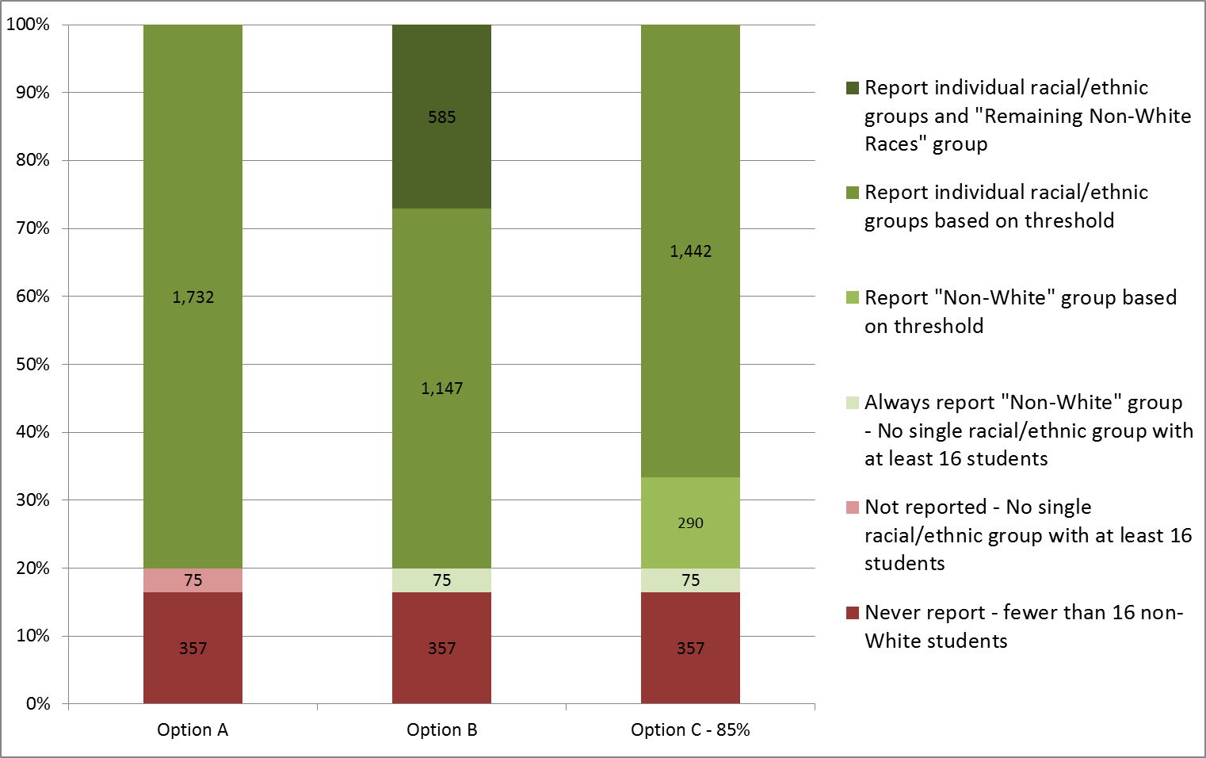
School Impact (3-year data)
Note: Calculations based on 2016 PARCC ELA achievement data. Student counts were multiplied by 3 to estimate 3 years of data.

Slide 21
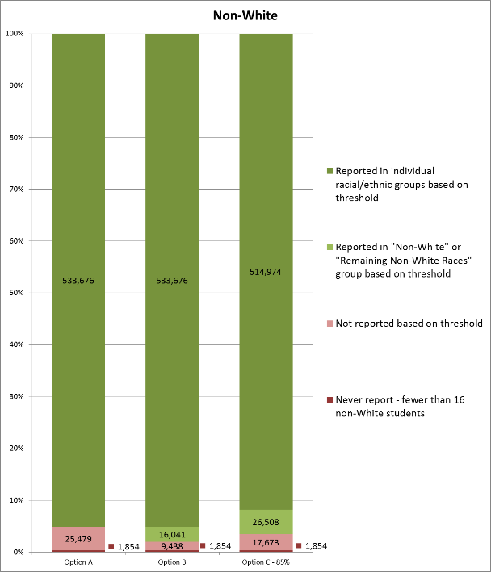
Student Impact (3-year data)
Note: Calculations based on 2016 PARCC ELA achievement data. Student counts were multiplied by 3 to estimate 3 years of data.

Slide 22
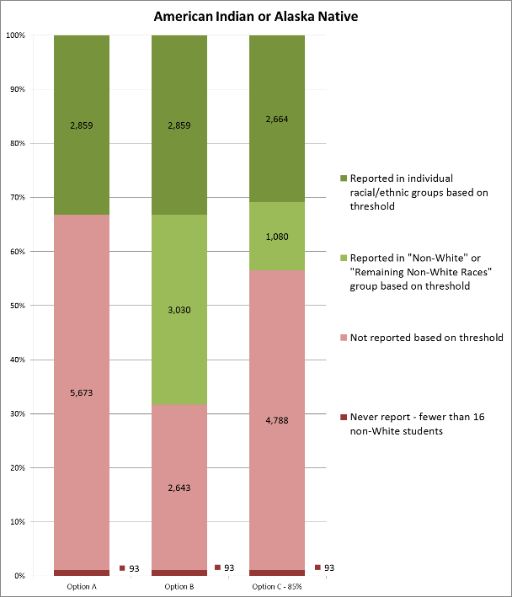
Student Impact, cont. (3-year data)
Note: Calculations based on 2016 PARCC ELA achievement data. Student counts were multiplied by 3 to estimate 3 years of data.

Slide 23
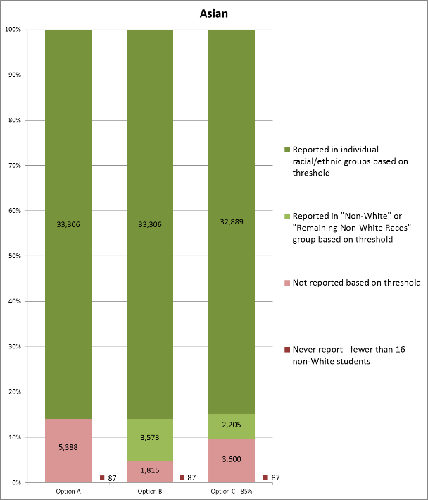

Student Impact, cont. (3-year data)
Note: Calculations based on 2016 PARCC ELA achievement data. Student counts were multiplied by 3 to estimate 3 years of data.

Slide 24
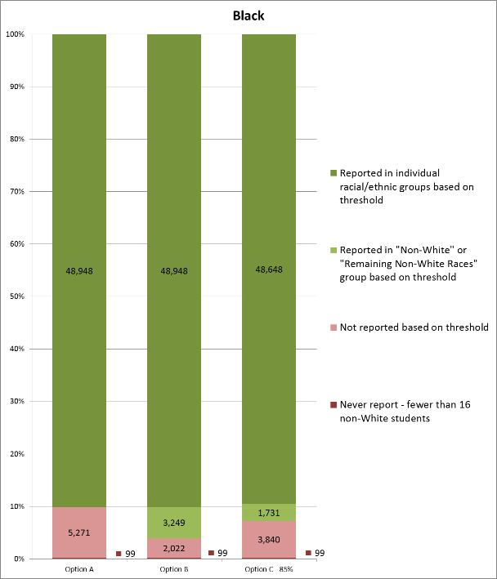
Student Impact, cont. (3-year data)
Note: Calculations based on 2016 PARCC ELA achievement data. Student counts were multiplied by 3 to estimate 3 years of data.

Slide 25
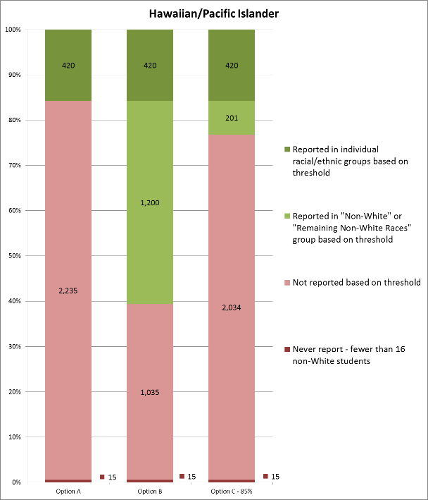
Student Impact, cont. (3-year data)
Note: Calculations based on 2016 PARCC ELA achievement data. Student counts were multiplied by 3 to estimate 3 years of data.

Slide 26
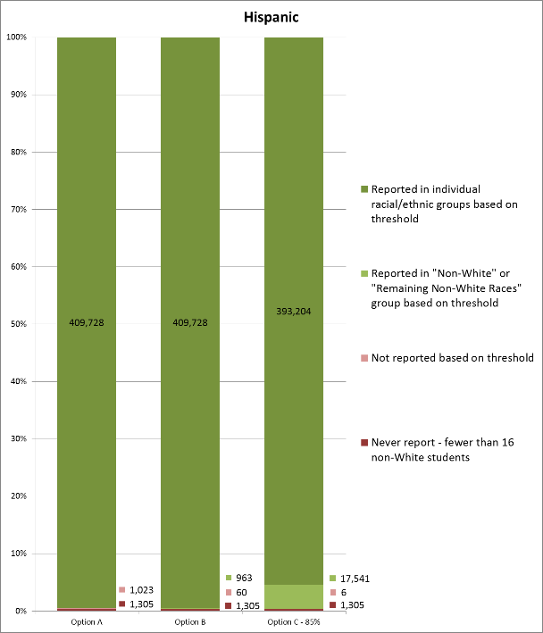
Student Impact, cont. (3-year data)
Note: Calculations based on 2016 PARCC ELA achievement data. Student counts were multiplied by 3 to estimate 3 years of data.

Slide 27
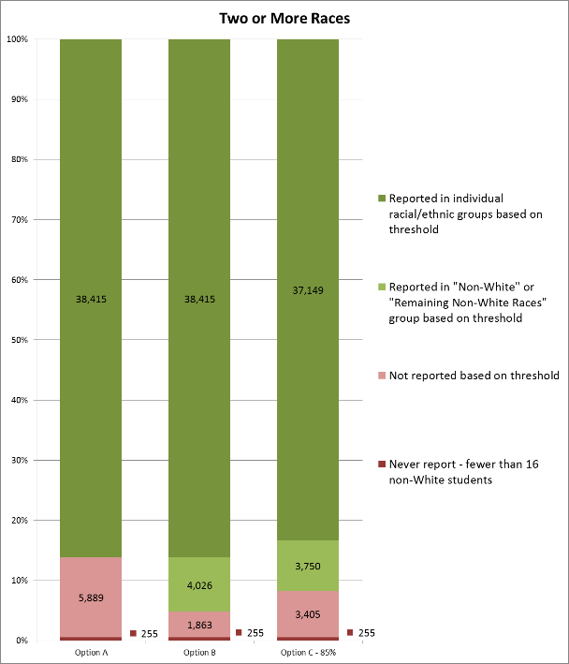
Student Impact, cont. (3-year data)
Note: Calculations based on 2016 PARCC ELA achievement data. Student counts were multiplied by 3 to estimate 3 years of data.

Slide 28
ESSA Accountability Work Group
Long-term Goals and Interim Targets
Decision Point
February 6, 2017
Notes:
Tina or Donna

Slide 29

Survey Responses
1 (strongly do not recommend) to 5 (strongly recommend)
  Base targets for interim progress and long-term goals on mean scale scores: 48 of 87 recommended; 20 did not recommend, average = 3.37
  Protects student PII.
  Factors in all students.
  Aligned with School and District Performance Frameworks (SPFs/DPFs).
  Proficiency standards articulate what we expect every student should know/be able to do. Accountability systems must be indexed to these standards.
  May allow under-performing students in high-performing schools/districts to slip through the cracks.
  Despite mean’s greater sensitivity to small changes, cannot support it as primary accountability measure; use in conjunction with proficiency rates to balance performance improvements with the imperative that schools serve all students.
  Establish graduation rate targets that consider the 4-year and extended-year, adjusted cohort graduation rates: 73 of 86 recommended; 7 did not recommend (average = 4.23)
  Only focus on graduation certificates, not alternative pathways for students with disabilities.
Notes:
Tina or Donna
Note that the ranking (1 to 5) is in the opposite direction as the previous section. The previous section asked respondents to assign the number “1” to their favorite option, 3 to their least favorite. This section asks respondents to rate the option on a 5-point (low to high) scale).
Do we want to have the supporting comments included too?

Slide 30
Survey Responses
1 (strongly do not recommend) to 5 (strongly recommend)
  Base long-term goals on cut-scores informed by historical data (e.g., percentile ranks): 44 of 84 recommend; 16 do not recommend (average = 3.37).
  Sets realistic long-term goals that are also ambitious.
  Aligned with School and District Performance Frameworks (SPFs/DPFs).
  Establishes a Colorado accountability system that meaningfully differentiates among schools.
  Accountability system that does not reference students meeting expectations ignores contribution of educators and relies on statisticians to create metrics that define achievement.
  Long-term goals based on percentiles not commensurate with belief Colorado proficiency standards articulate content all students need to master; mask how far system is from educating all students. Examine historical data to set ambitious yet attainable targets, but ground targets in student proficiency.
Notes:
Tina or Donna
We should be clear that we will report on the proficiency rates, but for accountability use the means. The data won’t be lost or hidden- just not used for accountability.

Slide 31
  Establishing Interim Targets
  (same long-term goal)
        Same interim targets for all students and disaggregated groups (10 of 85 recommend)
          Want high standards for all groups during interim period; setting lower bars for some groups sends wrong message.
          Communicating expectations to public is crucial; keep as simple as possible.
          Aligned with current School and District Performance Frameworks (SPFs/DPFs).
        Different interim targets based on starting point of disaggregated groups (75 of 85 recommend)
        We must consider where our students are starting.
        Each disaggregated group’s having different interim targets has potential to create confusion around public reporting; with different interim targets, one group could be higher performing and not make its target, while a lower performing group could.
        Some survey participants from the public believe that having lower interim targets based on starting point would impede student groups from attaining the long-term goals.
Notes:
Tina or Donna

Slide 32
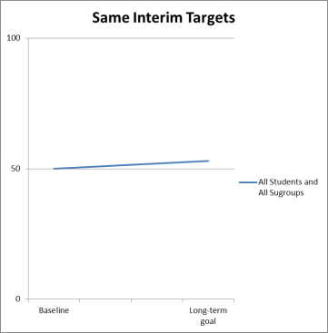
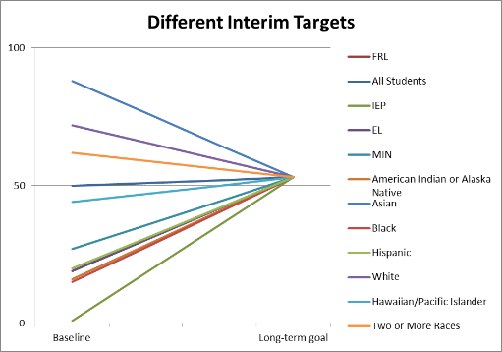
Same versus Different Interim Targets
Current Expectation
Current Expectation
Notes:
Alyssa

Slide 33
  Timeline and Frequency
        6-Year timeline for long-term goals: 5 years most votes (30); average=5.5.
          3 years maximum; schools can request a 2-year extension with justification for what they will do differently to achieve.
          Need consistent targets for 5-7 years.
          5-7 years has value for examining impact of middle school interventions on graduation rate. High standards for all groups during interim period; setting lower bars for some groups sends wrong message.
        Every year (20 of 85 recommend)
        Too many factors can change to support good data (Administrators can leave, funding issues, etc.).
        Too frequent; need consistency to track progress more meaningfully.
        A single year might be an anomaly and not accurate data.
        Every 2-3 years (65 of 85 recommend)
        Allows adjustments, investigation into research, etc.
        Schools/districts can do long-term UIP planning and not constantly seek a moving target.
Notes:
Tina or Donna

Slide 34
ESSA Accountability Work Group
Other Indicator Decision Point
February 6, 2017
Notes:
Dan

Slide 35
Decision Point
Identify long-term plan language for the use of the “Other indicator of school quality or student success”.
Notes:
Dan

Slide 36
Statutory & Regulatory Requirements
The indicator must be valid, reliable and comparable across districts.
The indicator must be the same for all schools at each level (elementary, middle, and high), but may vary across grade levels.
The indicator must be disaggregated by student groups.
The indicator is supported by research that high performance or improvement on such measures is likely to increase student learning.
Notes:
Dan

Slide 37
Timeline for Short and Long-Term Recommendations
For the short-term, data for the recommended indicator/s will be collected across districts this school year in time to report by next school year
Long-term considerations to be piloted by districts this year and beyond
2017-2018
2018-2019
2019 and beyond
In the short-term selected indicator/s will be reported out during this school year. Longer-term considerations to be deliberated this and next school year.
Notes:
Dan- This chart is very helpful!
I’d stress that the data for chronic absenteeism is already being collected- regardless of the decision of the hub/SBE/ESSA state plan

Slide 38
Long-Term Possibilities by Indicator
School Climate
School Safety
Postsecondary and Workforce Readiness
Workforce Readiness
Social-emotional Learning (SEL)
Discussions needed on defining indicators falling under SEL and what is appropriate for inclusion
Parent, Student and Educator Satisfaction
Engagement
Completion of advanced coursework
Students graduating with college credit and/or industry credentials
Post-graduation employment
Notes:
Dan

Slide 39
General Process for Considering Long-Term Options
In regards to future process, the subgroup recommends…
Defining a theory of action for selecting and using any given indicator in this area to support accountability goals.
Ensuring that key principles used to select the short-term indicators apply to the selection of the possible long-term indicators.
Reconvening members from the AWG, along with any other relevant stakeholders (e.g., parents), to develop and consider the long-term possibilities for the other indicator.
Ensuring that clear definitions are developed for each indicator in this new area as a means to identify better measures for evaluating each indicator and ensure comparability across the state.
Ensuring that a timeline and evaluation plan is defined to evaluate impact and efficacy of selected indicators relative to the theory of action.
Notes:
Dan

Slide 40
Long-Term Recommendations
Long-term Recommendations:
Convene workgroup to consider the following:
  Climate: School safety, Parent, Student and Educator satisfaction, other engagement indicators.
  Add to PWR: Develop workforce readiness specific indicators, completion of advanced coursework, students graduating with college credit and/or industry credential, post-graduation employment.
  Social-emotional learning: Discussions needed on defining indicators for this area and determining what is appropriate for inclusion.
Notes:
Dan

Slide 41
DRAFT LANGUAGE FOR STATE PLAN:
The successful implementation of an ‘other indicator’ requires sufficient time, resources, and reporting infrastructure to lead to the implementation of robust measures in both the short-term and long-term. The aforementioned short-term recommendations (i.e. 2018 inclusion) serves to bring forward meaningful data that is already available and removes the need for additional data collection. The long-term plan allows CDE and education stakeholders to examine student engagement, PWR and social-emotional learning metrics at a deeper level to determine what and how to best address the needs of Colorado citizens. For full implementation to occur during the fall of 2017, all supporting data would need to be collected currently. Similarly, any new measures or tools would need to be in place. In order to improve the feasibility and relevance of recommendations we are anticipating a Fall 2018 rollout to address short-term recommendations to be followed by a later roll-out of our long-term measures following a period of stakeholder work and tool development (i.e. as appropriate). The following measures/metrics will be considered for the long-term:
For student/engagement climate, school safety, parent, student and educator satisfaction, and/or other engagement indicators will be considered.
For postsecondary and workforce readiness, the possible development of workforce readiness specific indicators, such as completion of advanced coursework, students graduating with college credit and/or industry credential, and/or post-graduation employment will be investigated.
Last for social-emotional learning measures, discussion time is required for defining possible indicators and determining what may be appropriate for inclusion for state accountability.

Slide 42
Targeted:
Identification Criteria
Current estimates exclude Other Indicator
Achievement |  | Growth |  | ELP Progress | PWR (for HS) | Other Indicator
English Language Arts | Math | English Language Arts | Math | Access Growth | Grad, Drop out, Matriculation | When Available
N>16 | N>16 | N>20 | N>20 | N>20 | N>16 | N>16??
DNM
DNM
DNM
DNM
DNM
DNM
IDENTIFIED

Slide 43
ESSA Accountability Work Group
Participation Requirements
Decision Point
Input from the State Board of Education (SBE)
February 6, 2017
Notes:
Alyssa to talk through briefly.
As you all know, SBE has policy in place around this. The board members have been discussing the decision point and their current policy. Board will discuss this decision at the January 26th meeting. *

Slide 44
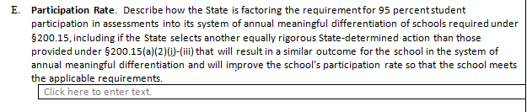
Decision Point
How will Colorado hold schools accountable for the 95% state assessment participation rate requirement (overall and for each disaggregated group)?
Notes:
The specific decision point is around how Colorado will hold schools accountable for the 95% state assessment participation rate requirement (overall and for each disaggregated group) within our school performance frameworks.
The language in the box is the language that the U.S. Department of Education has drafted for the state plan application.

Slide 45
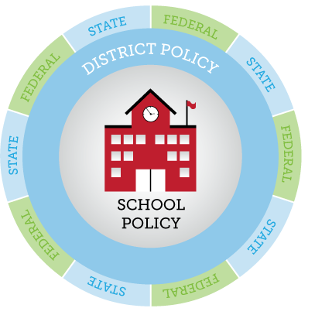
Participation Requirements and Policies
Federal-
95% of students must be assessed. States decide how participation factors into accountability, but non-participants below 95% are considered non-proficient.
Opt-out laws are recognized.
State-
Statute- acknowledged the right of parents to excuse children from testing. Prohibited schools/districts for penalizing parents or students, or encouraging students not to take the assessments.
State Board of Education motion- district should not be held liable for parent opt-out.
District-
Required to have a policy for how parents can excuse student from state assessments.
Notes:
We have a few different policies around testing and participation, at various levels of our government. Generally, state and federal policy exist as “guard rails” and the specific implementation happens at the district and school level.
When it comes to participation rate requirements, this holds true as well. Federal law requires that 95% of students must be assessed. But with ESSA, states decide how participation factors into accountability. ESSA also recognizes that states may have opt-out laws. In Colorado, we have state law the acknowledges that parents have the right to excuse their students from testing. The law does not allow schools and districts to penalize parents or students for opting-out; nor does the law allow schools or districts to encourage students not to take the assessments. How this is implemented is up to districts and schools, but each district must have a policy specific to parents excusing their students from testing.
Finally, the State Board of Education passed a motion in February 2015 that says that districts are not to be held liable for parents who excuse their students from the state assessment.
If you are interested in the specific citations for these different laws, please use the link on the PowerPoint and look at the materials from the September 21st Accountability Work Group meeting. Details around all of this information is available there.

Slide 46
Final USDE Regulations
(now on hold)
Lower rating
Lowest rating on academic achievement
Identified for targeted support and improvement plan
Sufficiently rigorous state-determined action or set of actions
* Requires an improvement plan for all that do not meet the 95% requirement.
Notes:
The U.S. Department of Education released proposed accountability regulations concerning how states could hold schools accountable for the 95% participation rate. The regulations have not yet been finalized (as of Nov. 21st), but are part of the possible policy guard rails around this issue.
In the proposed regulations, the U.S. Department of Education proposed the following 4 options for states if the 95% participation rate requirement is not met:
Lower the overall rating for the school.
Give the school the lowest rating on the academic achievement indicator.
Identify the school for a “targeted support and improvement plan”, or
Create an equally rigorous state-determined action.
Additionally, the proposed regulations require all schools that do not meet the 95% participation rate requirement to develop an improvement plan.
With this backdrop of policies and proposed policies, the ESSA Accountability Work Group was asked to develop options for how Colorado will hold schools accountable for the 95% state assessment participation rate requirement.

Slide 47
Direction from State Board of Education – Use Current Policy
(with clarifications)
Calculate and report participation rates
Address accountability participation rate under 95% in unified improvement plan
Use accountability participation rate as an indicator in ESSA program reviews
Provide communication materials around the state assessment
Lower ratings if below 95% accountability participation rate (removes the parent excusals) in two or more content areas

Slide 48
Input from Hub

Slide 49
ESSA Accountability Work Group
School Identification / Targeted
Decision Point
Reminder, Clarification, and Correction
February 6, 2017
Notes:
Nazie

Slide 50
Reminder, Clarification & Correction!
Identification criteria for targeted schools discussed at last meeting:
Description | Correct Number
Option 1: Use all indicators when a student group meets minimum N Identify schools that have earned DNM on all indicators | 60*
Option 2: Use a minimum of 3 indicators on which student group meets minimum N Identify schools that have earned DNM on all indicators for which they have met minimum N | 96*
*Based on 1 year of data; will be much higher when we have 3 years of data

Slide 51
Option 1

Slide 52
Targeted:
Identification Criteria
Current estimates exclude Other Indicator
Achievement |  | Growth |  | ELP Progress | PWR (for HS) | Other Indicator
English Language Arts | Math | English Language Arts | Math | Access Growth | Grad, Drop out, Matriculation | When Available
N>16 | N>16 | --- | --- | N>20 | N>16 | N>16??
DNM
DNM
DNM
DNM
NOT IDENTIFIED

Slide 53
Option 2

Slide 54
Targeted:
Identification Criteria
Current estimates exclude Other Indicator
Decision: Include schools with a minimum of 3 indicators with enough students and earned Does Not Meet
Achievement |  | Growth |  | ELP Progress | PWR (for HS) | Other Indicator
English Language Arts | Math | English Language Arts | Math | Access Growth | Grad, Drop out, Matriculation | When Available
N>16 | N>16 | N>20 | --- | --- | --- | N>16??
DNM
DNM
DNM
IDENTIFIED

Slide 55
Targeted:
Identification Criteria
Current estimates exclude Other Indicator
Decision: Include schools with a minimum of 3 indicators with enough students and earned Does Not Meet
Achievement |  | Growth |  | ELP Progress | PWR (for HS) | Other Indicator
English Language Arts | Math | English Language Arts | Math | Access Growth | Grad, Drop out, Matriculation | When Available
N>16 | N>16 | N>20 | N>20 | N>20 | --- | N>16??
DNM
DNM
APP+
APP+
DNM
NOT IDENTIFIED

Slide 56
Targeted:
Identification Criteria
Current estimates exclude Other Indicator
Decision: Include schools with a minimum of 3 indicators with enough students and earned Does Not Meet
Achievement |  | Growth |  | ELP Progress | PWR (for HS) | Other Indicator
English Language Arts | Math | English Language Arts | Math | Access Growth | Grad, Drop out, Matriculation | When Available
N>16 | N>16 | --- | --- | N>20 | --- | N>16??
DNM
DNM
DNM
IDENTIFIED

Slide 57
Targeted:
Identification Criteria
Current estimates exclude Other Indicator
Decision: Include schools with a minimum of 3 indicators with enough students and earned Does Not Meet
Achievement |  | Growth |  | ELP Progress | PWR (for HS) | Other Indicator
English Language Arts | Math | English Language Arts | Math | Access Growth | Grad, Drop out, Matriculation | When Available
N>16 | N>16 | --- | --- | N>20 | --- | N>16??
DNM
DNM
APP+
NOT IDENTIFIED

Slide 58
Next Steps
Incorporate votes from today for the materials for the State Board of Education’s February 8th meeting
Direction from the SBE on 2/8
Update draft ESSA state plan language
February- put draft ESSA state plan language out for public comment
Notes:
Alyssa

Slide 59
School Improvement Spoke Committee
Report to the Hub Committee
February 6, 2017

Slide 60


School Improvement
Decision Points
SEA supports for identified schools
Evidence-based interventions
Allocation of school improvement resources
60

Slide 61
Estimate of annual ESSA Title I funds
95% must be distributed to identified schools
61
Notes:
Good reference slides, but I’m worried about cluttering up the deck. We’ve also shared this every time. Can we have them in a supporting packet? lgm

Slide 62
Estimates for School Identification
Pulled from Accountability Spoke Committee recommendations.
Comprehensive Schools
  Lowest 5% of Title I = 35-37 schools
  High School with Low Grad Rates = 50-90
  Additional Targeted after 3 Years at TSI = No estimate yet. Will not occur until 2020-21.
Targeted Schools
  Including Targeted and Additional Targeted = 75-200
}
85 – 125 Comprehensive schools for 2017-18
}
75 – 200
Targeted schools for 2017-18
160 – 325 schools total
62
DRAFT – for Spoke Committee Discussion ONLY

Slide 63
Examples of Current Turnaround Support Structures | Awards and Funding Ranges
Support Structure | # of Schools Participating | Average Award Amount per School per Year | Range of Awards per School per Year | Funding Source
Turnaround Network 2014-2017 | 34 | $52,000 | $35,000-$70,000 | ESEA Federal funds 1003(a)
Connect for Success 2016-2017 | 20 | $20,000 yr. 1 $80,000 yrs. 2-3 | $20,000-$80,000
Tiered Intervention Grant (TIG) 2013-2016 | 51 | $350,000 | $3,000-$800,000 | ESEA Federal funds 1003(g)
Turnaround Leaders Development 2015-2016 | 78 schools | $42,947 per school | $3,000-$80,000 per school team | State funds C.R.S. 22-13-101
 | 120 participants | $27,684 per participant | $15,000-$47,000 per participant
63
Notes:
I don’t think this is quite the right slide here (maybe in a supplemental packet), but need something with anticipated ranges and $projections.

Slide 64

Allocation of Resources

In reserving 7% of the state Title I allocation to support identified schools, should the funds be distributed to LEAs through a formula, competitive process? Or maybe a blend of the two (hybrid)?
Reminders:
  Awards must be of sufficient size for an LEA to implement improvement strategies
  Allotments must represent the geographic diversity of the state
64

Slide 65
What did we hear?
Both the Spoke Committee and the public showed more preference for the hybrid approach to distributing funds. They diverged after that – the Spoke leaning toward competitive and the public leaning toward formula.
Comments demonstrate a
need for balance between
fairness/predictability and
effectiveness.
The hybrid may be the
most promising way to strike
that balance.
65

Slide 66
Recommendation
ESSA School Improvement Resources (funds and supports) will be:
  Differentiated and available to all identified Comprehensive and Targeted schools, dependent on CDE capacity. A larger portion will be allocated for the Comprehensive schools.
  Released to LEAs with identified schools through a hybrid method that balances predictability with effective practice. It will be in amounts matched to identified needs through a high quality plan, rather than upon a series of unconnected competitive grants.
  Used for planning supports, community engagement, evidence-based interventions/strategies/partners and progress monitoring.
  Continued based on ongoing and annual review of progress toward implementation benchmarks and commitment to strategies that will have a positive impact on student outcomes.
66

Slide 67
Annual Cycle of
Supports and Grants
State Accountability and ESSA Identification
Decisions about continued funding and intervention
Evaluation, Reflection, and Public Reporting of Progress
TSI & CSI eligible schools
Implementation of Support Programs
Ongoing monitoring and performance management
Engagement with CDE and/or external partners
Single Application Process
Identification of Needs
Matched Strategy
LEA Provides: Current needs assessment Past strategies Preferences for future strategy | CDE Provides: Consultation on matching needs with strategy Site visits (as needed) Criteria and tools | Intensive CDE Supports
 |  | Moderate CDE Supports
 |  | Leadership Development
 |  | District-identified strategy approved by CDE
 |  | Targeted supports
DRAFT – for Discussion ONLY

Slide 68
Potential Comprehensive Schools
Application Process and Timeline
Identification of schools and launch of application process
Applications Received and Sorting Process begins
Launch CDE/School partnership Activities
Progress Monitor Check and Continuation
Fall
Winter
Spring
May 1
$
Information sessions, application building
Discussions, Interviews, Site Visits for Matching Process
Turnaround Network
Connect for Success
District Capacity Building
Turnaround Leader Development
Specialized/Customized Supports
To be developed
External Review, Planning, Community Engagement
District-designed Interventions
DRAFT – For Discussion ONLY

Slide 69
Potential Comprehensive Schools
Funding Range
Support Structure | # of Available Slots (annually) | Range of Awards per Site | Estimated Total Earmark
Turnaround Network | 15-20 | $30,000 -$70,000 | $2.0 mil
Connect for Success | 10-15 | $20,000 yr. 1* | $400,000 (Y1)*
District Capacity Building | 3-10 | Tbd | tbd
Specialized/Customized Supports | 5 - 10 | $50,000-$100,000 | $500,000
Turnaround Leader Development | 20-200 | $5,000 - $50,000 | $1.0 mil
External Review, Planning, Community Engagement | 13-200 | $5,000 - $75,000 | $ 800,000
District-Designed Approach | -- | Up to $100,000 | $2.0 mil
Total |  |  | $6.75 mil (75% of $9 mil)
69
DRAFT – For Discussion ONLY
Notes:
I don’t think this is quite the right slide here (maybe in a supplemental packet), but need something with anticipated ranges and $projections.

Slide 70
Potential Targeted Support School (TSI)
Process and Timeline
Identification of TSI schools
LEA /School may apply for funds to implement evidence-based strategies to address the needs of specific subgroups of students
Launch Implementation of Strategies
Spring
Progress Monitor Check and Continuation
Fall
Winter
May 1
$
Strategies to support (all that apply):
English Learners
Students with disabilities
Students of poverty
Students from major racial or ethnic groups
LEA and school develop TSI Improvement
plan that addresses the needs of underperforming subgroups of students. Approved by the LEA. CDE provides support in identifying evidence-based strategies and access to funds to support an external review.
If applying for funds…
CDE approval of Strategies and budget to Support specific subgroups of students. Plans may address the needs of multiple subgroups.
External Review, Planning, Community Engagement
DRAFT – For Discussion ONLY
70

Slide 71
Potential Targeted Schools
Funding Process
Support Structure | # of Available Slots | Range of Awards per Site | Total Earmark
Customized Supports specific to identified population | Tbd | Tbd | Tbd
External Review, Planning, Community Engagement | Tbd | $5,000 - $75,000 | Tbd
District-Designed Approach | Tbd | Up to $xx | Tbd
Total |  |  | $2.25 mil (25% of $9 mil)
Option 1: Distribute to all identified ~$11,250 per site
Option 2: Competitive process for $2.25MM
Option 3: Prioritize smaller number of sites for awards (e.g., $15-30K for approximately 75 sites)
Note: All eligible for services (e.g., CDE training) and all must complete LEA approved plan
71
DRAFT – For Discussion ONLY
Notes:
I don’t think this is quite the right slide here (maybe in a supplemental packet), but need something with anticipated ranges and $projections.

Slide 72
Questions?

Slide 73
Stakeholder Consultation
Public Comment Process
February 6, 2017
Hub Committee Meeting

Slide 74
Agenda
Provide a review of the ESSA public input process to date
Discuss the proposed timeline and process for posting the state’s ESSA plan draft, soliciting and addressing public comments, and finalizing the plan for submission to the USDE
Notes:
Note: A full description of ESSA stakeholder consultation, including how the state took into account the input obtained through consultation and public comment, is required as part of the ESSA State Plan in Section 2. Consultation and Performance Management.

Slide 75
Stakeholder Consultation to Date
Listening Tour and Consultation
170 meetings since Feb. 2016
ESSA Committee
13 Board meetings, 7 Hub committee meetings, 3 ESSA meetings with state legislature
Approximately 1,500 attendees at Listening Tour
Over 3,800 comments
Over 30 spoke committee meetings
130 spoke committee members
Four rounds of online surveys on decision points or plan drafts, over 840 responses
Draft ESSA Plan
Review by Governor
30 day public comment period

Slide 76
Public Comment Process: Timeline
February 10
Public Comment on State Plan draft Opens
March 10
Public Comment on State Plan draft Closes
April 3
ESSA State Plan and Assurances Submitted to U.S. Dept of Ed.
April 13
State Board action item to approve USDE consideration of ESSA State Plan
Public Comment Period to open on February 10
  A draft of ESSA State Plan will be posted to CDE website
  CDE intends to post a Spanish language version of the draft
Notice for Public Comment
Public Comment Period will close on March 10
  Comments will be reviewed on a weekly basis
Notes:
Notice for Public Comment recipients will included, but not be limited to:
- ESSA E-Newsletter recipients (over 1,700)
- Posted on the ESSA website and blog
-- Hub and Spoke Committee members
- Committee of Practitioners
- Accountability Work Group Members, Technical Advisory Panel
- District Accountability Contacts
- District Assessment Coordinators
- Title I and Title III district contacts
- Culturally and Linguistically Diverse Educator advisory group members
- Advocacy and civil rights groups (
- 6Cs membership
- EdVoice Teachers
- Association of Colorado Education Evaluators (ACEE)
- Colorado Parent Teacher Association (PTA)
- Rural Education Council
- Special Education Directors and the Colorado Special Education Advisory Co. (
State Advisory Council for Parent Involvement in Education (SACPIE)
- Facebook and Twitter (
- Scoop (
- CDE Update

Slide 77
Public Comment Process: Proposed Method to Collect Feedback
Proposed method: Feedback will be collected through participation in online surveys
  Notice to Provide Public Comment will include details and instructions
  Comments can also be submitted by mail, email or by uploading a document into the survey
  Links to the survey will be posted on the ESSA Feedback page
  Links will also be embedded in the state plan draft document
CDE staff will review responses and must in some way address comments in the ESSA state plan
A summary of the survey results and comments will be made available on the CDE website
Notes:
Why this proposal? Staff reviewed ESSA public comment process, tools, and questions used by other states and identified high-quality ideas for collecting, formatting, and development
Most states used an online survey tool such as survey gizmo, survey monkey, or google forms. CDE staff proposes to use survey monkey for a number of reasons including:
Tools has been used previously in other department projects
Field familiarity
Design and functionality flexibility
Conforms to the Web Content Accessibility Guidelines 2.0, Level AA
Functionality for Spanish translation of questions
Ability to upload files and submit files into the survey

Slide 78
Survey Questions
The contents of this section reflect the input we have received from the general public and interested stakeholders to date and the recommendations of the ESSA Spoke and Hub Committees who have advised the department and the State Board of Education the development of this draft of the plan. Please indicate what requirements in the ESSA, are not adequately addressed in this draft plan.
Are there any areas in this draft plan that you strongly support?
Are there any areas in this draft plan that you have concerns about? If so, please indicate with specificity what your concerns are and how they might be addressed in this plan?

Slide 79
Questions for Hub Committee
Do you have recommendations regarding the method we use to solicit public and stakeholder feedback on the draft of Colorado’s ESSA plan?
Do you have recommendations regarding the survey questions?

Slide 80
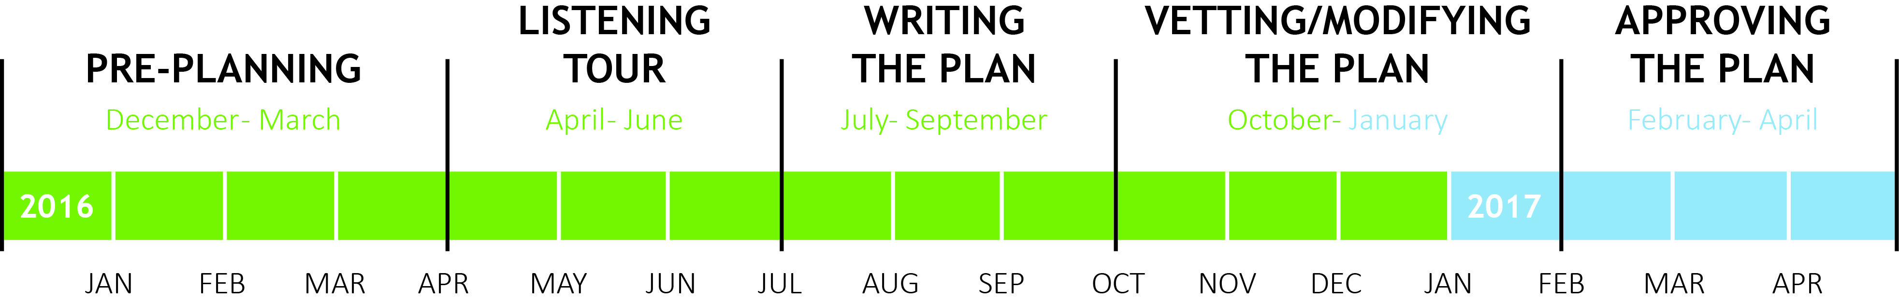
Wrap-Up
Hub Updates
Approval of Meeting Minutes
Timeline

Slide 81
Next Meeting
9th ESSA Hub Committee Meeting details
  Monday, March 6, 2017
    Location: State Board Room -201 E. Colfax Ave., Denver, CO 80203
    Time: 10:00 AM – 2:00 PM
    Review of first draft
What would you like to have at - or prior to - the March meeting so that you can complete your recommendations to the State Board at that meeting?
Notes:
Presentations from select spoke committees. Tentatively schedule: Stakeholder Consultation/Program Coordination and Title Programs spokes.

