Slide 1
CDE Office Hours
September 16, 2021

Slide 2
CDE Team!
CDE Contacts!
Emails: LastName_FirstInital@cde.state.co.us
ESSER/ESEA Program Partners
Nazie Mohajeri-Nelson, Director of ESEA Office (mohajeri-nelson_n@cde.state.co.us)
DeLilah Collins, Assistant Director of ESEA Office (collins_d@cde.state.co.us)
ESEA Regional Contacts assigned by district
Title I: Laura Meushaw, Kathryn Wisner, Niko Kaloudis
Title II: Jeremy Meredith, Niko Kaloudis
Title III: Lorenzo Moreno, Kathryn Wisner
Title IV: Tammy Giessinger, Michelle Prael
Title V: Kristen Collins
ESSER Team
Kristin Crumley, ESSER Monitoring Specialist (Crumley_k@cde.state.co.us)
Jonathan Schelke, ESSER Monitoring Specialist (schelke_j@cde.state.co.us)
Shannon Wilson, ESSER/ESEA Grants Administration Coordinator (Wilson_s@cde.state.co.us)
Mackenzie Owens, ESSER Reporting Specialist (owens_m@cde.state.co.us)
Data, Accountability, Reporting, and Evaluation
Tina Negley, Alan Shimmin, Mary Shen, and Mackenzie Owens
Fiscal Partners
Jennifer Okes, Chief Operating Officer (okes_j@cde.state.co.us)
Kate Bartlett, Executive Director of School District Operations (Bartlett_k@cde.state.co.us)
Jennifer Austin, Director of Grants Fiscal Management (Austin_j@cde.state.co.us)
Robert Hawkins, Grants Fiscal Analyst (Hawkins_s@cde.state.co.us)
Steven Kaleda, Grants Fiscal Analyst (Kaleda_s@cde.state.co.us)
ESSER Team
Bill Parsley, ESSER Fiscal Monitoring Supervisor (parsley_w@cde.state.co.us)
Hilery Morris, ESSER Fiscal Monitoring (morris_h@cde.state.co.us)
Sharon Mackey, ESSER Fiscal Monitoring (mackey_s@cde.state.co.us)

Slide 3
ESSER Office Hours
Topics
Updates and Announcements
ARP Homeless Children and Youth II Grants
ESSER and State Funded Preschool Programs
ESSER Funds to Support the Work Force
Notes:
Nazie

Slide 4
Updates and Announcements
Colorado’s request for a fiscal waiver has been approved by the U.S. Department of Education.
Fiscal provisions in the waiver:
Section 1127(b) of Title I, Part A of the ESEA so that SEA may waive for LEAs, more than once every three years, if necessary, the 15 percent carryover limitation in ESEA section 1127(a) for FY 2020 Title I, Part A funds.
Section 421(b) of the General Education Provisions Act (GEPA) to extend the period of availability of FY 2019 funds for ESEA/ESSA programs in the State’s approved consolidated State plan until September 30, 2022.
https://www.cde.state.co.us/fedprograms/eseacaresactfiscalwaiver

Slide 5
Reminders
ESSER II Application is due on September 30, 2021!
Administrative Units - separate login for the online application

Slide 6
American Rescue Plan – Homeless Children and Youth II Formula Grants Dana Scott Office of Student Support

Slide 7
American Rescue Plan–Homeless Children & Youth (ARP-HCY) Formula Grants
The U.S. Department of Education under section 2001(b)(1) of the American Rescue Plan Act of 2021 is providing additional funding to help support school districts in serving students experiencing homelessness.
The purposes of this funding include:
increasing the outreach, identification, enrollment and retention of students experiencing homelessness
providing wraparound services for these students considering the impact of the COVID-19 pandemic
providing assistance needed to enable homeless children and youth to attend school and participate fully in school activities.
Notes:
DAC should be included in a discussion related to use of ESSER funds
10 hours minimum - many families have a need for increased hours of child care

Slide 8
ARP-HCY I and II
CDE received two grants specifically focused on supporting the needs of students experiencing homelessness
ARP-HCY I- competitive competition held in July/August 2021
Grants to 23 LEAs/BOCES as supplemental funding
Notifications made in late August and early September
ARP-HCY II - formula grant released early September
$4,300,318 is available for this funding opportunity
Funds supplement the EHCY program, as well as the ARP-HCY I funds distributed through the competitive distribution process
All allowable EHCY and ARP-HCY I uses apply to these funds
Applications must be completed and submitted through the online application and will be accepted and reviewed on a rolling basis until Wednesday, December 1, 2021 by 11:59 p.m.
Notes:
DAC should be included in a discussion related to use of ESSER funds
10 hours minimum - many families have a need for increased hours of child care

Slide 9
ARP-HCY II
First time ever for a formula allocation
The formula is based equally on:
The proportional share of an LEA's allocation under Title I, Part A of the Elementary and Secondary Education Act of 1965 (ESEA) for the most recent fiscal year and
The LEA's proportional share of the number of homeless children and youth identified by each LEA relative to all LEAs in the State, using the greater of the number of homeless children and youth in either the 2018-19 or 2019-20 school year in each LEA.
The funding application, budget template and formula amounts can be found at: http://www.cde.state.co.us/studentsupport/homeless_index
Notes:
DAC should be included in a discussion related to use of ESSER funds
10 hours minimum - many families have a need for increased hours of child care

Slide 10
ARP-HCY II
The U.S. Department of Education establishes in paragraph (c)(2) that an LEA must have an allocation of at least $5,000 under the formula to be eligible for an ARP Homeless II subgrant on its own.
Per the U.S. Department of Education, this $5,000 minimum will enable each subgrantee to have sufficient ARP Homeless II funds to address the needs of homeless children and youth.
If an LEA's allocation is less than $5,000, in order to receive an ARP Homeless II subgrant, the LEA must join a consortium of LEAs/BOCES in which the sum of its members' allocations meets the $5,000 threshold. For LEAs/BOCES with an allocation less than $5,000, the rule encourages the use of consortia to create favorable economies of scale.
Notes:
DAC should be included in a discussion related to use of ESSER funds
10 hours minimum - many families have a need for increased hours of child care

Slide 11
ARP-HCY II
The McKinney-Vento Office at CDE will be holding a webinar specifically on ARP-HCY funds, application and approval process
We will also host a webinar to assist those with less than $5,000
Questions?
Other ideas on how CDE can support the development of consortia for those with less than $5,000?
Notes:
DAC should be included in a discussion related to use of ESSER funds
10 hours minimum - many families have a need for increased hours of child care

Slide 12
ESSER and Preschool Heidi White, Preschool Director Michele Pugsley, Regional Preschool Specialist
Preschool Through 3rd Grade Office
Notes:
The info shared in other segments of this Office Hour on homelessness and workforce also related to Preschool

Slide 13
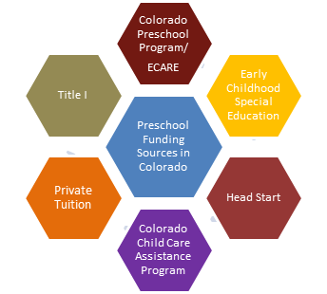
Publicly Funded Preschool in Colorado
Notes:
These are the different funding sources that support preschool in the state of Colorado.
For the purposes of financing district administered preschool with state funds, there are two 2 programs administered by CDE at this time: CPP and Preschool Special Education
Districts that administer preschool programs may also serve children through additional local or federal funding streams, including Head Start, Title I, or CCCAP. Most preschool classrooms administered by public schools are blended, meaning that the children are not all from one funding stream. Blending or braiding funding across funding streams also makes it more possible to meet the needs of families.

Slide 14
Colorado Preschool Program (CPP)
CPP is a voluntary program administered through school districts in Colorado.
176 of 179 districts participate (and CSI).
CPP serves children ages 3 and 4, who qualify with specific eligibility criteria.
Children served are at risk for later school challenges.
Children can be served in public school preschools, Head Start, or community based preschool programs for at least 10 hours per week at no cost.
CPP requirements include family partnering and family supports.
A CPP district advisory council must provide oversight of each CPP program.
Notes:
Hiedi
DAC should be included in a discussion related to use of ESSER funds
10 hours minimum - many families have a need for increased hours of child care

Slide 15
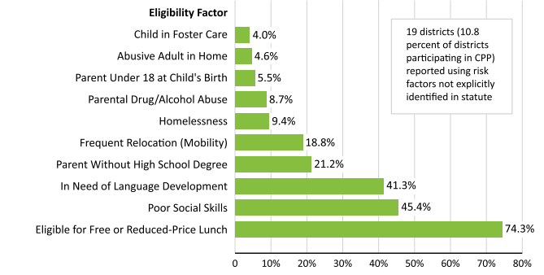
CPP Eligibility Criteria
Children who are two years from kindergarten entry need three eligibility criteria and children who are one year from kindergarten entry need one eligibility criteria.
Notes:
Heidi
Only about half of the potentially eligible population is served statewide, a bit more in rural, fewer in metro/urban areas
Lower enrollment last year due to COVID so some families who were likely eligible went unserved, some will have gone on to kindergarten without having had preschool experiences
Consider expanding preschool to those who might have qualified but didn’t get access

Slide 16
Preschool Special Education
Preschool is a grade level within the Special Education System under IDEA and ECEA.
Three- and four-year-old children must meet state eligibility criteria for special education.
Some children move into preschool from having received Early Intervention/Part C of IDEA.
Eligible children are entitled to a free appropriate public education in the least restrictive environment.
Every school district, some through a local Board of Cooperative Educational Services (BOCES), provides special education services to young children.
Special Education Administrative Units have a local preschool administrator, Child Find Coordinator, or Special Education Director who is responsible for coordinating services.
Notes:
Preschool special education is a state and federal mandated program for three- and four-year-old children who meet state eligibility criteria for special education and are experiencing challenges in their learning and development. A child is eligible if they have a significant delay in one or more areas of development, such as speech/language, cognitive, motor, and/or social/emotional development.
Eligible children are entitled to a free appropriate public education in the least restrictive environment. This means that the required preschool services are to be provided in an inclusive setting at no cost to parents.
Every school district, some through a local Board of Cooperative Educational Services (BOCES), provides special education services to young children.
Services are provided through school-based programs, community early childhood settings and/or Head Start programs.
Referrals of children with a suspected delay in development can be made to the local Child Find team where the family and child live.
Child Find is part of Colorado's system for identifying children suspected of having a delay in development. If a young child is not meeting typical developmental milestones, or someone is concerned about the child’s growth or learning, child find teams will evaluate how the child plays, learns, speaks, behaves and moves. The purpose of the evaluation is to determine if there is a significant delay or if there is a need for early intervention or special education services. Evaluations conducted by Child Find teams are at no cost to parents.
Early identification of children with special education needs helps children receive services as early as possible so they have the best chance of success in kindergarten and beyond. Identifying children eligible for special education early in each program year helps ensure that appropriate funding types are used for CPP and early childhood special education, thus maximizing the number of children who can benefit from the programs and services that best meet their needs.

Slide 17
Using ESSER Funds to Support Pre-Kindergarten or Other Early Childhood Education Programs
Reminder: any activity allowable under ESEA or IDEA is also allowable under ESSER!
Question C-20 from the USDE’s ESSER and GEER FAQs (May 2021)
Early Childhood Education Program - defined:
(1) a Head Start program or an Early Head Start program carried out under the Head Start Act (42 U.S.C. 9831 et seq.), including a migrant or seasonal Head Start program, an Indian Head Start program, or a Head Start program or an Early Head Start program that also receives State funding;
(2) a State licensed or regulated child care program; or
(3) a program that
serves children from birth through age six that addresses the children’s cognitive (including language, early literacy, and early mathematics), social, emotional, and physical development; and
is either:
a State prekindergarten program;
a program authorized under section 619 or Part C of the IDEA (see FAQ C-5); or
a program operated by an LEA. (See section 8101(16) of the ESEA.)
Notes:
Nazie
Consider tie in to slide 21 under workforce challenges-- applies to preK workforce in the district too (hiring additional staff, paras, interventionists to work with those with high risk populations, etc.)

Slide 18
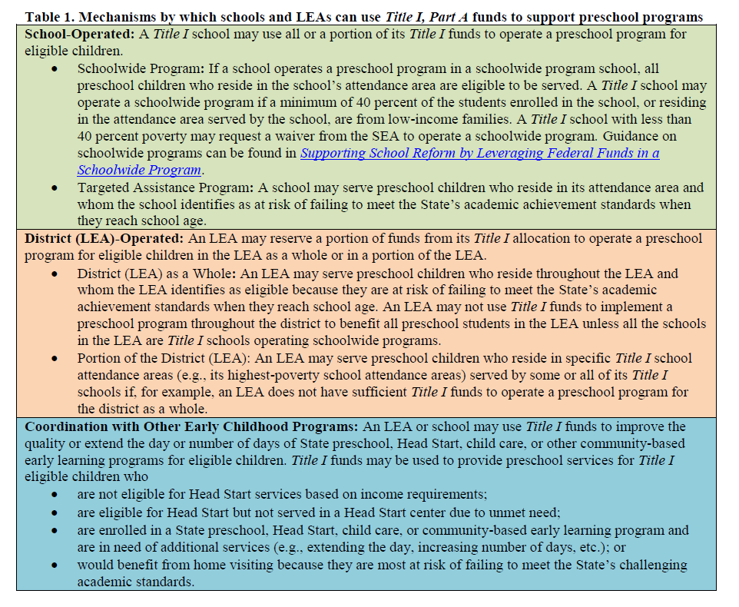
USDE Non-Regulatory Guidance
Early Learning in the Every Student Succeeds Act: Expanding Opportunities to Support Your Youngest Learners
(October 2016)
Outlines how Title I funds can be used to support early learners
Early Learning Guidance
Notes:
Nazie

Slide 19
FAQs
Can ESSER funds be used to support preschool aged children? If so, what steps need to be in place, or criteria met to use ESSER III? Do other state or federal public preschool funds have to be exhausted first?
Yes, ESSER funds can be used to pay for preschool because it is allowable under ESEA. Must also be reasonable and necessary to respond to, prepare for, or prevent the spread of COVID-19. No SNS provision.
In order to use ESSER III to cover any portion of a preschool expenditure, does the preschool have to be tied to a physical building (e.g. a brick and mortar elementary school in the district)?
It depends on which pathway used for allowability
For ESEA, see previous slide.
For IDEA Section 619(g) - children with disabilities aged 3 - 5
Any activity necessary to maintain the operation of and continuity of services in the LEA
In order to use ESSER III for preschool students, must the expense have to tie to COVID related needs?
Yes
What are the major considerations any district should be considering to use ESSER III to cover preschool?
Allowability, reasonableness, and allocability
Notes:
Nazie

Slide 20
Ideas for ESSER Funding in Preschool
Related to COVID-19
Classroom-based instructional programs
Salaries and benefits for teachers and other staff
Extending programs beyond part day, part week, or school year programming
Professional development for early childhood professionals
Summer enrichment programs
Support services (such as nutrition, vision, dental, and counseling services)
Screening and diagnostic assessments
Transition programs
Family involvement initiatives
Home visiting programs
Transportation
Data collection and sharing
Ideas come from this resource: Learning Policy Institute Fact Sheet
Notes:
Some investments, such as professional development and summer transition programs, may be better suited to one-time funding than others.

Slide 21
Using ESSER to Address Educator Workforce Needs
Jeremy Meredith, Senior Consultant, ESEA Title II
Niko Kaloudis, Senior Consultant, ESEA Title I & II
Shannon Wilson, ESSER/ESEA Grant Administration Coordinator

Slide 22
The Challenge
Notes:
JM

Slide 23
The pandemic has exacerbated workforce challenges
The pandemic has introduced new and more stressors on staff.
According to a recent RAND study, “teachers are navigating unfamiliar technology, are balancing multiple modes of teaching, and have concerns about returning to in-person instruction.”
According to a 2021 Frontline Education Report, “teacher shortages are most common in urban school systems, with 75% of districts in cities of any size reporting shortages. In comparison, 65% of rural districts reported shortages, along with 60% of suburban districts.”
The Frontline report also reported:
67% of district survey respondents reported shortage of substitute teachers
35% reported shortage of paraprofessionals
According to USDE (March 2021), teacher satisfaction with their employers is down more than 25 percentage points since last year at this time, to 44%, and more than a third have considered changing jobs as a result of working during the COVID-19 pandemic.
Notes:
JM
According to RAND study:
A much higher proportion of teachers reported frequent job-related stress and symptoms of depression than the general adult population.
Mode of instruction and health were the highest-ranked stressors for teachers.
One in three teachers were responsible for the care of their own children while teaching.
Many pandemic-era teaching conditions, such as technical problems while teaching remotely, were linked to job-related stress, depressive symptoms, and burnout.

Slide 24
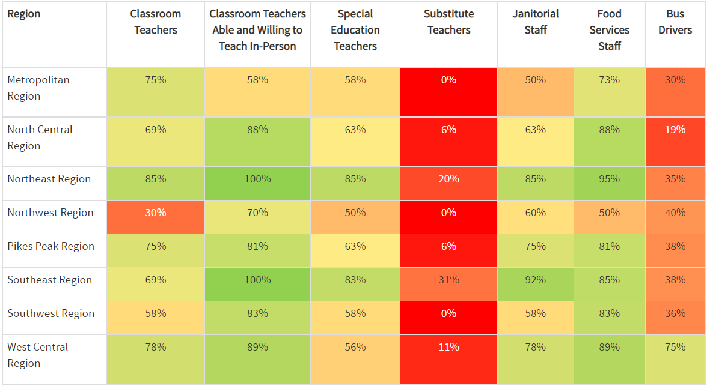
Challenges go beyond teachers, are workforce-wide
Percentage of district respondents by region reporting sufficient staff by role type.
Colorado Department of Education. Community Needs Survey (2020) https://www.cde.state.co.us/safeschools/communityneeds

Slide 25
How ESSER Can Help Address Your Workforce Needs
Notes:
JM slides/ideas

Slide 26
Leveraging ESSER
USDE May 2021 FAQ document provides guidance on allowable uses of ESSER funds to meet workforce needs
USDE released the a COVID-19 HANDBOOK: Roadmap to Reopening Safely and Meeting All Students’ Needs which may be of help
Types of activities that ESSER funds may be used for:
Recruitment and retention of staff
Hiring additional staff
Child Care
Staff mental health
Professional development

Slide 27
Recruitment and Retention of Staff
If the pandemic has created or exacerbated recruitment of staff, ESSER funds could be used to support recruitment activities such as:
Assistance programs to pay off student loans
Incentive pay for hard to fill or high-need subjects/positions
Supporting staff seeking or taking on additional responsibilities with extra duty stipends; including pay for covering classes
Job fair attendance and other recruitment efforts

Slide 28
Hiring Additional Staff
Sample Allowable Activities
Filling positions that were cut due to the pandemic recession
Hiring additional educators to address the needs of students
additional paras to support in all classrooms
interventionists to work with vulnerable student populations
liaisons to work with students experiencing homelessness or chronically absent students
Hire additional staff to manage the workload of current staff
Build/Maintain a cadre of highly-qualified substitute teachers
Paying for licensure and background check fees
Increasing daily rate to be competitive in the area

Slide 29
Child Care
Sample Allowable Activities
Partnering w/local daycare provider(s) with reserved spaces for children of staff members
Offer FSA dependent-care accounts; possibly also provide a benefit $ amount each month

Slide 30
Mental Health
Sample Allowable Activities
Hiring school psychologists and counselors, school nurses, social workers, and other health professionals who can work with staff, as well as students
Contracting with outside providers for online or in-person mental health services
Working with healthcare/insurance providers to increase mental health coverage
Providing intentional spaces for educators to recharge
Subscriptions for mindfulness apps for staff members

Slide 31
Leveraging Professional Development
Possible Allowable Activities
Providing PD to support staff in the COVID educational landscape
Offer relevant, flexible professional learning, including by leveraging existing digital learning options
Paying for college credit, graduate credit, additional credentials/certificates
Partnering with teacher/administrator preparation programs
Build/Bolster “Grow Your Own” programs
Fund robust PLCs to support team culture and consistent instructional practices
Funding the implementation of creative scheduling models to allow for more flexibility in planning and collaboration time for staff

Slide 32
Key Considerations

Slide 33
Planning Possible Activities
Not all activities will apply to your LEA or schools
Use stakeholder feedback and you local data sources to prioritize activities that will meet the unique needs of your community
Consider the implications on Maintenance of Effort
Consider any administrative impacts of hiring more staff
Consider sustainability and the funding cliff

Slide 34
Key Steps in Supporting Your Workforce with ESSER
Identify Needs
COVID Connection
Plan Possible Activities
Requirements
Apply for Funds
Gather data* about workforce needs in the LEA. Consider all levels of your workforce:
District level
Programmatic
School/Site Based
Content
Grade-level
Individual Positions
*consider using data gathered during UIP or ESEA planning
Investigate if the identified needs were as result of or worsened by COVID.
Work with stakeholders to compile activities that will mitigate the impact COVID had on the LEA’s workforce.
School Board
Leadership
Certified Staff
Classified Staff
Students & Families
Community Partners
Education Associations
CDE
Gauge how reasonably different activities can address the identified need(s). Choose acceptable activities that are evidence-based, cost-effective, and necessary to respond to the pandemic.
Describe why activities are reasonable, allowable, and necessary.
Work with your ESSER Review Team Lead to add clarity to the activities selected in the application.
Log into the ESSER application to complete the narrative and budget lines.

Slide 35
Apply an Equity Lens
Rely on data to drive decisions on where to allocate resources
Channel resources to student groups and staff most impacted by COVID
Consider any current gaps in Equitable Distribution of Teachers (EDT); make sure your efforts don’t exacerbate any gaps
Toolkit to Using EDT Data
Monitor the use of funds for equitable distribution to staff and schools

Slide 36
When In Breakout Rooms...
Please discuss the following:
What are some activities that you think may meet some workforce needs in your LEA?
Are there any other activities that you’ve come up with to meet your LEA needs?

Slide 37
Upcoming Office Hours

Slide 38
Reminder and Upcoming Topics!
09/23/21 ~
Indirect Cost Rate Training ~ Grants Fiscal Management Unit
Using ESSER Funds for Evidence-Based Curricula and Resources ~ Standards and Instructions Unit
09/30/21 ~ Maintenance of Equity ~ BruMan
10/07/21 ~ ESSER Program Monitoring – How to Prep ~ Program Office ESSER Team
10/14/21 ~ ESSER Fiscal Monitoring – How to Prep ~ Grants Fiscal Unit ESSER Team

Slide 39
Questions?

Slide 40
Thank you! Enjoy the Breakout Room Conversation! We’ll See You Next Week!

Slide 41
CDE Team!
CDE Contacts!
Emails: LastName_FirstInital@cde.state.co.us
ESSER/ESEA Program Partners
Nazie Mohajeri-Nelson, Director of ESEA Office (mohajeri-nelson_n@cde.state.co.us)
DeLilah Collins, Assistant Director of ESEA Office (collins_d@cde.state.co.us)
ESEA Regional Contacts assigned by district
Title I: Laura Meushaw, Kathryn Wisner, Niko Kaloudis
Title II: Jeremy Meredith, Niko Kaloudis
Title III: Lorenzo Moreno, Kathryn Wisner
Title IV: Tammy Giessinger, Michelle Prael
Title V: Kristen Collins
ESSER Team
Kristin Crumley, ESSER Monitoring Specialist (Crumley_k@cde.state.co.us)
Jonathan Schelke, ESSER Monitoring Specialist (schelke_j@cde.state.co.us)
Shannon Wilson, ESSER/ESEA Grants Administration Coordinator (Wilson_s@cde.state.co.us)
Mackenzie Owens, ESSER Reporting Specialist (owens_m@cde.state.co.us)
Data, Accountability, Reporting, and Evaluation
Tina Negley, Alan Shimmin, Mary Shen, and Mackenzie Owens
Fiscal Partners
Jennifer Okes, Chief Operating Officer (okes_j@cde.state.co.us)
Kate Bartlett, Executive Director of School District Operations (Bartlett_k@cde.state.co.us)
Jennifer Austin, Director of Grants Fiscal Management (Austin_j@cde.state.co.us)
Robert Hawkins, Grants Fiscal Analyst (Hawkins_s@cde.state.co.us)
Steven Kaleda, Grants Fiscal Analyst (Kaleda_s@cde.state.co.us)
ESSER Team
Bill Parsley, ESSER Fiscal Monitoring Supervisor (parsley_w@cde.state.co.us)
Hilery Morris, ESSER Fiscal Monitoring (morris_h@cde.state.co.us)
Sharon Mackey, ESSER Fiscal Monitoring (mackey_s@cde.state.co.us)

