Slide 1
CDE Office Hours
October 21, 2021

Slide 2
CDE Team!
CDE Contacts!
Emails: LastName_FirstInital@cde.state.co.us
ESSER/ESEA Program Partners
Nazie Mohajeri-Nelson, Director of ESEA Office (mohajeri-nelson_n@cde.state.co.us)
DeLilah Collins, Assistant Director of ESEA Office (collins_d@cde.state.co.us)
ESEA Regional Contacts assigned by district
Title I: Laura Meushaw, Kathryn Wisner, Niko Kaloudis
Title II: Niko Kaloudis
Title III: Lorenzo Moreno, Kathryn Wisner
Title IV: Tammy Giessinger, Michelle Prael
Title V: Kristen Collins
ESSER Team
Kristin Crumley, ESSER Monitoring Specialist (Crumley_k@cde.state.co.us)
Jonathan Schelke, ESSER Monitoring Specialist (schelke_j@cde.state.co.us)
Shannon Wilson, ESSER/ESEA Grants Administration Coordinator (Wilson_s@cde.state.co.us)
Mackenzie Owens, ESSER Reporting Specialist (owens_m@cde.state.co.us)
Data, Accountability, Reporting, and Evaluation
Tina Negley, Alan Shimmin, Mary Shen, and Mackenzie Owens
Fiscal Partners
Jennifer Okes, Chief Operating Officer (okes_j@cde.state.co.us)
Kate Bartlett, Executive Director of School District Operations (Bartlett_k@cde.state.co.us)
Jennifer Austin, Director of Grants Fiscal Management (Austin_j@cde.state.co.us)
Robert Hawkins, Grants Fiscal Analyst (Hawkins_s@cde.state.co.us)
Steven Kaleda, Grants Fiscal Analyst (Kaleda_s@cde.state.co.us)
ESSER Team
Bill Parsley, ESSER Fiscal Monitoring Supervisor (parsley_w@cde.state.co.us)
Hilery Morris, ESSER Fiscal Monitoring (morris_h@cde.state.co.us)
Sharon Mackey, ESSER Fiscal Monitoring (mackey_s@cde.state.co.us)

Slide 3
ESSER Office Hours
Topics
ESSER III Community Engagement & Planning
Maintenance of Equity Clarification
Updates and Reminders
Notes:
Nazie

Slide 4
ESSER III LEA Plan Requirements

Slide 5
ARP ESSER III Additional Requirements
ARP ESSER III has additional requirements that were not in ESSER I or II
Set Aside for Evidence-Based Interventions [Collected in the ARP ESSER III Budget (Funding Code)]
Evidence-based interventions (ESSA Section 8101(21)(A)] – EBI Explanation and Resources
Summer Learning Programs
Summer Enrichment Programs
Extended Day/School Year
Comprehensive afterschool programs
Safe Return/Remain In-Person Plan [Provide the URL in the ARP ESSER III Application Assurances]
LEA Use of Funds Plan [Collected in the ARP ESSER III Application]
Use of at least 20% set aside [Full Budget OR Narrative Question]
Use of at most 80% [Full Budget OR Narrative Question]
Ensuring that evidence-based interventions are addressing the academic, social, emotional, and mental health needs of students, particularly students from historically underserved populations [Narrative Question]
Mitigation strategies to ensure safety and health of students and staff
A minimum of 20% set aside to provide evidence-based interventions to address the academic impact of lost instructional time (or impact of the pandemic)
Must be updated at least every 6 months
Posted on LEA website within 30 days of award

Slide 6
ESSER III LEA Use of Funds Plan
Requirements under the Interim Final Rule from the U.S. Department of Education
The LEA plan must be developed in consultation with key stakeholders who have an opportunity to provide meaningful input, including the following:
students
families
school and district administrators (including special education administrators)
teachers, principals, school leaders, other educators, school staff, and their unions
In addition, the LEA must also provide an opportunity for the following stakeholders to provide input, to the extent present or served by the LEA:
Tribes
civil rights organizations (including disability rights organizations)
stakeholders representing the interests of children with disabilities, English learners, children experiencing homelessness, children in foster care, migratory students, children who are incarcerated, and other underserved students
The public has an opportunity to provide input on the LEA plan.
The LEA plan must be posted on the LEA website.
The plan, and any updates or revisions to it, are available in a language that parents can understand and meets Americans with Disabilities Act (ADA) accessibility requirements or the LEA has responded to any requests for translations for making materials available in an accessible manner (e.g., oral presentation for visually impaired individuals).

Slide 7
Narrative Questions in the Online Application
How the LEA will ensure that the interventions it implements, including but not limited to the interventions under section 2001(e)(1) of the ARP Act to address the academic impact of lost instructional time, will respond to the academic, social, emotional, and mental health needs of all students, and particularly those students disproportionately impacted by the COVID-19 pandemic, including students from low-income families, students of color, English learners, children with disabilities, students experiencing homelessness, children and youth in foster care, and migratory students. [met by the ESSER III application narrative question]
How the LEA will use the funds it reserves under section 2001(e)(1) of the ARP Act (totaling not less than 20 percent of the LEA’s total allocation of ARP ESSER funds) to address the academic impact of lost instructional time through the implementation of evidence-based interventions, such as summer learning or summer enrichment, extended day, comprehensive afterschool programs, or extended school year programs; [met by the ESSER III budget or narrative]
How the LEA will spend its remaining ARP ESSER funds consistent with section 2001(e)(2) of the ARP Act; [met by the ESSER III budget or narrative] and
The extent to which and how the funds will be used to implement prevention and mitigation strategies that are, to the greatest extent practicable, in line with the most recent CDC guidance, in order to continuously and safely operate schools for in-person learning. [met by ESSER III budget and the Safe Return to School Plans]

Slide 8
Check List for the Plan
20% Set-Aside
How is your LEA using ESSER Funds to address learning loss?
How will you present this to the public?
Use of at most 80%
What types of other reasonable, necessary, and allocable activities will be funded through ESSER?
How will you present this to the public?
Ensuring that Evidence-Based Interventions (EBI) are addressing the academic, social, emotional, and mental health needs of students, particularly students from historically underserved populations.
This is covered by the required narrative question in the ARP ESSER III application.
How will you present this to the public?
Stakeholder Input
For monitoring, you will need to provide evidence of consultation with key stakeholders, including:
students, families, school and district administrators (including special education), teachers, principals, schools leaders, school staff, and their unions,
other stakeholders as served by the LEA (tribes, civil rights organizations, stakeholders representing the interests of children considered underserved.
members of the public, and
Available in languages parents can understand and meets ADA accessibility requirements
The plan, and any updates or revisions to it, is available in a language that parents can understand and meets Americans with Disabilities Act (ADA) accessibility requirements or the LEA has responded to any requests for translations for making materials available in an accessible manner (e.g., oral for visually impaired individuals).

Slide 9
ESSER III community engagement & planning
Stakeholder Meetings
September & October 2021
Becky Allan, Chief Financial Officer

Slide 10
Agenda
COVID Relief Funding Summary
ESSER III Community Survey & Results
ESSER III Planning
The Way Ahead
Questions & Comments

Slide 11
COVID Relief Funding Summary

Slide 12
COVID Relief Funding Summary*
Coronavirus Aid, Relief, and Economic Security (CARES) Act
-March 2020-
Coronavirus Response and Relief Supplemental Appropriations (CRRSA) Act
-December 2020-
American Rescue Plan (ARP) Act
-March 2021-
Crisis Response
Resuming / Sustaining In-Person Learning
Recovery
Coronavirus Relief Funds (CRF)
Elementary & Secondary School Emergency Relief Funds (ESSER I)
ESSER II
ESSER III
ARP IDEA
Spending Completed March 2021
Application to CDE Approved
Application Due December 2021
Application Due October 2021
Application to CDE Approved
Funding Period through
Sept. 30, 2023
Funding Period through
Sept. 30, 2024
Funding Period through
Sept. 30, 2023
$10.1m for D20
Non-Charters $8.6m
NSCA $216k
TCA $1.3m
Funding Period through
Sept. 30, 2022
$3.8m for D20
Non-Charters $3.2m
NSCA $88k
TCA $512k
$8.6m for D20
Non-Charters $7.3m
NSCA $198k
TCA $1.1m
At Least 20% Required for Learning Loss
IDEA Part B
$1m for D20
Non-Charters $954k
NSCA $8k
TCA $37k
$862k for D20
Non-Charters $730k
NSCA $18k
TCA $114k
ESSER II SPED Supplemental
$170k for D20
Non-Charters $159k
NSCA $1,700
TCA $9,300
IDEA Preschool
$70k for D20
Non-Charters $70k
NSCA N/A
TCA N/A
*Amounts rounded, may not total exactly

Slide 13
ESSER III Community Survey & Results

Slide 14
ESSER III Community Survey
Survey window: September 10 – 24, 2021
September 10th Friday eNewsletter (sent to each ASD20 parent / guardian and staff member)
September 16th Individual 20 Alert (sent to each ASD20 parent / guardian and staff member)
Social Media Posts and Survey Link on Website
Schools: students in grades 5, 8, and 11
Community Partners - ARC, BOCES, Community Partnership for Child Development (CPCD), Griffith Center, The Resource Exchange (TRE), Roundup School and Day Treatment
Translation option

Slide 15
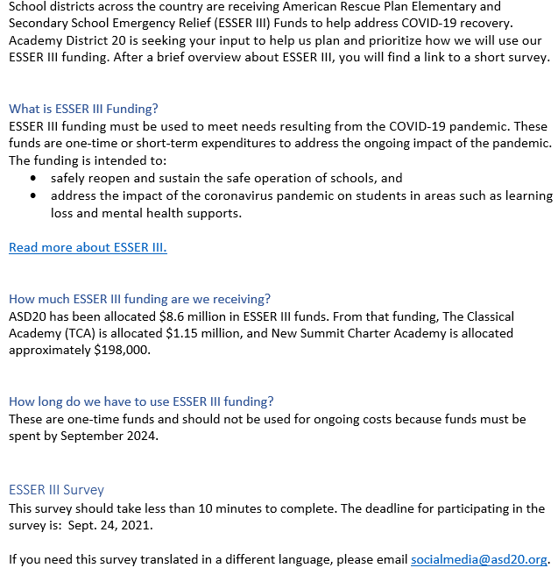
ESSER III Community Survey (General Information)

Slide 16
ESSER III Community Survey (#1-2 drop down, #3 fill in number, #4 open-ended)
What is your role?
What school(s) does your child attend or where are you currently employed?
3. Please rank the areas below by priority, as the district responds to the impacts of the COVID-19
pandemic. Note: one is most important, whereas 5 is least important.
Learning Loss
Provide instructional and intervention opportunities to address learning loss for all students, including students in special populations. Examples of special populations include, but are not limited to, students with disabilities, English Language Learners, students experiencing homelessness, and students in foster care.
Social/Emotional/Mental Well-being
Provide mental health services, supports, and related resources for students and staff.
Health & Safety Needs
Provide supplies, services, improvements, and personnel to help improve environmental health and safety and limit the spread of COVID-19.
Continuity of Operations
Add/retain staff to continue and/or enhance operations and address student needs. One example is funding additional staffing or instructional materials that would result if a transition to eLearning is necessary.
Technology & Digital Tools
Support for technology, tools, and digital supports.
4. What additional ideas do you have for ESSER III funds?

Slide 17
ESSER III Community Survey Results (Questions 1 & 2)
4,927 respondents
Each school in ASD20 represented
Role | Respondents | Percent
Parent / Guardian | 3,297 | 66.9%
Student | 889 | 18%
Staff Member | 679 | 13.8%
Community Member | 19 | 0.4%
Other | 41 | 0.8%
No Response | 2 | 0%

Slide 18
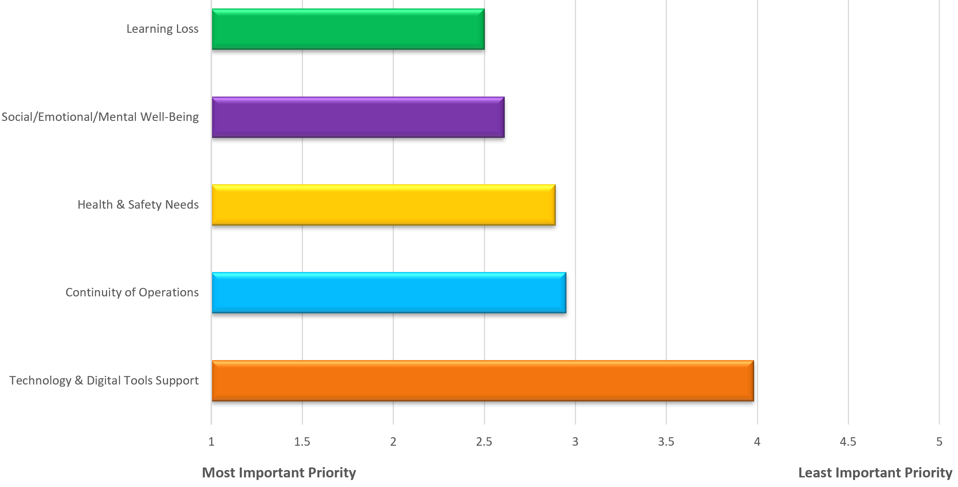
ESSER III Community Survey Results (Question 3)

Slide 19
ESSER III Community Survey Results (Question 4 – Highlights)
Summer school for all
Reading support
Catch up on missed work
After school tutoring
Smaller class sizes
Support students with special needs
More mental health work
More counselors and therapy
Resilience training
Increase staff pay
More clubs and other classes
Outdoor learning
More field trips
More music and band classes
Technology training for staff
Improve buildings and parking lots
Bathrooms and lockers
Ventilation (HVAC, Air Purifiers)
Hand sanitizer stations
Regular COVID testing for all
Better food
Free food for all students
Return money to taxpayers

Slide 20
ESSER III Planning

Slide 21
ESSER III Planning ($7.3 m D20 Non-Charters) (Approximated dollar amounts, May not add to total due to rounding, Subject to revision)
Learning Loss ($2.8 m)
K-5 After School Tutoring through May 2024
K-5 Summer Reading Clinic through July 2024
6-8 Tutoring through June 2024
9-12 Tutoring & Credit Recovery through June 2024
9-12 Summer School In-Person Credit Recovery & Advanced Credit Completion through July 2024 – Tuition $40 instead of $250
9-12 Summer School Online Credit Recovery & Advanced Credit Completion through July 2024 – Tuition $40 instead of $250
9-12 Online Course Licenses through June 2024
K-12 Behavior TOSA for Students with Disabilities through June 2024
AT LEAST 20% LEARNING LOSS?
D20 Non-Charters $2.8 m of $7.3 m = 38%
D20 All Schools $2.8 m of $8.6 m = 33%
Health & Safety Needs ($1.1 m)
ASD20 Food Bank and Clothing Closet at the Family Resource Center through June 2024
Transportation to Food Bank and Clothing Closet through August 2024 for Homeless Families
Nurse Support during Summer School 2021
21-22 School Staff Overtime, Additional Staffing, Central COVID Team to Support Required COVID Protocols
Masks
Continuity of Operations ($1.7 m)
21-22 JK8 additional teachers and curriculum costs
22-23 & 23-24 Title I teachers at FRES, HPES, PIES, PHES
Partial Accounting Costs
Social/Emotional/Mental Well-Being ($1.3 m)
21-22 Make Part-Time Counselors FT at ATES, EWES, & JK8
ASD20 Family Resource Counseling Center through June 2024
22-23 & 23-24 RULER Online Subscription
22-23 & 23-24 Sources of Strength
Technology & Digital Tools Support ($320k)
22-23 & 23-24 MS & HS DTT’s 260 Days
23-24 Home Internet Connectivity

Slide 22
The Way Ahead

Slide 23
The Way Ahead
ESSER III Stakeholder Presentations
9/30 – Special Education Advisory Committee (SEAC)
10/4 – K-12 Principals
10/5 – Academy Education Association (AEA)
10/6 – Parent Sounding Board (PSB)
10/6 – Superintendent's Student Advisory Council (SSAC)
10/6 – Teacher Communication Council (TCC)
10/18 – ASD20 Community Town Hall 5:00 pm – 6:00 pm on Teams
10/19 – District Accountability Committee (DAC)
Application
Finalize and Submit ESSER III Application to Colorado Department
of Education for Review by December 16, 2021

Slide 24
Comments & Questions
becky.allan@asd20.org
719-234-1268

Slide 25
Maintenance of Equity

Slide 26
ESSER III Use of Funds Additional Requirements
Maintenance of Equity
An SEA does not disproportionately reduce per-pupil State funding to high-need LEAs.
An SEA does not reduce per-pupil State funding to the highest-poverty LEAs below their FY 2019 level.
An LEA does not disproportionately reduce State and local per-pupil funding in high-poverty schools.
An LEA does not disproportionately reduce the number of full-time-equivalent (FTE) staff per-pupil in high-poverty schools.
LEA Requirements [Applies to LEA’s with more than 1,000 students, more than 1 school, and more than 1 school per grade span]
SEA Requirements

Slide 27
Maintenance of Equity Clarifications
How can an LEA know if they are exempt from Maintenance of Equity requirements?
On the spreadsheet of high-poverty schools located on the bottom of this page, look at column F, “LEA Exempt from Maintenance of Equity.” If your LEA is listed as “Yes”, the LEA is exempt and no further action is required.
Why is my LEA exempt from Maintenance of Equity requirements?
The spreadsheet provides the LEA automatic exemption reasons. Those are:
Has a total enrollment of less than 1,000 students;
Operates a single school; or
Serves all students within each grade span with a single school.

Slide 28
Maintenance of Equity Clarifications
Can an LEA request an exception if they are not automatically exempt?
Yes, an LEA can fill out the exception form for FY 2021-2022 if it is:
Experiencing unique timing and implementation challenges due to the pandemic and can certify to the USDE that it did not and will not implement an aggregate reduction in combined State and local per-pupil funding in FY 2022 (i.e., is not facing overall budget reductions).
Please see FAQ 32 of the attached Maintenance of Equity Updated FAQ document from the USDE for additional information.
CDE will maintain the exception forms, which may be requested by the USDE for monitoring and auditing purposes.

Slide 29
Updates and Reminders

Slide 30
Updates and Reminders
The U.S. Department of Education is seeking comments and input on Maintenance of Equity draft policies. They also have general questions about this new requirement and would like to hear from SEAs and LEAs.
ESSER III LEA Use of Funds Plans, with stakeholder input, is due to CDE by 12/16/21.

Slide 31
Consolidated Application AFR Submission – REMINDER
BEFORE Submitting the AFR:
Make sure you have entered financial information for ALL ESEA Title programs
The submit button on the bottom of the page submits the ENTIRE AFR, not just that page
If you submit the AFR before entering financial data for all programs, you will need to notify CDE to have the AFR unlocked.

Slide 32
Any Requests for Upcoming Topics or Questions!

Slide 33
Thank you! We’ll See You Next Week!

Slide 34
CDE Team!
CDE Contacts!
Emails: LastName_FirstInital@cde.state.co.us
ESSER/ESEA Program Partners
Nazie Mohajeri-Nelson, Director of ESEA Office (mohajeri-nelson_n@cde.state.co.us)
DeLilah Collins, Assistant Director of ESEA Office (collins_d@cde.state.co.us)
ESEA Regional Contacts assigned by district
Title I: Laura Meushaw, Kathryn Wisner, Niko Kaloudis
Title II: Niko Kaloudis
Title III: Lorenzo Moreno, Kathryn Wisner
Title IV: Tammy Giessinger, Michelle Prael
Title V: Kristen Collins
ESSER Team
Kristin Crumley, ESSER Monitoring Specialist (Crumley_k@cde.state.co.us)
Jonathan Schelke, ESSER Monitoring Specialist (schelke_j@cde.state.co.us)
Shannon Wilson, ESSER/ESEA Grants Administration Coordinator (Wilson_s@cde.state.co.us)
Mackenzie Owens, ESSER Reporting Specialist (owens_m@cde.state.co.us)
Data, Accountability, Reporting, and Evaluation
Tina Negley, Alan Shimmin, Mary Shen, and Mackenzie Owens
Fiscal Partners
Jennifer Okes, Chief Operating Officer (okes_j@cde.state.co.us)
Kate Bartlett, Executive Director of School District Operations (Bartlett_k@cde.state.co.us)
Jennifer Austin, Director of Grants Fiscal Management (Austin_j@cde.state.co.us)
Robert Hawkins, Grants Fiscal Analyst (Hawkins_s@cde.state.co.us)
Steven Kaleda, Grants Fiscal Analyst (Kaleda_s@cde.state.co.us)
ESSER Team
Bill Parsley, ESSER Fiscal Monitoring Supervisor (parsley_w@cde.state.co.us)
Hilery Morris, ESSER Fiscal Monitoring (morris_h@cde.state.co.us)
Sharon Mackey, ESSER Fiscal Monitoring (mackey_s@cde.state.co.us)

