Slide 1
CDE Office Hours
November 11, 2021

Slide 2
CDE Team!
CDE Contacts!
Emails: LastName_FirstInital@cde.state.co.us
ESSER/ESEA Program Partners
Nazie Mohajeri-Nelson, Director of ESEA Office (mohajeri-nelson_n@cde.state.co.us)
DeLilah Collins, Assistant Director of ESEA Office (collins_d@cde.state.co.us)
ESEA Regional Contacts assigned by district
Title I: Laura Meushaw, Kathryn Wisner, Niko Kaloudis
Title II: Niko Kaloudis
Title III: Kathryn Wisner
Title IV: Tammy Giessinger, Michelle Prael
Title V: Kristen Collins
ESSER Team
Kristin Crumley, ESSER Monitoring Specialist (Crumley_k@cde.state.co.us)
Jonathan Schelke, ESSER Monitoring Specialist (schelke_j@cde.state.co.us)
Shannon Wilson, ESSER/ESEA Grants Administration Coordinator (Wilson_s@cde.state.co.us)
Mackenzie Owens, ESSER Reporting Specialist (owens_m@cde.state.co.us)
Data, Accountability, Reporting, and Evaluation
Tina Negley, Alan Shimmin, Mary Shen, and Mackenzie Owens
Fiscal Partners
Jennifer Okes, Chief Operating Officer (okes_j@cde.state.co.us)
Kate Bartlett, Executive Director of School District Operations (Bartlett_k@cde.state.co.us)
Jennifer Austin, Director of Grants Fiscal Management (Austin_j@cde.state.co.us)
Robert Hawkins, Grants Fiscal Analyst (Hawkins_s@cde.state.co.us)
Steven Kaleda, Grants Fiscal Analyst (Kaleda_s@cde.state.co.us)
ESSER Team
Bill Parsley, ESSER Fiscal Monitoring Supervisor (parsley_w@cde.state.co.us)
Hilery Morris, ESSER Fiscal Monitoring (morris_h@cde.state.co.us)
Sharon Mackey, ESSER Fiscal Monitoring (mackey_s@cde.state.co.us)

Slide 3
ESSER Office Hours
Topics
Updates and Reminders
Staff recruitment and retention
CRF Expenditure Reporting Final Submission
LEA Use of Funds Plans
Mapping data and how to submit any changes to your district boundaries
Notes:
Nazie

Slide 4
Updates, Reminders, and Clarifications

Slide 5
Upcoming Training
The Office of ESEA Programs, at the Colorado Department of Education, will be facilitating a Virtual Training on Tuesday, November 16th from 1:00 pm-3:00 pm. The virtual training will cover HR data reported by local education agencies (LEAs) to CDE, and how that data is used to inform calculations for Title I, Part A Comparability and Equitable Distribution of Teachers (EDT) analyses.
The content is designed for HR fiscal and programing professionals, with a focus on data and analysis. CDE will provide future technical assistance and program aspect trainings.

Slide 6
Reminders and Clarifications
The Maintenance of Equity certification does not have a deadline, but the sooner the better.
In reviewing the data, all Colorado LEAs either meet the automatic exception or are eligible to apply for the certification.
New MoEq webpage with the data file posted – coming soon!
Colorado’s ARP ESSER III application has been approved and we have been awarded the remaining 1/3 of funds!

Slide 7
Educator Recruitment and Retention Statewide Initiatives
Fall 2021
Colleen O’Neil, Associate Commissioner, Educator Talent

Slide 8
2020-21 Colorado Context
Approximately 8,000 teaching and SSP positions needed to be hired for in 2020-21, representing 12% of all teaching and 15% of all SSP positions in the state.
As with 2019-20, the number of open positions was slightly lower than in the preceding school year for both teachers and SSPs in 2020-21.
Nearly 300 principal/assistant principal positions and over 1,200 paraprofessional positions needed to be hired for in 2020-2021

Slide 9
Positions Remaining Unfilled in 2020-21
Of the 6,910 total teaching positions to hire, 235 (3%) remained unfilled for the school year and 893 (13%) were filled through a shortage mechanism.
In core teaching subject areas, shortages of mathematics, science, special education and early childhood teachers were evident statewide.
In SSP categories, shortages of school psychologists, school occupational therapists, school physical therapists, and school nurses were the most common statewide.

Slide 10
Education Talent Division

Slide 11
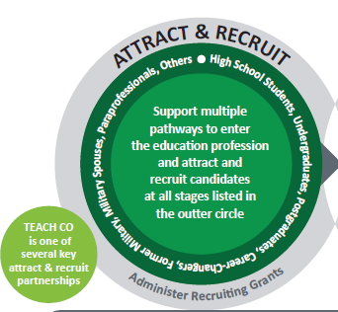
Programs to Attract and Recruit
Funding Sources
Colorado Substitute Stipend (ESSER Funded)
$100,000 each academic year through 2022-23
Substitute Boot Camps
Coaching support
Colorado Rural Teaching Fellowship (State)
$500,000 annually as funded
Colorado Rural Teaching Stipend (State)
$112,000 annually as funded
Rural Alternative Licensure Stipend (New State)
$5 million to alternative educator preparation programs annually as funded (up to $10,000 each applicant)
Ongoing and New Activities
TEACHColorado.org
Articulated Teacher Career Pathways (Coming Soon!)
Educator Recruitment and Retention
Job Board (Coming Soon!)
Increased Outreach
Licensing 101
Educator Boot Camps (specifically for new to the profession teachers)
CDE Educator Talent Recruitment & Retention https://www.cde.state.co.us/educatortalent/educatorrecruitmentandretention
CDE Research and Impact Tools
https://www.cde.state.co.us/educatortalent/researchandimpact
Colorado Center for Rural Education (CCRE)
https://www.unco.edu/colorado-center-for-rural-education/

Slide 12
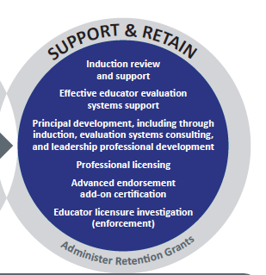
Retention Initiatives
Funding Sources
Colorado Rural Inservice Educator Stipend and National Board Certified Teacher Stipend (State)
$120,000 pot for both
ESSER I, II (ESSER III still in planning)
Educator Hazard Pay - Hazard pay is defined by the Treasury as: “Hazard pay means additional pay for performing hazardous duty or work involving physical hardship, in each case that is related to COVID-19
Overtime or extra duty - Overtime/additional hourly pay or extra duty (over and above contract time)/stipends are related one of the “Allowable Uses” such as modifications to comply with public health order, to prepare for school closures and reopenings, to facilitate distance learning, and to recover lost learning time.
All staff salary - allowable if additional hours are related to one of the “Allowable Uses” such as modifications to comply with public health order, to prepare for school closures and reopenings, or to facilitate distance learning.
CDE Educator Talent https://www.cde.state.co.us/educatortalent/educatorrecruitmentandretention
Colorado Center for Rural Education (CCRE)
https://www.unco.edu/colorado-center-for-rural-education/
ESSER Allowable Uses
http://www.cde.state.co.us/caresact/crf-allowableexpenditures

Slide 13
Feedback and Sharing What state-led recruitment and retention initiatives do you believe could be effective? What local recruitment and retention efforts are working that you want to highlight (as in let others know are effective for investment)?
Notes:
Thought Starters: 3 things you learned so far for local 2 ideas that connect to work at your district or school 1 (or more) wondering or suggestion you have

Slide 14
Thank you! Questions/Comments/Ideas Colleen O’Neil, oneil_c@cde.state.co.us

Slide 15
CRF Expenditure Reporting Final Submission

Slide 16
Where to report, and when
The final reporting period for expenditures from CRF funds (grants 4012, 5012, and 6012) is 9/01/2021 to 12/17/2021, and the final deadline for reporting these expenditures is 12/17/21. It is highly recommended that districts report as soon as they are finished spending CRF funds to avoid missing this deadline.
The links to the smartsheets can be found on the Grants Fiscal home page:
http://www.cde.state.co.us/cdefisgrant
Notes:
Kate
Bill P added verbiage from USDOE. It’s a bit lengthy so we can pare it down but the top one definitely speaks to the point I think we are driving home

Slide 17
How to report
Once you go the Grants Fiscal home page, you will see links to the smartsheet form for 4012, 5012, and 6012 reporting:
You will open the reporting form by clicking on the corresponding link. There are instructions on each form.

Slide 18
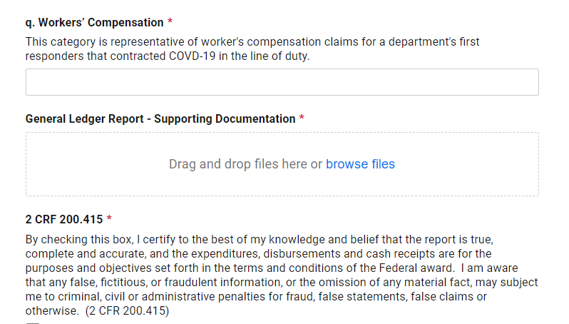
If you are only reporting expenditures for the period 9/01/21-12/17/21
If you are only reporting expenditures for this period, you will take the expenditures, by category, for this period only and enter them in the form. You will need to attach your supporting documentation, (such as your general ledger report for the period, filtered on the grant for which you are reporting expenditures) and complete the certifications.

Slide 19
How to submit and adjust previously reported totals
If you have adjustments to make to reported expenditures for a previous period, districts are to net these adjustments out of your current expenditures. That is, if you spent $1 less in a previous period than you reported, you would take what you spent in the current period and reduce what you report to CDE by $1.
If you have no expenditures to report for the current period but you wish to correct reported expenditures for a previous period, you would still enter your changes as a net change to this period; i.e., if you spent $1 less than you reported in a previous period and nothing in this period, you would enter ($1).
If you are adjusting previously reported expenditures due to a single audit finding, you would, by category, subtract any expenditures disallowed, and add any additional allowable expenditures using the method above. For example, if an audit has disallowed $100 of expenditures in category A., but you have found $75 in previously unreported expenditures that are allowable under CRF in the same category(or have expenditures during the current period), you would enter ($25) in that category. You will also need to check the box indicating that you are responding to a single audit finding.
If districts have expenditures that are allowable under CRF that are A. currently being paid for by ESSER funds and B. will be recurring expenses (such as cleaning supplies), you may move expenditures to CRF and spend ESSER funds later, within ESSER guidelines and your approved ESSER budgets.

Slide 20
If you are adjusting previously reported expenditures and will be returning funds to the State
If after adjusting previously reported expenditures using the procedure on the previous slide, you have unspent CRF funds, you will need to return these unspent funds to the State, by mailing a check to CDE. Please put the grant number (4012, 5012 or 6012) on the Check!
Mail the check to this address:
Vance Finley
CRF Refund
201 E. Colfax
Denver, CO 80203
CDE must receive unspent funds by 12/30/21.

Slide 21
If you have questions, please reach out to Patrick Mueller: mueller_p@cde.state.co.us 303-827-5980

Slide 22
Use of Funds Plan

Slide 23
ARP ESSER III Additional Requirements
LEA Use of Funds Plan [Collected in the ARP ESSER III Application]
Use of at least 20% set aside [Full Budget OR Narrative Question]
Use of at most 80% [Full Budget OR Narrative Question]
Ensuring that evidence-based interventions are addressing the academic, social, emotional, and mental health needs of students, particularly students from historically underserved populations [Narrative Question]
According to the Interim Final Requirement, LEAs must make their Use of Funds plan publicly available
See the new ESSER III Requirements webpage for further details.

Slide 24
Content of Use of Funds Plan
At minimum, the Use of Funds plan should answer the following questions. Answers to the questions should be reflected in the budget submitted to CDE:
How will the LEA use funds to address the impacts of lost instructional time using evidence based interventions (at least 20% of allocation must be directed toward this)?
How will the LEA use all other remaining funds?
If the LEA is using funds in support of the Safe In-Person strategies, how are funds being used to implement COVID-19 prevention and mitigation strategies in line with the most recent CDC guidance?
How did the LEA determine the academic, social, emotional, and mental health needs of all students, particularly historically underserved students disproportionately impacted by the COVID-19 pandemic?
How will the LEA measure the impact of the interventions funded through ESSER III?

Slide 25
Process Requirements
In creating this plan, the LEA must do the following and should be prepared to submit evidence of each action during monitoring:
Meaningful consultation with students, families, school and district administrators (including special education), teachers, principals, schools leaders, school staff, and their unions, and members of the public.
Consultation with other stakeholders as served by the LEA (tribes, civil rights organizations, stakeholders representing the interests of children considered underserved).
The public has the opportunity to provide input on the plan.
The plan, and any updates or revisions to it, is available in a language that parents can understand and meets Americans with Disabilities Act (ADA) accessibility requirements.
The LEA has responded to any requests for translations for making materials available in an accessible manner (e.g., oral for visually impaired individuals).
Use processes and data collections that you already have in place when possible.

Slide 26
Suggested Instructions for Website Content
Explain how you decided how to spend funds in order to respond to student needs.
Examples: assessment data, survey, community meetings, UIP or other district plan
List the type or category of activities being funded with ESSER III funds.
Required Category: Learning Loss/Addressing Lost Instructional Time (at least 20% of allocation)
Examples of other optional categories: Technology, Facilities, Mental Health, Mitigation of COVID-19, Staffing, etc. (at most 80% of allocation)
Explain how you will know if the interventions have been successful.
Examples of measurements: assessment growth, participation rates in tutoring programs, summer school programs, reduction in discipline referrals, survey data etc.
Use the language from your ESSER III Narrative Question on your application when you can!

Slide 27
Consider your local context
How do you usually communicate with your LEA stakeholders?
What are your stakeholders concerned about?
What is the level of detail that your stakeholders will want access to?
How do you usually gather public input and stakeholder feedback?

Slide 28
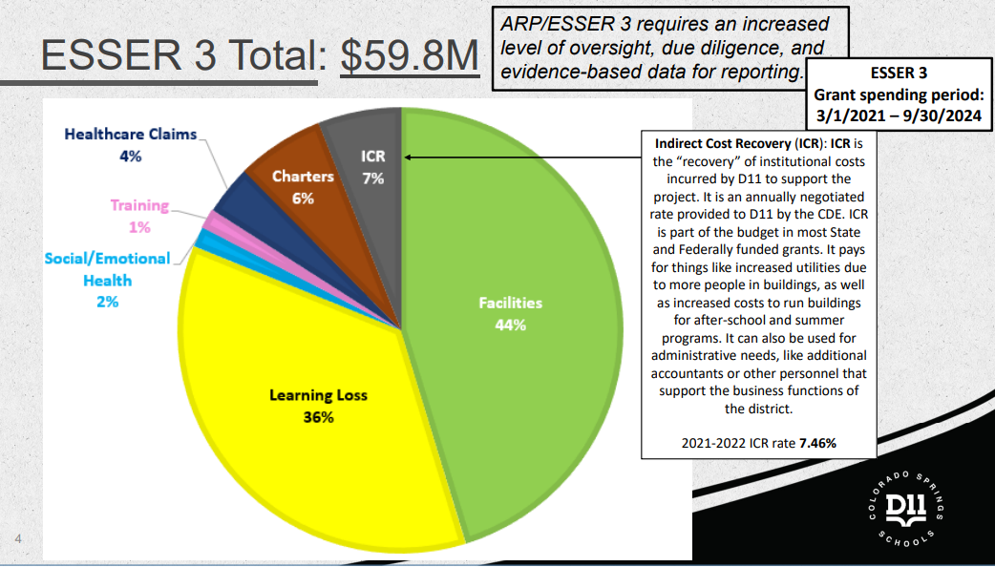
Example: How the LEA will use funds

Slide 29
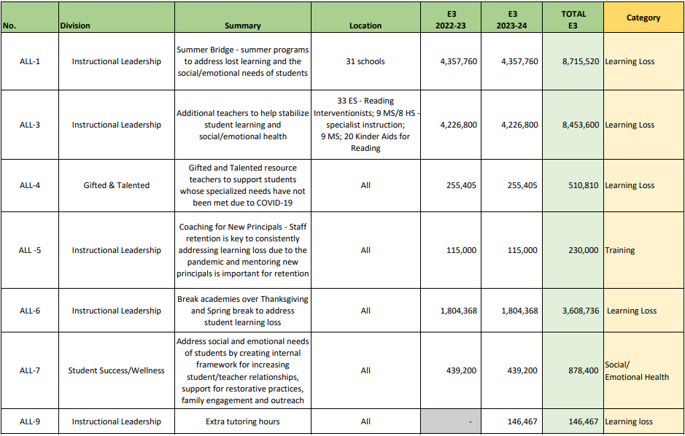

Slide 30
ESSER III Planning

Slide 31
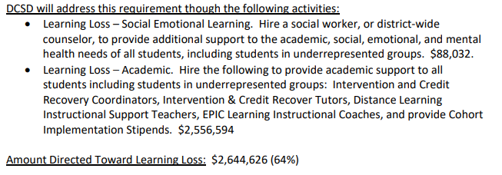
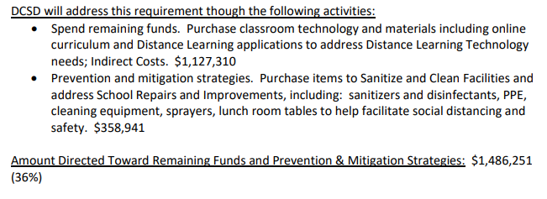
Allowable Use of Funds

Slide 32
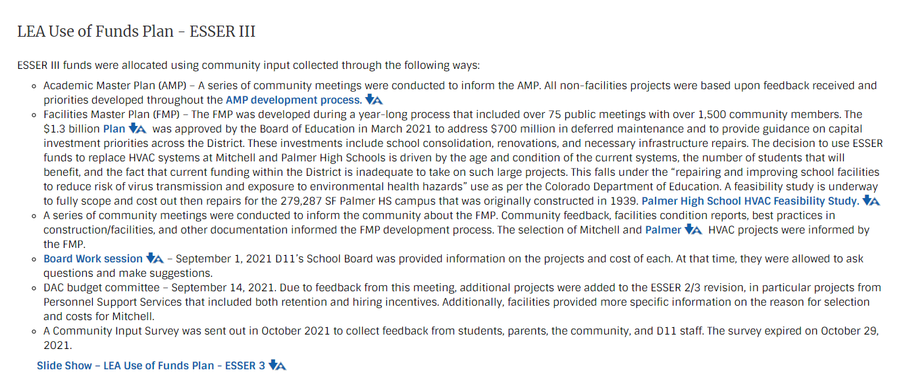
Example: How the LEA determined needs

Slide 33
Example: How LEA plans to measure impacts
Example 1:
The LEA will measure the success of our interventions through an intentional program evaluation. We will compare this year's 2022 end of year student outcomes against 2019 end of year (pre-COVID) outcomes in the area of daily attendance rate, grade point average, graduation rate, literacy and math for each population including low-income, students of color, English learners, children with disabilities, homeless, foster, and migrant students. Literacy and math evaluations will involve iReady for pre-K through 8th grade and CMAS results at tested grade levels.
Example 2:
The impact of this work with targeted schools will be measured at 90-day intervals and annually, using district formative academic assessments, student grades, CMAS/PSAT/SAT scores, graduation/completion rates, student attendance, school office referrals, and discipline rates. The district will also use a school climate survey to measure student engagement, social climate, academic support, and equitable practices in schools. Monitoring will be conducted by district leadership, including Assistant Superintendents, Executive Directors, program directors, and principals.

Slide 34
Questions?

Slide 35
U.S. Census Bureau Annual School District Review Program (SDRP) Presentation by Tina Negley

Slide 36
SDRP Purpose
The SDRP enables state officials to review the Census Bureau’s school district information and update Federal School District Local Education Agency (SDLEA) ID numbers, school district boundaries, names, levels, and grade ranges.
School district boundary data are used to estimate the number of school-aged children, ages 5 through 17, in families in poverty for each financially responsible school district.
The SDRP considers a school district financially responsible when they pay for the education of the students that reside within their boundaries.
These poverty estimates serve as the basis of Title I eligibility and are used to determine the distribution of Title I funding.

Slide 37
SDRP Phases
Two phases of the SDRP:
Annotation Phase – State officials review and update the Census Bureau’s school district boundaries and information for their state. Available until December 2021.
Verification Phase – State officials review the Census Bureau’s latest school district information to verify the accuracy and completeness of their annotation phase submission. Officials have one week to complete verification starting in April 2022.
2022 SDRP Schedule
December 31, 2021 | Annotation Phase submission deadline
April 2022 | Verification Phase begins
December 2022 | Preliminary Poverty Estimates released

Slide 38
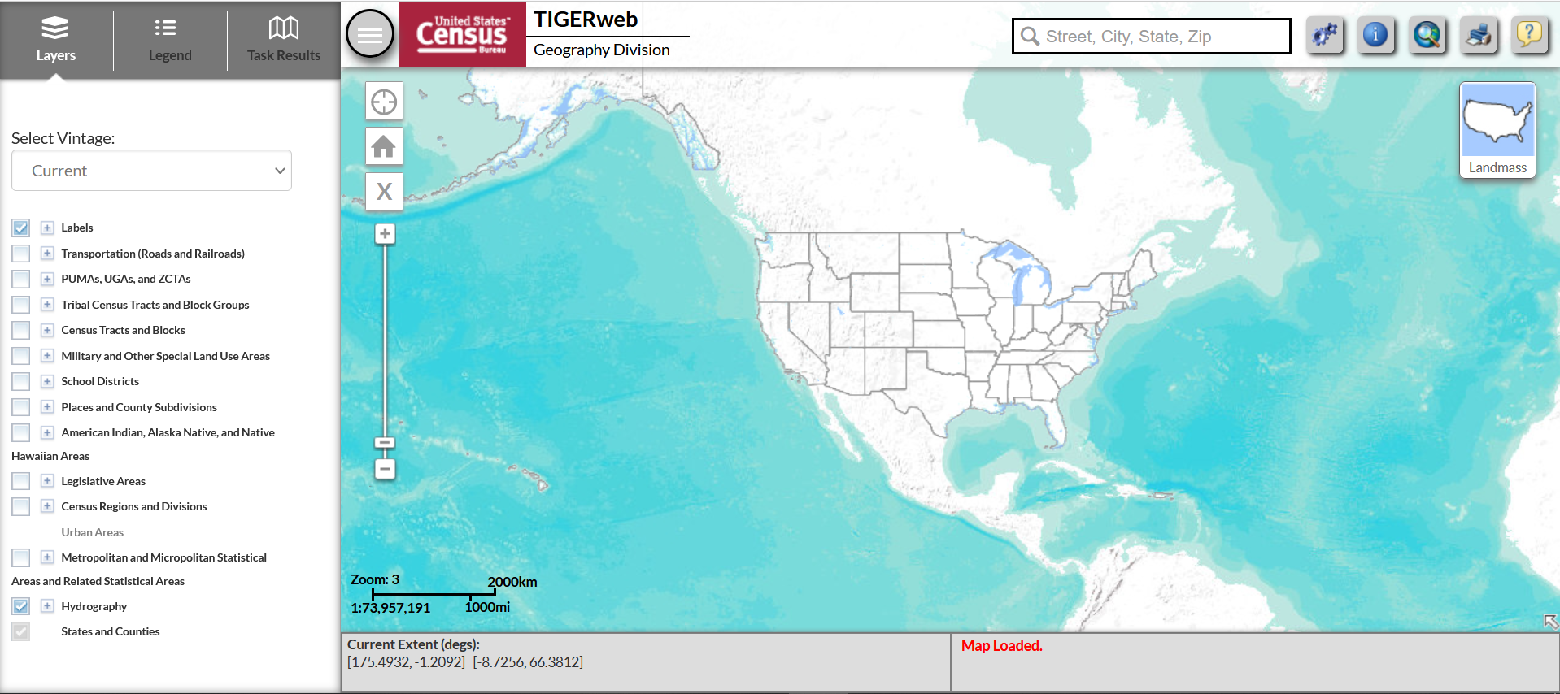
School District Boundaries
CDE is inviting districts to assist in the boundary review. Districts are encouraged to view their district boundaries online, using the TIGERweb application to determine if they accurately reflect school district boundaries.
https://tigerweb.geo.census.gov/tigerweb/
Applies to school district boundaries effective on or before January 1, 2022.

Slide 39
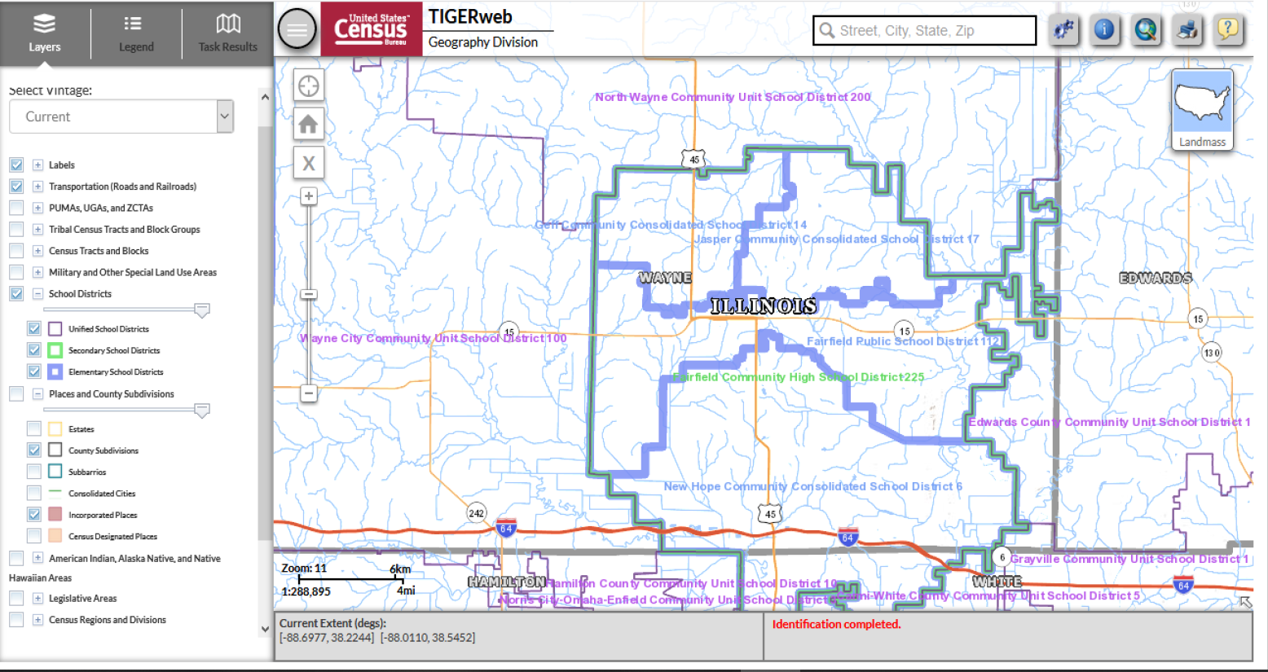
Introduction to TIGERweb
TIGERweb is the Census Bureau’s online application for viewing the most recent school district and legal boundaries.

Slide 40
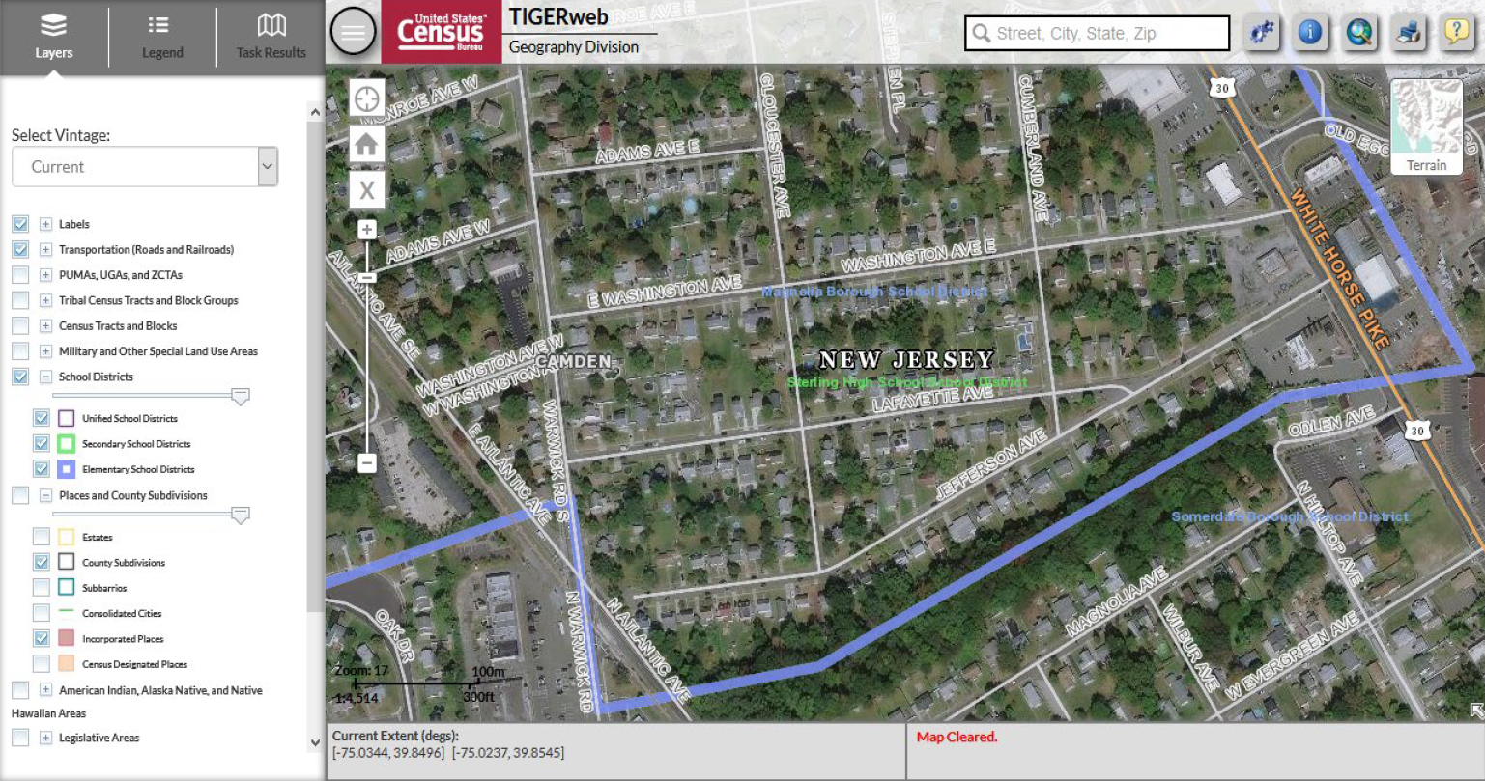
TIGERweb Functionality
TIGERweb includes imagery to better visualize structures and road features.

Slide 41
TIGERweb Demonstration

Slide 42
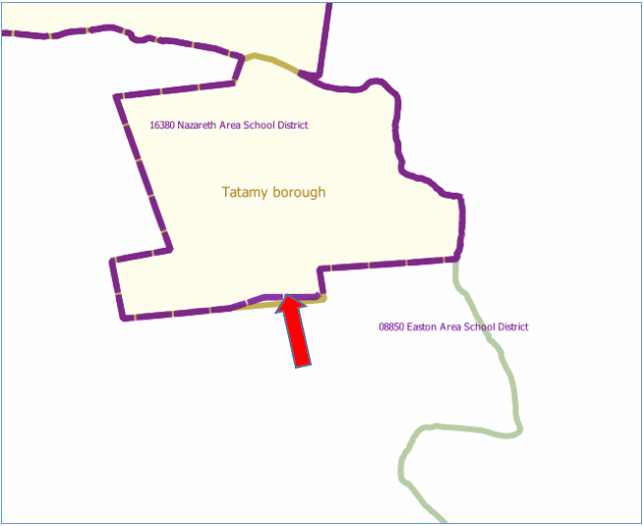
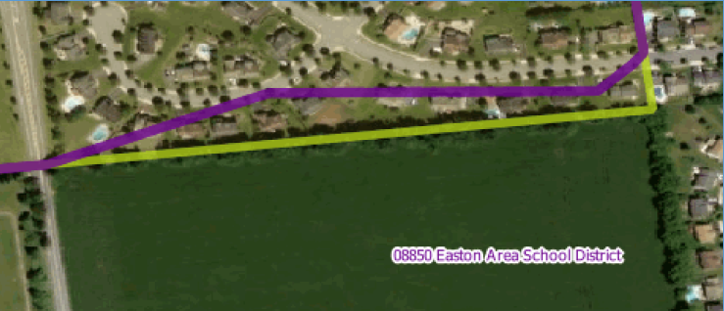
Correcting District Boundaries
To report an error in the district boundaries online, districts should take a screenshot of the current boundaries (using the TIGERweb system) and then annotate the updated boundary location on the same screenshot.
District should notify CDE as soon as possible to report any errors.

Slide 43
Submitting Boundary Changes
All requests to update school district boundaries should be submitted using the Annual School District Review Program form
Districts are encouraged to submit changes as soon as possible. All annotated screenshots must be submitted no later than December 15th to ensure the information is successfully uploaded in the Geographic Update Partnership Software (GUPS) by the December 31st deadline.
Boundary changes occur when a school district adds or removes area. Boundary changes of less than 30 feet are not accepted when the change does not affect housing. In areas of sparse population, such as rural areas, differences of 60 to 75 feet are not considered to be significant.

Slide 44
Contact Information
For all SDRP-related questions, please reach out to:
Tina Negley
negley_t@cde.state.co.us
720-766-2793

Slide 45
Upcoming Meetings

Slide 46
Any Requests for Upcoming Topics or Questions!
Upcoming Office Hours:
November 18: NO OFFICE HOURS
Cancelled due to Committee of Practitioners meeting
November 25: NO OFFICE HOURS
Cancelled due to Thanksgiving Holiday
December 2:
Open Session – email requests for topics

Slide 47
CDE Team!
CDE Contacts!
Emails: LastName_FirstInital@cde.state.co.us
ESSER/ESEA Program Partners
Nazie Mohajeri-Nelson, Director of ESEA Office (mohajeri-nelson_n@cde.state.co.us)
DeLilah Collins, Assistant Director of ESEA Office (collins_d@cde.state.co.us)
ESEA Regional Contacts assigned by district
Title I: Laura Meushaw, Kathryn Wisner, Niko Kaloudis
Title II: Niko Kaloudis
Title III: Kathryn Wisner
Title IV: Tammy Giessinger, Michelle Prael
Title V: Kristen Collins
ESSER Team
Kristin Crumley, ESSER Monitoring Specialist (Crumley_k@cde.state.co.us)
Jonathan Schelke, ESSER Monitoring Specialist (schelke_j@cde.state.co.us)
Shannon Wilson, ESSER/ESEA Grants Administration Coordinator (Wilson_s@cde.state.co.us)
Mackenzie Owens, ESSER Reporting Specialist (owens_m@cde.state.co.us)
Data, Accountability, Reporting, and Evaluation
Tina Negley, Alan Shimmin, Mary Shen, and Mackenzie Owens
Fiscal Partners
Jennifer Okes, Chief Operating Officer (okes_j@cde.state.co.us)
Kate Bartlett, Executive Director of School District Operations (Bartlett_k@cde.state.co.us)
Jennifer Austin, Director of Grants Fiscal Management (Austin_j@cde.state.co.us)
Robert Hawkins, Grants Fiscal Analyst (Hawkins_s@cde.state.co.us)
Steven Kaleda, Grants Fiscal Analyst (Kaleda_s@cde.state.co.us)
ESSER Team
Bill Parsley, ESSER Fiscal Monitoring Supervisor (parsley_w@cde.state.co.us)
Hilery Morris, ESSER Fiscal Monitoring (morris_h@cde.state.co.us)
Sharon Mackey, ESSER Fiscal Monitoring (mackey_s@cde.state.co.us)

