Slide 1
CDE Office Hours
November 4, 2021

Slide 2
CDE Team!
CDE Contacts!
Emails: LastName_FirstInital@cde.state.co.us
ESSER/ESEA Program Partners
Nazie Mohajeri-Nelson, Director of ESEA Office (mohajeri-nelson_n@cde.state.co.us)
DeLilah Collins, Assistant Director of ESEA Office (collins_d@cde.state.co.us)
ESEA Regional Contacts assigned by district
Title I: Laura Meushaw, Kathryn Wisner, Niko Kaloudis
Title II: Niko Kaloudis
Title III: Kathryn Wisner
Title IV: Tammy Giessinger, Michelle Prael
Title V: Kristen Collins
ESSER Team
Kristin Crumley, ESSER Monitoring Specialist (Crumley_k@cde.state.co.us)
Jonathan Schelke, ESSER Monitoring Specialist (schelke_j@cde.state.co.us)
Shannon Wilson, ESSER/ESEA Grants Administration Coordinator (Wilson_s@cde.state.co.us)
Mackenzie Owens, ESSER Reporting Specialist (owens_m@cde.state.co.us)
Data, Accountability, Reporting, and Evaluation
Tina Negley, Alan Shimmin, Mary Shen, and Mackenzie Owens
Fiscal Partners
Jennifer Okes, Chief Operating Officer (okes_j@cde.state.co.us)
Kate Bartlett, Executive Director of School District Operations (Bartlett_k@cde.state.co.us)
Jennifer Austin, Director of Grants Fiscal Management (Austin_j@cde.state.co.us)
Robert Hawkins, Grants Fiscal Analyst (Hawkins_s@cde.state.co.us)
Steven Kaleda, Grants Fiscal Analyst (Kaleda_s@cde.state.co.us)
ESSER Team
Bill Parsley, ESSER Fiscal Monitoring Supervisor (parsley_w@cde.state.co.us)
Hilery Morris, ESSER Fiscal Monitoring (morris_h@cde.state.co.us)
Sharon Mackey, ESSER Fiscal Monitoring (mackey_s@cde.state.co.us)

Slide 3
ESSER Office Hours
Topics
Updates, Reminders, and Clarifications
Marzano Research: Selecting evidence-based interventions and evaluating the impact of ESSER funds
Notes:
Nazie

Slide 4
Updates, Reminders, and Clarifications

Slide 5
Upcoming Training
The Office of ESEA Programs, at the Colorado Department of Education, will be facilitating a Virtual Training on Tuesday, November 16th from 1:00 pm-3:00 pm. The virtual training will cover HR data reported by local education agencies (LEAs) to CDE, and how that data is used to inform calculations for Title I, Part A Comparability and Equitable Distribution of Teachers (EDT) analyses.
The content is designed for HR fiscal and programing professionals, with a focus on data and analysis. CDE will provide future technical assistance and program aspect trainings.

Slide 6
Reminders and Clarifications
Clarifications received from the U.S. Department of Education (on 11/2/21)
If the FY2022 (2021-2022 school year) combined state and local per-pupil funding is the same as or higher than FY 2021 (2020-2021 school year), then the LEA is eligible for an exception through a “Certification of Exception” which must be submitted to CDE. However, this is not an automatic exception and requires submitting a certification of exception to CDE.
“Exceptional Circumstances” may include and LEA that “did not and will not implement an aggregate reduction in combined State and local per-pupil funding in FY 2022 (i.e., is not facing overall budget reductions)” [Quote from letter to states from Secretary Cardona]
If you meet this criteria, you are eligible for an exception. If you do not have an automatic exception, then you have to submit the form to CDE.
Forms available on the ESEA/ESSER Resources Page: https://www.cde.state.co.us/fedprograms/resourcesandtechnicalassistance
Certification of Exception from Local Maintenance of Equity [Word Doc Form]
Submittal Process [Form via Smartsheets]

Slide 7
Questions from Last Week
If we had an increase in combined local and state per pupil funding, but a reduction in staffing, do we still submit the exception?
Yes! The exception applies to any LEA that had an increase in combined state and local per pupil funding. If you meet this criteria, you do not have to demonstrate maintenance of equity through school level per pupil funding or FTE method.

Slide 8
Selecting evidence-based interventions and evaluating the impact of ESSER funds Presentation by Marzano Research

Slide 9
Identifying Evidence-Based Programs and Evaluation Strategies

Slide 10
Introduction
Marzano Research is a certified women-owned small business and certified benefit company and brings decades of experience in client-driven research projects and survey development, administration, and data analysis. Our team has successful experience reviewing tools and programs, working with content experts, and assessing client needs.

Slide 11
Assessing the Quality and Relevance of Research
Assessing the Quality and Relevance of Research
Supported by other research or strong theory
Well-designed and well-implemented study
Relevance
Local capacity/Resource requirements
Outcomes
Quality of Evidence
Local context Setting/Population
Statistically significant findings
A Balancing Act
When reviewing evidence related to your local needs, you will need to balance multiple considerations, including the quality, and relevance of the evidence.
U.S Department of Education provides guidance for understanding the relevance and evidence-base of interventions using ESSA’s four evidence levels.
11

Slide 12
Steps to identify a relevant evidence-based intervention
Identify intervention
Intervention in mind
Assess Quality
Research design (RCT, QED, Correlational, other)
Assess capacity requirements
Gather information about what resources are required to implement the intervention and assess local capacity to implement.
Search to identify
Statistically significant outcomes
Assess Relevance
Setting in which the research took place (e.g., elementary)
Population studied in the research (e.g., students with disabilities)
Plan Evaluation
Determine evaluation needs based on the level of evidence and local research needs.
Plan Implementation
Develop a logic model with well-defined activities and measurable goals.
Outline roles and develop implementation timeline.
Sample size
Steps to identify a relevant evidence-based intervention
School staff and community buy-in
IMPLEMENT
& EVALUATE
12

Slide 13
Where do I find interventions with Strong or Moderate evidence?
Where do I find interventions with Strong or Moderate evidence?
Databases that provide ratings for interventions
What Works Clearinghouse
Evidence for ESSA
Results First Clearinghouse Database
Ohio’s Evidence Based Clearing House
Places to find interventions that may not be rated
Peer reviewed journals
Publisher reports from external evaluators
ERIC Institute of Education Sciences
Where to find help
Research organizations with WWC certified reviewers – such as Marzano Research
13

Slide 14
Locating evidence-based interventions
Locating evidence-based interventions
https://ies.ed.gov/ncee/wwc/FWW
14

Slide 15
Intervention Reports
Intervention Reports
15

Slide 16
Intervention Reports
Intervention Reports
16

Slide 17
Intervention Reports
Intervention Reports
17

Slide 18
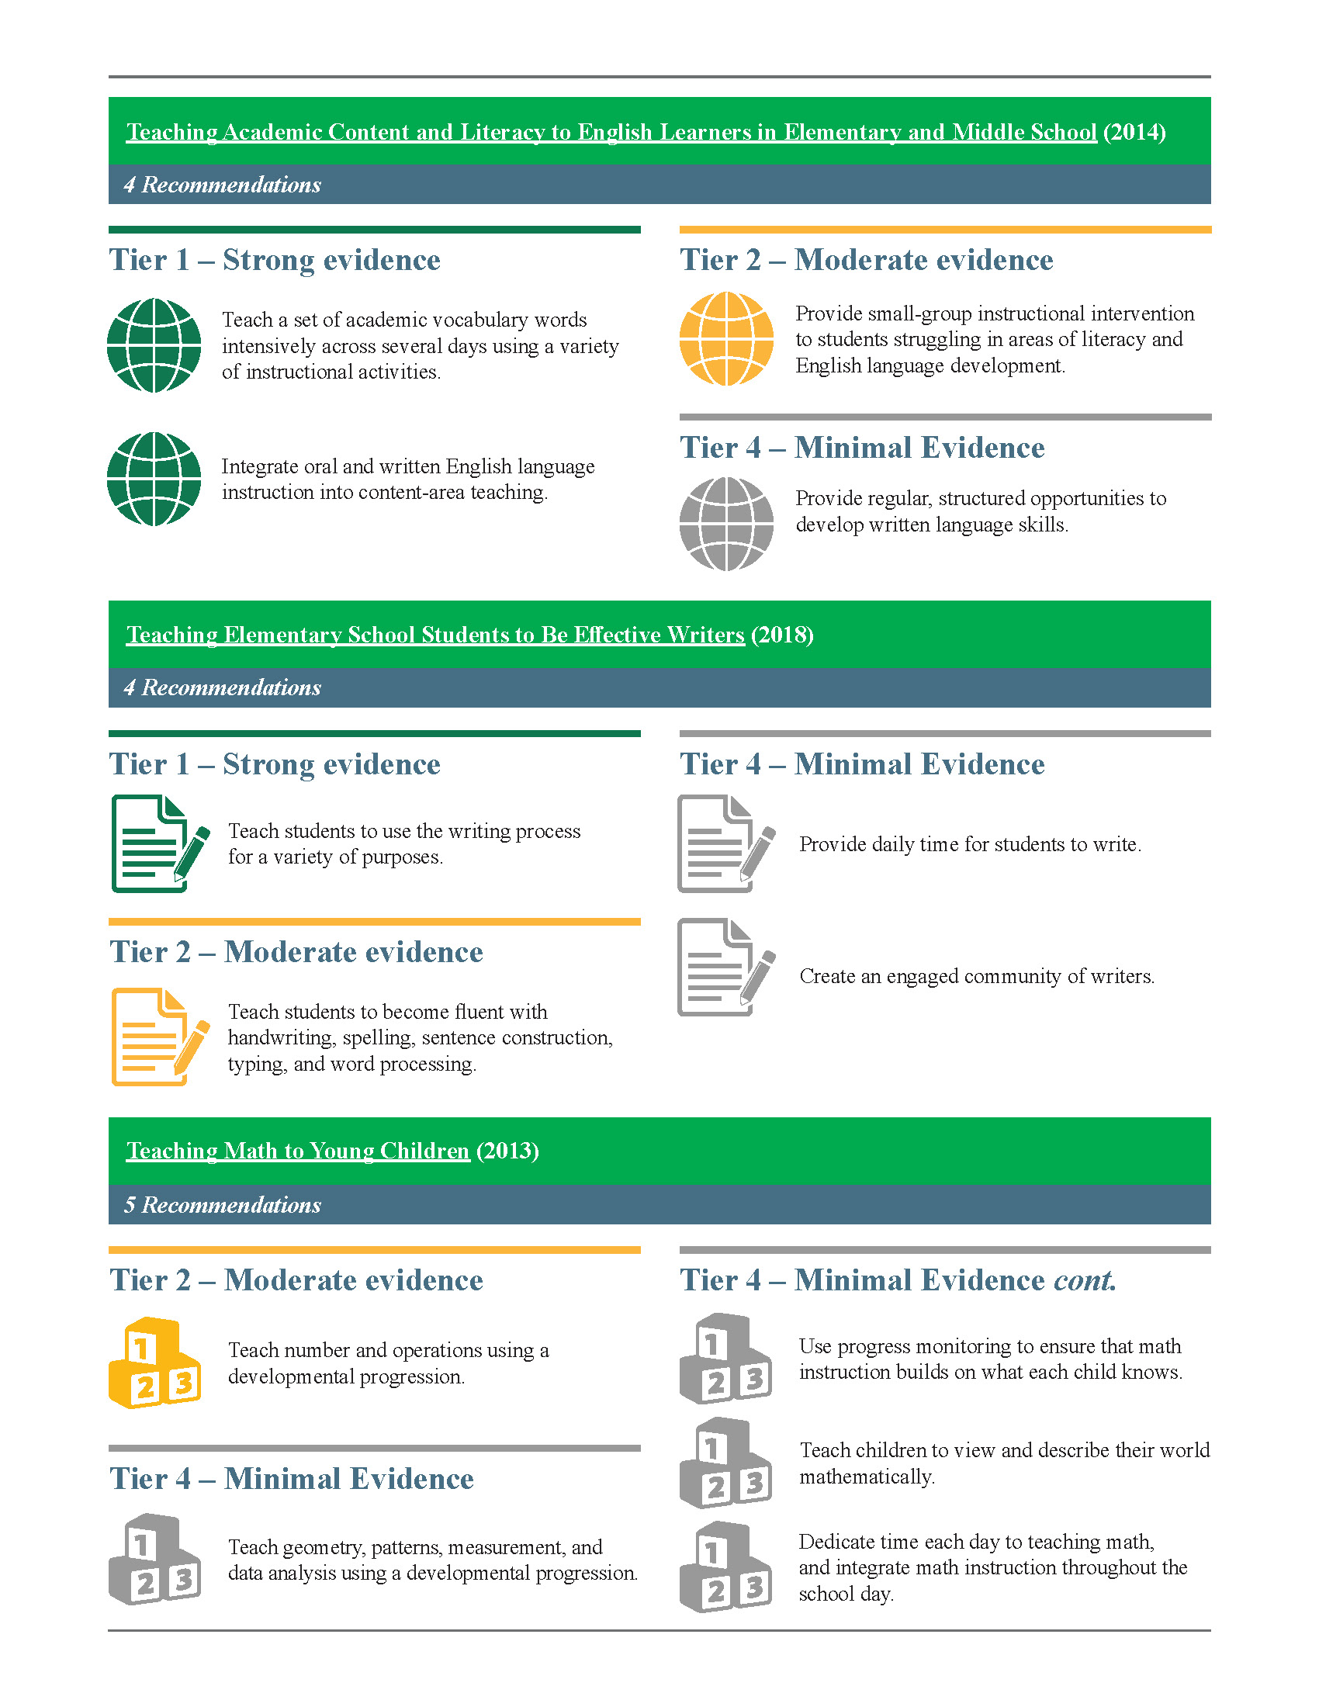
WWC Elementary Practice Guides
WWC Elementary Practice Guides: ESSA Alignment
18

Slide 19
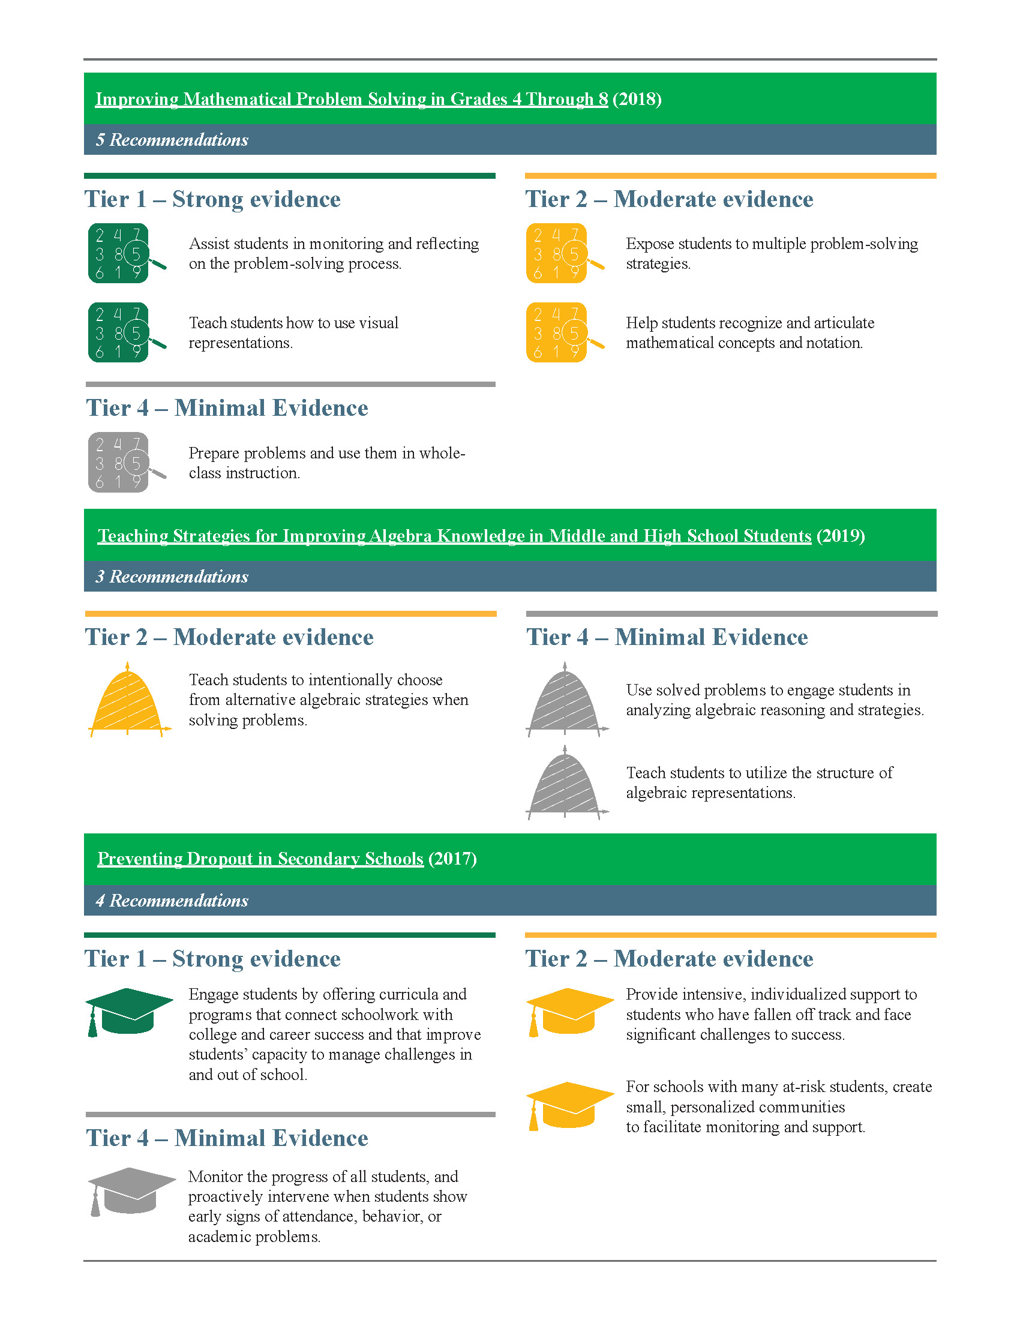
WWC Secondary Practice Guides
WWC Secondary Practice Guides: ESSA Alignment
19

Slide 20
Determining Evaluation and Local Research Needs
Determining Evaluation and Local Research Needs
Understanding implementation
determine catalysts and barriers to implementation
develop supports and identify resources
make continuous improvements to programs
Assessing progress toward outcomes
inform continuation or changes to programs
seek continued funding
20

Slide 21
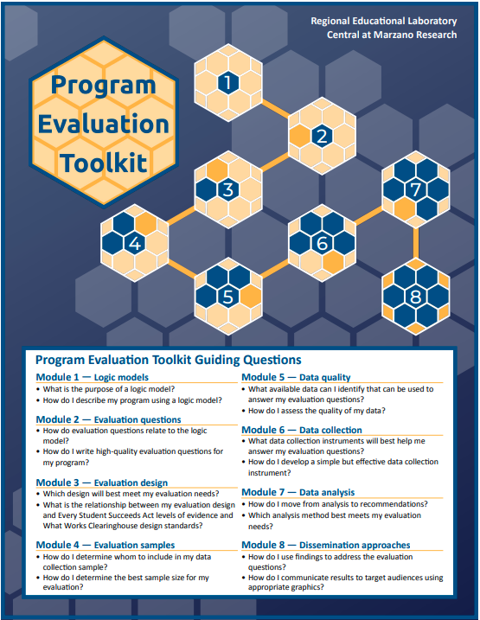
Program Evaluation Toolkit
Program Evaluation Toolkit
Module | What are my evaluation needs?
1. Logic models | I need to clearly define my program and my expected outcomes.
2. Evaluation questions | I need to develop or refine a set of relevant and measurable evaluation questions.
3. Evaluation design | I need to identify an evaluation design that will ensure that claims made from my evaluation are justifiable and align to tiers of evidence under the Every Student Succeeds Act and What Works Clearinghouse design standards.
4. Evaluation samples | I need to determine which participants (for example, students, parents) to include in my evaluation.
5. Data quality | I need to identify available data (for example, state assessments, student attendance) to address my evaluation questions and review the quality of the available data.
6. Data collection | I need to develop or identify quality instruments (for example, focus group protocols or surveys) to collect additional data.
7. Data analysis | I need to analyze my data and make recommendations for next steps to decisionmakers.
8. Dissemination approaches | I need to share the findings of my evaluation with different audiences (for example, teachers, community members).
21

Slide 22
Evaluation: should we do it ourselves or hire someone to help?
Internal Evaluation
- Cheaper
- No collaboration needed
- Staff may lack time or expertise
- Perceived bias
External Evaluation
- Conducted by experts
- Perceived objectivity
- More expensive
- Requires collaboration

Slide 23
Upcoming Meetings

Slide 24
Any Requests for Upcoming Topics or Questions!
Upcoming Office Hours:
November 11: Expanded to 2 hours
CRF Monitoring Update
Mapping data and how to submit any changes to your district boundaries
Staff recruitment and retention
Q&A in Breakout Rooms by Region
November 18: NO OFFICE HOURS
Cancelled due to Committee of Practitioners meeting
November 25: NO OFFICE HOURS
Cancelled due to Thanksgiving Holiday
December 2:
Open Session – email requests for topics

Slide 25
CDE Team!
CDE Contacts!
Emails: LastName_FirstInital@cde.state.co.us
ESSER/ESEA Program Partners
Nazie Mohajeri-Nelson, Director of ESEA Office (mohajeri-nelson_n@cde.state.co.us)
DeLilah Collins, Assistant Director of ESEA Office (collins_d@cde.state.co.us)
ESEA Regional Contacts assigned by district
Title I: Laura Meushaw, Kathryn Wisner, Niko Kaloudis
Title II: Niko Kaloudis
Title III: Kathryn Wisner
Title IV: Tammy Giessinger, Michelle Prael
Title V: Kristen Collins
ESSER Team
Kristin Crumley, ESSER Monitoring Specialist (Crumley_k@cde.state.co.us)
Jonathan Schelke, ESSER Monitoring Specialist (schelke_j@cde.state.co.us)
Shannon Wilson, ESSER/ESEA Grants Administration Coordinator (Wilson_s@cde.state.co.us)
Mackenzie Owens, ESSER Reporting Specialist (owens_m@cde.state.co.us)
Data, Accountability, Reporting, and Evaluation
Tina Negley, Alan Shimmin, Mary Shen, and Mackenzie Owens
Fiscal Partners
Jennifer Okes, Chief Operating Officer (okes_j@cde.state.co.us)
Kate Bartlett, Executive Director of School District Operations (Bartlett_k@cde.state.co.us)
Jennifer Austin, Director of Grants Fiscal Management (Austin_j@cde.state.co.us)
Robert Hawkins, Grants Fiscal Analyst (Hawkins_s@cde.state.co.us)
Steven Kaleda, Grants Fiscal Analyst (Kaleda_s@cde.state.co.us)
ESSER Team
Bill Parsley, ESSER Fiscal Monitoring Supervisor (parsley_w@cde.state.co.us)
Hilery Morris, ESSER Fiscal Monitoring (morris_h@cde.state.co.us)
Sharon Mackey, ESSER Fiscal Monitoring (mackey_s@cde.state.co.us)

