Slide 1
CDE Office Hours
October 12, 2023

Slide 2
ESSER Office Hours
Topics
Updates and Reminders
ESEA Planning and Implementation
Upcoming ESSER Deadlines
ESSER III Liquidation and Spend Down
Program Monitoring Self-evaluation Deadline
School District Review Program
ESSER Reporting
Notes:
Nazie

Slide 3
Updates and Reminders

Slide 4
ESEA Planning and Implementation
Year At A Glance
Happening Now - if applicable
Determine if Title I carryover will be over 15%, submit a request for a waiver
LEAs with ESSA identified schools:
Notify schools; support school with revising/updating UIPs to address reasons for identification; determine if should and support school with applying for EASI.
Ensure students of poverty and minority students are not taught at a higher percentage by ineffective, out-of-field, and inexperienced. Implement plan to address gaps, if applicable.
Ensure services in Title I schools are comparable to non-Title I schools.
On the Horizon – Next Couple of Months
Implement programs and plans as approved in the 2023-2024 Consolidated Application.
Determine if implementation is achieving desired outcomes.
If changes are needed after final approval, submit request for changes through the Post Award Revision (PAR) process.
Post LEA Report Cards on the LEA website outlining school performance, including performance of disaggregated groups OR reference the CDE LEA report card on your website.
Notes:
Nazie???

Slide 5
Reminders on Federal Funds
ESEA FY22 and ESSER II funds are paid on a reimbursement basis.
Obligate -> Spend -> Request Reimbursement
LEAs will need to complete and submit the Request for Funds Authorized Representative Designation form before requesting funds from CDE.
Program / Funding Stream | Obligation Due Date | Request for Funds Form
ESEA FY22 | September 30, 2023 | November 15, 2023
ESEA FY23 | September 30, 2024 | TBD
ESSER II | September 30, 2023 | November 15, 2023
ESSER III | September 30, 2024 | TBD
Notes:
Nazie

Slide 6
ESSER III Liquidation & Spend Down
Applications were submitted way back on 5/31/21 and a lot has happened and changed since then!
Many applicants have not submitted a PAR but still have remaining ARP ESSER III funds!
Good practice to revisit your ARP ESSER III applications
Application changes have occurred (e.g., new IDC rates, new year dropdown)
Did any needs and/or plans change since 5/31/21?
If so, must submit a PAR request!
Make sure there are no placeholders going into this final year of spending!
Spend and submit requests for reimbursement.
For questions or support, contact the ESSER Application Leads (NEW 8-29-23) assigned to your LEA!
Good practice to spend and submit requests for funds monthly, or at the very least quarterly!
Caution: Obligation deadline is set in statute and cannot be extended! Only the liquidation deadline!
Notes:
Nazie

Slide 7
PMSA Deadline
Program Monitoring Self-Assessment (PMSA) due
October 20,2023
(final submission via the Google Form)
ESEA/ESSER Link
ESSER-Only Link
Notes:
Kristin

Slide 8
US. Census Bureau Annual School District Review Program
Notes:
Tina

Slide 9
Purpose
The School District Review Program (SDRP) enables state officials to review the Census Bureau’s school district information and update Federal School District Local Education Agency ID numbers, school district boundaries, names, levels, and grade ranges.
School district boundary data are used to estimate the number of school-aged children, ages 5 through 17, in families in poverty for each financially responsible school district.
The SDRP considers a school district financially responsible when they pay for the education of the students that reside within their boundaries.
These poverty estimates serve as the basis of Title I eligibility and are used to determine the distribution of Title I funding.

Slide 10
SDRP Phases
Two phases of the SDRP:
Annotation Phase - State officials review and update the Census Bureau’s school district boundaries and information for their state. Available until December 2023.
Verification Phase - State officials review the Census Bureau’s latest school district information to verify the accuracy and completeness of their Annotation Phase submission. Officials have one week to complete the verification starting in April 2024.

Slide 11
School District Boundaries
CDE is inviting districts to assist in the boundary review. Districts are encouraged to view their district boundaries online, using the TIGERweb application to determine if they accurately reflect school district boundaries.
TIGERweb (https://tigerweb.geo.census.gov/tigerweb/) is the Census Bureau’s online application for viewing the most recent school district and legal boundaries.
Applies to school district boundaries effective on or before January 1, 2024.

Slide 12
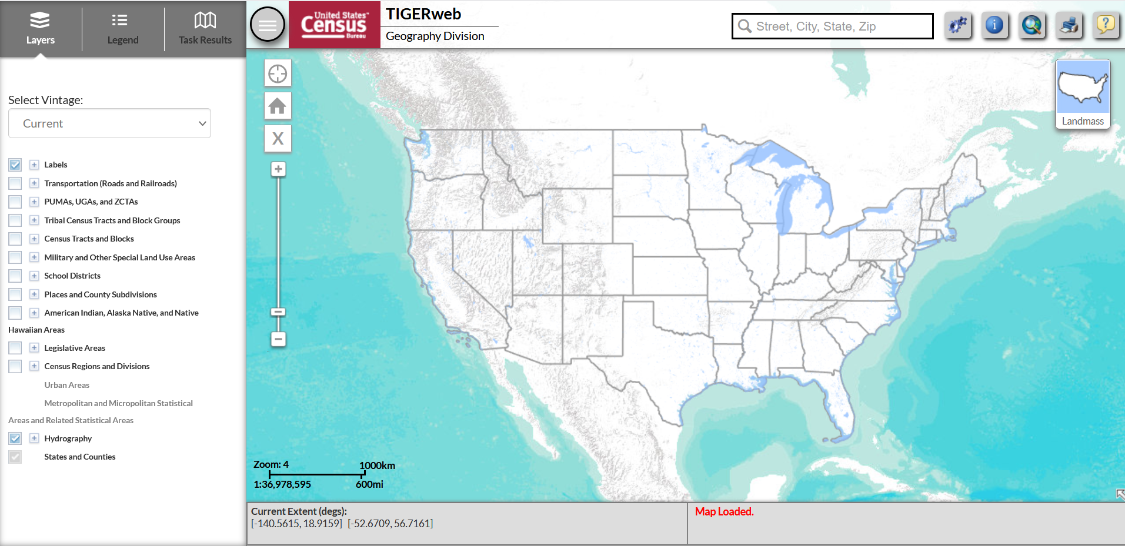
TIGERweb - Homescreen

Slide 13
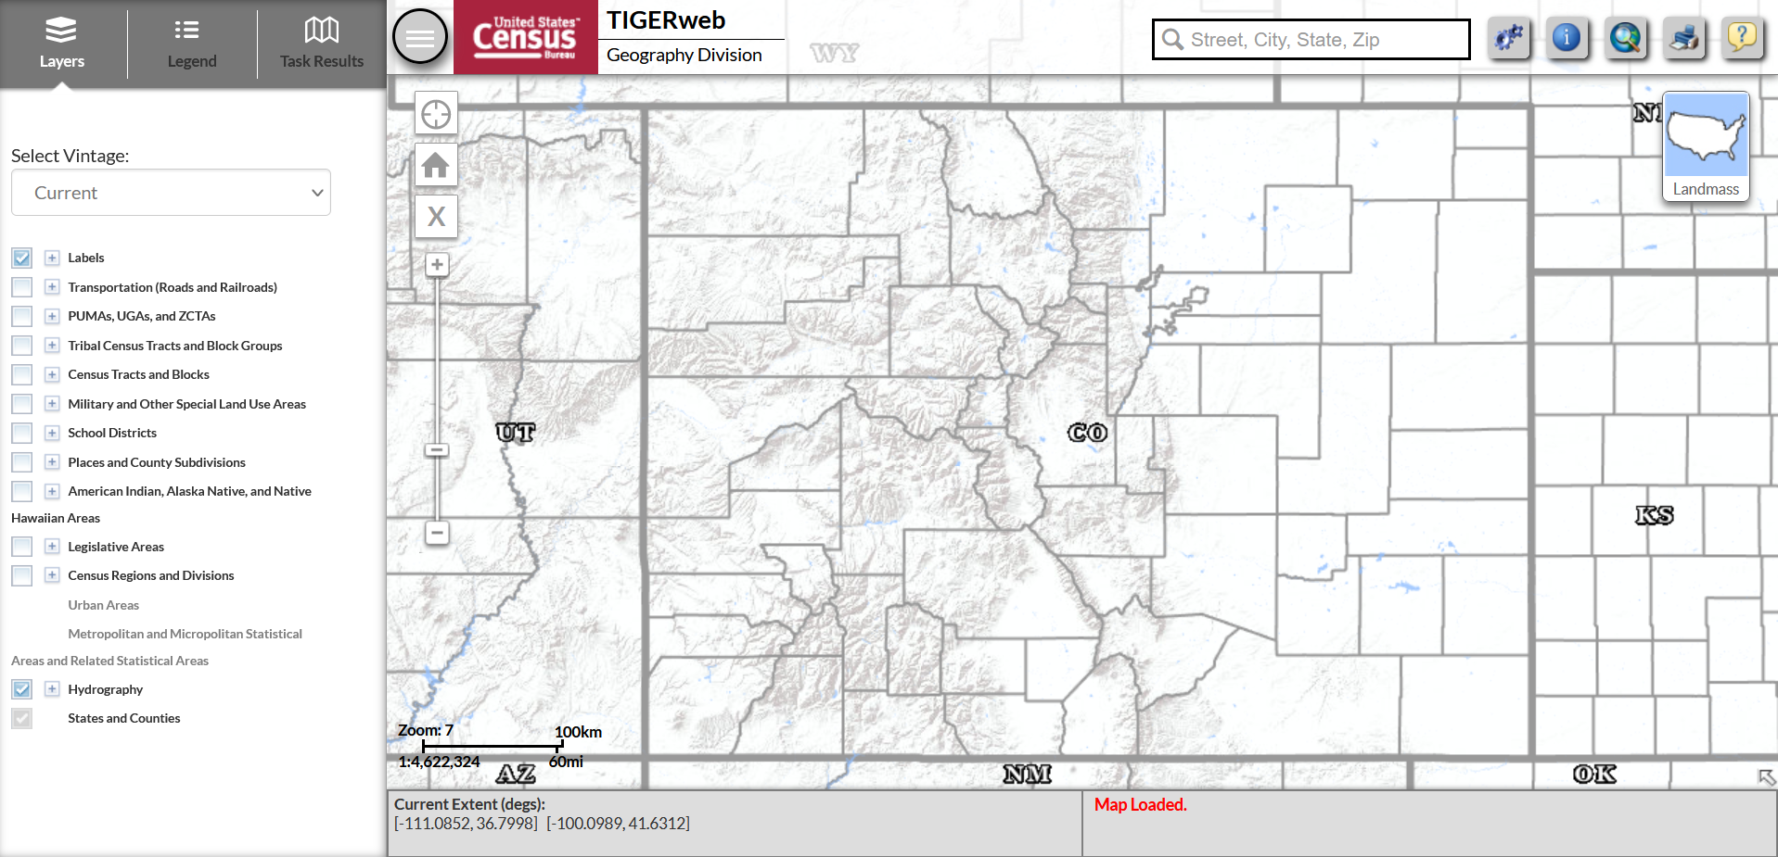
TIGERweb - Colorado

Slide 14
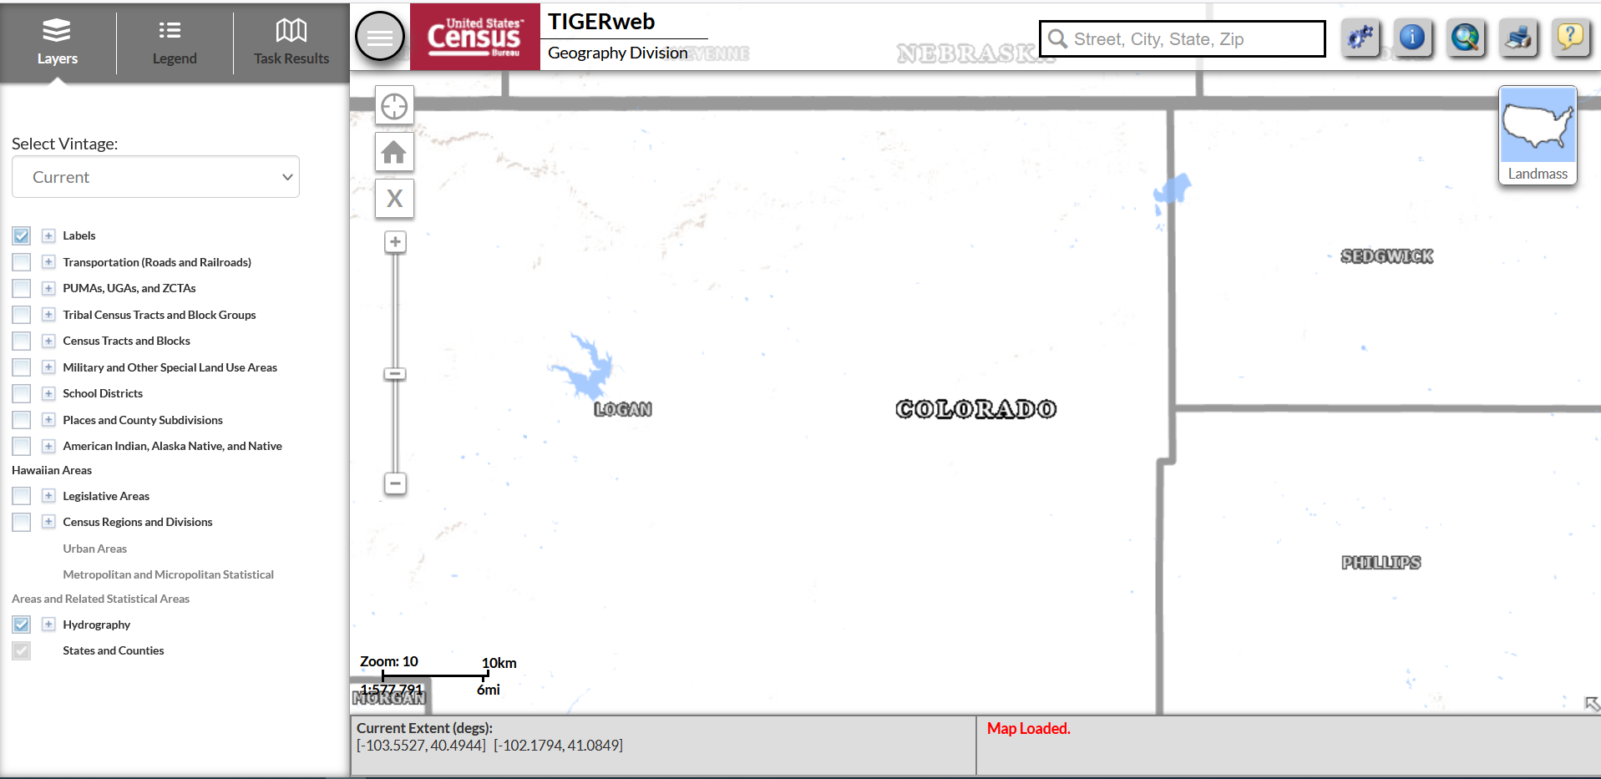
TIGERweb – Default Settings

Slide 15
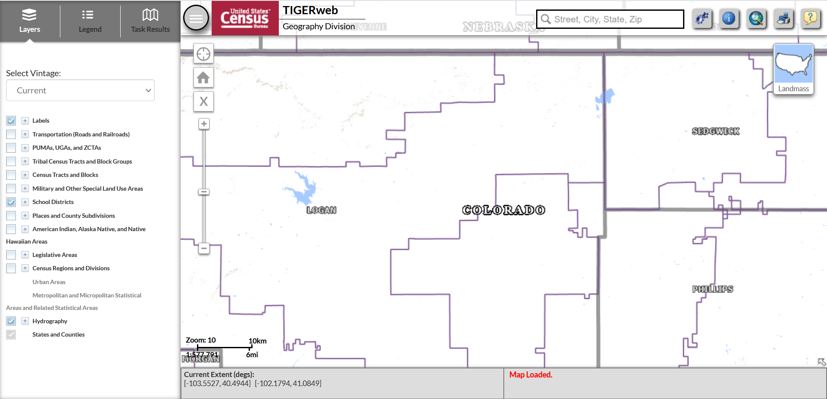
TIGERweb – District Boundaries

Slide 16
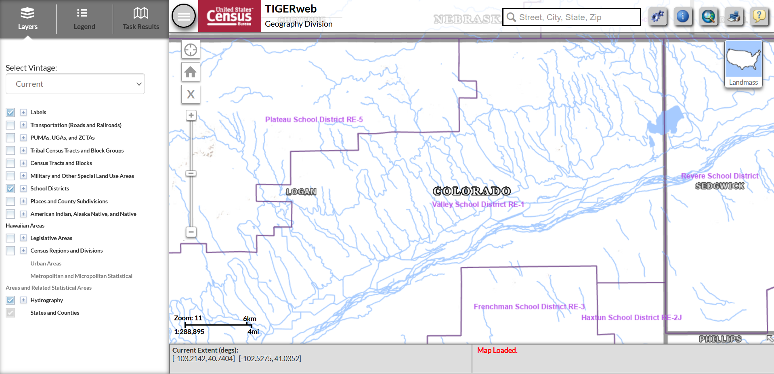
TIGERweb – Additional Features

Slide 17
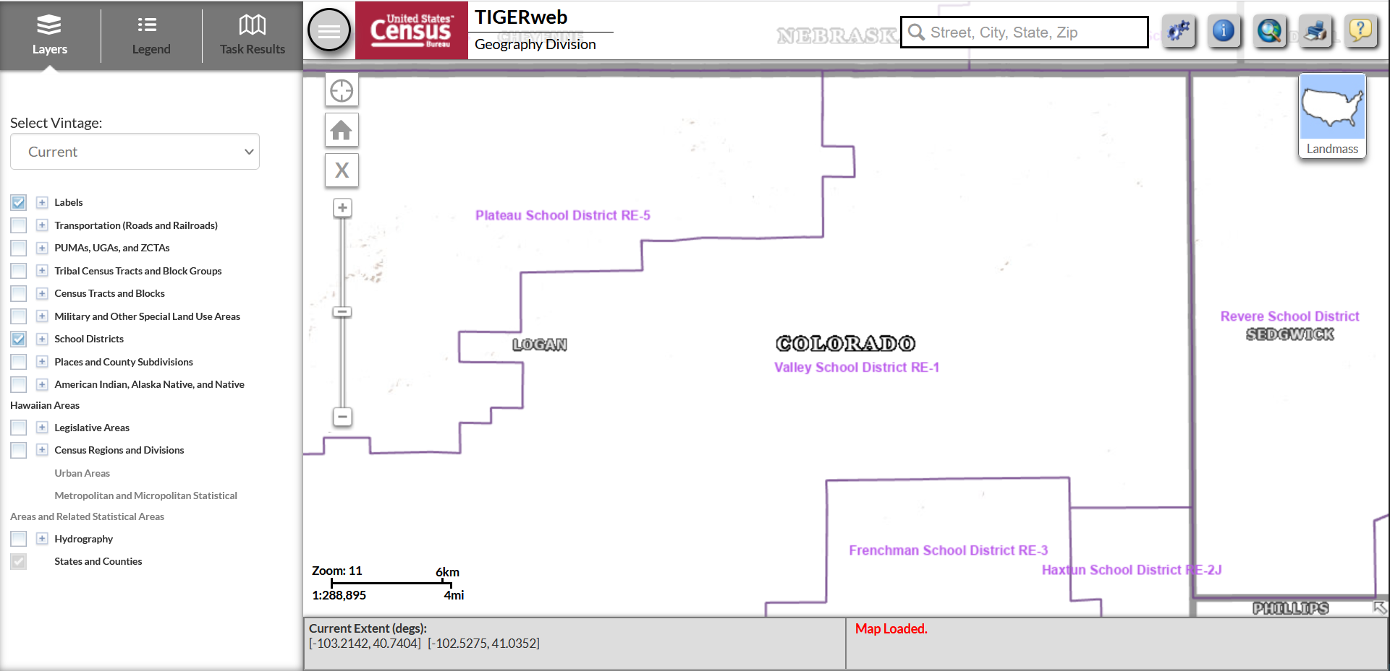
TIGERweb – Hydrography

Slide 18
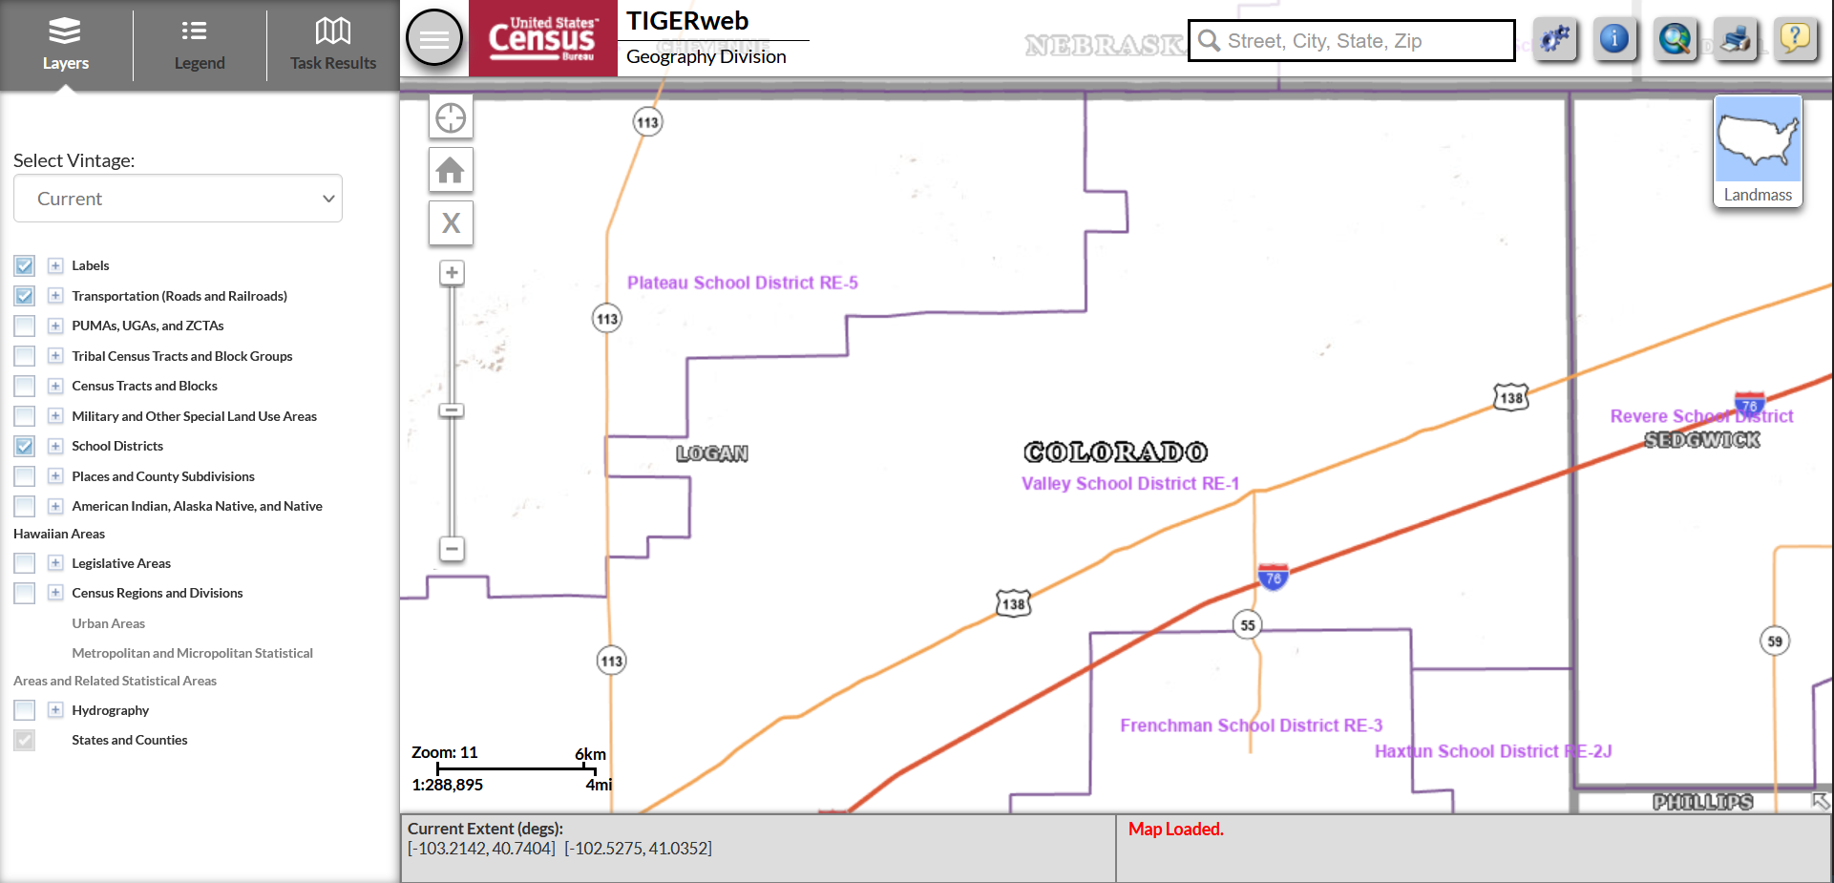
TIGERweb - Transportation

Slide 19
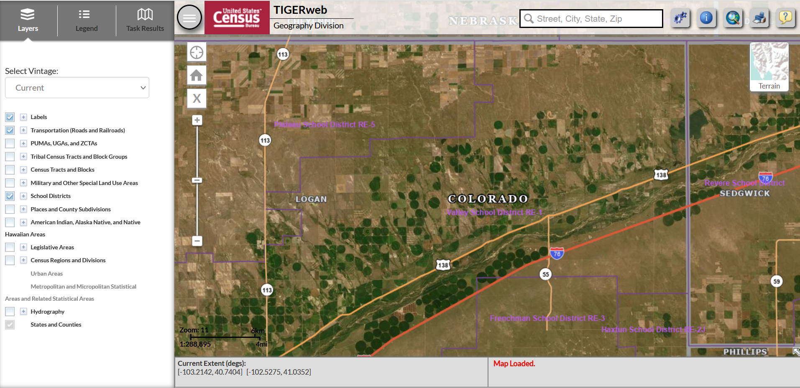
TIGERweb – Map Views

Slide 20
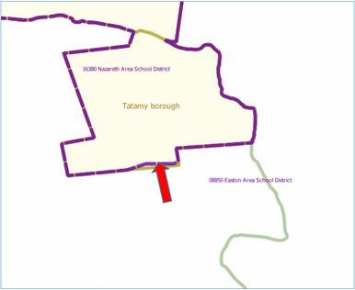
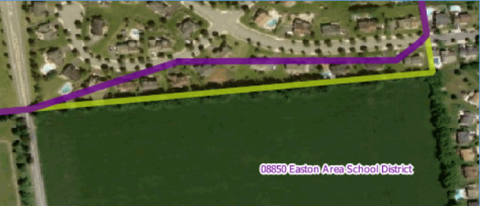
Correcting District Boundaries
To report an error in the district boundaries online, districts should take a screenshot of the current boundaries (using the TIGERweb system) and then annotate the updated boundary location on the same screenshot.
District should notify CDE as soon as possible to report any errors.

Slide 21
Submitting Boundary Changes
All requests to update school district boundaries should be submitted to Tina Negley (negley_t@cde.state.co.us).
Districts are encouraged to submit changes as soon as possible. All annotated screenshots must be submitted no later than December 1st to ensure the information is successfully uploaded in the Geographic Update Partnership Software (GUPS) by the deadline.
Note that the Census Bureau generally does not accept boundary changes of less than 30 feet when the correction does not affect housing. In remote areas with sparse population, the Census Bureau considers a difference of 60-75 feet to not be significant if housing units are not present.

Slide 22
Contact Information
For all SDRP-related questions, please reach out to:
Tina Negley
negley_t@cde.state.co.us
720-766-2793

Slide 23
ESSER Reporting
Notes:
Mackenzie

Slide 24
ESSER Reporting Survey Deadline Extended
The deadline for all three FY 22-23 ESSER surveys has been extended to December 1, 2023.
LEA Participation in ESSER Activities Survey (submitted via Syncplicity).
All LEAs, including AUs, BOCES, etc., must submit.
Please reach out if you need assistance or an extension.
Re-engaging Students Survey (Google form)
All LEAs who received an ESSER 90% allocation (districts) must submit.
School-Level Allocation Survey (Google form)
All LEAs who received an ESSER 90% allocation (districts) and allocated funds to schools in their ESSER applications during FY 22-23 must submit.
Our reporting website contains the surveys and helpful resources for completing them.
Notes:
Note: As this activity continued into the FY24 reporting period, the LEA should prepare to report information about this activity in their FY24 (Year 5) APR and include student group membership counts for the 20 students who participated in the program in FY24. Enrollment counts for activities that occur during the summer should be taken from the previous school year.

Slide 25
Example Reporting Scenario
Evidence-based summer learning program spanning multiple fiscal years
Scenario: An LEA implements an ESSER-funded evidence-based summer learning program that begins in June 2023 and ends in September 2023 in a State whose fiscal year ends on June 30th. This program is only available to students in the 8th grade and serves 30 students at full capacity. When the program begins, 5 students are enrolled in the program. In the last month of the program, enrollment increases to 20 students.
Reporting instructions: For summer programming, the LEA should:
Report “No” to “Is this program available to all students?” as this program is only available to 8th grade students
Indicate that the program serves 30 students at full capacity
Report “5” as the “Total unique headcount of students that participated in this activity”
Provide the student group membership counts for all 8th graders at the LEA in the “Enrolled
eligible Students at LEA in subgroup” fields. Enrollment counts should be taken from the most
recent school year—in this case, school year 2022-2023
Provide the student group membership counts for the 5 students who participated in the
program in FY23 (Year 4) in the “Eligible students in subgroup participating” fields

Slide 26
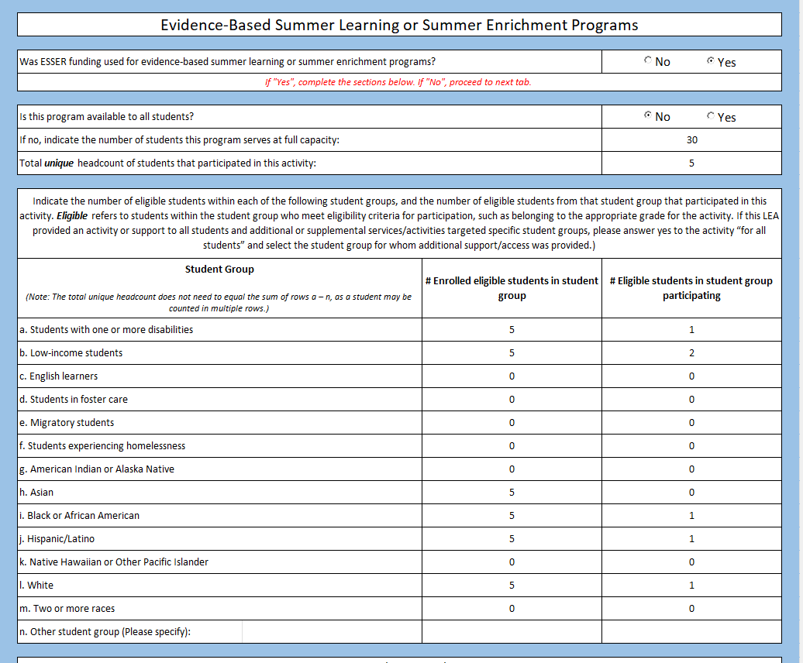
Example Reporting Scenario – LEA Level Template

Slide 27
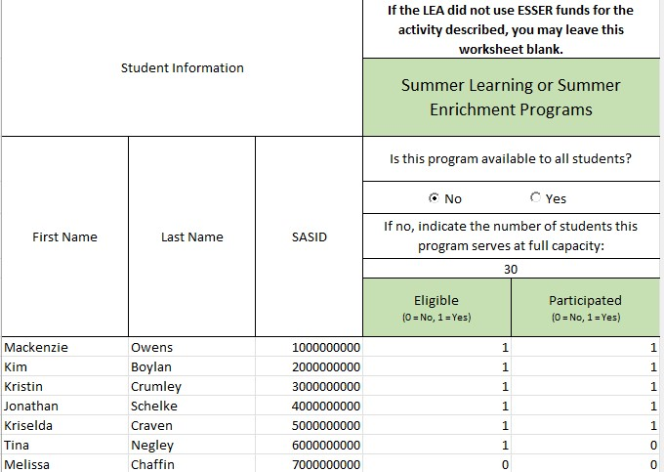
Example Reporting Scenario – Student Level Template

Slide 28
Upcoming Meetings

Slide 29
Looking Ahead…
Any requests for topics or questions?
Upcoming Office Hours:
October 26
November 16
* Due to scheduling conflicts, the November Office Hours have been rescheduled to Nov 16 and Nov 30.

Slide 30
CDE Contacts!
Emails: Lastname_Firstinitial@cde.state.co.us (e.g., Smith_a@cde.state.co.us)
Federal Programs & Supports (ESEA/ESSER Program Supports) | School Finance & Operations (Fiscal and Systems Supports)
Nazie Mohajeri-Nelson, Executive Director of Federal Programs & Supports Unit Program Specialists Program Implementation Supervisor: Laura Meushaw Program Implementation Coordinator: Christina Adeboye Sullivan Program Monitoring Supervisor: Tammy Giessinger ESEA/ESSER Monitoring Coordinator: Kristin Crumley Program Effectiveness Supervisor: Tina Negley Program Evaluation & Research Coordinator: Mary Shen ESEA Programs Specialists and ESEA Regional Contacts (assigned by district) Title I: Laura Meushaw, Evita Byrd, Rachel Echsner, Kim Boylan Title II: Rachel Echsner, Kim Boylan Title III: Rachel Temple Title IV & Stronger Connections Grant: Nathan Hickman, Evita Byrd Title V: Christina Adeboye-Sullivan ESSER Program Specialists Jonathan Schelke Kim Boylan Kriselda Craven ESEA and ESSER Data and Reporting Specialists Mackenzie Owens (ESSER) Melissa Chaffin (ESEA) Jerry Ring (ESEA) | Amy Carman, Executive Director of School District Operations Unit Fiscal Specialists Jennifer Austin, Director of Grants Fiscal Management ESEA Robert Hawkins, Grants Fiscal Analyst Steven Kaleda, Grants Fiscal Analyst ESSER Fiscal Specialist Steven Kaleda Grants Fiscal Analyst ESSER Monitoring Bill Parsley, ESSER Fiscal Monitoring Supervisor Hilery Morris, ESSER Fiscal Monitoring Kristina Jones, Federal Fiscal Monitoring and Reporting Specialist Werner Hagemann, ESSER Fiscal Monitoring Specialist Application Systems Specialists DeLilah Collins, Director of Grants Program Administration Online Applications Systems Technical Support Michelle Prael

