Slide 1
CDE Office Hours
August 4, 2022

Slide 2
Office Hours
Topics
Updates and Reminders
Upcoming ESSER Deadlines
Consolidated Application Updates
Regional Contact Assignments
CS UIP Training Opportunities
Upcoming Meetings
Q&A

Slide 3
Updates, Reminders, and Clarifications

Slide 4
Upcoming ESSER Deadlines
Important Dates
•ESSER III Supplemental budgets due - September 2
•Deadline to spend ESSER I Funds - September 30
~ Statutory Deadline! No Extensions Possible!
•Deadline to draw down ESSER I funds - October 31
Resources
•ESSER launchpad page- includes deadlines and resources
•ESSER I distribution report
•Request for funds webpage
•ESSER Lead Reviewer list - CDE staff to contact with questions on ESSER applications
Notes:
Kim

Slide 5
Updating ESSER III Contacts
Please update your ESSER III contacts if they are outdated to ensure we can reach you for important application, monitoring, and reporting information
You can update your contacts without submitting a PAR - simply go in to the application and update with your most current contact information, then hit the save button
For any questions, reach out to Mackenzie Owens at owens_m@cde.state.co.us
Notes:
Mackenzie

Slide 6
Consolidated Application Updates
Typically, we try to send back comments by the end of July.
We are striving to have preliminary feedback to all LEAs and BOCES within the first couple of weeks of August.
In our efforts to continuously improve our systems and resources to meet the needs of Local Education Agencies (LEAs), we invite you to complete the 2023-2024 Consolidated Application Platform Input survey. The survey will inform CDE on how to improve the application for the next 3 year application.
If you would like to check the status of your application or have any questions, please reach out to your Regional Contact.
Notes:
Tammy
Reviews are taking longer than other years and we greatly appreciate your patience and grace while our fiscal and program teams work hard to provide complete reviews as quickly as possible.
The 22-23 application is the last year of a three-year plan. CDE will need to update the Consolidated Application for the 2023-24 funding year.

Slide 7
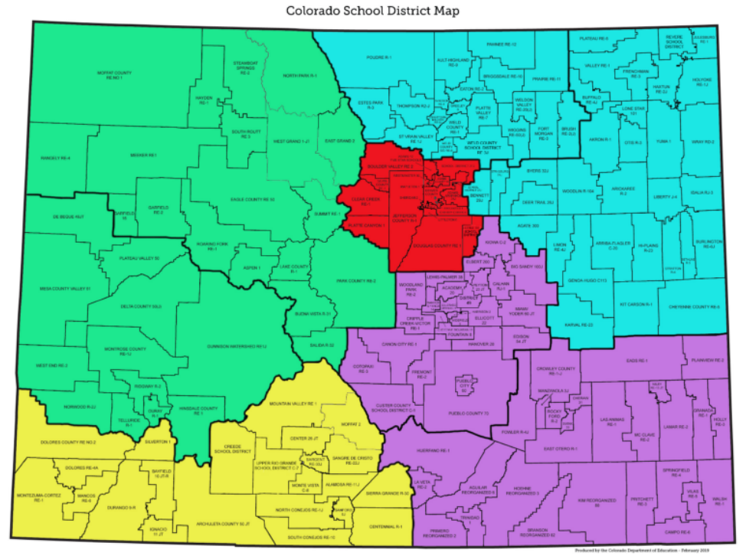
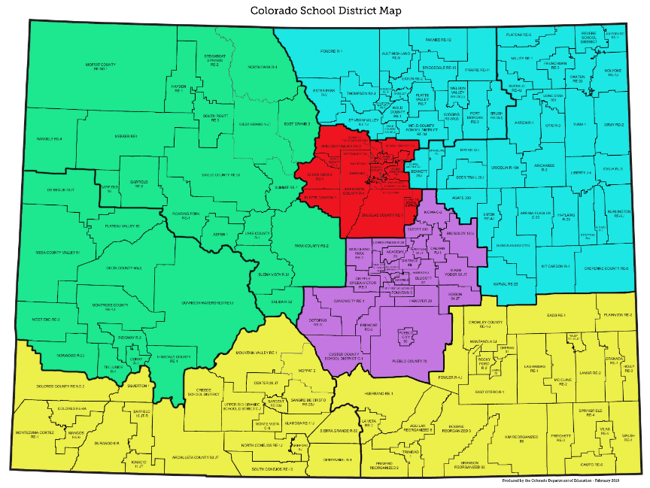
Regional Contact Assignments
Previous:
July 2022 Update:
https://www.cde.state.co.us/fedprograms/regionalcontactspage
Notes:
Tammy

Slide 8
CS UIP Planning
September Virtual Workshop Offerings
Additional Opportunity Coming in September: Workshop sessions for each identification type where CDE staff will assist with questions and help LEA and school staff complete the CS UIP requirements.
Thursday, September 1, 2022 from 8:00-11:00 - Comprehensive Support Plan for CS Identified Schools/UIP: Low Graduation Rate Register HERE
Thursday, September 1, 2022 from 12:00-3:00 - Comprehensive Support Plan/UIP for CS Identified Schools: Low Participation Register HERE
Thursday, September 8, 2022 from 8:00-11:00 - Comprehensive Support Plan/UIP for CS Identified Schools: Lowest 5% Elementary/ Secondary Register HERE
Thursday, September 8, 2022 from 12:00- 3:00 - Comprehensive Support Plan/UIP for CS Identified Schools: Lowest 5% Elementary K-2 Register HERE
Notes:
Karen

Slide 9
Any Requests for Upcoming Topics or Questions!
Upcoming Office Hours
August 18
September 1

Slide 10
Questions?

Slide 11
CDE Contacts!
Emails: Lastname_Firstinitial@cde.state.co.us
(e.g., Smith_a@cde.state.co.us)
Federal Programs & Supports (ESEA/ESSER Program Supports) | School Finance & Operations (Fiscal and Systems Supports)
Nazie Mohajeri-Nelson, Federal Programs & Supports Unit ESEA Programs Specialists and ESEA Regional Contacts (assigned by district) Title I: Laura Meushaw, Kathryn Wisner, Evita Byrd Title II: Karen Bixler Title III: Kathryn Wisner, Rachel Temple Title IV: Tammy Giessinger Title V: TBD ESEA and ESSER: Shannon Wilson ESSER Program Monitoring Specialists Kristin Crumley Jonathan Schelke Kim Boylan ESEA and ESSER Data and Reporting Specialists Tina Negley Mary Shen Mackenzie Owens | Kate Bartlett, Executive Director of School District Operations Unit Fiscal Specialists Jennifer Austin, Director of Grants Fiscal Management ESEA Robert Hawkins, Grants Fiscal Analyst Steven Kaleda, Grants Fiscal Analyst ESSER Fiscal Specialist Steven Kaleda Grants Fiscal Analyst ESSER Monitoring Bill Parsley, ESSER Fiscal Monitoring Supervisor Hilery Morris, ESSER Fiscal Monitoring Application Systems Specialists DeLilah Collins, Director of Grants Program Administration Online Applications Systems Technical Support Michelle Prael

