Slide 1
CDE ESEA and ESSER Office Hours
June 26, 2025

Slide 2
ESEA/ESSER Office Hours
Topics:
2025-26 Consolidated Application
  Substantial Approval
  FER Training Resources
  Q&A
ESSER Real Property Data Collection

Slide 3
ESEA & ESSER Reminders and Updates
Notes:
Nazie

Slide 4
2024-2025 Consolidated Application Updates
Will remain open for any LEAs with remaining funds in the current application so the funds can be accessed (spent and draw down) until 9/30/25.
PARs must be submitted to be able to use funds in July-September.
PARs are due by July 18, 2025.

Slide 5
Due by Monday, June 30, 2025
Completed Cross Program Section, as applicable to the LEA
  Alternative Fund Use Authority (AFUA)
  Contacts
  Cross Program Questions
  Non-Public Schools page and consultation forms
  2023-2024 EDT Data
  ESSA School Improvement Narratives
  Targeted and Additional Targeted Support Schools
  Tribal Consultation Attestation
  School Improvement Retention of Funds Request Form (2025-2026 SY)
  Assurances
  2025-2026 ESEA General Assurances
Completed Title I, Part A Section
  LEA Set-Aside
  LEA Data Profile
  School Ranking - must include all schools that the LEA is planning to serve in 2025-2026; rank order will be checked for final approval
  Preschool Table
  Title I, Part A Narratives
  Tentative Budget - LEA/BOCES can include projected carryover
Completed Title I, Part D Section (for LEAs that receive an allocation)
  Title I, Part D Narratives
  Tentative Budget - LEA can include projected carryover

Slide 6
Components for 2025-2026 Substantial Approval
Section | Minimum Required for Approval
Title I, Part A Budget | - Tentative Title I budget (may include projected carryover)
Title I, Part D Budget | - Tentative Title I, Part D budget (may include projected carryover)
Projected Carryover: The following is an available option for LEAs that would benefit from including projected carryover in their 2025-2026 application.
LEAs may include projected carryover in their Title I, Part A, Title Part D and Title IV budget as part of their Substantial Approval submission. Note: This will cause the amount budgeted to exceed the amount available.
LEAs will be unable to receive final approval until the LEA’s budget is balanced. In order for the budget to be balanced with carryover included, the LEA will need to submit their Final Expenditure Report (FER) so that official carryover can be transferred into the 2025-2026 Consolidated Application. After the official carryover is added, the LEA must make any adjustments needed to the tentative budget that had been submitted for substantial approval to balance the budget.

Slide 7
When Ready to “Submit”
When LEA has completed components for Substantial, the LEA/BOCES should not officially submit the application within GAINS until all allocations are available, the Authorized Representative will complete this form. This form will notify CDE that the application is ready to be reviewed for Substantial Approval.
Not officially submitting the application will minimize the resubmission of the application each time that new allocations are received and added to GAINS.
Form must be submitted by June 30, 2025 for Substantial Approval.
A Substantial Approval Letter will be sent through GAINS once the application is granted substantial approval.
  GAINS status will not change
  Substantial will be awarded for the allocations the state has been awarded. At this time, Colorado has been awarded Title I, Part A, Title I, Part D and Title IV.
    Other allocations will be added on a rolling basis as they are received.
When other allocations become available, the LEA will be required to complete the remainder of the sections and submit the application at that time to obtain final approval.

Slide 8
Extension Request
If the LEA has determined it is unable to complete the requirements for substantial approval by June 30, the LEA may submit an extension request.
  The LEA may not obligate funds until a complete application has been submitted to CDE and CDE has granted the application Substantial Approval.
  The LEA cannot request funding for any expenses incurred prior to the substantial approval date.
  Once the extension request has been submitted and approved, the LEA has until July 30 to submit the requirements for Substantial Approval.
  Extension Requests available through GAINS. Log into GAINS and from the navigation links on the left side of the screen, click on the Application Supplements link listed on the Application Supplements page. Users will see the ESEA Consolidated Application Extension Request link on the screen and will click that link to access the form.

Slide 9
Next Steps
All other remaining program pages will be due at a later date.
Final Expenditure Report - in order for the budget to be balanced with carryover included, the LEA will need to submit their Final Expenditure Report (FER) so that official carryover can be transferred into the 2025-2026 Consolidated Application. After the official carryover is added, the LEA must make any adjustments needed to the tentative budget that had been submitted for substantial approval to balance the budget.
FER is available in GAINS under 2025. Instructions are available here (FER Small Bite instructions and Recording.)
Reminder: Substantial approval allows for obligation of funds (making a binding commitment to pay for costs). Requests for funds / drawing down of funds requires final approval.

Slide 10
Resources
Email any questions and/or Schedule a 1x1 with the LEA’s Regional Contact(s) for support.
Consolidated Application Planning Resource
Application and GAINS Trainings
Consolidated Application general information
June 12th Office Hours PowerPoint and Recording

Slide 11
Components for 2025-2026 Substantial Approval (Part 1)
Due by June 30, 2025
Section | Minimum Required for Approval
Allocations | - Confirm Title I, Part A and Title I, Part D align with LEA's allocation.
AFUA, Contacts | - LEA can mark the anticipated plan for allocations or can mark that they will not AFUA and change it later. - Must have at least Authorized Representative for substantial approval.
Cross Program Narrative Questions | - Response provided for each narrative question. - Use “Copy Previous Fiscal Year Details” to use 2024-2025 response where applicable. - “Discuss Major Improvement Strategies” is a new component.
General Education Provisions Act (GEPA) | - Response is provided for each component.
Non-Public Schools | - Upload Consultation Forms with signature for all non public schools within the LEA. - Forms may include all Titles updated depending on future allocations. - Provide the Participation Status for each non public school.
Notes:
Cross Program, Title I, Part A and D,

Slide 12
Components for 2025-2026 Substantial Approval (Part 2)
Due by June 30, 2025
Section | Minimum Required for Approval
Equitable Distribution of Teachers (EDT) | - Response provided for each narrative question. (if applicable)
ESSA School Improvement Narratives | - Response provided for each narrative question. (if applicable)
Targeted and Additional Targeted Support Schools | For each school, indicate whether the district is exiting the school from TS/ATS status. If the LEA has indicated in Question 1 that it will annually exit all schools no longer meeting the state's identification criteria, select the "Pending state's identification process" option. When this option is selected, schools will be exited from TS/ATS status if they are not re-identified the subsequent year. If the LEA has indicated that it has established other exit criteria and timelines, select "Yes" to indicate that a school has met the LEA's exit criteria and timeline, or "No" to indicate that the school has not yet met the LEA's exit criteria and timeline. The LEA should keep their process on file for monitoring.

Slide 13
Components for 2025-2026 Substantial Approval (Part 3)
Due by June 30, 2025
Section | Minimum Required for Approval
Assurances and Attestations | Selection Within Application Tribal Consultation Attestation School Improvement Retention of Funds Request Form Assurances Upload with Signature 2025-2026 ESEA General Assurances (Board President Signature required to receive substantial approval)

Slide 14
Components for 2025-2026 Substantial Approval (Part 4)
Due by June 30, 2025
Section | Minimum Required for Approval
Title I, Part A Narratives | - Response provided for each narrative question.
Title I, Part A Data Profile | - The LEA has selected a poverty measure.
Title I, Part A School Ranking | - LEA selects a Qualifying Method for Serving Schools and is serving schools according to the Qualifying Method selected. - Title I schools have been identified. - If there are any change in Program Type (TA, SW, CSW) from 2024-2025 Include a comment in the Title I General Comment Box. - Complete list of Title I schools must be finalized by August 1. - Complete this form if the LEA needs to add a school to the School Ranking page.
Title I, Part D Narratives | - Response provided for each narrative question. - Formal Agreement is not required for substantial (will be required for final)

Slide 15
ESSER Real Property Data Collection
Notes:
Kim, Tammy

Slide 16
Action Required for All Recipients of ESSER Funds
Review Uses of ESSER funds for Real Property improvements.
  For recipients with NO Real Property improvements, complete and submit the Smartsheet Certification form, indicating “0” Real Property Reports will be submitted, due September 1, 2025.
  For recipients with Real Property improvements, complete and submit the Smartsheet Certification form, indicating the number of Real Property Reports to be submitted, and attach SF-429 Cover Page and SF-429-A forms for each parcel, due September 1, 2025 and September 1 of each subsequent year for 15 years.

Slide 17
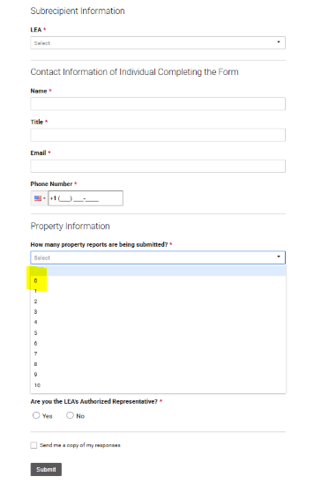
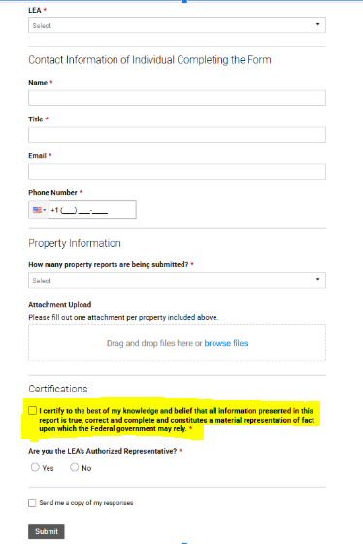
Complete the Smartsheet Submission Form - All ESSER recipients
Due Date
September 1, 2025
September 1 of each subsequent year if ESSER Real Property Reports are required for one or more parcel.
If reporting on 10 or more parcels, please complete and submit additional Smartsheets.
Notes:
Each recipient of ESSER funds will complete the Real Property Status Report Smartsheet, regardless if ESSER funds were used for real property projects. If the recipient determines there are no projects to report, select “0” from the drop-down, read and select the Certification, then click “Submit”. No further action will be required. If the recipient is required to submit ESSER Real Property reports, select the appropriate number from the drop-down, be sure to attach the SF-429 Cover Page and SF-429 A forms for each parcel. if submitting more than 10 attachments, please submit additional Smartsheet submission forms.

Slide 18
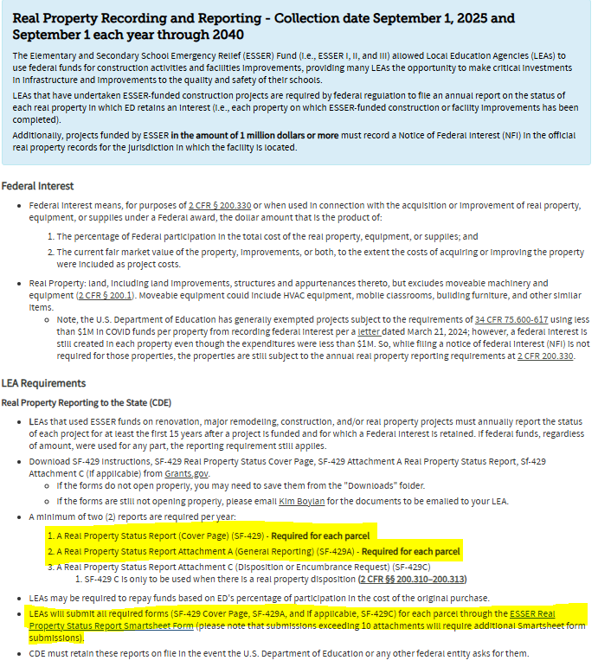
Accessing the Real Property Reporting Forms and Instructions
All SF-429 forms are available to download from Grants.gov and are linked on the ESSER Grantee/Subgrantee Reporting Webpage.

Slide 19
Additional Resources
USDE Guidance and FAQ
Grants.gov Post-Award Reporting Forms
ESSER Reporting Website
Disposition Guidance
For questions about the Real Property Data Collection, please contact: esserapplications@cde.state.co.us

Slide 20
Upcoming Meetings

Slide 21

Looking Ahead…
Any requests for topics or questions?
Upcoming Office Hours
  July 17 -
    Tentative date if needed. Unless there are urgent topics to cover, there will not be any Office Hours in July.

Slide 22
CDE Contacts!
Emails: Lastname_Firstinitial@cde.state.co.us (e.g., Smith_a@cde.state.co.us)
Federal Programs & Supports (ESEA/ESSER Program Supports) | School Finance & Operations (Fiscal and Systems Supports)
Nazie Mohajeri-Nelson, Executive Director of Federal Programs & Supports Unit Program Specialists Program Implementation Supervisor: Laura Meushaw Program Implementation Coordinator: Christina Adeboye Sullivan Program Monitoring Supervisor: Tammy Giessinger ESEA/ESSER Monitoring Coordinator: Kristin Crumley Program Effectiveness Supervisor: Tina Negley Program Evaluation & Research Coordinator: Anna Rowan ESEA Programs Specialists and ESEA Regional Contacts (assigned by district) Title I: Laura Meushaw, Evita Byrd, Rachel Echsner, Kim Boylan Title II: Rachel Echsner, Sue Miller-Curley Title III: Rachel Temple, Kim Boylan Title IV & Stronger Connections Grant: Nathan Hickman, Evita Byrd Title V: Christina Adeboye-Sullivan, Rachel Echsner ESEA and ESSER Data and Reporting Specialists Melissa Chaffin (ESEA) Jerry Ring (ESEA) Anna Rowan (ESEA) | Vacant, Executive Director of School District Operations Unit Fiscal Specialists Jennifer Austin, Director of Grants Fiscal Management ESEA Robert Hawkins, Grants Fiscal Analyst Steven Kaleda, Grants Fiscal Analyst ESSER Fiscal Specialist Steven Kaleda Grants Fiscal Analyst ESSER Monitoring Bill Parsley, ESSER Fiscal Monitoring Supervisor Hilery Morris, ESSER Fiscal Monitoring Application Systems Specialists DeLilah Collins, Director of Grants Program Administration Online Applications Systems Technical Support Jessica Hollingshead Michelle Prael

