Slide 1
CDE ESEA and ESSER Office Hours
April 24, 2025

Slide 2
ESEA/ESSER Office Hours
Topics:
Updates and Reminders
LEA Leadership and CS-Y3+ Convening

Slide 3
ESEA & ESSER Reminders and Updates
Notes:
Nazie

Slide 4
Update: ESSA State Plan Amendment
ESSA State Plan Amendment has been approved by ED!
Changes for 2025 ESSA identification
Will use the more asset based term of “Multilingual Learner”
School Quality and Student Success Indicator
Resume using the definition of chronic absenteeism (excused and unexcused) like prior to the pandemic
Added science back in
Added chronic absenteeism for K-2 schools
CS-Low Graduation Rate - three year weighted average of the 7-year graduation rate for identification and exit
21st Century
Five year awards to 21st CCLC subgrants
No activities during the school day
No news on allocations - possibly end of May
Notes:
Awarding Subgrants
CDE amended the description of its process to award subgrants to clarify that it will fully fund each 21st CCLC subgrant to which it makes an award for all five years of the subgrant. CDE also revised its State plan to clarify that it will no longer permit 21st CCLC subgrantees to use 21st CCLC funds for expanded learning program activities during the school day.

Slide 5
LEA Leadership for School Improvement
CS Y3+ SPRING 2024-2025 Convening
April 24, 2025
FPSU Office Hours
Notes:
Nazie

Slide 6
Purpose:
Purpose of Today’s Office Hours and CS-Y3+ Convening:
To provide LEA Leaders with the knowledge and tools to support School Improvement, including for ESSA-Identified Schools.
To provide additional clarification on the identification of “Comprehensive Support - Low Graduation”
To support LEA Leaders of CS-Y3+ Schools to support continuous improvement for identified schools. (List of Districts with CS Y3+ Schools on the next slide)
Notes:
Sue - speak to dual purpose, create graphic.

Slide 7
LEA Leadership for School Improvement
Notes:
Nazie

Slide 8
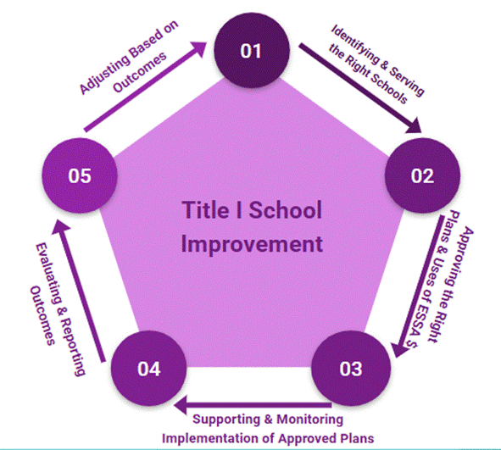
All LEAs lead schools in the continuous improvement process
ESSA, specifically Title I, Part A, requires State and Local Educational Agencies to provide technical assistance and oversight of the continuous improvement cycle for any school identified for support and improvement.
Today’s Objective:
Partner with you in improving outcomes for identified schools
Review the full cycle and requirements under each component
Provide any support needed for any of the components
Notes:
Nazie

Slide 9
To Begin: Zoom Poll
Our LEA understands ESSA Identification for Comprehensive Support, Targeted Support and Additional Targeted Support.
Our LEA understands how to support ESSA-Identified Schools in developing and monitoring improvement plans.
Our LEA understands how to use our Consolidated Application to support ESSA-Identified Schools.
Notes:
Sue

Slide 10
ESSA Identification
Notes:
Nazie

Slide 11
Acronyms - ESSA School Improvement
ESSA - Every Student Succeeds Act (Federal law)
TS - Targeted Support and Improvement
ATS - Additional Targeted Support and Improvement
CS - Comprehensive Support and Improvement
CS-Y3+ - Comprehensive Support for Three Years or More
UIP - Unified Improvement Plan
EASI - Empowering Action for School Improvement (Grants)

Slide 12
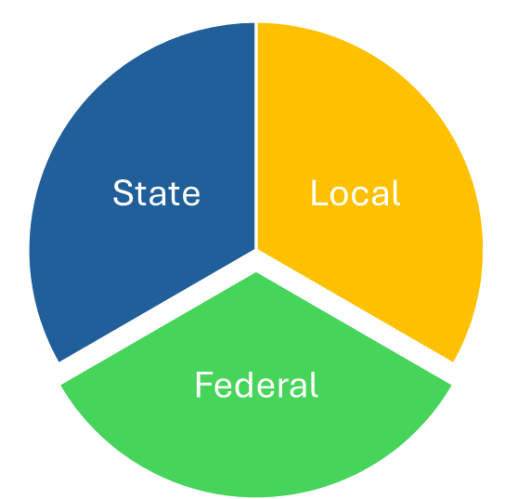
Colorado Educational Accountability System
Local accountability
Locally elected boards oversee superintendent and district policies
State Accountability
Colorado Educational Accountability Act
Includes Performance Frameworks, Improvement Planning, Accountability Clock, Accreditation Contracts, Accountability Committees
Federal Accountability
Every Student Succeeds Act (ESSA) - State plan approved
Schools on improvement (CS, TS, ATS)

Slide 13
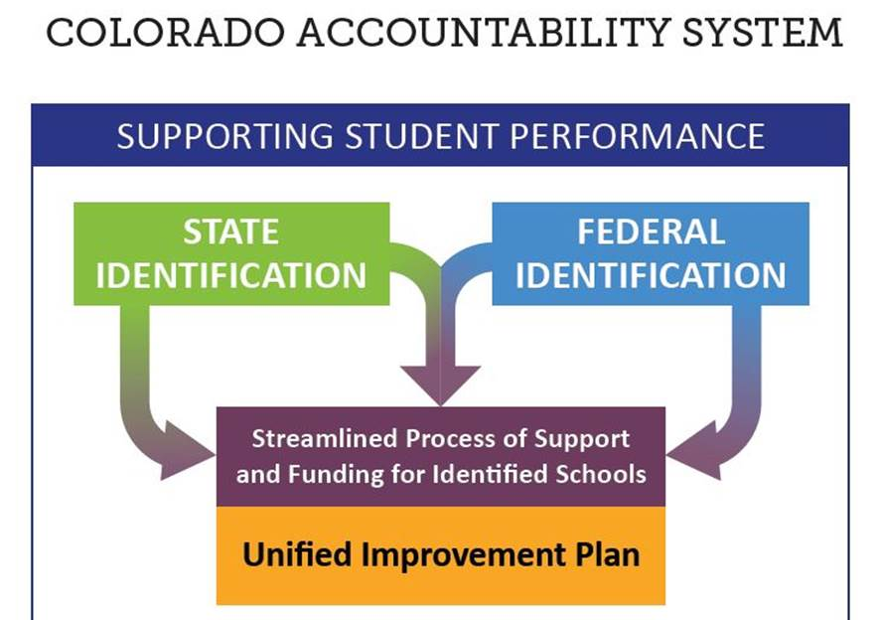
Colorado Accountability System

Slide 14
Overview of ESSA Identification
Every state that accepts funds under the Elementary and Secondary Education Act (ESEA), as reauthorized by the Every Student Succeeds Act (ESSA), must have an approved methodology for meaningfully differentiating the performance of and identifying schools for support and improvement.
CDE annually identifies schools within the following categories:
Comprehensive Support and Improvement (CS)
CS - Lowest 5% (Title I Schools)
CS - Low Graduation Rate
CS - Former ATS (Title I Schools)
Targeted Support and Improvement
Targeted Support (TS)
Additional Targeted Support (ATS)

Slide 15
CS - Lowest 5%
Lowest performing five percent of Title I schools based on:
Performance of all students and each student group (multilingual learners, students with disabilities, students experiencing poverty, and students from each racial/ethnic group)
Five ESSA Indicators:
Academic Achievement
Academic Progress (Growth)
Progress in Achieving English Language Proficiency (ELP)
School Quality or Student Success (SQSS)
Science and chronic absenteeism for elementary and middle schools
Science and dropout rates for high schools
Graduation Rates

Slide 16
Exiting CS - Lowest 5%
Based on stakeholder input, schools will remain on Comprehensive Support and Improvement (CS) for at least 3 consecutive years to allow time to implement improvement strategies. Schools that are not re-identified during those 3 years will continue to be eligible for supports and services and will be categorized as “On Watch”.
Schools exit if they are not re-identified for CS - Lowest 5% for 3 years following identification and if they no longer meet the criteria that resulted in their initial identification.

Slide 17
CS - Low Grad
Colorado identified all public schools with 4-year and 7-year graduation rates below 67% for three consecutive years for CS - Low Graduation Rate.
If a school had both a 4-year and 7-year graduation rate, both must be below 67%
Beginning in fall 2025, Colorado will use a three-year weighted average of the 7-year graduation rates only for identification of CS - Low Graduation Rate.
Schools with an average 7-year graduation rate below 67% will be identified.

Slide 18
Exiting CS - Low Grad
Based on stakeholder input, schools will remain on Comprehensive Support and Improvement (CS) for at least 3 consecutive years to allow time to implement improvement strategies. Schools that are not re-identified during those 3 years will continue to be eligible for supports and services and will be categorized as “On Watch”.
Previously, schools exited if they were not re-identified for CS - Low Grad for 3 years following identification and if they earned a graduation rate of at least 67% on either the 4- or 7-year graduation rate.
Beginning in Fall 2025, schools will exit if the three-year weighted average of the 7-year graduation rate is at least 67%.

Slide 19
Frequently Asked Questions - CS Low Grad
Notes:
Tina

Slide 20
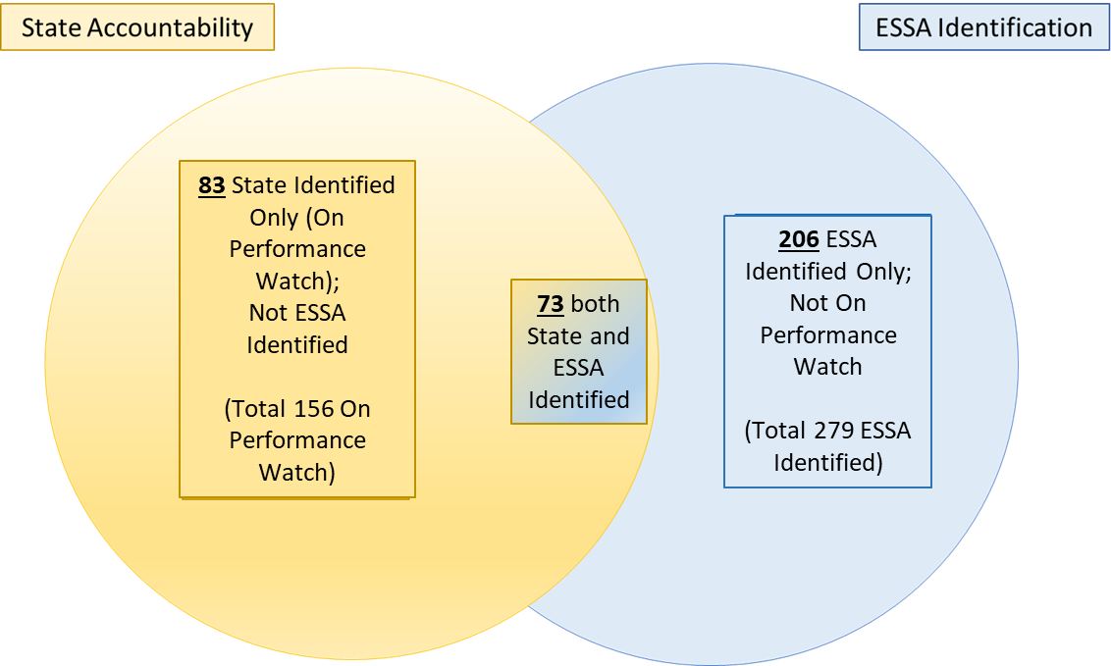
What are the Differences Between State and Federal Identification Methodologies?

Slide 21
Which Graduation Rate Cut Scores are Used in State and Federal Identification?
Federal (ESSA Identification)
All schools with graduation rates (based on methodology noted previously) below 67 percent are identified for CS - Low Graduation Rate.
State (School/District Performance Frameworks):
Traditional Framework- The “best of” graduation rate (best of the 4-, 5-, 6-, or 7-year rate) is compared to the following cut scores:
AEC Framework- The “best of” completion rate is compared to the following cut scores:
Graduation Rate | Rating
At or above 95.0% | Exceeds
At or above 85.0% but below 95.0% | Meets
At or above 75.0% but below 85.0% | Approaching
Below 75.0% | Does Not Meet
Completion Rate | Rating
At or above 69.4% | Exceeds
At or above 49.5% but below 69.4% | Meets
At or above 40.0% but below 49.5% | Approaching
Below 40.0% | Does Not Meet

Slide 22
What are the Differences Between Graduation and Completion Rates? When are they Used in Identification?
The graduation rate includes students who received a regular high school diploma upon completion of local graduation requirements and meeting Colorado’s Graduation Guidelines (i.e., graduates).
Used in state and federal identification
The completion rate includes graduates plus students who receive a High School Equivalency Diploma (HSED) or receive a non-diploma certificate of completion.
Because the completion rate includes graduates, the rate will always be equal to or greater than the graduation rate.
Used in state (AEC frameworks) but not federal identification

Slide 23
Our AEC school received a Performance Rating on the SPF and is also ESSA Identified for Comprehensive Support- Low Graduation Rate. Why does the school have two different ratings?
The SPF and ESSA identification look at different metrics with different expectations for school performance. This may result in a “Performance” rating on the AEC SPF, but ESSA identification for Comprehensive Support-Low Graduation Rate.
State identification
The AEC SPF includes data from four categories: Academic Achievement, Academic Growth, Student Engagement, and Postsecondary and Workforce Readiness.
The AEC SPF utilizes the best-of completion rate, with cut points normed across AECs. Graduation rate is an optional measure.
Federal identification
All public high schools, including AECs, must be evaluated based on graduation rate. Schools with a graduation rate less than 67% are identified for Comprehensive Support-Low Graduation.

Slide 24
More Questions about ESSA ID?
Visit Tina/Anna in Breakout Rooms
Coming Soon! FAQ for ESSA-Low Graduation

Slide 25
Leadership for ESSA Identification - TS, ATS, CS
Notes:
Tina, Anna, Sue (rework our AEC Conference Presentation)

Slide 26
Overview of LEA Requirements for ESSA Identified Schools
CDE identifies schools, notifies LEAs, and shares the data used in identification in ESSA School Profiles with the LEA, which:
Must notify the school of its identification under ESSA.
Must support schools in identifying the root causes of the reasons for identification (share ESSA profiles with the school) through a comprehensive needs assessment
For CS schools identify any resource inequities and ensure resource allocations to schools are sufficient to address needs
Must support schools with the development, implementation of, and progress monitoring improvement plans that will help the school progress towards meeting exit criteria
May apply for support/funding through the Empowering Action for School Improvement (EASI) for improvement efforts

Slide 27
Improvement Requirements for ESSA Identified Schools (Additional requirements for CS schools)
Plans must:
Be developed with stakeholders (including school leaders, teachers, and parents)
Be informed by student performance against ESSA indicators
Include evidence-based interventions that address the reasons for identification
Include a school-level needs assessment
Identified and addresses any resource inequities
Be reviewed and approved by the school and district for all ESSA identified schools, as well as by CDE for CS schools
Be monitored and periodically reviewed by CDE to ensure implementation
The UIP serves as the CS Improvement Plan and is reviewed and approved by CDE. The LEA must have a process for reviewing and approving all ESSA identified schools, particularly the TS and ATS schools which CDE does not review.
For detailed information:
ESSA Requirements Website
Resource Inequities Planning
UIP Resources - Rubric for ESSA-Identified CS Schools

Slide 28
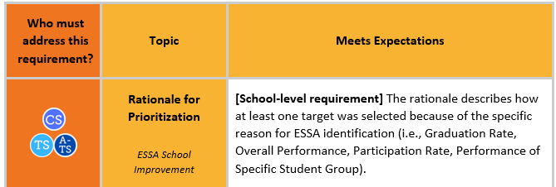
Example: Meeting TS, ATS and CS Requirements in School Improvement Planning

Slide 29
What is the timeline LEAs should follow for meeting ESSA Requirements in UIP for CS Schools?
Stage | CS
Initial Identification | September 2024
Begin addressing reason for identification | September 2024
Planning | 2024-2025
Include ESSA requirements in UIP | 2025-2026
CDE reviews plan for approval | 2025-2026

Slide 30
More Rigorous Actions CS Y3+
Notes:
Sue

Slide 31
More Rigorous Action: CS-Y3+ ESSA Sections 1111(d)(3)(A)(i) and 1111(d)(1)(C)
…schools identified by the State for comprehensive support and improvement under subsection (c)(4)(D)(i), which, if not satisfied within a State-determined number of years (not to exceed four years), shall result in more rigorous State-determined action, such as the implementation of interventions….
STATE EDUCATIONAL AGENCY DISCRETION.—With
respect to any high school in the State identified under sub- section (c)(4)(D)(i)(II), the State educational agency may—
(i) permit differentiated improvement activities that utilize evidence-based interventions in the case of such a school that predominantly serves students—
(I) returning to education after having exited secondary school without a regular high school diploma; or
(II) who, based on their grade or age, are significantly off track to accumulate sufficient academic credits to meet high school graduation requirements, as established by the State

Slide 32
More Rigorous Action
If the school is re-identified as CS for three consecutive years, the State Educational Agency (i.e., CDE) must take more rigorous state-determined actions beginning in the fourth year.
CDE has worked with stakeholders and the ESEA Committee of Practitioners to develop its process for More Rigorous Action (MRA). CDE is committed to working with the school and LEA to build the MRA that is supportive, and builds upon and continues the improvement efforts already in place and taken by the school and LEA. When a school is also identified under state accountability, the state accountability clock pathway is also considered the ESSA MRA.
The purpose of this convening is to hear from LEAs regarding the improvement efforts already underway and how CDE can support the school or LEA in next steps. We have analyzed where schools are based on the information available to us! We want to hear from you on what other steps or strategies would benefit the identified schools.

Slide 33
Framework for “More Rigorous Action”
ESSA permits differentiated evidence-based improvement activities for schools serving students re-engaging in education (in Colorado, our AECs)
BEGIN with School Improvement Planning
PROVIDE Funding for School Improvement
CONTINUE Implementation and Monitoring

Slide 34
Continuum for More Rigorous Action:
UIP Planning Support: Consultation
UIP Review and Feedback
State
Accountability:
Support and Monitoring
1.Develop CS Plan
EASI Pathway:
Diagnostic Review
EASI Pathways: Matched to Local Need and Context
2. Fund the Plan
3.Continue to Implement and Monitor
EASI Targeted Grants:
Implementation Partner (PILOT);
Other Targeted Grants
Support: Matched to Local Need and Context
LEA-Led Actions:
LEA Support, Monitoring and Resources

Slide 35
More Rigorous Action Steps: CS Y3+ Schools at a Glance
21 schools have an approved CS plan (within last 3 years)
7 schools participated this year in a UIP Consultation
19 schools have had or are currently having a Diagnostic Review
19 schools have taken part in “Big” EASI Grants (within last 3 years)
12 schools part of latest EASI Grant (EASI Cohort 8)
6 schools applied to be part of EASI Targeted Grant: Implementation Partner Pilot

Slide 36
LEA Responsibilities - ESSA Identified Schools
Notes:
Tammy

Slide 37
Notifying Schools and Sharing Identification Data
LEAs must:
Notify each school of their identification for CS, TS, or ATS, including the reason for identification
Ensure that each identified school understands their identification status and related requirements
LEAs are encouraged to:
Notify parents and families when a school is identified as CS, TS, or ATS
Share the ESSA School Profile with the school
Meet with each school to review the School Profile provided by CDE and help the school understand the data (if need be, invite CDE to help answer questions about the data)

Slide 38
Developing and Implementing Improvement Plans
LEAs must develop and implement a plan for each CS-identified school that is reviewed and approved by CDE
Each school identified as TS and ATS must develop and implement a support and improvement plan that is reviewed and approved by the LEA
Improvement plans should be implemented in the school year for which the school is identified; a planning year is allowed
All planning requirements must be addressed
Planning Resources:
ESSA Improvement Planning Requirements website
UIP Quality Criteria

Slide 39
Selecting Evidence-Based Interventions
All improvement plans must include one or more evidence-based interventions
LEAs must conduct a comprehensive needs assessment before selecting an intervention for CS-identified schools
LEAs and schools should consider how interventions selected in the improvement plan relate to activities funded with 1003 funds
TS and ATS schools identified based on the performance of a particular student group must ensure that implemented interventions comply with civil rights laws, in addition to addressing the reasons for identification

Slide 40
Identifying Resource Inequities
Improvement plans for CS and ATS schools must identify resource inequities
LEAs and identified schools should consider the following data when completing resource allocation reviews to identify resource inequities:
Per-pupil expenditures from Federal, State, and local funds
Equitable Distribution of Teachers data
Access to specialized instructional support personnel
Access to and participation in comprehensive and rigorous coursework
Access to and participation in preschool and full-day kindergarten
Access to additional educational resources

Slide 41
Addressing Resource Inequities
Reminder:
Up to 5% of an LEA’s total Title I, Part A allocation can be budgeted to provide support to CS, TS, and ATS schools that are also operating Title I programs.

Slide 42
Reviewing, Approving, and Monitoring Improvement Plans
Improvement plans for CS schools must first be approved by the identified school and the LEA; the state must also approve the plan
If the state determines that the plan does not meet all requirements, revisions need to be made so the plan can be approved and implemented in a timely manner
The state must monitor and periodically review each LEA’s implementation of CS plans.
LEAs must review and approve TS and ATS plans; the LEA must also monitor the implementation of the plans
An annual review is recommended.
LEAs must establish the criteria and timeline for existing TS schools. CDE annually identifies TS and ATS schools. If a TS schools is not identified again, the LEA may opt to keep the TS school on the list of identified schools, if the LEA has not yet exited the school.

Slide 43
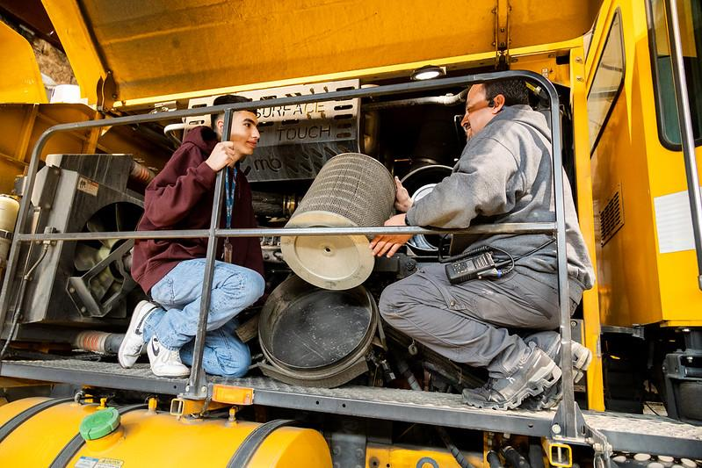
Important!
All identified schools, including charter schools, online schools, and AECs, need LEA support for the development, implementation, and monitoring of improvement plans aligned to each school’s reason for identification.

Slide 44
Evaluating and Making Adjustments
All improvement efforts should be evaluated to determine if the intended outcomes are being reached. Specifically for ESSA identified schools, evaluation results should show that the school is making progress towards meeting exit criteria, for CS and ATS as established by CDE and for TS as established by the LEA.
If not, adjustments should be made in the subsequent year to improvement plans and efforts, resources allocated / applied for / funds used in support of improvement activities, or if necessary different evidence-based intervention or strategies are selected and implemented.

Slide 45
Funding Opportunities to Support School Improvement Efforts
Notes:
Laura

Slide 46
Funding Opportunities
Funding Sources | Examples of School Improvement Efforts
Title I, Part A | School level funding for Title I schools to support Additional staff to meet the academic needs of students A partner to conduct a diagnostic review Time for staff to develop and monitor improvement plans Professional development opportunities
Title II, Part A | School and/or district level funding to support Professional development opportunities including coaching support and conferences Recruitment and retention strategies Support for licensure for challenging to fill positions
Title IV, Part A | School and/or district level funding to support School-based mental health services Establishing or improving school dropout and reentry programs Reimbursing low-income students to cover the costs of accelerated learning examination fees The opportunity to earn credits from institutions of higher learning
The Consolidated Application is due June 30 and is the budget plan for the following school year.

Slide 47
Funding Opportunities, continued
Funding Sources | Examples of School Improvement Efforts
Empowering Action for School Improvement (EASI) | School and/or district level funding for schools identified for improvement to support Diagnostic reviews (Exploration) Leadership development (School Turnaround Leadership Development Program) CDE supports (Connect for Success, Transformation Network) Implementation of evidence based improvement strategies designed and implemented by school and/or district (District Designed and Led)
The EASI application opens in the fall, due in December with funds available in February for both the current school year and future years.

Slide 48
Discussion - Small Group Rooms
Notes:
Sue and Emily

Slide 49
Discussion Rooms - Visit with Federal Programs OR Choose an empty room to meet as a team!
ZOOM ROOMS:
Room 1: Laura Meushaw (EASI)
Room 2: Erin Loften and Tammy Giessinger (UIP)
Room 3: Nazie and Sue Miller-Curley (CS-Y3+)
Room 4: Tina Negley and Anna Rowan (ESSA Identification)
Room X: “Grab a Room”
In the chat, invite colleagues to join you for your own discussion
“Hey Jesse, let’s grab room 5 so we can chat”
What actions is your organization taking this spring to support ESSA-Identified Schools in school improvement (UIP) planning?
How are ESSA-Identified Schools included in your district’s comprehensive needs assessment, planning, and budgeting?
What have you learned today that moves you to change or update your current practice?
How can CDE support you with the next steps?
Notes:
15 minutes

Slide 50
Request Time with Federal Programs Support Team!
Have questions that pertain to your district?
Complete the Google form to request follow-up from the CDE team.

Slide 51
Closing

Slide 52
Contacts
Nazie Mohajeri-Nelson, Executive Director Federal Programs
mohajeri-nelson_n@cde.state.co.us
Laura Meushaw, Program Implementation Supervisor/EASI Grants
meushaw_l@cde.state.co.us
Sue Miller Curley, ESEA Consultant and Monitoring Specialist
miller-curley_s@cde.state.co.us
Erin Loften, School Improvement and Planning Supervisor
loften_e@cde.state.co.us

Slide 53
Resources:
Identification Dashboard
Unified Improvement Planning: Quality Criteria Rubrics
ESSA Planning Requirements
*Resource Inequities: CDE Website for Resource Inequities (CS and ATS)
Coming Soon: FAQ for ESSA Identification - Low Graduation

Slide 54
Looking Ahead…
Any requests for topics or questions?
Upcoming Office Hours
May 8
Schoolwide and Targeted Assistance Programs
May 22
District Showcase: Poudre's Summer School and Afterschool Programs

Slide 55
CDE Contacts!
Emails: Lastname_Firstinitial@cde.state.co.us (e.g., Smith_a@cde.state.co.us)
Federal Programs & Supports (ESEA/ESSER Program Supports) | School Finance & Operations (Fiscal and Systems Supports)
Nazie Mohajeri-Nelson, Executive Director of Federal Programs & Supports Unit Program Specialists Program Implementation Supervisor: Laura Meushaw Program Implementation Coordinator: Christina Adeboye Sullivan Program Monitoring Supervisor: Tammy Giessinger ESEA/ESSER Monitoring Coordinator: Kristin Crumley Program Effectiveness Supervisor: Tina Negley Program Evaluation & Research Coordinator: Anna Rowan Strategic Recovery Office (ESSER State Reserve): Matt Koziol ESEA Programs Specialists and ESEA Regional Contacts (assigned by district) Title I: Laura Meushaw, Evita Byrd, Rachel Echsner, Kim Boylan Title II: Rachel Echsner, Sue Miller-Curley Title III: Rachel Temple, Kim Boylan Title IV & Stronger Connections Grant: Nathan Hickman, Evita Byrd Title V: Christina Adeboye-Sullivan, Rachel Echsner ESEA and ESSER Data and Reporting Specialists Melissa Chaffin (ESEA) Jerry Ring (ESEA) Anna Rowan (ESEA) | Vacant, Executive Director of School District Operations Unit Fiscal Specialists Jennifer Austin, Director of Grants Fiscal Management ESEA Robert Hawkins, Grants Fiscal Analyst Steven Kaleda, Grants Fiscal Analyst ESSER Fiscal Specialist Steven Kaleda Grants Fiscal Analyst ESSER Monitoring Bill Parsley, ESSER Fiscal Monitoring Supervisor Hilery Morris, ESSER Fiscal Monitoring Application Systems Specialists DeLilah Collins, Director of Grants Program Administration Online Applications Systems Technical Support Jessica Hollingshead Michelle Prael

