Slide 1
CDE Office Hours
February 23, 2023

Slide 2
ESSER Office Hours
Topics
Updates and Reminders
Tools to Examine ARP Funded Interventions
Using Federal Funds to Support STEM Strategies

Slide 3
Updates and Reminders
Notes:
Nzie

Slide 4
Wester Educational Equity Assistance Center
Training Opportunity: Organizing a District Team to Address Chronic Absenteeism
Date and Time: Monday, February 27, 2023; 12:30-2:00 p.m. (PT)
Session Overview
Districts play a key role in supporting and sustaining effective practice at the school level by building key systemic ingredients for reducing chronic absence. This webinar offers examples of districts that are designing more just and equitable systems to improve attendance and engagement. Participants will have access to Attendance Works’ district self-assessment as a reflection and planning tool.
Participants will:
• Learn about the six ingredients for taking a systemic approach to reducing chronic absence
• Understand best practices that promote a positive culture of attendance and early intervention
• Gain insight into specific ways districts have designed equitable systems to improve attendance
Register for the second in a six-part webinar series hosted by the Western Educational Equity Assistance Center (WEEAC) at WestEd.

Slide 5
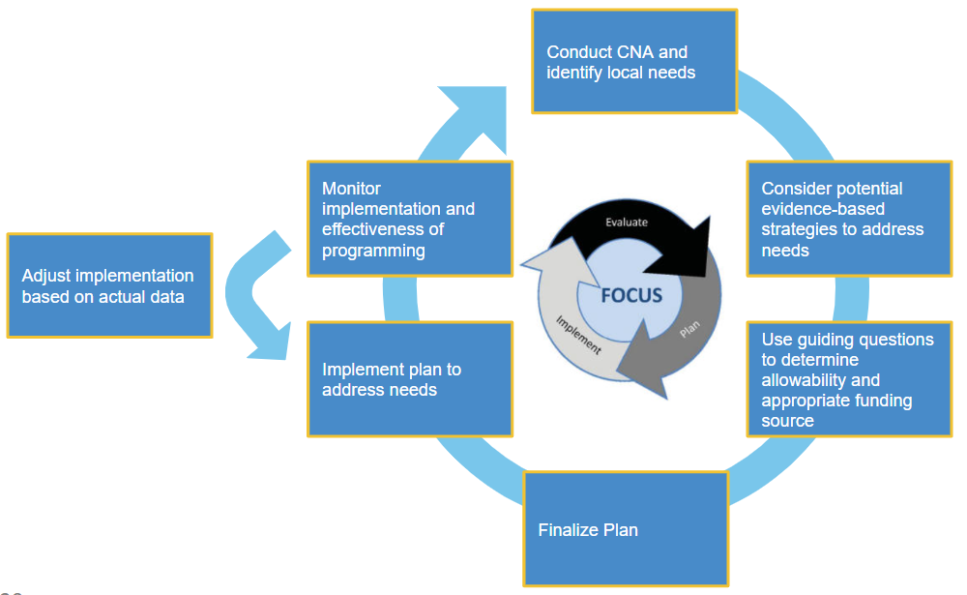
Upcoming Regional Network Meetings
Content: The Winter RNMs will focus on supporting LEAs in creating a Consolidated Application that is driven by student needs and will result in improved student outcomes.
Target Audience: LEA staff or school leaders who support the development of the Consolidated Application or manage federal programs. This training will be specifically helpful for anyone new to managing the Consolidated Application or wanting to learn more about allowable uses of federal funds.
RNM Objectives:
Understand important updates from FPSU, including the 23-24 Consolidated Application
Know the steps to plan for and implement activities that respond to student needs using federal funds
Build knowledge of allowable uses of federal funds
Identify evidence-based interventions to meet student needs
Reflect on past programming and plan for future activities using federal funds

Slide 6
Upcoming Regional Network Meetings
Dates and Locations:
Greeley-Evans Family Center: Tuesday, February 28th, 2023, 12:30-3:30pm
Summit RE-1 Professional Development Building: Wednesday, March 1st 2023, 12:30-3:30pm
Pueblo 60 Board Room at the Administration Office: Tuesday, March 7th, 2023, 12:30-3:30pm
Virtual Session: Thursday, March 9th, 2023, 12:30-3:30 pm
See full details and registration links at the RNM webpage

Slide 7
ESSER Reporting Requirements
The U.S. Department of Education has been authorized by Congress to collect data from all ESSER I, II, and III grantees, including but not limited to the uses and impact of funds. CDE is able to use the ESSER I, II, and III applications to provide the vast majority of the requested data on behalf of our grantees, with the exception of the following data points:
How students with poor attendance or participation have been re-engaged;
How school level allocations were determined; and
LEA participation in ESSER activities.
CDE has created an ESSER Grantee/Subgrantee Reporting webpage to share resources, trainings, and data collection templates/surveys, to support grantees in successfully meeting these reporting requirements.
A recorded training, instructional manual, and links to surveys and data collection templates are available now on the website.

Slide 8
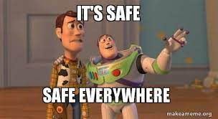
Safe Return to In-Person Instruction Plans
Reminder for ARP-ESSER III Safe Return to In-Person Instruction Plans
Plans must be posted on the LEA’s website through the end of the grant award period.
Plans must be reviewed and updated (if needed) at least every 6 months.
Best practice is to document when plans are reviewed and updated.
CDE needs to have the link to your LEA’s plan on the CDE website. Check to see if yours is posted and current here.

Slide 9
Tools to Examine ARP Funded Interventions

Slide 10
Overview
The National Comprehensive Center and a panel of practitioners have provided four tools that recipients can use to better implement and monitor ARP funds. These tools will help states and districts track financial and outcome data and determine if interventions are making a difference for the students who need them the most.
The tools can help:
Assess progress on activities at the state and local level
Identify and prioritize districts most in need of support
Evaluate existing ARP-funded interventions to inform future decisions
Track short-, medium-, and long-term outcomes for common interventions and communicate their impact

Slide 11
The Investment Grid: Linking Costs and Outcomes
The investment grid can help leaders assess current investments and finalize spending plans to do the most for students. Customize this tool to compare investments of different strategies and dosages for a particular evidence-based intervention or across different interventions for the same students. In addition to financial costs, the tool requires consideration of desired outcomes and risks.

Slide 12
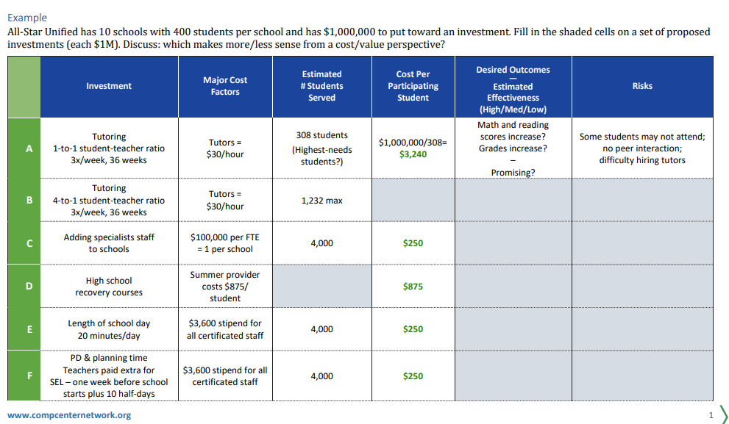
Investment Grid Example

Slide 13
Evaluating the Impact of ARP-Funded Programs Using Logic Models
This logic model can help SEAs and LEAs understand the impact of learning-recovery activities by defining a challenge, implementing an intervention, and articulating the intended outcomes of ARP-funded programs. Provided is a logic model on high-dosage tutoring, accompanied by example statements that illustrate how to use a logic model to communicate with stakeholders as well as a blank logic model template with communication prompts for SEAs and LEAs to personalize.
CDE has also worked with our Regional Educational Laboratory to create training modules, available on CDE’s Program Evaluation Training website, on how to develop a logic model.

Slide 14
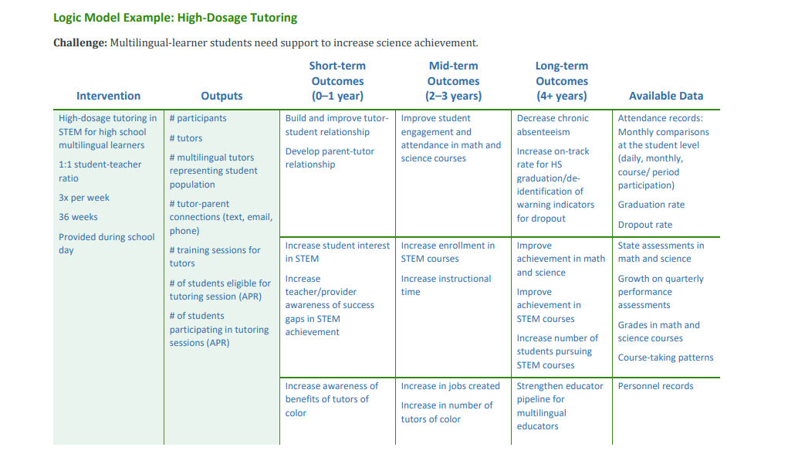
Logic Model Example: High Dosage Tutoring

Slide 15
Logic Model Communication Examples
Here is an example of how you can use the logic model to communicate with stakeholders about the need for the intervention, what you are doing, and what you expect to achieve.
Example Statement: Our district found that multilingual-learner students need support to increase science achievement. To address this challenge, we are investing in evidence-based, high-dosage tutoring in STEM for high school multilingual learners. The tutoring will have a 1:1 student-teacher ratio, will take place 3x per week for 36 weeks and will be provided during the school day. We will ensure that this approach is meeting the needs of multilingual learners by tracking some key metrics, such as # participants, # tutors, # multilingual tutors representing the student population, and the # tutor–parent connections (text, email, phone), among other things.
Here is an example of a way you might use the logic model to respond to key questions from stakeholders.
Example Question: We see your intervention is really focused on building relationships with the tutor. Why? Our students need to accelerate their learning—shouldn’t you be more focused on grades and test scores?
Example Answer: Developing a consistent, trusting relationship with a tutor is the first step toward Accelerated Learning. A trusted tutor develops a strong understanding of students’ learning needs and can facilitate better relationships with teachers as well.

Slide 16
Making the Most of ESSER Funding
National Center in partnership with Edunomics Lab at Georgetown University is hosting a series of webinars focused on how states and districts can make the most of their Elementary and Secondary School Emergency Relief (ESSER) fund spending.
These include:
What Can ESSER Spending Data Tell Us
ESSER Spending: Connecting Investments and Outcomes

Slide 17
Using Federal Funds to Support STEM Education Strategies
Notes:
Mackenzie, Jonathan

Slide 18
Background
The USDE has released new guidance regarding how Federal funds can support science, technology, engineering, and mathematics (STEM) education. The COVID-19 pandemic has presented an immense set of challenges for educating our students. Despite the efforts of educators from across the country, early indications suggest many students fell behind in their academic achievement, including in STEM subjects.

Slide 19
Categories
The following examples and resources fall into three categories:
Implement STEM learning acceleration programs that support students who have been disproportionately impacted by COVID-19.
Redesign STEM courses and learning experiences to promote diversity, equity, and inclusion in STEM.
Increase students’ equitable access to STEM courses and experiences, including out-of- school time (OST) programs, dual enrollment, STEM-themed schools, and career pathways.

Slide 20
STEM Learning Acceleration Programs
I. Implement STEM learning acceleration programs that support students who have been disproportionately impacted by COVID-19
Some examples of learning acceleration that are particularly relevant for STEM learning include:
High-impact, evidence-based tutoring (see page 21 in ED’s COVID Handbook Volume 2)
Project/problem-based learning
Work-based learning and career academies
Access to rigorous coursework such as dual enrollment or AP course-taking
Summer learning and enrichment
Comprehensive afterschool programs

Slide 21
Redesigning STEM Courses
II. Redesign STEM courses, learning experiences, and assessments to promote diversity, equity, and inclusion in STEM
LEAs can use ARP ESSER funds, as well as funds from Title I schoolwide programs, Title II, Part A and Title IV, Part A, to redesign STEM teaching and learning experiences to ensure that all student groups are able to participate equitably, particularly those that faced additional barriers to participation during the pandemic.
LEAs can use Perkins V funding to develop comprehensive STEM career pathways and programs of study, including career guidance and counseling, instructor compensation, professional development, career and technical student organization advisor costs, equipment, and technical skill assessments.

Slide 22
Increase Students’ Equitable Access to STEM Courses 1
III. Increase students’ equitable access to STEM courses and experiences, including Out of School Time (OST) programs, dual enrollment, STEM-themed schools, and career pathways
Increase access to rigorous STEM coursework for all students.
Depending on the student population served, program funds (see potential options below) can be used to support dual or concurrent enrollment programs, early college high school models, or other methods to increase access to rigorous STEM coursework and enhance career and college readiness. Schools and LEAs can use Federal funds to support STEM coursework for:
Students who are members of underrepresented groups in STEM.
Students attending a school operating a Title I schoolwide program
Students identified as failing, or most at risk of failing, to meet the challenging State academic standards who are attending a school operating a Title I targeted assistance program.
Supplemental English language acquisition activities in STEM courses for English learners.
Supplemental early college high school or dual or concurrent enrollment programs or courses designed to support English learners’ success in postsecondary education.
IDEA-eligible children with disabilities who require STEM coursework in order to receive a free appropriate public education, or who need additional services and supports in STEM courses to access the general education curriculum.

Slide 23
Increase Students’ Equitable Access to STEM Courses 2
B. Increase access to Out of School Time (OST) and expanded learning programs in STEM.
LEAs can use funds from the Department’s 21st Century Community Learning Centers program to provide high-quality STEM and computer science activities to students in Out of School Time learning settings and as part of expanded learning programs. Eligible entities can use funds to carry out programs that foster innovation in learning by supporting non-traditional STEM education teaching methods that can emphasize hands-on, experiential learning.
Technical Assistance Resource: YouforYouth (Y4Y) STEM is a free, online professional learning and technical assistance website for 21st Century Community Learning Centers and other OST providers.
Schools operating eligible targeted assistance school programs can use Title I, Part A resources to support students identified as failing, or most at risk of failing, through expanded learning time, before- and after-school programs, and summer programs and opportunities.
Eligible entities may use Title IV, Part A funds to support the participation of low-income students in nonprofit competitions related to STEM subjects, such as robotics, science research, invention, mathematics, computer science, and technology competitions.

Slide 24
Additional Resources
Please find additional resources here, including:
Regional Educational Laboratory (REL) Northeast and Islands Creating and Using Performance Assessments: An Online Course for Practitioners
REL Midwest Toolkit for Assessing Learning Changes After COVID-19 School Closures
REL Central Using Assessments to Identify and Address COVID-19 Learning Gaps Virtual Presentation and Handout
REL Central Personalizing Instruction to Address COVID-19 Learning Gaps Virtual Chat and Handout
ED Games Expo: Remote Tutoring to Accelerate Learning featuring AmeriCorps and Institute of Education Sciences (IES) Grantees

Slide 25
Open Q & A

Slide 26
Upcoming Meetings

Slide 27
Looking Ahead…
Upcoming Office Hours
Any requests for topics or questions?
March Changes!
March 16
March 30

Slide 28
CDE Contacts!
Emails: Lastname_Firstinitial@cde.state.co.us
(e.g., Smith_a@cde.state.co.us)
Federal Programs & Supports (ESEA/ESSER Program Supports) | School Finance & Operations (Fiscal and Systems Supports)
Nazie Mohajeri-Nelson, Executive Director of Federal Programs & Supports Unit Program Specialists Program Implementation Supervisor: Laura Meushaw Program Implementation Coordinator: Christina Adeboye Sullivan Program Monitoring Supervisor: Tammy Giessinger ESEA/ESSER Monitoring Coordinator: Kristin Crumley Program Effectiveness Supervisor: Tina Negley ESEA Programs Specialists and ESEA Regional Contacts (assigned by district) Title I: Laura Meushaw, Evita Byrd, Rachel Echsner Title II: Karen Bixler Title III: Rachel Temple Title IV: Tammy Giessinger, Nathan Hickman Title V: Shannon Wilson ESSER Program Specialists Jonathan Schelke Kim Boylan Shannon Wilson ESEA and ESSER Data and Reporting Specialists Tina Negley Mary Shen Mackenzie Owens Melissa Chaffin | Amy Carman, Executive Director of School District Operations Unit Fiscal Specialists Jennifer Austin, Director of Grants Fiscal Management ESEA Robert Hawkins, Grants Fiscal Analyst Steven Kaleda, Grants Fiscal Analyst ESSER Fiscal Specialist Steven Kaleda Grants Fiscal Analyst ESSER Monitoring Bill Parsley, ESSER Fiscal Monitoring Supervisor Hilery Morris, ESSER Fiscal Monitoring Kristina Jones, Federal Fiscal Monitoring and Reporting Specialist Werner Hagemann, ESSER Fiscal Monitoring Specialist Application Systems Specialists DeLilah Collins, Director of Grants Program Administration Online Applications Systems Technical Support Michelle Prael

