Slide 1
CDE Office Hours
February 15, 2024

Slide 2
ESSER Office Hours
Topics
Listening Segment
Updates and Reminders
Title III GAINS Training Opportunity
Upcoming BruMan Training
ESSA Reporting Requirements
Title II State & District Use of Funds
UIP Feedback

Slide 3
Listening Segment
Beginning today, each Office Hours will have a listening segment, wherein we would like to hear from LEAs regarding:
Current hot topics/matters in your LEAs and in your roles
How CDE can support you with ESSA and/or ESSER implementation
What TA or guidance would be helpful for your roles
Any questions you may have

Slide 4
Updates and Reminders

Slide 5
Upcoming BruMan Training
An in-person Uniform Grant Guidance training will be provided by the Bruman group late Summer/early Fall. The exact date and location has not yet been determined.
Please complete this brief Google Form indicating your availability to attend and preferred meeting date.

Slide 6
Title III GAINS Training Opportunity
Training Opportunity for LEAs to learn about changes to Title III, Part A Narratives and Immigrant Set-Aside Narratives in GAINS.
If applicable, invite colleagues that will be involved in the Title III narratives.
Thursday, February 22 from 2:00-3:00 pm
Register in advance for this meeting:
https://us02web.zoom.us/meeting/register/tZElduigqjIiHtco0gPljBZyDSsnSYn4o6m9
Tuesday, February 27 from 10:00-11:00 am
Register in advance for this meeting:
https://us02web.zoom.us/meeting/register/tZ0rdOChpjwoGdaiKcL4DSLQWt2U2Vbb4yt6

Slide 7
ESSA State and Local Reports

Slide 8
Public Reporting Under ESSA
The Every Student Succeeds Act (ESSA) requires states and districts to annually prepare and disseminate reports to inform policymakers, community, families/parents, and other stakeholders of the performance of all students and each disaggregated group at each level
State, as a whole (SEA responsibility)
District, as a whole and compared to the State (LEA responsibility)
School, as a whole and compared to the District and State (LEA responsibility)

Slide 9
State Report Card
Each State Educational Agency (SEA) that accepts funds under ESSA, shall prepare and disseminate to the public an annual State report card that is concise, widely accessible in a language and format that parents can understand, and developed in consultation with parents. ESEA §1111(h)(1)

Slide 10
Required Student Groups
All students
Racial/ethnic groups
Gender
Disability status
English proficiency status
Free/reduced meal eligibility
Migrant status
Homeless status
Status as a child in foster care
Military-connected status

Slide 11
Required Data Elements
Description and results of accountability system under ESSA, including:
Minimum number of students for use in accountability system.
Long-term goals and measures of interim progress.
Indicators and methodology used to identify schools for, and exit from, support and improvement.
Schools identified for Comprehensive, Targeted, or Additional Support & Improvement.
Student achievement (by proficiency level)
English language arts (ELA), math, and science
Student academic growth
English language arts (ELA) and math
High school graduation rates
4-year and 7-year adjusted cohorts
English language proficiency

Slide 12
Required Data Elements, Part 2
Other indicator(s) of school quality or student success
Chronic absenteeism rates (elementary and middle)
Dropout rates (high)
Progress toward meeting long-term goals and interim targets
Assessment participation rates
Percentages of students taking an alternate assessment
Select elements from the Civil Rights Data Collection (CRDC)
Measures of school quality, climate, and safety
Student enrollment
Professional qualifications of educators
Inexperienced
Teaching with emergency/provisional credentials
Not teaching in the subject/field for which they are certified/licensed
Per-pupil expenditures of Federal, State, and local funds

Slide 13
Required Data Elements, Part 3
Results on the National Assessment of Educational Progress (NAEP)
Reading and math
Grades 4 and 8
Rate at which graduates enrolled, for the first academic year, in programs of postsecondary education
Any additional information the State or LEA believes will best provide parents, students, and other members of the public with information regarding the progress of each school

Slide 14
LEA Report Cards
Each Local Educational Agency (LEA) that accepts funds under ESSA, shall prepare and disseminate to the public a local report card that is concise and widely accessible, in a language parents can understand. ESSA §1111(h)(2)
Must include the same data elements as the SEA Report Card.
Must compare LEA to the State.
Must compare all schools in the LEA to the LEA and State.
Should include other LEA-determined information that will best provide parents, students, and other members of the public with information regarding the progress of each school.

Slide 15
ESSA State and Local Report Resources
ESSA State Report is posted on CDE website
https://www.cde.state.co.us/fedprograms/statereportcard
To assist districts in meeting their ESSA LEA Report requirements, CDE has posted State, LEA, and school level data on its website
https://www.cde.state.co.us/fedprograms/localreportcards
Districts may link to CDE’s website or develop their own Local Report
If a district chooses to develop their own report, please provide a link to Melissa Chaffin (chaffin_m@cde.state.co.us) or Tina Negley (negley_t@cde.state.co.us)

Slide 16
State and District Use of ESEA Title II, Part A Funds in 2021–22
Shared by U.S. Department of Education Office of Elementary and Secondary Education
Presented by Sue Miller-Curley (ESEA Title II Specialist) and
Rachel Echsner (ESEA Title I & II Specialist)

Slide 17
Purpose
To inform district leaders of the state and district uses of Title II Funds in the 21-22 school year (Report published in August 2023).
State and district leaders are informed of uses and trends in the field as they prepare for Title II planning into the 2024-2025 school year.

Slide 18
Citation
Westat & U.S. Department of Education Office of Elementary and Secondary Education. (2023). State and District Use of Title II, Part A Funds in 2021–22.
Read the report: https://oese.ed.gov/offices/office-of-formula-grants/school-support-and-accountability/instruction-state-grants-title-ii-part-a/resources/

Slide 19
ESSA Title II, Part A (Purpose)
The purpose of this title is to:
increase student achievement consistent with the challenging State academic standards;
improve the quality and effectiveness of teachers, principals, and other school leaders;
increase the number of teachers, principals, and other school leaders who are effective in improving student academic achievement in schools; and
provide low-income and minority students greater access to effective teachers, principals, and other school leaders.

Slide 20
ESSA Title II, Part A (Use of Funds)
Title II, Part A funds must be used to supplement, not supplant, other Federal or State funds available to carry out activities described in this subpart.
In Colorado, Title II cannot be used for:
State required induction programs
State required evaluation programs
State required system of professional learning and growth

Slide 21
State Uses of Funds

Slide 22
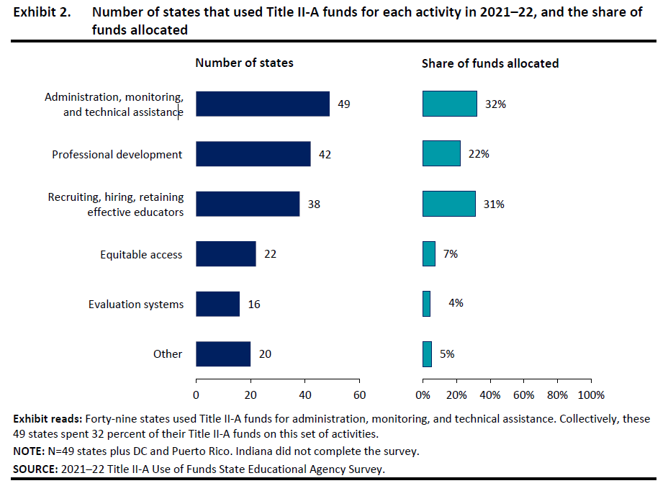
State Uses of Title II, Part A Funds by Activity
At the state level, the most common use and allocation of funds of Title II-A was related to program administration, monitoring, and technical assistance.
Professional development and educator recruitment/retention were also common uses.

Slide 23
State Uses of Title II, Part A Funds Professional Development
The number of states using Title II, Part A funds for professional development and the allocation amounts increased from 20-21 to 21-22 (18% to 22%)
In 21-22, 42 States (compared to 36 in 20-21) used funds for professional development
Most of the funds states spent on professional development were devoted to programs for principals (30 states and $14.7million).
States reported supported professional development to improve instruction and instructional leadership in STEM (17 states and $4.2 million), among other things.

Slide 24
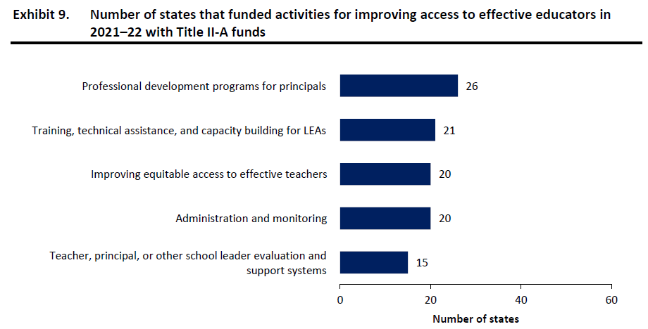
State Uses of Title II, Part A Funds Improving Access to Effective Educators
States used Title II, Part A funds to improve equitable access to effective educators.

Slide 25
District Uses of Funds

Slide 26
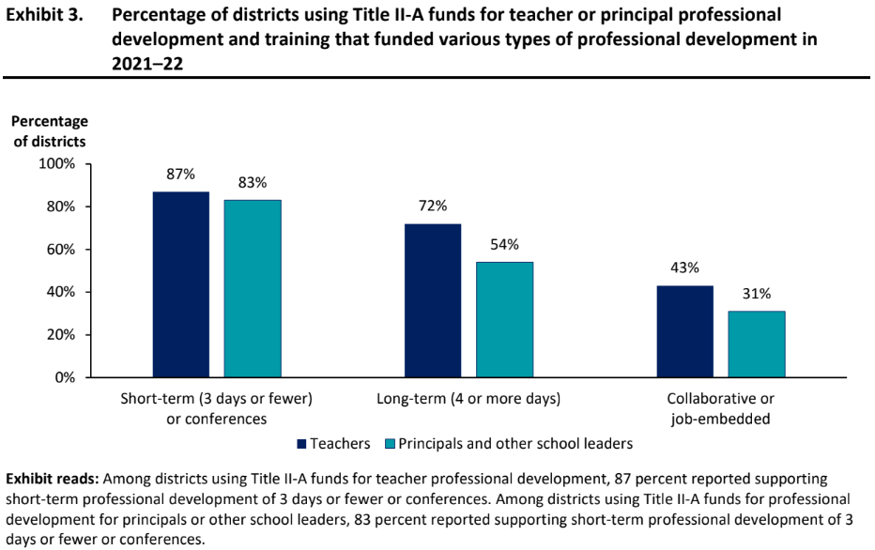
District Uses of Title II, Part A Funds Professional Development
Professional Development (PD)
Districts most commonly used funds for short-term PD.
Many districts also supported longer term PD and some supported PD that was collaborative or job embedded.

Slide 27
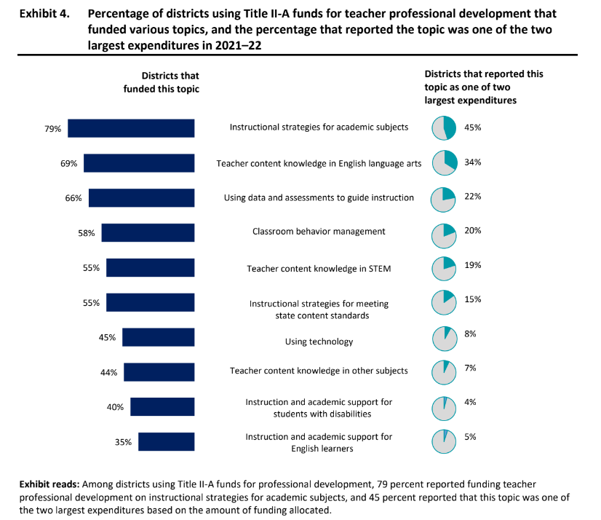
District Uses of Title II, Part A Funds Professional Development Topics
Professional Development Topics
Professional development for teachers most commonly focused on instructional strategies and teacher content knowledge in ELA.

Slide 28
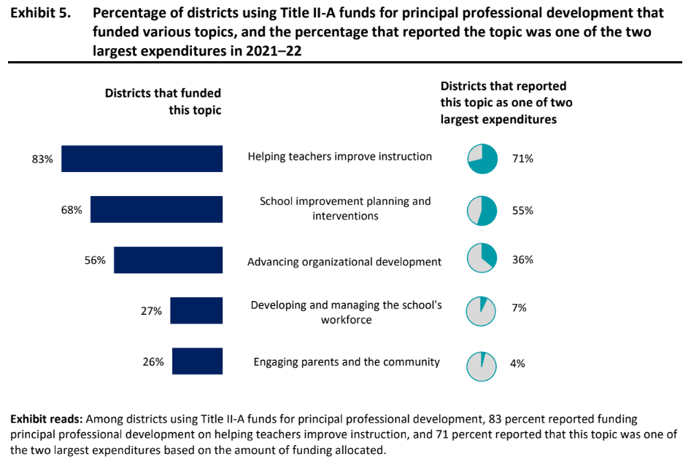
District Uses of Title II, Part A Funds Principal Professional Development Topics
Principal Professional Development Topics
For principal professional development, districts most commonly invested in strategies and practices to help teachers improve instruction.

Slide 29
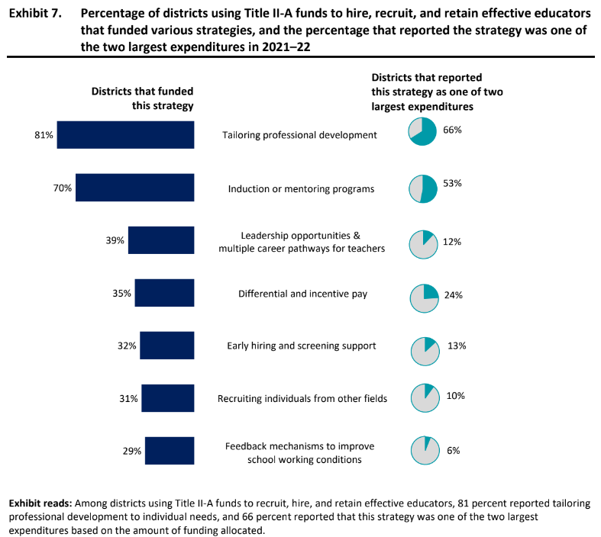
District Uses of Title II, Part A Funds Hiring, Recruiting, and Retention
Recruiting, hiring, and retaining effective educators
Overall, 33 percent of districts reported using funds for recruiting, hiring, and retaining effective educators.

Slide 30
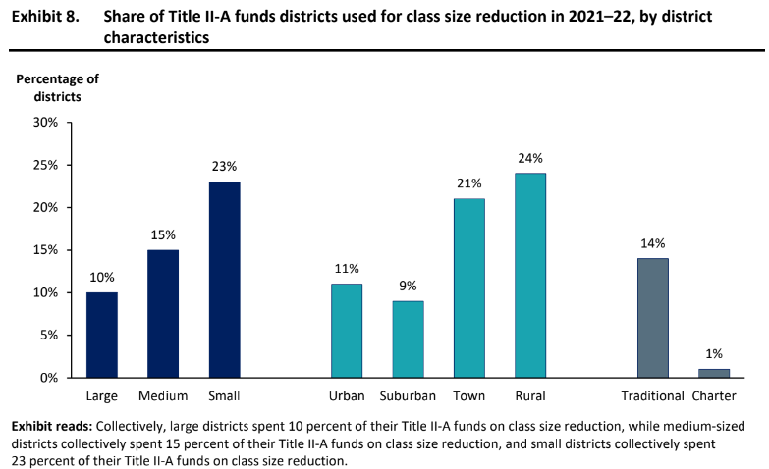
District Uses of Title II, Part A Funds Class Size Reduction
Class Size Reduction (CSR)
One-fifth of districts used Title II funds for class size reduction.

Slide 31
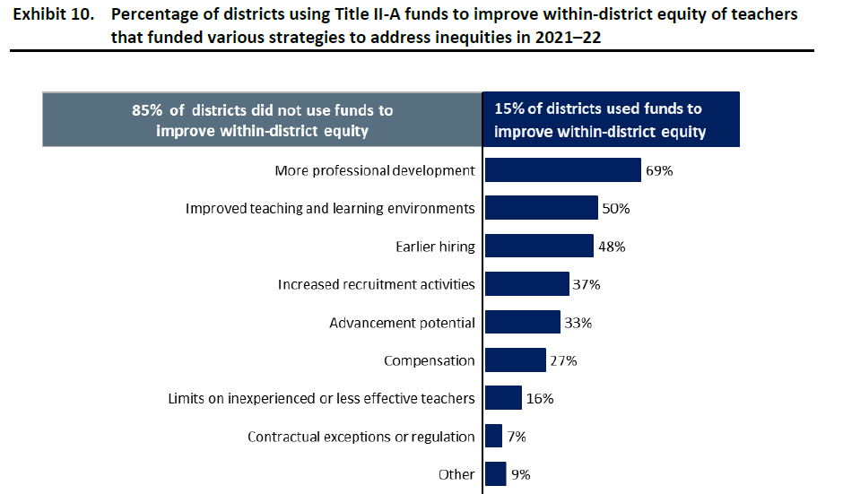
District Uses of Title II, Part A Funds Within-District Equity
District strategies to improve with-in district equity of teachers.
Only 15% of districts used Title II-A funds to improve equitable distribution of effective educators.
Most common strategy: More professional development

Slide 32
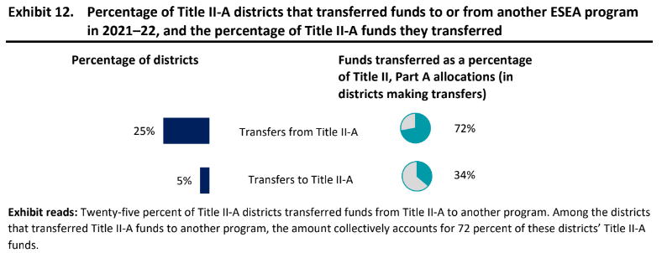
District Uses of Title II, Part A Funds Fund Transfers
Transferring Funds
Districts most commonly transferred funds from Title II-A to Title I-A.

Slide 33
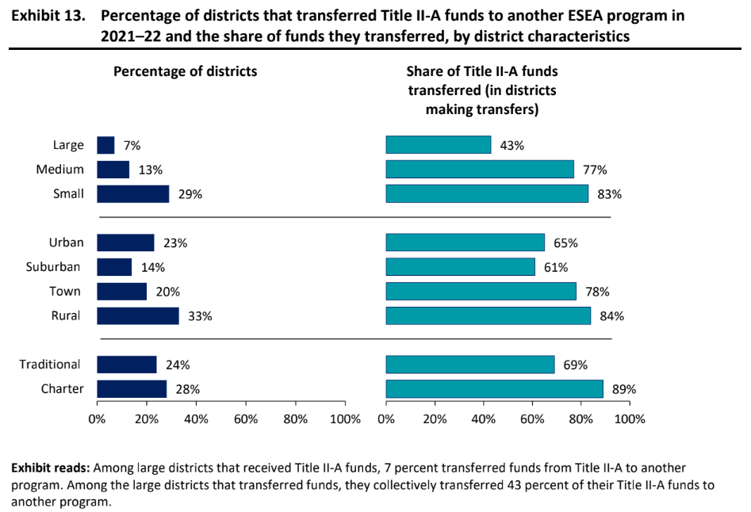
District Uses of Title II, Part A Funds Fund Transfers by District Characteristic
Transferring Funds
Small and rural districts most commonly transferred funds from Title II to another program.

Slide 34
Changes in the Use of Funds from 2020-21 to 2021-22
Districts allocated smaller shares of Title II-A funding for class size reduction and professional development, and a larger share for other activities.
The percentage of rural districts allocating Title II-A funds for class size reduction increased.
The percentage of districts allocating funding for professional development and evaluation systems decreased and districts were less likely to support all types of professional development (short-term, longer-term, and collaborative or job-embedded).

Slide 35
Considerations
Consider using Title II funds for evidence-based strategies in:
Recruitment efforts
Retaining/sustaining teachers and principals
“Grow Your Own” programs
Professional learning opportunities
Teacher advancement initiatives
Supplemental induction or mentoring programs

Slide 36
Reflection
Does your LEA’s use of Title II, Part A funds align with the trends identified by ED?
Does this data give you new ideas on how to use your Title II, Part A funds?
What evidence do you have at the local level to determine if your uses of funds are improving outcomes for your educators and students? What data could you use in your planning process to identify needs and how Title II funds can support those needs?

Slide 37
Questions?

Slide 38
Upcoming Event
Featuring: Travis Garoutte, Educator Talent
Many LEAs are experiencing educator and staffing shortages. What are strategies to consider?
Join us on February 29th for an Office Hours presentation with
Travis Garoutte, Educator Talent
about educator development opportunities and recruitment and retention strategies available in Colorado.

Slide 39
Title II-A Resources
Contacts:
Sue Miller-Curley (ESEA Title II Specialist) miller-curley_s@cde.state.co.us
Rachel Echsner (ESEA Title I & II Specialist) echsner_r@cde.state.co.us
Other Resources:
Colorado Department of Education Title II-A Webpage
Office of Elementary and Secondary Education Act Title II, Part A Information
CDE Federal Programs and Supports Unit Contacts

Slide 40
Unified Improvement Plan (UIP) Feedback

Slide 41
Feedback and Approval Release for 23-24 Comprehensive Support (CS) UIPs
Schools identified for Comprehensive Support and Improvement (CS) must develop and implement an improvement plan that addresses the reasons for the school’s identification as CS and will result in the improvement of student outcomes. These plans must all be reviewed and approved by CDE. For more information: https://www.cde.state.co.us/fedprograms/essaplanningrequirements
CDE reviews UIPs for all CS-Identified Schools in order to provide feedback and determine if the plan is approved for meeting the CS requirements.
CDE provides feedback on a rolling basis as the UIPs are reviewed.
The first set of CS-feedback is out this week. Reviews were prioritized for students identified in the current year, and feedback for CS schools “On Watch” will be sent in the coming weeks.
For technical assistance, reach out to UIPhelp@cde.state.co.us
If you have any questions about CS identifications and requirements, please reach out to your CDE Regional Contact.

Slide 42
Upcoming Meetings

Slide 43
Looking Ahead…
Any requests for topics or questions?
Upcoming Office Hours:
February 29
Spring Training Opportunities
District Level Set Aside
Uses of Title II Funds to Address Teacher Shortages

Slide 44
CDE Contacts!
Emails: Lastname_Firstinitial@cde.state.co.us (e.g., Smith_a@cde.state.co.us)
Federal Programs & Supports (ESEA/ESSER Program Supports) | School Finance & Operations (Fiscal and Systems Supports)
Nazie Mohajeri-Nelson, Executive Director of Federal Programs & Supports Unit Program Specialists Program Implementation Supervisor: Laura Meushaw Program Implementation Coordinator: Christina Adeboye Sullivan Program Monitoring Supervisor: Tammy Giessinger ESEA/ESSER Monitoring Coordinator: Kristin Crumley Program Effectiveness Supervisor: Tina Negley Program Evaluation & Research Coordinator: Mary Shen ESEA Programs Specialists and ESEA Regional Contacts (assigned by district) Title I: Laura Meushaw, Evita Byrd, Rachel Echsner, Kim Boylan Title II: Rachel Echsner, Sue Miller-Curley Title III: Rachel Temple, Kim Boylan Title IV & Stronger Connections Grant: Nathan Hickman, Evita Byrd Title V: Christina Adeboye-Sullivan, Rachel Echsner ESSER Program Specialists Jonathan Schelke Kim Boylan Kriselda Craven Nadine Penn ESEA and ESSER Data and Reporting Specialists Mackenzie Owens (ESSER) Melissa Chaffin (ESEA) Jerry Ring (ESEA) | Amy Carman, Executive Director of School District Operations Unit Fiscal Specialists Jennifer Austin, Director of Grants Fiscal Management ESEA Robert Hawkins, Grants Fiscal Analyst Steven Kaleda, Grants Fiscal Analyst ESSER Fiscal Specialist Steven Kaleda Grants Fiscal Analyst ESSER Monitoring Hilery Morris, ESSER Fiscal Monitoring Kristina Jones, Federal Fiscal Monitoring and Reporting Specialist Werner Hagemann, ESSER Fiscal Monitoring Specialist Application Systems Specialists DeLilah Collins, Director of Grants Program Administration Online Applications Systems Technical Support Michelle Prael

