Slide 1
CDE Office Hours
May 20, 2021

Slide 2
CDE Team Introductions!
ESSER/ESEA
Nazie Mohajeri-Nelson, Director of ESEA Office (mohajeri-nelson_n@cde.state.co.us)
DeLilah Collins, Assistant Director of ESEA Office (collins_d@cde.state.co.us)
Kristin Crumley, ESSER Monitoring & Reporting Specialist (Crumley_k@cde.state.co.us)
ESEA Regional Contacts assigned to your district
Fiscal Experts
Jennifer Okes, Chief Operating Officer (okes_j@cde.state.co.us)
Kate Bartlett, Executive Director of School District Operations (Bartlett_k@cde.state.co.us)
Jennifer Austin, Director of Grants Fiscal Management (Austin_j@cde.state.co.us)
Robert Hawkins, Grants Fiscal Analyst (Hawkins_s@cde.state.co.us)
Steven Kaleda, Grants Fiscal Analyst (Kaleda_s@cde.state.co.us)
Adam Williams, Financial Data Coordinator (Williams_a@cde.state.co.us)

Slide 3
ESSER Office Hours
Topics
Updates and Follow-Ups (Kate, Nazie, and DeLilah)
ARP Homeless Funds (Dana and Kerry)
ESSER Grant Codes (Adam)
GEPA Statements (Nazie, if time in this week; if not, we’ll cover next week)
Notes:
Nazie

Slide 4
Updates, Clarifications, and Follow-Ups

Slide 5
CRF Monitoring - Breaking!
What has happened so far?
Office of the State Controller engaged KPMG to do a sampling monitoring of districts regarding their expenditure of CRF funds
What’s new?
CDE has learned that the department is now also required to perform monitoring
We are working on a protocol for this that will place the least possible burden on districts
Monitoring must be performed by December 2021
Notes:
Kate

Slide 6
Updates
Some resources have been posted that might be of help/use to you:
https://www.cde.state.co.us/fedprograms/resourcesandtechnicalassistance
ESSER EL FAQ
McKinney-Vento Education for Homeless Children and Youth
Funding Matrix for COVID-19 Related Activities
ESSER I, II, and III Due Dates and Timelines
ESSER Planning Tool Created by Chiefs for change
LEA ESSER Policy Repository Submission Form
Notes:
Nazie

Slide 7
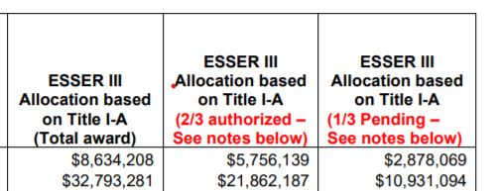
Clarifications
Allocations to districts
2/3 of funds released to CDE
1/3 will be released once we submit an application and receive approval from USDE (application due 6/7)
Clarification for district allocations
Full allocations are in the system
However, you can only draw down funds up to 2/3 of your allocation
Allocation Table
Notes:
Nazie

Slide 8
Clarifications on ARP ESSER III
A minimum of 20% of the total allocation must be set aside and used for addressing learning loss using evidence-based interventions
An LEA plan for the use of funds that includes meaningful stakeholder input must be submitted to CDE within 90-days of being awarded funds (~ August 24th)
CDE has asked for an extension of this deadline
If not awarded extension, plan is to collect the plans with the stakeholder input that was possible to get over the summer and then submit additional input at a later time
Safe Return to In-Person Plan
Must be posted on the LEA website within 30-days of receipt of funds (must meet specific criteria; creating a self-check tool)
Assurance in the ESSER III application – either send link or describe plans for developing the plan
Notes:
Nazie

Slide 9
Post Award Revision and Application Reviews
Notes:
DeLilah

Slide 10
Post Award Revision - When to Submit Post-Award Revisions
LEAs should submit Post-Award Revisions for the following reasons:
Any changes to equipment purchases require program approval
To update indirect costs if the LEA:
Overrode the indirect amount allocated, or
Will now take the full indirect cost rate
To reflect changes in the project/program scope or objective, such as:
PD activities to purchasing Instructional materials
PD activities to hiring an Interventionist
Changes among direct cost programs (Instructional, Support, Improvement of Instructional Services, or Administrative) or object categories (Salaries, Benefits, etc.) that exceed, or are expected to exceed, 10% of the total budget for that category as last approved

Slide 11
Post Award Revision - Exceptions to Post-Award Revisions
Minor changes may not need to be captured through the PAR process.
Minor adjustments do not alter the overall scope or goals of the approved application
Training for staff changed from 2 to 3 days
Changes that should be made towards June 30th, but not necessarily on an ongoing basis
Changes to reflect actual costs and updates to line items to reflect final allocations
Because the ESSER application is used to meet federal reporting requirements, it is necessary to have as close to actuals as possible by June 30th. But saving all such changes to submit once works best.
NOTE: If these types of revisions change the scope of the activity, then a Post-Award Revision must be submitted through the online platform.
Please refrain from submitting multiple revisions each month!
Collect all required revisions and submit them at the same time
Please allow 1-2 weeks for PAR submissions to be reviewed

Slide 12
Consolidated Application and ESSER Application Reviews
The ESEA team will begin reviewing Consolidated Applications as they come in. As a reminder, Consolidated Applications and all application components are due on June 30, 2021.
Since Consolidated Application and ESSER Application review will occur at the same time:
Please be patient as the review process may take a bit longer
ESEA staff will work diligently to perform timely reviews of all applications submitted
Communication is KEY!
Address all comments provided by reviewers
Ask for clarification before re-submitting your application
Avoid the rinse & repeat cycle

Slide 13
Application Approvals
There are two types of approval:
Substantial – allows the district/grantee to obligate funds; but not draw down funds
ESSER I and II – when a full application has been submitted, including a balanced budget
ESSER III – when the Approval and Transmittal Form, assurances, and GEPA statement have been submitted
Final – allows the district/grantee to draw down funds on a reimbursement basis
ESSER I, II, and III – when the full application, including a balanced budget, have been reviewed and budgeted items are determined to be allowable, reasonable, and necessary to respond to, prepare for, or prevent the spread of COVID-19
Notes:
Steven or DeLilah or Nazie?

Slide 14
American Rescue Plan Homeless Children and Youth Fund
Letter to Chief State School Officers Announcing Grant Award
Notes:
Kerry Wrenick and Dana Scott

Slide 15
ARP-HCY AT A GLANCE
Section 2001(b)(1) of the American Rescue Plan Act of 2021

Slide 16
ARP Homeless I and ARP Homeless II Two Disbursements of ARP-HCY Funds
ARP Homeless 1
$1,910,019 (25% of ARP-HCY)
Available NOW
Designed to supplement McKinney-Vento EHCY funds
Must be administered by the Office of the State Coordinator for the Education of Homeless Children and Youth
SEAs may reserve up to 25% of allocation for State-level activities
At least 75% of allocation must be distributed to LEAs (following EHCY requirements)
ARP Homeless II
$5,730,056 (75% of ARP-HCY)
Available as soon as June 2021
Over the coming months, ED will undertake emergency rulemaking to develop a formula for the distribution of funds.
ED anticipates requiring States to distribute funds to LEAs via formula based upon: 1. Each LEA’s Title I, Part A allocation, and 2. The number of identified homeless children and youth in school year 2018-19.

Slide 17
ARP HOMELESS I Funding for State-Level Activities
Each SEA may reserve up to 25% of its ARP Homeless I allocation for State-level activities.
To help LEAs identify and support students experiencing homelessness, ED encourages SEAs to use their reservation to support:
Training and technical assistance,
Capacity building, and
Engagement of State and local practitioners/stakeholders.
States should use ARP Elementary and Secondary School Emergency Relief (ARP ESSER) funds to support the needs of students experiencing homelessness. ARP-HCY funds are in addition to these funds.
SEAs are encouraged to award subgrants or contracts to community-based organizations to identify and serve historically underserved populations.

Slide 18
ARP HOMELESS I Funding for LEA-Level Activities
Each SEA must distribute at least 75% of its ARP Homeless I allocation to LEAs following EHCY program requirements.
To ensure ARP Homeless I funds are disbursed rapidly, ED encourages States to use the funds reserved for LEAs primarily to supplement existing EHCY program subgrants.
SEAs should encourage LEAs receiving ARP Homeless I funds to use funds to:
Identify students during spring 2021,
Connect students and families to summer 2021 learning and enrichment programs, and
Engage students and their families in preparation for fall.
ED encourages LEAs with sufficient funds to award contracts to community-based organizations to identify and provide wraparound services to historically under-identified populations.

Slide 19
ARP HOMELESS I Allowable Uses of Funds
As ARP Homeless I funds supplement the EHCY program, all allowable uses of funds under the EHCY program apply to ARP Homeless I funds.
Allowable activities may include any expenses necessary to facilitate the identification, enrollment, retention, and educational success of homeless children and youth.
LEAs must ensure that all costs are reasonable and necessary and that these uses of funds align with the purpose of the EHCY.
When considering whether a use of funds is allowable under section 723(d)(16), LEAs should analyze the needs of students experiencing homelessness in light of the COVID-19 pandemic and its extraordinary impact.
Notes:
These activities may include any expenses necessary to facilitate the identification, enrollment, retention, and educational success of homeless children and youth, such as:
• providing wraparound services (which could be provided in collaboration with and/or through contracts with community-based organizations, and could include academic supports, trauma-informed care, social-emotional support, and mental health services);
• purchasing needed supplies (e.g., PPE, eyeglasses, school supplies, personal care items);
• providing transportation to enable children and youth to attend classes and participate fully in school activities;
• purchasing cell phones or other technological devices for unaccompanied youth to enable the youth to attend and fully participate in school activities;
• providing access to reliable, high-speed internet for students through the purchase of internet-connected devices/equipment, mobile hotspots, wireless service plans, or installation of Community Wi-Fi Hotspots (e.g., at homeless shelters), especially in underserved communities;
• paying for short-term, temporary housing (e.g., a few days in a motel) when such emergency housing is the only reasonable option for COVID-safe temporary housing and when necessary to enable the homeless child or youth to attend school and participate fully in school activities (including summer school); and
• providing store cards/prepaid debit cards to purchase materials necessary for students to participate in school activities.

Slide 20
ESSER Grant Codes
Notes:
Adam Williams

Slide 21
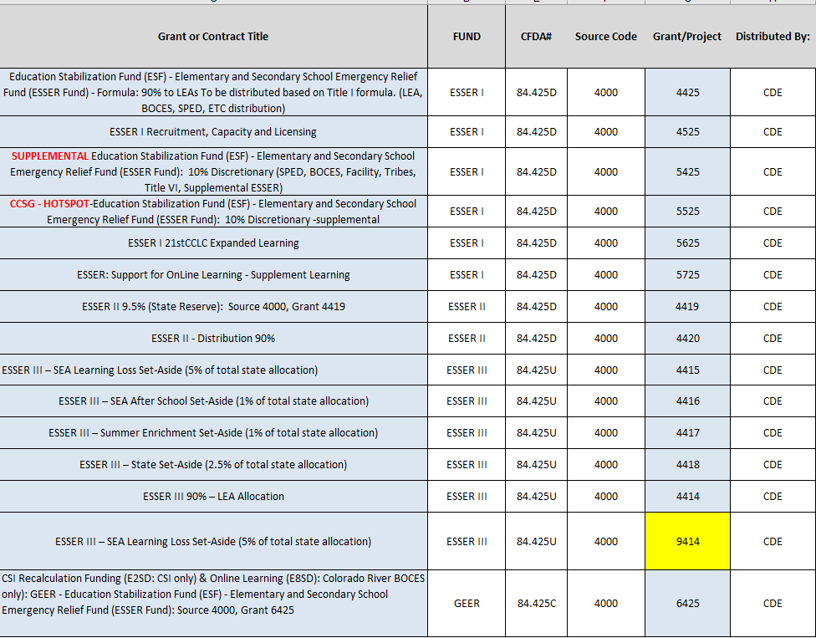
All ESSER Grant Codes Assigned to Date

Slide 22
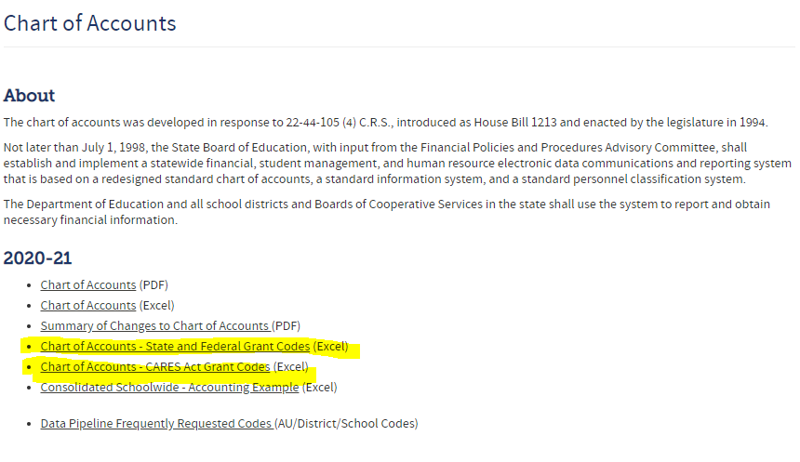
Complete CARES Act Grant Codes
The complete CARES Act grant codes are posted on CDE’s website
The complete Chart of Accounts Grant Codes (all assigned state and federal grant codes) are posted on CDE’s website
http://www.cde.state.co.us/cdefinance/sfcoa

Slide 23
Grant Code 9414 - ESSER III Minimum 20% Set-Aside Learning Loss
In order to allow districts to successfully capture all ESSER III minimum 20% Learning Loss Set-Aside expenditure accounts, Grant Code 9414 has been established
Use of Grant 9414 is limited to ESSER III expenditures, to meet the minimum 20% learning loss set-aside requirement: Objects 0001-0999, Grant 9414
Not all ESSER III expenditures should be coded with Grant 9414.
Code ESSER III expenditures which meet criteria for the minimum 20% learning loss requirement to Grant 9414
Code ESSER III non learning loss expenditures to Grant 4414
ESSER III revenue should be coded as Source 4000, Grant 4414

Slide 24
Grant Code 9414 - ESSER III Minimum 20% Set-Aside – Stipend Expenditure
Stipend account example for a regular teacher tied to the ESSER III minimum 20% set-aside learning loss grant code (9414)

Slide 25
Reminders
Notes:
Nazie

Slide 26
Upcoming Office Hours
Changed times
May 27 – 11 to noon
Future Topics:
ARP IDEA
IDEA MOE
Migrant Education
20% set aside for using evidence-based interventions to address learning loss
LEA Plans

Slide 27
Questions? Future Topics?

Slide 28
CDE Team Contact Information
ESSER/ESEA
Nazie Mohajeri-Nelson, Director of ESEA Office (mohajeri-nelson_n@cde.state.co.us)
DeLilah Collins, Assistant Director of ESEA Office (collins_d@cde.state.co.us)
Kristin Crumley, ESSER Monitoring & Reporting Specialist (Crumley_k@cde.state.co.us)
ESEA Regional Contacts assigned to your district
Fiscal Experts
Jennifer Okes, Chief Operating Officer (okes_j@cde.state.co.us)
Kate Bartlett, Executive Director of School District Operations (Bartlett_k@cde.state.co.us)
Jennifer Austin, Director of Grants Fiscal Management (Austin_j@cde.state.co.us)
Robert Hawkins, Grants Fiscal Analyst (Hawkins_s@cde.state.co.us)
Steven Kaleda, Grants Fiscal Analyst (Kaleda_s@cde.state.co.us)
Adam Williams, Financial Data Coordinator (Williams_a@cde.state.co.us)

