Slide 1
Comprehensive Support Plans
(Lowest 5% and Low Graduation Rates)
Federal Program and Support Unit in Partnership with the School Improvement & Planning Team

Slide 2
The Who,What, Where, and Why (for this session)
Any school currently identified as comprehensive support and improvement must submit to both their district and the SEA an approvable plan
A plan that meets the statutory required elements to help LEAs ensure they are working towards rectifying the reasons for identification
In Colorado, the UIP can serve as the CS Improvement Plan and requires review and approval by the school, district, and CDE. CDE periodically reviews UIPs from CS schools to ensure they meet ESSA requirements.
Schools that have been identified for Targeted Support and Improvement must also develop a plan that addresses the reasons for identification, which must be reviewed and approved by the school and district. CDE does not approve these plans; however, they are reviewed during monitoring. Most schools, identified as TS, utilize the UIP and add in the needed information to meet the ESSA requirements. However, you do not have to use this format, any plan that contains the required elements will suffice.
The Data Team member will address the reasons for and the procedures of identification and how schools are exited.
The remainder of the time will be devoted to outlining the ESSA requirements that must be met in order for CDE to approve an improvement plan from a school identified for comprehensive support and improvement

Slide 3
ESSA Identification

Slide 4
Background
Every state that accepts funds under the Every Student Succeeds Act (ESSA) must have an approved methodology for meaningfully differentiating the performance of and identifying schools for support and improvement.
Due to the COVID-19 pandemic, Colorado was approved to amend its State plan to account for short-term changes in the 2022-2023 school year (http://www.cde.state.co.us/fedprograms/essa).
Use 1-year of accountability data, instead of 3-years of aggregated data.
Modify the Academic Progress indicator to only include mathematics growth for grades 5 and 7, and English language arts growth for grades 4, 6, and 8.
Modify the School Quality or Student Success (SQSS) indicator to:
Exclude science achievement.
Alter the definition of chronic absenteeism to include unexcused absences only.
For schools identified for Comprehensive Support and Improvement in Fall 2022, modify the exit criteria such that schools may be eligible to exit after two consecutive years, rather than three consecutive years.

Slide 5
Identification of Schools
Annual identification of Schools for Support and Improvement under ESSA
Comprehensive Support and Improvement (CS)
CS - Lowest 5%
CS - Low Graduation Rate
CS - Former ATS (first year of identification will be Fall 2022)
Targeted Support and Improvement (TS)
TS - based on disaggregated group(s)
Additional Targeted Support (ATS) - based on disaggregated group(s) that on their own meet the criteria for Lowest 5%
Possible to be identified due to participation only

Slide 6
Overview of ESSA Indicators
K-2 School Identification
Academic Achievement
English Language Arts
READ Act Percent with a Significant Reading Deficiency (SRD)
Academic Progress
English Language Arts
Change in SRD
English Language Proficiency
Median Growth Percentile
On-track to attain fluency
Academic Achievement
English Language Arts
CMAS (grades 3-8) and SAT (grade 11) mean scale scores (MSS)
Math
CMAS (grades 3-8) and SAT (grade 11) mean scale scores (MSS)
Academic Progress
English Language Arts
CMAS and SAT median growth percentiles (MGP)
Math
CMAS and SAT median growth percentiles (MGP)
Progress in Achieving English Language Proficiency
Median growth percentiles
On-track to attain fluency
School Quality or Student Success (SQSS)
CMAS science (grades 5, 8, and 11) mean scale scores
Chronic absenteeism (Elementary/Middle)
Dropout rates (High)
Graduation Rates
Four-year graduation rate
Seven-year graduation rate
Alternative Education Campuses (AEC)
When necessary, the following indicators are also used to differentiate among lowest performing AECs, in addition to other indicators (listed to left)
Attendance rate
Truancy rate

Slide 7
ESSA Student Groups
All students
English learners
Students with disabilities
Students experiencing poverty
Students from each racial/ethnic group, separately
Aggregated Non-White group - Any non-White students from racial/ethnic groups that do not meet the minimum number of students to be reported on their own will be combined into one group for accountability purposes

Slide 8
Comprehensive Support and Improvement (CS) - Lowest 5%
Performance of all students and each student group on all available indicators are used to assign ratings and award points on each sub-indicator
Points are added across all indicators to calculate the total points earned and total points possible for each school
Total points earned are divided by total points possible to create an overall summative score for each school
Colorado annually ranks all schools based the overall summative score, and Title I schools with the lowest total percentage points earned are identified as CS - Lowest 5%
Identification includes a minimum of 5 percent of all Title I schools
Colorado will identify one AEC, using attendance and truancy data if the total percentage points does not adequately differentiate performance
Possible to be identified due to participation only
~ Would be labeled as such

Slide 9
Comprehensive Support and Improvement - Low Graduation Rate
Colorado identifies all public schools with 4-year and 7-year graduation rates below 67 percent for three consecutive years for CS - Low Graduation Rate
If a school has both a 4-year and 7-year graduation rate, both must be below 67%

Slide 10
Additional Information
For more information, please visit Colorado’s ESSA Methods and Criteria for Identification of Schools for Support and Improvement Webpage (http://www.cde.state.co.us/fedprograms/essa_csi_tsi)
For additional information regarding the methodology, criteria, or data used to identify schools for support and improvement under ESSA, please contact:
Tina Negley
Supervisor, Program Effectiveness Office
720-766-2793
negley_t@cde.state.co.us
Mary Shen
ESEA Research Analyst
720-766-8723
shen_t@cde.state.co.us

Slide 11
Planning Requirements

Slide 12
Improvement Planning Requirements for ESSA Identified Schools
CS plans must:
Be developed by the LEA in partnership with stakeholders, including the principal, other school leaders, teacher and parents of the school.
Be informed by student performance on accountability indicators. In Colorado, this currently refers to performance indicators on the School Performance Frameworks (i.e., English language arts and math achievement and growth, science achievement, and postsecondary workforce readiness).
Include evidence-based interventions.
Be based on a school-level needs assessment.
Address resource inequities.
Be approved by the school, LEA, and CDE.
CS Plan Submission and Approval Process and Monitoring:
CS plans should be documented within the school’s Unified Improvement Plan (UIP) and submitted through the Online UIP System.
The timeline for CS plan submission follows the typical UIP submission process.
If performance and identified for this category, then eligible for biennial flex.
If identified for the first time in 2022, can request to submit UIP in January.
CDE will use the ESSA CS plan requirements embedded within the Quality Criteria to approve plans.
Once plans are approved, CDE is required to monitor implementation of and periodically review CS plans.
Once identified, schools will remain CS for three years.
Schools may exit this category after the third year, if they no longer meet the identification criteria for the year in which the school was identified and they not re-identified in the fourth year.
CDE has been and will continue to work with stakeholders to determine what actions will be necessary for any schools that do not meet the exit criteria.

Slide 13
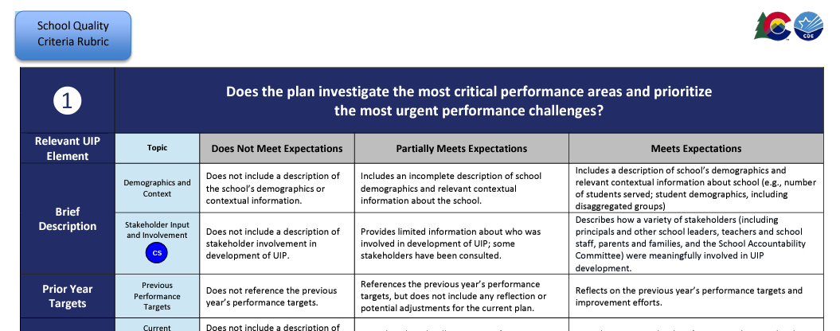
Where are requirements described?
https://www.cde.state.co.us/uip/school_qcrubric

Slide 14
Acknowledge the Reason for Identification
&
Stakeholders and Planning
Section 1

Slide 15
Reason for Identification
The school acknowledges the reason for Identification, what led to the identification, and how the reason was communicated to your stakeholders and given an opportunity to provide input.
Lowest 5 % K-2 Title I Schools
Is determined to be in the lowest-performing five percent K-2 schools, based on the state’s accountability system,
Lowest 5% Title I Schools
Is determined to be in the lowest-performing five percent of all schools, based on the state’s accountability system
Low Participation
Less than 95% of qualifying students participate in state assessments
Low Graduation Rate
Is a high school with one-third or more of its students not graduating
Chronically Low Performing Student Group [formerly ATS]
Former ATS schools that have been identified for the same student group for four years
Initiating 22-23 School Year

Slide 16
Reason for Identification Example – Low Graduation
This could look like (low graduation):
We were identified for low graduation rate in 2021/2022 year. The key factor/s that led to this identification was a graduation rate of 27% as compared to the state average/requirement of 81%. We communicated this information to our stakeholders by communicating the reasons for our identification with our SAC.
We were identified for ________ in ______year. The key factor/s that led to this identification were __________ as compared to the state average/requirement of ________. We communicated this information to our stakeholders by______________________. Stakeholders were given opportunity to provide input through ______________.

Slide 17
Reason for Identification Example – Lowest 5%
This could look like (lowest 5%):
We were identified for lowest 5% in 2021/2022 year. The key factor/s that led to this identification was low math performance as compared to the state average. We communicated this information to our stakeholders by sending letters home and communicating the reasons for our identification with our SAC.
We were identified for ________ in ______year. The key factor/s that led to this identification were __________ as compared to the state average/requirement of ________. We communicated this information to our stakeholders by______________________. Stakeholders were given opportunity to provide input through ______________.

Slide 18
Stakeholder Identification
Stakeholder groups that must be involved are:
Principals and other school leaders
Teachers
Parents and families
Other groups that are best practice but not required to add are:
Non-teaching staff
Community partners
Students
Plans must be approved by District Partners before submission to CDE, this is acknowledged through the submission process.

Slide 19
Stakeholder Identification Example
This could look like:
We strive to include our full school community but ensure we have representation of Principals and other School Leaders, Teachers, and Parents. We will refer to this group as our SAC.
Another Example from a current school plan:
The Leadership Team consisted of the following positions within the building:
•Administrative Team (Principal, Assistant Principal)
•Instructional Coach
•Learning Specialist
•Classified Staff
•Parents
•Specialist
•One Teacher per Grade Level
•Gifted and Talented Coordinator

Slide 20
Stakeholder Involvement Throughout
Meaningful involvement throughout the process
Review performance on ESSA indicators, including reason(s) for ESSA identification
Give input on strategies or interventions to be used in meeting identified needs related to CS-identification
Continuing involvement

Slide 21
Stakeholder Involvement Throughout Example
This could look like:
Additionally, our SAC is involved in our review of the ESSA indicators especially the indicators that are related to our CS identification, Lowest 5%. They gave input about our major improvement strategies and evidence based interventions during our school kick-off gathering. In addition, we have put a scheduled review of the CS plan during _______3.5.
Additionally, our ____________ is involved in our review of the ESSA indicators especially the indicators that are related to our identification. They gave input about our _________________ during ____________. In addition, we have put a scheduled review of the CS plan during __________meeting ________ times a year.

Slide 22
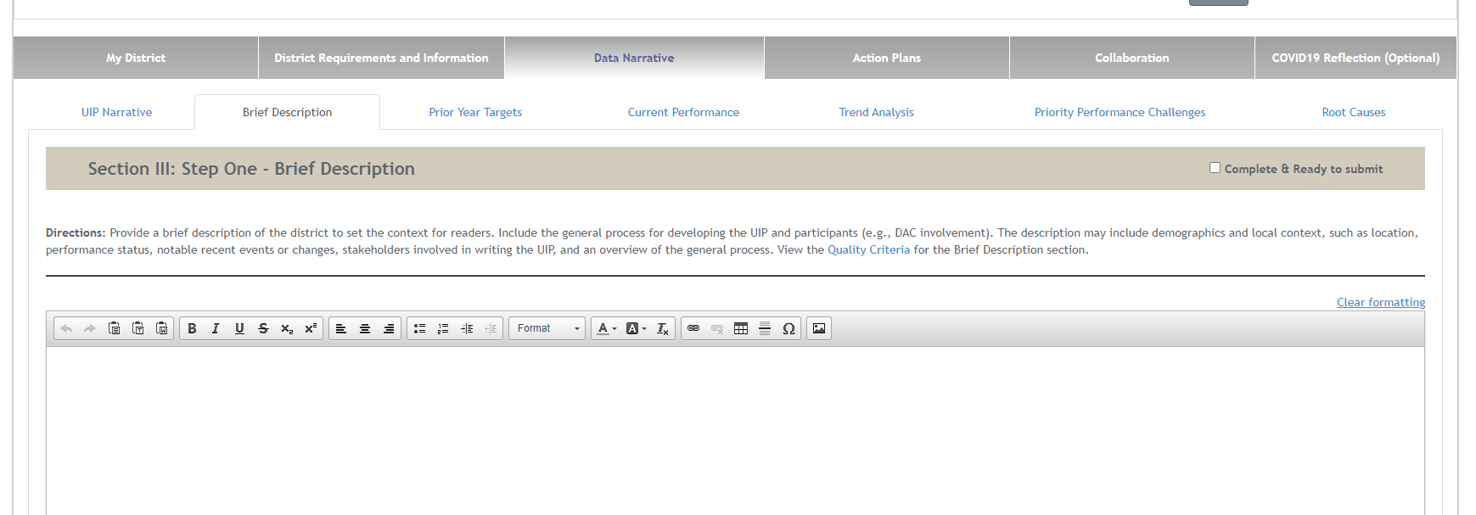
Where to Enter in the UIP-Brief Description Tab

Slide 23
Data Narrative
Section 2

Slide 24
Current Performance
Includes an explanation of the school’s current performance on each ESSA indicator within the school-level needs assessment based on the school’s ESSA identification
Each identification type has specific indicators that must be addressed (slide 26)
If data on an indicator is unavailable then please provide an explanation as to why
Broken down by the major demographic groups (Slide 27)
If there is a group whose N group is too small for public reporting then please state that reason. Examples:
Hispanic and two or more races groups numbers are too small to report CMAS math scores.
Our district does not currently have any students in the Hawaiian or other Pacific Islander subgroups.
Our school does not have student counts or reportable numbers for the other disaggregated groups of students.
Data can be represented in a variety of ways such as narrative form or within a table.

Slide 25
Unified Improvement Planning – Typical Cycle
Unified Improvement Planning - Typical Cycle
January- March
April-June
July-September
October-December
ACCESS Testing
State Assessment Window
State Assessment Initial Data Release
State Growth Data and Frameworks Released
Graduation Data Release
ESSA Identifications Released
Accountability and Assessment
MOY READ Assessment
EOY READ Assessment
October Count
SBE/Accountability Clock Hearings
BOY READ Assessment
Request to Reconsider
Improvement Plan Implementation
January - June
September - December
Implement UIP and Adjust Based on IB, Interim Measures
Implement UIP and Adjust Based on IB, Interim Measures
April
July/August
Current Year data analysis, adjust PPCs and targets
Adjust Data Analysis based on State Data
Submit UIP by October 17th
UIP Process
May
March
Solidify current year data analysis, PPCs, Root Causes, MIS
August/September
Reflect on current year, recent local data. Highlight potential Priority Performance Challenges
June
Confirm draft plan with rating and identification release, share with stakeholders. Build detailed action plan.
Draft Implementation Benchmarks and Interim Measures
March
May
June- August
September-December
Related School Leadership Moves
Refine budget and hiring vision to support improvement efforts
Make purchases related to improvement efforts (e.g. curriculum)
Plan teacher induction, including improvement efforts
Closely monitor implementation and keep stakeholders informed
Stakeholder Engagement
Progress Monitoring
Input on initial data, PPCs and targets
Input on Root Causes and MIS
Input on Finalized UIP
Progress Monitoring
Progress Monitoring

Slide 26
Required Student Performance Data Based on Identification
CS Lowest 5%: K-2 School Only | CS Lowest 5%: Elementary and Middle Schools | CS Lowest 5%: High Schools | CS Low Graduation | CS Lowest 5%; Participation Only
Academic Achievement English Language Arts READ Act Percent with a Significant Reading Deficiency (SRD) Academic Progress English Language Arts Change in SRD English Language Proficiency Median Growth Percentile On-track to attain fluency | Academic achievement on English language arts and math Academic growth on English language arts and math English language proficiency for English learners School quality and student success indicator Science achievement Chronic absenteeism for elementary and middle schools | Academic achievement on English language arts and math Academic growth on English language arts and math English language proficiency for English learners Graduation rates for high schools School quality and student success indicator Science Achievement Dropout rate for high schools | Graduation rates for high schools | Participation rates for state assessments in English language arts and math

Slide 27
Major Demographic Groups
All students
English learners
Economically disadvantaged students (FRL)
Students with disabilities
Students from major race and ethnic groups
American Indian or Alaskan Native
Asian
Black or African American
Hispanic or Latino
White
Native Hawaiian or Other Pacific Islander
Two or More Races
Aggregated Non-White

Slide 28
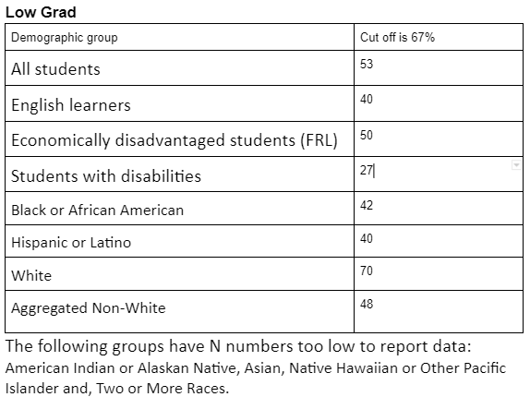
Current Performance Example – Low Graduation
This could look like (low graduation rate):

Slide 29
Current Performance / Low Graduation Rate Example
This could look like (low graduation rate):
Our graduation rates are below the low graduation rate of 67% and the state average of 81%. Our students are graduating at the following rates: all students 53%, EL at 40%, FRM students 50%, SWD 27%, Black or African American 42%, Hispanic or Latino 40%, White 70%, and aggregated non-white students at 48%. All other demographic subgroups have N numbers two low to be reported.

Slide 30
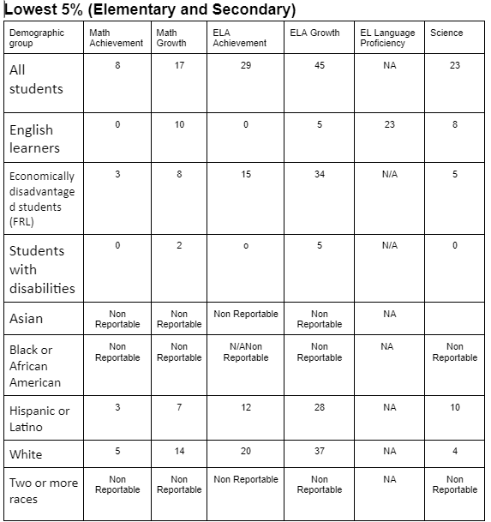
Current Performance Example – Lowest 5%

Slide 31
Priority Performance Challenge/s & Example
Uses performance on all ESSA indicators to select at least one priority performance challenge that is clearly and explicitly contributed to the reason for identification under ESSA
You can see a list of priority challenges in the UIP handbook
This could look like (lowest 5%):
Based on our ESSA identification of Lowest 5%, one of our areas of highest need is our students lack foundational math skills.
Rationale:
Our priority challenge that addresses this need is targeted interventions for targeting missing math foundational skills. This is necessary to ensure our students have the skills necessary to build firm mathematical foundations that will support them as they continue to work with more complex mathematical concepts.
Based on our ESSA identification of ________, one of our areas of highest need is _________. Our priority challenge that addresses this need is _________________________________. This is necessary to ______________________.

Slide 32
Priority Performance Challenge/s & Example, con’t
This could look like (low graduation rate):
One of our areas of highest need is retention of students.
Rationale:
Our priority challenge that addresses this need is to increase our CTE pathway choices . This is necessary to ensure that the curriculum is relevant to students’ interests and provides them with a firm connection between the classroom and their futures. Increased retention will lead to improved graduation rates.
Our priority challenge that addresses this need is _________________________________. This is necessary to ______________________. _________________(How this connects to your ESSA identification )

Slide 33
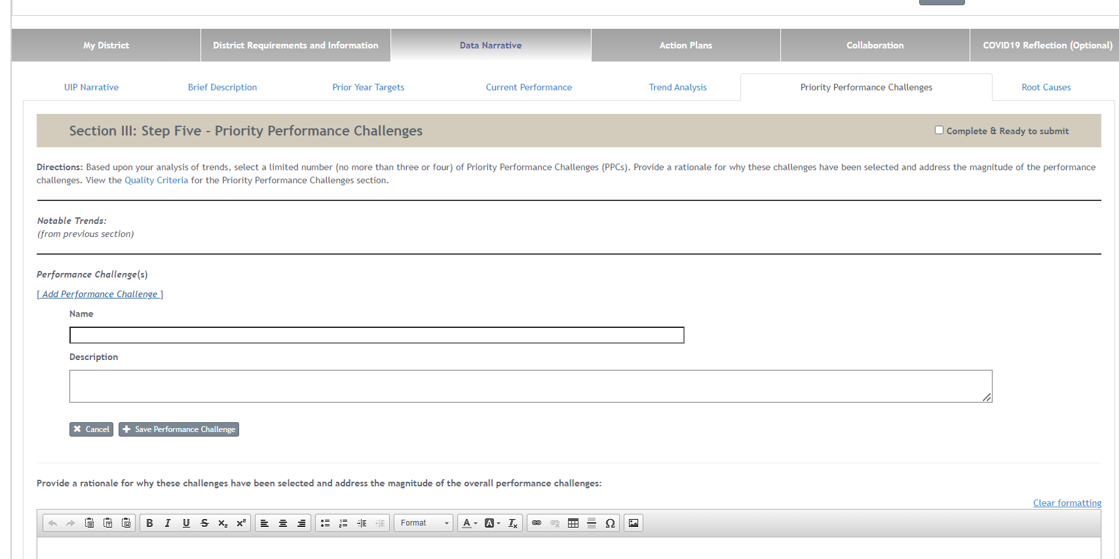
Where to Enter in the UIP

Slide 34
Major Improvement Strategies
Section 3

Slide 35
Major Improvement Strategies (MIS)
At least one MIS must fulfill the following criteria. This can be done with each MIS, but this is not required.
Includes at least one intervention and/or strategy that is clearly and explicitly aligned with the reason for ESSA identification.
Includes an evidence-based intervention (EBI). Provides a short description of what has been found in research regarding the success of the selected intervention and/or strategy as aligned to the school’s identification.
Describes the contextual fit for the implementation of the selected intervention and/or strategy aligned to the reason for identification

Slide 36
Major Improvement Strategies Example
This could look like (lowest 5%):
Based on our ESSA identification of Lowest 5%, our chosen priority improvement challenge is lack of teacher training in using data to inform instruction. Our major improvement strategy we have chosen that addresses this need is having staff work through the National Board for Professional Teaching Standards (NBPTS) Certification. NBPTS Certification has rigorous PD that allows teachers to learn to effectively use data with a hands-on approach using their own student data. This intervention has been shown to be effective in improving teacher data usage by research that can be found here https://ies.ed.gov/ncee/wwc/study/67272. This strategy was chosen for this challenge because we struggle to higher experienced teachers and in conjunction of allowing them to work with data, this program will help our new teachers and and less experienced staff gain a deeper knowledge and understanding of the connection between standards-based teaching, using data, and results.
Based on our ESSA identification of ________, our chosen priority improvement challenge is _________. Our major improvement strategy we have chosen that addresses this need is _________________________________. _____________________________(Program name) _____________________________( what it provides) . This intervention has been shown to be effective in improving /mitigating ____________________ by research that can be found here_______________________. This strategy was chosen for this challenge because _____________________________.

Slide 37
Major Improvement Strategies Example
This could look like (low graduation rate):
Based on our ESSA identification of Low Graduation Rate, our chosen priority improvement challenge it to increase our CTE pathway choices . Our major improvement strategy we have chosen that addresses this need is Increasing the CTE pathways that are available for our students including accessing those provided by local community colleges. This intervention has been shown to be effective in improving student outcomes including graduation rates within the research that can be found here: https://cepa.uconn.edu/wp-content/uploads/sites/399/2018/05/Career-and-Technical-Education-Current-Trends-and-Results.pdf. This strategy was chosen for this challenge because we struggle keeping students engaged in classes, many choose to work or need to work due to family dynamics. By offering classes that provide students with employable skills and a firm connection to their after school goals, the hope is more students will continue to pursue education.
Based on our ESSA identification of ________, our chosen priority improvement challenge is _________. Our major improvement strategy we have chosen that addresses this need is _________________________________. _____________________________(Program name) _____________________________( what it provides) . This intervention has been shown to be effective in improving /mitigating ____________________ by research that can be found here_______________________. This strategy was chosen for this challenge because _____________________________.

Slide 38
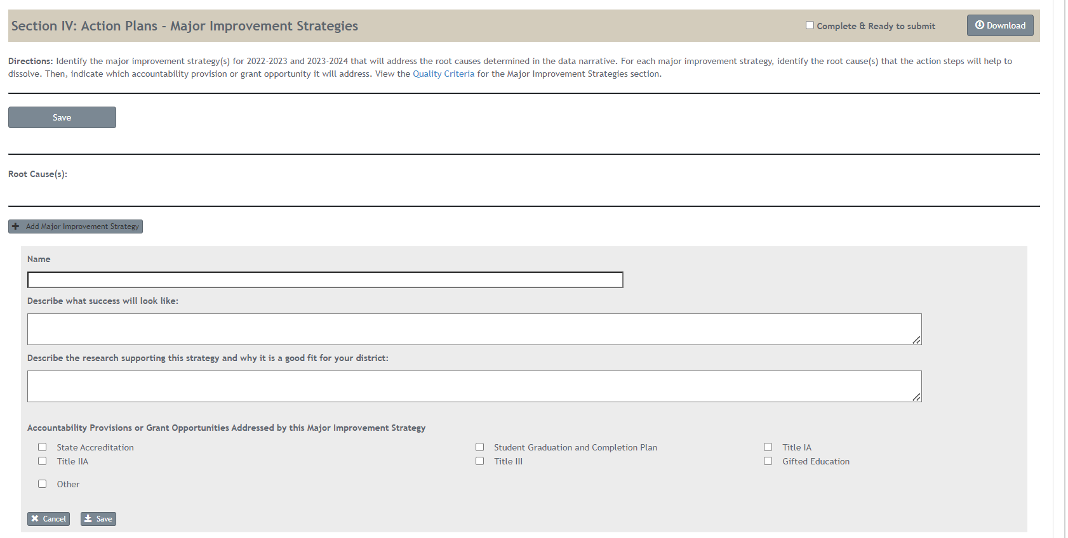
Where to Enter in the UIP
EBI screenshot

Slide 39
Monitoring and Action Steps
Section 4

Slide 40
Monitoring - Implementation Benchmarks
Shares a monitoring plan for tracking implementation and for determining if the selected intervention and/or strategy aligned to the reason for ESSA identification and is being implemented with fidelity.
We will monitor the implementation _____________ in our _________________.
We will monitor the implementation monthly in our PLC meetings.

Slide 41
Evaluation- Action Steps & Example
Provides an evaluation plan for assessing the impact of the selected intervention and/or strategy. Includes a timeline and methods for determining if the school’s performance has increased on the ESSA indicator(s) that resulted in the school’s identification.
This may look like (lowest 5%):
We will assess the impact of the intervention at our monthly meeting where we will look at student data to assess if the scores are reflecting growth. Additionally, we will assess if any specific skills identified for additional instruction informed by data demonstrated improvement after the reteaching the skills.
We will assess the impact of the intervention at our __________ meeting we will look ______________(what you will look at to see if the intervention is effective).

Slide 42
Evaluation- Action Steps Example
This may look like (low graduation rate):
We will assess the impact of the intervention at our monthly meeting where we will look at student data to assess if the scores are reflecting student retainment. Additionally, we will assess if any specific classes are more popular than others and if there are holes in our offerings that would increase student engagement.
We will assess the impact of the intervention at our __________ meeting we will look ______________(what you will look at to see if the intervention is effective).

Slide 43
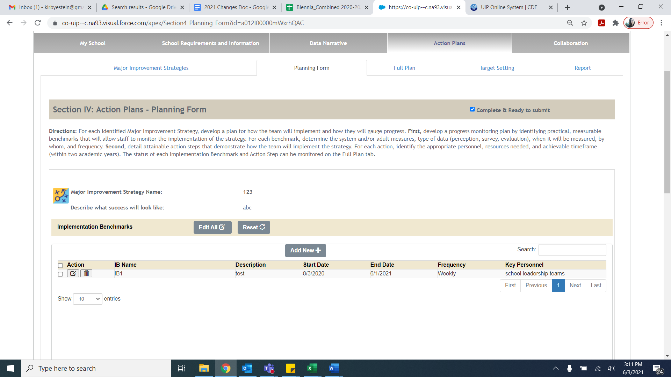
Where in the UIP – Planning Form
Notes:
Erin

Slide 44
Where in the UIP – Improvement Action Steps

Slide 45
Where in the UIP – Target Setting

Slide 46
Resources
UIP 101
The UIP 101 video series provides an introduction to the elements of the school UIP and the UIP online system.
https://www.cde.state.co.us/uip/uip101
UIP Training Page
This page hosts a variety of training and technical assistance, both past and present.
https://www.cde.state.co.us/uip/uip_training
Other Resources
Implementation Benchmarks Guidance Document
Data Analysis for Small Student Populations
UIP School QC Rubric- (DOC)

Slide 47
Resources
Colorado’s ESSA Methods and Criteria for Identification of Schools for Support and Improvement Webpage:
http://www.cde.state.co.us/fedprograms/essa_csi_tsi
ESSA Planning Requirements:
https://www.cde.state.co.us/fedprograms/essaplanningrequirements

Slide 48
Contacts
Identification
Tina Negley Negley_t@cde.state.co.us
Mary Shen Shen_m@cde.state.co.us
Programmatic
Karen Bixler Bixler_k@cde.state.co.us
Tammy Giessinger Giessinger_t@cde.state.co.us
UIP General and Platform
Erin Loften Loften_e@cde.state.co.us
Victoria Rilett Rilett_@cde.state.co.us
Notes:
Karen
Other http://www.cde.state.co.us/fedprograms/essaplanningrequirements

Slide 49
Questions

